Slide 1
Task-Oriented Dialogue Systems & Multi-Modal Dialog System
Chia-Yi Su
Department of Electronic Engineering
National Kaohsiung University of Science and Technology

Slide 2
Course Outline
Basic Knowledge on Natural Language Processing
Applications of Natural Language Processing
Word Vector
Neural Network (Including Relative Math Derivation)
Dependency Parsing
Recurrent Neural Network, Variants of Recurrent Neural Network, and Language Model
Machine Translation
Contextual Representation
Dialog System (Including MultiModal Dialog System)

Slide 3
Agenda
Introduction
Properties of Human Conversation
Task-Oriented Dialog System
Continuously Learning Neural Dialogue Management
Augment Information with Multimodal Information

Slide 4
Introduction

Slide 5
Two Categories of Dialog System
Task-Oriented Dialogue System
Siri
Google Assistant
Alexa
Cortana
DoNotPay
Chit-Chat

Slide 6
Properties of Human Conversation

Slide 7
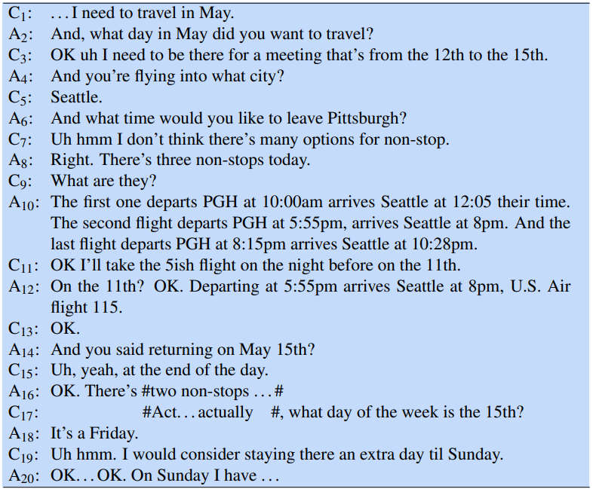
Conversation Example

Slide 8
Turn
A turn is similar to an interactive system you take turn, then I take turn and repeat.
A conversation has multiple turns.
A turn can be a complete sentence or a word.
The example has 20 turns.

Slide 9
Endpoint Detection
Endpoint detection is to detect whether the speech is end.
The human beings sometimes cease speaking in the middle of the speech.
Therefore: Endpoint detection is a challenge task.

Slide 10
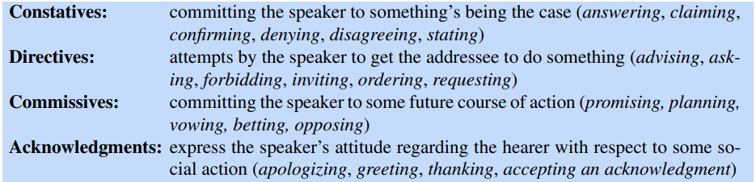
Speech Acts
a.k.a Dialog act
Each utterance is an action being performed by speaker. (Wittgenstein, 1953; Austin, 1962)
The example of speech acts is as follows. (Bach and Harnish, 1979)

Slide 11
Grounding
The dialog acts of utterances are collective.
Therefore: The establishment of what both agree on becomes crucial.
Grounding is to acknowledge the hearer understands what the speaker says.
The types of grounding is as follows:
Simple message such as OK, Got it.
Repeat what speaker says.
Asking next question.

Slide 12
Adjacency Pairs
One type of dialog often ensues another type of dialog.
The pairs are consisted of first pair part and second pair part.
Example:
Question = > Answer
Proposal => Acceptance/Rejection
Complement => Downplayers

Slide 13
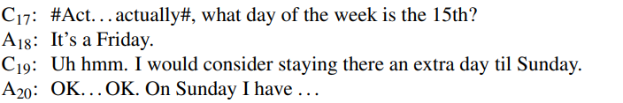
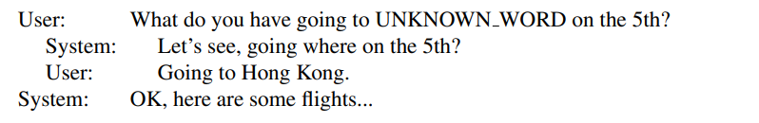
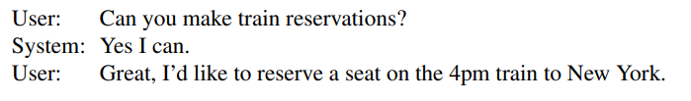
Subdialog
Sometimes the second pair part does not appear right after the first pair part.
Example:
Correction
Clarification
Pre-Sequence

Slide 14
Initiative
Someone who controls the conversation has the conversational initiative.
Mixed initiative means someone who sometimes ask question, sometimes answer the question, and sometimes redirect the topics of the conversation.
Mixed initiative is a difficult task in the dialog system.
Sometimes the system initiative makes the user frustrated.

Slide 15

Inference and Implicature
Sometimes human beings do not say something explicitly.
Therefore: The hearer requires to infer what the speaker says.
Example

Slide 16
Task-Oriented Dialog System

Slide 17
Architecture of Task-Oriented Dialog System
Natural Language Understanding
Dialog Management
Natural Language Generation

Slide 18
Natural Language Understanding (NLU)
Natural Language Understanding
Dialog Management
Natural Language Generation

Slide 19
NLU: Domain Classification
To classify the domain of information that the user provides
In order to find the right Database
Sequence classification problems
Example:
Show me morning flights from Boston to San Francisco on Tuesday
Air travel DB

Slide 20
NLU: Intent Detection
To classify what type of task that the user wants to achieve
Sequence classification problems
Example:
Show me morning flights from Boston to San Francisco on Tuesday
Show flights

Slide 21
NLU: Slot Filling
To extract the information in the user utterances
Can be treated as a sequence label problem and combining with BIO encoding
Example:
Show me morning flights from Boston to San Francisco on Tuesday
ORIGIN-CITY: Boston
ORIGIN-DATE: Tuesday
ORIGIN-TIME: morning
DEST-CITY: San Francisco

Slide 22
Dialog Management (DM)
Natural Language Understanding
Dialog Management
Natural Language Generation

Slide 23
DM: Dialog State Tracking
To maintain the state of the current dialog
Usually using the dictionary structure to maintain this state
Requiring to know the dialog acts

Slide 24
DM: Dialog Policy Making
To decide the dialog act of the system
An easy method to achieve this task is applying supervised learning which is to calculate the probability of the dialog policy given the current state
The modern method to achieve this task is applying reinforcement learning to decide the dialog policy

Slide 25
DM: Dialog Acts
To detect the dialog acts of the user
Can be treated as a short-text classification problem (Lee & Dernoncourt, 2016)

Slide 26
DM: Confirmation and Rejection
Because: The NLU is not robust and sometimes makes mistakes
Therefore: It’s vital to make the system know its misunderstanding.
There are two approaches to make system understand its mistakes
Confirmation
Rejection
Confirmation can be further divided into two categories
Explicit Confirmation
Implicit Confirmation

Slide 27
Natural Language Generation (NLG)
Natural Language Understanding
Dialog Management
Natural Language Generation

Slide 28
Natural Language Generation (NLG)
Two Stage of NLG
Content Planning (What to say)
Sentence Realization (How to say)
Two methods to generate the response
Template-Based Generation Method
Language Model Generation Method

Slide 29
NLG: Template-Based Generation Method
Using the template in the prompts to generate the response
Example
Hello, What do you want me to achieve?
When do you want to depart from Depart_City?
When do you want to arrive at Dest_City?
The task-oriented dialog system usually uses template-based method to generate the response.

Slide 30
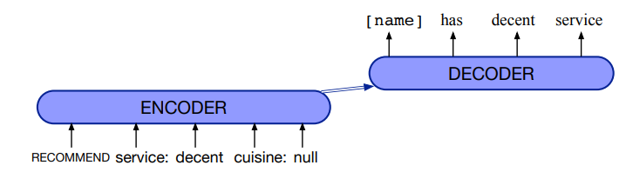
NLG: Language Model Generation Method
Training a model to generate the response
The architecture for this model is usually an encoder-decoder model
The input is the combination of the slot pair and the dialog acts
We often delexicalize the contents in the output and replace the words with slots since it’s difficult to see all the contents in the training step

Slide 31
Continuously Learning Neural Dialogue Management
Su et al., Arxiv, 2016.

Slide 32
Limitation of Supervised Learning
The future dialog acts may not be considered.
The dialog states may be large.

Slide 33
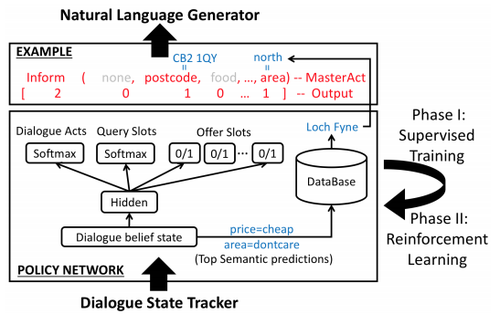
Architecture of the System

Slide 34
Input and Output of the System
Input (State Vector)
A state vector which encodes information of the dialog history (Mrkšić, 2017)
Output
Dialog Act: request, offer, confirm, select, bye
Query for the Search Constraint: food, pricerange, area, none – matters when dialog act is one of the following: request, confirm, select
Offer Slots: slots that the system can mention

Slide 35

Phase 1: Supervised Learning
The network architecture is as follows:
One hidden layer with the tanh non-linear function
Training objective is to minimize a joint cross-entropy loss
$ℒ\left(θ\right)=\sum_{kε\left\{d_{a},q,O_{s}\right\}}{H\left\{y_{k},p_{k}\right\}}$
This phase is basically the same as our lecture before

Slide 36
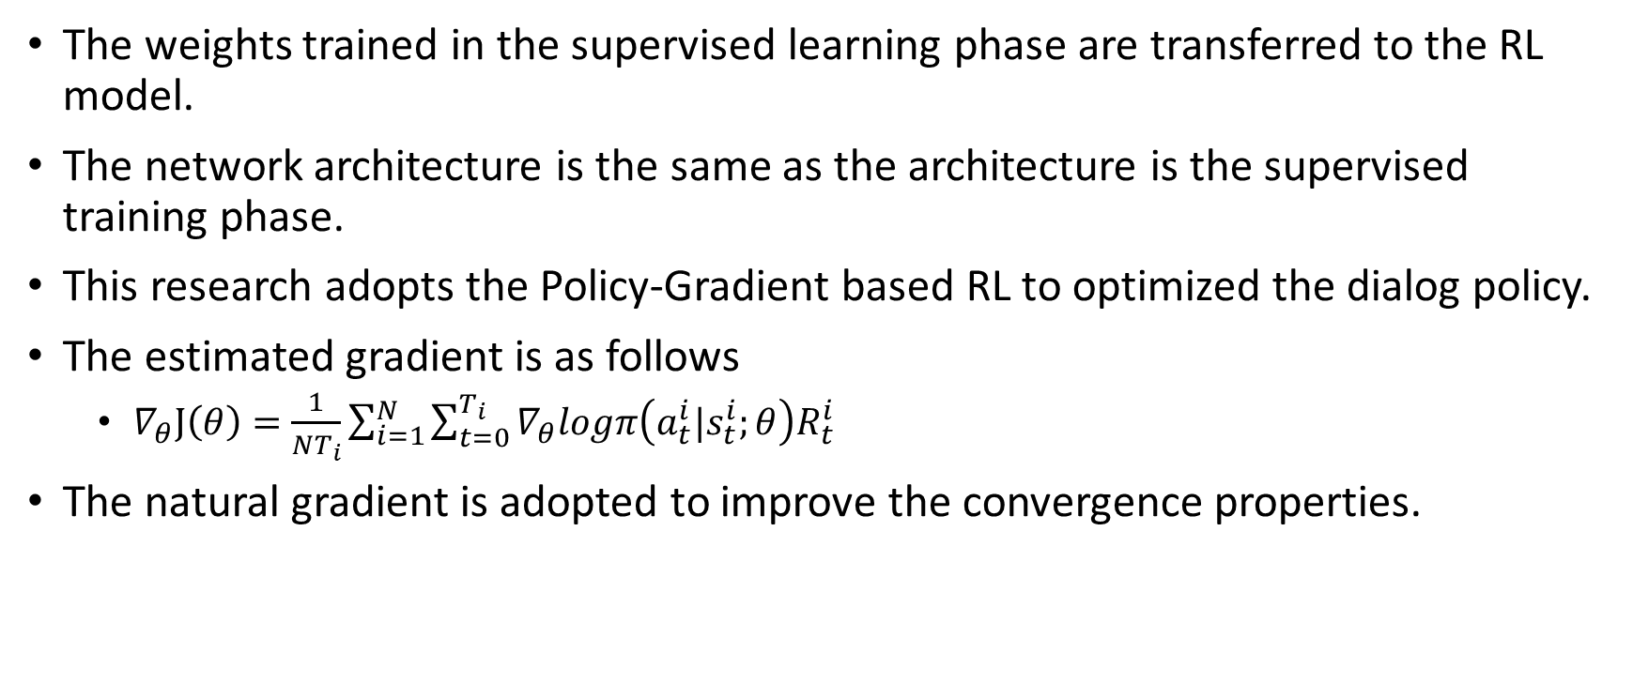
Phase 2: Reinforcement Learning
The weights trained in the supervised learning phase are transferred to the RL model.
The network architecture is the same as the architecture is the supervised training phase.
This research adopts the Policy-Gradient based RL to optimized the dialog policy.
The estimated gradient is as follows
$∇_{θ}J\left(θ\right)=\frac{1}{NT_{i}}\sum_{i=1}^{N}{\sum_{t=0}^{T_{i}}{∇_{θ}logπ\left(a_{t}^{i}|s_{t}^{i};θ\right)R_{t}^{i}}}$
The natural gradient is adopted to improve the convergence properties.

Slide 37
Experimental Results
Setting
A live telephone-based SDS to provide the restaurant information in the Cambridge, UK.
The domain has 150 venues, each having 6 slots, three for search constraint and three are informable properties
Corpus Data for Supervised Learning
Consisting of 720 user dialogs
Collected via Amazon Mechanical Turk (AMT)
Adagrad is employed during back-propagation

Slide 38
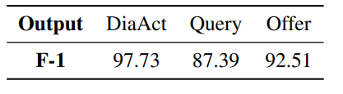
F-1 Scores of Supervised Learning
Hypothesis
Training corpus has less data related to query
Therefore: Its F-1 score is lower
Solution: Using reinforcement learning to mitigate it

Slide 39
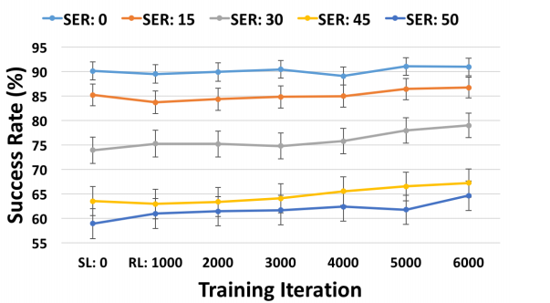
Policy Network in Simulation
The model is tested under various semantic error rates (SER) which average over 500 dialog.
The maximum dialog length is 30 turns.
After 6000 iterations, the improvement is around 1-8%.
The model learns to double-check more when the condition is more corrupted, which indicates the RL model’s ability to improve its own behavior.

Slide 40
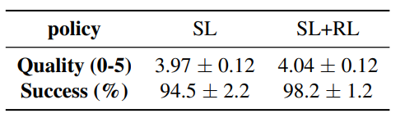
Policy Network with Real Users
The users are asked to rate by answering the question “Do you think this dialog was successful?”
The range is between 0 to 5 which is a six-point scale range.
The users are also asked to provide a binary rating.
This result demonstrates that the RL model is more adaptable to the uncertain environment.

Slide 41
Sample-efficient Actor-Critic Reinforcement Learning with Supervised Data for Dialogue Management
Su et al., SigDial, 2017.

Slide 42
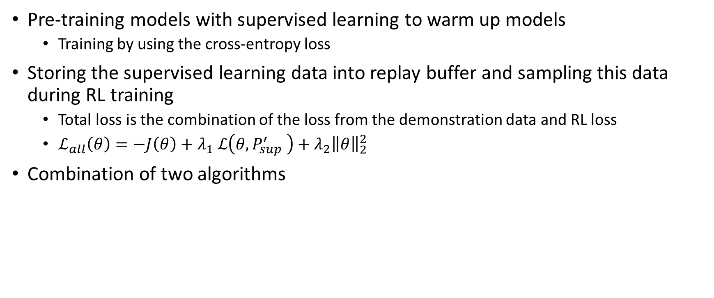
Learning from Demonstration Data
Pre-training models with supervised learning to warm up models
Training by using the cross-entropy loss
Storing the supervised learning data into replay buffer and sampling this data during RL training
Total loss is the combination of the loss from the demonstration data and RL loss
$ℒ_{all}\left(θ\right)=−J\left(θ\right)+{λ_{1}}_{ }ℒ\left(θ,P_{sup}^{′} \right)+λ_{2}{\left\|θ\right\|}_{2}^{2}$
Combination of two algorithms

Slide 43
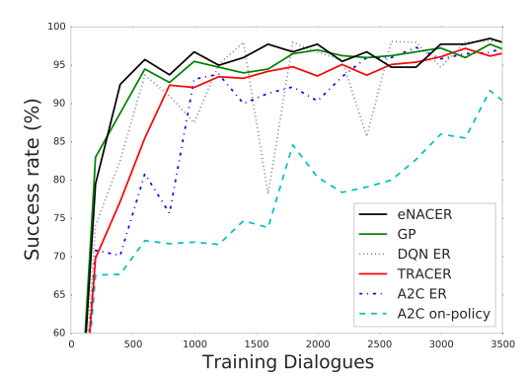
Experimental Results: Learning from Scratch

Slide 44
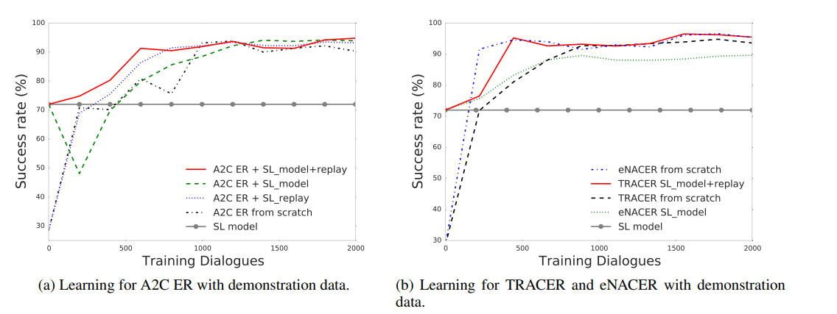
Experimental Results: Learning from Demonstration

Slide 45
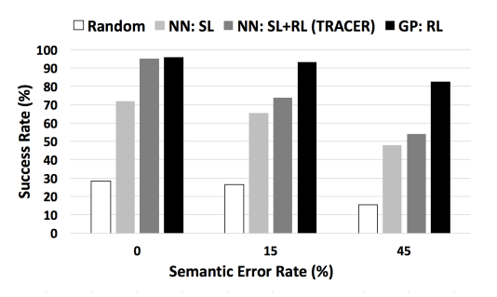
Experimental Results: with Noisy Sample

Slide 46
Multimodal Applications

Slide 47

Multimodal Translation
Help to translate ambiguous words e.g. minion
Two meaning of minion
奴才
小小兵

Slide 48

Rumer Verification
Facebook
Instagram
Google
Microsoft IE

Slide 49
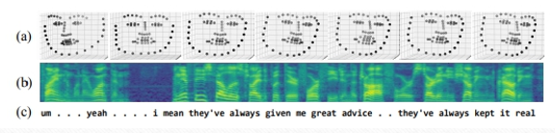
Mental Health Consultant
Haque et al., Measuring Depression Symptom Severity from Spoken Language and 3D Facial Expressions, Arxiv, 2018.

Slide 50
Visual 20 Question Games
Zhang, Zhao & Yu SIGDIAL 2018.

Slide 51
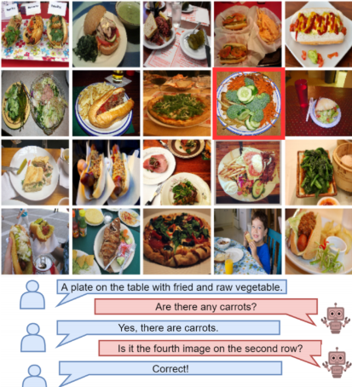
Visual 20 Question Games

Slide 52
Visual 20 Questions Game Rules
How to judge and provide answers?
Human Beings
Answer Bot
The termination of the game is under one of three following conditions
Guess the correct answer
Reach maximum guess number (3 times)
Reach maximum dialog turns (10 or 20 times)
Reward Polices
Win Reward: +10
Loss Reward: -10
Guess Wrong Answer: -3

Slide 53
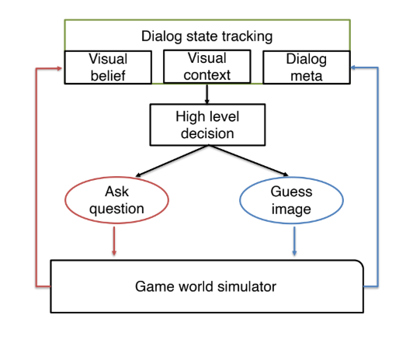
Hierarchical Reinforcement Learning

Slide 54
Dialog State
Vision Belief State: Accumulate the semantic information of the imaged image
Vision Context State: Similarity score between vision belief state and candidate images (Cosine Distance)
Dialog Meta Information (META): Records all of the history information such as the number of asked questions

Slide 55
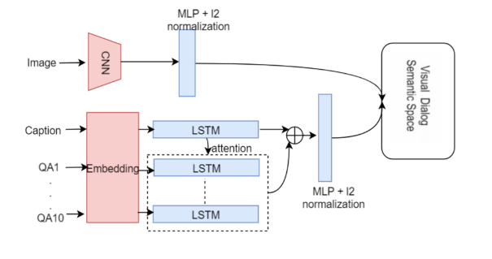
Vision Belief State
Map QAs + Images into multimodal sematic space

Slide 56
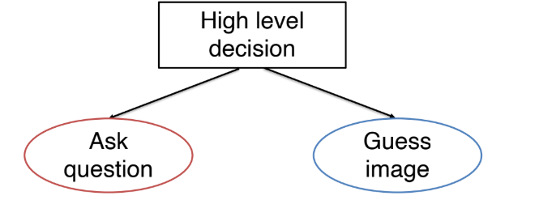
High-Level Policies Making
Double DQN

Slide 57
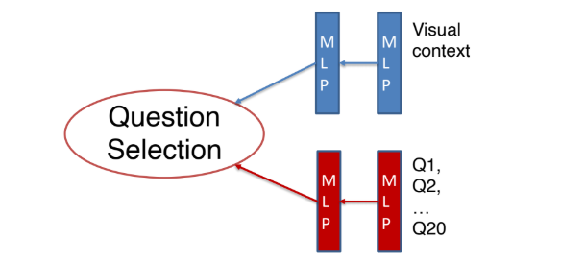
Low-Level Policies Making
DRRN (Deep Reinforcement Relevance Network)
The goal is to make the distribution Vision Context State to be more peaky.

Slide 58
Ablation Analysis
Random Policy: Randomly guess answer and ask question
Random Question + DQN: ask question randomly and makes a high level decision with DQN
DRRN+DQN: ask question with DRRN and makes a high level decision with DQN

Slide 59
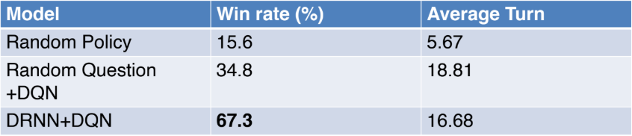
Ablation Analysis: Human Q + Machine A
Maximum Dialog Round: 20
QA pool: 200

Slide 60
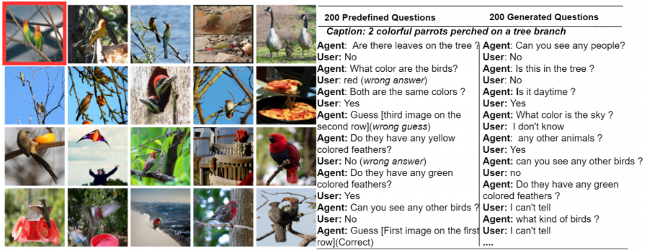
Interesting Findings: Recover from Wrong Answer

Slide 61
References
Jurafsky and Martin, Speech and Language Processing.
Su et al., Continuously Learning Neural Dialogue Management.
Yu, Augment Information with Multimodal Information, CVPR Invited Talk, 2020.

