Slide 1
Actor-Critic Algorithm
Chia-Yi Su
Department of Electronic Engineering
National Kaohsiung University of Science and Technology

Slide 2
Course Outline
Introduction to Reinforcement Learning
Markov Decision Processes
Planning by Dynamic Programming
Model-Free Prediction
Model-Free Control
Neural Network
Value Function Approximation
Policy Gradient
Actor-Critic Algorithm

Slide 3
Today’s Agenda
Introduction
From Evaluation to Actor Critic
Actor-Critic Design Decision
Critics as Baselines

Slide 4
Introduction

Slide 5




Recap: policy gradients
REINFORCE algorithm (Williams, 1992)
Sample trajectory $\left\{τ^{i}\right\}$ from $π_{θ}\left(a_{t}|s_{t}\right)$
$∇_{θ}J\left(θ\right)≈\frac{1}{N}\sum_{i=1}^{N}{\left(\sum_{t=1}^{T}{∇_{θ}log{π_{θ}\left(a_{i, t}|s_{i,t}\right)}}\right)\left(\sum_{t=t}^{T}{r\left(s_{i,t}|a_{i,t}\right)}\right)}$
Update through gradient ascend
$$\sum_{t=t}^{T}{r\left(s_{i,t}|a_{i,t}\right)}$$
reward to go
$${\hat{Q}}_{i,t}$$
fit samples to model to generate return
generate samples
Improve the policy
$$θ←θ+α∇_{θ}J\left(θ\right)$$

Slide 6
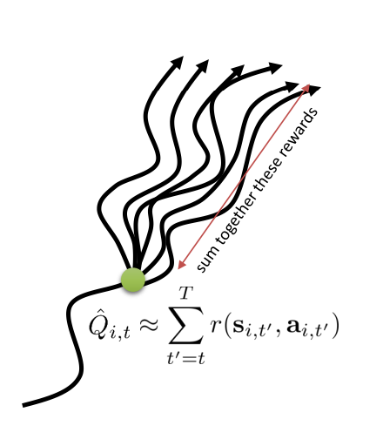

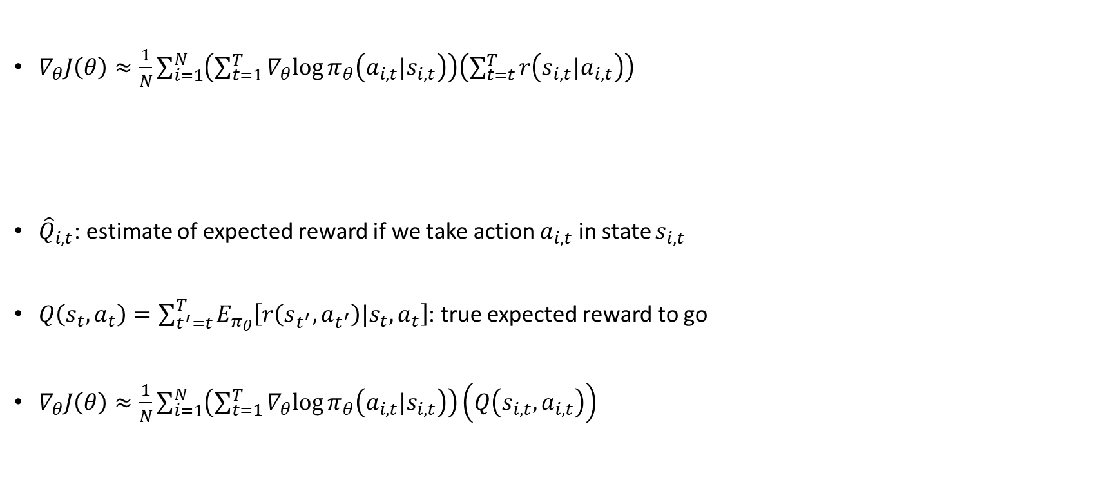
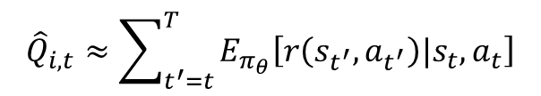
Improving the policy gradient
$∇_{θ}J\left(θ\right)≈\frac{1}{N}\sum_{i=1}^{N}{\left(\sum_{t=1}^{T}{∇_{θ}log{π_{θ}\left(a_{i, t}|s_{i,t}\right)}}\right)\left(\sum_{t=t}^{T}{r\left(s_{i,t}|a_{i,t}\right)}\right)}$
${\hat{Q}}_{i,t}$: estimate of expected reward if we take action $a_{i,t}$ in state $s_{i,t}$
$Q\left(s_{t},a_{t}\right)=\sum_{t^{′}=t}^{T}{E_{π_{θ}}\left[r\left(s_{t^{′}},a_{t^{′}}\right)|s_{t},a_{t}\right]}$: true expected reward to go
$∇_{θ}J\left(θ\right)≈\frac{1}{N}\sum_{i=1}^{N}{\left(\sum_{t=1}^{T}{∇_{θ}log{π_{θ}\left(a_{i, t}|s_{i,t}\right)}}\right)\left(Q\left(s_{i,t},a_{i,t}\right)\right)}$
$${\hat{Q}}_{i,t}$$
$${\hat{Q}}_{i,t}≈\sum_{t^{′}=t}^{T}{E_{π_{θ}}\left[r\left(s_{t^{′}},a_{t^{′}}\right)|s_{t},a_{t}\right]}$$

Slide 7
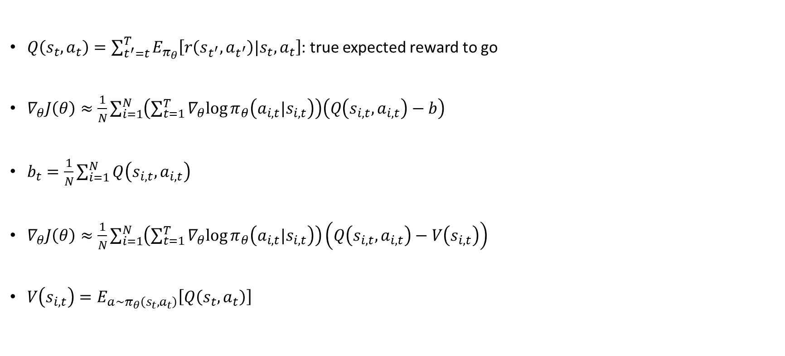
What about the baseline?
$Q\left(s_{t},a_{t}\right)=\sum_{t^{′}=t}^{T}{E_{π_{θ}}\left[r\left(s_{t^{′}},a_{t^{′}}\right)|s_{t},a_{t}\right]}$: true expected reward to go
$∇_{θ}J\left(θ\right)≈\frac{1}{N}\sum_{i=1}^{N}{\left(\sum_{t=1}^{T}{∇_{θ}log{π_{θ}\left(a_{i, t}|s_{i,t}\right)}}\right)\left(Q\left(s_{i,t},a_{i,t}\right)−b\right)}$
$b_{t}=\frac{1}{N}\sum_{i=1}^{N}{Q\left(s_{i,t},a_{i,t}\right)}$
$∇_{θ}J\left(θ\right)≈\frac{1}{N}\sum_{i=1}^{N}{\left(\sum_{t=1}^{T}{∇_{θ}log{π_{θ}\left(a_{i, t}|s_{i,t}\right)}}\right)\left(Q\left(s_{i,t},a_{i,t}\right)−V\left(s_{i,t}\right)\right)}$
$V\left(s_{i,t}\right)=E_{a\sim π_{θ}\left(s_{t},a_{t}\right)}\left[Q\left(s_{t},a_{t}\right)\right]$
Advantage function

Slide 8

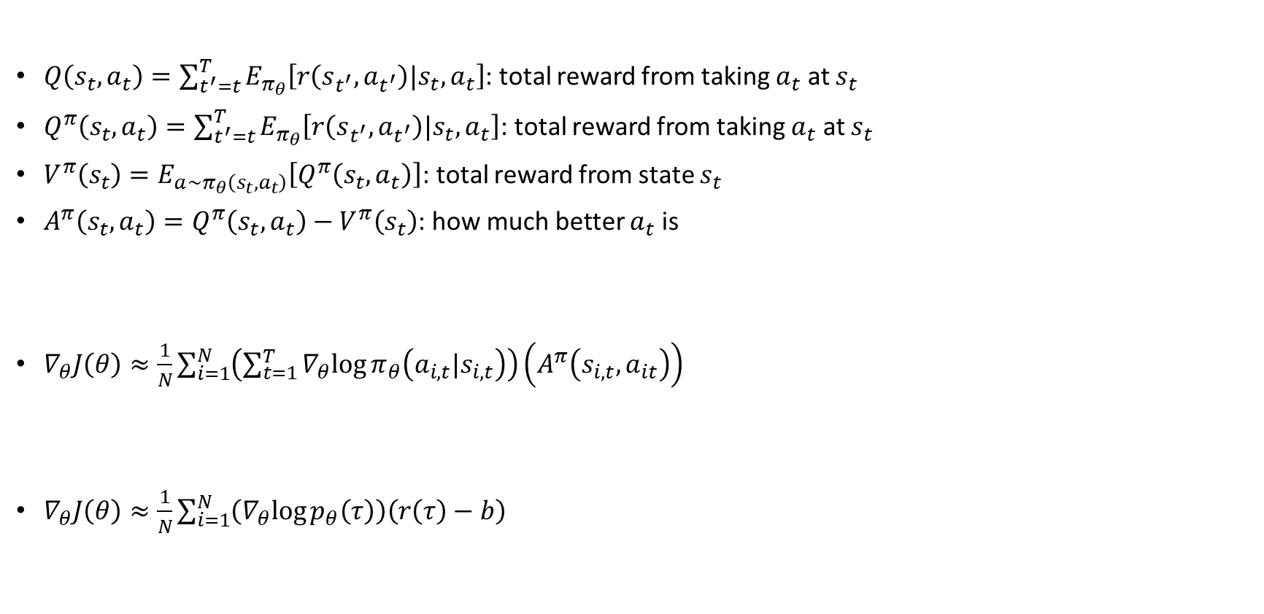

State & state-action value functions
$Q\left(s_{t},a_{t}\right)=\sum_{t^{′}=t}^{T}{E_{π_{θ}}\left[r\left(s_{t^{′}},a_{t^{′}}\right)|s_{t},a_{t}\right]}$: total reward from taking $a_{t}$ at $s_{t}$
$Q^{π}\left(s_{t},a_{t}\right)=\sum_{t^{′}=t}^{T}{E_{π_{θ}}\left[r\left(s_{t^{′}},a_{t^{′}}\right)|s_{t},a_{t}\right]}$: total reward from taking $a_{t}$ at $s_{t}$
$V^{π}\left(s_{t}\right)=E_{a\sim π_{θ}\left(s_{t},a_{t}\right)}\left[Q^{π}\left(s_{t},a_{t}\right)\right]$: total reward from state $s_{t}$
$A^{π}\left(s_{t},a_{t}\right)=Q^{π}\left(s_{t},a_{t}\right)−V^{π}\left(s_{t}\right)$: how much better $a_{t}$ is
$∇_{θ}J\left(θ\right)≈\frac{1}{N}\sum_{i=1}^{N}{\left(\sum_{t=1}^{T}{∇_{θ}log{π_{θ}\left(a_{i, t}|s_{i,t}\right)}}\right)\left(A^{π}\left(s_{i,t},a_{it}\right)\right)}$
$∇_{θ}J\left(θ\right)≈\frac{1}{N}\sum_{i=1}^{N}{\left(∇_{θ}log{p_{θ}\left(τ\right)}\right)\left(r\left(τ\right)−b\right)}$
Fit $A^{π}$, $Q^{π}{,V}^{π}$
fit samples to model to generate return
generate samples
the better this estimate is, the lower the variance
Improve the policy
Unbiased, but high variance
$$θ←θ+α∇_{θ}J\left(θ\right)$$

Slide 9
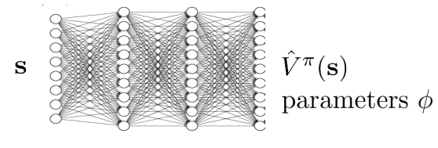

Value function fitting
${ A}^{π}$, $Q^{π}{,V}^{π}$ Fit what to what?
$Q^{π}\left(s_{t},a_{t}\right)=\sum_{t^{′}=t}^{T}{E_{π_{θ}}\left[r\left(s_{t^{′}},a_{t^{′}}\right)|s_{t},a_{t}\right]}$
$Q^{π}\left(s_{t},a_{t}\right)≈r\left(s_{t},a_{t}\right)+\sum_{t^{′}=t+1}^{T}{E_{π_{θ}}\left[r\left(s_{t^{′}},a_{t^{′}}\right)|s_{t},a_{t}\right]}$
$Q^{π}\left(s_{t},a_{t}\right)≈r\left(s_{t},a_{t}\right)+V^{π}\left(s_{t+1}\right)$
${ A}^{π}≈r\left(s_{t},a_{t}\right)+V^{π}\left(s_{t+1}\right)−V^{π}\left(s_{t}\right)$
Just fit $V^{π}(s)$

Slide 10

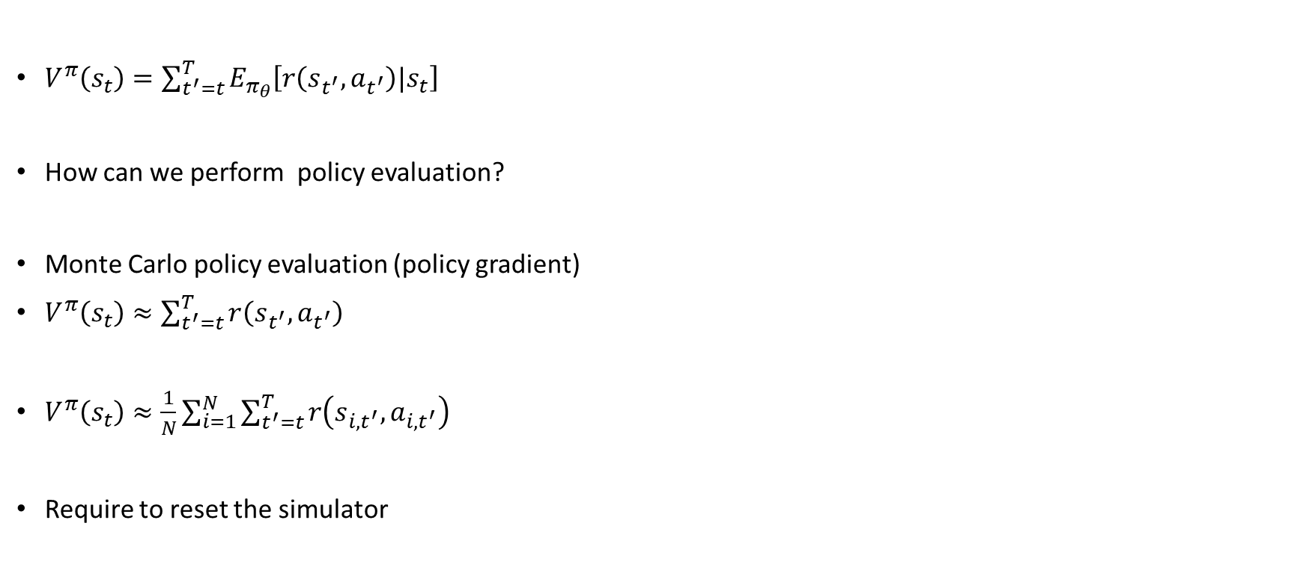
Policy evaluation
Fit $V^{π}$
$V^{π}\left(s_{t}\right)=\sum_{t^{′}=t}^{T}{E_{π_{θ}}\left[r\left(s_{t^{′}},a_{t^{′}}\right)|s_{t}\right]}$
How can we perform policy evaluation?
Monte Carlo policy evaluation (policy gradient)
$V^{π}\left(s_{t}\right)≈\sum_{t^{′}=t}^{T}{r\left(s_{t^{′}},a_{t^{′}}\right)}$
$V^{π}\left(s_{t}\right)≈\frac{1}{N}\sum_{i=1}^{N}{\sum_{t^{′}=t}^{T}{r\left(s_{{i,t}^{′}},a_{i,t^{′}}\right)}}$
Require to reset the simulator
fit samples to model to generate return
generate samples
Improve the policy

Slide 11
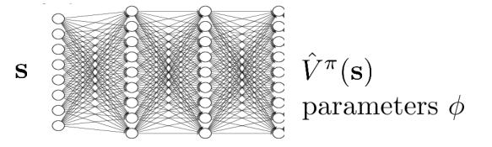
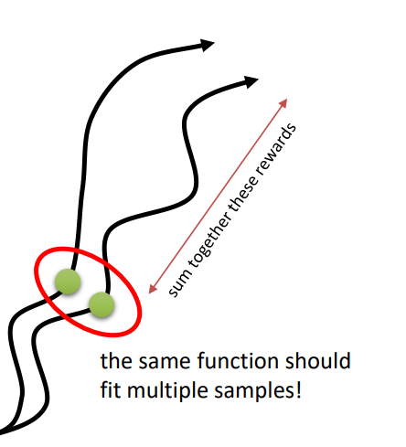
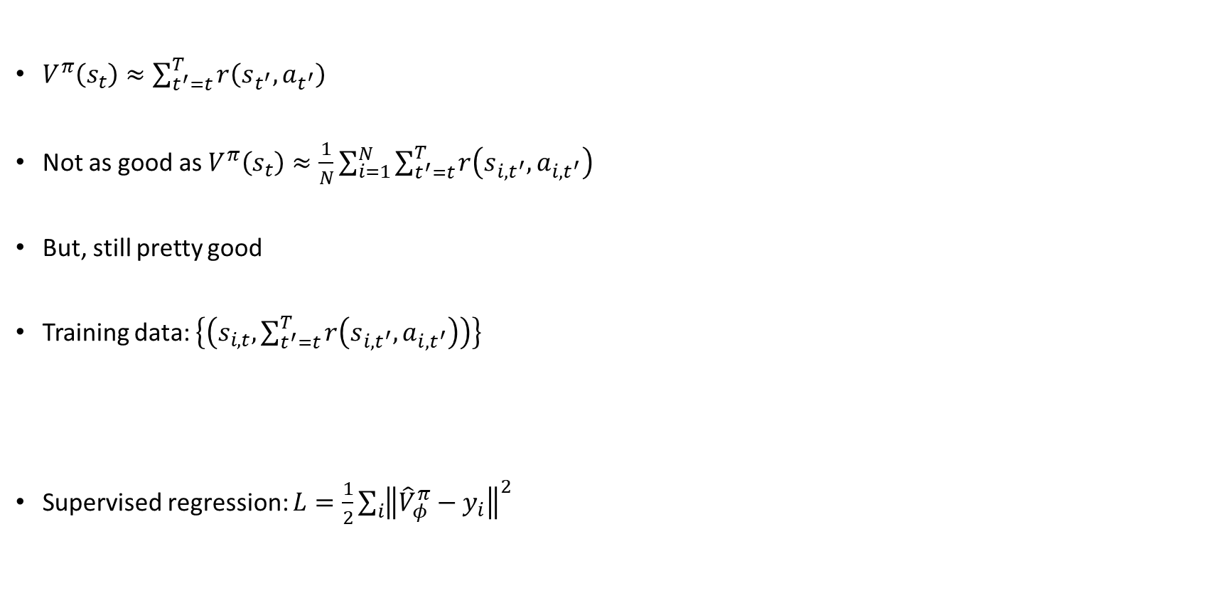

Monte Carlo evaluation with function approximation
$V^{π}\left(s_{t}\right)≈\sum_{t^{′}=t}^{T}{r\left(s_{t^{′}},a_{t^{′}}\right)}$
Not as good as $V^{π}\left(s_{t}\right)≈\frac{1}{N}\sum_{i=1}^{N}{\sum_{t^{′}=t}^{T}{r\left(s_{{i,t}^{′}},a_{i,t^{′}}\right)}}$
But, still pretty good
Training data: $\left\{\left(s_{i,t},\sum_{t^{′}=t}^{T}{r\left(s_{{i,t}^{′}},a_{i,t^{′}}\right)}\right)\right\}$
Supervised regression: $L=\frac{1}{2}\sum_{i}{{\left\|{\hat{V}}_{φ}^{π}−y_{i}\right\|}^{2}}$
$$y_{i,t}$$

Slide 12

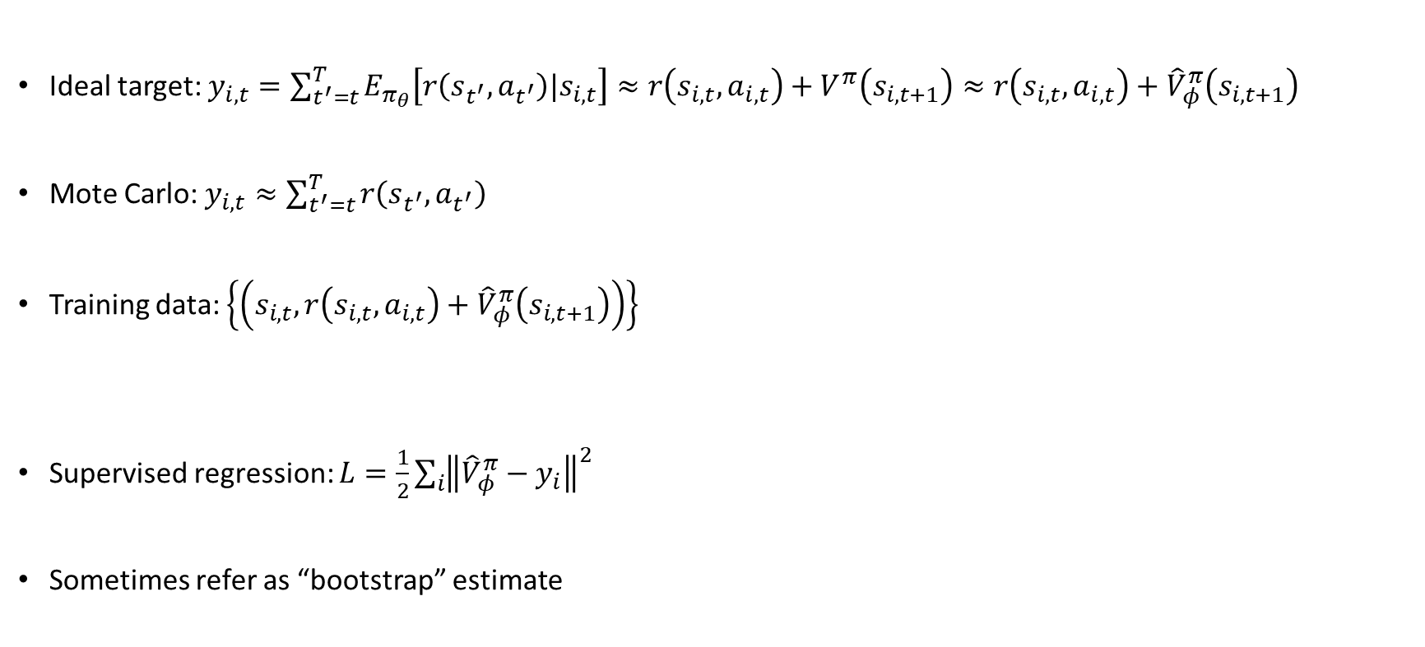
Can we do better?
Ideal target: $y_{i,t}=\sum_{t^{′}=t}^{T}{E_{π_{θ}}\left[r\left(s_{t^{′}},a_{t^{′}}\right)|s_{i,t}\right]≈r\left(s_{i,t},a_{i,t}\right)+V^{π}\left(s_{i,t+1}\right)}≈r\left(s_{i,t},a_{i,t}\right)+{\hat{V}}_{φ}^{π}\left(s_{i,t+1}\right)$
Mote Carlo: $y_{i,t}≈\sum_{t^{′}=t}^{T}{r\left(s_{t^{′}},a_{t^{′}}\right)}$
Training data: $\left\{\left(s_{i,t},r\left(s_{i,t},a_{i,t}\right)+{\hat{V}}_{φ}^{π}\left(s_{i,t+1}\right)\right)\right\}$
Supervised regression: $L=\frac{1}{2}\sum_{i}{{\left\|{\hat{V}}_{φ}^{π}−y_{i}\right\|}^{2}}$
Sometimes refer as “bootstrap” estimate
$$y_{i,t}$$

Slide 13
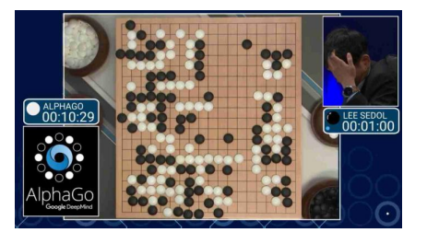

Policy evaluation examples
AlphaGo, Silver et al. 2016
Reward: game outcome
Value function: ${\hat{V}}_{φ}^{π}\left(s_{t}\right)$: Expected outcome given board state

Slide 14
From Evaluation to Actor Critic

Slide 15



An actor-critic algorithm
Batch actor-critic algorithm:
Sample trajectory $\left\{s_{i},a_{i}\right\}$ from $π_{θ}\left(a|s\right)$
Fit ${\hat{V}}_{φ}^{π}$ to sample reward sums
Evaluate ${\hat{A}}^{π}\left(s_{i},a_{i}\right)=r\left(s_{i},a_{i}\right)+{\hat{V}}_{φ}^{π}\left(s_{i}^{′}\right)−{\hat{V}}_{φ}^{π}\left(s_{i}\right)$
$∇_{θ}J\left(θ\right)≈\frac{1}{N}\sum_{i=1}^{N}{\left(\sum_{t=1}^{T}{∇_{θ}log{π_{θ}\left(a_{i, t}|s_{i,t}\right)}}\right)\left({\hat{A}}^{π}\left(s_{i},a_{i}\right)\right)}$
$θ←θ+α∇_{θ}J\left(θ\right)$
$$y_{i,t}≈\sum_{t^{′}=t}^{T}{r\left(s_{t^{′}},a_{t^{′}}\right)}$$
$$y_{i,t}≈r\left(s_{i,t},a_{i,t}\right)+{\hat{V}}_{φ}^{π}\left(s_{i,t+1}\right)$$

Slide 16
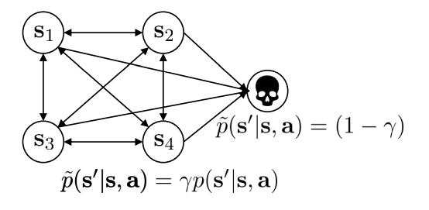


Aside: discount factors
$y_{i,t}≈r\left(s_{i,t},a_{i,t}\right)+{\hat{V}}_{φ}^{π}\left(s_{i,t+1}\right)$
Supervised regression: $L=\frac{1}{2}\sum_{i}{{\left\|{\hat{V}}_{φ}^{π}−y_{i}\right\|}^{2}}$
What if T is $∞$?
${\hat{V}}_{φ}^{π}$ can be infinity
Simple trick: better to get reward sooner that later
$y_{i,t}≈r\left(s_{i,t},a_{i,t}\right)+{γ\hat{V}}_{φ}^{π}\left(s_{i,t+1}\right)$
Discount factor$γ ∈\left[0,1\right]$ (0.99 works well)

Slide 17
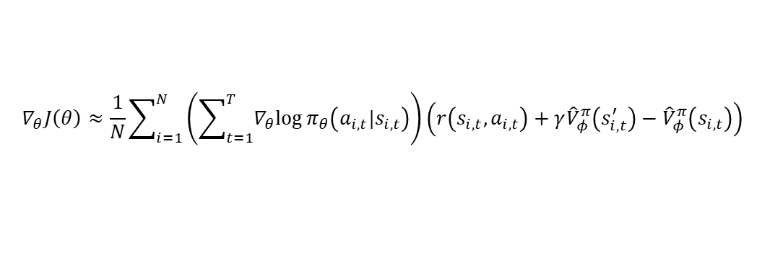
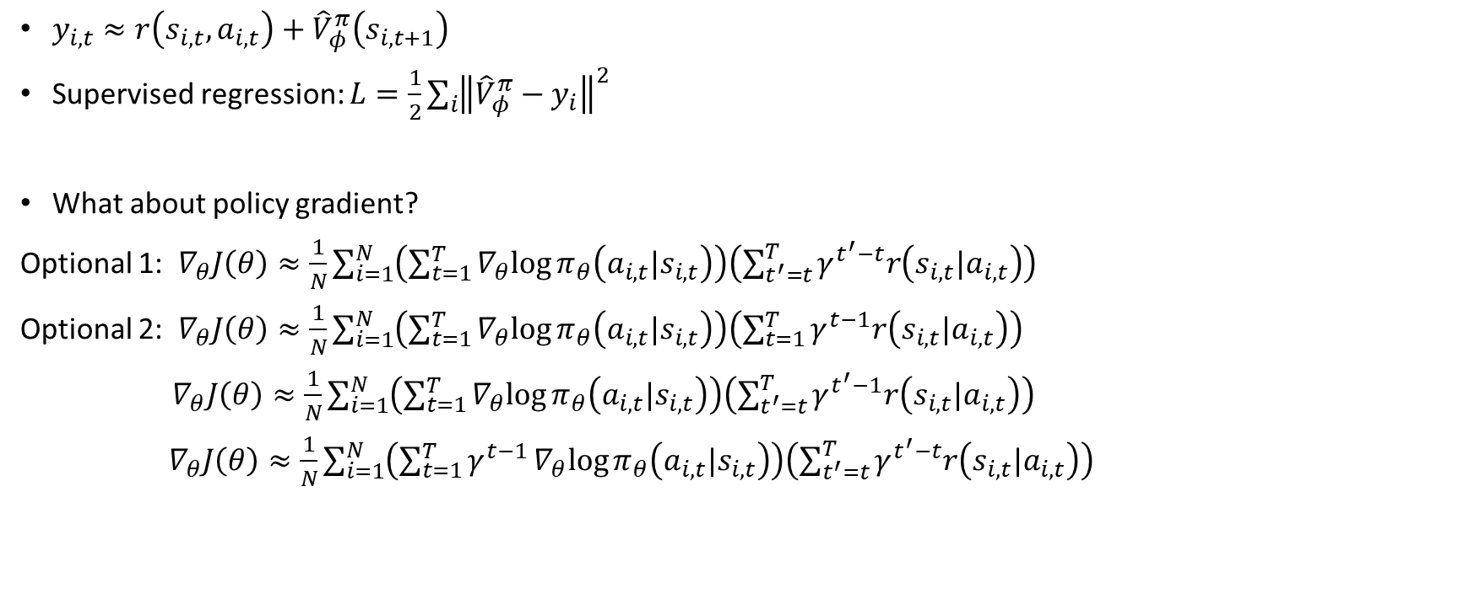

Aside: discount factors for policy gradients
$${\hat{A}}^{π}\left(s_{i,t},a_{i,t}\right)$$
$y_{i,t}≈r\left(s_{i,t},a_{i,t}\right)+{\hat{V}}_{φ}^{π}\left(s_{i,t+1}\right)$
Supervised regression: $L=\frac{1}{2}\sum_{i}{{\left\|{\hat{V}}_{φ}^{π}−y_{i}\right\|}^{2}}$
What about policy gradient?
Optional 1: $∇_{θ}J\left(θ\right)≈\frac{1}{N}\sum_{i=1}^{N}{\left(\sum_{t=1}^{T}{∇_{θ}log{π_{θ}\left(a_{i, t}|s_{i,t}\right)}}\right)\left(\sum_{t^{′}=t}^{T}{γ^{t^{′}−t}r\left(s_{i,t}|a_{i,t}\right)}\right)}$
Optional 2: $∇_{θ}J\left(θ\right)≈\frac{1}{N}\sum_{i=1}^{N}{\left(\sum_{t=1}^{T}{∇_{θ}log{π_{θ}\left(a_{i, t}|s_{i,t}\right)}}\right)\left(\sum_{t=1}^{T}{γ^{t−1}r\left(s_{i,t}|a_{i,t}\right)}\right)}$
$∇_{θ}J\left(θ\right)≈\frac{1}{N}\sum_{i=1}^{N}{\left(\sum_{t=1}^{T}{∇_{θ}log{π_{θ}\left(a_{i, t}|s_{i,t}\right)}}\right)\left(\sum_{t^{′}=t}^{T}{γ^{t^{′}−1}r\left(s_{i,t}|a_{i,t}\right)}\right)}$
$∇_{θ}J\left(θ\right)≈\frac{1}{N}\sum_{i=1}^{N}{\left(\sum_{t=1}^{T}{γ^{t−1}∇_{θ}log{π_{θ}\left(a_{i, t}|s_{i,t}\right)}}\right)\left(\sum_{t^{′}=t}^{T}{γ^{t^{′}−t}r\left(s_{i,t}|a_{i,t}\right)}\right)}$
$$∇_{θ}J\left(θ\right)≈\frac{1}{N}\sum_{i=1}^{N}{\left(\sum_{t=1}^{T}{∇_{θ}log{π_{θ}\left(a_{i, t}|s_{i,t}\right)}}\right)\left(r\left(s_{i,t},a_{i,t}\right)+γ{\hat{V}}_{φ}^{π}\left(s_{i,t}^{′}\right)−{\hat{V}}_{φ}^{π}\left(s_{i,t}\right)\right)}$$
Not the same

Slide 18
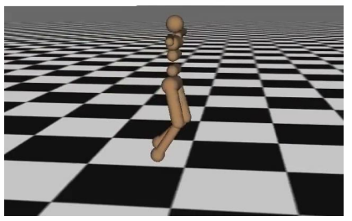
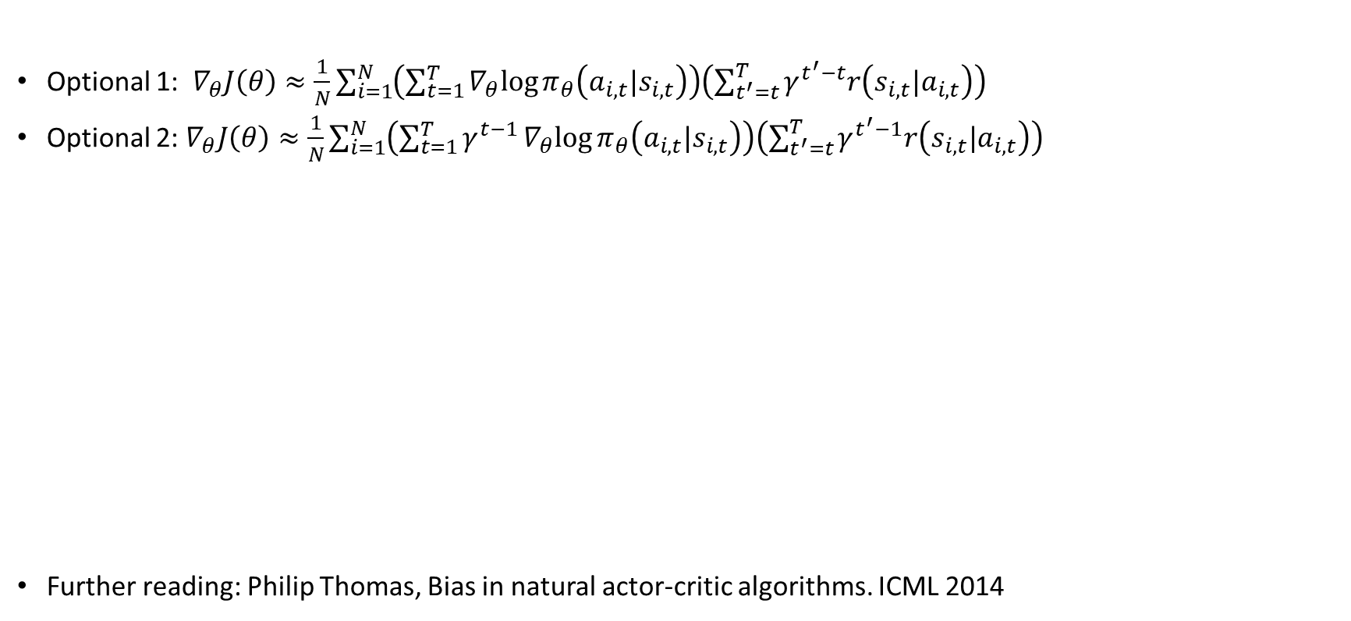
Which version is the right one?
Optional 1: $∇_{θ}J\left(θ\right)≈\frac{1}{N}\sum_{i=1}^{N}{\left(\sum_{t=1}^{T}{∇_{θ}log{π_{θ}\left(a_{i, t}|s_{i,t}\right)}}\right)\left(\sum_{t^{′}=t}^{T}{γ^{t^{′}−t}r\left(s_{i,t}|a_{i,t}\right)}\right)}$
Optional 2: $∇_{θ}J\left(θ\right)≈\frac{1}{N}\sum_{i=1}^{N}{\left(\sum_{t=1}^{T}{γ^{t−1}∇_{θ}log{π_{θ}\left(a_{i, t}|s_{i,t}\right)}}\right)\left(\sum_{t^{′}=t}^{T}{γ^{t^{′}−1}r\left(s_{i,t}|a_{i,t}\right)}\right)}$
Further reading: Philip Thomas, Bias in natural actor-critic algorithms. ICML 2014

Slide 19
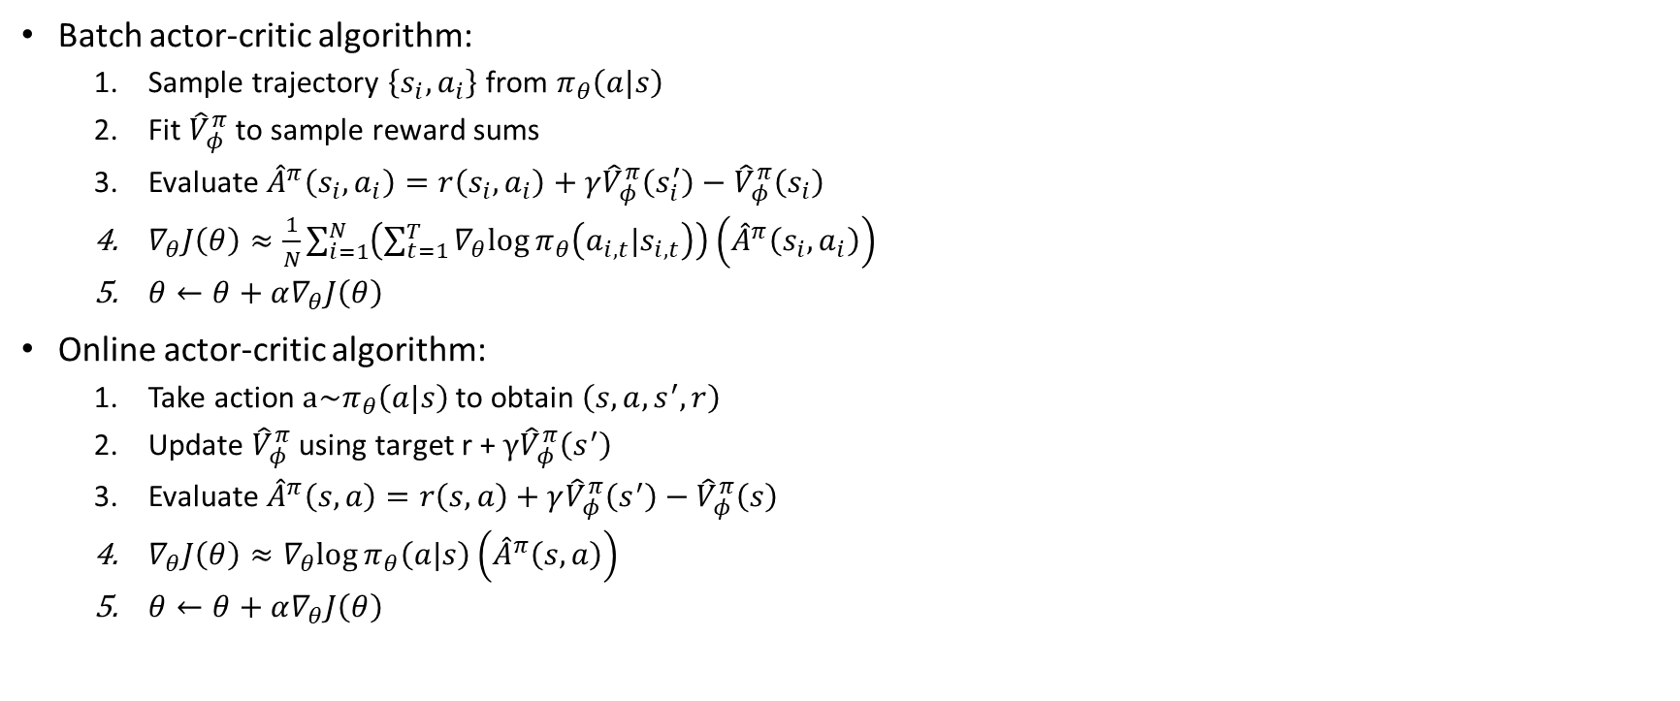
Actor-critic with discount
Batch actor-critic algorithm:
Sample trajectory $\left\{s_{i},a_{i}\right\}$ from $π_{θ}\left(a|s\right)$
Fit ${\hat{V}}_{φ}^{π}$ to sample reward sums
Evaluate ${\hat{A}}^{π}\left(s_{i},a_{i}\right)=r\left(s_{i},a_{i}\right)+γ{\hat{V}}_{φ}^{π}\left(s_{i}^{′}\right)−{\hat{V}}_{φ}^{π}\left(s_{i}\right)$
$∇_{θ}J\left(θ\right)≈\frac{1}{N}\sum_{i=1}^{N}{\left(\sum_{t=1}^{T}{∇_{θ}log{π_{θ}\left(a_{i, t}|s_{i,t}\right)}}\right)\left({\hat{A}}^{π}\left(s_{i},a_{i}\right)\right)}$
$θ←θ+α∇_{θ}J\left(θ\right)$
Online actor-critic algorithm:
Take action $a\sim π_{θ}\left(a|s\right)$to obtain $\left(s, a, s^{′}, r\right)$
Update ${\hat{V}}_{φ}^{π}$ using target r + $γ{\hat{V}}_{φ}^{π}\left(s^{′}\right)$
Evaluate ${\hat{A}}^{π}\left(s, a\right)=r\left(s, a\right)+γ{\hat{V}}_{φ}^{π}\left(s^{′}\right)−{\hat{V}}_{φ}^{π}\left(s\right)$
$∇_{θ}J\left(θ\right)≈∇_{θ}log{π_{θ}\left(a|s\right)}\left({\hat{A}}^{π}\left(s, a\right)\right)$
$θ←θ+α∇_{θ}J\left(θ\right)$

Slide 20
Actor-Critic Design Decision

Slide 21
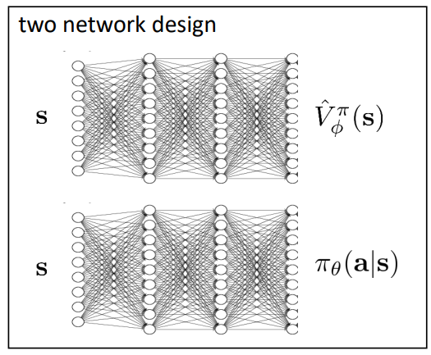
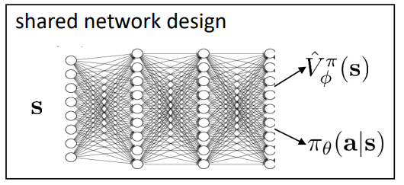

Architecture design
Online actor-critic algorithm:
Take action $a\sim π_{θ}\left(a|s\right)$to obtain $\left(s, a, s^{′}, r\right)$
Update ${\hat{V}}_{φ}^{π}$ using target r + $γ{\hat{V}}_{φ}^{π}\left(s^{′}\right)$
Evaluate ${\hat{A}}^{π}\left(s, a\right)=r\left(s, a\right)+γ{\hat{V}}_{φ}^{π}\left(s^{′}\right)−{\hat{V}}_{φ}^{π}\left(s\right)$
$∇_{θ}J\left(θ\right)≈∇_{θ}log{π_{θ}\left(a|s\right)}\left({\hat{A}}^{π}\left(s, a\right)\right)$
$θ←θ+α∇_{θ}J\left(θ\right)$
+ simple & stable
- No shared features between actor and critic

Slide 22
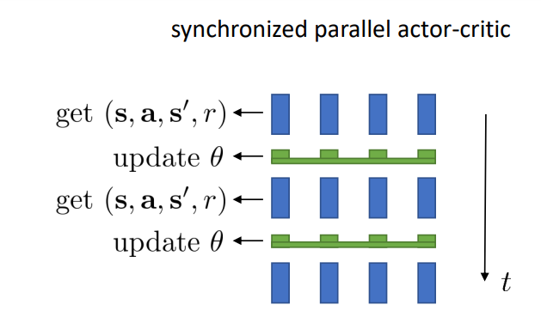
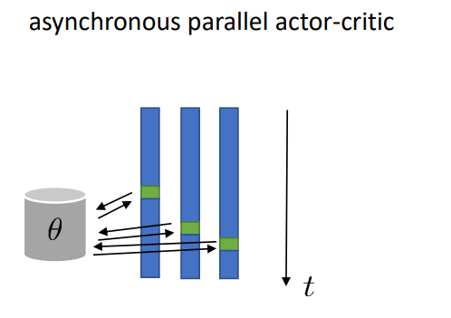

Online actor-critic in practice
Online actor-critic algorithm:
Take action $a\sim π_{θ}\left(a|s\right)$to obtain $\left(s, a, s^{′}, r\right)$
Update ${\hat{V}}_{φ}^{π}$ using target r + $γ{\hat{V}}_{φ}^{π}\left(s^{′}\right)$
Evaluate ${\hat{A}}^{π}\left(s, a\right)=r\left(s, a\right)+γ{\hat{V}}_{φ}^{π}\left(s^{′}\right)−{\hat{V}}_{φ}^{π}\left(s\right)$
$∇_{θ}J\left(θ\right)≈∇_{θ}log{π_{θ}\left(a|s\right)}\left({\hat{A}}^{π}\left(s, a\right)\right)$
$θ←θ+α∇_{θ}J\left(θ\right)$
Work best with batch

Slide 23
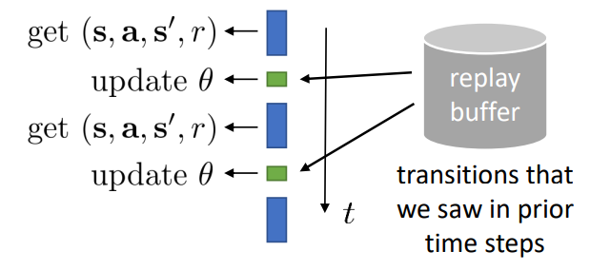
Can we remove the on-policy assumption entirely?
Online actor-critic algorithm:
Take action $a\sim π_{θ}\left(a|s\right)$to obtain $\left(s, a, s^{′}, r\right)$
Update ${\hat{V}}_{φ}^{π}$ using target r + $γ{\hat{V}}_{φ}^{π}\left(s^{′}\right)$
Evaluate ${\hat{A}}^{π}\left(s, a\right)=r\left(s, a\right)+γ{\hat{V}}_{φ}^{π}\left(s^{′}\right)−{\hat{V}}_{φ}^{π}\left(s\right)$
$∇_{θ}J\left(θ\right)≈∇_{θ}log{π_{θ}\left(a|s\right)}\left({\hat{A}}^{π}\left(s, a\right)\right)$
$θ←θ+α∇_{θ}J\left(θ\right)$
Using old data to form a batch
Off-policy actor-critic

Slide 24

Let’s see what that looks like
Online actor-critic algorithm:
Take action $a\sim π_{θ}\left(a|s\right)$to obtain $\left(s, a, s^{′}, r\right)$ and store in replay buffer
Update ${\hat{V}}_{φ}^{π}$ using target r + $γ{\hat{V}}_{φ}^{π}\left(s^{′}\right)$ from replay buffer for each s
Evaluate ${\hat{A}}^{π}\left(s, a\right)=r\left(s, a\right)+γ{\hat{V}}_{φ}^{π}\left(s^{′}\right)−{\hat{V}}_{φ}^{π}\left(s\right)$
$∇_{θ}J\left(θ\right)≈∇_{θ}log{π_{θ}\left(a|s\right)}\left({\hat{A}}^{π}\left(s, a\right)\right)$
$θ←θ+α∇_{θ}J\left(θ\right)$

Slide 25
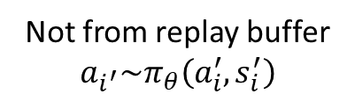
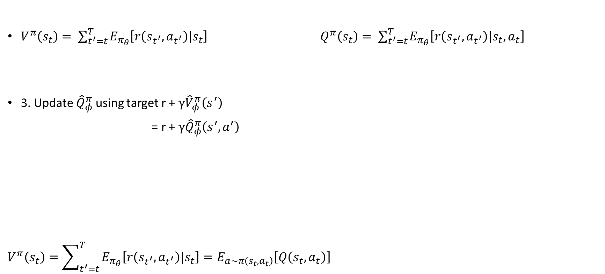
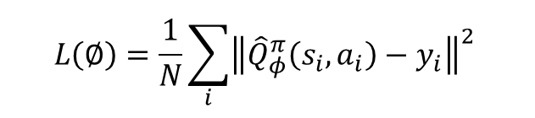
Fixing the value function
$V^{π}\left(s_{t}\right)= \sum_{t^{′}=t}^{T}{E_{π_{θ}}\left[r\left(s_{t^{′}},a_{t^{′}}\right)|s_{t}\right] } Q^{π}\left(s_{t}\right)= \sum_{t^{′}=t}^{T}{E_{π_{θ}}\left[r\left(s_{t^{′}},a_{t^{′}}\right)|s_{t},a_{t}\right]}$
3. Update ${\hat{Q}}_{φ}^{π}$ using target r + $γ{\hat{V}}_{φ}^{π}\left(s^{′}\right)$
= r + $γ{\hat{Q}}_{φ}^{π}\left(s^{′},a^{′}\right)$
$$V^{π}\left(s_{t}\right)=\sum_{t^{′}=t}^{T}{E_{π_{θ}}\left[r\left(s_{t^{′}},a_{t^{′}}\right)|s_{t}\right]=E_{a\sim π\left(s_{t},a_{t}\right)}\left[Q\left(s_{t},a_{t}\right)\right]}$$
$$L\left(∅\right)=\frac{1}{N}\sum_{i}{{\left\|{\hat{Q}}_{φ}^{π}\left(s_{i},a_{i}\right)−y_{i}\right\|}^{2}}$$
Not from replay buffer
$$a_{i^{′}}\sim π_{θ}\left(a_{i}^{′},s_{i}^{′}\right)$$

Slide 26
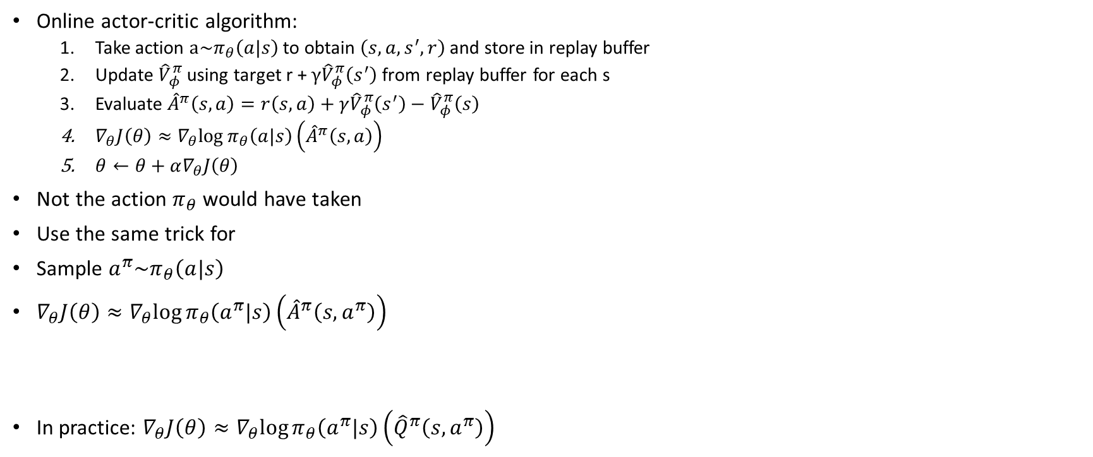
Fixing the policy update
Online actor-critic algorithm:
Take action $a\sim π_{θ}\left(a|s\right)$to obtain $\left(s, a, s^{′}, r\right)$ and store in replay buffer
Update ${\hat{V}}_{φ}^{π}$ using target r + $γ{\hat{V}}_{φ}^{π}\left(s^{′}\right)$ from replay buffer for each s
Evaluate ${\hat{A}}^{π}\left(s, a\right)=r\left(s, a\right)+γ{\hat{V}}_{φ}^{π}\left(s^{′}\right)−{\hat{V}}_{φ}^{π}\left(s\right)$
$∇_{θ}J\left(θ\right)≈∇_{θ}log{π_{θ}\left(a|s\right)}\left({\hat{A}}^{π}\left(s, a\right)\right)$
$θ←θ+α∇_{θ}J\left(θ\right)$
Not the action $π_{θ}$ would have taken
Use the same trick for
Sample $a^{π}\sim π_{θ}\left(a|s\right)$
$∇_{θ}J\left(θ\right)≈∇_{θ}log{π_{θ}\left(a^{π}|s\right)}\left({\hat{A}}^{π}\left(s,a^{π}\right)\right)$
In practice: $∇_{θ}J\left(θ\right)≈∇_{θ}log{π_{θ}\left(a^{π}|s\right)}\left({\hat{Q}}^{π}\left(s,a^{π}\right)\right)$
High variance, but convenient
Why is higher variance ok?
Not from replay buffer

Slide 27
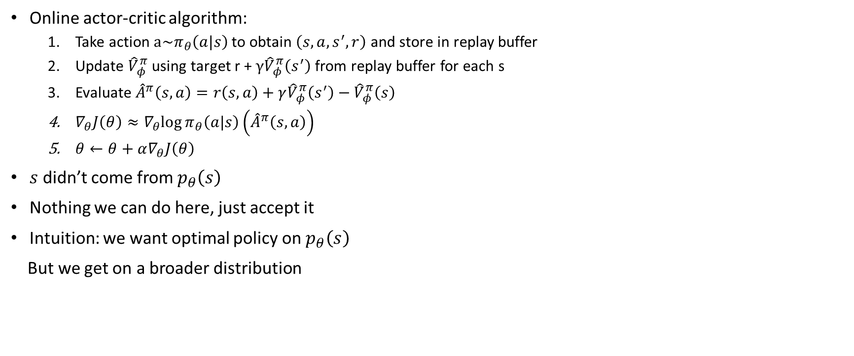
What else is left?
Online actor-critic algorithm:
Take action $a\sim π_{θ}\left(a|s\right)$to obtain $\left(s, a, s^{′}, r\right)$ and store in replay buffer
Update ${\hat{V}}_{φ}^{π}$ using target r + $γ{\hat{V}}_{φ}^{π}\left(s^{′}\right)$ from replay buffer for each s
Evaluate ${\hat{A}}^{π}\left(s, a\right)=r\left(s, a\right)+γ{\hat{V}}_{φ}^{π}\left(s^{′}\right)−{\hat{V}}_{φ}^{π}\left(s\right)$
$∇_{θ}J\left(θ\right)≈∇_{θ}log{π_{θ}\left(a|s\right)}\left({\hat{A}}^{π}\left(s, a\right)\right)$
$θ←θ+α∇_{θ}J\left(θ\right)$
$s$ didn’t come from $p_{θ}\left(s\right)$
Nothing we can do here, just accept it
Intuition: we want optimal policy on $p_{θ}\left(s\right)$
But we get on a broader distribution

Slide 28
Critics as Baselines

Slide 29
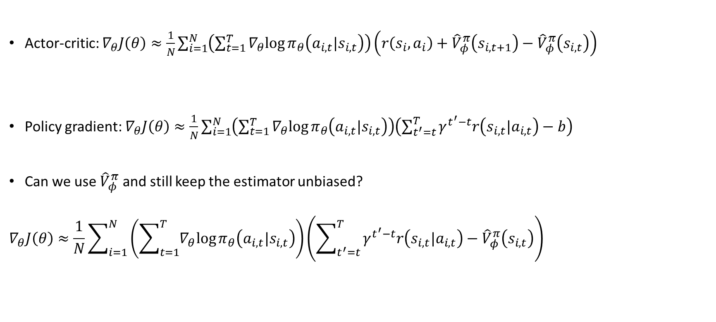
Critics as state-dependent baselines
Actor-critic: $∇_{θ}J\left(θ\right)≈\frac{1}{N}\sum_{i=1}^{N}{\left(\sum_{t=1}^{T}{∇_{θ}log{π_{θ}\left(a_{i, t}|s_{i,t}\right)}}\right)\left(r\left(s_{i},a_{i}\right)+{\hat{V}}_{φ}^{π}\left(s_{i,t+1}\right)−{\hat{V}}_{φ}^{π}\left(s_{i,t}\right)\right)}$
Policy gradient: $∇_{θ}J\left(θ\right)≈\frac{1}{N}\sum_{i=1}^{N}{\left(\sum_{t=1}^{T}{∇_{θ}log{π_{θ}\left(a_{i, t}|s_{i,t}\right)}}\right)\left(\sum_{t^{′}=t}^{T}{γ^{t^{′}−t}r\left(s_{i,t}|a_{i,t}\right)}−b\right)}$
Can we use ${\hat{V}}_{φ}^{π}$ and still keep the estimator unbiased?
$$∇_{θ}J\left(θ\right)≈\frac{1}{N}\sum_{i=1}^{N}{\left(\sum_{t=1}^{T}{∇_{θ}log{π_{θ}\left(a_{i, t}|s_{i,t}\right)}}\right)\left(\sum_{t^{′}=t}^{T}{γ^{t^{′}−t}r\left(s_{i,t}|a_{i,t}\right)}−{\hat{V}}_{φ}^{π}\left(s_{i,t}\right)\right)}$$
+ lower variance
- biased
+ no bias
- higher variance
+ no bias
+ lower variance

Slide 30
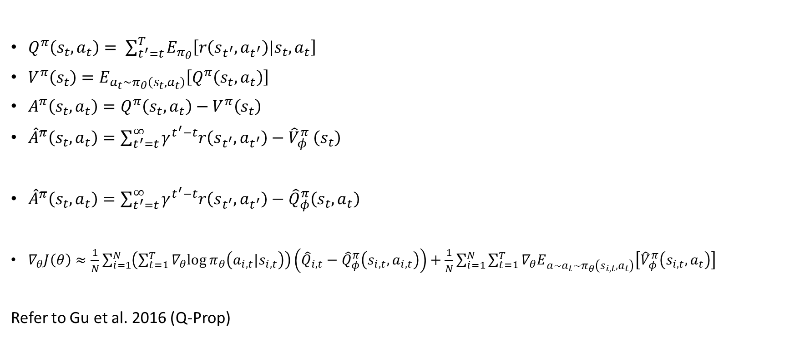
Control variates: action-dependent baselines
$Q^{π}\left(s_{t},a_{t}\right)= \sum_{t^{′}=t}^{T}{E_{π_{θ}}\left[r\left(s_{t^{′}},a_{t^{′}}\right)|s_{t},a_{t}\right]}$
$V^{π}\left(s_{t}\right)=E_{{a_{t}\sim π}_{θ}\left(s_{t},a_{t}\right)}\left[Q^{π}\left(s_{t},a_{t}\right)\right]$
$A^{π}\left(s_{t},a_{t}\right)=Q^{π}\left(s_{t},a_{t}\right)−V^{π}\left(s_{t}\right)$
${\hat{A}}^{π}\left(s_{t},a_{t}\right)=\sum_{t^{′}=t}^{∞}{γ^{t^{′}−t}r\left(s_{t^{′}},a_{t^{′}}\right){− \hat{V}}_{φ}^{π}\left(s_{t}\right)}$
${\hat{A}}^{π}\left(s_{t},a_{t}\right)=\sum_{t^{′}=t}^{∞}{γ^{t^{′}−t}r\left(s_{t^{′}},a_{t^{′}}\right)−{\hat{Q}}_{φ}^{π}\left(s_{t},a_{t}\right)}$
$∇_{θ}J\left(θ\right)≈\frac{1}{N}\sum_{i=1}^{N}{\left(\sum_{t=1}^{T}{∇_{θ}log{π_{θ}\left(a_{i, t}|s_{i,t}\right)}}\right)\left({\hat{Q}}_{i,t}−{\hat{Q}}_{φ}^{π}\left(s_{i,t},a_{i,t}\right)\right)}+\frac{1}{N}\sum_{i=1}^{N}{\sum_{t=1}^{T}{{∇_{θ}E}_{a\sim {a_{t}\sim π}_{θ}\left(s_{i,t},a_{t}\right)}\left[{\hat{V}}_{φ}^{π}\left(s_{i,t},a_{t}\right)\right]}}$
Refer to Gu et al. 2016 (Q-Prop)
+ no biase
- higher variance
+ goes to 0 in expectation if critic is correct
- Not correct

Slide 31
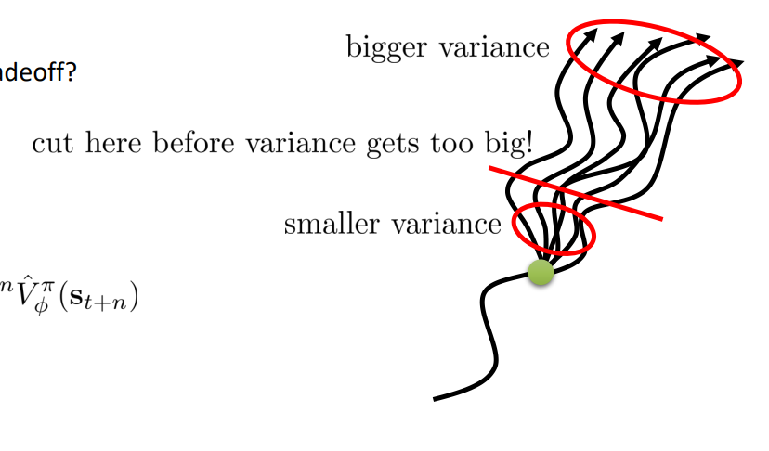
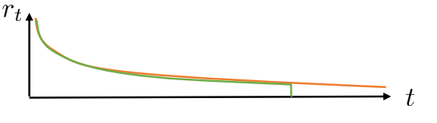

Eligibility traces & n-step returns
+ lower variance
- higher bias if value is wrong (always wrong)
${\hat{A}}_{C}^{π}\left(s_{t},a_{t}\right)=r\left(s_{t},a_{t}\right)+γ{\hat{V}}_{∅}^{π}\left(s_{t+1}\right)−{\hat{V}}_{∅}^{π}\left(s_{t}\right)$
${\hat{A}}_{MC}^{π}\left(s_{t},a_{t}\right)=\sum_{t^{′}=t}^{∞}{γ^{t^{′}− t}}r\left(s_{t^{′}},a_{t^{′}}\right)−{\hat{V}}_{∅}^{π}\left(s_{t}\right)$
Can we combine these two, to control bias/variance tradeoff?
${\hat{A}}_{n}^{π}\left(s_{t},a_{t}\right)=\sum_{t^{′}=t}^{t+n}{γ^{t^{′}− t}}r\left(s_{t^{′}},a_{t^{′}}\right)−{\hat{V}}_{∅}^{π}\left(s_{t}\right)+γ^{n}{\hat{V}}_{∅}^{π}\left(s_{t+n}\right)$
n > 1 often works better
+ no biased
- higher variance (single sample estimate)

Slide 32
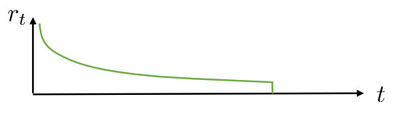


Generalized advantage estimation
Do we have to choose one n?
What if construct all possibility?
${\hat{A}}_{n}^{π}\left(s_{t},a_{t}\right)=\sum_{t^{′}=t}^{t+n}{γ^{t^{′}− t}}r\left(s_{t^{′}},a_{t^{′}}\right)−{\hat{V}}_{∅}^{π}\left(s_{t}\right)+γ^{n}{\hat{V}}_{∅}^{π}\left(s_{t+n}\right)$
${\hat{A}}_{GAE}^{π}\left(s_{t},a_{t}\right)=\sum_{n=1}^{∞}{{w_{n}\hat{A}}_{n}^{π}\left(s_{t},a_{t}\right)}$
How to weight?
${\hat{A}}_{GAE}^{π}\left(s_{t},a_{t}\right)=\sum_{n=1}^{∞}{{\left(γλ\right)}^{t^{′}−t}{\hat{A}}_{n}^{π}\left(s_{t},a_{t}\right)}$
Weighted combination of n step return
Prefer cutting earlier (lower variance)
$w_{n}∝λ^{n−1}$ exponential fall off
Similar effect as discount factor

Slide 33
References
Levine, “CS285: Deep Reinforcement Learning”, UC Berkeley.

