Slide 1
Markov Decision Process
Lecturer: Chia-Yi Su
Advisor: Prof. Tsong-Yi Chen
Department of Electronic Engineering
National Kaohsiung University of Science and Technology
https://chiayisu.github.io/teaching/2022-spring-teaching

Slide 2
Course Outline
Introduction to Reinforcement Learning
Markov Decision Processes
Planning by Dynamic Programming
Model-Free Prediction
Model-Free Control
Neural Network
Value Function Approximation
Policy Gradient
Actor-Critic Algorithm
Dialog System (Including MultiModal Dialog System)

Slide 3
Today’s Agenda
Markov Process
Markov Reward Process
Markov Decision Process
Extensions to MDPs

Slide 4
Markov Process

Slide 5
Introduction to MDPs
MDPs are to describe an environment for reinforcement learning mathematically.
MDP environments are fully observable.
i.e. The environment state is fully known.
Almost all RL problems can be treated as MDP problems.

Slide 6
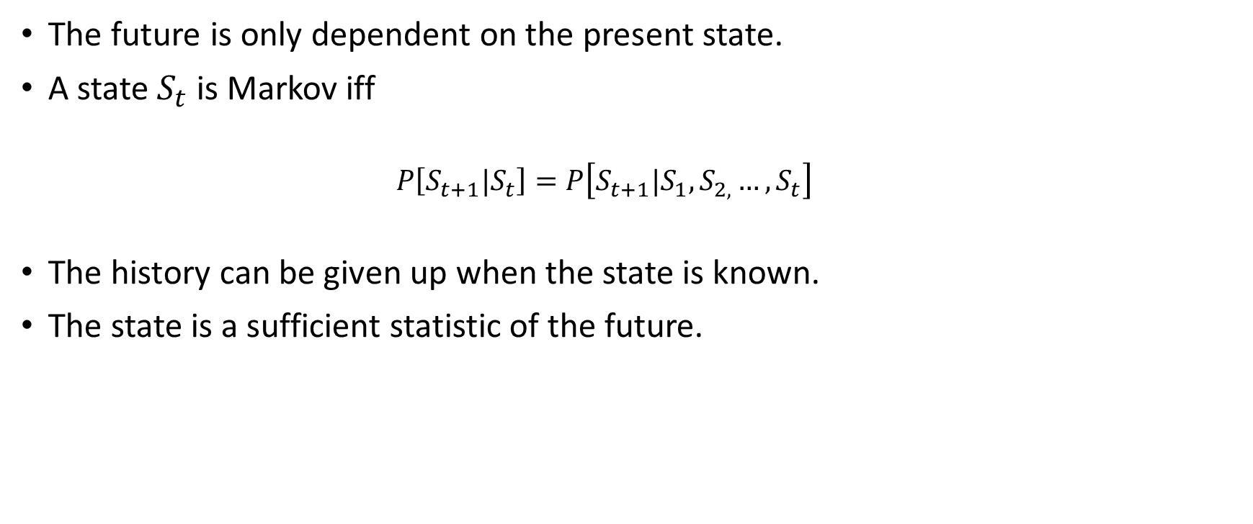
Markov Property
The future is only dependent on the present state.
A state $S_{t}$ is Markov iff
$$P\left[S_{t+1}|S_{t}\right]=P\left[S_{t+1}|S_{1},S_{2,}…, S_{t}\right]$$
The history can be given up when the state is known.
The state is a sufficient statistic of the future.

Slide 7
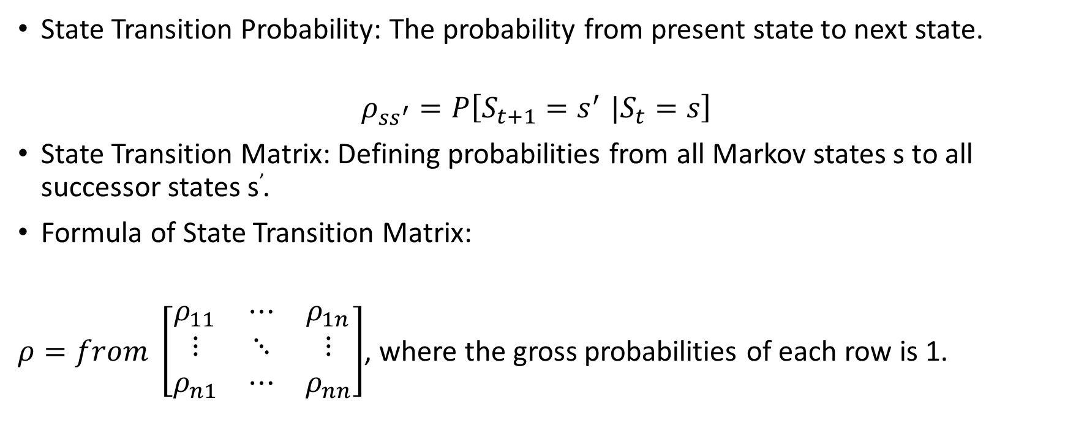
State Transition Matrix
State Transition Probability: The probability from present state to next state.
$$ρ_{ss^{′}}=P\left[S_{t+1}{=s}^{′}|S_{t}=s\right]$$
State Transition Matrix: Defining probabilities from all Markov states s to all successor states s’.
Formula of State Transition Matrix:
$ρ=from \left[\begin{matrix}ρ_{11} & ⋯ & ρ_{1n} \\ ⋮ & ⋱ & ⋮ \\ ρ_{n1} & ⋯ & ρ_{nn}\end{matrix}\right]$, where the gross probabilities of each row is 1.
to

Slide 8
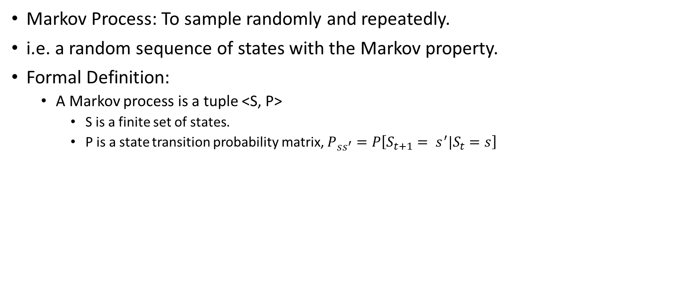
Markov Process
Markov Process: To sample randomly and repeatedly.
i.e. a random sequence of states with the Markov property.
Formal Definition:
A Markov process is a tuple <S, P>
S is a finite set of states.
P is a state transition probability matrix, $P_{ss^{′}}=P\left[S_{t+1}= s^{′}|S_{t}=s\right]$

Slide 9
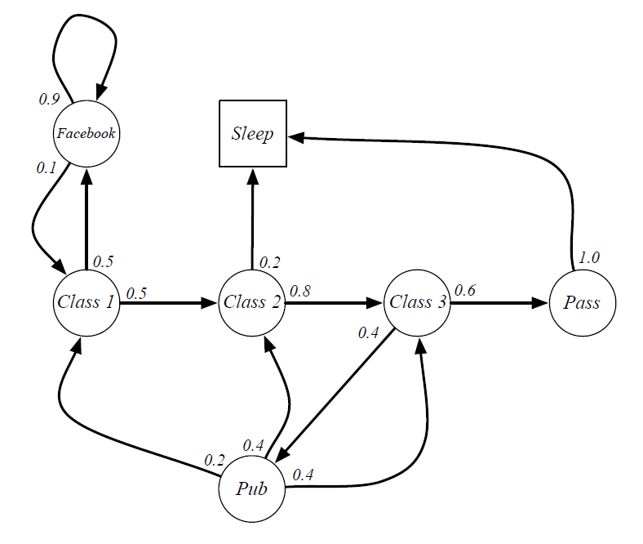
Example: Student Markov Chain

Slide 10
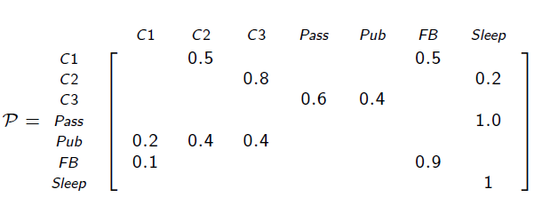
Example: Student Markov Transition Matrix

Slide 11
Markov Reward Process

Slide 12
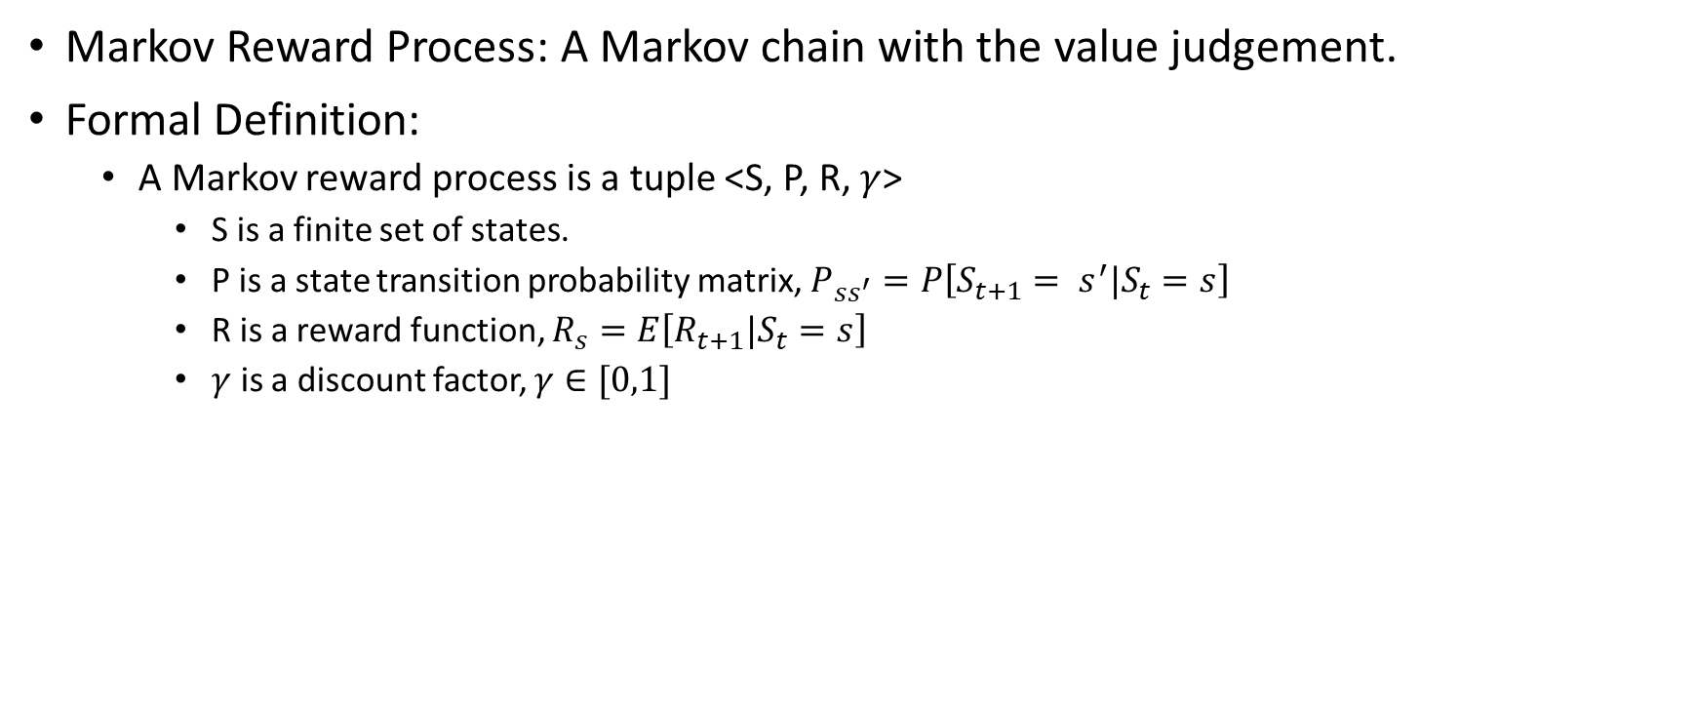
Markov Reward Process
Markov Reward Process: A Markov chain with the value judgement.
Formal Definition:
A Markov reward process is a tuple <S, P, R, $γ$>
S is a finite set of states.
P is a state transition probability matrix, $P_{ss^{′}}=P\left[S_{t+1}= s^{′}|S_{t}=s\right]$
R is a reward function, $R_{s}=E\left[R_{t+1}|S_{t}=s\right]$
$γ$ is a discount factor, $γ∈[0,1]$

Slide 13
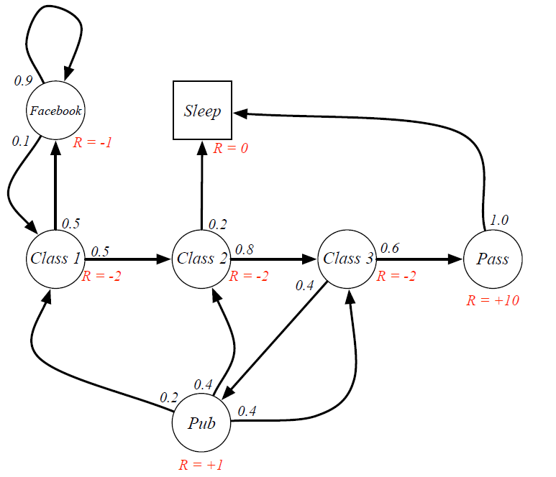
Example: Student MRP

Slide 14

Return
Return: Total discounted reward from time-step t
$$G_{t}=R_{t+1}+γR_{t+2}+…=\sum_{k=0}^{∞}{γ^{k}R_{t+k+1}}$$

Slide 15
Why Discounted Factor?
Convenient to discount rewards mathematically
Avoids infinites returns in cyclic Markov processes
The uncertainty of the future
Immediate rewards may be preferred in some cases.
Financial Investment
Human Behavior
It’s sometimes better to use undiscounted reward.

Slide 16

Value Function
Value Function v(s): Total rewards from state s
Formal Definition:
Expected return from the state s
$$v\left(s\right)=E\left[G_{t}|S_{t}=s\right]$$

Slide 17

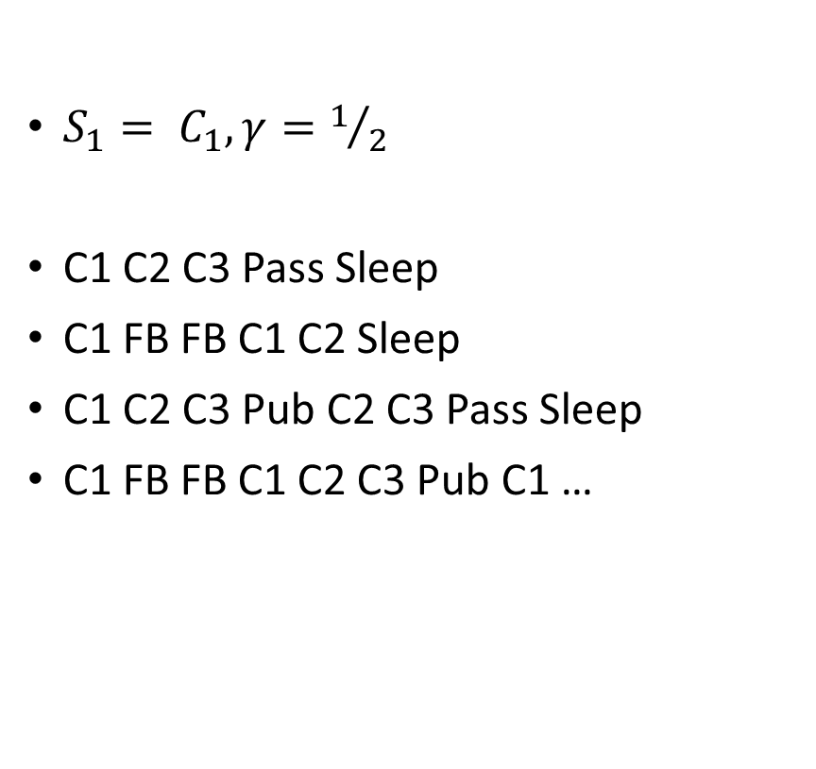
Example: Student MRP Returns
$S_{1}= C_{1},γ=1/2$
C1 C2 C3 Pass Sleep
C1 FB FB C1 C2 Sleep
C1 C2 C3 Pub C2 C3 Pass Sleep
C1 FB FB C1 C2 C3 Pub C1 …
$v_{1}=−2−2∗\frac{1}{2}−2∗\frac{1}{4}+10∗\frac{1}{8}$
$v_{1}=−2−1∗\frac{1}{2}−1∗\frac{1}{4}−2∗\frac{1}{8}$
$v_{1}=−2−2∗\frac{1}{2}−2∗\frac{1}{4}+1∗\frac{1}{8}…$
$v_{1}=−2−1∗\frac{1}{2}−1∗\frac{1}{4}+2∗\frac{1}{8}…$

Slide 18
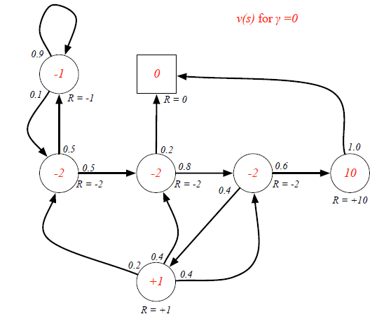
Example: State-Value Function for Student MRP

Slide 19
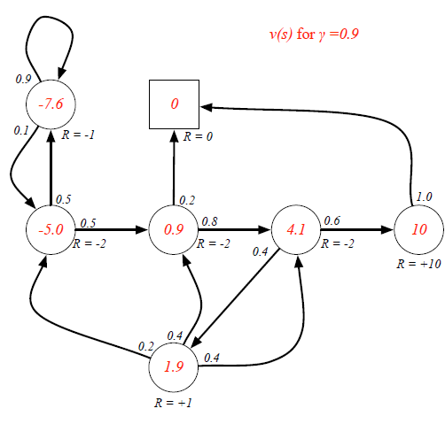
Example: State-Value Function for Student MRP

Slide 20
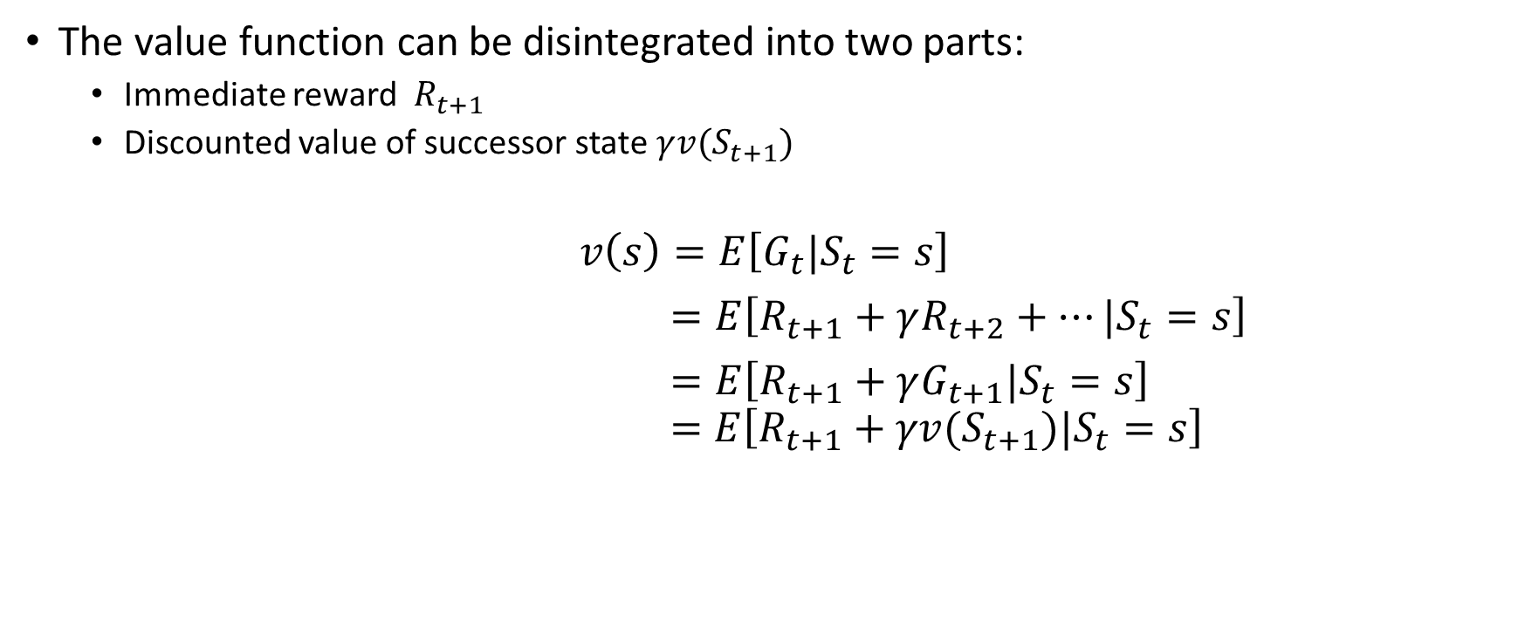
Bellman Equation for MRPs
The value function can be disintegrated into two parts:
Immediate reward $R_{t+1}$
Discounted value of successor state $γ{v(S}_{t+1})$
$$v\left(s\right)=E\left[G_{t}|S_{t}=s\right]$$
$=E\left[R_{t+1}+γR_{t+2}+…|S_{t}=s\right]$
$=E\left[R_{t+1}+γG_{t+1}|S_{t}=s\right]$
$$=E\left[R_{t+1}+γv(S_{t+1})|S_{t}=s\right]$$

Slide 21
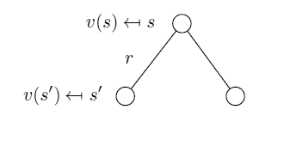
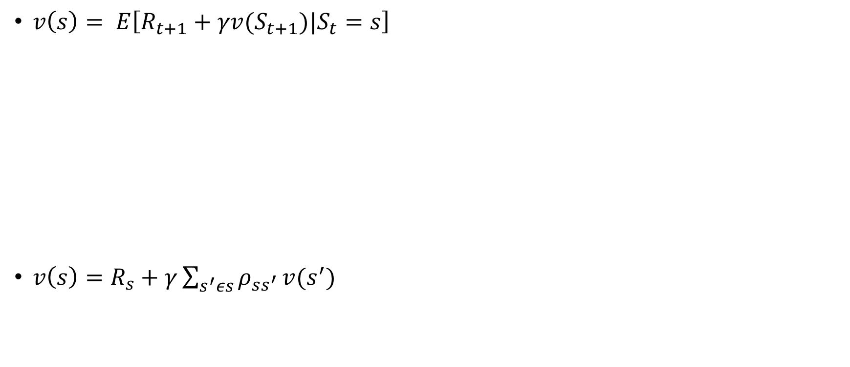
Bellman Equation for MRPs
$v\left(s\right)= E\left[R_{t+1}+γv(S_{t+1})|S_{t}=s\right]$
$v\left(s\right)=R_{s}+γ\sum_{s^{′}εs}{ρ_{ss^{′}}}v(s^{′})$

Slide 22
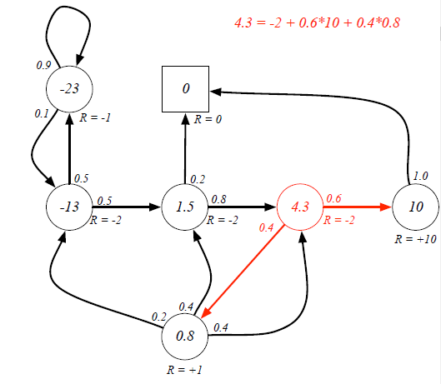
Bellman Equation for MRPs

Slide 23

Vectorzied Representation of Bellman Equation
The Bellman equation can be vectorized as follows:
$$v=R+γPv$$
Where v is a column vector
$$\left[\begin{matrix}v(1) \\ ⋮ \\ v(n)\end{matrix}\right]=\left[\begin{matrix}R_{1} \\ ⋮ \\ R_{n}\end{matrix}\right]+γ\left[\begin{matrix}P_{11} & … & P_{1n} \\ ⋮ & ⋱ & ⋮ \\ P_{n1} & … & P_{nn}\end{matrix}\right]\left[\begin{matrix}v(1) \\ ⋮ \\ v(n)\end{matrix}\right]$$

Slide 24
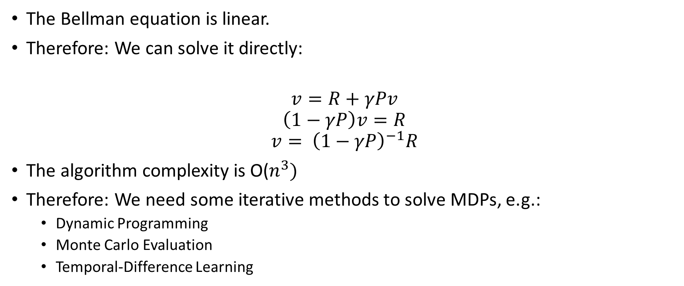
How to solve the Bellman Equation?
The Bellman equation is linear.
Therefore: We can solve it directly:
$$v=R+γPv$$
$$\left(1−γP\right)v=R$$
$$v= {\left(1−γP\right)}^{−1}R$$
The algorithm complexity is O($n^{3})$
Therefore: We need some iterative methods to solve MDPs, e.g.:
Dynamic Programming
Monte Carlo Evaluation
Temporal-Difference Learning

Slide 25
Markov Decision Process

Slide 26
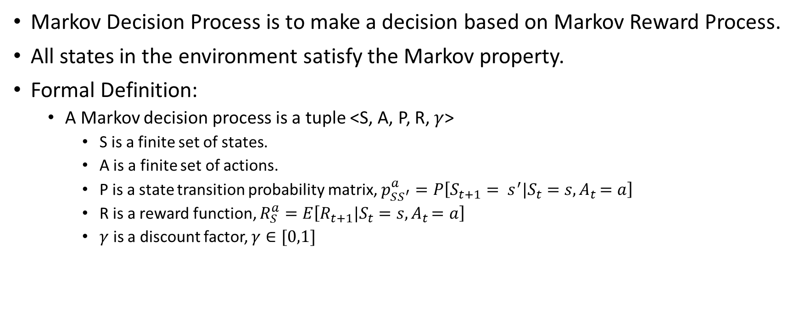
Markov Decision Process
Markov Decision Process is to make a decision based on Markov Reward Process.
All states in the environment satisfy the Markov property.
Formal Definition:
A Markov decision process is a tuple <S, A, P, R, $γ$>
S is a finite set of states.
A is a finite set of actions.
P is a state transition probability matrix, $p_{SS^{′}}^{a}=P\left[S_{t+1}= s^{′}|S_{t}=s{, A}_{t}=a\right]$
R is a reward function, $R_{S}^{a}=E\left[R_{t+1}|S_{t}=s{, A}_{t}=a\right]$
$γ$ is a discount factor, $γ∈[0,1]$

Slide 27
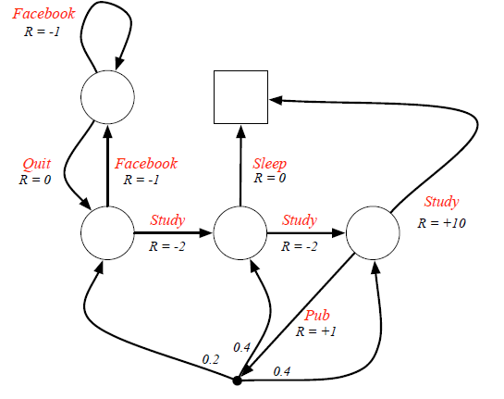
Example: Student MDP

Slide 28
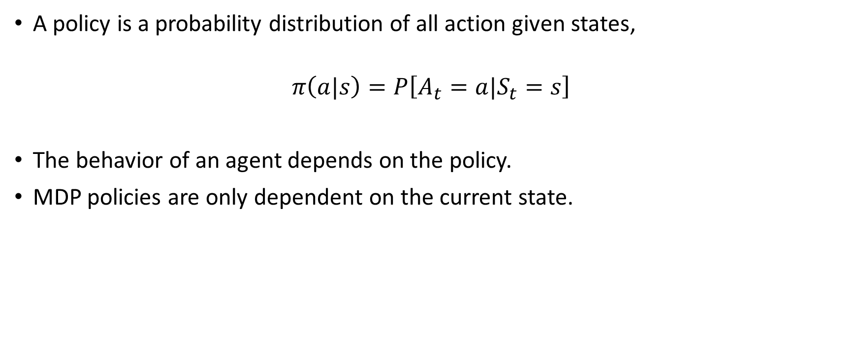
Policies
A policy is a probability distribution of all action given states,
$$π\left(a|s\right)=P\left[A_{t}=a|S_{t}=s\right]$$
The behavior of an agent depends on the policy.
MDP policies are only dependent on the current state.

Slide 29
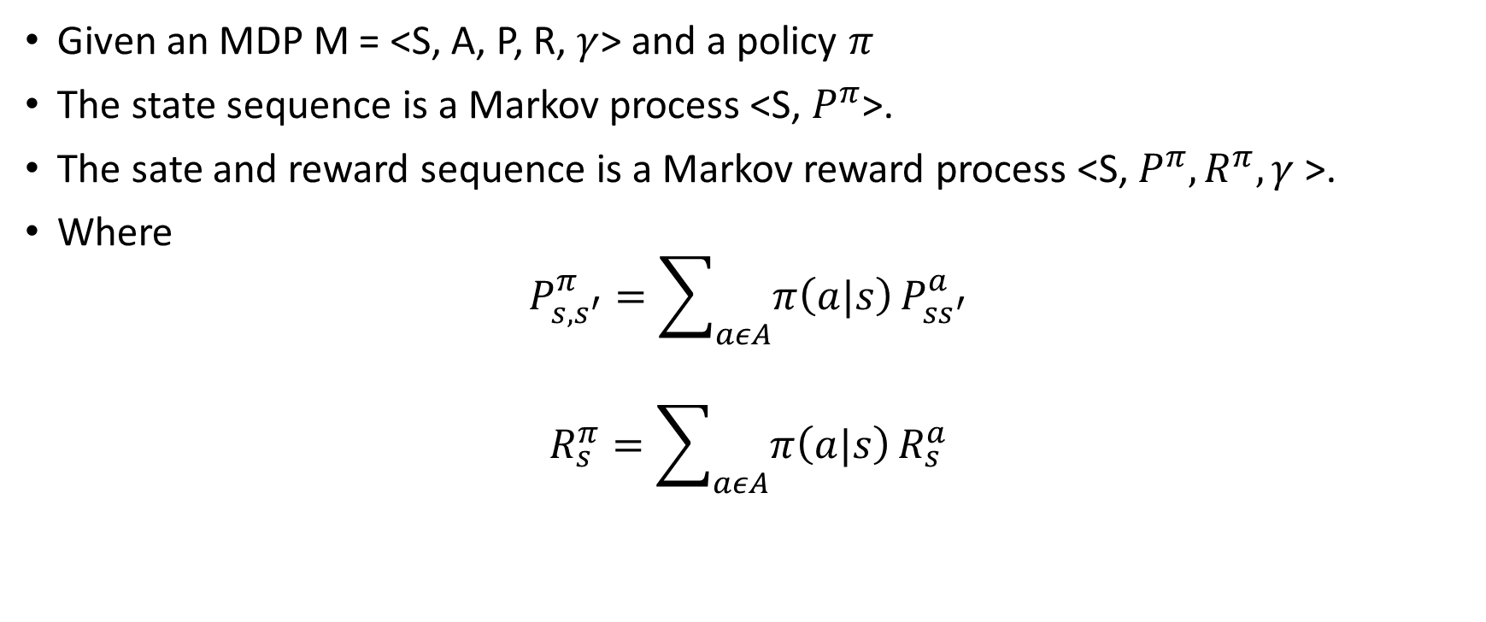
Policies
Given an MDP M = <S, A, P, R, $γ$> and a policy $π$
The state sequence is a Markov process <S, $P^{π}$>.
The sate and reward sequence is a Markov reward process <S, $P^{π},R^{π}, γ$>.
Where
$$P_{s, s^{′}}^{π}=\sum_{aεA}{π\left(a|s\right)}P_{ss^{′}}^{a}$$
$$R_{s}^{π}=\sum_{aεA}{π\left(a|s\right)}R_{s}^{a}$$

Slide 30
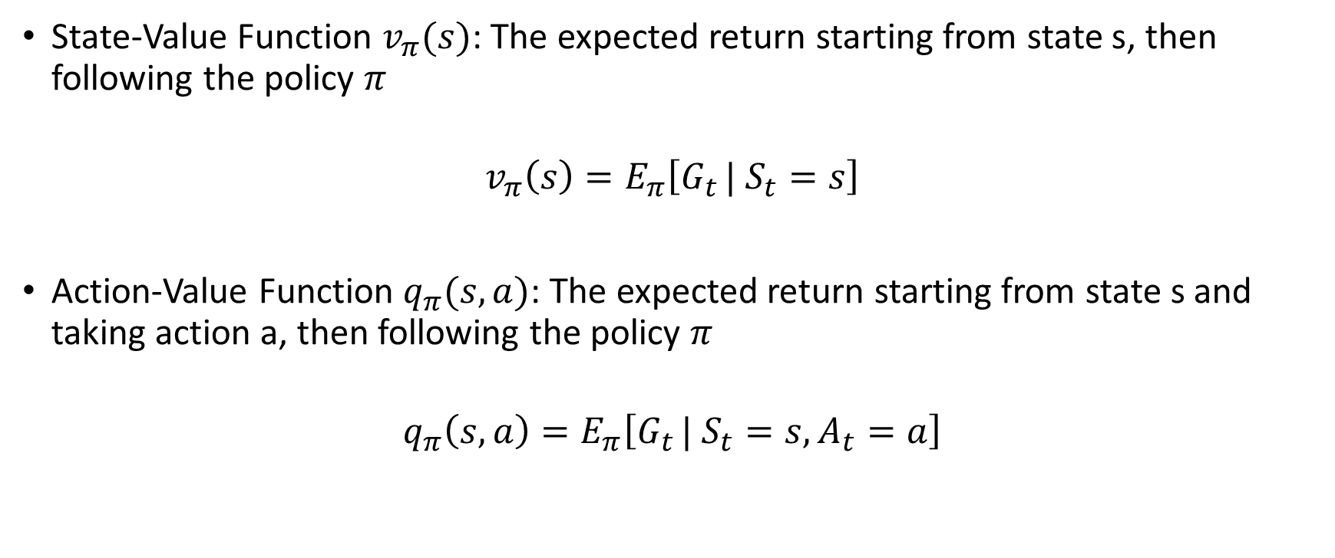
Value Function
State-Value Function $v_{π}(s)$: The expected return starting from state s, then following the policy $π$
$$v_{π}\left(s\right)=E_{π}\left[G_{t }| S_{t}=s\right]$$
Action-Value Function $q_{π}(s, a)$: The expected return starting from state s and taking action a, then following the policy $π$
$$q_{π}\left(s, a\right)=E_{π}\left[G_{t }| S_{t}=s,A_{t}=a\right]$$

Slide 31
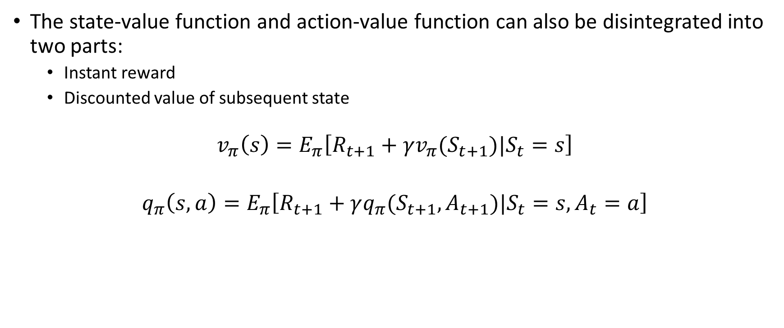
Bellman Expectation Equation
The state-value function and action-value function can also be disintegrated into two parts:
Instant reward
Discounted value of subsequent state
$$v_{π}\left(s\right)=E_{π}\left[R_{t+1}+γv_{π}(S_{t+1})|S_{t}=s\right]$$
$$q_{π}\left(s,a\right)=E_{π}\left[R_{t+1}+γq_{π}(S_{t+1},A_{t+1})|S_{t}=s,A_{t}=a\right]$$

Slide 32
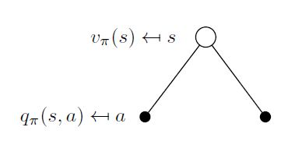

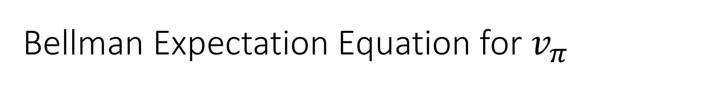
Bellman Expectation Equation for $v_{π}$
$$v_{π}\left(s\right)=\sum_{aεA}{π\left(a|s\right)q_{π}\left(s,a\right)}$$

Slide 33
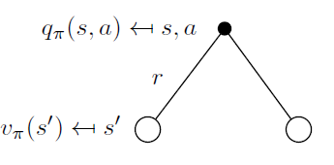

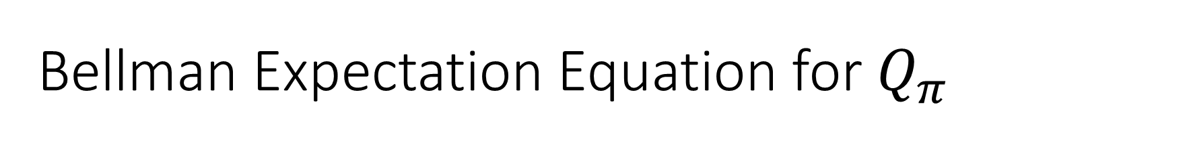
Bellman Expectation Equation for $Q_{π}$
$q_{π}\left(s,a\right)=R_{s}^{a}+γ\sum_{s^{′}=S}{P_{ss^{′}}^{a}v_{π}\left(s^{′}\right)}$

Slide 34
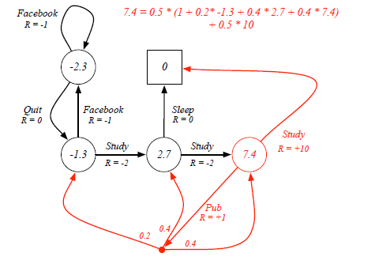
Example: Bellman Expectation Equation in Student MDP

Slide 35
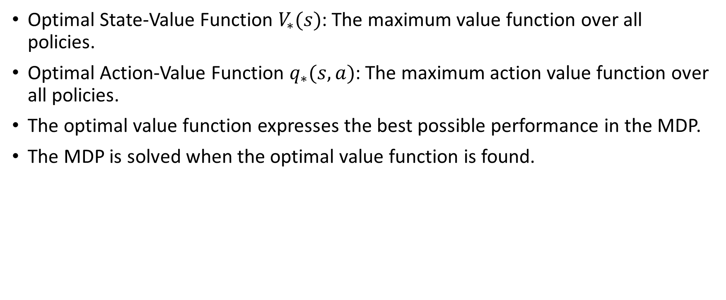
Optimal Value Function
Optimal State-Value Function $V_{∗}(s)$: The maximum value function over all policies.
Optimal Action-Value Function $q_{∗}(s, a)$: The maximum action value function over all policies.
The optimal value function expresses the best possible performance in the MDP.
The MDP is solved when the optimal value function is found.

Slide 36
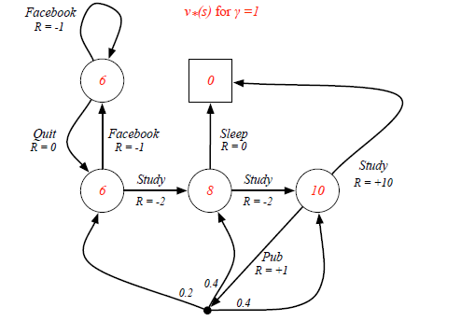
Example: Optimal Value Function for Student MDP

Slide 37
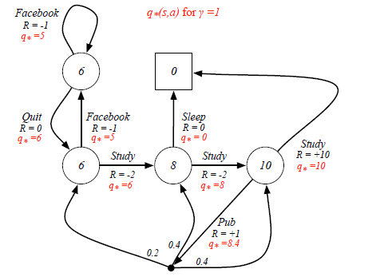
Example: Optimal Action-Value Function for Student MDP

Slide 38
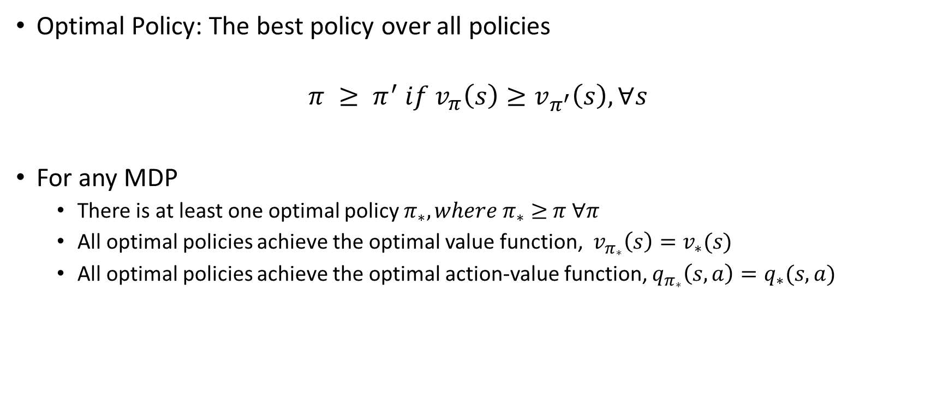
Optimal Policy
Optimal Policy: The best policy over all policies
$$π ≥ π^{′} if v_{π}\left(s\right)≥v_{π^{′}}\left(s\right), ∀s$$
For any MDP
There is at least one optimal policy $π_{∗}, where π_{∗}$ $≥$ $π ∀π$
All optimal policies achieve the optimal value function, $v_{π_{∗}}\left(s\right)=v_{∗}(s)$
All optimal policies achieve the optimal action-value function, $q_{π_{∗}}\left(s, a\right)=q_{∗}(s,a)$

Slide 39
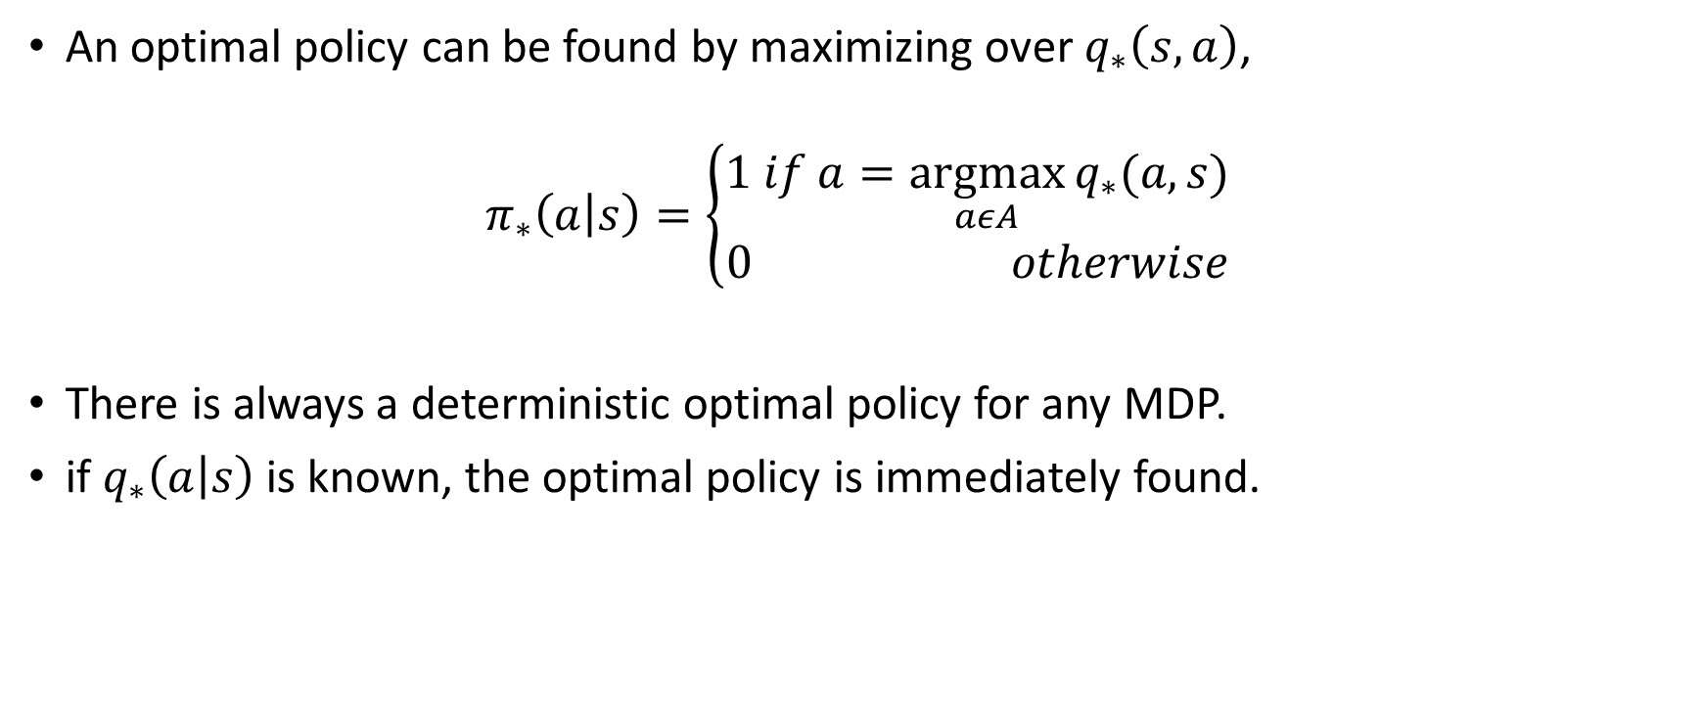
Finding an Optimal Policy
An optimal policy can be found by maximizing over $q_{∗}\left(s,a\right)$,
$$π_{∗}\left(a | s\right)=\left\{\begin{matrix}1 if a=\underset{aεA}{argmax}{q_{∗}(a,s)} \\ 0 otherwise\end{matrix}\right.$$
There is always a deterministic optimal policy for any MDP.
if $q_{∗}\left(a | s\right)$ is known, the optimal policy is immediately found.

Slide 40
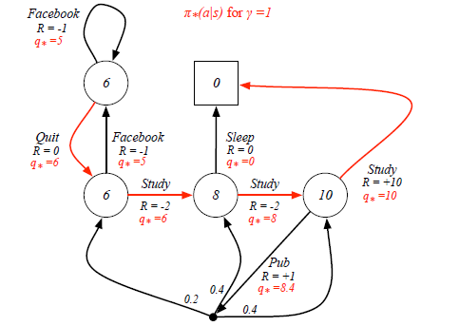
Example: Optimal Policy for Student MDP

Slide 41
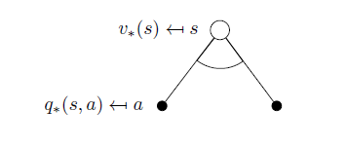

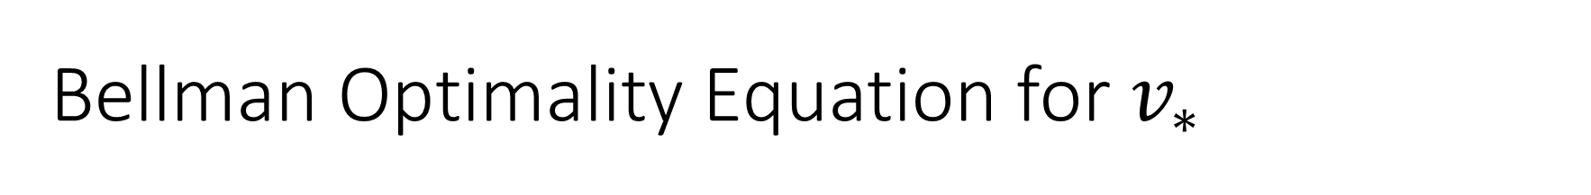
Bellman Optimality Equation for $v_{∗}$
Bellman optimality equation is to find the maximum value in the state s.
$$v_{∗}\left(s\right)=\max_{a}{q_{∗}(s,a)}$$

Slide 42
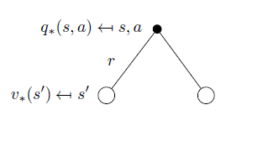
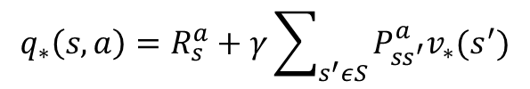
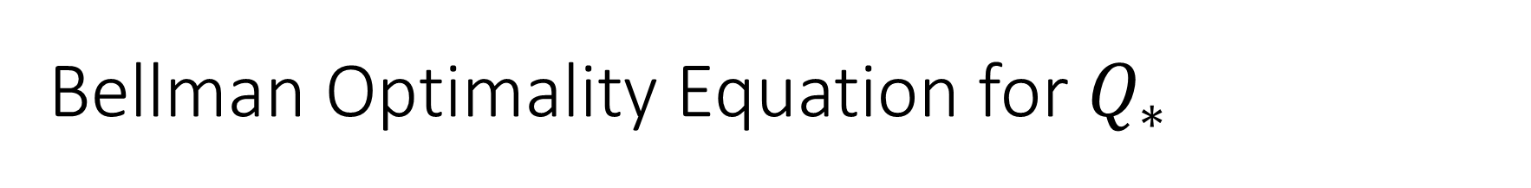
Bellman Optimality Equation for $Q_{∗}$
$$q_{∗}\left(s, a\right)=R_{s}^{a}+γ\sum_{s^{′}εS}{P_{ss^{′}}^{a}v_{∗}(s^{′})}$$

Slide 43
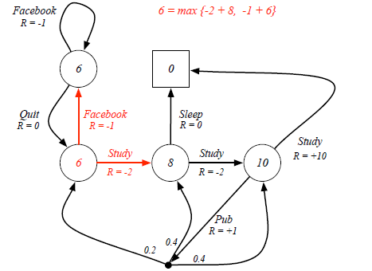
Example: Bellman Optimality Equation in Student MDP

Slide 44
Solving the Bellman Optimality Equation
Bellman Optimality Equation is non-linear.
Therefore: Bellman Optimality Equation will be solved by using iterative methods:
Value Iteration
Policy Iteration
Q-Learning
Sarsa

Slide 45
Extensions to MDPs

Slide 46
Extensions to MDPs
Infinite and continuous MDPs
Partially observable MDPs
Undiscounted, average reward MDPs

Slide 47
References
Introduction to Reinforcement Learning with David Silver, DeepMind x UCL.

