Slide 1
Planning by Dynamic Programing
Lecturer: Chia-Yi Su
Advisor: Prof. Tsong-Yi Chen
Department of Electronic Engineering
National Kaohsiung University of Science and Technology
https://chiayisu.github.io/teaching/2022-spring-teaching

Slide 2
Course Outline
Introduction to Reinforcement Learning
Markov Decision Processes
Planning by Dynamic Programming
Model-Free Prediction
Model-Free Control
Neural Network
Value Function Approximation
Policy Gradient
Actor-Critic Algorithm
Dialog System (Including MultiModal Dialog System)

Slide 3
Today’s Agenda
Introduction
Iterative Policy Evaluation
Policy Iteration
Value Iteration
Extensions to Dynamic Programming

Slide 4
Introduction

Slide 5
What is Dynamic Programming?
Dynamic: The sequential component to the problem
Programming: Optimizing a program e.g. policy
How to solve a complex problem?
Break down into subproblem
Solve the subproblem
Combine the solution to the subproblem together

Slide 6
Two Properties of Dynamic Programming
Optimal Structure
Principle of Optimality: Decomposing a optimal solution into subproblems
Overlapping Subproblems
Subproblem: should recur multiple times
Solutions: should be reused and cached
How MDP satisfy those properties?
Bellman Equation gives recursive decomposition.
Value function stores and reuses solutions.

Slide 7

Planning by Dynamic Programming
Dynamic programming
assumes full knowledge of MDP
Uses for planning in MDP
Prediction
Input: MDP <S, A, P, R, $γ$> and Policy $π$
Or: MRP <S, P, R, $γ$>
Output: Value Function $V_{π }$
Control
Input: MDP <S, A, P, R, $γ$>
Output: Optimal value function${ V_{∗}}_{ }$
Or: Optimal Policy $π_{∗}$

Slide 8
Iterative Policy Evaluation

Slide 9
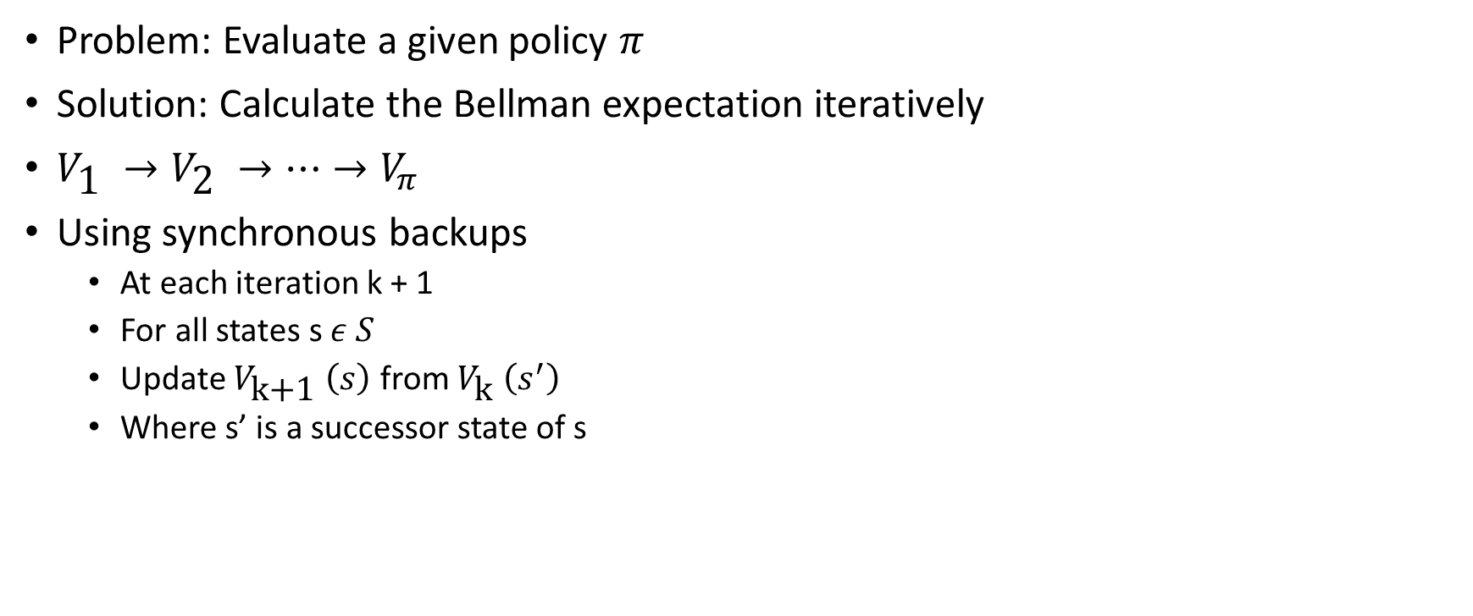
Iterative Policy Evaluation: Introduction
Problem: Evaluate a given policy $π$
Solution: Calculate the Bellman expectation iteratively
$V_{\text{1} }→V_{\text{2} }→…→V_{π }$
Using synchronous backups
At each iteration k + 1
For all states s $ε S$
Update $V_{\text{k}\text{+1} }\left(s\right)$ from $V_{\text{k} }\left(s^{′}\right)$
Where s’ is a successor state of s

Slide 10
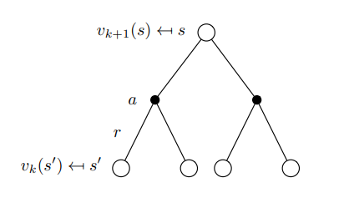

Iterative Policy Evaluation: Representation in Tree
$v_{k+1}\left(s\right)=\sum_{aεA}{π\left(a|S\right)}\left(R_{s}^{a}+γ\sum_{s^{′}εS}{P_{ss^{′}}^{a}}v_{k}\left(s^{′}\right)\right)$
$v_{k+1}\left(s\right)=R^{π}+γ P^{π}v^{k}$

Slide 11
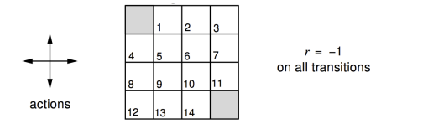
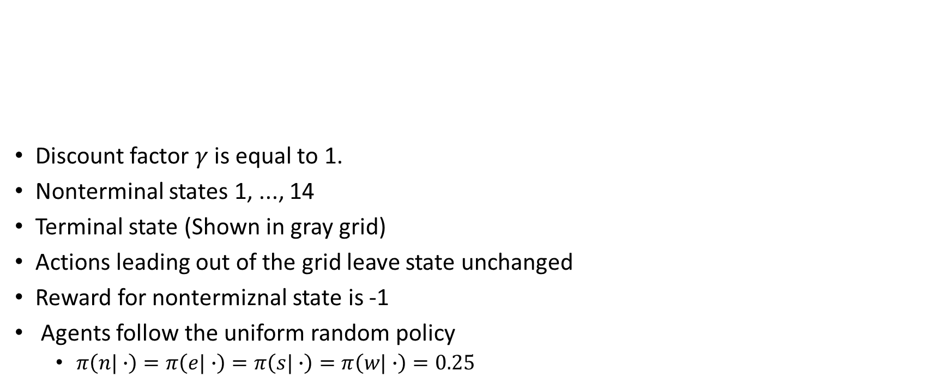
Iterative Policy Evaluation: Example
Discount factor $γ$ is equal to 1.
Nonterminal states 1, ..., 14
Terminal state (Shown in gray grid)
Actions leading out of the grid leave state unchanged
Reward for nontermiznal state is -1
Agents follow the uniform random policy
$π\left(n|∙\right)=π\left(e|∙\right)=π\left(s|∙\right)=π\left(w|∙\right)=0.25$

Slide 12
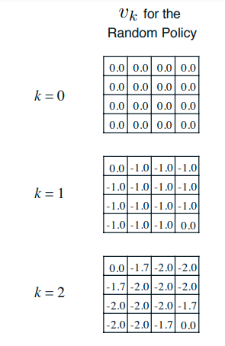
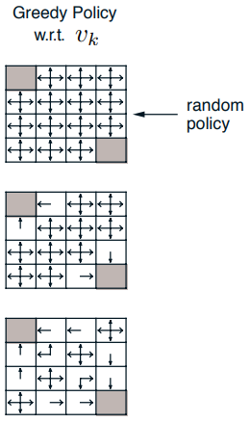
Iterative Policy Evaluation: Example

Slide 13
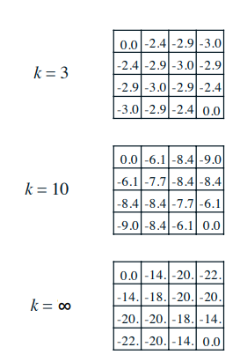
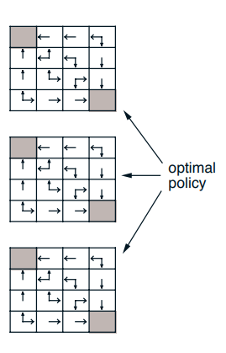
Iterative Policy Evaluation: Example

Slide 14
Policy Iteration

Slide 15
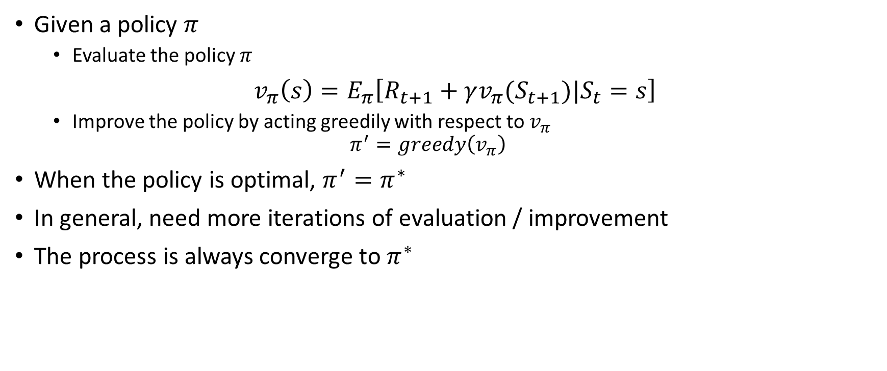
How to improve the Policy?
Given a policy $π$
Evaluate the policy $π$
$v_{π}\left(s\right)=E_{π}\left[R_{t+1}+γv_{π}(S_{t+1})|S_{t}=s\right]$
Improve the policy by acting greedily with respect to $v_{π}$
$$π^{′}=greedy\left(v_{π}\right)$$
When the policy is optimal, $π^{′}=π^{∗}$
In general, need more iterations of evaluation / improvement
The process is always converge to $π^{∗}$

Slide 16
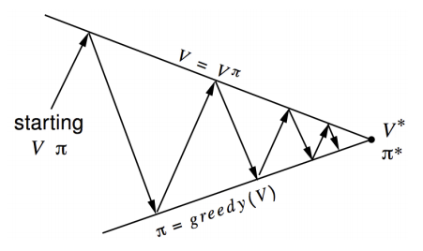
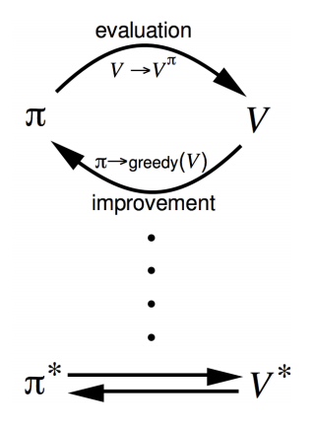

Policy Iteration
Policy Evaluation: Evaluate $v_{π}$
Iterative policy evaluation
Policy Improvement: Generate $π^{′}≥π$
Greedy policy improvement

Slide 17
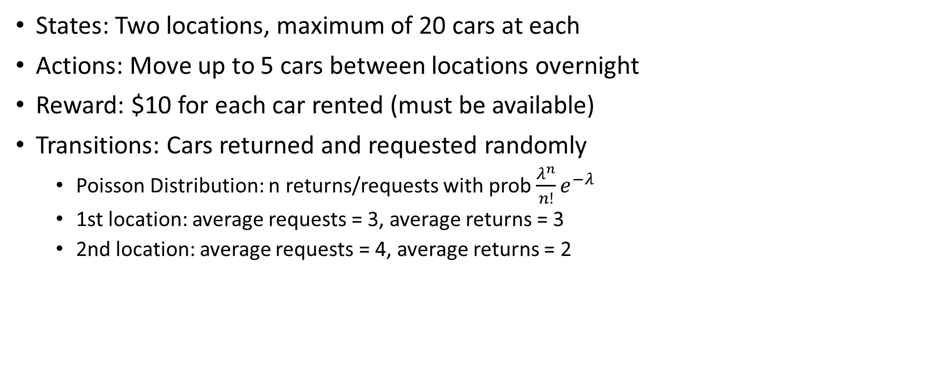
Policy Iteration: Car Rental Example
States: Two locations, maximum of 20 cars at each
Actions: Move up to 5 cars between locations overnight
Reward: $10 for each car rented (must be available)
Transitions: Cars returned and requested randomly
Poisson Distribution: n returns/requests with prob$\frac{λ^{n}}{n!}e^{−λ}$
1st location: average requests = 3, average returns = 3
2nd location: average requests = 4, average returns = 2

Slide 18
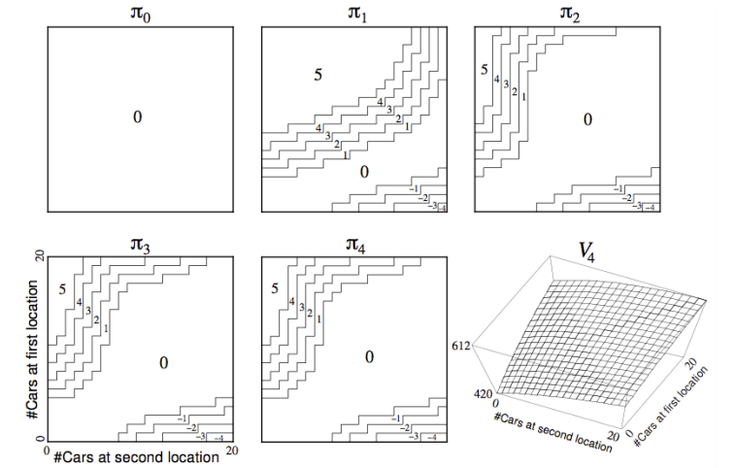
Policy Iteration: Car Rental Example

Slide 19
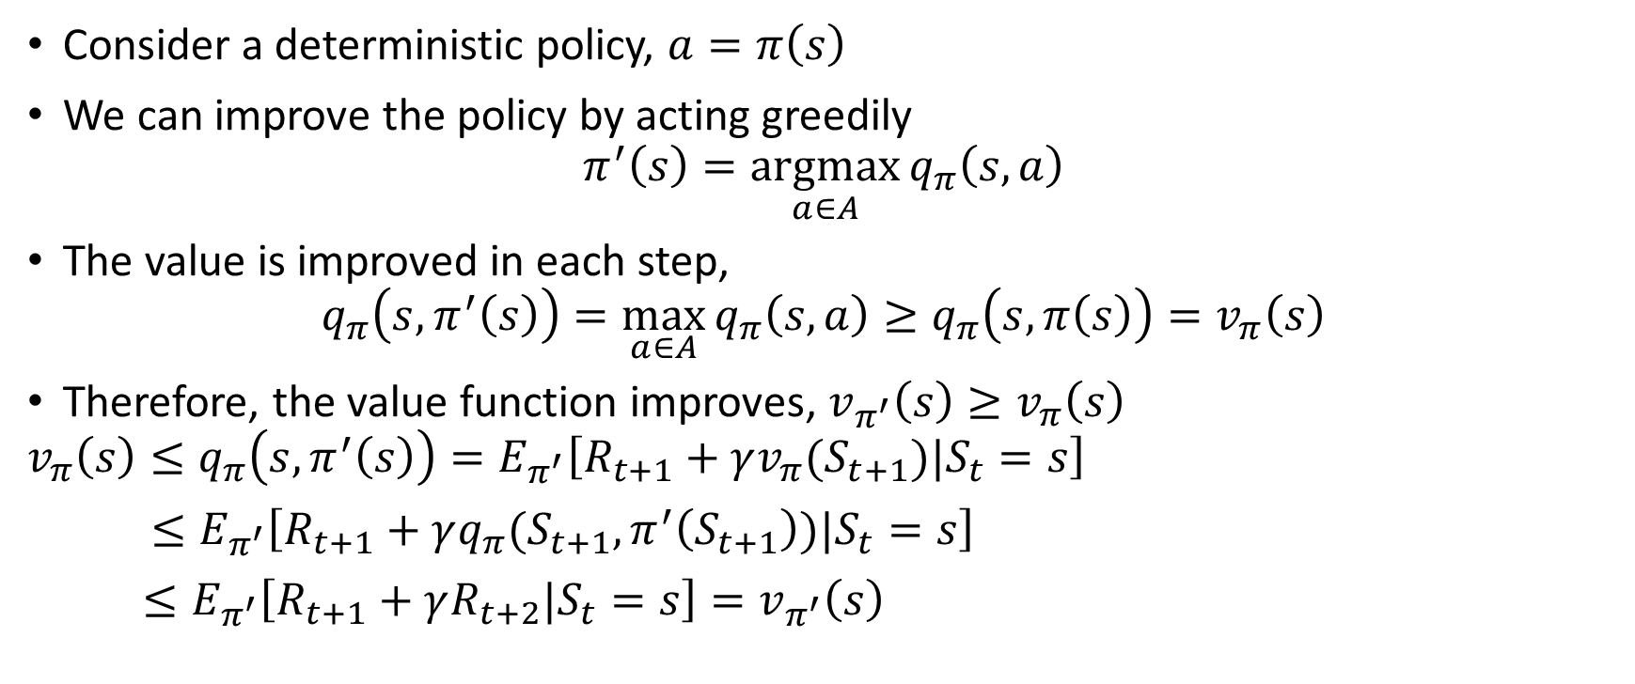
Policy Improvement
Consider a deterministic policy, $a=π\left(s\right)$
We can improve the policy by acting greedily
$$π^{′}\left(s\right)=\underset{a∈A}{argmax}{q_{π}\left(s,a\right)}$$
The value is improved in each step,
$$q_{π}\left(s, π^{′}\left(s\right)\right)=\max_{a∈A}{q_{π}\left(s,a\right)≥q_{π}\left(s,π\left(s\right)\right)=v_{π}\left(s\right)}$$
Therefore, the value function improves, $v_{π^{′}}\left(s\right)≥v_{π}\left(s\right)$
$$v_{π}\left(s\right)≤q_{π}\left(s, π^{′}\left(s\right)\right)=E_{π^{′}}\left[R_{t+1}+γv_{π}(S_{t+1})|S_{t}=s\right]$$
$≤E_{π^{′}}\left[R_{t+1}+γq_{π}(S_{t+1},π^{′}\left(S_{t+1}\right))|S_{t}=s\right]$
$≤E_{π^{′}}\left[R_{t+1}+γR_{t+2}|S_{t}=s\right]=v_{π^{′}}\left(s\right)$

Slide 20
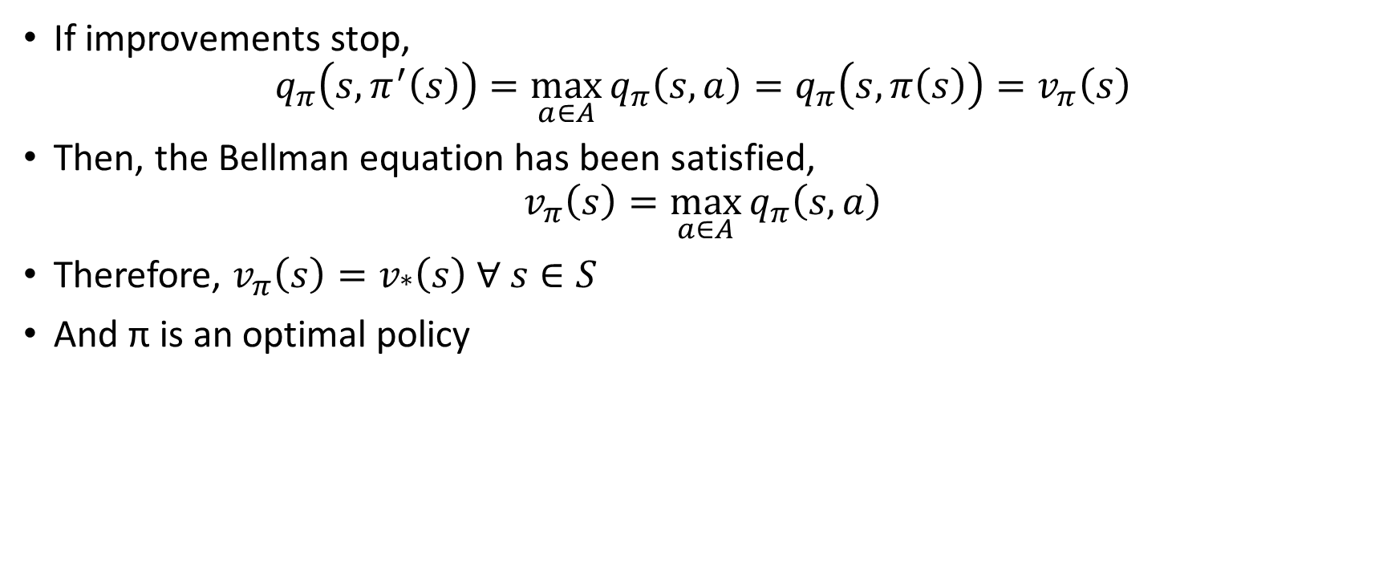
Policy Improvement
If improvements stop,
$$q_{π}\left(s, π^{′}\left(s\right)\right)=\max_{a∈A}{q_{π}\left(s,a\right)=q_{π}\left(s,π\left(s\right)\right)=v_{π}\left(s\right)}$$
Then, the Bellman equation has been satisfied,
$$v_{π}\left(s\right)=\max_{a∈A}{q_{π}\left(s,a\right)}$$
Therefore, $v_{π}\left(s\right)=v_{∗}\left(s\right) ∀ s∈S$
And π is an optimal policy

Slide 21
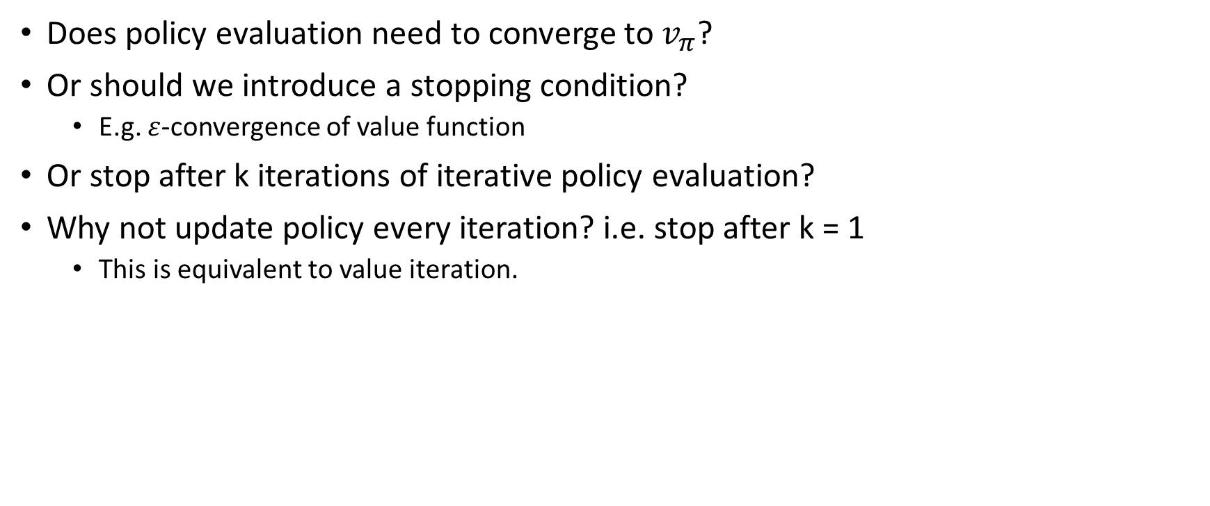
Modified Policy Evaluation
Does policy evaluation need to converge to $v_{π}$?
Or should we introduce a stopping condition?
E.g. $ε$-convergence of value function
Or stop after k iterations of iterative policy evaluation?
Why not update policy every iteration? i.e. stop after k = 1
This is equivalent to value iteration.

Slide 22
Value Iteration

Slide 23
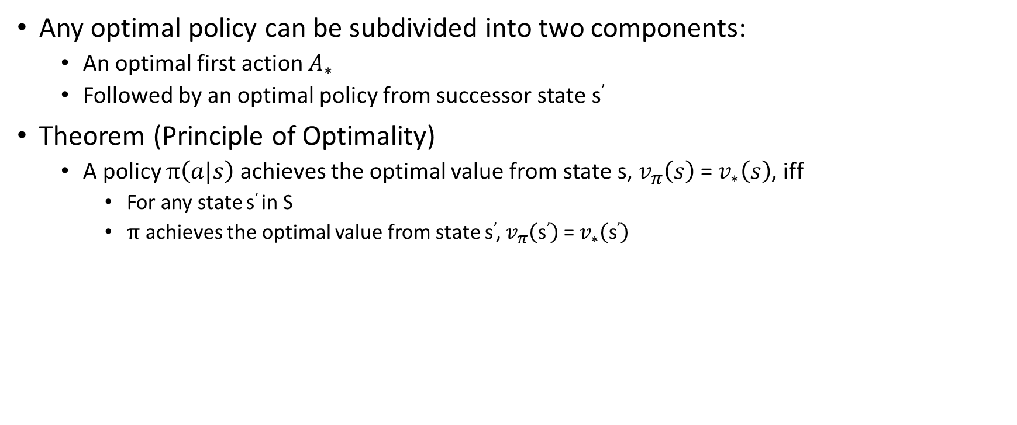
Principle of Optimality
Any optimal policy can be subdivided into two components:
An optimal first action $A_{∗}$
Followed by an optimal policy from successor state s’
Theorem (Principle of Optimality)
A policy $π\left(a|s\right)$ achieves the optimal value from state s, $v_{π}\left(s\right)$ = $v_{∗}\left(s\right)$, iff
For any state s’ in S
$π$ achieves the optimal value from state s’, $v_{π}\left(\text{s}\text{’}\right)$ = $v_{∗}\left(\text{s}\text{’}\right)$

Slide 24
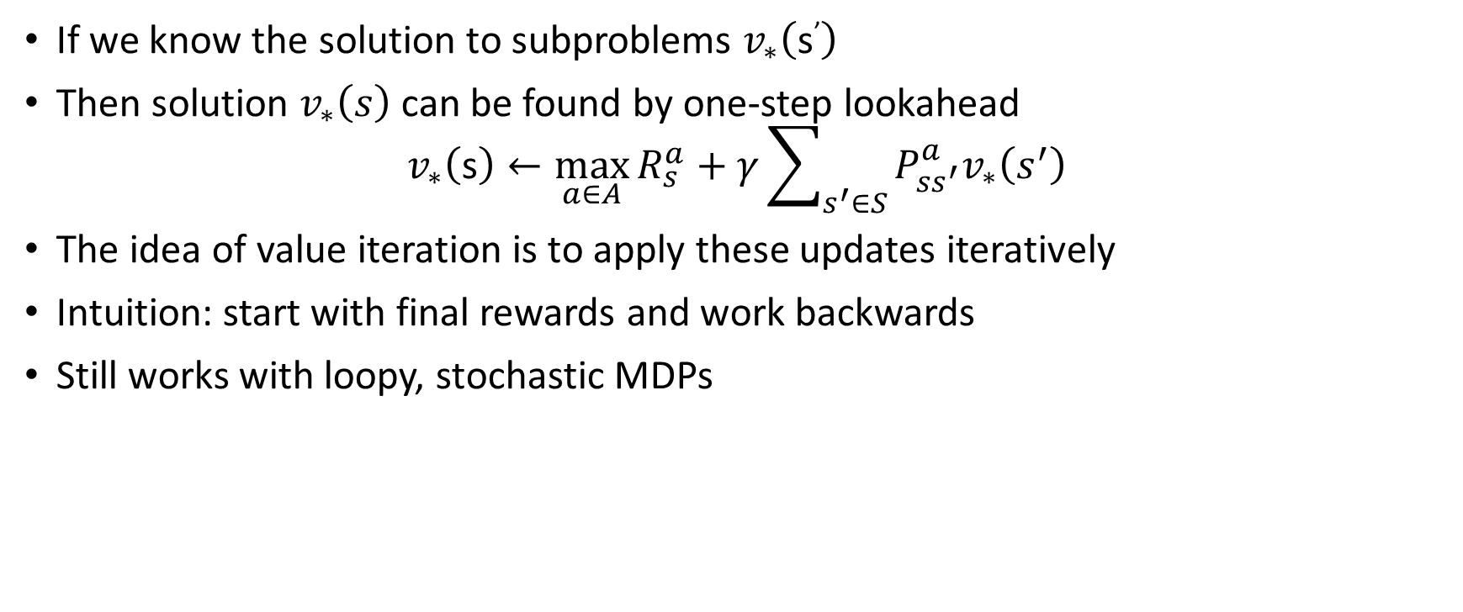
Deterministic Value Iteration
If we know the solution to subproblems $v_{∗}\left(\text{s}\text{’}\right)$
Then solution $v_{∗}\left(s\right)$can be found by one-step lookahead
$$v_{∗}\left(\text{s}\right)←\max_{a∈A}{R_{s}^{a}+γ\sum_{s^{′}∈S}{P_{ss^{′}}^{a}v_{∗}\left(s^{′}\right)}}$$
The idea of value iteration is to apply these updates iteratively
Intuition: start with final rewards and work backwards
Still works with loopy, stochastic MDPs

Slide 25
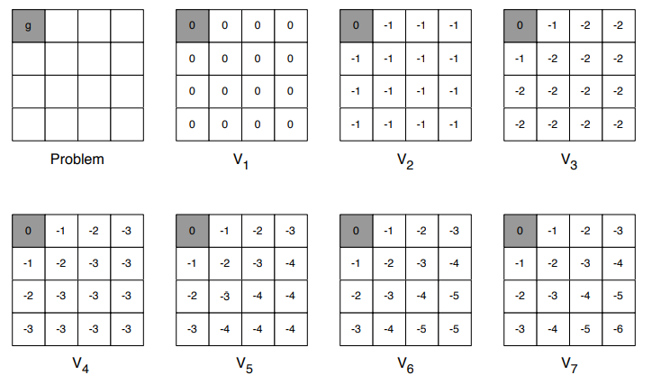
Example: Shortest Path

Slide 26
Value Iteration
Problem: find optimal policy π
Solution: iterative application of Bellman optimality equation
$v_{1} →v_{2 }→… →v_{∗ }$
Using synchronous backups
At each iteration k + 1
For all states s ∈ S
Update $v_{k+1}\left(s\right) from v_{k}\left(s^{′}\right)$
Unlike policy iteration, there is no explicit policy
Intermediate value functions may not correspond to any policy

Slide 27
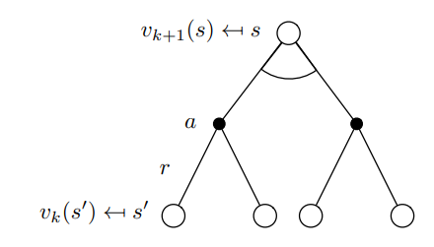
Value Iteration
$v_{k+1}\left(s\right)=\max_{a∈A}\left(R_{s}^{a}+γ\sum_{s^{′}εS}{P_{ss^{′}}^{a}v_{k}(s^{′})} \right)$

Slide 28
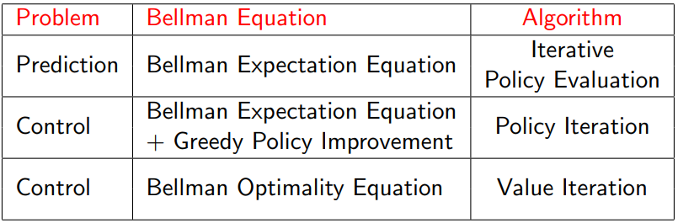
Synchronous Dynamic Programming Algorithms
Algorithms are based on state-value function $v_{π}\left(s\right)$ or $v_{∗}\left(s\right)$
Complexity O(m$n^{2}$) per iteration, for m actions and n states
Could also apply to action-value function $q_{π}\left(s, a\right)$ or $q_{∗}\left(s, a\right)$
Complexity O($m^{2}n^{2}$) per iteration

Slide 29
Extensions to Dynamic Programming

Slide 30
Asynchronous Dynamic Programming
Asynchronous DP
Means we do not need to update each state every time
Reduces computation
Guarantees to converge if all states are updated

Slide 31
Three Categories of Asynchronous Dynamic Programming
In-Place Dynamic Programming
Prioritized Sweeping
Real-Time Dynamic Programming

Slide 32
In-Place Dynamic Programming
Synchronous value iteration needs to store two value functions
$$v_{new}\left(s\right)=\max_{a∈A}\left(R_{s}^{a}+γ\sum_{s^{′}εS}{P_{ss^{′}}^{a}v_{old}(s^{′})} \right), for all s in S$$
$$v_{old }←v_{new}$$
In-place value iteration stores one value function only
v$\left(s\right)=\max_{a∈A}\left(R_{s}^{a}+γ\sum_{s^{′}εS}{P_{ss^{′}}^{a}v(s^{′})} \right), for all s in S$

Slide 33
Prioritized Sweeping
Calculate the Bellman error to guide the state selection e.g.
$$\left|\max_{a∈A}\left(R_{s}^{a}+γ\sum_{s^{′}εS}{P_{ss^{′}}^{a}v(s^{′})} \right)−v(s)\right|$$
Backup the state with the largest remaining Bellman error
Update Bellman error of affected states after each backup
Can be implemented efficiently by maintaining a priority queue

Slide 34
Real-Time Dynamic Programming
Idea: Update states that are relevant to agent only
Use agent’s experience to guide the selection of states
After each time-step $S_{t}$, $A_{t}$, $R_{t+1}$
Backup the state $S_{t}$
v$\left(S_{t}\right)=\max_{a∈A}\left(R_{S_{t}}^{a}+γ\sum_{s^{′}εS}{P_{S_{t}s^{′}}^{a}v(s^{′})} \right)$

Slide 35
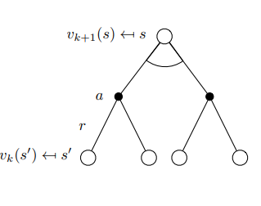
Full-Width Backups
DP uses full-width backups
For each backup (sync or async)
Every successor state and action is considered
Using knowledge of the MDP transitions and reward function
DP is effective for medium-sized problems
For large problems DP suffers Bellman’s curse of dimensionality
Therefore: Computation is very expensive

Slide 36
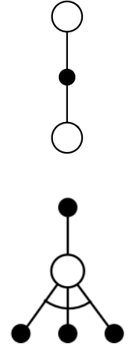
Sample Backups
Using sample rewards and sample transitions M = <S, A, R, S’>
Instead of reward function R and transition dynamics P
Advantages:
Model-free: no advance knowledge of MDP required
Breaks the curse of dimensionality through sampling
Cost of backup is constant, independent of n = |S|

Slide 37
References
Silver, Introduction to Reinforcement Learning with David Silver, UCL X DeepMind.

