Slide 1
Model-Free Prediction
Lecturer: Chia-Yi Su
Advisor: Prof. Tsong-Yi Chen
Department of Electronic Engineering
National Kaohsiung University of Science and Technology
https://github.com/chiayisu/Natural-Language-Processing-Fall-2021

Slide 2
Course Outline
Introduction to Reinforcement Learning
Markov Decision Processes
Planning by Dynamic Programming
Model-Free Prediction
Model-Free Control
Neural Network
Value Function Approximation
Policy Gradient
Actor-Critic Algorithm
Dialog System (Including MultiModal Dialog System)

Slide 3
Agenda
Introduction
Monte-Carlo Learning
Temporal-Difference Learning
TD(λ)
Backward View TD(λ)

Slide 4
Introduction

Slide 5
Model-Free Reinforcement Learning
Planning by Dynamic Programming
Solve a known MDP
Model-Free Prediction
Estimate the value function of an unknown MDP
Model-Free Control
Optimize the value function of an unknown MDP

Slide 6
Monte-Carlo Learning

Slide 7
Monte-Carlo Reinforcement Learning
MC methods learn directly from episodes of experience
MC is model-free: no knowledge of MDP transitions / rewards
MC learns from complete episodes: none bootstrapping
MC uses the simplest possible idea: value = mean return
Caveat: can only apply MC to episodic MDPs
All episodes must terminate

Slide 8
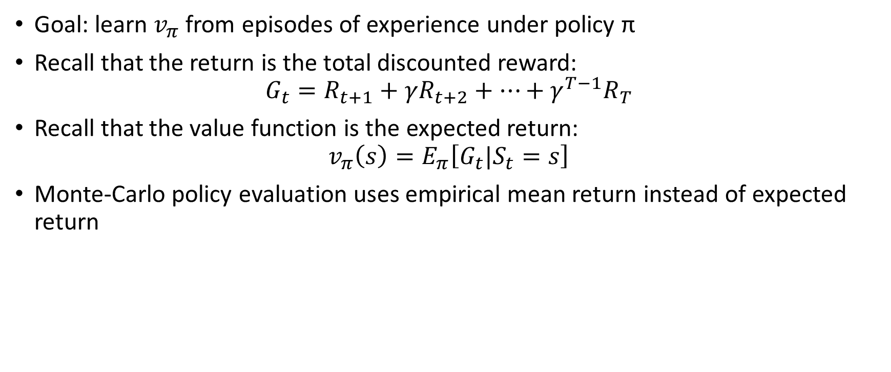
Monte-Carlo Policy Evaluation
Goal: learn $v_{π}$ from episodes of experience under policy π
Recall that the return is the total discounted reward:
$$G_{t}=R_{t+1}+γR_{t+2}+…+γ^{T−1}R_{T}$$
Recall that the value function is the expected return:
$$v_{π}\left(s\right)=E_{π}\left[G_{t}|S_{t}=s\right]$$
Monte-Carlo policy evaluation uses empirical mean return instead of expected return

Slide 9
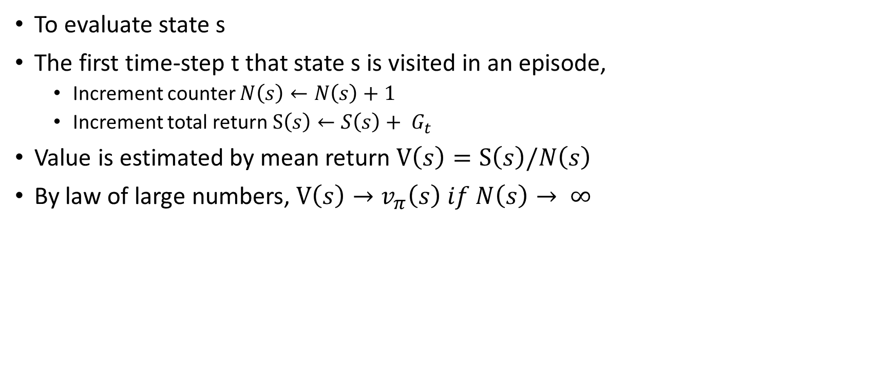
First-Visit Monte-Carlo Policy Evaluation
To evaluate state s
The first time-step t that state s is visited in an episode,
Increment counter $N\left(s\right)←N\left(s\right)+1$
Increment total return $S\left(s\right)←S\left(s\right)+ G_{t}$
Value is estimated by mean return $V\left(s\right)=S\left(s\right)/N\left(s\right)$
By law of large numbers, $V\left(s\right)→v_{π}\left(s\right) if N\left(s\right)→ ∞$

Slide 10
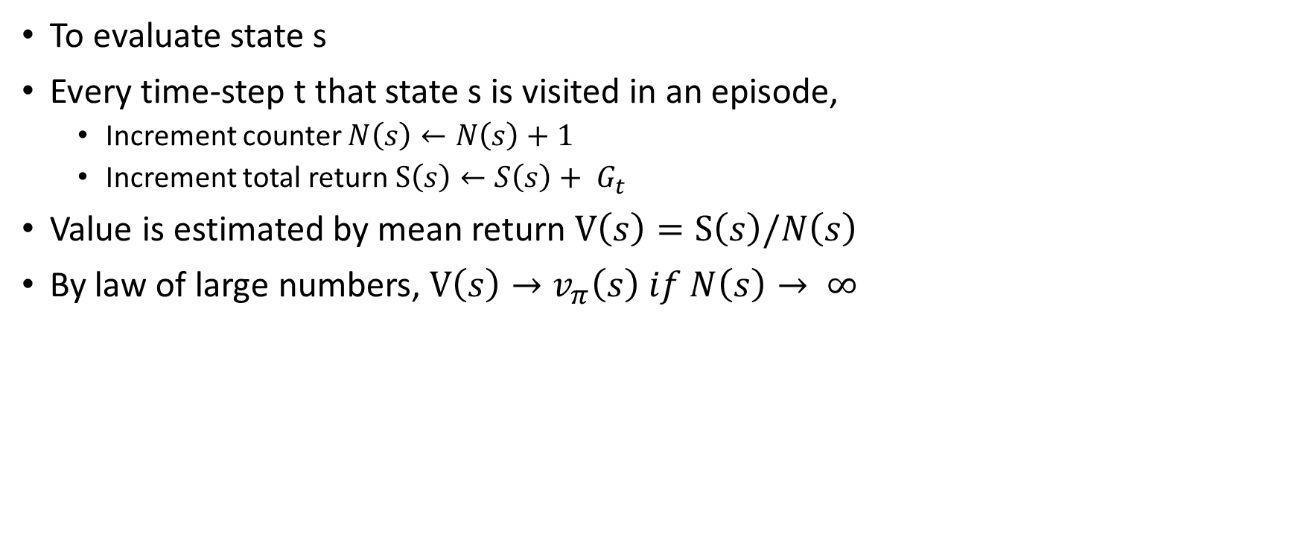
Every-Visit Monte-Carlo Policy Evaluation
To evaluate state s
Every time-step t that state s is visited in an episode,
Increment counter $N\left(s\right)←N\left(s\right)+1$
Increment total return $S\left(s\right)←S\left(s\right)+ G_{t}$
Value is estimated by mean return $V\left(s\right)=S\left(s\right)/N\left(s\right)$
By law of large numbers, $V\left(s\right)→v_{π}\left(s\right) if N\left(s\right)→ ∞$

Slide 11
Blackjack Example: Rules
States (200 of them)
Current sum (12-21)
Dealer’s showing card (ace-10)
Do I have a “useable” ace? (yes-no)
Action
stick: Stop receiving cards (and terminate)
twist: Take another card (no replacement)
Reward for stick
+1 if sum of cards > sum of dealer cards
0 if sum of cards = sum of dealer cards
-1 if sum of cards < sum of dealer cards
Reward for twist
-1 if sum of cards > 21 (and terminate)
0 otherwise
Transitions: automatically twist if sum of cards < 12

Slide 12
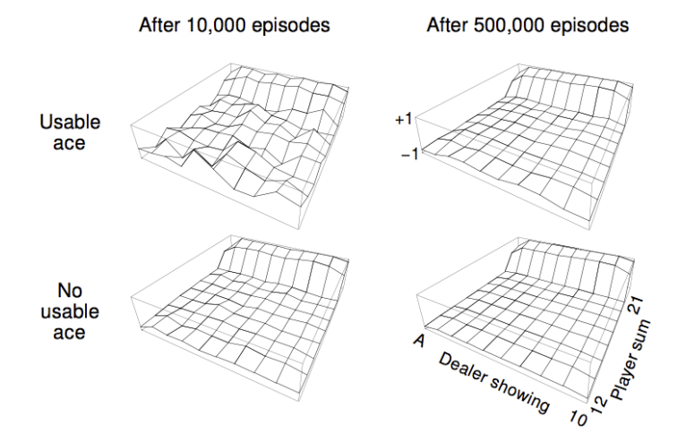
Blackjack Example: Value Function after Monte-Carlo Learning
Policy: stick if sum of cards ≥ 20, otherwise twist

Slide 13

Incremental Mean
The mean $μ_{1}, μ_{2}, …,$of a sequence $x_{1}, x_{2}, …,$can be computed incrementally,
$$μ_{k}=\frac{1}{k}\sum_{j=1}^{k}{x_{j}}$$
$=\frac{1}{k}\left(x_{k}+\sum_{j=1}^{k−1}{x_{j}}\right)$
$=\frac{1}{k}\left(x_{k}+(k−1)μ_{k−1}\right)$
$=μ_{k−1}+\frac{1}{k}\left(x_{k}−μ_{k−1}\right)$

Slide 14
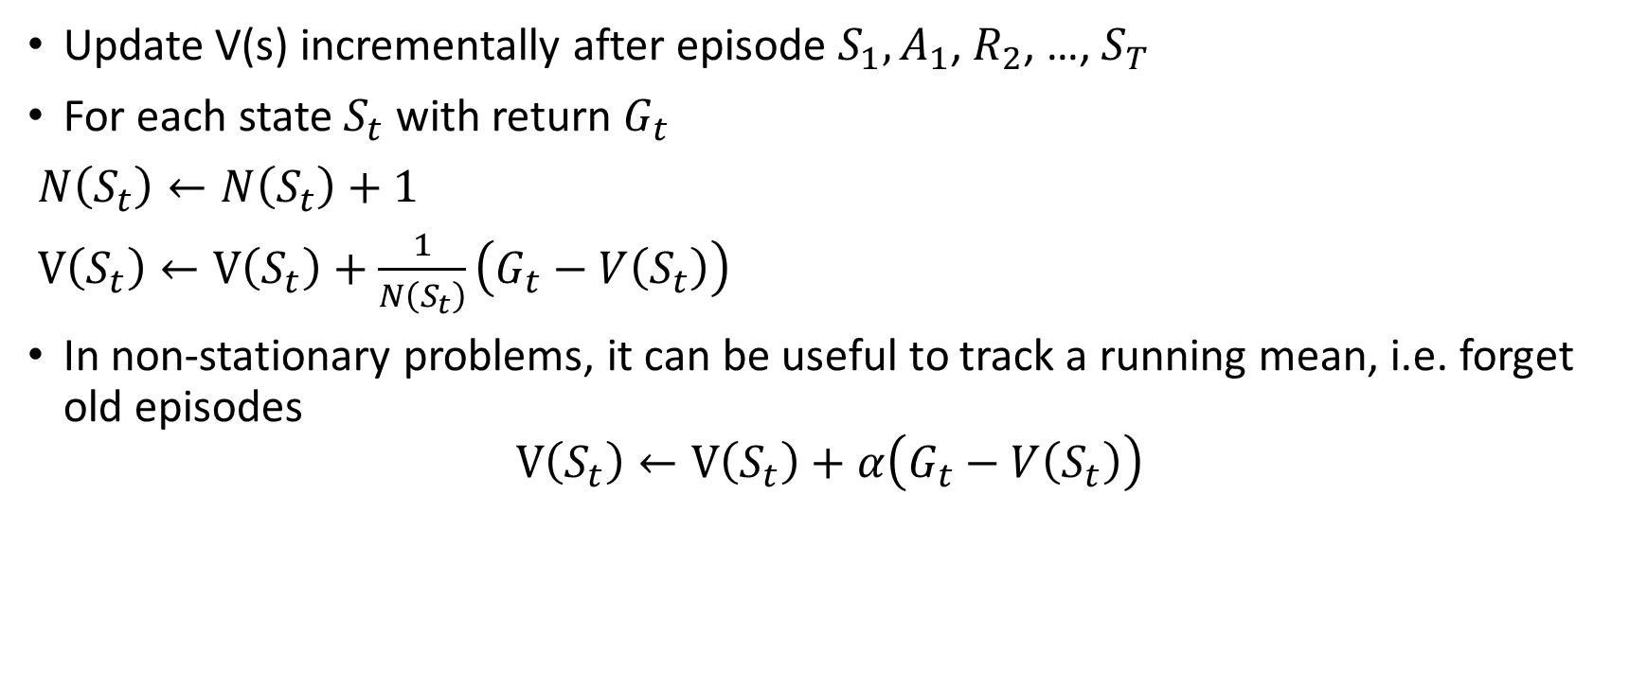
Incremental Monte-Carlo Updates
Update V(s) incrementally after episode $S_{1}, A_{1}$, $R_{2}$, …, $S_{T}$
For each state $S_{t}$with return $G_{t}$
$N\left(S_{t}\right)←N\left(S_{t}\right)+1$
$V\left(S_{t}\right)←V\left(S_{t}\right)+\frac{1}{N\left(S_{t}\right)}\left(G_{t}−V\left(S_{t}\right)\right)$
In non-stationary problems, it can be useful to track a running mean, i.e. forget old episodes
$$V\left(S_{t}\right)←V\left(S_{t}\right)+α\left(G_{t}−V\left(S_{t}\right)\right)$$

Slide 15
Temporal-Difference Learning

Slide 16
Temporal-Difference Learning
TD methods learn directly from episodes of experience
TD is model-free: no knowledge of MDP transitions / rewards
TD learns from incomplete episodes, by bootstrapping
TD updates a guess towards a guess

Slide 17
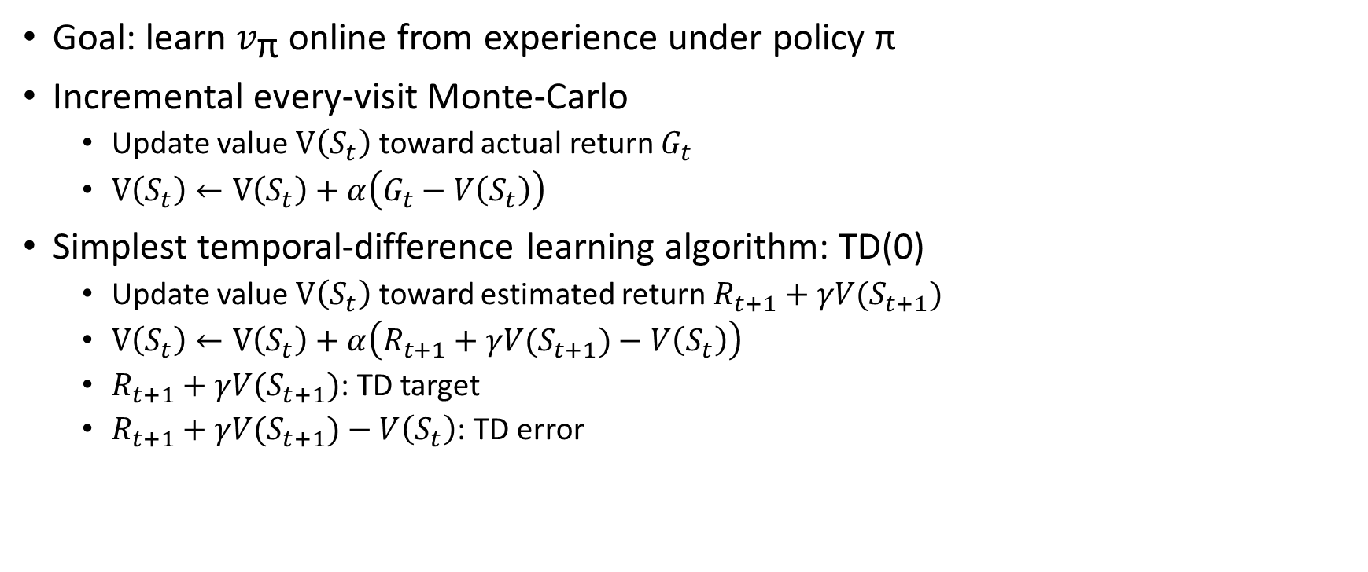
MC and TD
Goal: learn $v_{\text{π}}$ online from experience under policy π
Incremental every-visit Monte-Carlo
Update value $V\left(S_{t}\right)$ toward actual return $G_{t}$
$V\left(S_{t}\right)←V\left(S_{t}\right)+α\left(G_{t}−V\left(S_{t}\right)\right)$
Simplest temporal-difference learning algorithm: TD(0)
Update value $V\left(S_{t}\right)$ toward estimated return $R_{t+1}+γV(S_{t+1})$
$V\left(S_{t}\right)←V\left(S_{t}\right)+α\left(R_{t+1}+γV(S_{t+1})−V\left(S_{t}\right)\right)$
$R_{t+1}+γV(S_{t+1})$: TD target
$R_{t+1}+γV(S_{t+1})−V\left(S_{t}\right)$: TD error

Slide 18
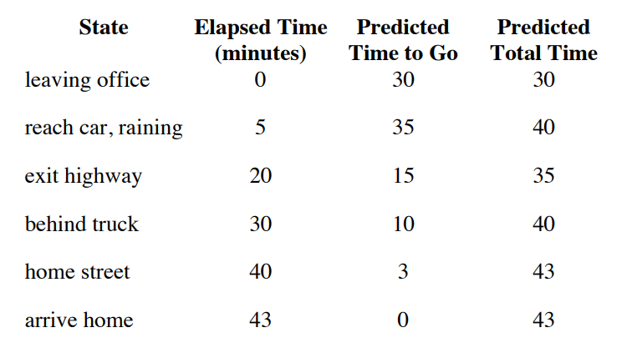
Driving Home Example

Slide 19
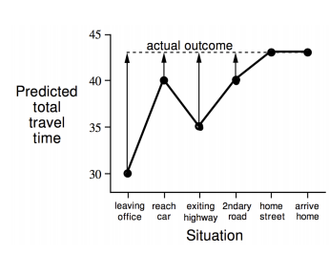
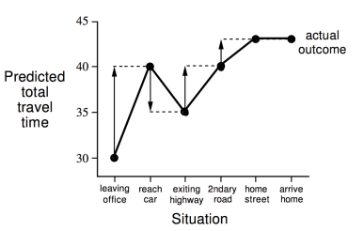
Driving Home Example: MC vs. TD
Changes recommended by Monte Carlo methods (α=1)
Changes recommended by TD methods (α =1)

Slide 20
Advantages and Disadvantages of MC and TD (1)
TD can learn before knowing the final outcome
TD can learn online after every step
MC must wait until end of episode before return is known
TD can learn without the final outcome
TD can learn from incomplete sequences
MC can only learn from complete sequences
TD works in continuing (non-terminating) environments
MC only works for episodic (terminating) environments

Slide 21
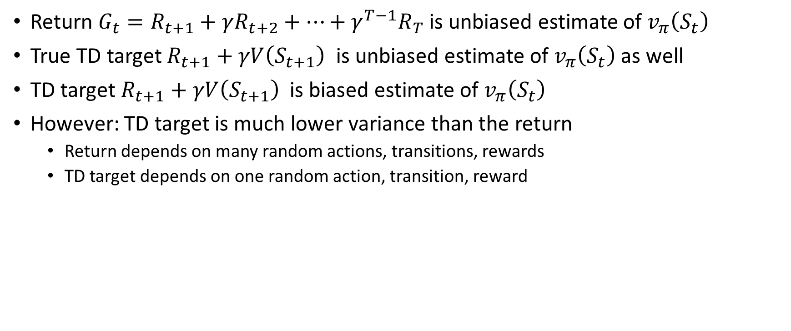
Bias/Variance Trade-Of
Return $G_{t}=R_{t+1}+γR_{t+2}+…+γ^{T−1}R_{T}$ is unbiased estimate of $v_{π}\left(S_{t}\right)$
True TD target $R_{t+1}+γV\left(S_{t+1}\right)$ is unbiased estimate of $v_{π}\left(S_{t}\right)$ as well
TD target $R_{t+1}+γV\left(S_{t+1}\right)$ is biased estimate of $v_{π}\left(S_{t}\right)$
However: TD target is much lower variance than the return
Return depends on many random actions, transitions, rewards
TD target depends on one random action, transition, reward

Slide 22
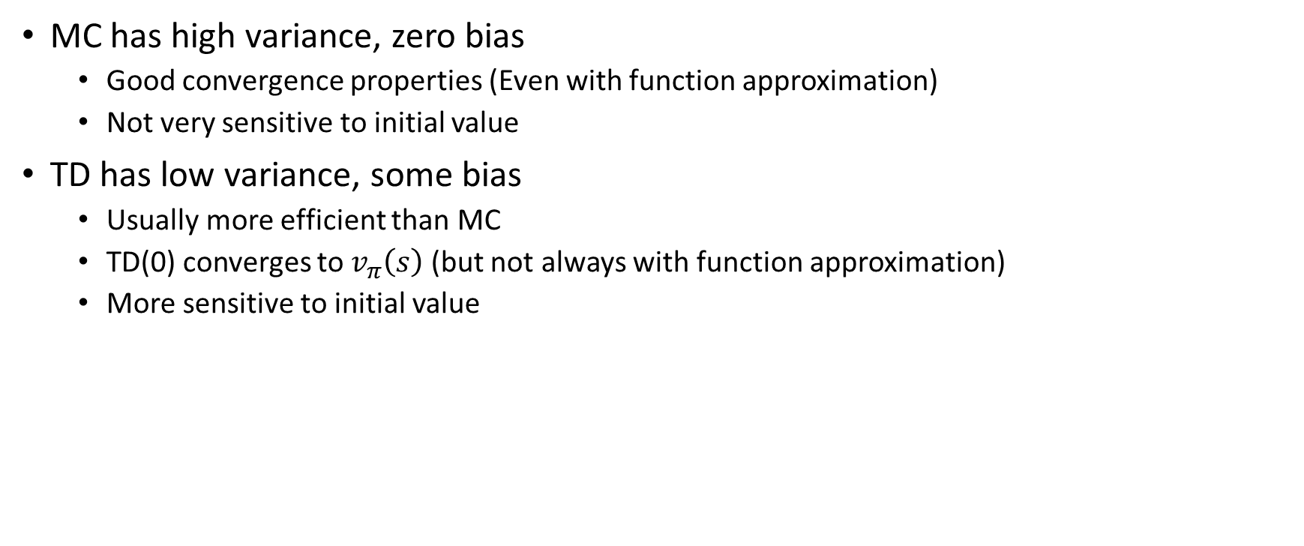
Advantages and Disadvantages of MC and TD (2)
MC has high variance, zero bias
Good convergence properties (Even with function approximation)
Not very sensitive to initial value
TD has low variance, some bias
Usually more efficient than MC
TD(0) converges to $v_{π}\left(s\right)$ (but not always with function approximation)
More sensitive to initial value

Slide 23
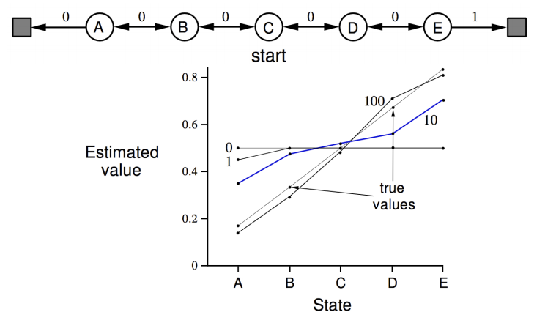
Random Walk Example

Slide 24
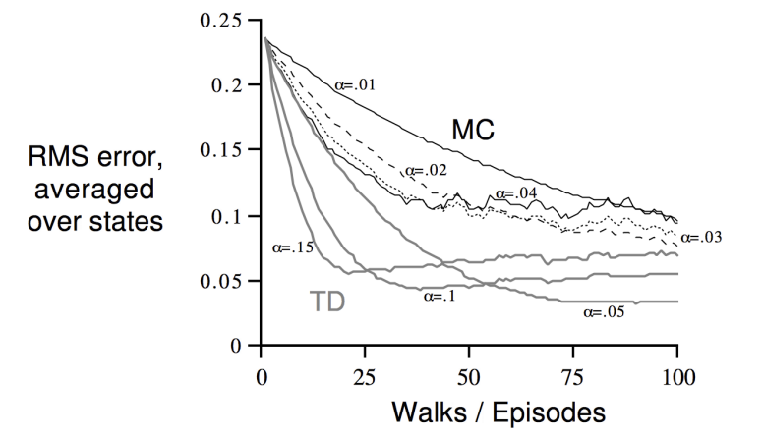
Random Walk: MC vs. TD

Slide 25
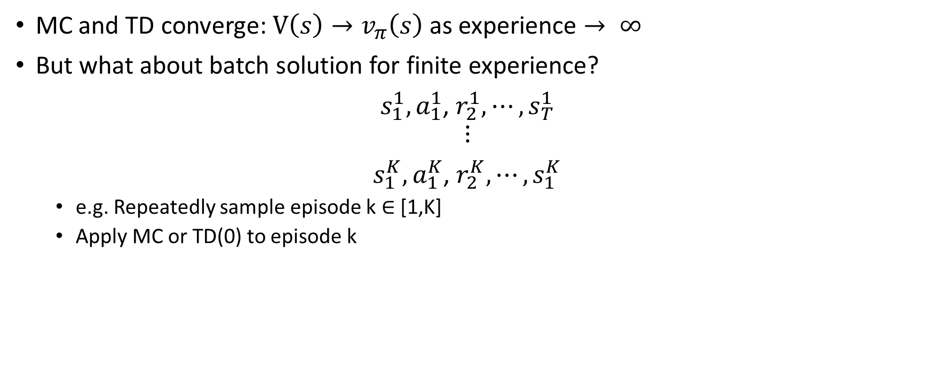
Batch MC and TD
MC and TD converge: $V\left(s\right)→v_{π}\left(s\right)$ as experience $→ ∞$
But what about batch solution for finite experience?
$s_{1}^{1},a_{1}^{1}$, $r_{2}^{1}, ⋯,s_{T}^{1}$
$$⋮$$
$s_{1}^{K},a_{1}^{K}$, $r_{2}^{K}, ⋯,s_{1}^{K}$
e.g. Repeatedly sample episode k ∈ [1,K]
Apply MC or TD(0) to episode k

Slide 26
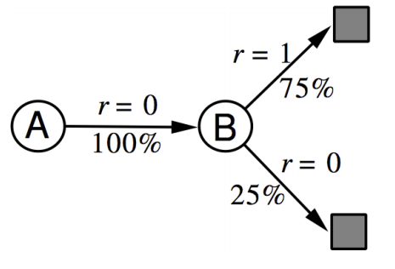
AB Example
Two states A, B; no discounting; 8 episodes of experience
A, 0, B, 0
B, 1
B, 1
B, 1
B, 1
B, 1
B, 1
B, 0
What is V(A), V(B)?

Slide 27
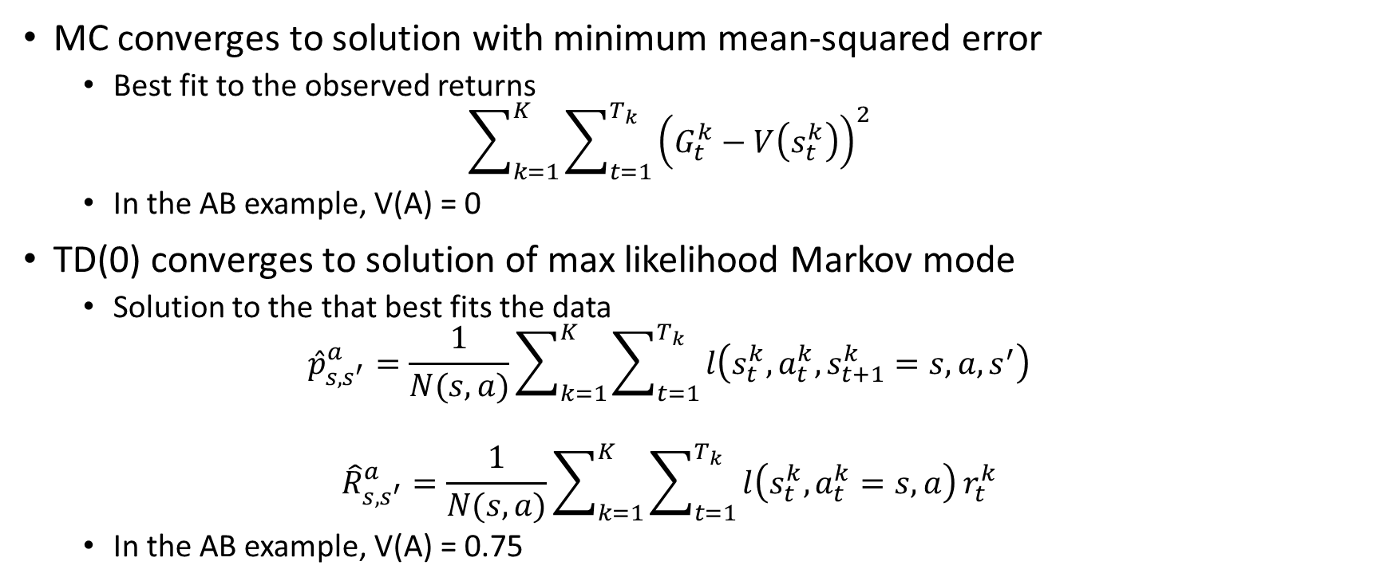
Certainty Equivalence
MC converges to solution with minimum mean-squared error
Best fit to the observed returns
$$\sum_{k=1}^{K}{\sum_{t=1}^{T_{k}}{{\left(G_{t}^{k}−V\left(s_{t}^{k}\right)\right)}^{2}}}$$
In the AB example, V(A) = 0
TD(0) converges to solution of max likelihood Markov mode
Solution to the that best fits the data
$${\hat{p}}_{s, s^{′}}^{a}=\frac{1}{N(s,a)}\sum_{k=1}^{K}{\sum_{t=1}^{T_{k}}{l\left(s_{t}^{k},a_{t}^{k},s_{t+1}^{k}=s, a, s^{′}\right)}}$$
$${\hat{R}}_{s, s^{′}}^{a}=\frac{1}{N(s,a)}\sum_{k=1}^{K}{\sum_{t=1}^{T_{k}}{l\left(s_{t}^{k},a_{t}^{k}=s, a\right)}r_{t}^{k}}$$
In the AB example, V(A) = 0.75

Slide 28
Advantages and Disadvantages of MC and TD (3)
TD exploits Markov property
Usually more efficient in Markov environments
MC does not exploit Markov property
Usually more effective in non-Markov environments

Slide 29
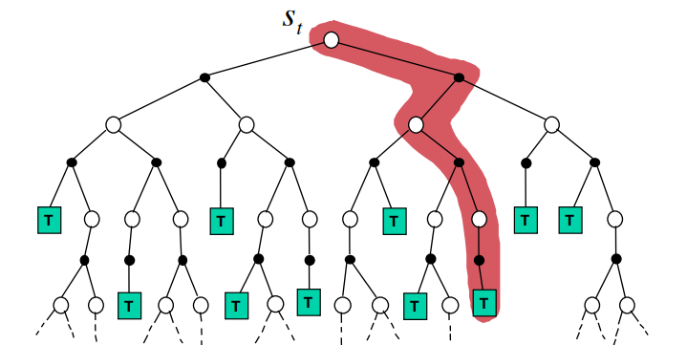

Monte-Carlo Backup
$V\left(S_{t}\right)←V\left(S_{t}\right)+α\left(G_{t}−V\left(S_{t}\right)\right)$

Slide 30
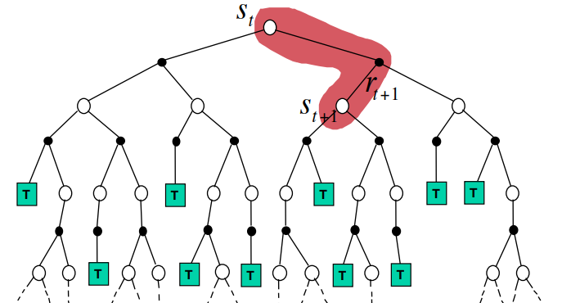

Temporal-Difference Backup
$V\left(S_{t}\right)←V\left(S_{t}\right)+α\left(R_{t+1}+γV(S_{t+1})−V\left(S_{t}\right)\right)$

Slide 31
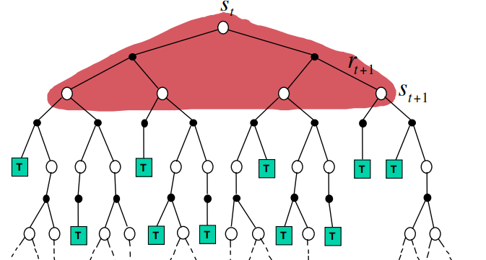

Dynamic Programming Backup
$V\left(S_{t}\right)← E_{π}\left[R_{t+1}+γV\left(S_{t+1}\right)\right]$

Slide 32
Bootstrapping and Sampling: Summary
Bootstrapping: update involves an estimate
MC does not bootstrap
DP bootstraps
TD bootstraps
Sampling: update samples an expectation
MC samples
DP does not sample
TD samples

Slide 33
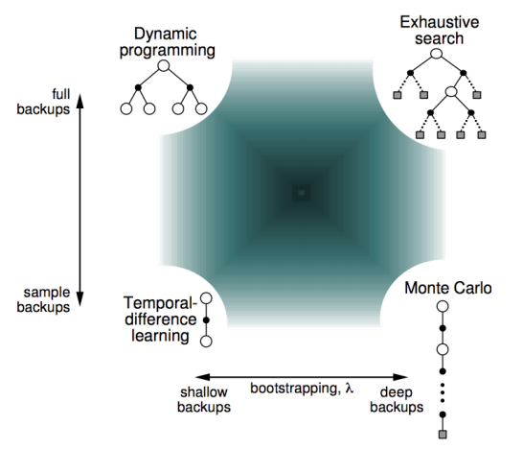
Unified View of Reinforcement Learning

Slide 34
TD(λ)

Slide 35
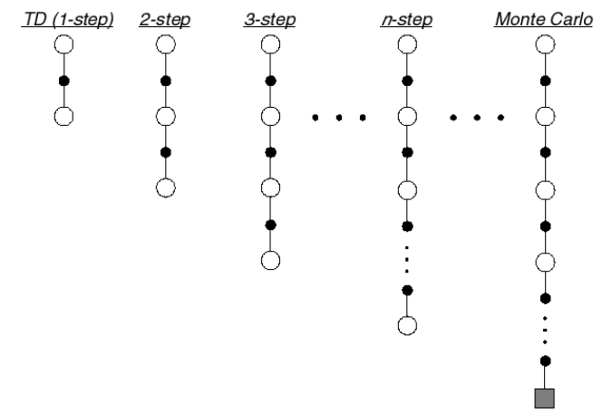
n-Step Prediction
Let TD target look n steps into the future

Slide 36
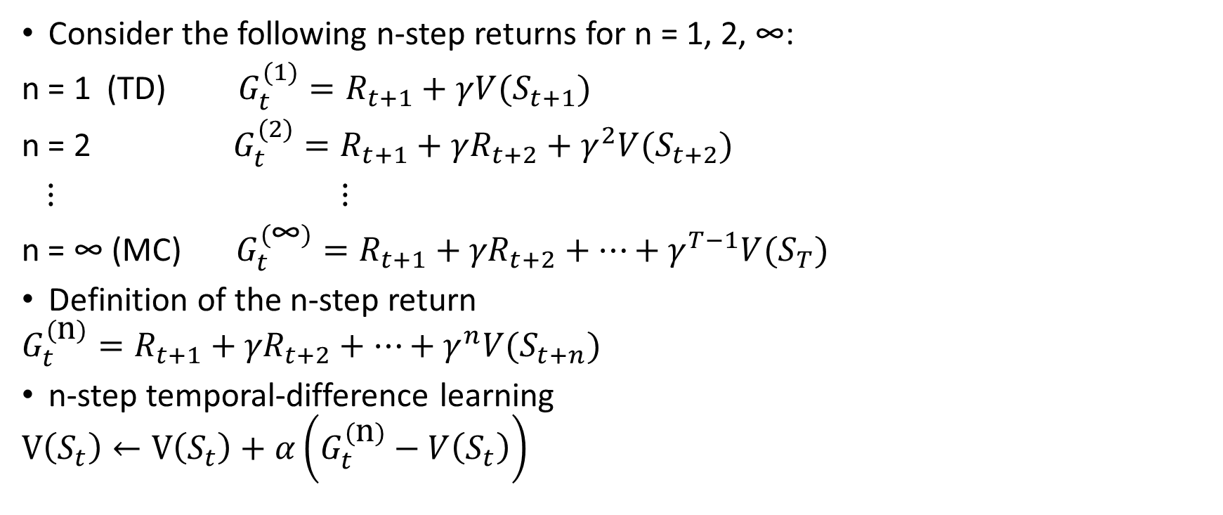
n-Step Return
Consider the following n-step returns for n = 1, 2, ∞:
n = 1 (TD) $G_{t}^{(1)}=R_{t+1}+γ{V(S}_{t+1})$
n = 2 $G_{t}^{(2)}=R_{t+1}+γR_{t+2}+γ^{2}{V(S}_{t+2})$
$⋮$ $⋮$
n = ∞ (MC) $G_{t}^{\left(\text{∞}\right)}=R_{t+1}+{γR}_{t+2}+⋯+γ^{T−1}{V(S}_{T})$
Definition of the n-step return
$$G_{t}^{\left(\text{n}\right)}=R_{t+1}+{γR}_{t+2}+⋯+γ^{n}{V(S}_{t+n})$$
n-step temporal-difference learning
$$V\left(S_{t}\right)←V\left(S_{t}\right)+α\left(G_{t}^{\left(\text{n}\right)}−V\left(S_{t}\right)\right)$$

Slide 37
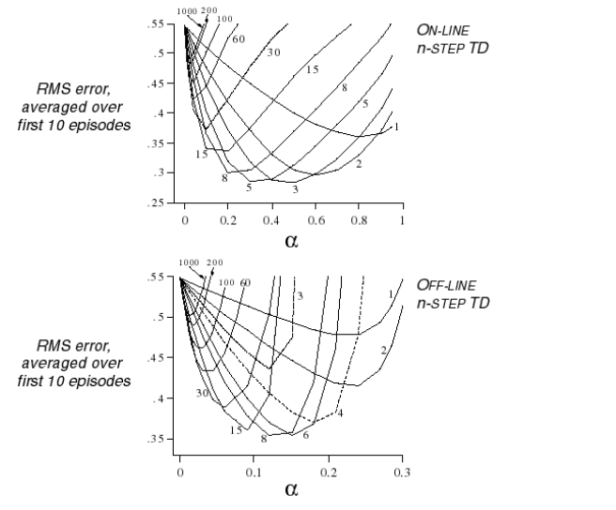
Large Random Walk Example

Slide 38
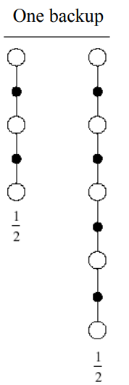
Averaging n-Step Returns
We can average n-step returns over different n
e.g. average the 2-step and 4-step returns
Can we efficiently combine information from all time-steps?

Slide 39
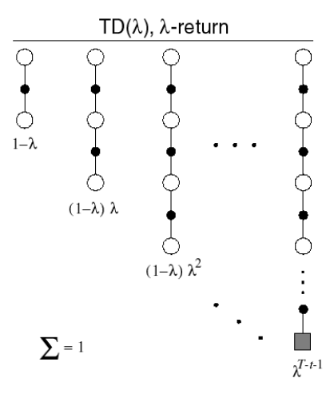
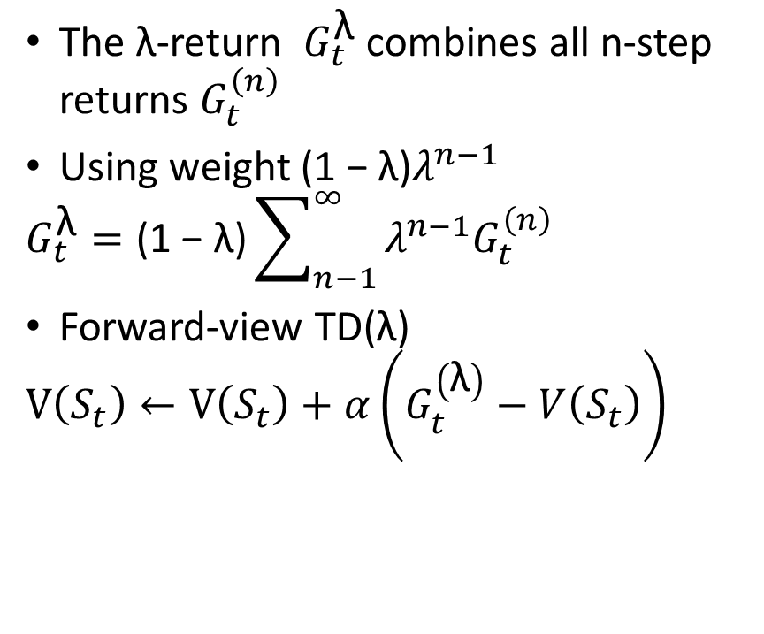
λ-return
The λ-return $G_{t}^{\text{λ}}$ combines all n-step returns $G_{t}^{\left(n\right)}$
Using weight ${\text{(1 − }\text{λ}\text{)}λ}^{n−1}$
$$G_{t}^{\text{λ}}=\text{(1 − }\text{λ}\text{)}\sum_{n−1}^{∞}{λ^{n−1}G_{t}^{\left(n\right)}}$$
Forward-view TD(λ)
$$V\left(S_{t}\right)←V\left(S_{t}\right)+α\left(G_{t}^{\left(\text{λ}\right)}−V\left(S_{t}\right)\right)$$

Slide 40
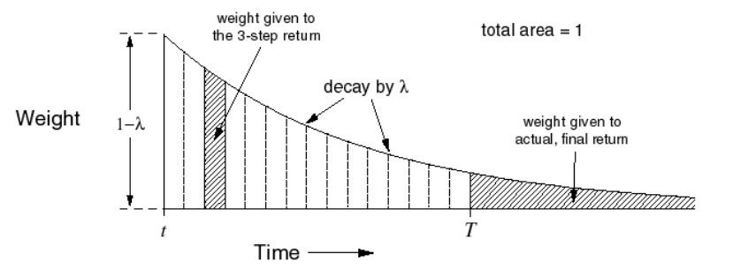

TD(λ) Weighting Function
$G_{t}^{\text{λ}}=\text{(1 − }\text{λ}\text{)}\sum_{n−1}^{∞}{λ^{n−1}G_{t}^{\left(n\right)}}$

Slide 41
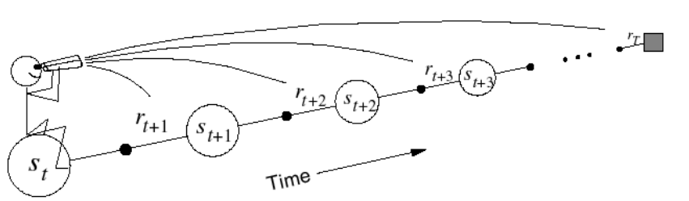

Forward-view TD(λ)
Update value function towards the λ-return
Forward-view looks into the future to compute $G_{t}^{\text{λ}}$
Like MC, can only be computed from complete episodes
The advantage of TD(λ) is that it does not need to experience all of the states

Slide 42
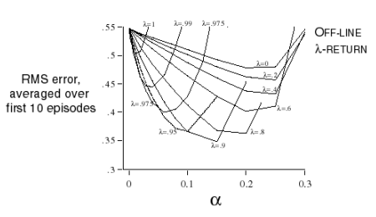
Forward-View TD(λ) on Large Random Walk

Slide 43
Backward View TD(λ)

Slide 44

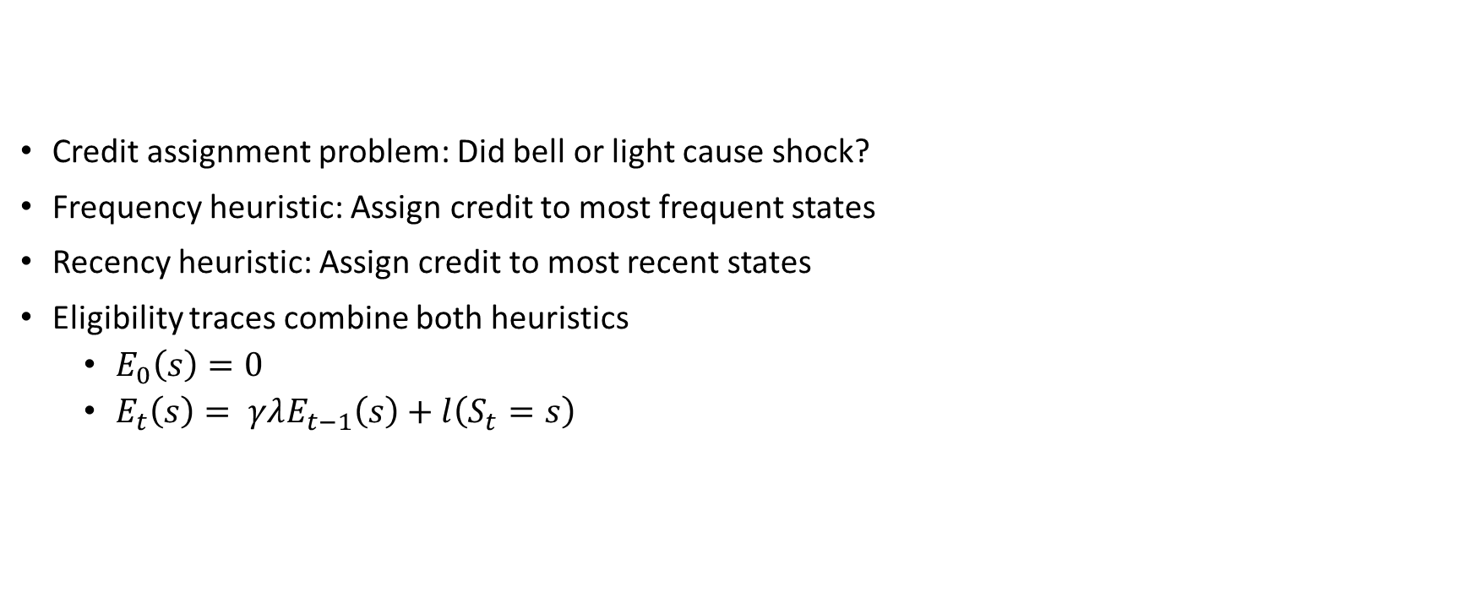
Eligibility Traces
Credit assignment problem: Did bell or light cause shock?
Frequency heuristic: Assign credit to most frequent states
Recency heuristic: Assign credit to most recent states
Eligibility traces combine both heuristics
$E_{0}\left(s\right)=0$
$E_{t}\left(s\right)= γλE_{t−1}\left(s\right)+l\left(S_{t}=s\right)$

Slide 45

Backward View TD(λ)
Keep an eligibility trace for every state s
Update value V(s) for every state s
In proportion to TD-error $δ_{t}$and eligibility trace $E_{t}(s)$
$δ_{t}=R_{t+1}+γV\left(S_{t+1}\right)−V\left(S_{t}\right)$
$V\left(s\right)←V\left(s\right)+ αδ_{t}E_{t}(s)$

Slide 46

TD(λ) and TD(0)
When λ = 0, only current state is updated
$E_{t}\left(s\right)=l\left(S_{t}=s\right)$
$V\left(s\right)←V\left(s\right)+ αδ_{t}E_{t}(s)$
This is exactly equivalent to TD(0) update
$V\left(s\right)←V\left(s\right)+ αδ_{t}$

Slide 47

TD(λ) and MC
When λ = 1, credit is deferred until end of episode
The sum of offline updates is identical for forward-view and backward-view TD(λ)
$\sum_{t=1}^{T}{αδ_{t}E_{t}(s) }=\sum_{t=1}^{T}{α\left({ G}_{t}^{\text{λ}}−V(S_{t})\right) l(S_{t}=s)}$

Slide 48
Forward and Backward View of TD(λ)
Forward view provides theory
Backward view assigns the credits to each state

Slide 49
References
Introduction to Reinforcement Learning with David Silver, DeepMind x UCL.

