Slide 1
Value Function Approximation
Lecturer: Chia-Yi Su
Advisor: Prof. Tsong-Yi Chen
Department of Electronic Engineering
National Kaohsiung University of Science and Technology
https://chiayisu.github.io/teaching/2022-spring-teaching

Slide 2
Course Outline
Introduction to Reinforcement Learning
Markov Decision Processes
Planning by Dynamic Programming
Model-Free Prediction
Model-Free Control
Neural Network
Value Function Approximation
Policy Gradient
Actor-Critic Algorithm
Dialog System (Including MultiModal Dialog System)

Slide 3
Agenda
Introduction
Incremental Methods
Batch Methods

Slide 4
Introduction

Slide 5

Large-Scale Reinforcement Learning
Reinforcement learning can be used to solve large problems, e.g.
Backgammon: ${10}^{20}$ states
Computer Go: ${10}^{170}$ states
Helicopter: continuous state space

Slide 6
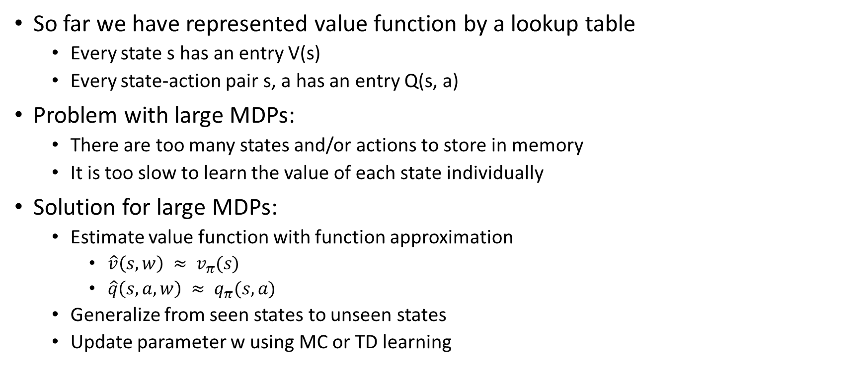
Value Function Approximation
So far we have represented value function by a lookup table
Every state s has an entry V(s)
Every state-action pair s, a has an entry Q(s, a)
Problem with large MDPs:
There are too many states and/or actions to store in memory
It is too slow to learn the value of each state individually
Solution for large MDPs:
Estimate value function with function approximation
$\hat{v}\left(s, w\right) ≈ v_{π}(s)$
$\hat{q}\left(s, a, w\right) ≈ q_{π}(s, a)$
Generalize from seen states to unseen states
Update parameter w using MC or TD learning

Slide 7
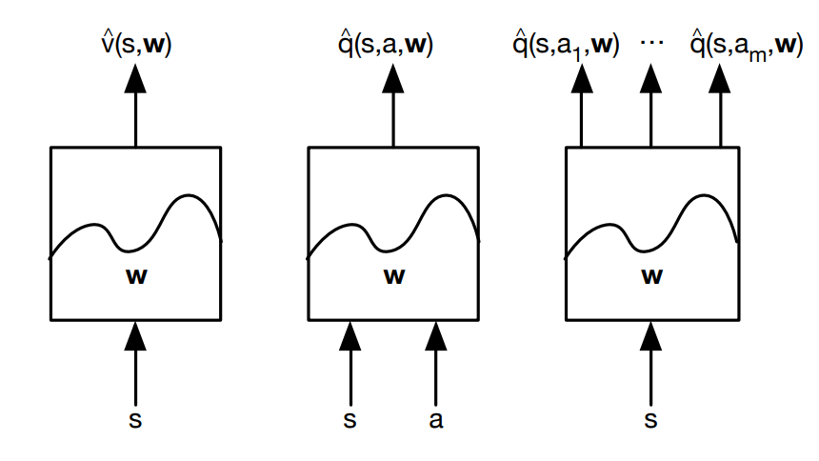
Types of Value Function Approximation

Slide 8
Which Function Approximator?
There are many function approximators, e.g.
Linear combinations of features
Neural network
Decision tree
Nearest neighbor
Fourier / wavelet bases ...
Furthermore, we require a training method that is suitable for non-stationary, non-iid data

Slide 9
Incremental Methods

Slide 10
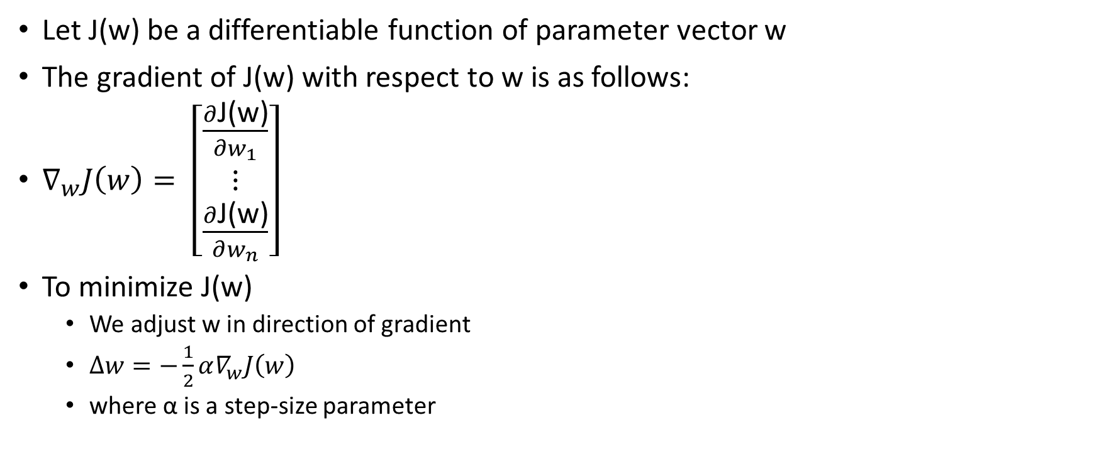
Gradient Descent
Let J(w) be a differentiable function of parameter vector w
The gradient of J(w) with respect to w is as follows:
$∇_{w}J\left(w\right)= \left[\begin{matrix}\frac{∂\text{J}\text{(}\text{w}\text{)}}{∂w_{1}} \\ ⋮ \\ \frac{∂\text{J}\text{(}\text{w}\text{)}}{∂w_{n}}\end{matrix}\right]$
To minimize J(w)
We adjust w in direction of gradient
$∆w=−\frac{1}{2}α∇_{w}J\left(w\right)$
where α is a step-size parameter

Slide 11
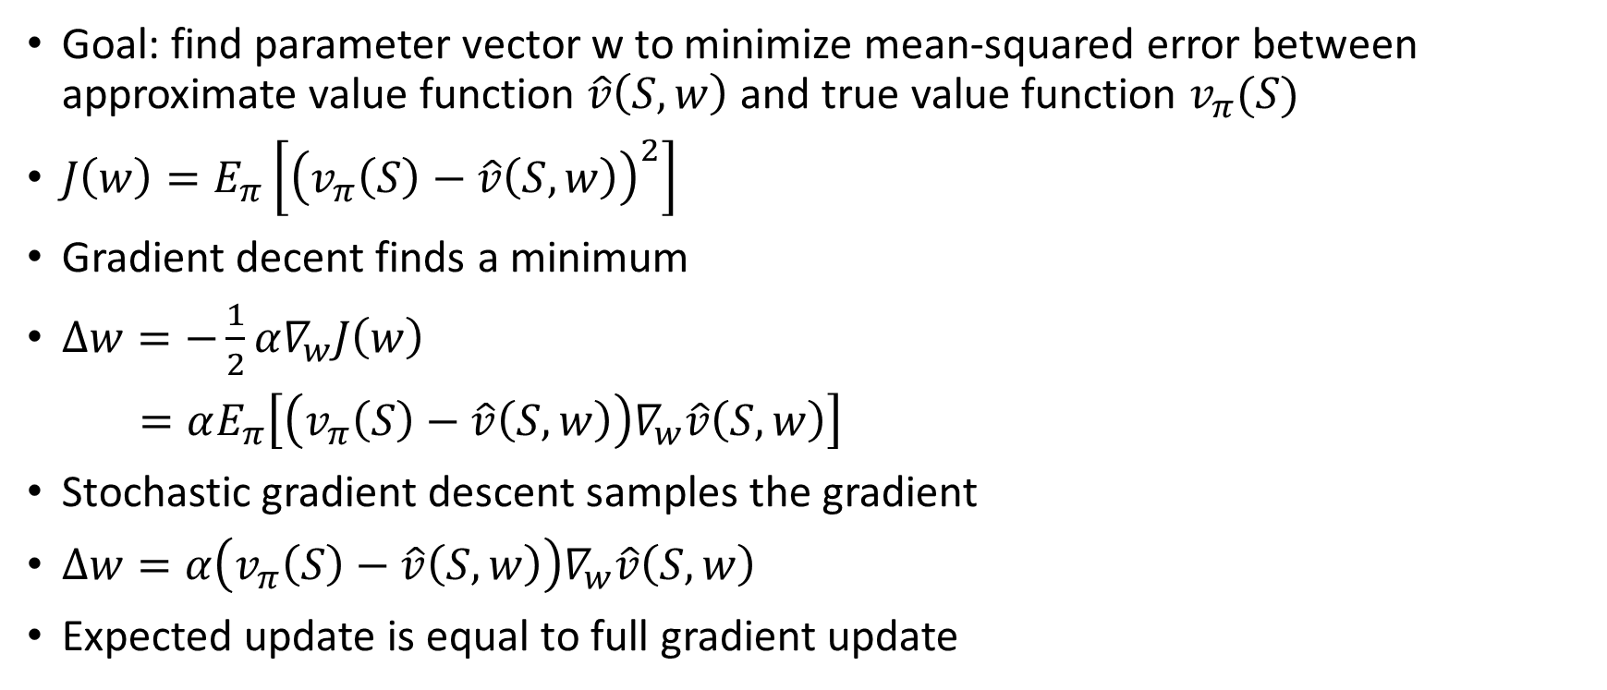
Value Function Approx. by Stochastic Gradient Descent
Goal: find parameter vector w to minimize mean-squared error between approximate value function $\hat{v}\left(S,w\right)$ and true value function $v_{π}(S)$
$J\left(w\right)=E_{π}\left[{\left(v_{π}\left(S\right)−\hat{v}\left(S,w\right)\right)}^{2}\right]$
Gradient decent finds a minimum
$∆w=−\frac{1}{2}α∇_{w}J\left(w\right)$
$=αE_{π}\left[\left(v_{π}\left(S\right)−\hat{v}\left(S,w\right)\right)∇_{w}\hat{v}\left(S,w\right)\right]$
Stochastic gradient descent samples the gradient
$∆w=α\left(v_{π}\left(S\right)−\hat{v}\left(S,w\right)\right)∇_{w}\hat{v}\left(S,w\right)$
Expected update is equal to full gradient update

Slide 12

Feature Vectors
Represent state by a feature vector
$x\left(S\right)= \left[\begin{matrix}x_{1}(S) \\ ⋮ \\ x_{n}(S)\end{matrix}\right]$
For example:
Distance of robot from landmarks
Trends in the stock market

Slide 13
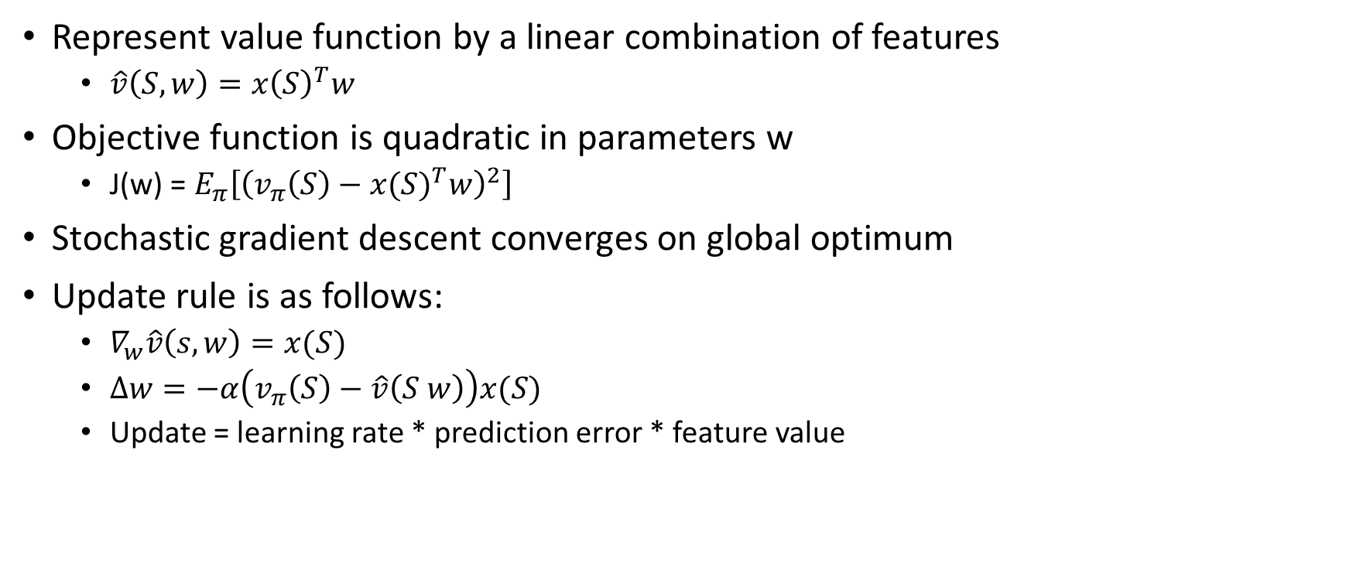
Linear Value Function Approximation
Represent value function by a linear combination of features
$\hat{v}\left(S, w\right)={x\left(S\right)}^{T}w$
Objective function is quadratic in parameters w
$\text{J}\text{(}\text{w}\text{) = }E_{π}\left[{\left(v_{π}\left(S\right)−{x(S)}^{T}w\right)}^{2}\right]$
Stochastic gradient descent converges on global optimum
Update rule is as follows:
$∇_{w}\hat{v}\left(s, w\right)=x(S)$
$∆w=−α\left(v_{π}\left(S\right)−\hat{v}\left(S w\right)\right)x(S)$
Update = learning rate * prediction error * feature value

Slide 14
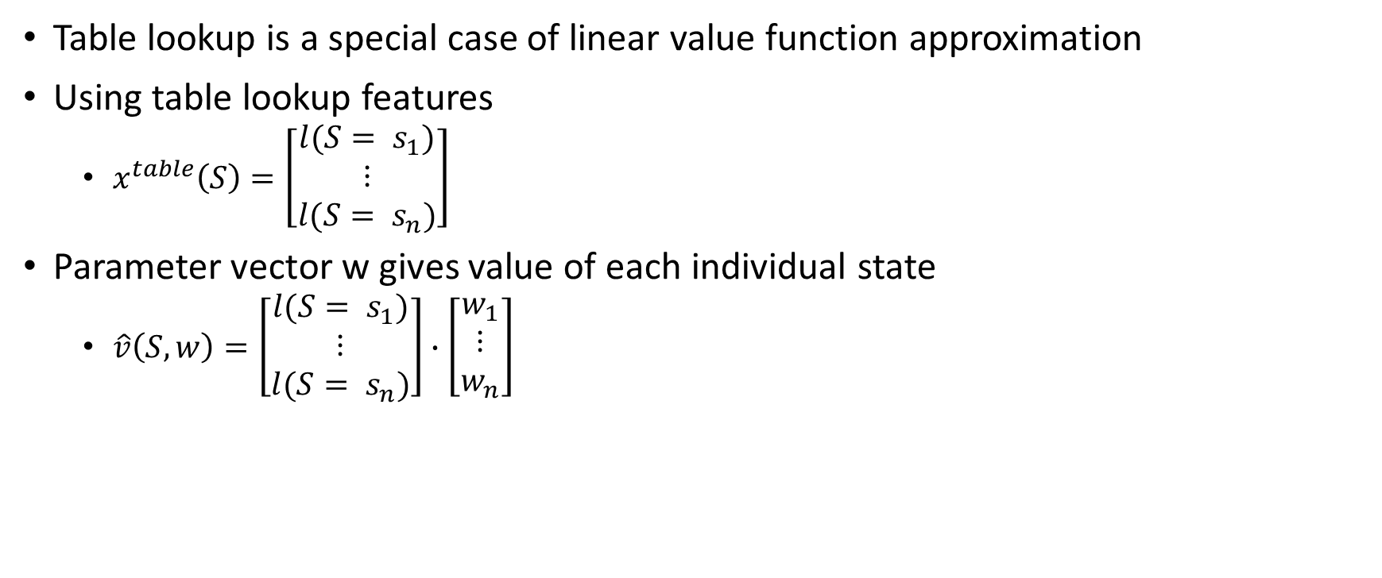
Table Lookup Features
Table lookup is a special case of linear value function approximation
Using table lookup features
$x^{table}\left(S\right)=\left[\begin{matrix}l(S= s_{1}) \\ ⋮ \\ l(S= s_{n})\end{matrix}\right]$
Parameter vector w gives value of each individual state
$\hat{v}\left(S,w\right)=\left[\begin{matrix}l(S= s_{1}) \\ ⋮ \\ l(S= s_{n})\end{matrix}\right]∙\left[\begin{matrix}w_{1} \\ ⋮ \\ w_{n}\end{matrix}\right]$

Slide 15
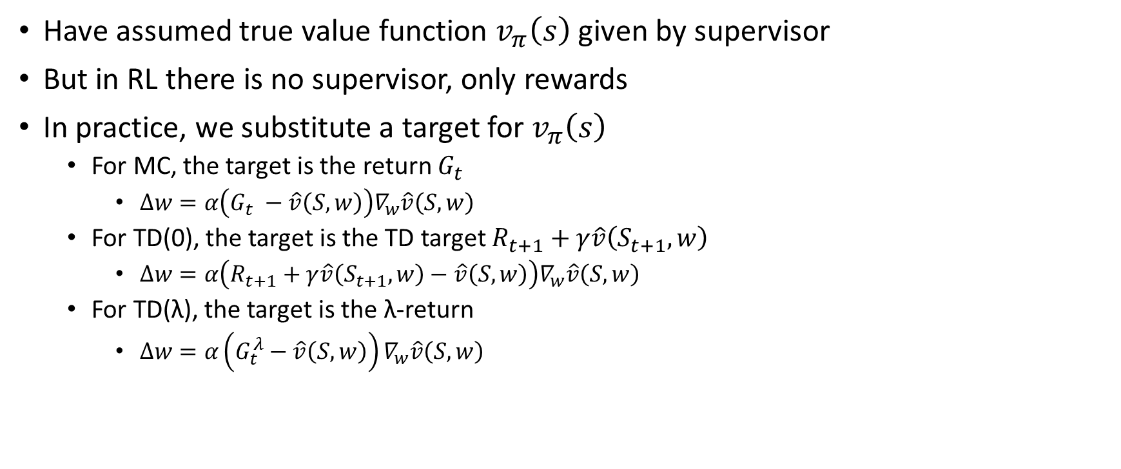
Incremental Prediction Algorithms
Have assumed true value function $v_{π}\left(s\right)$ given by supervisor
But in RL there is no supervisor, only rewards
In practice, we substitute a target for $v_{π}\left(s\right)$
For MC, the target is the return $G_{t}$
$∆w=α\left(G_{t} −\hat{v}\left(S,w\right)\right)∇_{w}\hat{v}\left(S,w\right)$
For TD(0), the target is the TD target $R_{t+1}+γ\hat{v}\left(S_{t+1}, w\right)$
$∆w=α\left(R_{t+1}+γ\hat{v}\left(S_{t+1}, w\right)−\hat{v}\left(S,w\right)\right)∇_{w}\hat{v}\left(S,w\right)$
For TD(λ), the target is the λ-return
$∆w=α\left(G_{t}^{λ}−\hat{v}\left(S,w\right)\right)∇_{w}\hat{v}\left(S,w\right)$

Slide 16
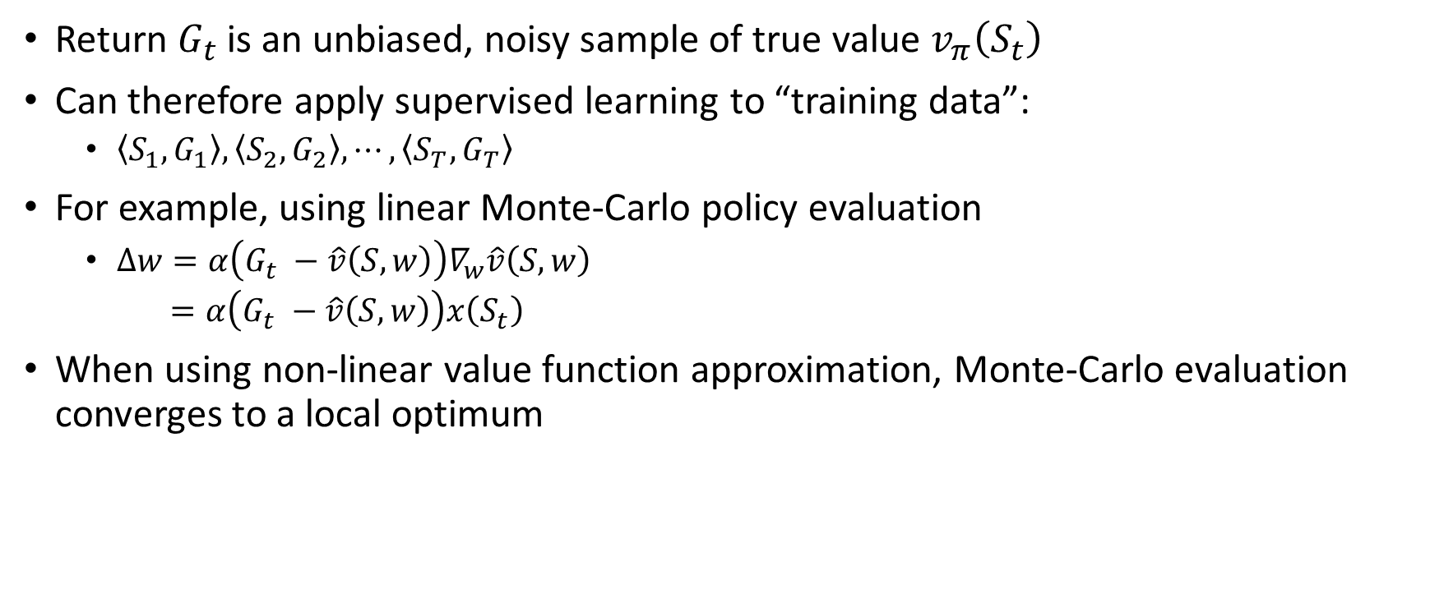
Monte-Carlo with Value Function Approximation
Return $G_{t}$ is an unbiased, noisy sample of true value $v_{π}\left(S_{t}\right)$
Can therefore apply supervised learning to “training data”:
$\left\langle S_{1},G_{1}\right\rangle ,\left\langle S_{2},G_{2}\right\rangle , ⋯,\left\langle S_{T},G_{T}\right\rangle$
For example, using linear Monte-Carlo policy evaluation
$∆w=α\left(G_{t} −\hat{v}\left(S,w\right)\right)∇_{w}\hat{v}\left(S,w\right)$
$=α\left(G_{t} −\hat{v}\left(S,w\right)\right)x\left(S_{t}\right)$
When using non-linear value function approximation, Monte-Carlo evaluation converges to a local optimum

Slide 17
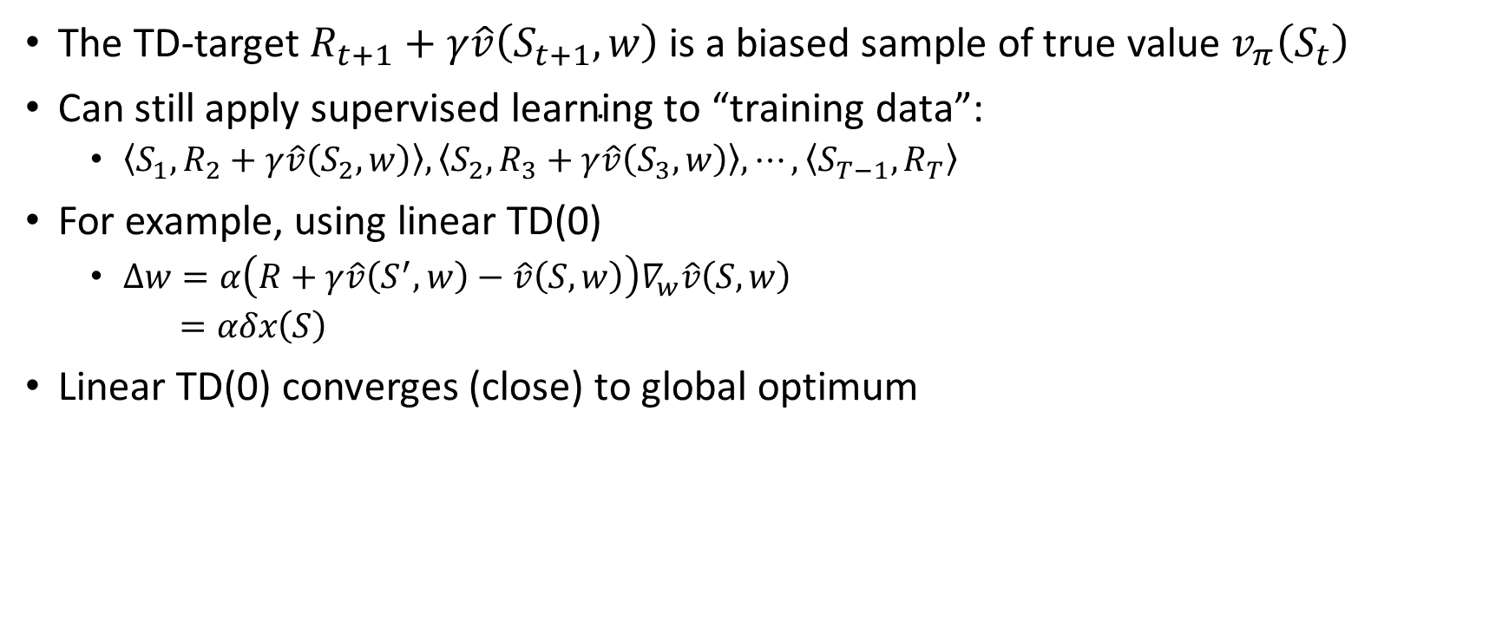
TD Learning with Value Function Approximation
The TD-target $R_{t+1}+γ\hat{v}\left(S_{t+1}, w\right)$ is a biased sample of true value
$\left\langle S_{1},R_{2}+γ\hat{v}\left(S_{2}, w\right)\right\rangle ,\left\langle S_{2},R_{3}+γ\hat{v}\left(S_{3}, w\right)\right\rangle , ⋯,\left\langle S_{T−1},R_{T}\right\rangle$
For example, using linear TD(0)
$∆w=α\left(R+γ\hat{v}\left(S^{′}, w\right)−\hat{v}\left(S,w\right)\right)∇_{w}\hat{v}\left(S,w\right)$
$=αδx\left(S\right)$
Linear TD(0) converges (close) to global optimum

Slide 18
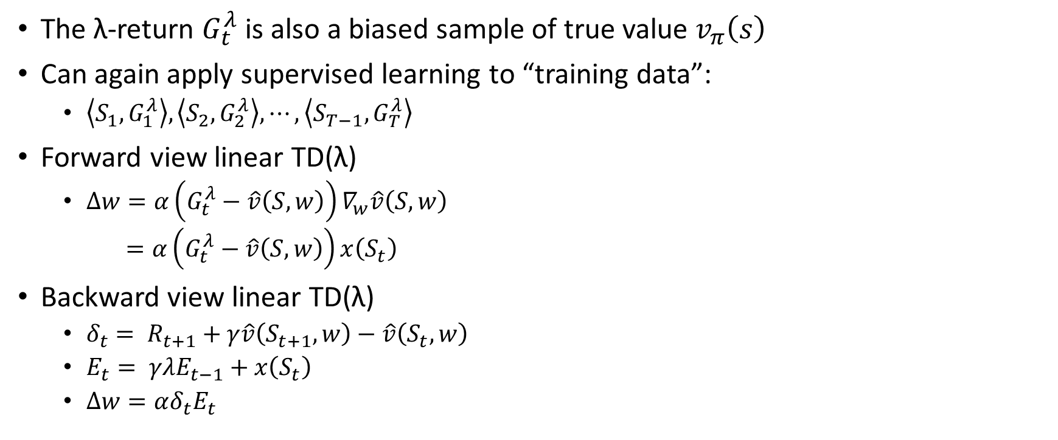
TD(λ) with Value Function Approximation
The λ-return $G_{t}^{λ}$ is also a biased sample of true value $v_{π}\left(s\right)$
Can again apply supervised learning to “training data”:
$\left\langle S_{1},G_{1}^{λ}\right\rangle ,\left\langle S_{2},G_{2}^{λ}\right\rangle , ⋯,\left\langle S_{T−1},G_{T}^{λ}\right\rangle$
Forward view linear TD(λ)
$∆w=α\left(G_{t}^{λ}−\hat{v}\left(S,w\right)\right)∇_{w}\hat{v}\left(S,w\right)$
$=α\left(G_{t}^{λ}−\hat{v}\left(S,w\right)\right)x\left(S_{t}\right)$
Backward view linear TD(λ)
$δ_{t}= R_{t+1}+γ\hat{v}\left(S_{t+1},w\right)−\hat{v}\left(S_{t},w\right)$
$E_{t}= γλE_{t−1}+x\left(S_{t}\right)$
$∆w=αδ_{t}E_{t}$

Slide 19
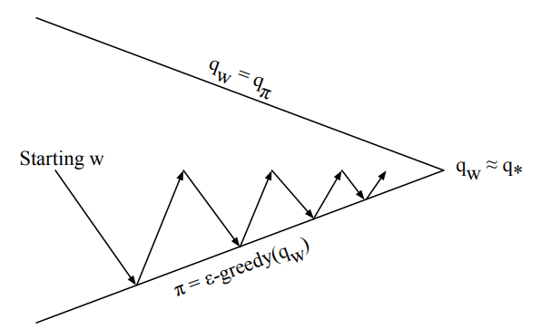

Control with Value Function Approximation
Policy Evaluation: Approximate policy evaluation, $\hat{q}\left(∙,∙,w\right)≈q_{π}$
Policy Improvement: $ε$-greedy policy improvement

Slide 20
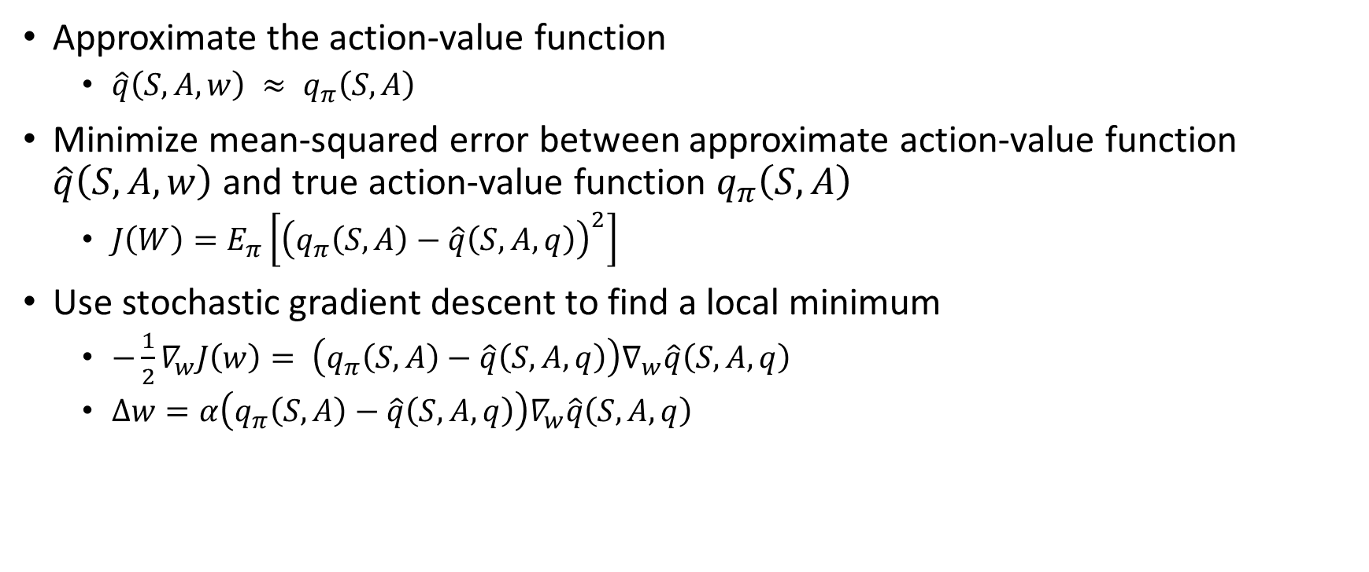
Action-Value Function Approximation
Approximate the action-value function
$\hat{q}\left(S,A,w\right) ≈ q_{π}\left(S, A\right)$
Minimize mean-squared error between approximate action-value function $\hat{q}\left(S,A,w\right)$ and true action-value function $q_{π}\left(S, A\right)$
$J\left(W\right)=E_{π}\left[{\left(q_{π}\left(S,A\right)−\hat{q}\left(S,A,q\right)\right)}^{2}\right]$
Use stochastic gradient descent to find a local minimum
$−\frac{1}{2}∇_{w}J\left(w\right)= \left(q_{π}\left(S,A\right)−\hat{q}\left(S,A,q\right)\right)∇_{w}\hat{q}\left(S,A,q\right)$
$∆w=α\left(q_{π}\left(S,A\right)−\hat{q}\left(S,A,q\right)\right)∇_{w}\hat{q}\left(S,A,q\right)$

Slide 21
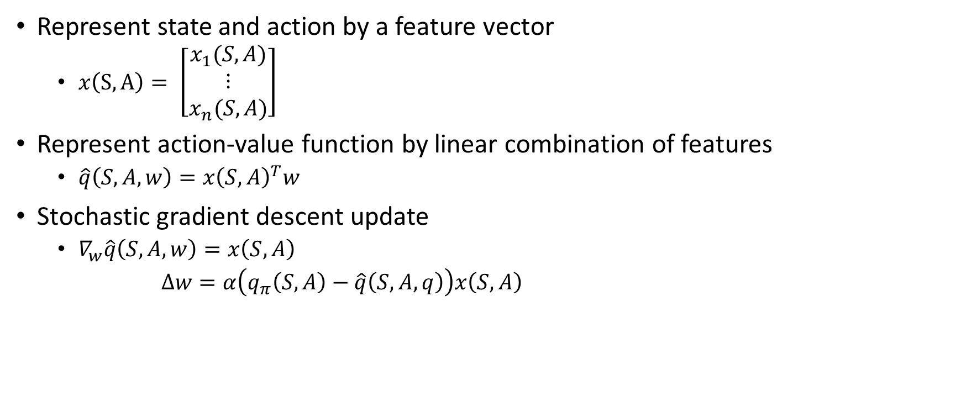
Linear Action-Value Function Approximation
Represent state and action by a feature vector
$x\left(S, A\right)= \left[\begin{matrix}x_{1}(S, A) \\ ⋮ \\ x_{n}(S, A)\end{matrix}\right]$
Represent action-value function by linear combination of features
$\hat{q}\left(S,A,w\right)={x\left(S,A\right)}^{T}w$
Stochastic gradient descent update
$∇_{w}\hat{q}\left(S,A,w\right)=x\left(S,A\right)$
$∆w=α\left(q_{π}\left(S,A\right)−\hat{q}\left(S,A,q\right)\right)x\left(S,A\right)$

Slide 22
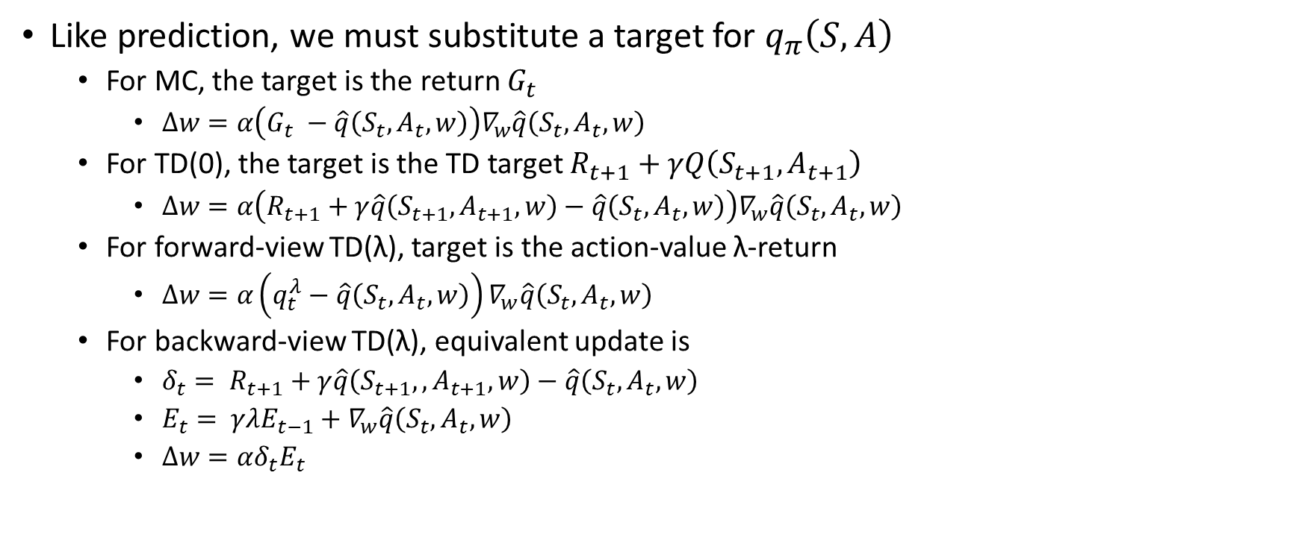
Incremental Control Algorithms
Like prediction, we must substitute a target for $q_{π}\left(S,A\right)$
For MC, the target is the return $G_{t}$
$∆w=α\left(G_{t} −\hat{q}\left(S_{t},A_{t},w\right)\right)∇_{w}\hat{q}\left(S_{t},A_{t},w\right)$
For TD(0), the target is the TD target $R_{t+1}+γQ\left(S_{t+1},A_{t+1}\right)$
$∆w=α\left(R_{t+1}+γ\hat{q}\left(S_{t+1},A_{t+1}, w\right)−\hat{q}\left(S_{t},A_{t},w\right)\right)∇_{w}\hat{q}\left(S_{t},A_{t},w\right)$
For forward-view TD(λ), target is the action-value λ-return
$∆w=α\left(q_{t}^{λ}−\hat{q}\left(S_{t},A_{t},w\right)\right)∇_{w}\hat{q}\left(S_{t},A_{t},w\right)$
For backward-view TD(λ), equivalent update is
$δ_{t}= R_{t+1}+γ\hat{q}\left(S_{t+1},,A_{t+1},w\right)−\hat{q}\left(S_{t},A_{t},w\right)$
$E_{t}= γλE_{t−1}+∇_{w}\hat{q}\left(S_{t},A_{t},w\right)$
$∆w=αδ_{t}E_{t}$

Slide 23
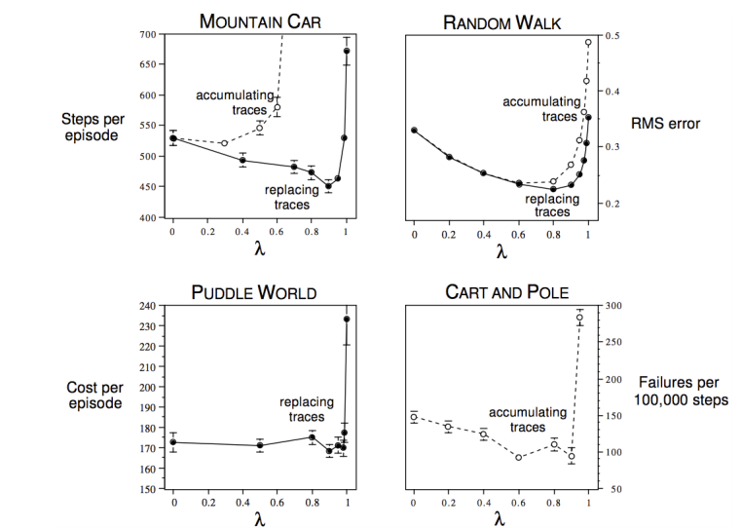
Study of λ: Should We Bootstrap?

Slide 24
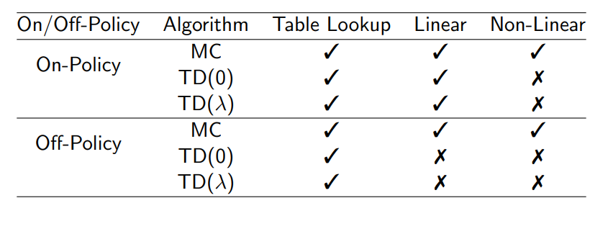
Convergence of Prediction Algorithms

Slide 25
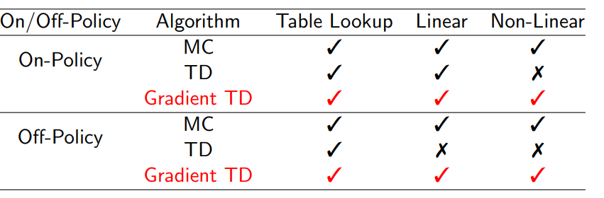
Gradient Temporal-Difference Learning
TD does not follow the gradient of any objective function
This is why TD can diverge when off-policy or using non-linear function approximation
Gradient TD follows true gradient of projected Bellman error

Slide 26
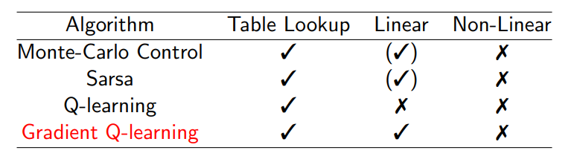
Convergence of Control Algorithms
(✓) = chatters around near-optimal value function

Slide 27
Batch Methods

Slide 28
Batch Reinforcement Learning
Gradient descent is simple and appealing
But it is not sample efficient
Batch methods seek to find the best fitting value function
Given the agent’s experience (“training data”)

Slide 29
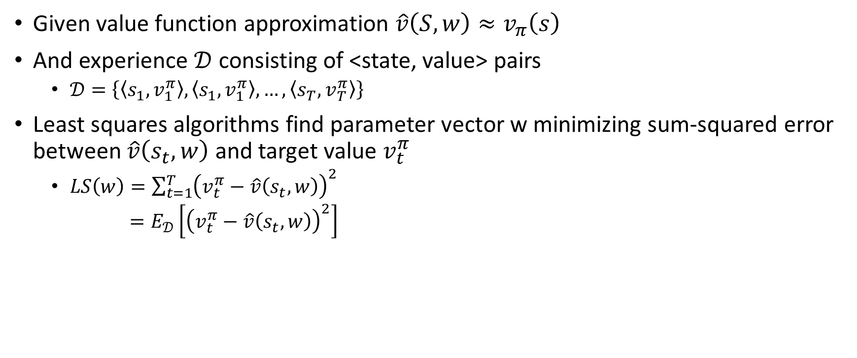
Least Squares Prediction
Given value function approximation $\hat{v}\left(S,w\right)≈v_{π}\left(s\right)$
And experience $𝒟$ consisting of <state, value> pairs
$𝒟=\left\{\left\langle s_{1},v_{1}^{π}\right\rangle ,\left\langle s_{1},v_{1}^{π}\right\rangle , …,\left\langle s_{T},v_{T}^{π}\right\rangle \right\}$
Least squares algorithms find parameter vector w minimizing sum-squared error between $\hat{v}\left(s_{t},w\right)$ and target value $v_{t}^{π}$
$LS\left(w\right)=\sum_{t=1}^{T}{{\left(v_{t}^{π}−\hat{v}\left(s_{t},w\right)\right)}^{2}}$
$=E_{𝒟}\left[{\left(v_{t}^{π}−\hat{v}\left(s_{t},w\right)\right)}^{2}\right]$

Slide 30
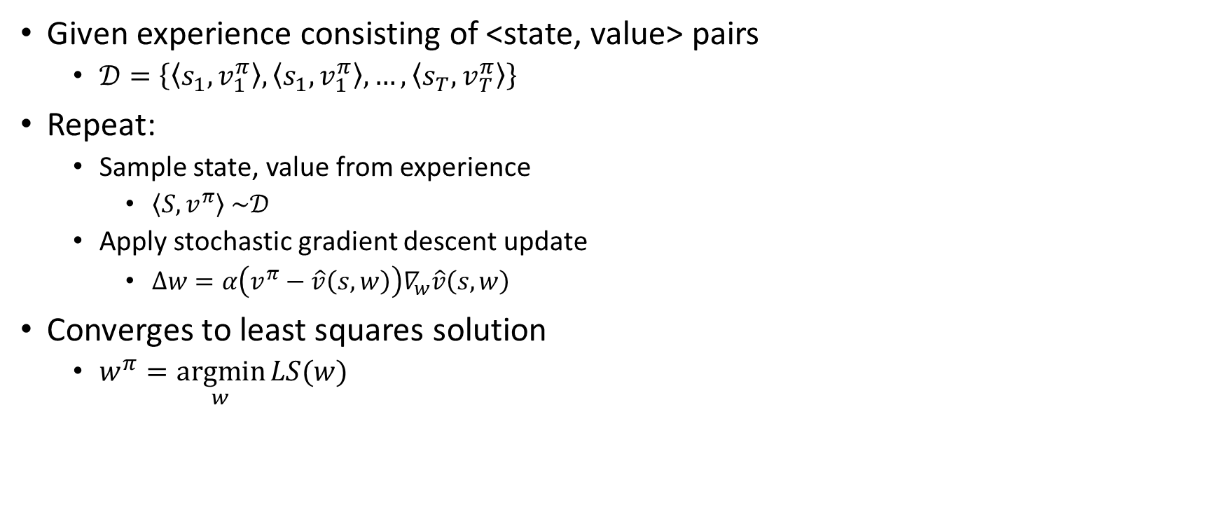
Stochastic Gradient Descent with Experience Replay
Given experience consisting of <state, value> pairs
$𝒟=\left\{\left\langle s_{1},v_{1}^{π}\right\rangle ,\left\langle s_{1},v_{1}^{π}\right\rangle , …,\left\langle s_{T},v_{T}^{π}\right\rangle \right\}$
Repeat:
Sample state, value from experience
$\left\langle S, v^{π}\right\rangle \sim 𝒟$
Apply stochastic gradient descent update
$∆w=α\left(v^{π}−\hat{v}\left(s,w\right)\right)∇_{w}\hat{v}\left(s,w\right)$
Converges to least squares solution
$w^{π}=\underset{w}{argmin}{LS(w)}$

Slide 31
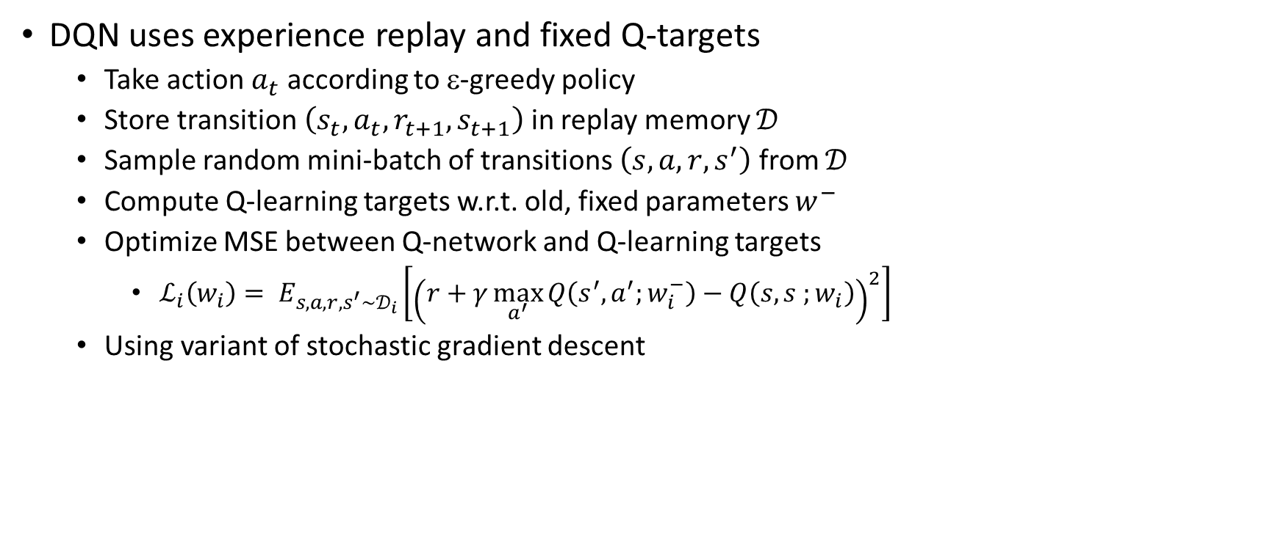
Experience Replay in Deep Q-Networks (DQN)
DQN uses experience replay and fixed Q-targets
Take action $a_{t}$ according to ε-greedy policy
Store transition $\left(s_{t},a_{t},r_{t+1},s_{t+1}\right)$ in replay memory $𝒟$
Sample random mini-batch of transitions $\left(s, a,r, s^{′}\right)$ from $𝒟$
Compute Q-learning targets w.r.t. old, fixed parameters $w^{−}$
Optimize MSE between Q-network and Q-learning targets
$ℒ_{i}\left(w_{i}\right)= E_{s, a, r, s^{′}\sim 𝒟_{i}}\left[{\left(r+γ\max_{a^{′}}{Q\left(s^{′},a^{′};w_{i}^{−}\right)}−Q\left(s,s ;w_{i}\right)\right)}^{2}\right]$
Using variant of stochastic gradient descent

Slide 32
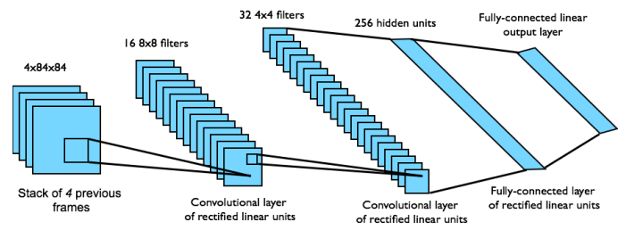
DQN in Atari
Input state s is stack of raw pixels from last 4 frames
Output is Q(s, a) for 18 joystick/button positions
Reward is change in score for that step

Slide 33
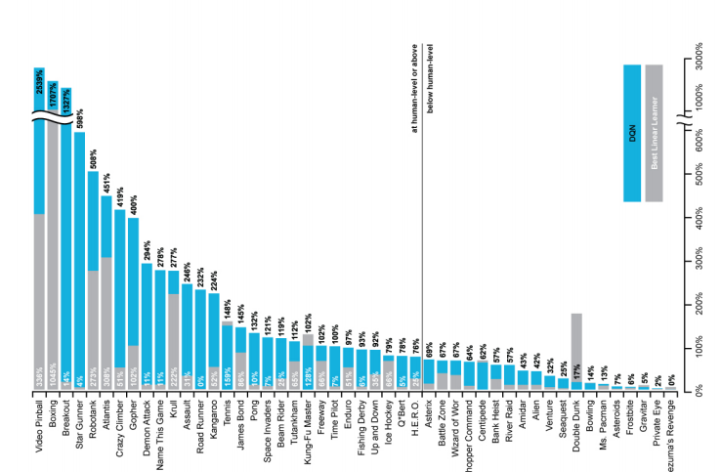
DQN Results in Atari

Slide 34
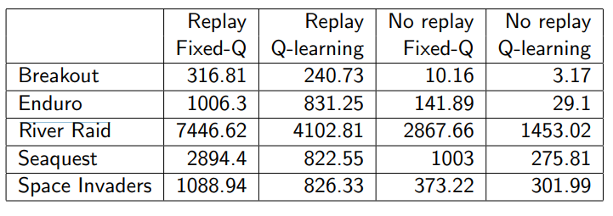
How much does DQN help?

Slide 35

Linear Least Squares Prediction
Experience replay finds least squares solution
But it may take many iterations
Using linear value function approximation $\hat{v}\left(s,w\right)={x\left(s\right)}^{T} w$
We can solve the least squares solution directly

Slide 36
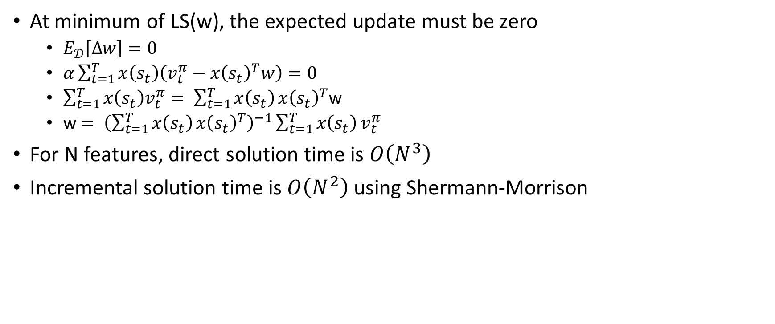
Linear Least Squares Prediction
At minimum of LS(w), the expected update must be zero
$E_{𝒟}\left[∆w\right]=0$
$α\sum_{t=1}^{T}{x\left(s_{t}\right)\left(v_{t}^{π}−{x\left(s_{t}\right)}^{T}w\right)=0}$
$\sum_{t=1}^{T}{x\left(s_{t}\right)v_{t}^{π}= \sum_{t=1}^{T}{x\left(s_{t}\right)}}{x\left(s_{t}\right)}^{T}$w
w$= {\left({\sum_{t=1}^{T}{x\left(s_{t}\right)}x\left(s_{t}\right)}^{T}\right)}^{−1}\sum_{t=1}^{T}{x\left(s_{t}\right)}v_{t}^{π}$
For N features, direct solution time is $O\left(N^{3}\right)$
Incremental solution time is $O\left(N^{2}\right)$ using Shermann-Morrison

Slide 37
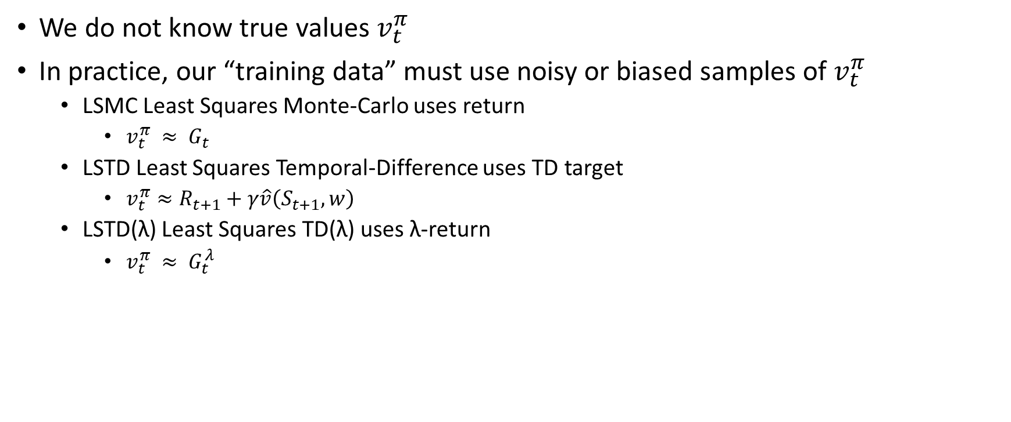
Linear Least Squares Prediction Algorithms
We do not know true values $v_{t}^{π}$
In practice, our “training data” must use noisy or biased samples of $v_{t}^{π}$
LSMC Least Squares Monte-Carlo uses return
$v_{t}^{π} ≈ G_{t}$
LSTD Least Squares Temporal-Difference uses TD target
${v_{t}^{π}≈R}_{t+1}+γ\hat{v}\left(S_{t+1}, w\right)$
LSTD(λ) Least Squares TD(λ) uses λ-return
$v_{t}^{π} ≈ G_{t}^{λ}$

Slide 38
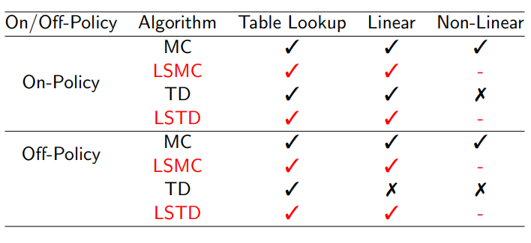
Convergence of Linear Least Squares Prediction Algorithms

Slide 39
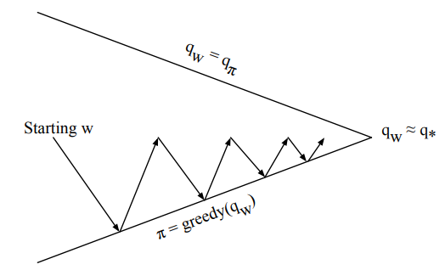
Least Squares Policy Iteration
Policy Evaluation: Policy evaluation by least squares Q-learning
Policy Improvement: Greedy policy improvement

Slide 40
References
Introduction to Reinforcement Learning with David Silver, DeepMind x UCL.

