Slide 1
Variational Inference and Generative Models
Chia-Yi Su
Department of Electronic Engineering
National Kaohsiung University of Science and Technology

Slide 2
Today’s Agenda
Introduction
Variational Inference
Amortized Variational Inference
Example Models

Slide 3
Objective for Today
Understand latent variable models in deep learning
Understand how to use (amortized) variational inference

Slide 4
Introduction

Slide 5
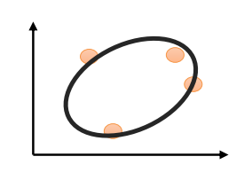
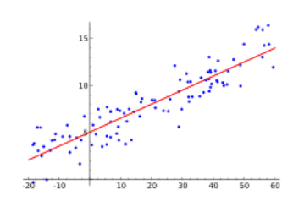
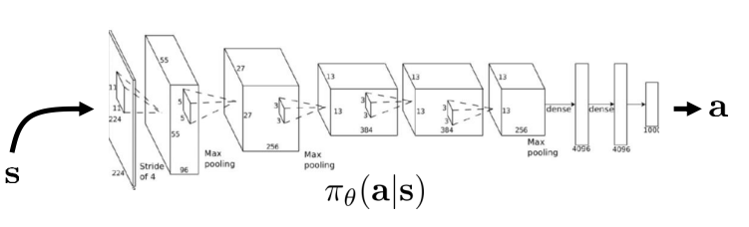
Probabilistic models
P(x)
P(y|x)

Slide 6
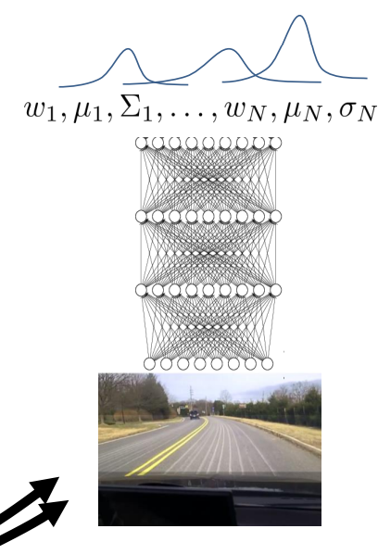
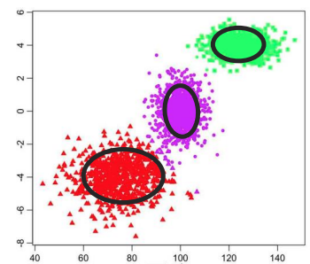
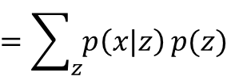
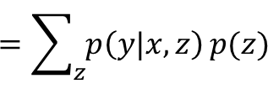
Latent variable models
P(x)
$$=\sum_{z}{p\left(x|z\right)}p(z)$$
P(y|x)
$$=\sum_{z}{p\left(y|x,z\right)}p(z)$$

Slide 7
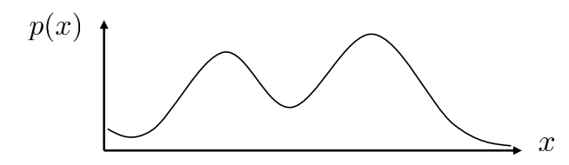
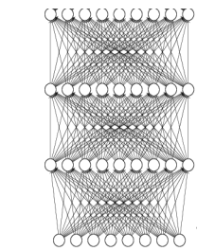

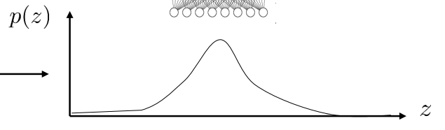
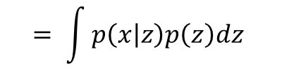
Latent variable models in general
p(x)
$$= \int{p\left(x | z\right)p\left(z\right)dz}$$
Easy distribution
(e.g. Conditional Gaussian)
Easy distribution
(e.g. Gaussian)
Easy distribution
(e.g. Gaussian)

Slide 8
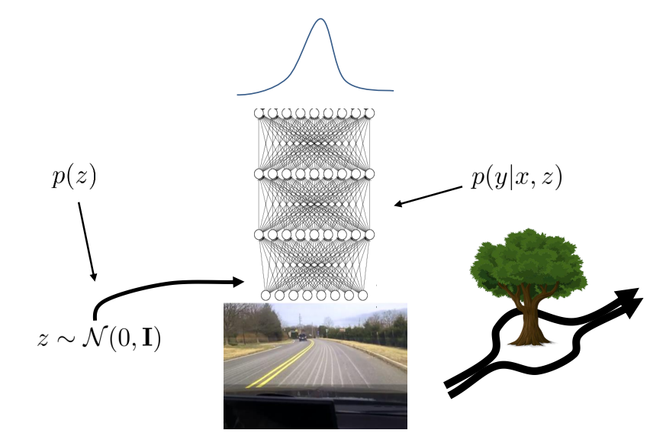
Latent variable models in RL
conditional latent variable models for multi-modal policies

Slide 9


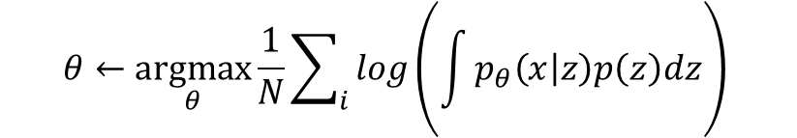
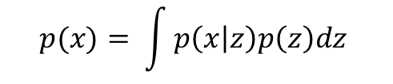

How do we train latent variable models?
The model: $p_{θ}\left(x\right)$
$$p(x)= \int{p\left(x | z\right)p\left(z\right)dz}$$
The data: $D=\left\{x_{1},x_{2},…,x_{N}\right\}$
$$θ←\underset{θ}{argmax}{\frac{1}{N}\sum_{i}{log\left(\int{p_{θ}\left(x | z\right)p\left(z\right)dz}\right)}}$$
Maximum likelihood fit:
$$θ←\underset{θ}{argmax}{\frac{1}{N}\sum_{i}{logp_{θ}\left(x_{i}\right)}}$$
Completely intractable

Slide 10
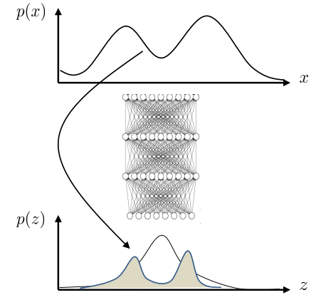
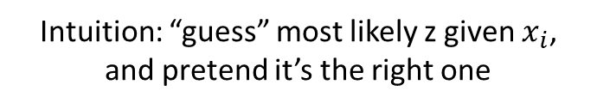


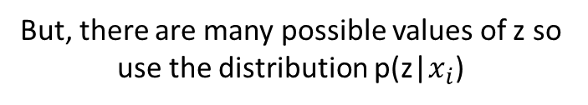
Estimating the log-likelihood
Alternative: expected log-likelihood
Intuition: “guess” most likely z given $x_{i}$, and pretend it’s the right one
$$θ←\underset{θ}{argmax}{\frac{1}{N}\sum_{i}{E_{z\sim p\left(z|x_{i}\right)}\left[logp_{θ}\left(x_{i}, z\right)\right]}}$$
But, there are many possible values of z so use the distribution p(z|$x_{i}$)
But, how do we calculate p(z|$x_{i}$)

Slide 11
Variational Inference

Slide 12



The variational approximation
$$\log{p\left(x_{i}\right)=\log{\int{p\left(x_{i}|z\right)p\left(z\right)}}}$$
$=\log{\int{p\left(x_{i}|z\right)p\left(z\right)}\frac{q_{i}\left(z\right)}{q_{i}\left(z\right)}}$
$=\log{E_{z\sim q_{i}\left(z\right)}}\left[\frac{p\left(x_{i}|z\right)p\left(z\right)}{q_{i}\left(z\right)}\right]$
But, how do we calculate p(z|$x_{i}$)
What if we approximate with $q_{i}\left(z\right)=N\left(μ_{i},σ_{i}\right)$
Can bound log p($x_{i}$) !

Slide 13

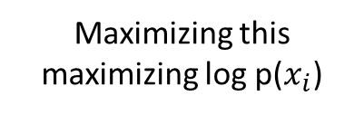



The variational approximation
$$\log{p\left(x_{i}\right)=\log{\int{p\left(x_{i}|z\right)p\left(z\right)}}}$$
$=\log{\int{p\left(x_{i}|z\right)p\left(z\right)}\frac{q_{i}\left(z\right)}{q_{i}\left(z\right)}}$
$=\log{E_{z\sim q_{i}\left(z\right)}}\left[\frac{p\left(x_{i}|z\right)p\left(z\right)}{q_{i}\left(z\right)}\right]$
$≥E_{z\sim q_{i}\left(z\right)}\left[\log{\frac{p\left(x_{i}|z\right)p\left(z\right)}{q_{i}\left(z\right)}}\right]$
$=E_{z\sim q_{i}\left(z\right)}\left[\log{p\left(x_{i}|z\right)+\log{p\left(z\right)}}\right]+H\left[q_{i}\right]$
But, how do we calculate p(z|$x_{i}$)
Jensen’s Inequality
$$\log{E\left[y\right]≥E\left[\log{y}\right]}$$
Can bound log p($x_{i}$) !
$$=E_{z\sim q_{i}\left(z\right)}\left[\log{p\left(x_{i}|z\right)+\log{p\left(z\right)}}\right]−E_{z\sim q_{i}\left(z\right)}\left[log q_{i}\left(z\right)\right]$$
Maximizing this maximizing log p($x_{i}$)

Slide 14
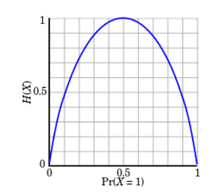
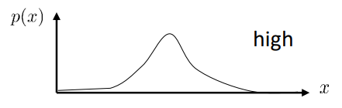
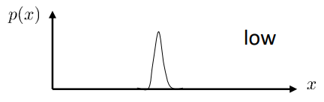
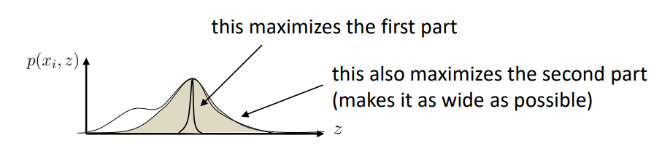

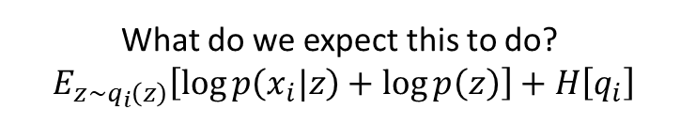
A brief aside
Entropy:
$$H\left[p\right]=−E_{z\sim p\left(x\right)}\left[\log{p\left(x\right)}\right]=−\int{p\left(x\right)\log{p\left(x\right)dx}}$$
Intuition 1: how random is the random variable?
Intuition 2: how large is the log probability in expectation under itself?
What do we expect this to do?
$E_{z\sim q_{i}\left(z\right)}\left[\log{p\left(x_{i}|z\right)+\log{p\left(z\right)}}\right]+H\left[q_{i}\right]$

Slide 15
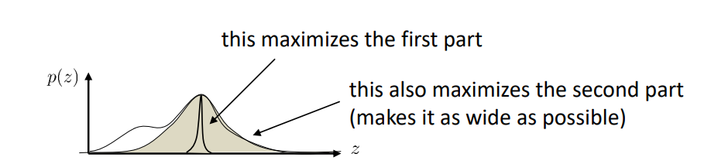


A brief aside
KL-Divergence:
$$D_{KL}\left(q||p\right)=E_{x\sim q(x)}\left[\log{\frac{q(x)}{p(x)}}\right]$$
Intuition 1: how different are two distributions?
Intuition 2: how small is the expected log probability of one distribution under another, minus entropy?
why entropy?
$$=E_{x\sim q(x)}\left[\log{q(x)}\right]−E_{x\sim q(x)}\left[log p\left(x\right)\right]$$
$$=−E_{x\sim q\left(x\right)}\left[log p\left(x\right)\right]−H(q)$$

Slide 16
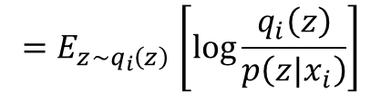


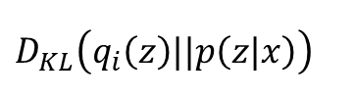



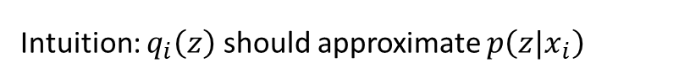
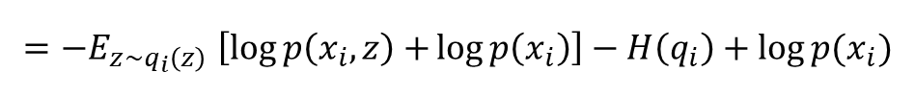

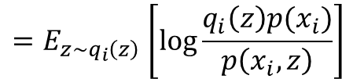
The variational approximation
$$ℒ_{i}\left(p_{i},q_{i}\right)$$
${\log{p\left(x_{i}\right)≥}E}_{z\sim q_{i}\left(z\right)}\left[\log{p\left(x_{i}|z\right)+\log{p\left(z\right)}}\right]+H\left[q_{i}\right]$
What makes a good $q_{i}\left(z\right)?$
Intuition: $q_{i}\left(z\right)$ should approximate $p\left(z|x_{i}\right)$
Approximate in what sense?
Compare in terms of KL-divergence: $D_{KL}\left(q_{i}\left(z\right)||p\left(z|x\right)\right)$
why?
$D_{KL}\left(q_{i}\left(z\right)||p\left(z|x\right)\right)$
$${=E}_{z\sim q_{i}\left(z\right)}\left[\log{\frac{q_{i}\left(z\right)}{p\left(z|x_{i}\right)}}\right]$$
$${=E}_{z\sim q_{i}\left(z\right)}\left[\log{\frac{q_{i}\left(z\right)p(x_{i})}{p\left(x_{i},z\right)}}\right]$$
$${=−E}_{z\sim q_{i}\left(z\right)}\left[\log{p\left(x_{i},z\right)+}\log{p\left(x_{i}\right)}\right]−H\left(q_{i}\right)+\log{p(x_{i})}$$
$${=−ℒ}_{i}\left(p_{i},q_{i}\right)+\log{p(x_{i})}$$
$$\log{p\left(x_{i}\right)=D_{KL}\left(q_{i}\left(z\right)||p\left(z|x\right)\right)+ℒ_{i}\left(p_{i},q_{i}\right)}$$
$$\log{p\left(x_{i}\right)≥ℒ_{i}\left(p_{i},q_{i}\right)}$$

Slide 17





The variational approximation
$$ℒ_{i}\left(p_{i},q_{i}\right)$$
${\log{p\left(x_{i}\right)≥}E}_{z\sim q_{i}\left(z\right)}\left[\log{p\left(x_{i}|z\right)+\log{p\left(z\right)}}\right]+H\left[q_{i}\right]$
$\log{p\left(x_{i}\right)=D_{KL}\left(q_{i}\left(z\right)||p\left(z|x\right)\right)+ℒ_{i}\left(p_{i},q_{i}\right)}$
$\log{p\left(x_{i}\right){≥ℒ}_{i}\left(p_{i},q_{i}\right)}$
Maximizing $ℒ_{i}\left(p,q_{i}\right)$ w.r.t. $q_{i}$ minimizes KL-divergence!
$$D_{KL}\left(q_{i}\left(z\right)||p\left(z|x\right)\right){=E}_{z\sim q_{i}\left(z\right)}\left[\log{\frac{q_{i}\left(z\right)}{p\left(z|x_{i}\right)}}\right]{=E}_{z\sim q_{i}\left(z\right)}\left[\log{\frac{q_{i}\left(z\right)p(x_{i})}{p\left(x_{i},z\right)}}\right]$$
$${=−E}_{z\sim q_{i}\left(z\right)}\left[\log{p\left(x_{i},z\right)+}\log{p\left(x_{i}\right)}\right]−H\left(q_{i}\right)+\log{p(x_{i})}$$
$${−ℒ}_{i}\left(p,q_{i}\right)$$
Independent of $q_{i}$

Slide 18
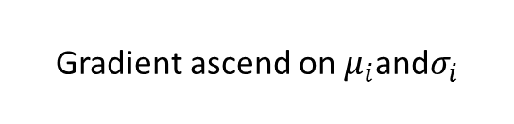
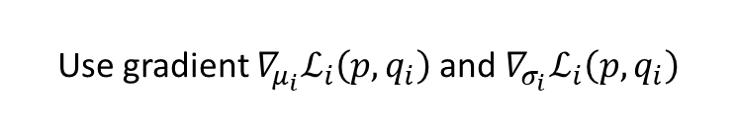

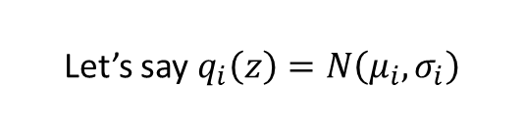
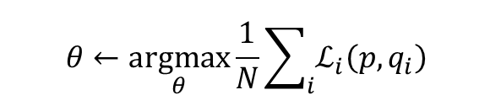
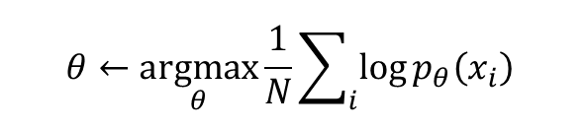
How do we use this?
$$ℒ_{i}\left(p_{i},q_{i}\right)$$
${\log{p\left(x_{i}\right)≥}E}_{z\sim q_{i}\left(z\right)}\left[\log{p\left(x_{i}|z\right)+\log{p\left(z\right)}}\right]+H\left[q_{i}\right]$
For each $x_{i}$ (or mini-batch):
calculate ${∇_{θ}ℒ}_{i}\left(p_{i},q_{i}\right)$
sample z$\sim q_{i}\left(z\right)$
${∇_{θ}ℒ}_{i}\left(p_{i},q_{i}\right)≈∇_{θ}log{ p}_{θ}\left(x_{i}|z\right)$
$θ←θ+α{∇_{θ}ℒ}_{i}\left(p,q_{i}\right)$
update $q_{i}$ to maximize ${∇_{θ}ℒ}_{i}\left(p,q_{i}\right)$
$$θ←\underset{θ}{argmax}{\frac{1}{N}\sum_{i}{\log{p_{θ}\left(x_{i}\right)}}}$$
$$θ←\underset{θ}{argmax}{\frac{1}{N}\sum_{i}{ℒ_{i}\left(p,q_{i}\right)}}$$
Let’s say $q_{i}\left(z\right)=N\left(μ_{i},σ_{i}\right)$
Use gradient ${∇_{μ_{i}}ℒ}_{i}\left(p,q_{i}\right)$ and ${∇_{σ_{i}}ℒ}_{i}\left(p,q_{i}\right)$
Gradient ascend on $μ_{i}$and$σ_{i}$
How?

Slide 19
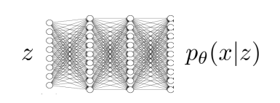
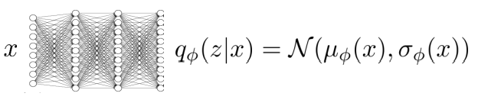
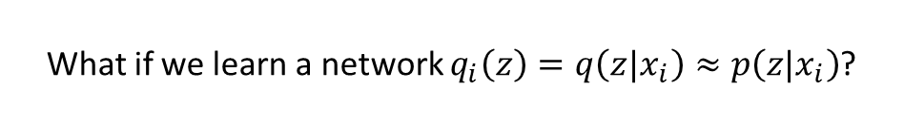
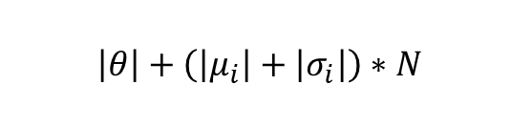

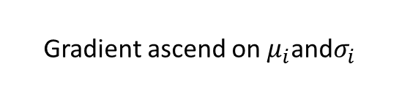
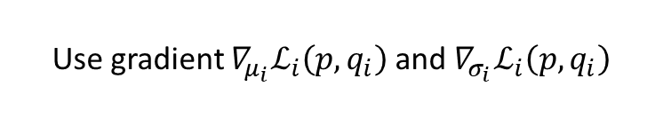
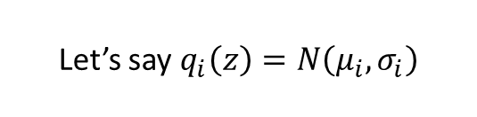
How do we use this?
$$ℒ_{i}\left(p_{i},q_{i}\right)$$
${\log{p\left(x_{i}\right)≥}E}_{z\sim q_{i}\left(z\right)}\left[\log{p\left(x_{i}|z\right)+\log{p\left(z\right)}}\right]+H\left[q_{i}\right]$
For each $x_{i}$ (or mini-batch):
calculate ${∇_{θ}ℒ}_{i}\left(p_{i},q_{i}\right)$
sample z$\sim q_{i}\left(z\right)$
${∇_{θ}ℒ}_{i}\left(p_{i},q_{i}\right)≈∇_{θ}log{ p}_{θ}\left(x_{i}|z\right)$
$θ←θ+α{∇_{θ}ℒ}_{i}\left(p,q_{i}\right)$
update $q_{i}$ to maximize ${∇_{θ}ℒ}_{i}\left(p,q_{i}\right)$
How many parameters are there?
intuition: $q_{i}\left(z\right)$ should approximate $p\left(z|x_{i}\right)$
Let’s say $q_{i}\left(z\right)=N\left(μ_{i},σ_{i}\right)$
Use gradient ${∇_{μ_{i}}ℒ}_{i}\left(p,q_{i}\right)$ and ${∇_{σ_{i}}ℒ}_{i}\left(p,q_{i}\right)$
Gradient ascend on $μ_{i}$and$σ_{i}$
$\left|θ\right|+\left(\left|μ_{i}\right|+\left|σ_{i}\right|\right)∗N$
What if we learn a network $q_{i}\left(z\right)=q\left(z|x_{i}\right)≈p\left(z|x_{i}\right)$?

Slide 20
Amortized Variational Inference

Slide 21

How do we use this?
$$ℒ_{i}\left(p_{i},q_{i}\right)$$
${\log{p\left(x_{i}\right)≥}E}_{z\sim q_{i}\left(z\right)}\left[\log{p\left(x_{i}|z\right)+\log{p\left(z\right)}}\right]+H\left[q_{i}\right]$
For each $x_{i}$ (or mini-batch):
calculate ${∇_{θ}ℒ}_{i}\left(p_{i},q_{i}\right)$
sample z$\sim q_{i}\left(z\right)$
${∇_{θ}ℒ}_{i}\left(p_{i},q_{i}\right)≈∇_{θ}log{ p}_{θ}\left(x_{i}|z\right)$
$θ←θ+α{∇_{θ}ℒ}_{i}\left(p,q_{i}\right)$
update $q_{i}$ to maximize ${∇_{θ}ℒ}_{i}\left(p,q_{i}\right)$
How many parameters are there?
intuition: $q_{i}\left(z\right)$ should approximate $p\left(z|x_{i}\right)$
Let’s say $q_{i}\left(z\right)=N\left(μ_{i},σ_{i}\right)$
Use gradient ${∇_{μ_{i}}ℒ}_{i}\left(p,q_{i}\right)$ and ${∇_{σ_{i}}ℒ}_{i}\left(p,q_{i}\right)$
Gradient ascend on $μ_{i}$and$σ_{i}$
$\left|θ\right|+\left(\left|μ_{i}\right|+\left|σ_{i}\right|\right)∗N$
What if we learn a network $q_{i}\left(z\right)=q\left(z|x_{i}\right)≈p\left(z|x_{i}\right)$?

Slide 22





Amortized variational inference
For each $x_{i}$ (or mini-batch):
calculate$∇_{θ}ℒ\left(p_{θ}\left(x_{i}|z\right),q_{∅}\left(z|x_{i}\right)\right)$
sample z$\sim q_{∅}\left(z|x_{i}\right)$
$∇_{θ}ℒ≈∇_{θ}log{ p}_{θ}\left(x_{i}|z\right)$
$θ←θ+α∇_{θ}ℒ$
$$∅←∅+α∇_{∅}ℒ$$
$$ℒ\left(p_{θ}\left(x_{i}|z\right),q_{∅}\left(z|x_{i}\right)\right)$$
$${\log{p\left(x_{i}\right)≥}E}_{z\sim q_{i}\left(z\right)}\left[\log{p\left(x_{i}|z\right)+\log{p\left(z\right)}}\right]+H\left[q_{i}\right]$$
How do we calculate this ?

Slide 23





Amortized variational inference
For each $x_{i}$ (or mini-batch):
calculate$∇_{θ}ℒ\left(p_{θ}\left(x_{i}|z\right),q_{∅}\left(z|x_{i}\right)\right)$
sample z$\sim q_{∅}\left(z|x_{i}\right)$
$∇_{θ}ℒ≈∇_{θ}log{ p}_{θ}\left(x_{i}|z\right)$
$θ←θ+α∇_{θ}ℒ$
$$∅←∅+α∇_{∅}ℒ$$
$$q_{∅}\left(z|x\right)=N\left(μ_{∅}\left(x\right),σ_{∅}\left(x\right)\right)$$
Formula for entropy of Gaussian
$${\log{p\left(x_{i}\right)≥}E}_{z\sim q_{i}\left(z\right)}\left[\log{p\left(x_{i}|z\right)+\log{p\left(z\right)}}\right]+H\left[q_{i}\right]$$
$$J\left(∅\right)=E_{z\sim q_{i}\left(z|x_{i}\right)}\left[r\left(x_{i}|z\right)\right]$$
Can just use policy gradient
What’s wrong with this gradient?
$$∇J\left(∅\right)≈\frac{1}{M}\sum_{j}{∇_{∅}\log{q_{∅}\left(z_{j}|x_{i}\right)r\left(x_{i},z_{j}\right)}}$$

Slide 24





The reparameterization trick
Is there a better way?
$$J\left(∅\right)=E_{z\sim q_{∅}\left(z|x_{i}\right)}\left[r\left(x_{i},z\right)\right]$$
$=E_{ε\sim N\left(0,1\right)}\left[r\left(x_{i},μ_{∅}\left(x_{i}\right)+εσ_{∅}\left(x_{i}\right)\right)\right]$
Estimating $∇_{∅}J\left(∅\right)$
sample $ε_{1}, …,ε_{M}$ from N(0,1) (a single sample works well)
$∇_{∅}J\left(∅\right)≈\frac{1}{M}\sum_{j}{∇_{∅}r\left(x_{i},μ_{∅}\left(x_{i}\right)+εσ_{∅}\left(x_{i}\right)\right)}$
$$q_{∅}\left(z|x\right)=N\left(μ_{∅}\left(x\right),σ_{∅}\left(x\right)\right)$$
$$z=μ_{∅}\left(x\right)+εσ_{∅}\left(x\right)$$
$$ε\sim N(0,1)$$
Independent of $∅$!
Most autodiff software (e.g. PyTorch) will compute this for you

Slide 25



Another way to look at it
$$ℒ_{i}\left(p_{i},q_{i}\right)=E_{z\sim q_{i}\left(z\right)}\left[\log{p_{θ}\left(x_{i}|z\right)+\log{p\left(z\right)}}\right]+H\left[q_{∅}\left(z|x_{i}\right)\right]$$
$=E_{z\sim q_{i}\left(z\right)}\left[\log{p_{θ}\left(x_{i}|z\right)}\right]+E_{z\sim q_{i}\left(z\right)}\left[\log{p\left(z\right)}\right]+H\left[q_{∅}\left(z|x_{i}\right)\right]$
$$−D_{KL}\left(q_{∅}\left(z|x_{i}\right)||p\left(z\right)\right)$$
This often has a convenient analytical form e.g. KL-divergence for Gaussian
$=E_{z\sim q_{i}\left(z\right)}\left[\log{p_{θ}\left(x_{i}|z\right)}\right]−D_{KL}\left(q_{∅}\left(z|x_{i}\right)||p\left(z\right)\right)$
$=E_{ε\sim N\left(0,1\right)}\left[\log{p_{θ}\left(x_{i}|μ_{∅}\left(x_{i}\right)+εσ_{∅}\left(x_{i}\right)\right)}\right]−D_{KL}\left(q_{∅}\left(z|x_{i}\right)||p\left(z\right)\right)$
$≈\log{p_{θ}\left(x_{i}|μ_{∅}\left(x_{i}\right)+εσ_{∅}\left(x_{i}\right)\right)}−D_{KL}\left(q_{∅}\left(z|x_{i}\right)||p\left(z\right)\right)$

Slide 26
Reparameterization trick vs. policy gradient
Policy gradient
Can handle both discrete and continuous latent variables
High variance, requires multiple samples & small learning rates
Reparameterization trick
Only continuous latent variables
Very simple to implement
Low variance

Slide 27
Example Models

Slide 28






The variational autoencoder
$$q_{∅}\left(z|x\right)=N\left(μ_{∅}\left(x\right),σ_{∅}\left(x\right)\right)$$
$$p_{θ}\left(x|z\right)=N\left(μ_{θ}\left(x\right),σ_{θ}\left(x\right)\right)$$
$$\max_{θ,∅}{\frac{1}{N}\sum_{i}{\log{p_{θ}\left(x_{i}|μ_{∅}\left(x_{i}\right)+εσ_{∅}\left(x_{i}\right)\right)}−D_{KL}\left(q_{∅}\left(z|x_{i}\right)||p\left(z\right)\right)}}$$

Slide 29


Using the variational autoencoder
$$q_{∅}\left(z|x\right)=N\left(μ_{∅}\left(x\right),σ_{∅}\left(x\right)\right)$$
$$p_{θ}\left(x|z\right)=N\left(μ_{θ}\left(x\right),σ_{θ}\left(x\right)\right)$$
$$p\left(x\right)=\int{p\left(x|z\right)p\left(z\right)dz}$$
Why does this work?
Sampling:
$$z\sim p(z)$$
$$x\sim p(x|z)$$
$$ℒ_{i}\left(p_{i},q_{i}\right)=E_{z\sim q_{i}\left(z\right)}\left[\log{p_{θ}\left(x_{i}|z\right)}\right]−D_{KL}\left(q_{∅}\left(z|x\right)||p(z)\right)$$

Slide 30



Conditional models
Can optionally depend on x
$$ℒ_{i}\left(p_{i},q_{i}\right)=E_{z\sim q_{i}\left(z\right)}\left[\log{p_{θ}\left(y_{i}|x_{i},z\right)+\log{p\left(z|x_{i}\right)}}\right]+H\left[q_{∅}\left(z|x_{i},y_{i}\right)\right]$$
Just like before, only now generating $y_{i}$ and everything is conditioned on $x_{i}$
At test time:
$$z\sim p(z|x_{i})$$
$$y\sim p(y|x_{i},z)$$

Slide 31
References
Levine, “CS285: Deep Reinforcement Learning”, UC Berkeley.

