Slide 1
Model-Free Control
Chia-Yi Su
Department of Electronic Engineering
National Kaohsiung University of Science and Technology

Slide 2
Course Outline
Introduction to Reinforcement Learning
Markov Decision Processes
Planning by Dynamic Programming
Model-Free Prediction
Model-Free Control
Neural Network
Value Function Approximation
Policy Gradient

Slide 3
Today’s Agenda
Introduction
On-Policy Monte-Carlo Control
On-Policy Temporal-Difference Learning
Off-Policy Learning

Slide 4
Introduction

Slide 5
Model-Free Reinforcement Learning
Model-Free Prediction
Estimate the value function of an unknown MDP
Model-Free Control
Optimize the value function of an unknown MDP

Slide 6
Uses of Model-Free Control
Elevator
Ship Steering
Helicopter
Portfolio Management
Robot Walking
Game of Go
For most of these problems, either:
MDP model is unknown, but experience can be sampled
MDP model is known, but is too big to use, except by samples
Model-free control can solve these problems

Slide 7
On and Off-Policy Learning
On-Policy Learning
Learning from agent’s own behavior
Learn about policy π from experience sampled from π
Off-Policy Learning
Look over someone’s shoulder
Learn about policy π from experience sampled from µ

Slide 8
On-Policy Monte-Carlo Control

Slide 9
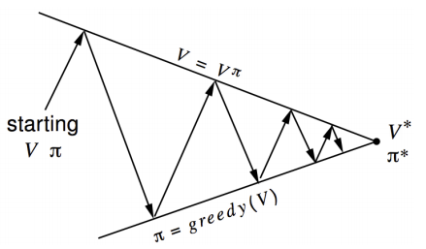

Generalized Policy Iteration (Refresher)
Policy Evaluation Estimate $v_{π}$
e.g. Iterative Policy Evaluation
Policy Improvement Generate $π^{′} ≥ π$
Greedy policy improvement

Slide 10
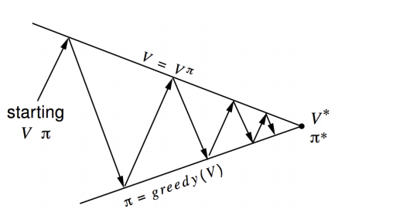

Generalized Policy Iteration With Monte-Carlo Evaluation
Policy Evaluation: Monte-Carlo Policy Evaluation, V = $v_{π}$?
Policy Improvement: Greedy Policy Improvement?

Slide 11

Model-Free Policy Iteration Using Action-Value Function
Greedy policy improvement over V(s) requires model of MDP
$$π^{′}\left(s\right)=a\underset{a ∈A}{rgmax}{R_{s}^{a}+ P_{ss^{′}}^{a} V(s^{′})}$$
Greedy policy improvement over Q(s, a) is model-free
$$π^{′}\left(s\right)=a\underset{a ∈A}{rgmax}{\text{Q}\text{(}\text{s}\text{, }\text{a}\text{)}}$$

Slide 12
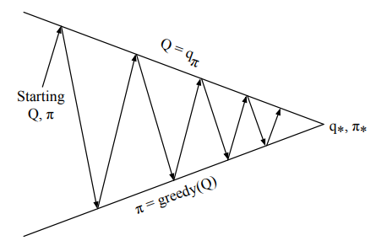

Generalized Policy Iteration with Action-Value Function
Policy Evaluation: Monte-Carlo Policy Evaluation, Q = $q_{π}$
Policy Improvement: Greedy Policy Improvement ?

Slide 13
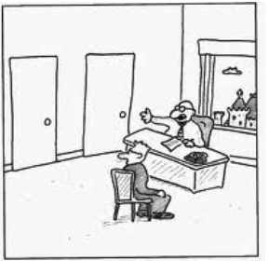
Example of Greedy Action Selection
There are two doors in front of you.
You open the left door and get reward 0
V(left) = 0
You open the right door and get reward +1
V(right) = +1
You open the right door and get reward +3
V(right) = +2
You open the right door and get reward +2
V(right) = +2
. . .
Are you sure you’ve chosen the best door?

Slide 14
ε-Greedy Exploration
Simplest idea for ensuring continual exploration
All m actions are tried with non-zero probability
With probability ε choose an action at random
With probability 1 − ε choose the greedy action

Slide 15
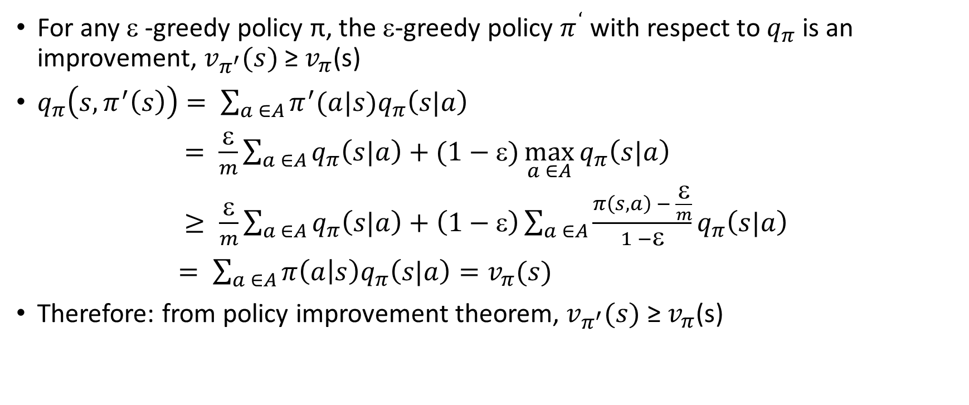
ε-Greedy Policy Improvement
For any ε -greedy policy π, the ε-greedy policy $π^{‘}$ with respect to $q_{π}$ is an improvement, $v_{π^{′}}(s)$ ≥ $v_{π}$(s)
$q_{π}\left(s, π^{′}\left(s\right)\right)= \sum_{a ∈A}{π^{′}(a|s)q_{π}\left(s|a\right)}$
$= \frac{\text{ε}}{m}\sum_{a ∈A}{q_{π}\left(s|a\right)+(1−\text{ε})\max_{a ∈A}{q_{π}\left(s|a\right)}}$
$≥ \frac{\text{ε}}{m}\sum_{a ∈A}{q_{π}\left(s|a\right)+\left(1−\text{ε}\right)\sum_{a ∈A}{\frac{π\left(s,a\right) − \frac{\text{ε}}{m}}{1 −\text{ε}}q_{π}\left(s|a\right)} }$
$= \sum_{a ∈A}{π\left(a | s\right)q_{π}\left(s|a\right)=v_{π}(s)}$
Therefore: from policy improvement theorem, $v_{π^{′}}(s)$ ≥ $v_{π}$(s)

Slide 16
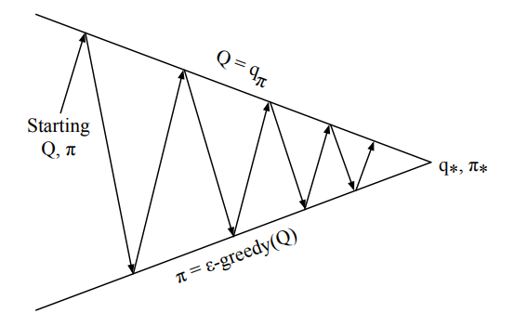

Monte-Carlo Policy Iteration
Policy Evaluation: Monte-Carlo Policy Evaluation, Q = $q_{π}$
Policy Improvement: ε-Greedy Policy Improvement

Slide 17
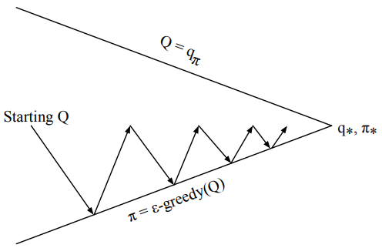

Monte-Carlo Control
Every Episode:
Policy Evaluation: Monte-Carlo Policy Evaluation, Q = $q_{π}$
Policy Improvement: ε-Greedy Policy Improvement

Slide 18
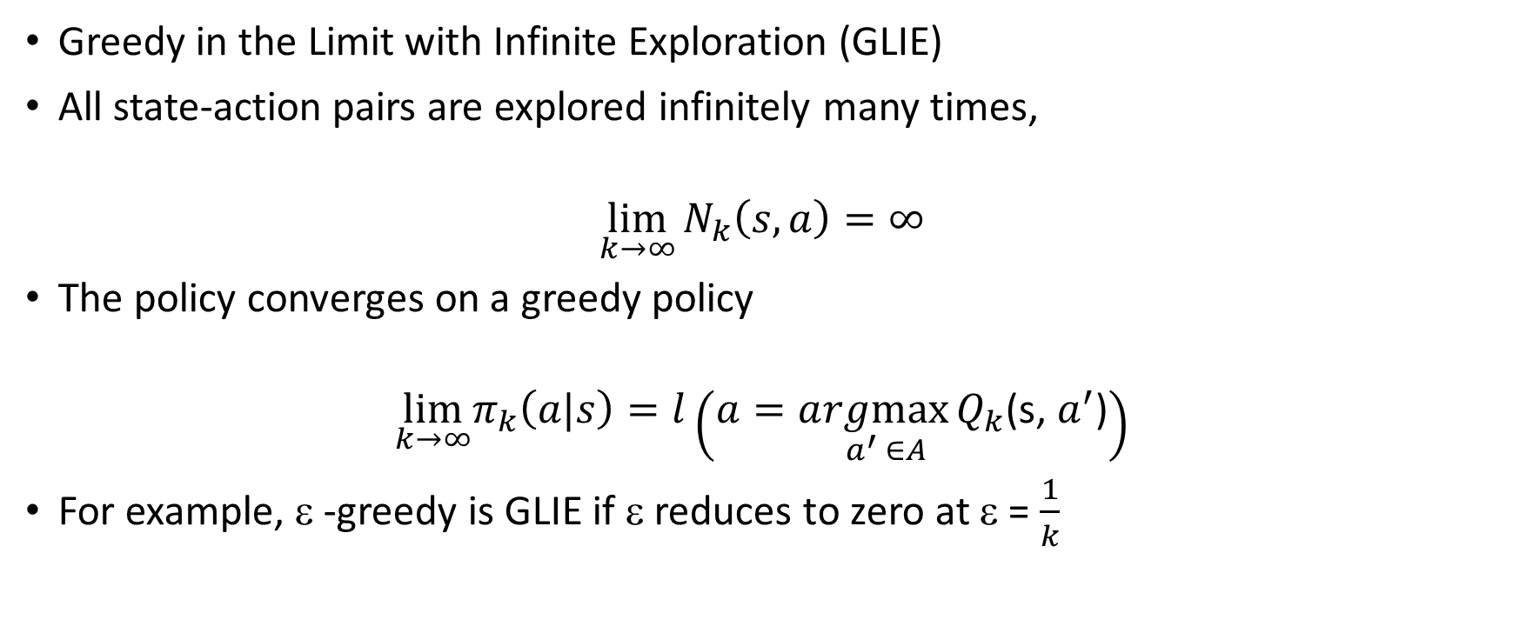
GLIE
Greedy in the Limit with Infinite Exploration (GLIE)
All state-action pairs are explored infinitely many times,
$$\lim_{k→∞}{N_{k}\left(s,a\right)=∞}$$
The policy converges on a greedy policy
$$\lim_{k→∞}π_{k}\left(a|s\right)=l\left(a=a\underset{a^{′} ∈A}{rgmax}{Q_{k}\text{(}\text{s}\text{, }a^{′}\text{)}}\right)$$
For example, ε -greedy is GLIE if ε reduces to zero at ε = $\frac{1}{k}$

Slide 19
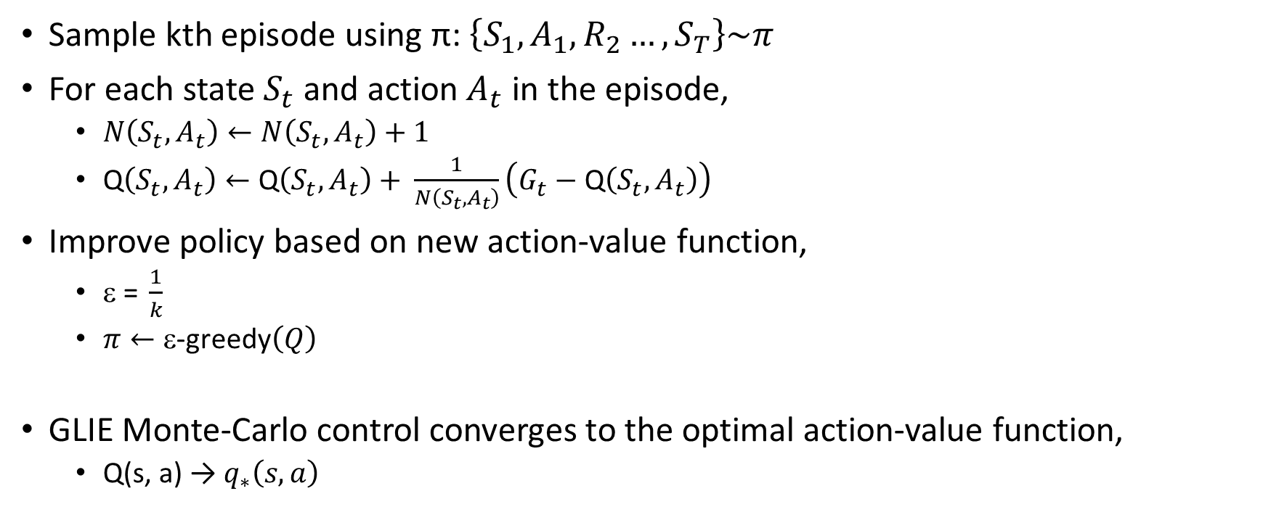
GLIE Monte-Carlo Control
Sample kth episode using π: $\left\{S_{1}, A_{1},R_{2}…, S_{T}\right\}\sim π$
For each state $S_{t}$ and action $A_{t}$ in the episode,
$N\left(S_{t},A_{t}\right)←N\left(S_{t},A_{t}\right)+1$
Q$\left(S_{t},A_{t}\right)←\text{Q}\left(S_{t},A_{t}\right)+ \frac{1}{N\left(S_{t},A_{t}\right)}\left(G_{t}−\text{Q}\left(S_{t},A_{t}\right)\right)$
Improve policy based on new action-value function,
$\text{ }\text{= }\frac{1}{k}$
$π←\text{ε}\text{−}\text{greedy}\left(Q\right)$
GLIE Monte-Carlo control converges to the optimal action-value function,
Q(s, a) → $q_{∗}\left(s,a\right)$

Slide 20
On-Policy Temporal-Difference Learning

Slide 21
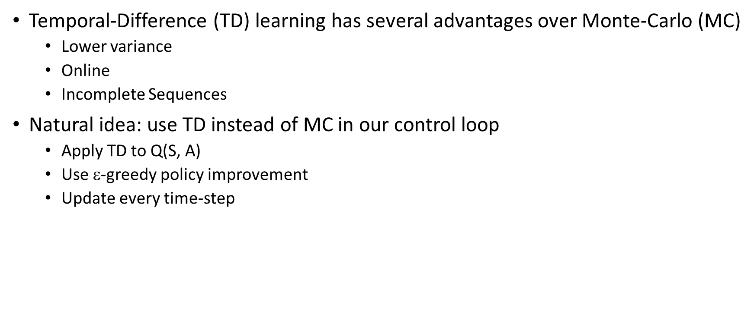
MC vs. TD Control
Temporal-Difference (TD) learning has several advantages over Monte-Carlo (MC)
Lower variance
Online
Incomplete Sequences
Natural idea: use TD instead of MC in our control loop
Apply TD to Q(S, A)
Use $\text{}$-greedy policy improvement
Update every time-step

Slide 22
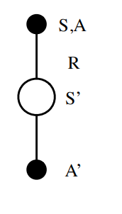

Updating Action-Value Functions with Sarsa
$\text{Q}\text{(}\text{S}\text{, }\text{A}\text{)}=\text{Q}\text{(}\text{S}\text{, }\text{A}\text{) + }α \left(R+γ\text{Q}\left(S^{′},A^{′}\right)−\text{Q}\text{(}\text{S}\text{, }\text{A}\text{)}\right)$

Slide 23
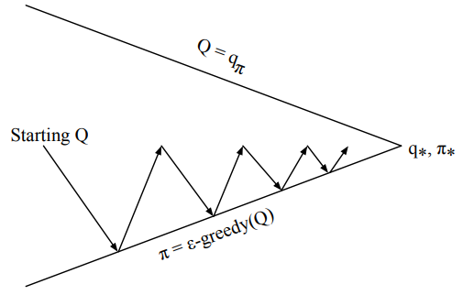

On-Policy Control With Sarsa
Every time-step:
Policy Evaluation: Sarsa, Q $≈q_{π}$
Policy Improvement: ε-greedy policy improvement

Slide 24
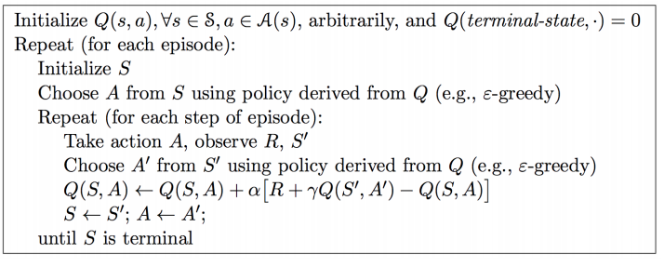
Sarsa Algorithm for On-Policy Control

Slide 25

Convergence of Sarsa
Sarsa converges to the optimal action-value function, Q(s, a) → $q_{∗}\left(s,a\right)$, under the following conditions:
GLIE sequence of policies $π_{t}\left(a|s\right)$
Robbins-Monro sequence of step-sizes ${\text{α}}_{t}$
$\sum_{t=1}^{∞}{α_{t}=∞}$
$\sum_{t=1}^{∞}{α_{t}^{2}<∞}$

Slide 26
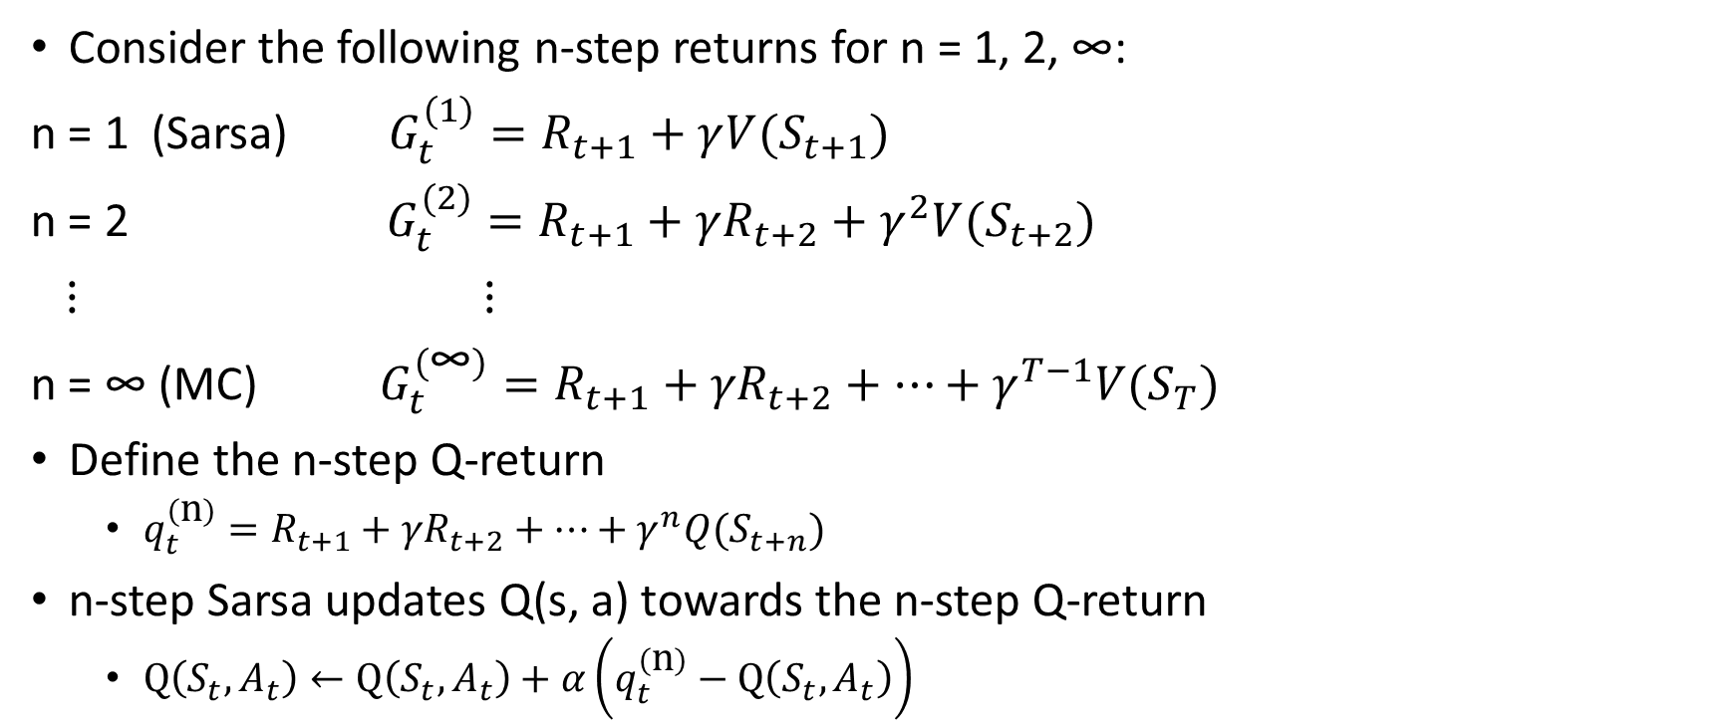
n-Step Sarsa
Consider the following n-step returns for n = 1, 2, ∞:
n = 1 (Sarsa) $G_{t}^{(1)}=R_{t+1}+γ{V(S}_{t+1})$
n = 2 $G_{t}^{(2)}=R_{t+1}+γR_{t+2}+γ^{2}{V(S}_{t+2})$
$⋮$ $⋮$
n = ∞ (MC) $G_{t}^{\left(\text{∞}\right)}=R_{t+1}+{γR}_{t+2}+⋯+γ^{T−1}{V(S}_{T})$
Define the n-step Q-return
$q_{t}^{\left(\text{n}\right)}=R_{t+1}+{γR}_{t+2}+⋯+γ^{n}{Q(S}_{t+n})$
n-step Sarsa updates Q(s, a) towards the n-step Q-return
$Q\left(S_{t},A_{t}\right)←Q\left(S_{t},A_{t}\right)+α\left(q_{t}^{\left(\text{n}\right)}−Q\left(S_{t},A_{t}\right)\right)$

Slide 27
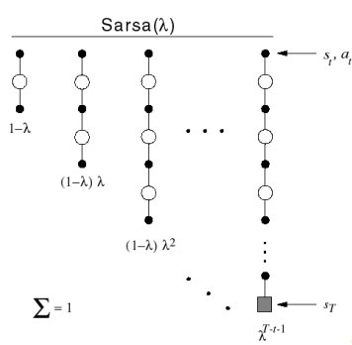
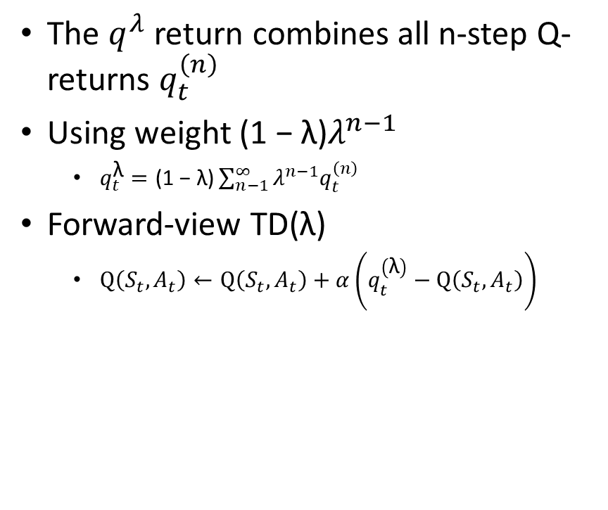
Forward View Sarsa(λ)
The $q^{λ}$ return combines all n-step Q-returns $q_{t}^{\left(n\right)}$
Using weight ${\text{(1 − }\text{λ}\text{)}λ}^{n−1}$
$q_{t}^{\text{λ}}=\text{(1 − }\text{λ}\text{)}\sum_{n−1}^{∞}{λ^{n−1}q_{t}^{\left(n\right)}}$
Forward-view TD(λ)
$Q\left(S_{t},A_{t}\right)←Q\left(S_{t},A_{t}\right)+α\left(q_{t}^{\left(\text{λ}\right)}−Q\left(S_{t},A_{t}\right)\right)$

Slide 28
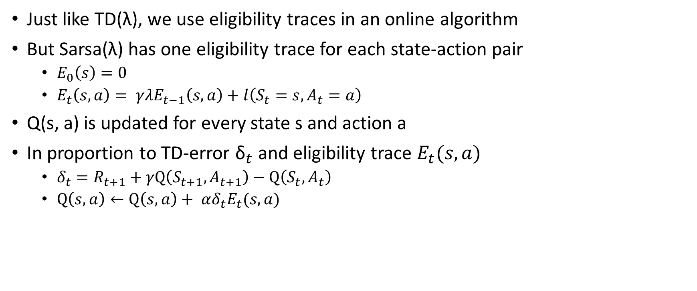
Backward View Sarsa(λ)
Just like TD(λ), we use eligibility traces in an online algorithm
But Sarsa(λ) has one eligibility trace for each state-action pair
$E_{0}\left(s\right)=0$
$E_{t}\left(s, a\right)= γλE_{t−1}\left(s, a\right)+l\left(S_{t}=s,A_{t}=a\right)$
Q(s, a) is updated for every state s and action a
In proportion to TD-error ${\text{δ}}_{t}$ and eligibility trace $E_{t}(s,a)$
$δ_{t}=R_{t+1}+γQ\left(S_{t+1},A_{t+1}\right)−Q\left(S_{t},A_{t}\right)$
$Q\left(s,a\right)←Q\left(s,a\right)+ αδ_{t}E_{t}(s, a)$

Slide 29
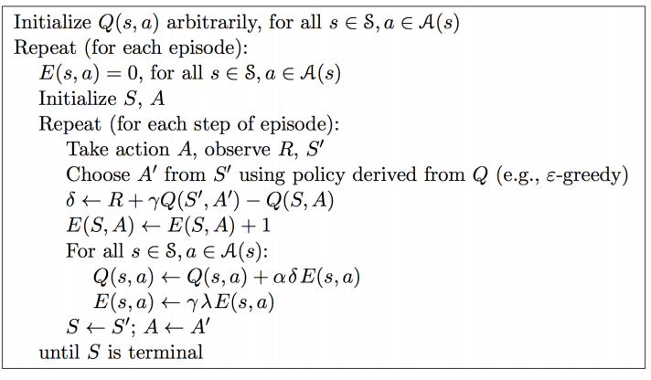
Sarsa(λ) Algorithm

Slide 30
Off-Policy Learning

Slide 31
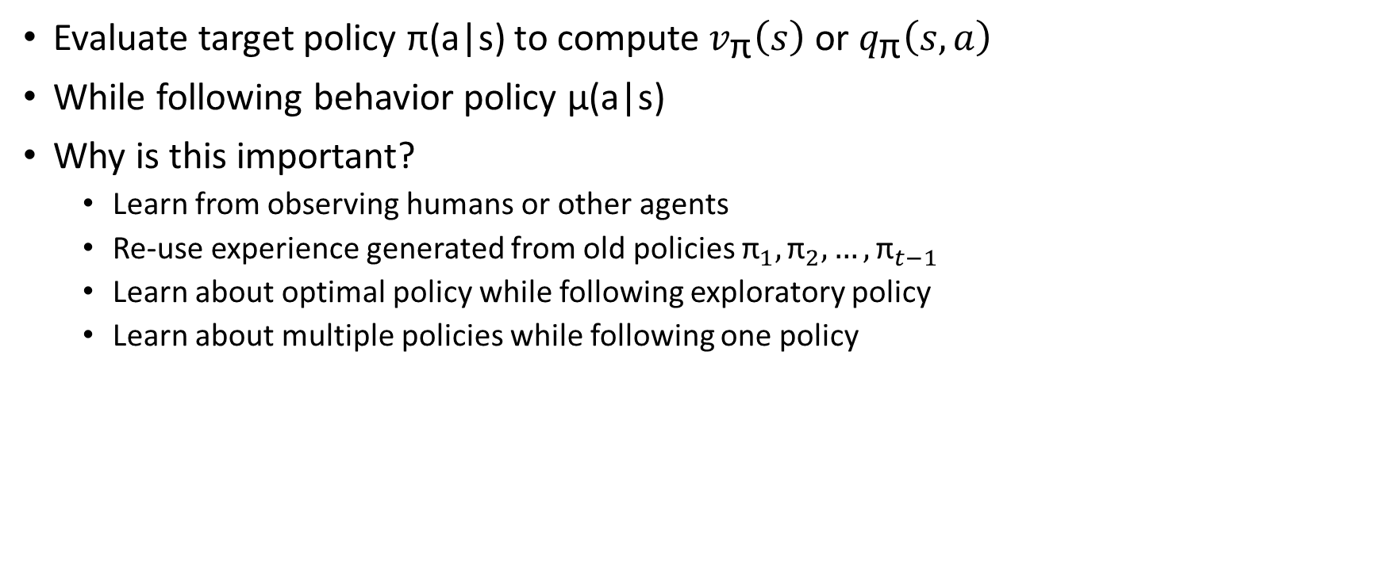
Off-Policy Learning
Evaluate target policy π(a|s) to compute $v_{\text{π}}\left(s\right)$ or $q_{\text{π}}\left(s, a\right)$
While following behavior policy µ(a|s)
Why is this important?
Learn from observing humans or other agents
Re-use experience generated from old policies ${\text{π}}_{1},{\text{π}}_{2}, …,{\text{π}}_{t−1}$
Learn about optimal policy while following exploratory policy
Learn about multiple policies while following one policy

Slide 32
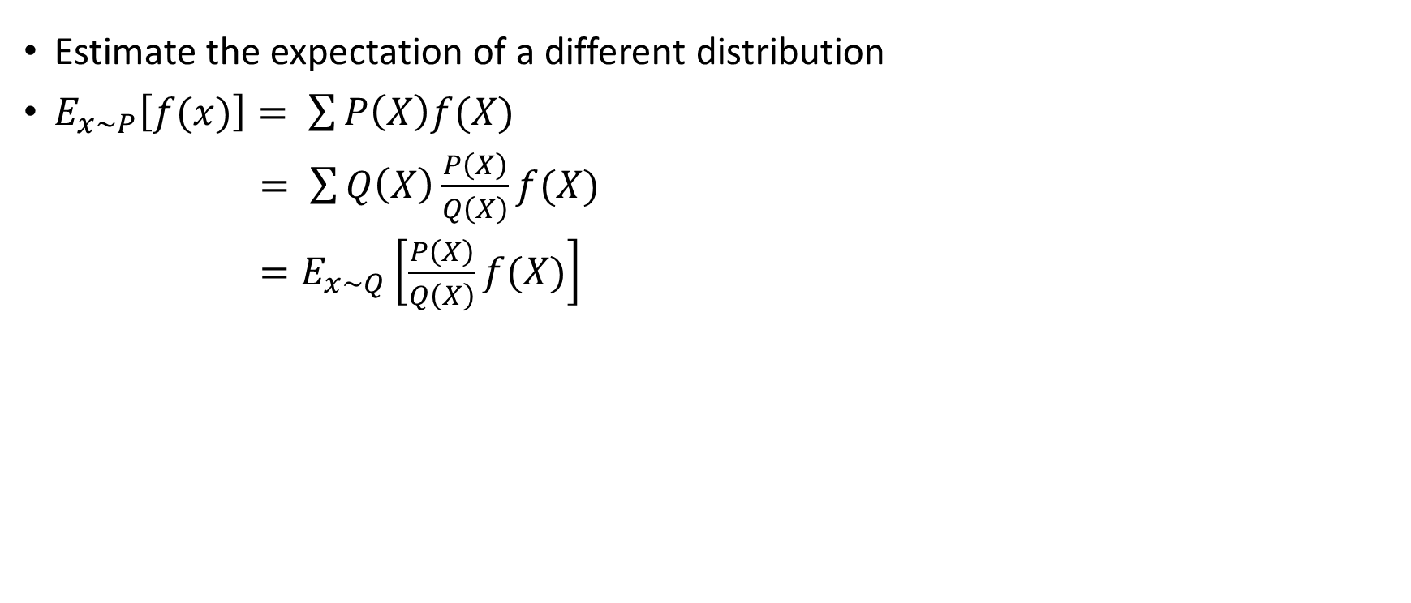
Importance Sampling
Estimate the expectation of a different distribution
$E_{x\sim P}\left[f(x)\right]= \sum{P\left(X\right)f(X)}$
$= \sum{Q\left(X\right)\frac{P\left(X\right)}{Q\left(X\right)}f(X)}$
$=E_{x\sim Q}\left[\frac{P\left(X\right)}{Q\left(X\right)}f(X)\right]$

Slide 33
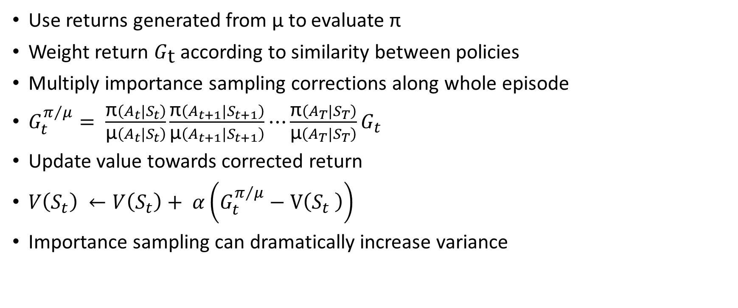
Importance Sampling for Off-Policy Monte-Carlo
Use returns generated from µ to evaluate π
Weight return $G_{\text{t}}$ according to similarity between policies
Multiply importance sampling corrections along whole episode
$G_{t}^{π/μ}= \frac{\text{π}\left({A_{t}|S}_{t}\right)}{\text{µ}\left({A_{t}|S}_{t}\right)}\frac{\text{π}\left({A_{t+1}|S}_{t+1}\right)}{\text{µ}\left({A_{t+1}|S}_{t+1}\right)}⋯\frac{\text{π}\left({A_{T}|S}_{T}\right)}{\text{µ}\left({A_{T}|S}_{T}\right)}G_{t}$
Update value towards corrected return
$V\left(S_{t}\right) ←V\left(S_{t}\right)+ α\left(G_{t}^{π/μ}−V\left(S_{t} \right)\right)$
Importance sampling can dramatically increase variance

Slide 34
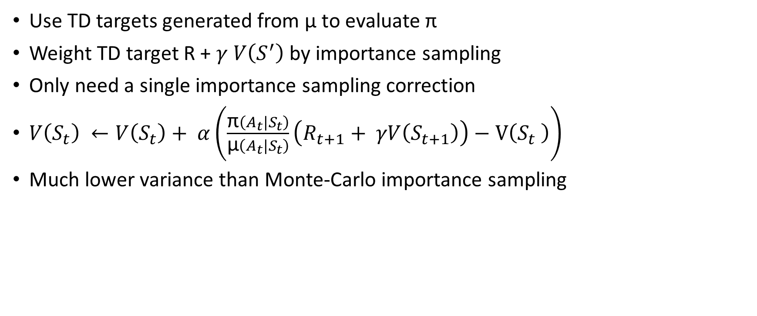
Importance Sampling for Off-Policy TD
Use TD targets generated from µ to evaluate π
Weight TD target R + $γ V\left(S^{′}\right)$ by importance sampling
Only need a single importance sampling correction
$V\left(S_{t}\right) ←V\left(S_{t}\right)+ α\left(\frac{\text{π}\left({A_{t}|S}_{t}\right)}{\text{µ}\left({A_{t}|S}_{t}\right)}\left(R_{t+1}+ γV\left(S_{t+1}\right)\right)−V\left(S_{t} \right)\right)$
Much lower variance than Monte-Carlo importance sampling

Slide 35
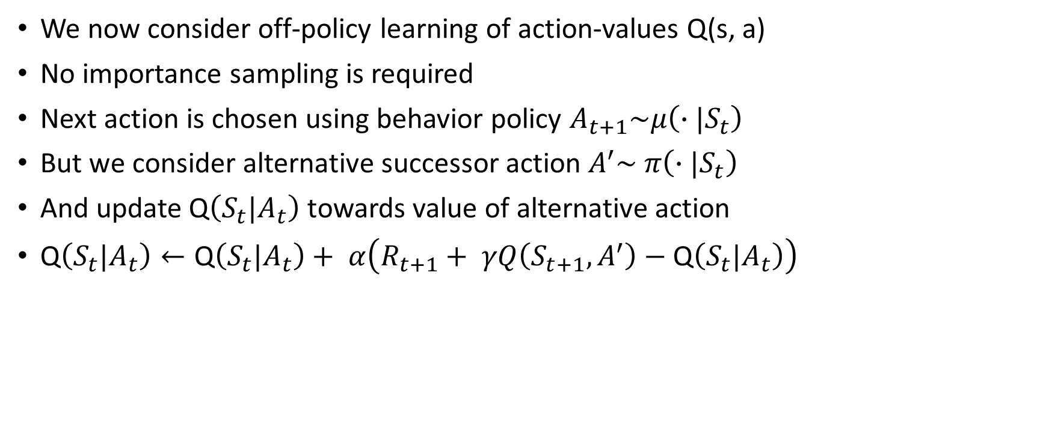
Q-Learning
We now consider off-policy learning of action-values Q(s, a)
No importance sampling is required
Next action is chosen using behavior policy $A_{t+1}\sim μ\left(∙|S_{t}\right)$
But we consider alternative successor action $A^{′}\sim π\left(∙|S_{t}\right)$
And update Q$\left(S_{t}|A_{t}\right)$ towards value of alternative action
Q$\left(S_{t}|A_{t}\right)←\text{Q}\left(S_{t}|A_{t}\right)+ α\left(R_{t+1}+ γQ\left(S_{t+1},A^{′}\right)−\text{Q}\left(S_{t}|A_{t}\right)\right)$

Slide 36
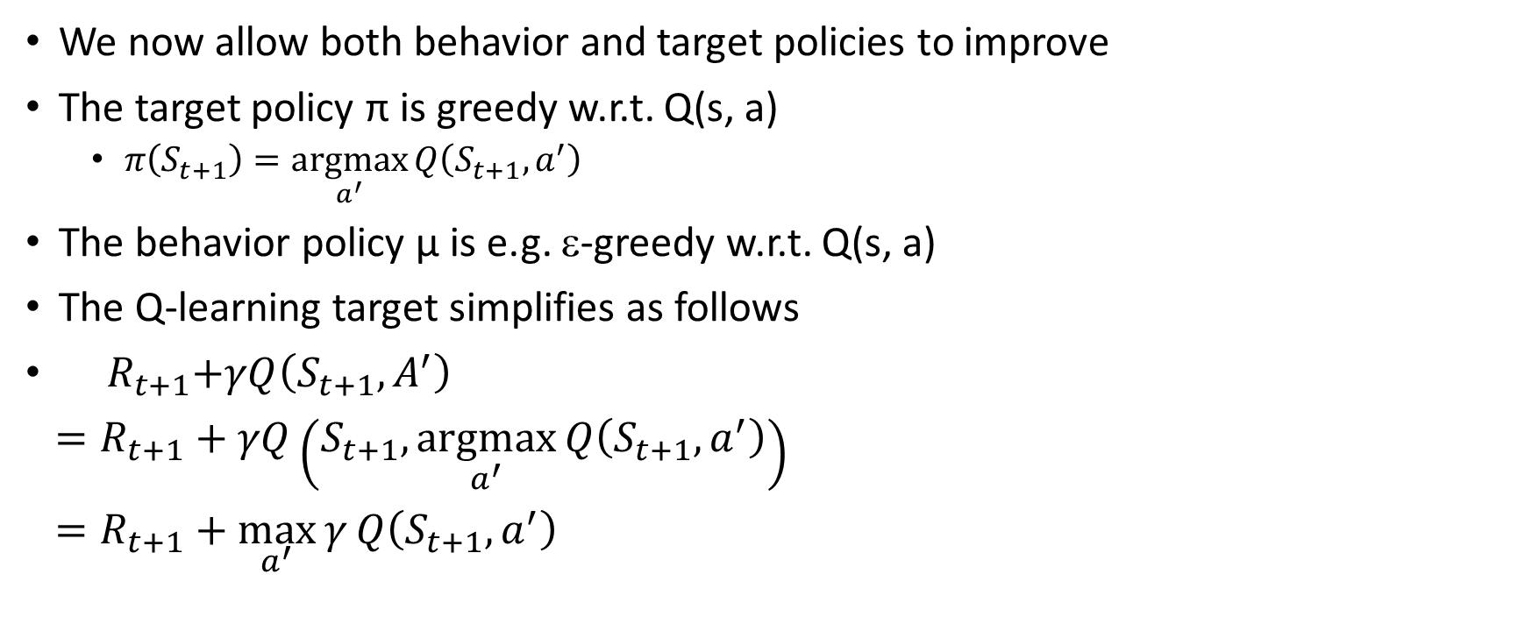
Off-Policy Control with Q-Learning
We now allow both behavior and target policies to improve
The target policy π is greedy w.r.t. Q(s, a)
$π\left(S_{t+1}\right)=\underset{a^{′}}{argmax}{Q\left(S_{t+1}, a^{′}\right)}$
The behavior policy µ is e.g. ε-greedy w.r.t. Q(s, a)
The Q-learning target simplifies as follows
${ R}_{t+1}+γQ\left(S_{t+1}, A^{′}\right)$
$=R_{t+1}+γQ\left(S_{t+1},\underset{a^{′}}{argmax}{Q\left(S_{t+1}, a^{′}\right)}\right)$
$=R_{t+1}+\max_{a^{′}}{γ}Q\left(S_{t+1},a^{′}\right)$

Slide 37
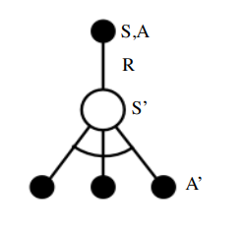

Q-Learning Control Algorithm
Q(S, A)$←\text{Q}\text{(}\text{S}\text{, }\text{A}\text{)}+\left(R+\max_{a^{′}}{γ}Q\left(S_{t+1},a^{′}\right)−\text{Q}\text{(}\text{S}\text{, }\text{A}\text{)}\right)$
Q-learning control converges to the optimal action-value function
Q(s, a)$→q_{∗}(s,a)$

Slide 38
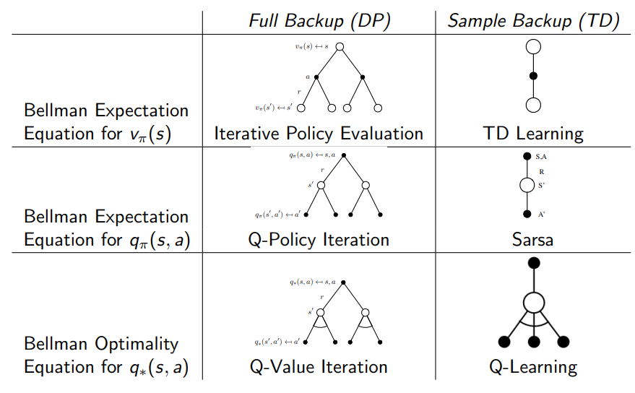
Relationship Between DP and TD

Slide 39
References
Silver, Introduction to Reinforcement Learning with David Silver, DeepMind x UCL.

