Slide 1
Policy Gradient
Lecturer: Chia-Yi Su
Advisor: Prof. Tsong-Yi Chen
Department of Electronic Engineering
National Kaohsiung University of Science and Technology
https://chiayisu.github.io/teaching/2022-spring-teaching

Slide 2
Course Outline
Introduction to Reinforcement Learning
Markov Decision Processes
Planning by Dynamic Programming
Model-Free Prediction
Model-Free Control
Neural Network
Value Function Approximation
Policy Gradient
Actor-Critic Algorithm
Dialog System (Including MultiModal Dialog System)

Slide 3
Today’s Agenda
Objective of Reinforcement Learning
Understanding Policy Gradients
Reducing Variance
Advanced Policy Gradient
Bounding the Distribution Change
Policy Gradients with Constraints
Natural Gradient

Slide 4
Objective of Reinforcement Learning

Slide 5
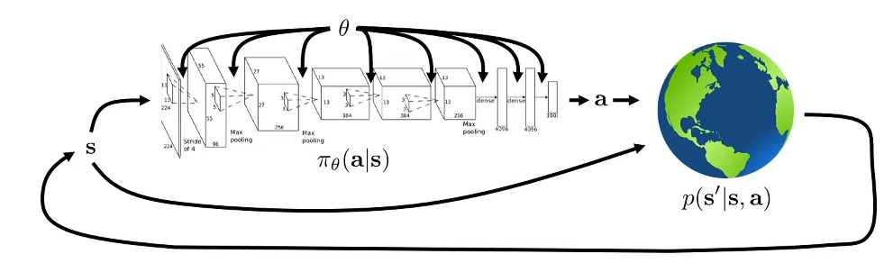
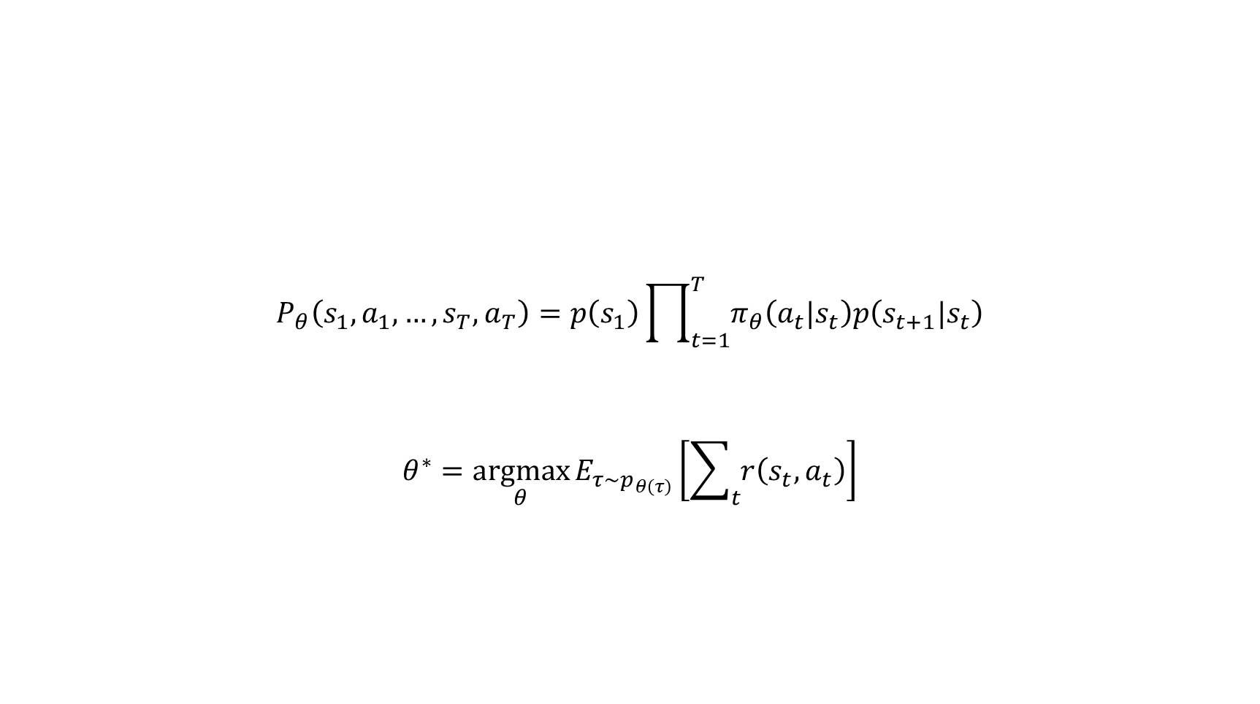

Objective of Reinforcement Learning
$$P_{θ}\left(s_{1}, a_{1},…, s_{T},a_{T}\right)=p\left(s_{1}\right)\prod_{t=1}^{T}{π_{θ}\left(a_{t}|s_{t}\right)p\left(s_{t+1}|s_{t}\right)}$$
$$θ^{∗}=\underset{θ}{argmax}{E_{τ\sim p_{θ\left(τ\right)}}\left[\sum_{t}{r\left(s_{t},a_{t}\right)}\right]}$$
$$τ$$

Slide 6


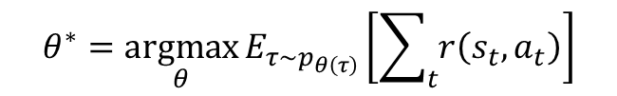
Objective of Reinforcement Learning
$$θ^{∗}=\underset{θ}{argmax}{E_{τ\sim p_{θ\left(τ\right)}}\left[\sum_{t}{r\left(s_{t},a_{t}\right)}\right]}$$
Infinite Horizon Case
$θ^{∗}=\underset{θ}{argmax}{E_{\left(s,a\right)\sim p_{θ\left(s,a\right)}}\left[r\left(s_{t},a_{t}\right)\right]}$
Finite Horizon Case
$θ^{∗}=\underset{θ}{argmax}{\sum_{t1=}^{T}{E_{\left(s_{t},a_{t}\right)\sim p_{θ\left(s_{t},a_{t}\right)}}\left[r\left(s_{t},a_{t}\right)\right]}}$

Slide 7
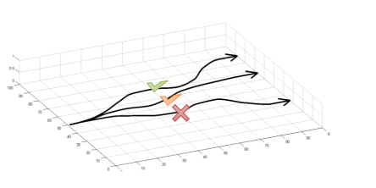
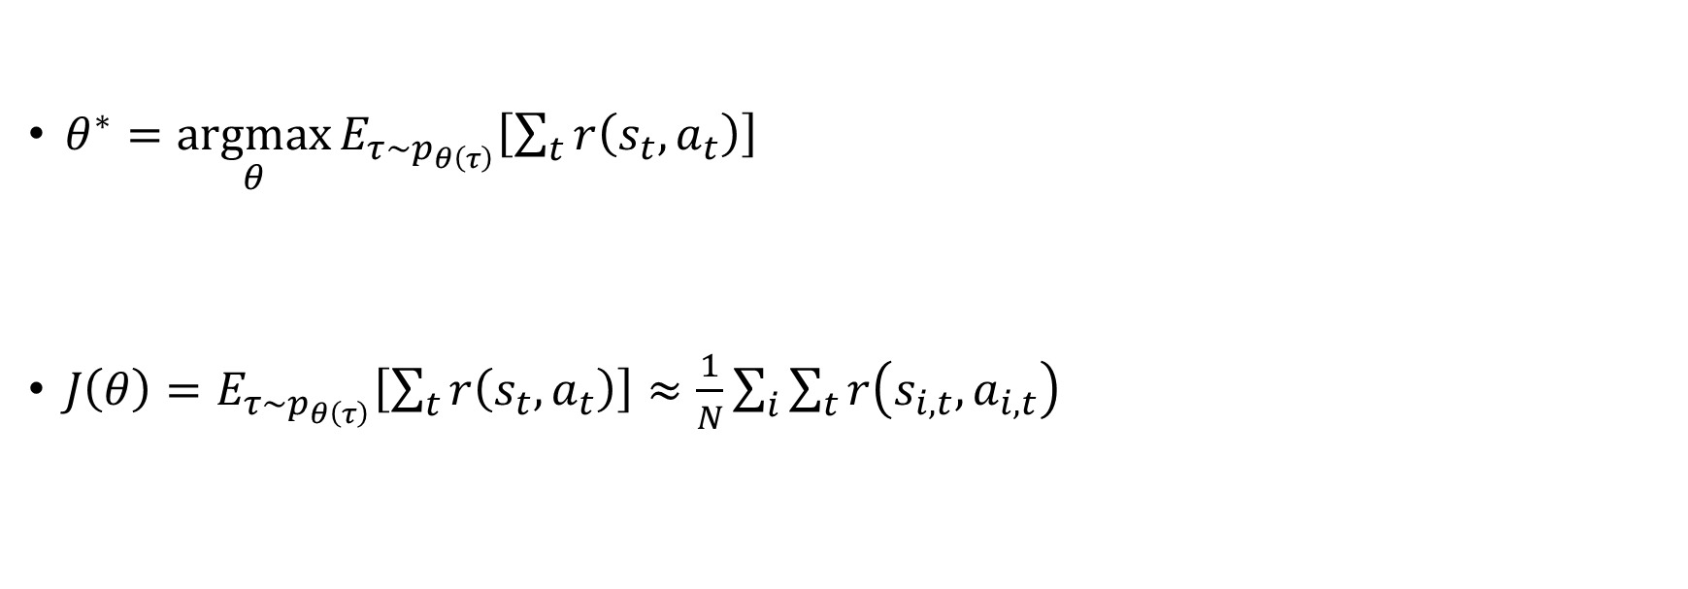
Objective Evaluation
$θ^{∗}=\underset{θ}{argmax}{E_{τ\sim p_{θ\left(τ\right)}}\left[\sum_{t}{r\left(s_{t},a_{t}\right)}\right]}$
$J\left(θ\right)=E_{τ\sim p_{θ\left(τ\right)}}\left[\sum_{t}{r\left(s_{t},a_{t}\right)}\right]≈\frac{1}{N}\sum_{i}{\sum_{t}{r\left(s_{i,t},a_{i,t}\right)}}$
J(θ)
Sum over sample from π(θ)

Slide 8

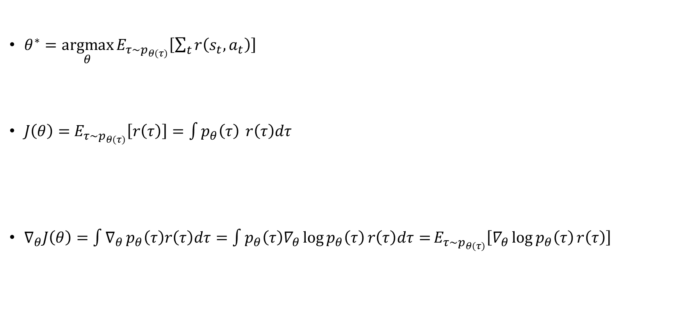

Direct Policy Differentiation
$θ^{∗}=\underset{θ}{argmax}{E_{τ\sim p_{θ\left(τ\right)}}\left[\sum_{t}{r\left(s_{t},a_{t}\right)}\right]}$
$J\left(θ\right)=$ $E_{τ\sim p_{θ\left(τ\right)}}\left[r\left(τ\right)\right]=\int{p_{θ}\left(τ\right)} r\left(τ\right)dτ$
$∇_{θ}J\left(θ\right)=\int{∇_{θ}}p_{θ}\left(τ\right)r\left(τ\right)dτ=\int{p_{θ}\left(τ\right)∇_{θ}\log{p_{θ}\left(τ\right)}r\left(τ\right)dτ=}E_{τ\sim p_{θ\left(τ\right)}}\left[∇_{θ}\log{p_{θ}\left(τ\right)}r\left(τ\right)\right]$
J(θ)
$$\sum_{t=1}^{T}{r\left(s_{t},a_{t}\right)}$$
$$∇_{θ}\log{p_{θ}\left(τ\right)}=\frac{∇_{θ}p_{θ}\left(τ\right)}{p_{θ}\left(τ\right)}$$

Slide 9

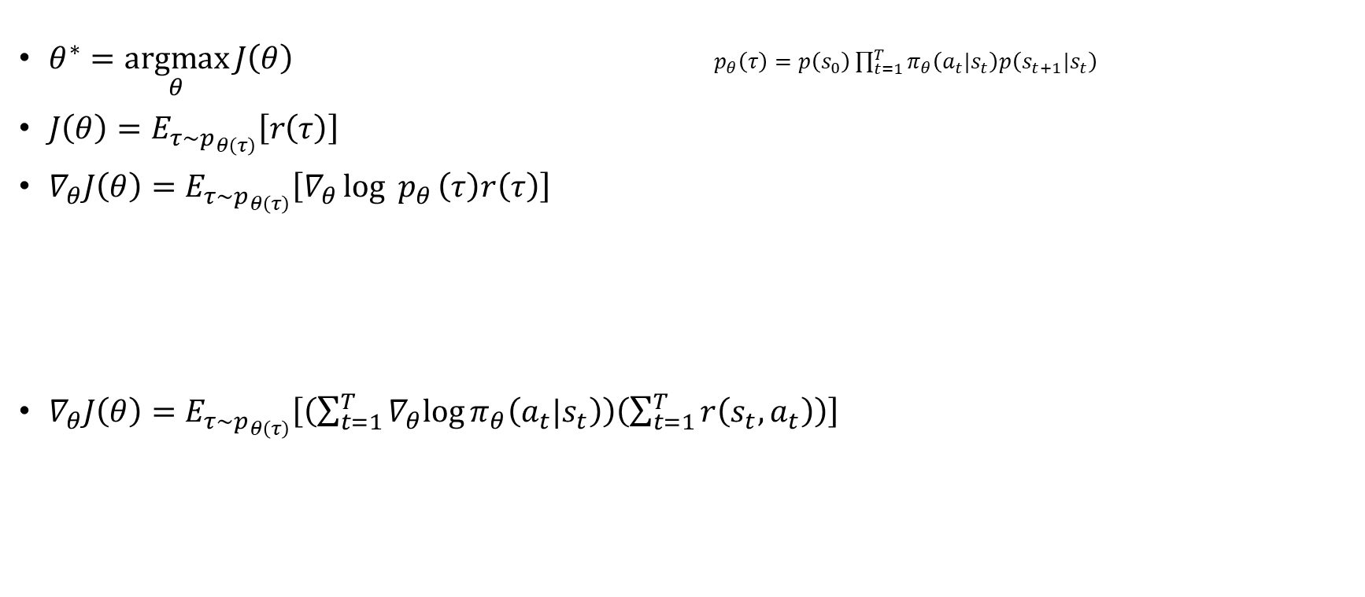
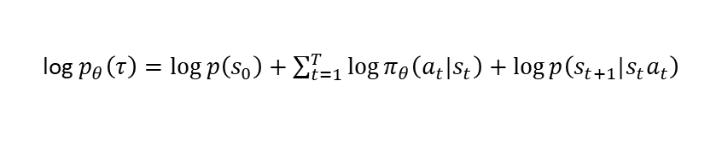
Direct Policy Differentiation (CONT.)
$θ^{∗}=\underset{θ}{argmax}{J\left(θ\right)}$ $p_{θ}\left(τ\right)=p\left(s_{0}\right)\prod_{t=1}^{T}{π_{θ}\left(a_{t}|s_{t}\right)p\left(s_{t+1}|s_{t}\right)}$
$J\left(θ\right)=E_{τ\sim p_{θ\left(τ\right)}}\left[r\left(τ\right)\right]$
$∇_{θ}J\left(θ\right)=E_{τ\sim p_{θ\left(τ\right)}}\left[∇_{θ}\log{{ p}_{θ}}\left(τ\right)r\left(τ\right)\right]$
$∇_{θ}J\left(θ\right)=E_{τ\sim p_{θ\left(τ\right)}}\left[\left(\sum_{t=1}^{T}{∇_{θ}log{π_{θ}\left(a_{t}|s_{t}\right)}}\right)\left(\sum_{t=1}^{T}{r\left(s_{t},a_{t}\right)}\right)\right]$
Log of both sides
log${ p}_{θ}\left(τ\right)=\log{p\left(s_{0}\right)+\sum_{t=1}^{T}{\log{π_{θ}\left(a_{t}|s_{t}\right)}}+\log{p\left(s_{t+1}|s_{t}a_{t}\right)}}$
$$∇_{θ}\left[\log{p\left(s_{1}\right)}+\sum_{t=1}^{T}{\log{π_{θ}\left(a_{t}|s_{t}\right)}}+\log{p\left(s_{t+1}|s_{t}a_{t}\right)}\right]$$

Slide 10
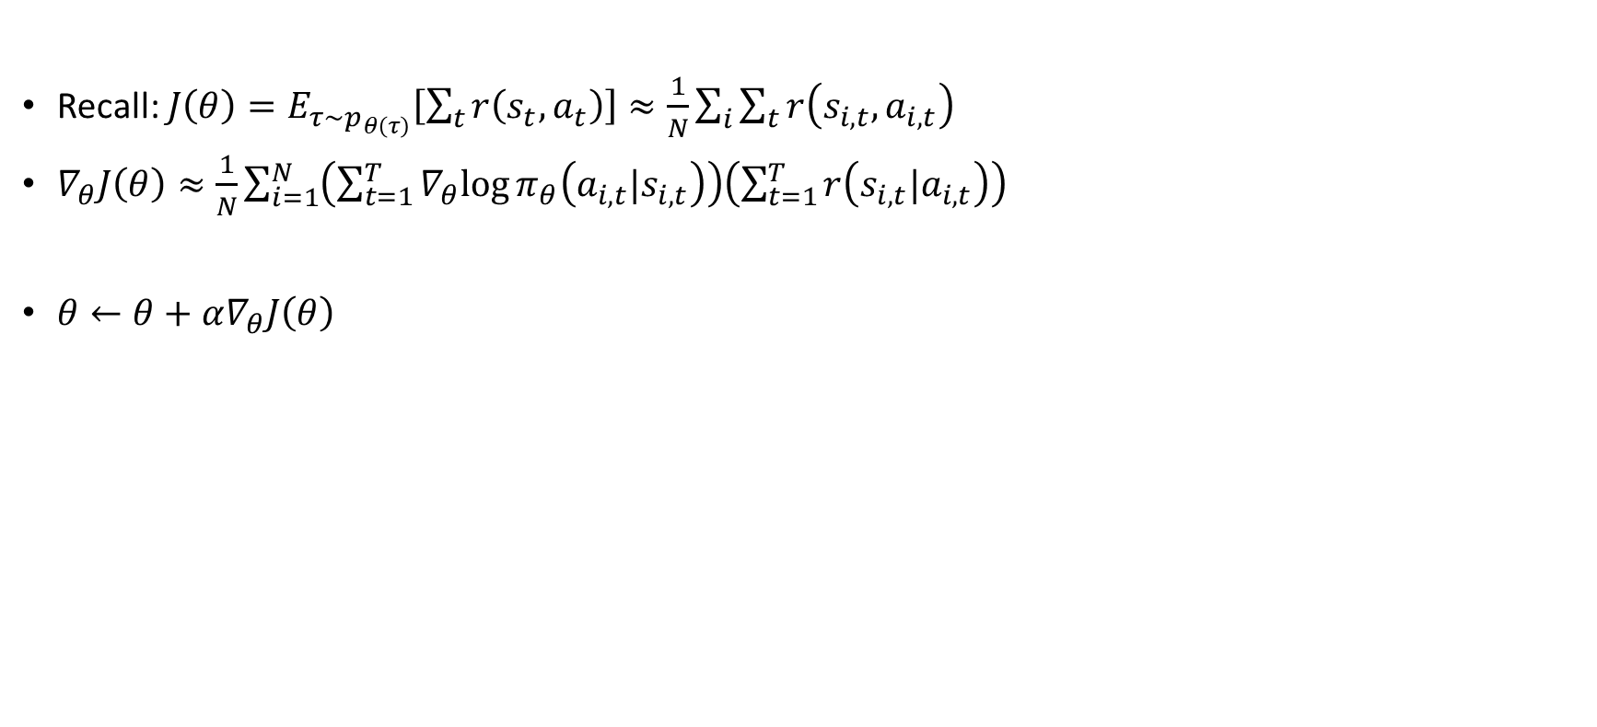
Policy Gradient Evaluation
Recall: $J\left(θ\right)=E_{τ\sim p_{θ\left(τ\right)}}\left[\sum_{t}{r\left(s_{t},a_{t}\right)}\right]≈\frac{1}{N}\sum_{i}{\sum_{t}{r\left(s_{i,t},a_{i,t}\right)}}$
$∇_{θ}J\left(θ\right)≈\frac{1}{N}\sum_{i=1}^{N}{\left(\sum_{t=1}^{T}{∇_{θ}log{π_{θ}\left(a_{i, t}|s_{i,t}\right)}}\right)\left(\sum_{t=1}^{T}{r\left(s_{i,t}|a_{i,t}\right)}\right)}$
$θ←θ+α∇_{θ}J\left(θ\right)$
fit samples to model to generate return
generate samples
Improve the policy

Slide 11

REINFORCE Algorithm (Williams, 1992)
Sample trajectory $\left\{τ^{i}\right\}$ from $π_{θ}\left(a_{t}|s_{t}\right)$
$∇_{θ}J\left(θ\right)≈\frac{1}{N}\sum_{i=1}^{N}{\left(\sum_{t=1}^{T}{∇_{θ}log{π_{θ}\left(a_{i, t}|s_{i,t}\right)}}\right)\left(\sum_{t=1}^{T}{r\left(s_{i,t}|a_{i,t}\right)}\right)}$
Update through gradient ascend

Slide 12
Understanding Policy Gradients

Slide 13
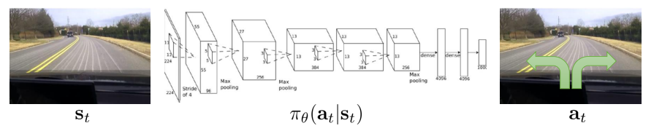
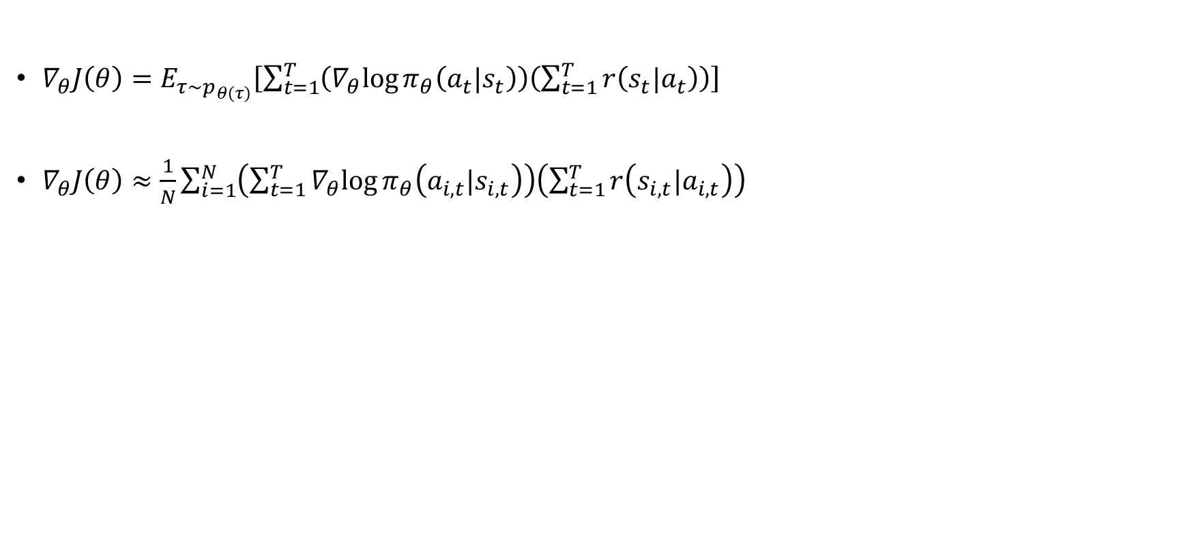
Policy Gradient Evaluation
$∇_{θ}J\left(θ\right)=E_{τ\sim p_{θ\left(τ\right)}}\left[\sum_{t=1}^{T}{\left(∇_{θ}log{π_{θ}\left(a_{t}|s_{t}\right)}\right)\left(\sum_{t=1}^{T}{r\left(s_{t}|a_{t}\right)}\right)}\right]$
$∇_{θ}J\left(θ\right)≈\frac{1}{N}\sum_{i=1}^{N}{\left(\sum_{t=1}^{T}{∇_{θ}log{π_{θ}\left(a_{i, t}|s_{i,t}\right)}}\right)\left(\sum_{t=1}^{T}{r\left(s_{i,t}|a_{i,t}\right)}\right)}$

Slide 14
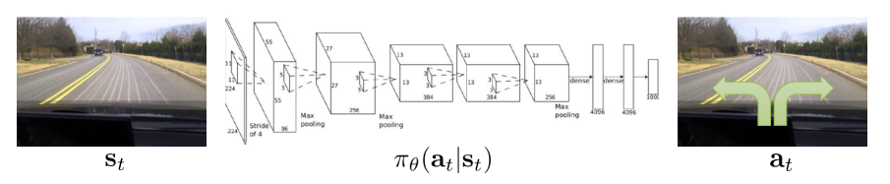


Comparison to maximum likelihood
Policy Gradient: $∇_{θ}J\left(θ\right)≈\frac{1}{N}\sum_{i=1}^{N}{\left(\sum_{t=1}^{T}{∇_{θ}log{π_{θ}\left(a_{i, t}|s_{i,t}\right)}}\right)\left(\sum_{t=1}^{T}{r\left(s_{i,t}|a_{i,t}\right)}\right)}$
Maximum Likelihood: $∇_{θ}J\left(θ\right)≈\frac{1}{N}\sum_{i=1}^{N}{\left(\sum_{t=1}^{T}{∇_{θ}log{π_{θ}\left(a_{i, t}|s_{i,t}\right)}}\right)}$
Supervised Data
Supervised Learning
$$π_{θ}\left(a_{i, t}|s_{i,t}\right)$$

Slide 15
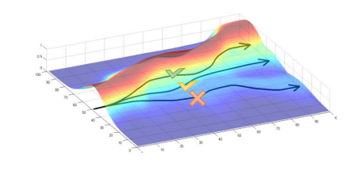
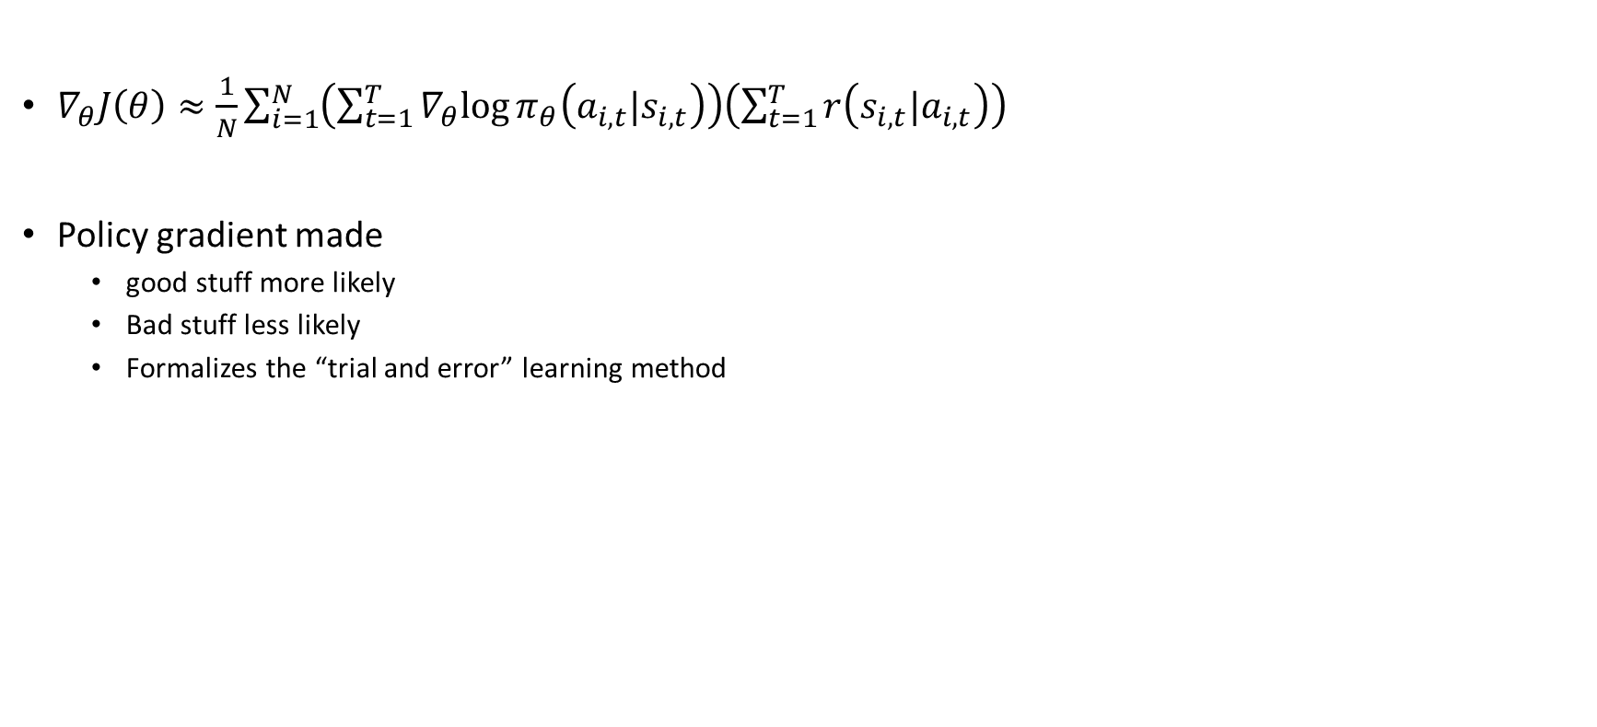
What did we just do?
$∇_{θ}J\left(θ\right)≈\frac{1}{N}\sum_{i=1}^{N}{\left(\sum_{t=1}^{T}{∇_{θ}log{π_{θ}\left(a_{i, t}|s_{i,t}\right)}}\right)\left(\sum_{t=1}^{T}{r\left(s_{i,t}|a_{i,t}\right)}\right)}$
Policy gradient made
good stuff more likely
Bad stuff less likely
Formalizes the “trial and error” learning method

Slide 16
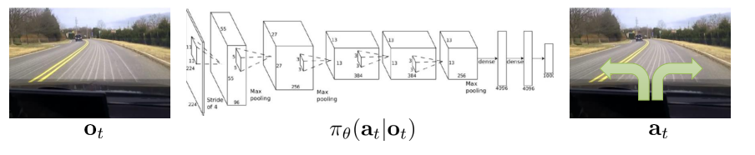

POMDP
$∇_{θ}J\left(θ\right)≈\frac{1}{N}\sum_{i=1}^{N}{\left(\sum_{t=1}^{T}{∇_{θ}log{π_{θ}\left(a_{i, t}|o_{i,t}\right)}}\right)\left(\sum_{t=1}^{T}{r\left(s_{i,t}|a_{i,t}\right)}\right)}$
Policy gradient also works on POMDP case

Slide 17
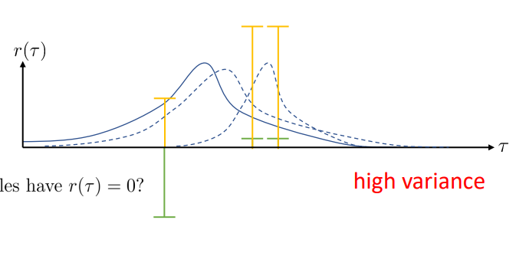
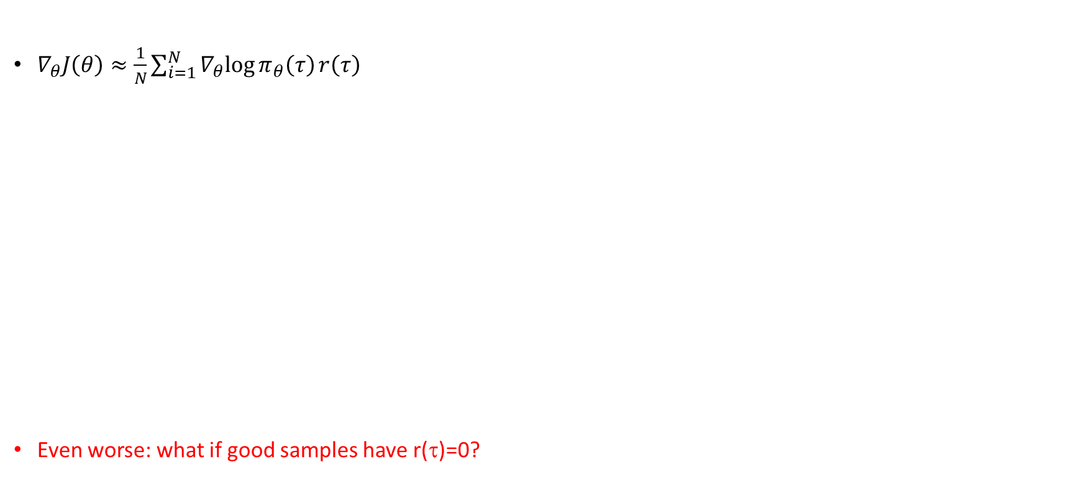
What’s wrong with the policy gradient?
$∇_{θ}J\left(θ\right)≈\frac{1}{N}\sum_{i=1}^{N}{∇_{θ}log{π_{θ}\left(τ\right)}r\left(τ\right)}$
Even worse: what if good samples have r(τ)=0?
High Variance

Slide 18
Reducing Variance

Slide 19

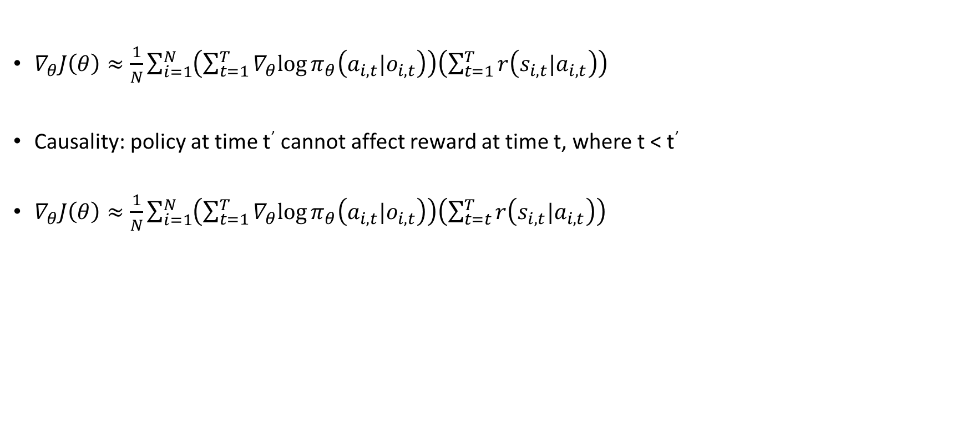
Reducing Variance
$∇_{θ}J\left(θ\right)≈\frac{1}{N}\sum_{i=1}^{N}{\left(\sum_{t=1}^{T}{∇_{θ}log{π_{θ}\left(a_{i, t}|o_{i,t}\right)}}\right)\left(\sum_{t=1}^{T}{r\left(s_{i,t}|a_{i,t}\right)}\right)}$
Causality: policy at time t’ cannot affect reward at time t, where t < t’
$∇_{θ}J\left(θ\right)≈\frac{1}{N}\sum_{i=1}^{N}{\left(\sum_{t=1}^{T}{∇_{θ}log{π_{θ}\left(a_{i, t}|o_{i,t}\right)}}\right)\left(\sum_{t=t}^{T}{r\left(s_{i,t}|a_{i,t}\right)}\right)}$
reward to go
$${\hat{Q}}_{i,t}$$

Slide 20
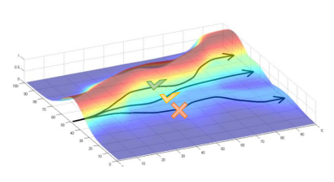
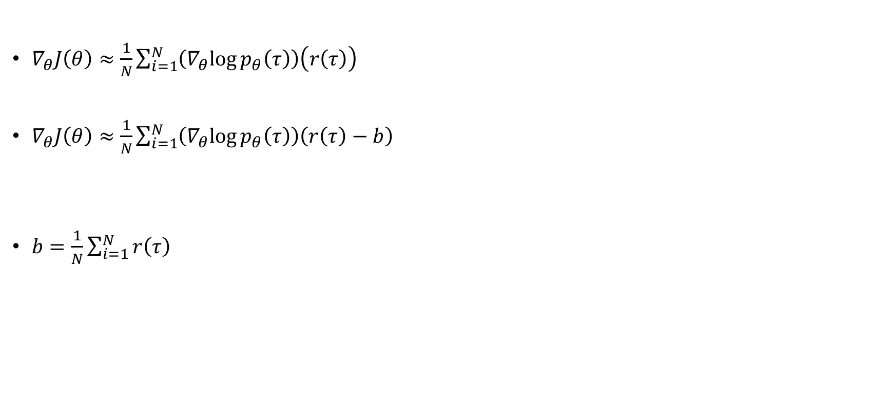
Baselines
$∇_{θ}J\left(θ\right)≈\frac{1}{N}\sum_{i=1}^{N}{\left(∇_{θ}log{p_{θ}\left(τ\right)}\right)\left(r\left(τ\right)\right)}$
$∇_{θ}J\left(θ\right)≈\frac{1}{N}\sum_{i=1}^{N}{\left(∇_{θ}log{p_{θ}\left(τ\right)}\right)\left(r\left(τ\right)−b\right)}$
$b=\frac{1}{N}\sum_{i=1}^{N}{r\left(τ\right)}$
But!! Are we allowed to do that?

Slide 21
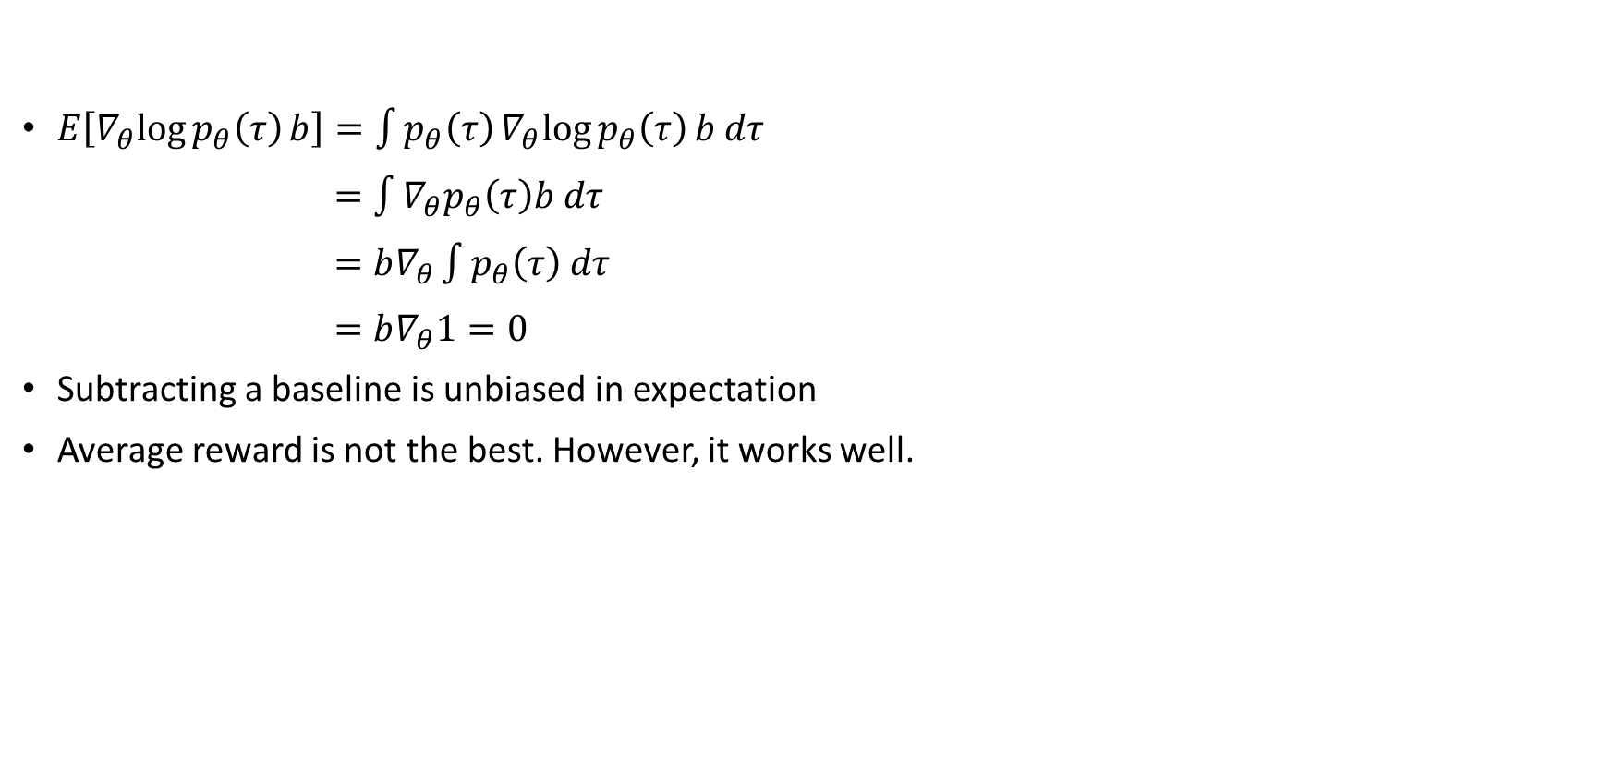
Baselines: Proof
$E\left[∇_{θ}log{p_{θ}\left(τ\right)}b\right]=\int{p_{θ}\left(τ\right)∇_{θ}log{p_{θ}\left(τ\right)}b dτ}$
$=\int{∇_{θ}p_{θ}\left(τ\right)b dτ}$
$=b∇_{θ}\int{p_{θ}\left(τ\right) dτ}$
$=b∇_{θ}1=0$
Subtracting a baseline is unbiased in expectation
Average reward is not the best. However, it works well.

Slide 22

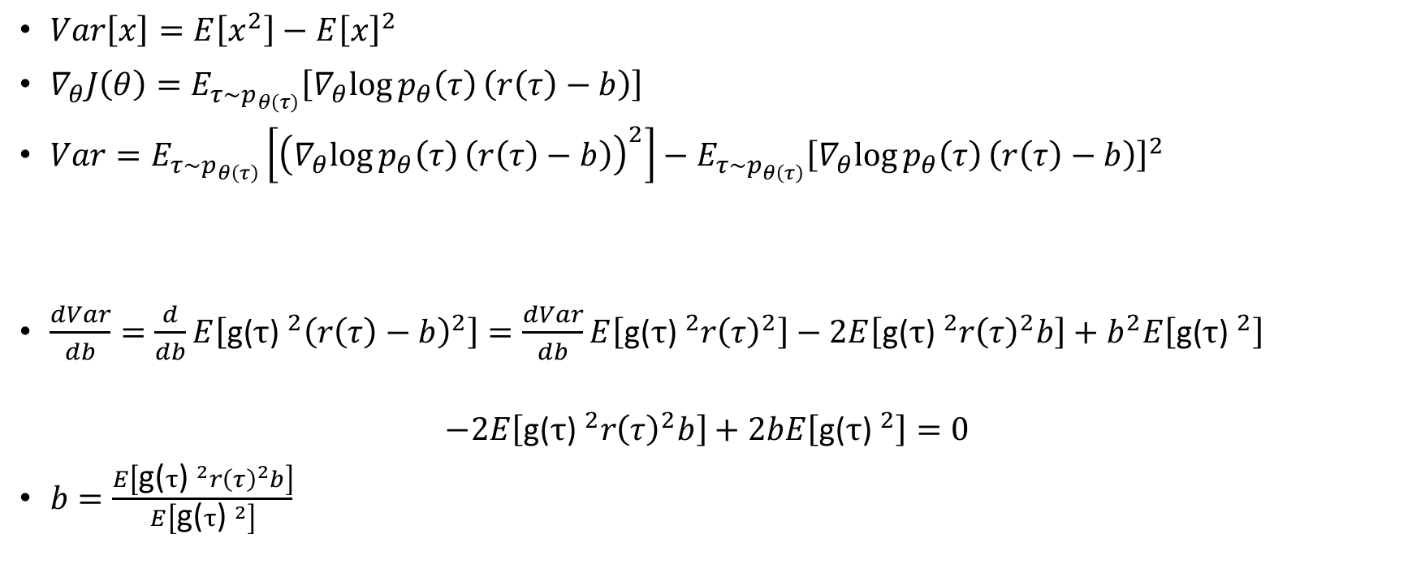
Analyzing variance
$Var\left[x\right]=E\left[x^{2}\right]−{E\left[x\right]}^{2}$
$∇_{θ}J\left(θ\right)=E_{τ\sim p_{θ\left(τ\right)}}\left[∇_{θ}log{p_{θ}\left(τ\right)}\left(r\left(τ\right)−b\right)\right]$
$Var=E_{τ\sim p_{θ\left(τ\right)}}\left[{\left(∇_{θ}log{p_{θ}\left(τ\right)}\left(r\left(τ\right)−b\right)\right)}^{2}\right]−{E_{τ\sim p_{θ\left(τ\right)}}\left[∇_{θ}log{p_{θ}\left(τ\right)}\left(r\left(τ\right)−b\right)\right]}^{2}$
$\frac{dVar}{db}=\frac{d}{db}E\left[{\text{g}\text{(}τ\text{) }}^{2}{\left(r\left(τ\right)−b\right)}^{2}\right]=\frac{dVar}{db}E\left[{\text{g}\text{(}τ\text{) }}^{2}{r\left(τ\right)}^{2}\right]−2E\left[{\text{g}\text{(}τ\text{) }}^{2}{r\left(τ\right)}^{2}b\right]+b^{2}E\left[{\text{g}\text{(}τ\text{) }}^{2}\right]$
$$−2E\left[{\text{g}\text{(}τ\text{) }}^{2}{r\left(τ\right)}^{2}b\right]+2bE\left[{\text{g}\text{(}τ\text{) }}^{2}\right]=0$$
$b=\frac{E\left[{\text{g}\text{(}τ\text{) }}^{2}{r\left(τ\right)}^{2}b\right]}{E\left[{\text{g}\text{(}τ\text{) }}^{2}\right]}$
g(τ)
This is just $E_{τ\sim p_{θ\left(τ\right)}}\left[∇_{θ}log{p_{θ}\left(τ\right)}\left(r\left(τ\right)\right)\right]$

Slide 23
Advanced Policy Gradient

Slide 24
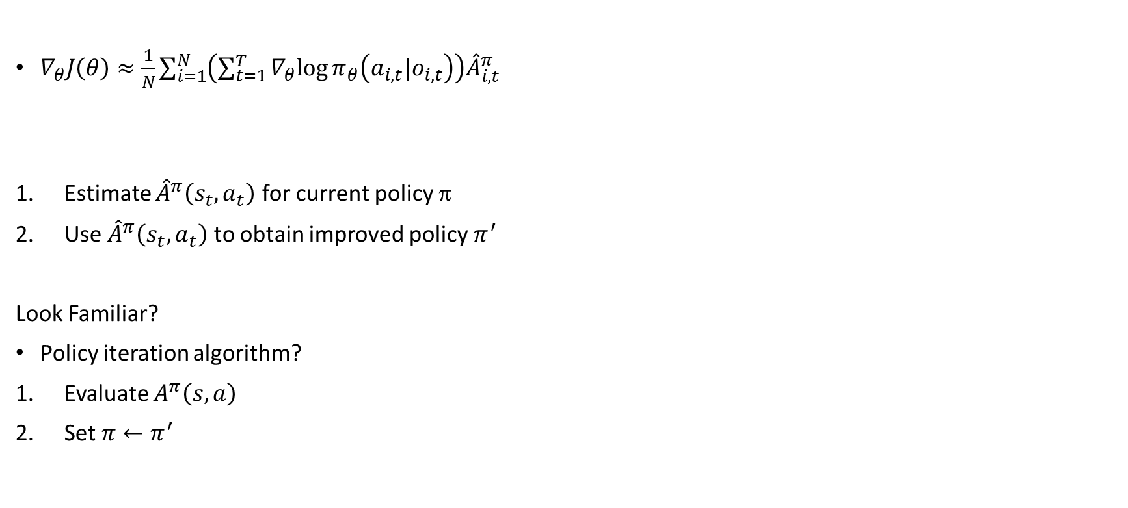
Why does policy gradient work?
$∇_{θ}J\left(θ\right)≈\frac{1}{N}\sum_{i=1}^{N}{\left(\sum_{t=1}^{T}{∇_{θ}log{π_{θ}\left(a_{i, t}|o_{i,t}\right)}}\right){\hat{A}}_{i,t}^{π}}$
Estimate ${\hat{A}}^{π}\left(s_{t},a_{t}\right)$ for current policy $$
Use ${\hat{A}}^{π}\left(s_{t},a_{t}\right)$ to obtain improved policy $π^{′}$
Look Familiar?
Policy iteration algorithm?
Evaluate $A^{π}\left(s,a\right)$
Set $π←π^{′}$

Slide 25
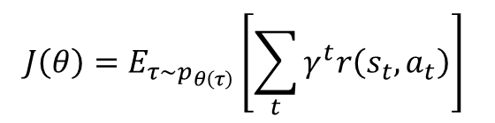
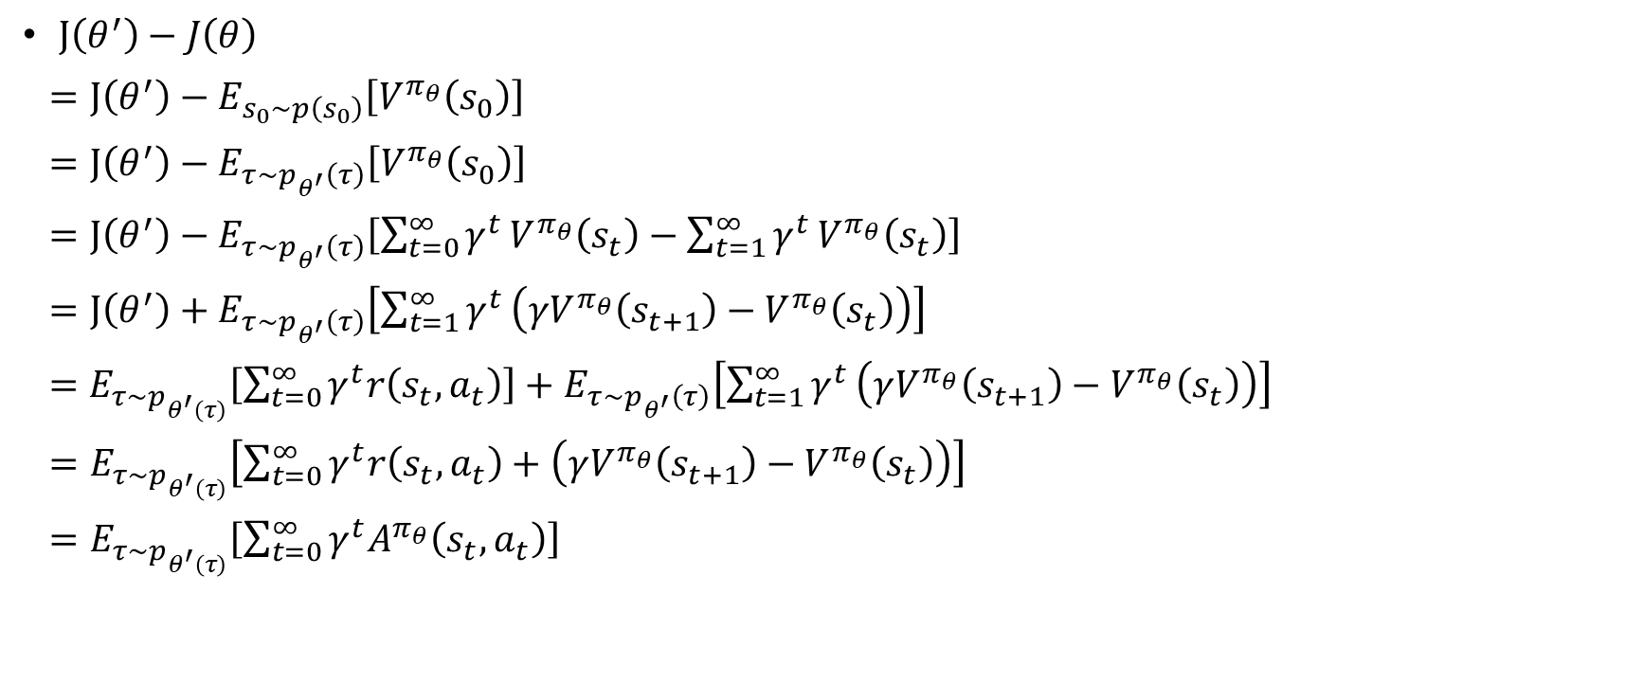
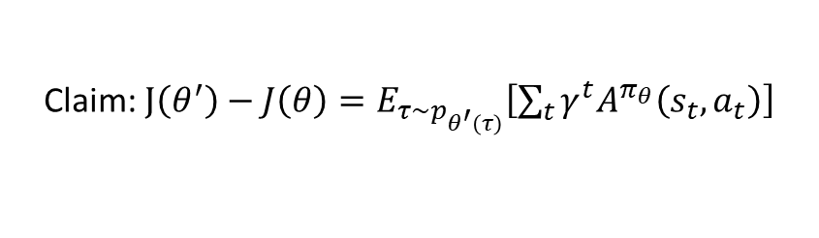
Policy Gradient as Policy Iteration
$$J\left(θ\right)=E_{τ\sim p_{θ\left(τ\right)}}\left[\sum_{t}{γ^{t}r\left(s_{t},a_{t}\right)}\right]$$
$J\left(θ^{′}\right)−J\left(θ\right)$
$=J\left(θ^{′}\right)−E_{s_{0}\sim p\left(s_{0}\right)}\left[V^{π_{θ}}\left(s_{0}\right)\right]$
$=J\left(θ^{′}\right)−E_{τ\sim p_{θ^{′}}\left(τ\right)}\left[V^{π_{θ}}\left(s_{0}\right)\right]$
$=J\left(θ^{′}\right)−E_{τ\sim p_{θ^{′}}\left(τ\right)}\left[{\sum_{t=0}^{∞}{γ^{t}}V}^{π_{θ}}\left(s_{t}\right)−{\sum_{t=1}^{∞}{γ^{t}}V}^{π_{θ}}\left(s_{t}\right)\right]$
$=J\left(θ^{′}\right)+E_{τ\sim p_{θ^{′}}\left(τ\right)}\left[\sum_{t=1}^{∞}{γ^{t}}\left(γV^{π_{θ}}\left(s_{t+1}\right)−V^{π_{θ}}\left(s_{t}\right)\right)\right]$
$=E_{τ\sim p_{θ^{′}\left(τ\right)}}\left[\sum_{t=0}^{∞}{γ^{t}r\left(s_{t},a_{t}\right)}\right]+E_{τ\sim p_{θ^{′}}\left(τ\right)}\left[\sum_{t=1}^{∞}{γ^{t}}\left(γV^{π_{θ}}\left(s_{t+1}\right)−V^{π_{θ}}\left(s_{t}\right)\right)\right]$
$=E_{τ\sim p_{θ^{′}\left(τ\right)}}\left[\sum_{t=0}^{∞}{γ^{t}r\left(s_{t},a_{t}\right)+\left(γV^{π_{θ}}\left(s_{t+1}\right)−V^{π_{θ}}\left(s_{t}\right)\right)}\right]$
$=E_{τ\sim p_{θ^{′}\left(τ\right)}}\left[\sum_{t=0}^{∞}{γ^{t}A^{π_{θ}}\left(s_{t},a_{t}\right)}\right]$
Claim: $J\left(θ^{′}\right)−J\left(θ\right)=E_{τ\sim p_{θ^{′}\left(τ\right)}}\left[\sum_{t}{γ^{t}A^{π_{θ}}\left(s_{t},a_{t}\right)}\right]$

Slide 26

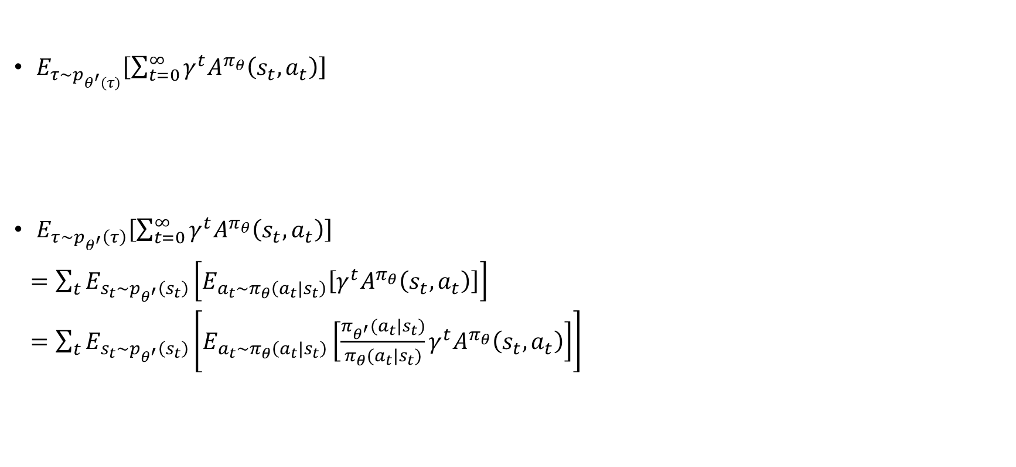


Policy Gradient as Policy Iteration
$E_{τ\sim p_{θ^{′}\left(τ\right)}}\left[\sum_{t=0}^{∞}{γ^{t}A^{π_{θ}}\left(s_{t},a_{t}\right)}\right]$
$E_{τ\sim p_{θ^{′}}\left(τ\right)}\left[\sum_{t=0}^{∞}{γ^{t}A^{π_{θ}}\left(s_{t},a_{t}\right)}\right]$
$=\sum_{t}{E_{s_{t}\sim p_{θ^{′}}\left(s_{t}\right)}\left[E_{a_{t}\sim π_{θ}\left(a_{t}|s_{t}\right)}\left[γ^{t}A^{π_{θ}}\left(s_{t},a_{t}\right)\right]\right]}$
$=\sum_{t}{E_{s_{t}\sim p_{θ^{′}}\left(s_{t}\right)}\left[E_{a_{t}\sim π_{θ}\left(a_{t}|s_{t}\right)}\left[\frac{π_{θ^{′}}(a_{t}|s_{t})}{π_{θ}(a_{t}|s_{t})}γ^{t}A^{π_{θ}}\left(s_{t},a_{t}\right)\right]\right]}$
Expectation under $π_{θ^{′}}$
Advantage under $π_{θ}$
Important Sampling
Is it ok to use $p_{θ}\left(s_{t}\right)?$

Slide 27

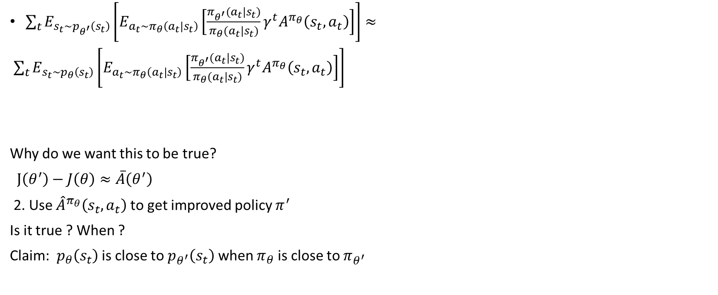

Ignoring Distribution Mismatch?
$\sum_{t}{E_{s_{t}\sim p_{θ^{′}}\left(s_{t}\right)}\left[E_{a_{t}\sim π_{θ}\left(a_{t}|s_{t}\right)}\left[\frac{π_{θ^{′}}(a_{t}|s_{t})}{π_{θ}(a_{t}|s_{t})}γ^{t}A^{π_{θ}}\left(s_{t},a_{t}\right)\right]\right]}≈$
$\sum_{t}{E_{s_{t}\sim p_{θ}\left(s_{t}\right)}\left[E_{a_{t}\sim π_{θ}\left(a_{t}|s_{t}\right)}\left[\frac{π_{θ^{′}}(a_{t}|s_{t})}{π_{θ}(a_{t}|s_{t})}γ^{t}A^{π_{θ}}\left(s_{t},a_{t}\right)\right]\right]}$
Why do we want this to be true?
$J\left(θ^{′}\right)−J\left(θ\right)≈\overline{A}\left(θ^{′}\right)$
2. Use ${\hat{A}}^{π_{θ}}\left(s_{t},a_{t}\right)$ to get improved policy $π^{′}$
Is it true ? When ?
Claim: $p_{θ}\left(s_{t}\right)$ is close to $p_{θ^{′}}\left(s_{t}\right)$when $π_{θ}$ is close to $π_{θ^{′}}$
$$\overline{A}\left(θ^{′}\right)$$
$$θ^{′}←\underset{θ^{′}}{argmax}{\overline{A}\left(θ\right)}$$

Slide 28
Bounding the Distribution Change

Slide 29
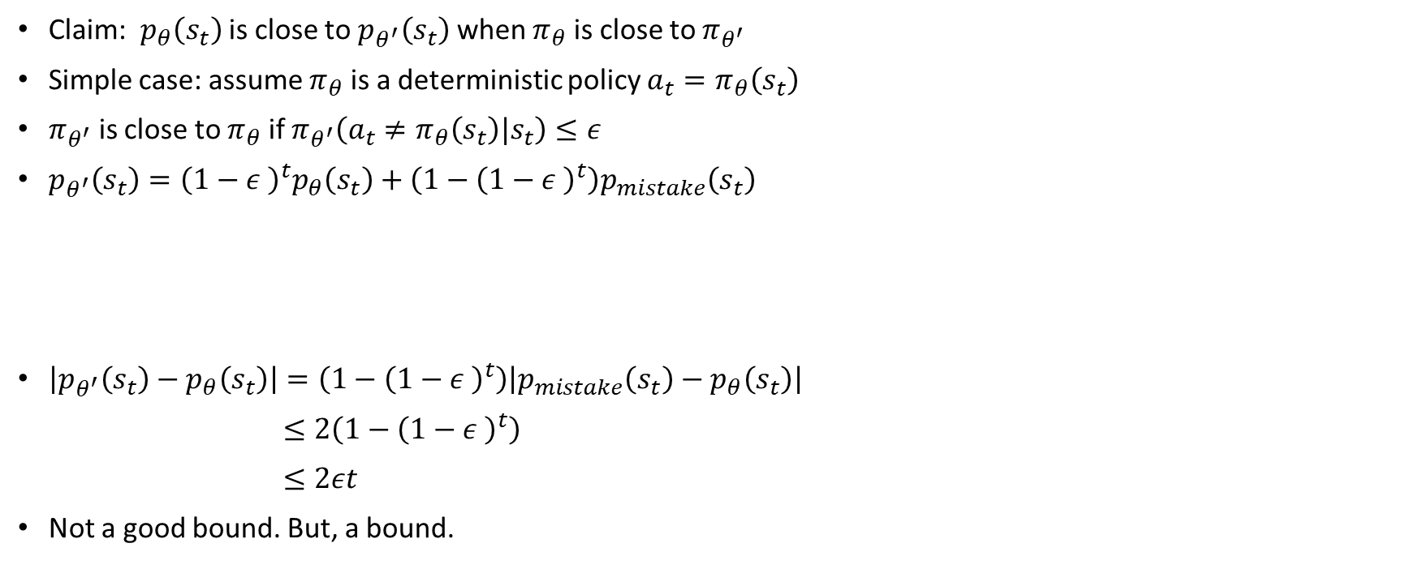
Bounding the Distribution Change
Claim: $p_{θ}\left(s_{t}\right)$ is close to $p_{θ^{′}}\left(s_{t}\right)$when $π_{θ}$ is close to $π_{θ^{′}}$
Simple case: assume $π_{θ}$ is a deterministic policy $a_{t}=π_{θ}\left(s_{t}\right)$
$π_{θ^{′}}$ is close to $π_{θ}$ if $π_{θ^{′}}\left(a_{t}≠π_{θ}\left(s_{t}\right)|s_{t}\right)≤ε$
$p_{θ^{′}}\left(s_{t}\right)={\left(1−ε \right)}^{t}p_{θ}\left(s_{t}\right)+\left(1−{\left(1−ε \right)}^{t}\right)p_{mistake}\left(s_{t}\right)$
$\left|p_{θ^{′}}\left(s_{t}\right)−p_{θ}\left(s_{t}\right)\right|=\left(1−{\left(1−ε \right)}^{t}\right)\left|p_{mistake}\left(s_{t}\right)−p_{θ}\left(s_{t}\right)\right|$
$≤2\left(1−{\left(1−ε \right)}^{t}\right)$
$≤2εt$
Not a good bound. But, a bound.
Probability that we made no mistakes
Other distributions
Useful identity: $\left(1−{\left(1−ε\right)}^{t}\right)≥1−εt for ε ∈ \left[0,1\right]$

Slide 30
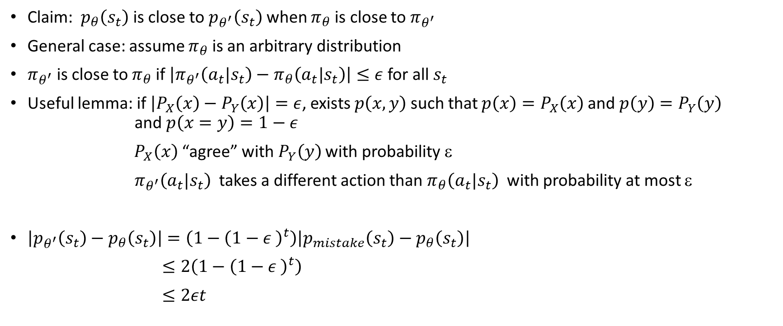
Bounding the Distribution Change
Claim: $p_{θ}\left(s_{t}\right)$ is close to $p_{θ^{′}}\left(s_{t}\right)$when $π_{θ}$ is close to $π_{θ^{′}}$
General case: assume $π_{θ}$ is an arbitrary distribution
$π_{θ^{′}}$ is close to $π_{θ}$ if $\left|π_{θ^{′}}\left(a_{t}|s_{t}\right)−π_{θ}\left(a_{t}|s_{t}\right)\right|≤ε$ for all $s_{t}$
Useful lemma: if $\left|P_{X}\left(x\right)−P_{Y}\left(x\right)\right|=ε$, exists $p\left(x,y\right)$ such that $p\left(x\right)=P_{X}\left(x\right)$ and $p\left(y\right)=P_{Y}\left(y\right)$ cc and $p\left(x=y\right)=1−ε$
$P_{X}\left(x\right)$ “agree” with $P_{Y}\left(y\right)$ with probability ε
${ π}_{θ^{′}}\left(a_{t}|s_{t}\right)$ takes a different action than $π_{θ}\left(a_{t}|s_{t}\right)$ with probability at most ε
$\left|p_{θ^{′}}\left(s_{t}\right)−p_{θ}\left(s_{t}\right)\right|=\left(1−{\left(1−ε \right)}^{t}\right)\left|p_{mistake}\left(s_{t}\right)−p_{θ}\left(s_{t}\right)\right|$
$≤2\left(1−{\left(1−ε \right)}^{t}\right)$
$≤2εt$

Slide 31

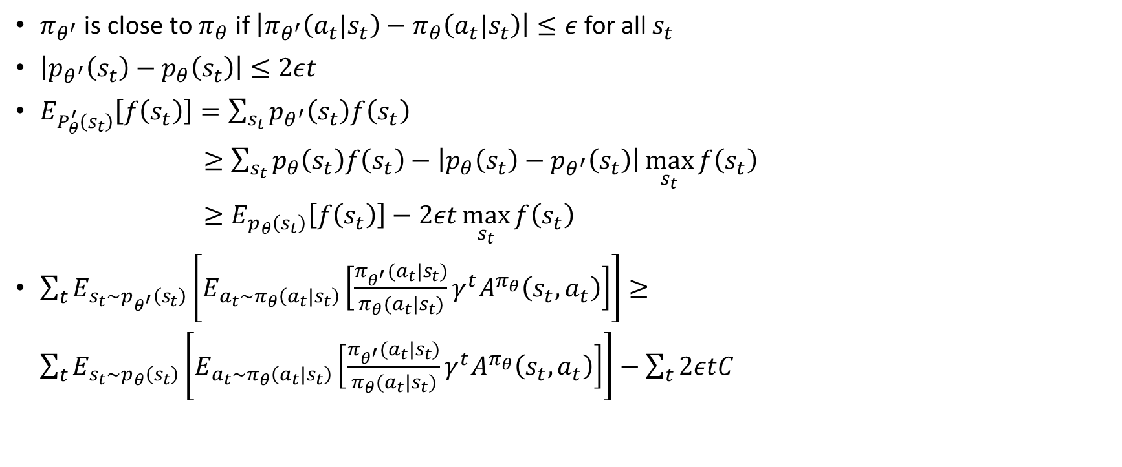
Bounding the Objective Value
$π_{θ^{′}}$ is close to $π_{θ}$ if $\left|π_{θ^{′}}\left(a_{t}|s_{t}\right)−π_{θ}\left(a_{t}|s_{t}\right)\right|≤ε$ for all $s_{t}$
$\left|p_{θ^{′}}\left(s_{t}\right)−p_{θ}\left(s_{t}\right)\right|≤2εt$
$E_{P_{θ}^{′}\left(s_{t}\right)}\left[f\left(s_{t}\right)\right]=\sum_{s_{t}}{p_{θ^{′}}\left(s_{t}\right)f\left(s_{t}\right)}$
$≥\sum_{s_{t}}{p_{θ}\left(s_{t}\right)f\left(s_{t}\right)−\left|p_{θ}\left(s_{t}\right)−p_{θ^{′}}\left(s_{t}\right)\right|\max_{s_{t}}{f\left(s_{t}\right)}}$
$≥E_{p_{θ}\left(s_{t}\right)}\left[f\left(s_{t}\right)\right]−2εt\max_{s_{t}}{f\left(s_{t}\right)}$
$\sum_{t}{E_{s_{t}\sim p_{θ^{′}}\left(s_{t}\right)}\left[E_{a_{t}\sim π_{θ}\left(a_{t}|s_{t}\right)}\left[\frac{π_{θ^{′}}(a_{t}|s_{t})}{π_{θ}(a_{t}|s_{t})}γ^{t}A^{π_{θ}}\left(s_{t},a_{t}\right)\right]\right]}≥$
$\sum_{t}{E_{s_{t}\sim p_{θ}\left(s_{t}\right)}\left[E_{a_{t}\sim π_{θ}\left(a_{t}|s_{t}\right)}\left[\frac{π_{θ^{′}}(a_{t}|s_{t})}{π_{θ}(a_{t}|s_{t})}γ^{t}A^{π_{θ}}\left(s_{t},a_{t}\right)\right]\right]−\sum_{t}{2εtC}}$
$O\left(Tr_{max}\right)$ or$O\left(\frac{r_{max}}{1−γ}\right)$
Maximizing this maximizes a bound on the thing that we want

Slide 32

Where are we at so far?
$θ^{′}←\underset{θ^{′}}{argmax}{\sum_{t}{E_{s_{t}\sim p_{θ}\left(s_{t}\right)}\left[E_{a_{t}\sim π_{θ}\left(a_{t}|s_{t}\right)}\left[\frac{π_{θ^{′}}(a_{t}|s_{t})}{π_{θ}(a_{t}|s_{t})}γ^{t}A^{π_{θ}}\left(s_{t},a_{t}\right)\right]\right]}}$
$such that \left|π_{θ^{′}}\left(a_{t}|s_{t}\right)−π_{θ}\left(a_{t}|s_{t}\right)\right|≤ε$
For small enough ε, this is guaranteed to improve $J\left(θ^{′}\right)−J\left(θ\right)$

Slide 33
Policy Gradients with Constraints

Slide 34
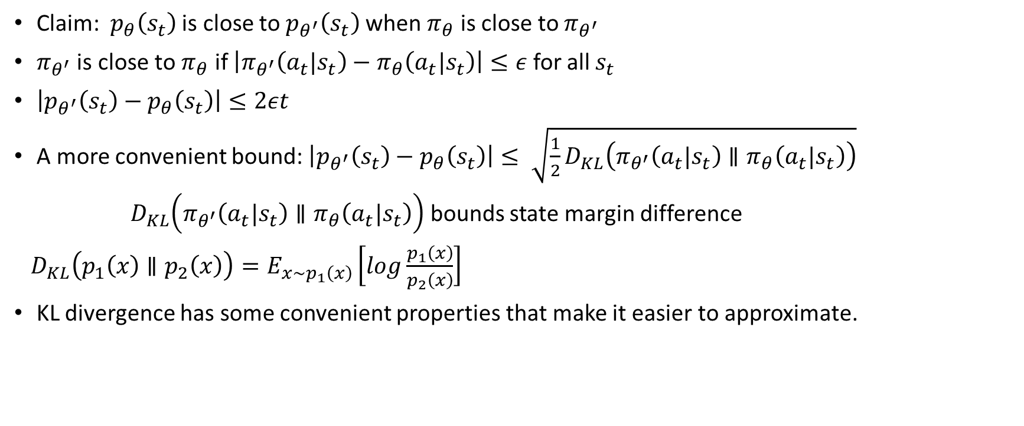
A More Convenient Bound
Claim: $p_{θ}\left(s_{t}\right)$ is close to $p_{θ^{′}}\left(s_{t}\right)$when $π_{θ}$ is close to $π_{θ^{′}}$
$π_{θ^{′}}$ is close to $π_{θ}$ if $\left|π_{θ^{′}}\left(a_{t}|s_{t}\right)−π_{θ}\left(a_{t}|s_{t}\right)\right|≤ε$ for all $s_{t}$
$\left|p_{θ^{′}}\left(s_{t}\right)−p_{θ}\left(s_{t}\right)\right|≤2εt$
A more convenient bound: $\left|p_{θ^{′}}\left(s_{t}\right)−p_{θ}\left(s_{t}\right)\right|≤ \sqrt{\frac{1}{2}D_{KL}\left(π_{θ^{′}}\left(a_{t}|s_{t}\right)∥π_{θ}\left(a_{t}|s_{t}\right)\right)}$
$D_{KL}\left(π_{θ^{′}}\left(a_{t}|s_{t}\right)∥π_{θ}\left(a_{t}|s_{t}\right)\right)$ bounds state margin difference
$D_{KL}\left(p_{1}\left(x\right)∥p_{2}\left(x\right)\right)=E_{x∼p_{1}\left(x\right)}\left[log\frac{p_{1}\left(x\right)}{p_{2}\left(x\right)}\right]$
KL divergence has some convenient properties that make it easier to approximate.

Slide 35

How do we optimize the objective?
$θ^{′}←\underset{θ^{′}}{argmax}{\sum_{t}{E_{s_{t}\sim p_{θ}\left(s_{t}\right)}\left[E_{a_{t}\sim π_{θ}\left(a_{t}|s_{t}\right)}\left[\frac{π_{θ^{′}}(a_{t}|s_{t})}{π_{θ}(a_{t}|s_{t})}γ^{t}A^{π_{θ}}\left(s_{t},a_{t}\right)\right]\right]}}$
$such that D_{KL}\left(π_{θ^{′}}\left(a_{t}|s_{t}\right)∥π_{θ}\left(a_{t}|s_{t}\right)\right)≤ε$
For small enough ε, this is guaranteed to improve $J\left(θ^{′}\right)−J\left(θ\right)$

Slide 36
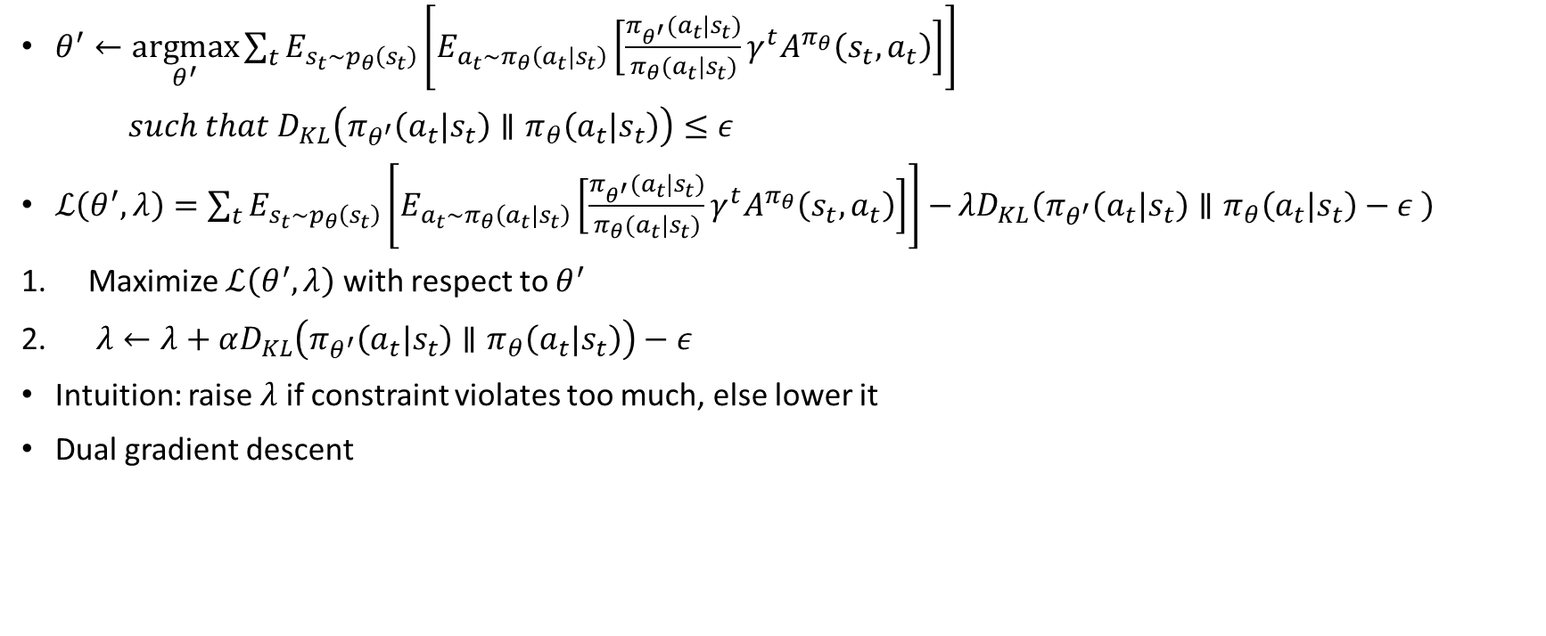
How do we enforce the constraint?
$θ^{′}←\underset{θ^{′}}{argmax}{\sum_{t}{E_{s_{t}\sim p_{θ}\left(s_{t}\right)}\left[E_{a_{t}\sim π_{θ}\left(a_{t}|s_{t}\right)}\left[\frac{π_{θ^{′}}(a_{t}|s_{t})}{π_{θ}(a_{t}|s_{t})}γ^{t}A^{π_{θ}}\left(s_{t},a_{t}\right)\right]\right]}}$
$such that D_{KL}\left(π_{θ^{′}}\left(a_{t}|s_{t}\right)∥π_{θ}\left(a_{t}|s_{t}\right)\right)≤ε$
$ℒ\left(θ^{′},λ\right)=\sum_{t}{E_{s_{t}\sim p_{θ}\left(s_{t}\right)}\left[E_{a_{t}\sim π_{θ}\left(a_{t}|s_{t}\right)}\left[\frac{π_{θ^{′}}(a_{t}|s_{t})}{π_{θ}(a_{t}|s_{t})}γ^{t}A^{π_{θ}}\left(s_{t},a_{t}\right)\right]\right]−}λD_{KL}\left(π_{θ^{′}}\left(a_{t}|s_{t}\right)∥π_{θ}\left(a_{t}|s_{t}\right)−ε \right)$
Maximize $ℒ\left(θ^{′},λ\right)$ with respect to $θ^{′}$
$λ←λ+αD_{KL}\left(π_{θ^{′}}\left(a_{t}|s_{t}\right)∥π_{θ}\left(a_{t}|s_{t}\right)\right)−ε$
Intuition: raise $λ$ if constraint violates too much, else lower it
Dual gradient descent
Few steps are required

Slide 37
Natural Gradient

Slide 38
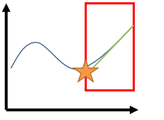
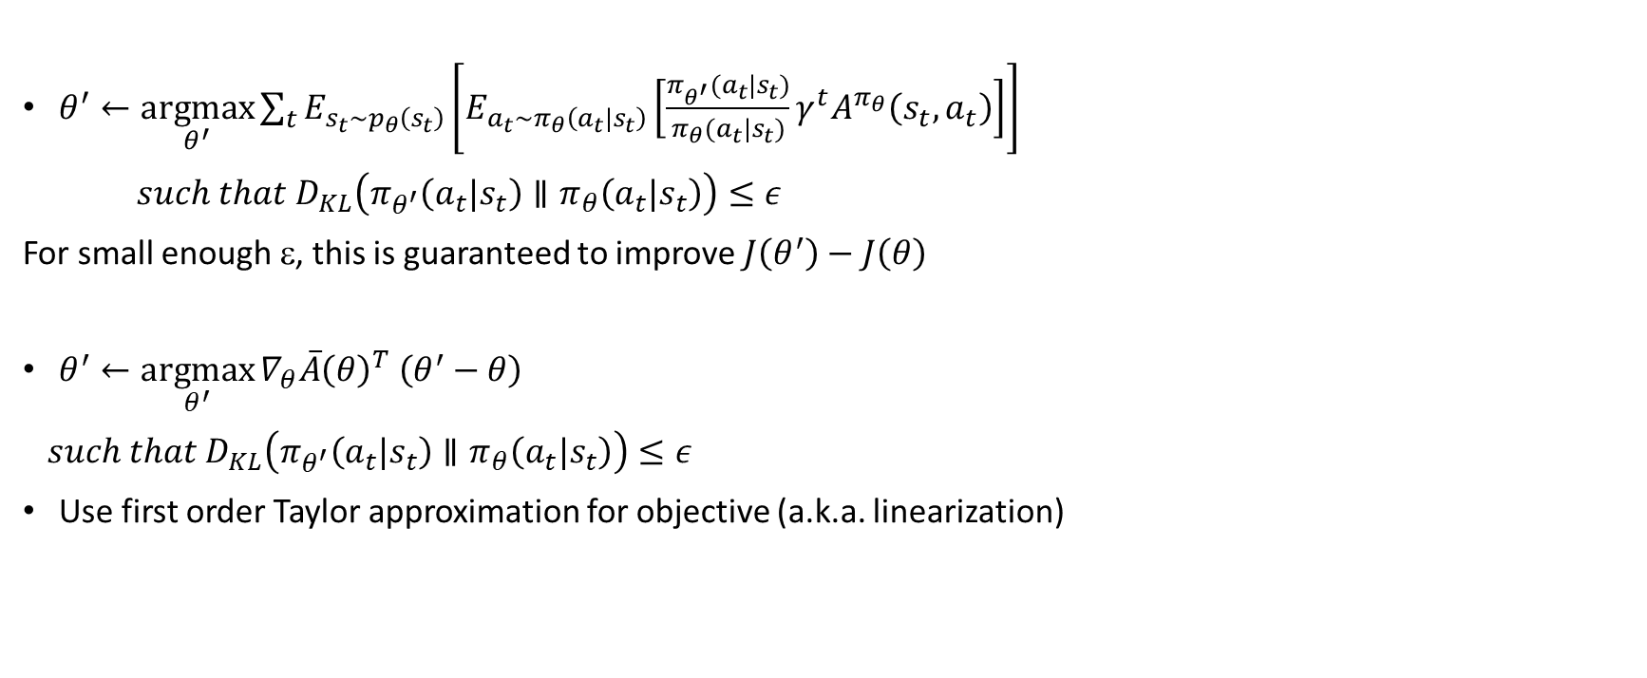

How (else) do we optimize the objective?
$$\overline{A}\left(θ^{′}\right)$$
$θ^{′}←\underset{θ^{′}}{argmax}{\sum_{t}{E_{s_{t}\sim p_{θ}\left(s_{t}\right)}\left[E_{a_{t}\sim π_{θ}\left(a_{t}|s_{t}\right)}\left[\frac{π_{θ^{′}}(a_{t}|s_{t})}{π_{θ}(a_{t}|s_{t})}γ^{t}A^{π_{θ}}\left(s_{t},a_{t}\right)\right]\right]}}$
$such that D_{KL}\left(π_{θ^{′}}\left(a_{t}|s_{t}\right)∥π_{θ}\left(a_{t}|s_{t}\right)\right)≤ε$
For small enough ε, this is guaranteed to improve $J\left(θ^{′}\right)−J\left(θ\right)$
$θ^{′}←\underset{θ^{′}}{argmax}{∇_{θ}{\overline{A}\left(θ\right)}^{T} \left(θ^{′}−θ\right)}$
$such that D_{KL}\left(π_{θ^{′}}\left(a_{t}|s_{t}\right)∥π_{θ}\left(a_{t}|s_{t}\right)\right)≤ε$
Use first order Taylor approximation for objective (a.k.a. linearization)

Slide 39
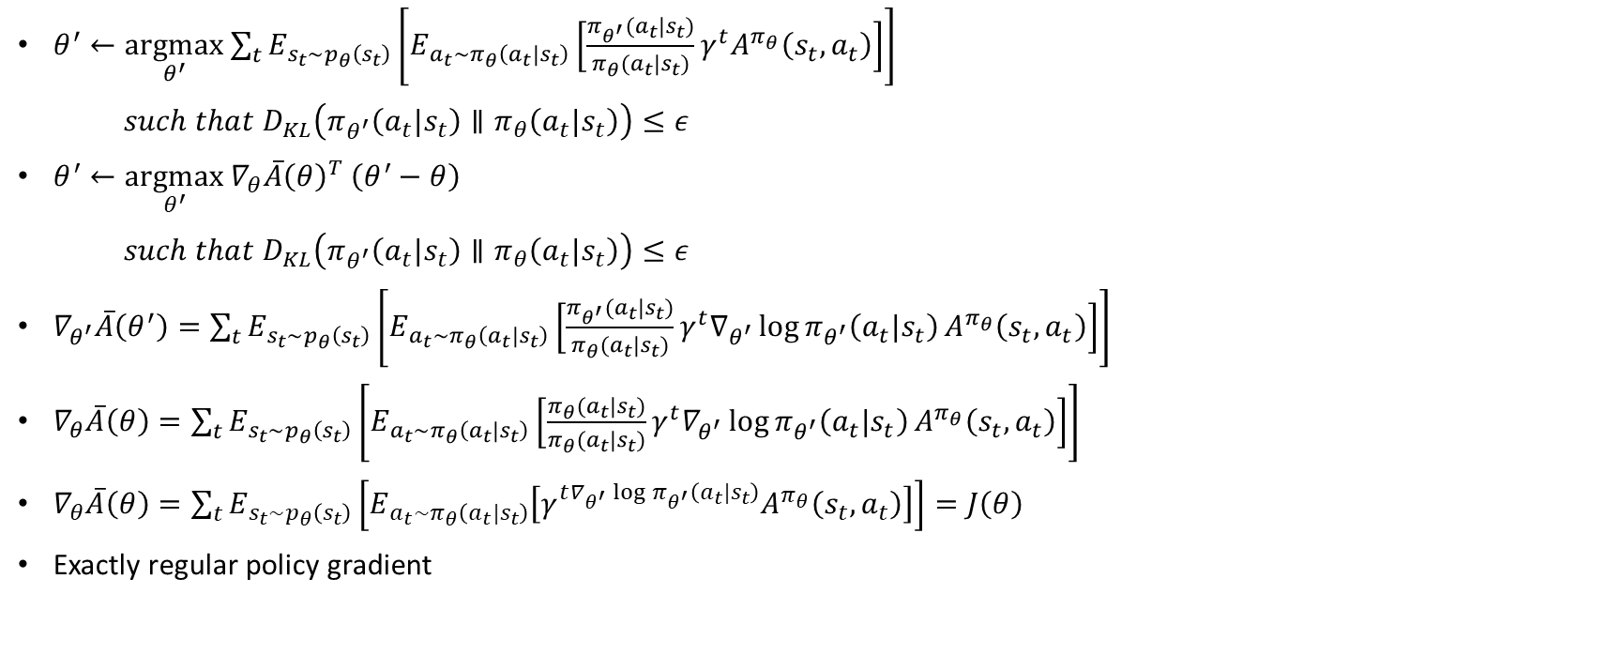
How do we optimize the objective?
$θ^{′}←\underset{θ^{′}}{argmax}{\sum_{t}{E_{s_{t}\sim p_{θ}\left(s_{t}\right)}\left[E_{a_{t}\sim π_{θ}\left(a_{t}|s_{t}\right)}\left[\frac{π_{θ^{′}}(a_{t}|s_{t})}{π_{θ}(a_{t}|s_{t})}γ^{t}A^{π_{θ}}\left(s_{t},a_{t}\right)\right]\right]}}$
$such that D_{KL}\left(π_{θ^{′}}\left(a_{t}|s_{t}\right)∥π_{θ}\left(a_{t}|s_{t}\right)\right)≤ε$
$θ^{′}←\underset{θ^{′}}{argmax}{∇_{θ}{\overline{A}\left(θ\right)}^{T} \left(θ^{′}−θ\right)}$
$such that D_{KL}\left(π_{θ^{′}}\left(a_{t}|s_{t}\right)∥π_{θ}\left(a_{t}|s_{t}\right)\right)≤ε$
$∇_{θ^{′}}\overline{A}\left(θ^{′}\right)=\sum_{t}{E_{s_{t}\sim p_{θ}\left(s_{t}\right)}\left[E_{a_{t}\sim π_{θ}\left(a_{t}|s_{t}\right)}\left[\frac{π_{θ^{′}}(a_{t}|s_{t})}{π_{θ}(a_{t}|s_{t})}γ^{t}∇_{θ^{′}}\log{π_{θ^{′}}\left(a_{t}|s_{t}\right)}A^{π_{θ}}\left(s_{t},a_{t}\right)\right]\right]}$
$∇_{θ}\overline{A}\left(θ\right)=\sum_{t}{E_{s_{t}\sim p_{θ}\left(s_{t}\right)}\left[E_{a_{t}\sim π_{θ}\left(a_{t}|s_{t}\right)}\left[\frac{π_{θ}(a_{t}|s_{t})}{π_{θ}(a_{t}|s_{t})}γ^{t}{∇_{θ^{′}}\log{π_{θ^{′}}\left(a_{t}|s_{t}\right)}A}^{π_{θ}}\left(s_{t},a_{t}\right)\right]\right]}$
$∇_{θ}\overline{A}\left(θ\right)=\sum_{t}{E_{s_{t}\sim p_{θ}\left(s_{t}\right)}\left[E_{a_{t}\sim π_{θ}\left(a_{t}|s_{t}\right)}\left[γ^{t∇_{θ^{′}}\log{π_{θ^{′}}\left(a_{t}|s_{t}\right)}}A^{π_{θ}}\left(s_{t},a_{t}\right)\right]\right]}=J\left(θ\right)$
Exactly regular policy gradient

Slide 40
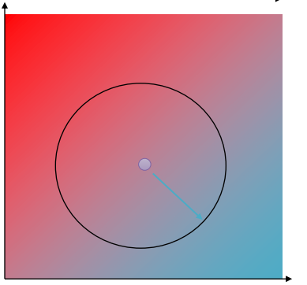

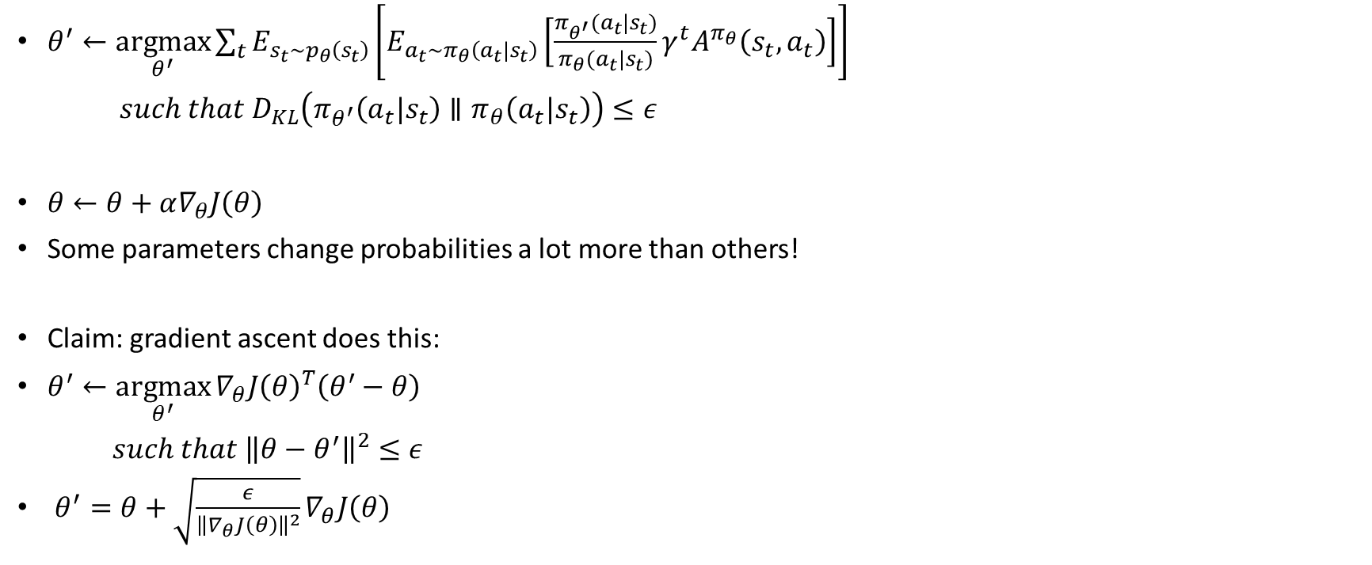
Can we just use the gradient then?
$θ^{′}←\underset{θ^{′}}{argmax}{\sum_{t}{E_{s_{t}\sim p_{θ}\left(s_{t}\right)}\left[E_{a_{t}\sim π_{θ}\left(a_{t}|s_{t}\right)}\left[\frac{π_{θ^{′}}(a_{t}|s_{t})}{π_{θ}(a_{t}|s_{t})}γ^{t}A^{π_{θ}}\left(s_{t},a_{t}\right)\right]\right]}}$
$such that D_{KL}\left(π_{θ^{′}}\left(a_{t}|s_{t}\right)∥π_{θ}\left(a_{t}|s_{t}\right)\right)≤ε$
$θ←θ+α∇_{θ}J\left(θ\right)$
Some parameters change probabilities a lot more than others!
Claim: gradient ascent does this:
$θ^{′}←\underset{θ^{′}}{argmax}{∇_{θ}{J\left(θ\right)}^{T}\left(θ^{′}−θ\right)}$
$such that {\left\|θ−θ^{′}\right\|}^{2}≤ε$
$θ^{′}=θ+\sqrt{\frac{ε}{{\left\|∇_{θ}J\left(θ\right)\right\|}^{2}}}∇_{θ}J\left(θ\right)$
$$π_{θ}\left(a_{t}|s_{t}\right)$$

Slide 41


Can we just use the gradient then?
$θ^{′}←\underset{θ^{′}}{argmax}{\sum_{t}{E_{s_{t}\sim p_{θ}\left(s_{t}\right)}\left[E_{a_{t}\sim π_{θ}\left(a_{t}|s_{t}\right)}\left[\frac{π_{θ^{′}}(a_{t}|s_{t})}{π_{θ}(a_{t}|s_{t})}γ^{t}A^{π_{θ}}\left(s_{t},a_{t}\right)\right]\right]}}$
$such that D_{KL}\left(π_{θ^{′}}\left(a_{t}|s_{t}\right)∥π_{θ}\left(a_{t}|s_{t}\right)\right)≤ε$
$θ^{′}←\underset{θ^{′}}{argmax}{∇_{θ}{J\left(θ\right)}^{T}\left(θ^{′}−θ\right)}$
$such that {\left\|θ−θ^{′}\right\|}^{2}≤ε$
$D_{KL}\left(π_{θ^{′}}\left(a_{t}|s_{t}\right)∥π_{θ}\left(a_{t}|s_{t}\right)\right)≈\frac{1}{2}{\left(θ^{′}−θ\right)}^{T}F\left(θ^{′}−θ\right)$
Can estimate with samples
Second order Taylor expansion
$$F=E_{π_{θ}}\left[∇_{θ}\log{π_{θ}\left(a|s\right) {∇_{θ}\log{π_{θ}\left(a|s\right)}}^{T}}\right]$$

Slide 42
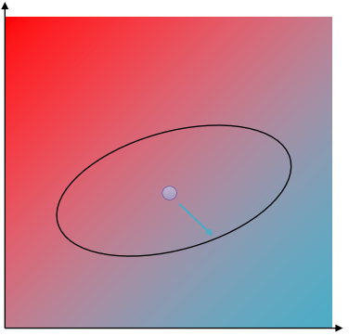

Can we just use the gradient then?
$θ^{′}←\underset{θ^{′}}{argmax}{\sum_{t}{E_{s_{t}\sim p_{θ}\left(s_{t}\right)}\left[E_{a_{t}\sim π_{θ}\left(a_{t}|s_{t}\right)}\left[\frac{π_{θ^{′}}(a_{t}|s_{t})}{π_{θ}(a_{t}|s_{t})}γ^{t}A^{π_{θ}}\left(s_{t},a_{t}\right)\right]\right]}}$
$such that D_{KL}\left(π_{θ^{′}}\left(a_{t}|s_{t}\right)∥π_{θ}\left(a_{t}|s_{t}\right)\right)≤ε$
$D_{KL}\left(π_{θ^{′}}\left(a_{t}|s_{t}\right)∥π_{θ}\left(a_{t}|s_{t}\right)\right)≈\frac{1}{2}{\left(θ^{′}−θ\right)}^{T}F\left(θ^{′}−θ\right)$
$θ^{′}=θ+αF^{−1}\left(θ^{′}−θ\right)$
$α=\sqrt{\frac{2ε}{∇_{θ}{J\left(θ\right)}^{T}F∇_{θ}J\left(θ\right)}}$
natural gradient

Slide 43
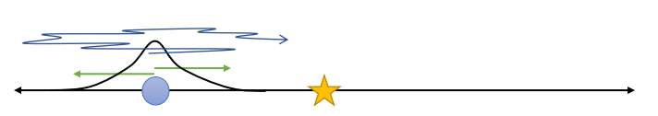





Is this even a problem in practice?
$r\left(s_{t},a_{t}\right)=−s_{t}^{2}−a_{t}^{2}$
$\log{π_{θ}\left(a_{t}|s_{t}\right)=−\frac{1}{2σ^{2}}{\left(ks_{t}−a_{t}\right)}^{2}}+const$
$$θ=\left(k,σ\right)$$

Slide 44
Practical Methods and Notes
Natural Policy Gradient
Good choice to stabilize policy gradient training
More details: Peters, Schaal. Reinforcement learning of motor skills with policy gradients
But, requires efficient computation for Fishier-vector products
Detail: Schulman et al. Trust region policy optimization
Just use the IS objective directly
Proximal policy optimization

Slide 45
References
Levine, “CS285: Deep Reinforcement Learning”, UC Berkeley.

