Slide 1
ᢋᡭᡬᡪᢛᡪᢊᡪᡫ ᢔᡭᢞᡱᡱᡪᢑᢙᡧ᠂ ᢔᢜᢟᢎᡪᡪᢙᡬᢣ ᢔᢜᢟᢊᢎᢜᢟᡪᢙᢚᡬᢑᡪᢐ ᡬᡬᢚᡫ ᡥᡭᡬᡳᡪᢝ ᡭᡧ ᢔᡭᢙᡭᢑᡱᡱᡪᡧ ᡳ ᢘᡭᡪᡪᡪᡫ ᢘᡭᡳᢚᡫ ᢘᡪᡱᡬᢑᢚᡪᡱᡱᡭᢑᢉᡨ
ᡥᡪᡱᡱᡭᢙᡪᢍ
12/19/2021

Slide 2

ᢘᡭᡳᢚᡫ ᢘᡪᡱᡬᢑᢚᡪᡱᡱᡭᢑᢉᡨ
ᢌᡬᡱᡳ ᢔᡭᢙᡭᢑᡱᡱᡪᡧ ᠄ ᢋᡭᡬᡪᢛᡪᢊᡪᡫ ᢔᡭᢞᡱᡱᡪᢑᢙᡧ ᡬᡫ ᡥᡪᢔᡬᡪᡪᢑᡪᡪᡪᢔᡪᡧ
ᡬᡪᢍ ᡭᡧ ᢘᡪᢎᢙᡪᡬᡨ ᡭᡧ ᢔᢜᢟᢎᡪᡪᢙᡬᢣ ᢔᢜᢟᢊᢎᢜᢟᡪᢙᢚᡬᢑᡪᢐ ᡭᡧ ᢘᡭᡪᡪᡪᡫ
My research:
Semantic segmentation of
road markings
using
deep learning methods
ᡥᡪᡱᡱᡭᢙᡪᢍ ᠂ 9/ 21/1994 2009 ᡢ 2012 ᠄ ᡥᡭᡬᡴᡭᢝ ᢌᡭᡪᢊᡱᡱᡭᢐ ᡭᡧ ᡳᡪᡪᡪᢔᡫ ᡬᡬᡧ ᢜᡪᢊᡪᡨ ᢔᡭᢞᡱᡱᡪᡱᡱᡭᢑᡫ ᡬᡬᡧ ᡸᡪᢞᡬᢜᡪᢙᡳ ᢘᡭᢎᢙᡪᢙᡳ ᢔᡭᢞᡱᡱᡪᡱᡱᡭᢑᡫ᠂ ᢘᡪᢊᡪᢙᡳ ᢘᡭᢎᢙᡪᢙᡳ 2013 ᡢ 2017᠄ ᡳᡪᢊᡪᢛᡬᡪᡬᡨ ᡭᡧ ᢔᡬᡪᢛᡬᢑᡪᢊᡪᡨ ᢌᡪᢞᢊᡪᢛᡬᢐ ᡭᡧ ᢜᡪᢊᡪᡨ ᢔᡭᢞᡱᡱᡪᡱᡱᡭᢑᡫ᠂ ᡥᡭᢜᡭᢙᡪᡧ
2019 ᡢ 2021᠄ ᢚᡬᡳᡪᡨ ᢜᡪᢊᡪᡨ ᢔᡭᢞᡱᡱᡪᡱᡱᡭᢑᡫ᠂ ᢌᡪᢔᢘᢟᢝ
ᡥᡭᢙᡳ ᠄ ᢚᡬᡳᡪᡨ ᢜᡪᢊᡪᡨ ᢔᡭᢞᡱᡱᡪᡱᡱᡭᢑᡫ ᠂ ᢘᡪᢑᡪᢊᡪᡫ ᡬᡬᡧ ᡴᡭᡬᢎᡴᡭᢞᢚᡪᡬᡨ ᡭᡧ ᡳᡪᡬᡬᡱᡱᡪᢑᡫ ᡥᡭᢞᢚᡬᡧ ᡳ ᢔᡬᡪᢛᡬᢑᡪᢋᡭ ᡥᡭᡪᡪᡪᡱᡱᡪᡧ ᠂ ᢙᡭᢤᢘᡭᢞᡪᡪᢘᡦ ᡭᡧ ᡯᡬᢊᡪᢙᡭᢊᡪᢝ ᡥᡭᡧ
Deep learning
Semantic segmentation
ᢋᡭᡬᡪᢛᡪᢊᡪᡫ ᢔᡭᢞᡱᡱᡪᢑᢙᡧ
ᢔᢜᢟᢎᡪᡪᢙᡬᢣ ᢔᢜᢟᢊᢎᢜᢟᡪᢙᢚᡬᢑᡪᢐ

Slide 3
ᢘᡭᡬᡬᢎᡳ
ᢋᡭᡬᡪᢛᡪᢊᡪᡫ ᢔᡭᢞᡱᡱᡪᢑᢙᡧ ( Deep learning)
ᢔᢜᢟᢎᡪᡪᢙᡬᢣ ᢔᢜᢟᢊᢎᢜᢟᡪᢙᢚᡬᢑᡪᢐ (Semantic segmentation)
ᡥᡭᡬᡳᡪᢝ ᡭᡧ ᢔᡭᢙᡭᢑᡱᡱᡪᡧ (My research)

Slide 4
ᡥᡪᢔᡪᡱᡱᡭᢑᢙᡧ 1. ᡥᡪᢎᡬᢙᡭᢞᡪᢐ ᢘᡭᢎᢙᡪᢊᡬᡦ ᢋᡭᡬᡪᢛᡪᢊᡪᡫ ᢔᡭᢞᡱᡱᡪᢑᢙᡧ ᡓ 2. ᢋᡭᡬᡪᢛᡪᢊᡪᡫ ᢔᡭᢞᡱᡱᡪᢑᢙᡧ ᢊᡪᢙᡪᡬᡨ ᡯᡫ ᢜᡪᡱᡱᡳ ᡴᡭᡫ ᡓ 3. ᢜᡪᡱᡱᡪᢊᡬᡱᡱᡪᡭᡧ ᡥᡭᢙᡳ ᡥᡬᡬᢎᡳ ᢌᡭᡪᢙᡪᢇ ᡴᡭᢑᢛᡳ ᡳᡪᡬᡬᡪᡪᡳ ᡴᡭᡫ ᡓ
ᢋᡭᡬᡪᢛᡪᢊᡪᡫ ᢔᡭᢞᡱᡱᡪᢑᢙᡧ ( Deep learning)

Slide 5
1. ᡥᡪᢎᡬᢙᡭᢞᡪᢐ ᢘᡭᢎᢙᡪᢊᡬᡦ ᢋᡭᡬᡪᢛᡪᢊᡪᡫ ᢔᡭᢞᡱᡱᡪᢑᢙᡧ ᡓ ᡬᡬᢞᡭᢇᢘᡭᡬᢞᢔᡳ ᡬᡫ ᢘᡪᡱᡬᡪᡪᡳ Computer vision (CV) ᡥᡭᡬᢊᡪᡨ ᢊᡪᢑᡪᡧ ᡳ ᡴᡭᢑᡳᡪᢔᡭᢞᡪᡱᡱᡭᢑᡭᢑᢙᡧ Natural language processing(NLP) ᡬᡭᡬᡳᢑᡪᢑᢊᡪᡨ ᡬᡬᡧ ᢔᡬᢔᢘᢟᢍ Recommender system
ᢋᡭᡬᡪᢛᡪᢊᡪᡫ ᢔᡭᢞᡱᡱᡪᢑᢙᡧ ( Deep learning)

Slide 6
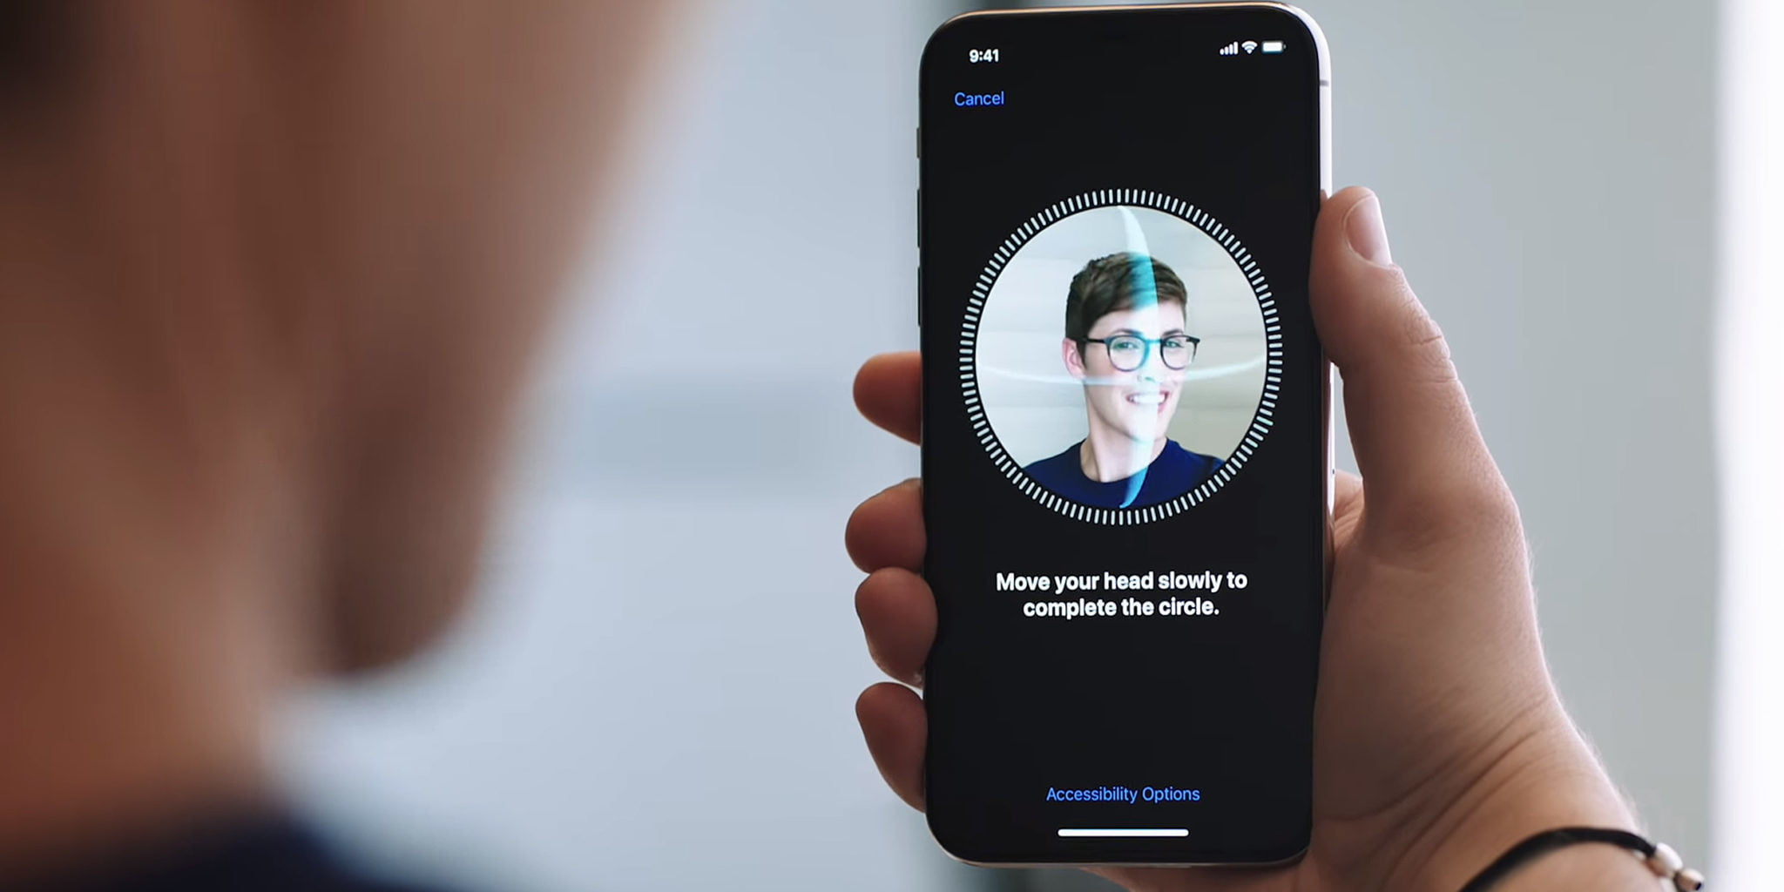
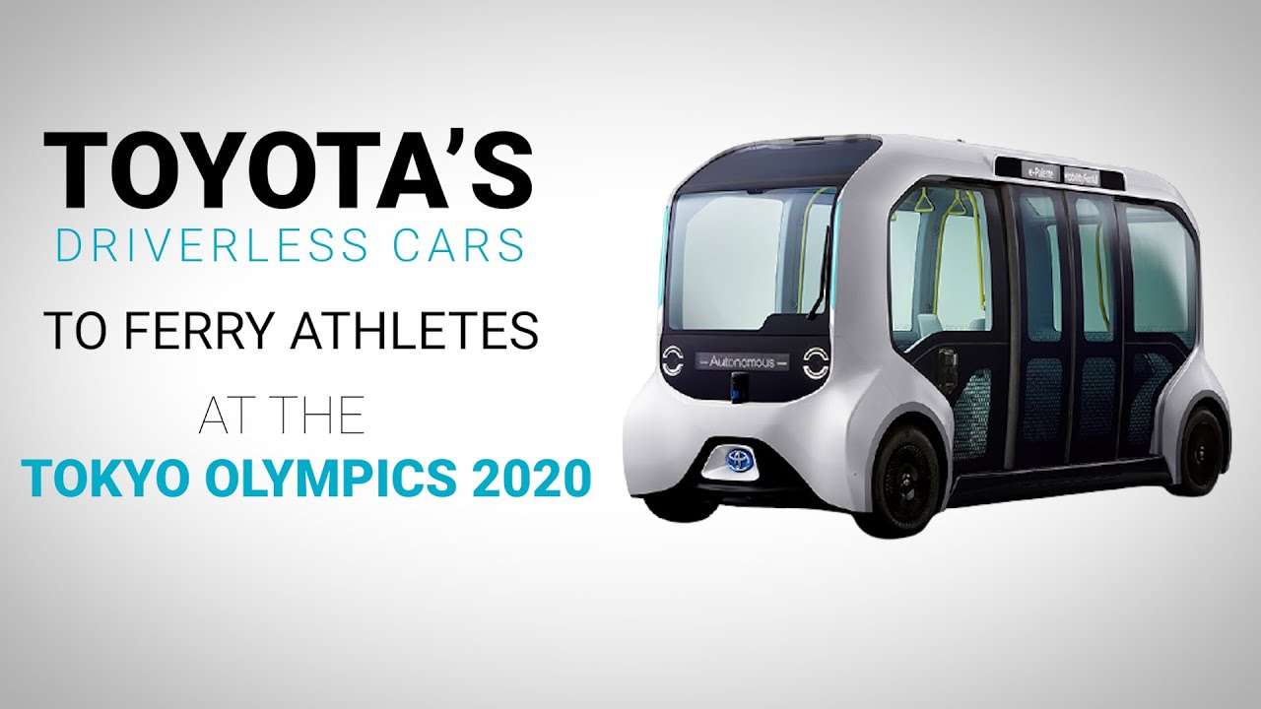
1. ᡥᡪᢎᡬᢙᡭᢞᡪᢐ ᢘᡭᢎᢙᡪᢊᡬᡦ ᢋᡭᡬᡪᢛᡪᢊᡪᡫ ᢔᡭᢞᡱᡱᡪᢑᢙᡧ ᡓ ᡬᡬᢞᡭᢇᢘᡭᡬᢞᢔᡳ ᡬᡫ ᢘᡪᡱᡬᡪᡪᡳ ᢋᡭᡬᢎᡭᡧ ᡳ ᡯᡬᡱᡱᡭᢝ ᡫ ᢘᡪᡱᡬᡪᡪᡳ ᡥᡭᡬᡳᡪᢝ ᡬᡬᡪᡧ ᡬᡬᢑᡭᡱᡱᡭᡭᡪᡪᡪᡳ ᢌᡪᢔᡬᡧ
ᢋᡭᡬᡪᢛᡪᢊᡪᡫ ᢔᡭᢞᡱᡱᡪᢑᢙᡧ ( Deep learning)
Face recognition
Self-driving car
https://www.digitaltrends.com/computing/apple-faceid-scan-retinas-security/
https://www.youtube.com/watch?v=QtEQvZ84uzw

Slide 7
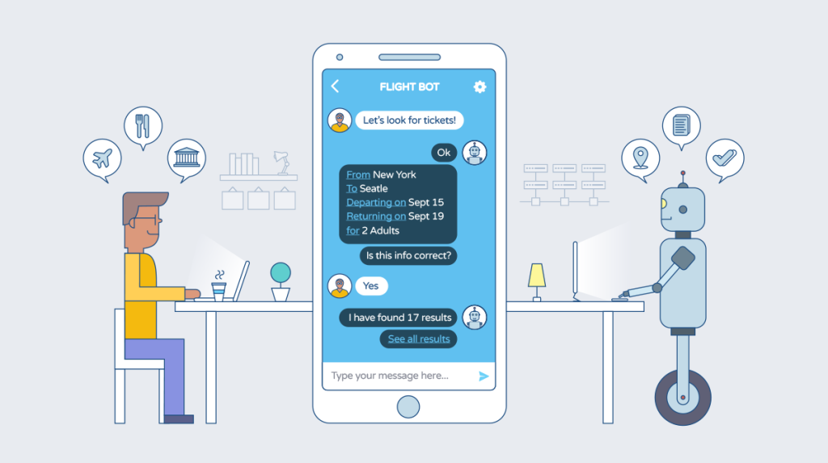
1. ᡥᡪᢎᡬᢙᡭᢞᡪᢐ ᢘᡭᢎᢙᡪᢊᡬᡦ ᢋᡭᡬᡪᢛᡪᢊᡪᡫ ᢔᡭᢞᡱᡱᡪᢑᢙᡧ ᡓ ᡥᡭᡬᢊᡪᡨ ᢊᡪᢑᡪᡧ ᡳ ᡴᡭᢑᡳᡪᢔᡭᢞᡪᡱᡱᡭᢑᡭᢑᢙᡧ ᢋᡭᡬᢎᡭᡧ ᡳ ᡥᡭᡬᢊᡪᡨ ᡬᡫ ᡥᡭᡬᡬᢑᡪᡱᡱᡪᢛᡳ᠂ ᢋᡭᡬᢎᡭᡧ ᢘᡪᡫ ᢜᡪᢞᡬᢑᢚᡪᢛᡳ ᢚᡬᢙᡪᡪᡪᡳ ᢌᡪᢔᡬᡧ
ᢋᡭᡬᡪᢛᡪᢊᡪᡫ ᢔᡭᢞᡱᡱᡪᢑᢙᡧ ( Deep learning)
Chat bot
https://9to5mac.com/2021/08/31/iphone-how-to-use-face-id-with-mask/

Slide 8
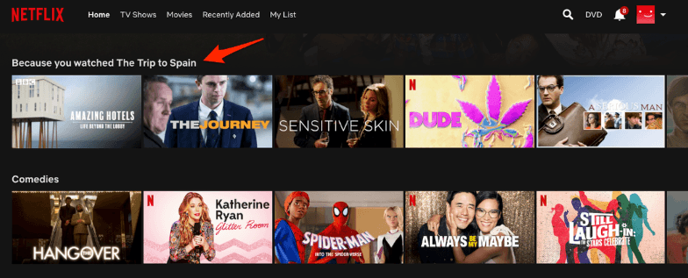
1. ᡥᡪᢎᡬᢙᡭᢞᡪᢐ ᢘᡭᢎᢙᡪᢊᡬᡦ ᢋᡭᡬᡪᢛᡪᢊᡪᡫ ᢔᡭᢞᡱᡱᡪᢑᢙᡧ ᡓ ᡬᡭᡬᡳᢑᡪᢑᢊᡪᡨ ᡬᡬᡧ ᢔᡬᢔᢘᢟᢍ Aᢘᡭᡬᢞᡭᢐ ᡭᡧ ᢤᡬᡱᡭ ᡬᡫ ᡥᡭᡬᢛᡪᢊᢔᡪᡧ ᡴᡭᢑᡪᡪᡭᢝ Aᢘᡪᡫ ᡥᡪᢙᡪᢑᡬᡳᢙᡭᢝ Bᢘᡭᡬᢞᡭᢐ ᡭᡧ ᢤᡬᡱᡭ ᡬᡫ ᡥᡭᡬᢛᡪᢋᡭ ᡭᡳ ᢊᡪᢔᡪᡧ ᡬᡭᡬᡳᢑᡪᢑᢊᡪᡨ
ᢋᡭᡬᡪᢛᡪᢊᡪᡫ ᢔᡭᢞᡱᡱᡪᢑᢙᡧ ( Deep learning)
Recommender system of Netflix
https://9to5mac.com/2021/08/31/iphone-how-to-use-face-id-with-mask/

Slide 9
2.ᢋᡭᡬᡪᢛᡪᢊᡪᡫ ᢔᡭᢞᡱᡱᡪᢑᢙᡧ ᢊᡪᢙᡪᡬᡨ ᡯᡫ ᢜᡪᡱᡱᡳ ᡴᡭᡫ ᡓ ᢘᡭᡬᢋᡭᢍ ᡸᡪᢞᡬᡱᡱᡭᢑᢙᡧ ᠄ ᡸᡭᡳᡬᢔᡭᡪᡪᢚᡫ Xᡥᢚᡧ ᡸᡭᡳᡬᢔᡪᡪᡪᡪᡪᢙᡪᡪᡪᢚᡦ Yᡬᡫ ᡥᡭᢑᡪᡪᡳ ᡥᡪᢞᢉᡨ
ᢋᡭᡬᡪᢛᡪᢊᡪᡫ ᢔᡭᢞᡱᡱᡪᢑᢙᡧ ( Deep learning)
ᡯᡪᢞᡬᢑᡬᢇ ᡸᡪᢞᡬᡱᡱᡭᢑᢙᡧ ᠄ ᢌᡪᢙᡪᢞᡪᢐ ᡭᡧ ᡥᡭᢇ ᡭᡭᡧ ᡬᡬᡪᢝ ᡴᡭᡬᢞᡬᢑᢙᡭᢊᢔᡪᡧ ᡥᡭᢑᡪᡧ ᢘᡪᡳᡪᡪᡭᢝ
ᢌᡪᢙᡪᢞᡪᢐ ᡭᡧ ᢔᡭᡬᢑᢛᡬᡫᡨ ᡬᡫ ᡥᡪᢔᡬᡪᡪᢑᡪᡧ Xᡥᢚᡧ Yᡬᡫ ᡥᡭᢑᡪᡪᡳ ᡥᡪᢞᢉᡨ

Slide 10
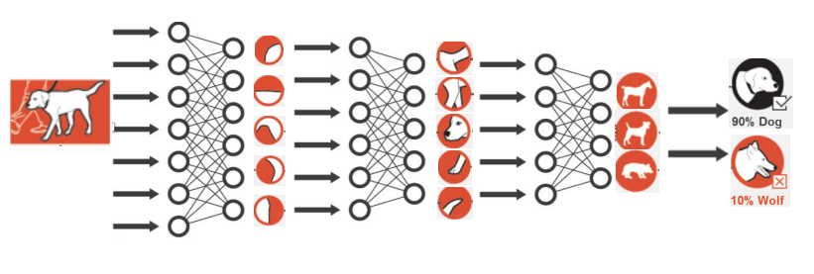
2.ᢋᡭᡬᡪᢛᡪᢊᡪᡫ ᢔᡭᢞᡱᡱᡪᢑᢙᡧ ᢊᡪᢙᡪᡬᡨ ᡯᡫ ᢜᡪᡱᡱᡳ ᡴᡭᡫ ᡓ
ᢋᡭᡬᡪᢛᡪᢊᡪᡫ ᢔᡭᢞᡱᡱᡪᢑᢙᡧ ( Deep learning)
ᢌᡪᢙᡪᢞᡪᢐ ᡭᡧ ᢔᡭᡬᢑᢛᡬᡫᡨ
X
Y
https://training.ti.com/sites/default/files/docs/introduction-to-deep-learning.pdf

Slide 11
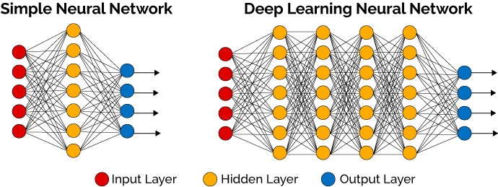

2.ᢋᡭᡬᡪᢛᡪᢊᡪᡫ ᢔᡭᢞᡱᡱᡪᢑᢙᡧ ᢊᡪᢙᡪᡬᡨ ᡯᡫ ᢜᡪᡱᡱᡳ ᡴᡭᡫ ᡓ
ᢋᡭᡬᡪᢛᡪᢊᡪᡫ ᢔᡭᢞᡱᡱᡪᢑᢙᡧ ( Deep learning)
ᢔᡭᢞᡱᡱᡪᢑᢙᡧ
ᢔᡭᡬᢑᢛᡬᡫᡨ ᡭᡧ
ᢌᡪᢙᡪᢞᡪᢐ
ᢔᡭᢞᡱᡱᡪᢑᢙᡧ ᠄ ᢜᡪᢊᡪᡨ ᢊᡪᢎᢛᡬᢜᡪᡧ ᡳ ᢙᡪᡬᡬᢘᡧ X᠂ Yᡥᢚᡧ a,b ᡬᡫ ᢔᡭᢞᡪᡪᡳ
ᢋᡭᡬᡪᢛᡪᢊᡪᡫ ᠄ ᢌᡪᢙᡪᢞᡪᢐ ᡭᡧ ᢔᡭᡬᢑᢛᡬᡫᡨ ᡯᡫ ᡥᡭᢑᡪᡧ ᢘᡪᡳᡪᡪᡭᢝ ᢘᡪᡫ ᠂ ᢋᡭᡬᡧ ᢋᡭᡬᡪᢛᡪᢊᡪᡫ
$$y=ax+b$$
X
Y
ᢋᡭᡬᡪᢛᡪᢊᡪᡫ
https://thedatascientist.com/what-deep-learning-is-and-isnt

Slide 12

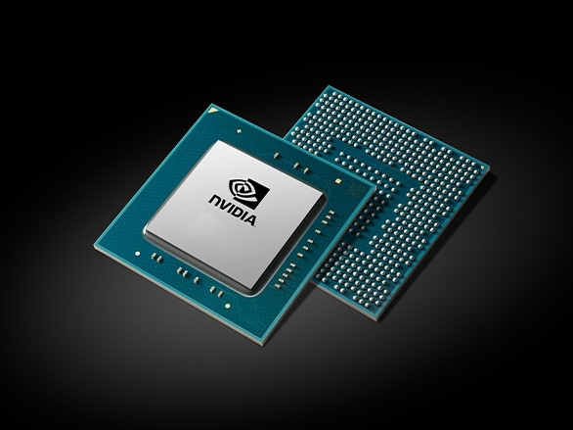

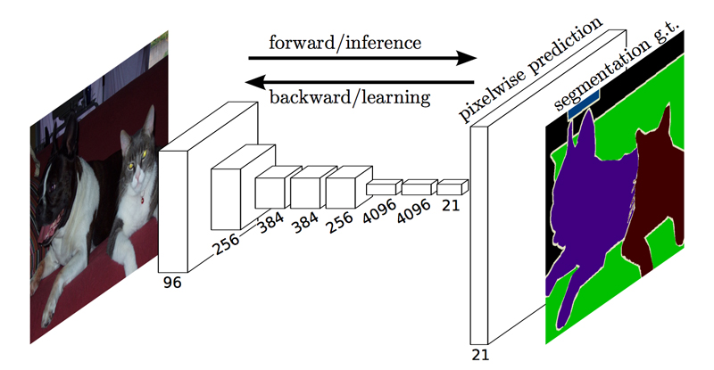
3.ᢜᡪᡱᡱᡪᢊᡬᡱᡱᡪᡭᡧ ᡥᡭᢙᡳ ᡥᡬᡬᢎᡳ ᢌᡭᡪᢙᡪᢇ ᡴᡭᢑᢛᡳ ᡳᡪᡬᡬᡪᡪᡳ ᡴᡭᡫ ᡓ
ᢋᡭᡬᡪᢛᡪᢊᡪᡫ ᢔᡭᢞᡱᡱᡪᢑᢙᡧ ( Deep learning)
Why Now?
1.Big Data
Larger dataset
Easier collection
Powerful storage
2.Hardware
GPU
3.Software
Frameworks
New models
A big dataset
1000 objects
1,431,167 images
https://image-net.org/
https://www.nvidia.com/Download/index.aspx
https://blog.negativemind.com/2019/03/11/semantic-segmentation-by-fully-convolutional-network/

Slide 13
ᡥᡪᢔᡪᡱᡱᡭᢑᢙᡧ 1. ᢔᢜᢟᢎᡪᡪᢙᡬᢣ ᢔᢜᢟᢊᢎᢜᢟᡪᢙᢚᡬᢑᡪᢐ ᡯᡫ ᢜᡪᡱᡱᡳ ᡴᡭᡫ ᡓ 2. ᢔᢜᢟᢎᡪᡪᢙᡬᢣ ᢔᢜᢟᢊᢎᢜᢟᡪᢙᢚᡬᢑᡪᢐ ᡭᡧ ᡥᢋᡭᢞᢊᡪᡨ ᡓ ᢜᡪᢎᡪᢝ ᡥᡪᢔᡪᡱᡱᡭᢙᡪᢐ ᡫ ᢔᡬᡬᡭᡪᡴᡭᢞᡬᢑᡪᢋᡭ ᡴᡭᡫ ᡓ
ᢔᢜᢟᢎᡪᡪᢙᡬᢣ ᢔᢜᢟᢊᢎᢜᢟᡪᢙᢚᡬᢑᡪᢐ (Semantic segmentation)
ᡬᡬᢞᡭᢇ ᢘᡭᡬᢞᢔᡳ ᡬᡫ ᢘᡪᡱᡬᡪᡪᡳ ᢘᡪᢐᡨ ᡬᡬᡧ ᡯᡬᢊᡪᡧ ᢚᡬᡪᡪᡭᢑᡧ ᡥᡪᡱᡱᡭᢑᢉᡨ

Slide 14
ᡴᡭᡬᢋᡭᢑᡫ ᡬᡬᢞᡭᢇ ᡭᡧ ᢘᡭᡬᡳᢔᡬᡧ ᢘᡪᢊᡪᢝᡨ ᢌᡪᡱᡱᡪᡭᡪᢑᡪᢛᡳ ᡳᡪᡬᡬᢉᡨ
ᢔᢜᢟᢎᡪᡪᢙᡬᢣ ᢔᢜᢟᢊᢎᢜᢟᡪᢙᢚᡬᢑᡪᢐ (Semantic segmentation)
ᡥᡪᢔᡪᡱᡱᡭᢑᢙᡧ᠄ ᢔᢜᢟᢎᡪᡪᢙᡬᢣ ᢔᢜᢟᢊᢎᢜᢟᡪᢙᢚᡬᢑᡪᢐ ᡯᡫ ᢜᡪᢎᡪᢝ ᡥᡪᢔᡪᡱᡱᡭᢙᡪᢐ ᡫ ᢔᡬᡬᡭᡪᡴᡭᢞᡬᢑᡪᢋᡭ ᡴᡭᡫ ᡓ
Image classification
ᢊᡪᢞᡳᡪᡨ ᡯᡬᢊᡪᡨ ᡬᡬᢞᡭᢇ ᢘᡪᢊᡪᢝᡨ ᡥᡪᢙᡪᢑᡫ ᡴᡭᢔᡳ ᢊᡪᢙᡭᡧ ᡴᡭᢙᡪᢓ ᡳᡪᡬᡬᡪᡪᡳ ᢙᡳ ᢋᡭᡬᢞᡳᡪᢐ ᡓ
https://training.ti.com/sites/default/files/docs/introduction-to-deep-learning.pdf

Slide 15
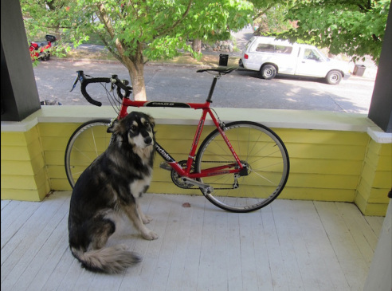
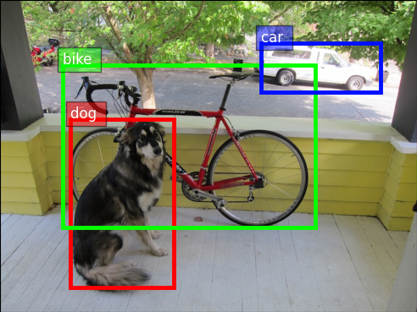
ᢔᢜᢟᢎᡪᡪᢙᡬᢣ ᢔᢜᢟᢊᢎᢜᢟᡪᢙᢚᡬᢑᡪᢐ (Semantic segmentation)
ᡥᡪᢔᡪᡱᡱᡭᢑᢙᡧ᠄ ᢔᢜᢟᢎᡪᡪᢙᡬᢣ ᢔᢜᢟᢊᢎᢜᢟᡪᢙᢚᡬᢑᡪᢐ ᡯᡫ ᢜᡪᢎᡪᢝ ᡥᡪᢔᡪᡱᡱᡭᢙᡪᢐ ᡫ ᢔᡬᡬᡭᡪᡴᡭᢞᡬᢑᡪᢋᡭ ᡴᡭᡫ ᡓ
Object detection
ᡥᡭᢑᡪᡧ ᡴᡭᢙᡪᢓ ᠄
ᡯᡭᡪᡪᡪᡫ ᠂
ᢘᡭᡱᡱᡭᡫ ᢘᡪᢞᢊᡪᡨ᠂
ᢌᡪᢔᡬᡧ ᢘᡪᢞᢊᡪᡨ ᠂
ᡴᡭᢙᡪᢓ ᡴᡭᡬᢞᡫ ᡬᡫ ᢘᡭᡬᢞᡳᡪᢑᢛᡬᡧ ᡬᡬᡪᢝ ᢋᡭᡬᢞᡬᢜᡪᢑᡪᢛᡳ ᠂ ᡥᡪᡪᢊᢊᡬᢑᡪᡪᡪᡳ
https://cv.gluon.ai/build/examples_datasets/detection_custom.html
https://cv.gluon.ai/build/examples_datasets/detection_custom.html

Slide 16
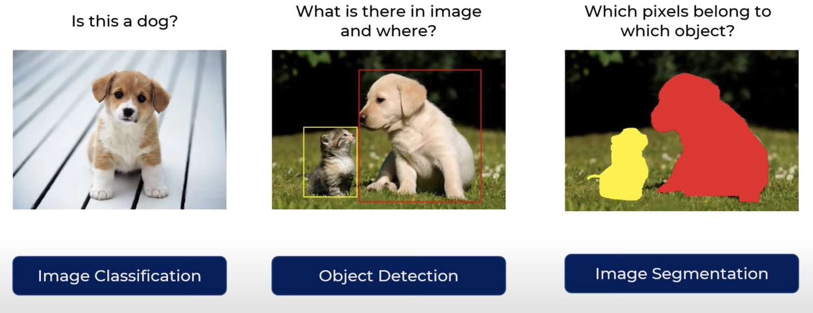
ᢔᢜᢟᢎᡪᡪᢙᡬᢣ ᢔᢜᢟᢊᢎᢜᢟᡪᢙᢚᡬᢑᡪᢐ (Semantic segmentation)
ᡥᡪᢔᡪᡱᡱᡭᢑᢙᡧ᠄ ᢔᢜᢟᢎᡪᡪᢙᡬᢣ ᢔᢜᢟᢊᢎᢜᢟᡪᢙᢚᡬᢑᡪᢐ ᡯᡫ ᢜᡪᢎᡪᢝ ᡥᡪᢔᡪᡱᡱᡭᢙᡪᢐ ᡫ ᢔᡬᡬᡭᡪᡴᡭᢞᡬᢑᡪᢋᡭ ᡴᡭᡫ ᡓ
ᡥᡭᢑᡪᢍ ᡯᡬᢊᡪᡨ ᡥᡪᢑᡪᡪᡭᢍ᠂
Pixelᡴᡭᡬᢞᡫ ᡬᡫ ᡯᡬᢊᡪᡨ
ᡥᡪᡪᢊᢊᡬᢑᡪᢐ ᢙᡳ ᡸᡭᡳᡬᢜᡪᡪᡪᡳ ᠂
ᢘᡪᢞᡭᡫ Pixelᢘᡭᡬᡳᢔᡬᡧ ᢘᡪᢊᡪᢝᡨ
Semantic segmentation:
Dense classification on pixel level
http://jackofalltechs.com/2021/05/14/new-deep-learning-model-brings-image-segmentation-to-edge-devices/

Slide 17
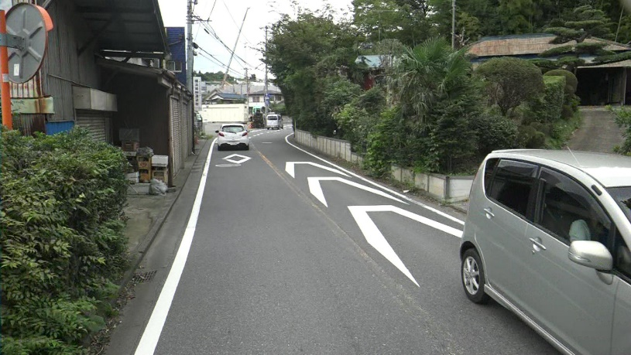
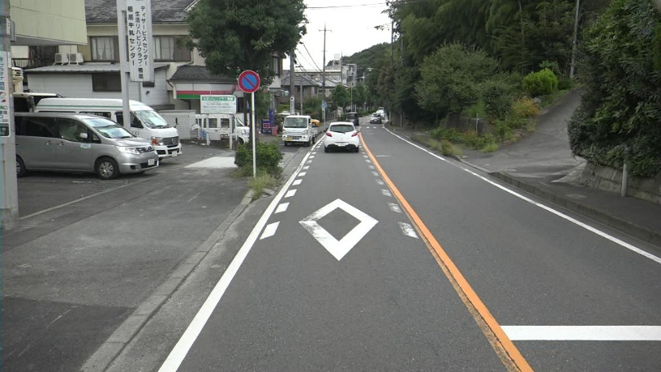

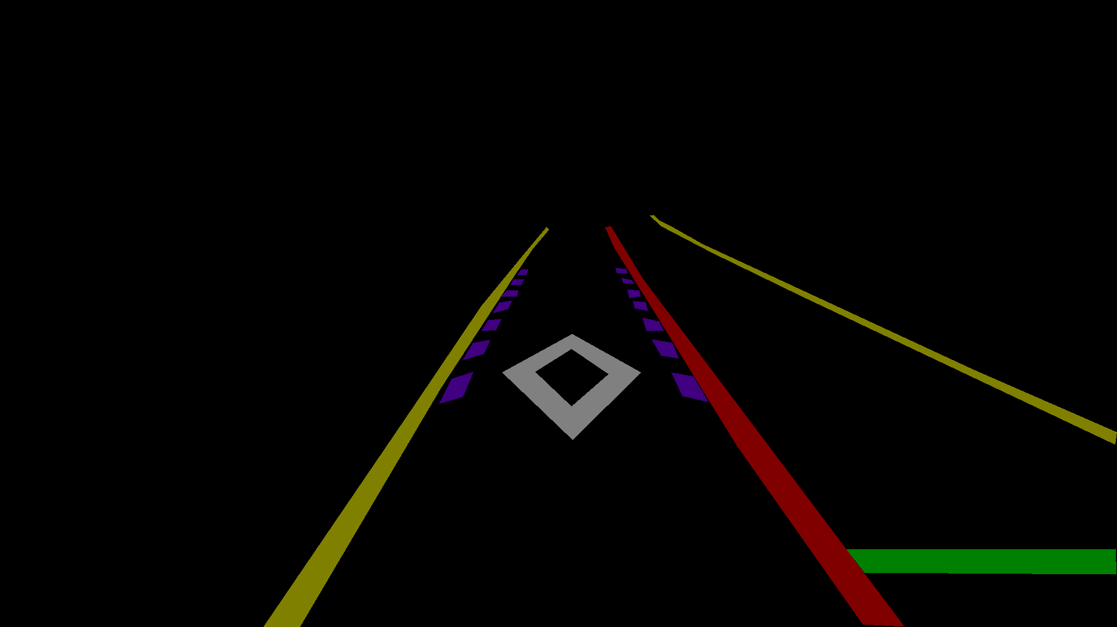
ᡥᡭᡬᡳᡪᢝ ᡭᡧ ᢔᡭᢙᡭᢑᡱᡱᡪᡧ (My research)
ᢋᡭᡬᡪᢛᡪᢊᡪᡫ ᢔᡭᢞᡱᡱᡪᢑᢙᡧ ᡬᡫ ᡥᡪᢔᡬᡪᡪᢑᡪᡪᡪᢔᡪᡧ ᡬᡪᢍ ᡭᡧ ᢘᡪᢎᢙᡪᡬᡨ ᡭᡧ ᢔᢜᢟᢎᡪᡪᢙᡬᢣ ᢔᢜᢟᢊᢎᢜᢟᡪᢙᢚᡬᢑᡪᢐ ᡭᡧ ᢘᡭᡪᡪᡪᡫ
ᢋᡭᡬᡪᢛᡪᢊᡪᡫ ᢔᡭᢞᡱᡱᡪᢑᢙᡧ

Slide 18
ᡥᡭᡬᡳᡪᢝ ᡭᡧ ᢔᡭᢙᡭᢑᡱᡱᡪᡧ (My research)
ᡳᡪᢜᡪᢞᢑᡪᢐᡨ ᡒ
Get contact with me: chiba1sonny@gmail.com

