Slide 1
Tensor Logic The Language of AI
Pedro Domingos
University of Washington
Notes:
What I would like to propose here today is a new programming language. A language that will suit AI’s needs better than anything we have today and correspondingly speed up progress.

Slide 2
Fields Take Off When They Find Their Language
Physics: Calculus
Electrical engineering: Complex numbers
Digital circuits: Boolean logic
Chip design: HDLs
Networking: Internet Protocol
Web: HTML
Databases: Relational algebra
Computer science: High-level languages
Etc.
Notes:
Physics took off when Newton invented calculus, and it couldn’t have taken off without it.
Maxwell’s equations would be unusable without Heaviside’s vector calculus notation (curl, divergence, etc.).
Physicists like to say that a good notation is half the battle.
HDLs: hardware description languages.
And it’s not just in quantitative fields: jargon in qualitative fields, style/genre in art, etc.

Slide 3
What a Field’s Language Does
Saves time
Makes key things obvious
Focuses attention
Decreases entropy
Avoids hacking
Unites the field
Changes how people think
Notes:
Entropy: researchers push in all directions, so there isn’t much progress in any.

Slide 4
Has AI Found Its Language?
LISP, Prolog?
Graphical models?
Markov logic networks?
Python?
NumPy, PyTorch, TensorFlow, Keras, JAX, etc.?
Neurosymbolic AI?
Notes:
Decade by decade: 50s+, 80s, 90s, 2000s, last 15 years

Slide 5
What Should the Language of AI Do?
Hide everything that’s not AI
Easily incorporate knowledge
Reason automatically
Learn automatically
Make models transparent
Ensure reliability
Scale effortlessly

Slide 6
What Should the Language of AI Do?
Hide everything that’s not AI
Easily incorporate knowledge
Reason automatically
Learn automatically
Make models transparent
Ensure reliability
Scale effortlessly
Symbolic AI
Deep Learning
Notes:
So the language of AI needs to combine the key features of symbolic AI and deep learning.
As long as we have just one of them, we’re condemned to hack the other, with predictably poor results.

Slide 7
Tensor Logic = Tensor Algebra + Logic Programming
Deep Learning
Symbolic AI
Notes:
Tensor logic doesn’t just combine tensor algebra and logic programming; it unifies them.

Slide 8
Logic Programming
Logic program = Rules + Facts
Fact: Relation(Object₁, ... , Object_{k})
E.g.: Parent(Bob,Chris), Ancestor(Alice,Bob)
Rule: Head :- Body
Or: Consequent :- Antecedent₁, … , Antecedent_{n}
E.g.: Ancestor(x,y) :- Parent(x,y)
Ancestor(x,z) :- Ancestor(x,y),Parent(y,z)
Prolog: arguments may be constants, variables or functions
Datalog: no functions
Notes:
My apologies if you already know this, but it’ll still be useful to pin down the terminology.
In the interests of time I won’t be very rigorous. I’ll just try to get the main concepts across.
A logic program can also be viewed as a knowledge base.
Logic programs have both declarative and procedural semantics.
Declarative: a set of statements about the world.
Procedural: each rule is a function.

Slide 9
The Database View
In database terms, a rule is a series of joins followed by a projection
The join of relations R and S is the set of all tuples formed from tuples in R and S having the same values of the same arguments
E.g.:
The projection of a relation R onto a subset G of its arguments is the relation obtained by discarding all arguments of R not in G
E.g:
x | y
Alice | Bob
Alice | Ed
y | z
Bob | Chris
Bob | Dan
x | y | z
Alice | Bob | Chris
Alice | Bob | Dan
x | y | z
Alice | Bob | Chris
Alice | Bob | Dan
x, z
x | z
Alice | Chris
Alice | Dan
Notes:
You can see how the second rule in the previous slide is a join of Ancestor and Parent projected onto Ancestor.
And these tables apply that rule to the database {Ancestor(Alice, Bob), Ancestor(Alice, Ed), Parent(Bob, Chris), Parent(Bob, Dan)}.

Slide 10
Inference in Logic Programming
Forward chaining: Repeatedly apply all rules until no new facts can be inferred
Backward chaining: Given query, check if it’s a fact If not, find rule(s) with head = query & repeat with their bodies
E.g.: Query: Ancestor(Alice,Chris)? Answer: True
E.g. Query: Ancestor(Alice,x)? Answer: {Bob,Chris}
Notes:
Forward chaining on Datalog programs has the important property that it’s sound and complete.
Imagine having that in neural networks: sound and complete inference. Well, stay tuned.
There’s also resolution, but applied to logic programs it’s no more powerful than forward and backward chaining, and we won’t be needing it here.

Slide 11
Inductive Logic Programming
Input: Database
Output: Logic program
Inverse deduction: What rules would allow inferring target predicate from evidence?
Search: greedy, beam, etc.
Objective: accuracy, information gain, simplicity, etc.
Prior knowledge is easy to incorporate
Declarative bias: predefined form for rules, etc.
Predicate invention: discovering hidden relations

Slide 12
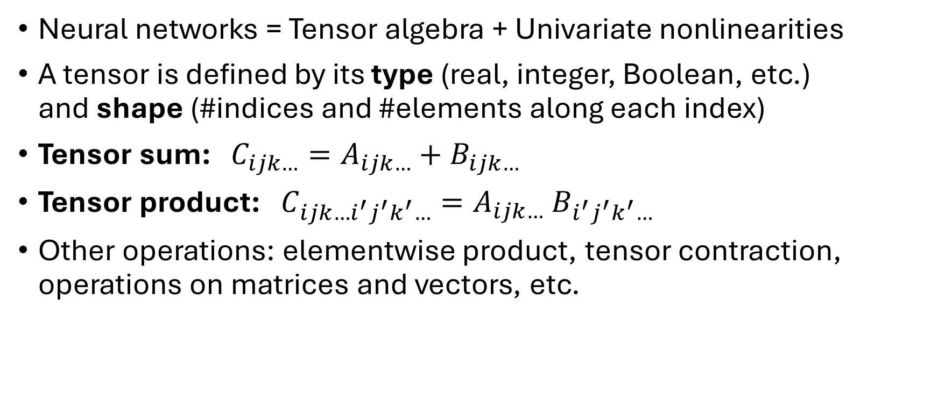
Tensor Algebra
Neural networks = Tensor algebra + Univariate nonlinearities
A tensor is defined by its type (real, integer, Boolean, etc.) and shape (#indices and #elements along each index)
Tensor sum: $C_{ijk…}=A_{ijk…}+B_{ijk…}$
Tensor product: $C_{ijk…i^{′}j^{′}k^{′}…}=A_{ijk…} B_{i^{′}j^{′}k^{′}…}$
Other operations: elementwise product, tensor contraction, operations on matrices and vectors, etc.
Notes:
The indices are also called the modes of the tensor, and the #indices is also called the rank of the tensor.
A scalar is a tensor of rank 0, a vector is a tensor of rank 1, and a matrix is a tensor of rank 2, i.e., it has two modes, one vertical and one horizontal.
A tensor of rank 3 also has a mode perpendicular to the slide.
E.g., if a book had a matrix of the same dimensions on each page, the page number would be the third mode.

Slide 13
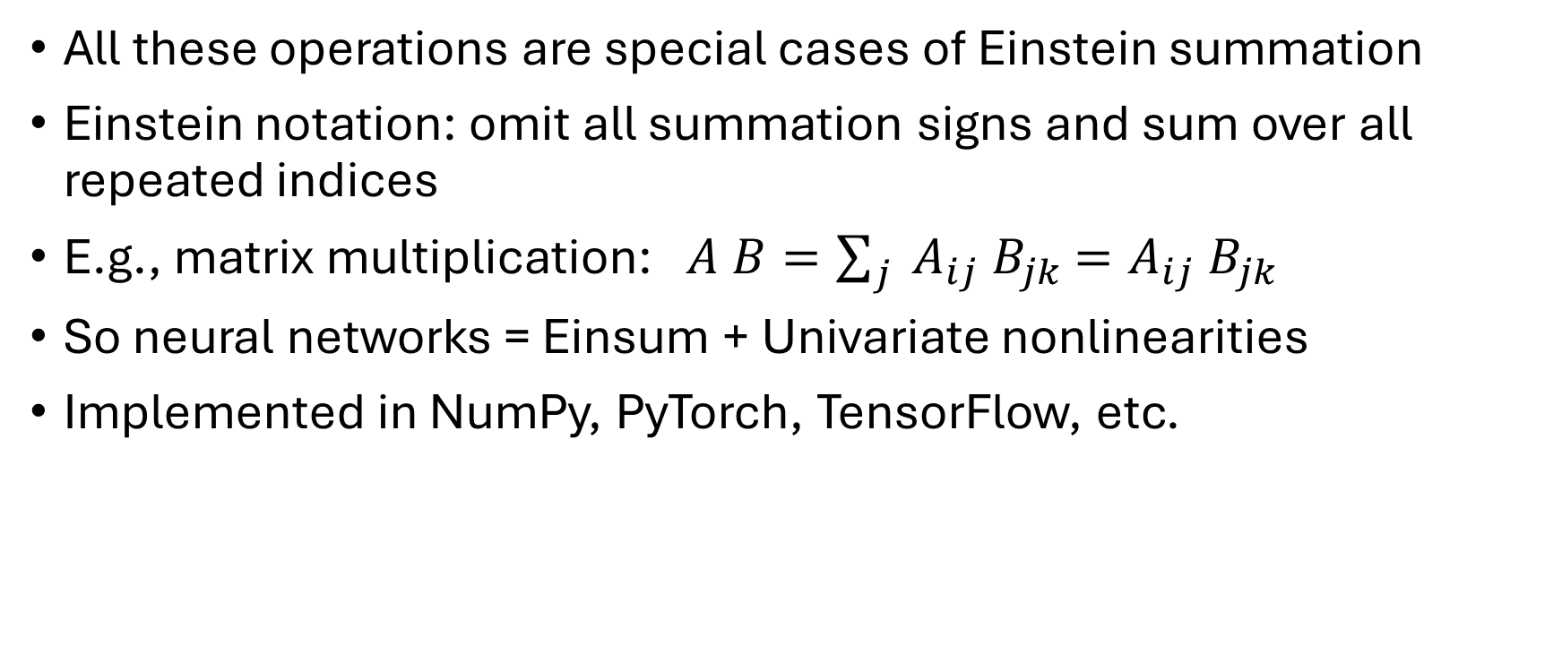
Einstein Summation (Einsum)
All these operations are special cases of Einstein summation
Einstein notation: omit all summation signs and sum over all repeated indices
E.g., matrix multiplication: $A B=\sum_{j}{{ A}_{ij}{ B}_{jk} =A_{ij}{ B}_{jk}}$
So neural networks = Einsum + Univariate nonlinearities
Implemented in NumPy, PyTorch, TensorFlow, etc.
Notes:
You can only get away with omitting the indices if there’s at most 2. For everything else there’s einsum.
Einsum is amazing. If all you get out of this talk is that you should be using einsum instead of matmul, that’s enough to make the talk worth it.

Slide 14
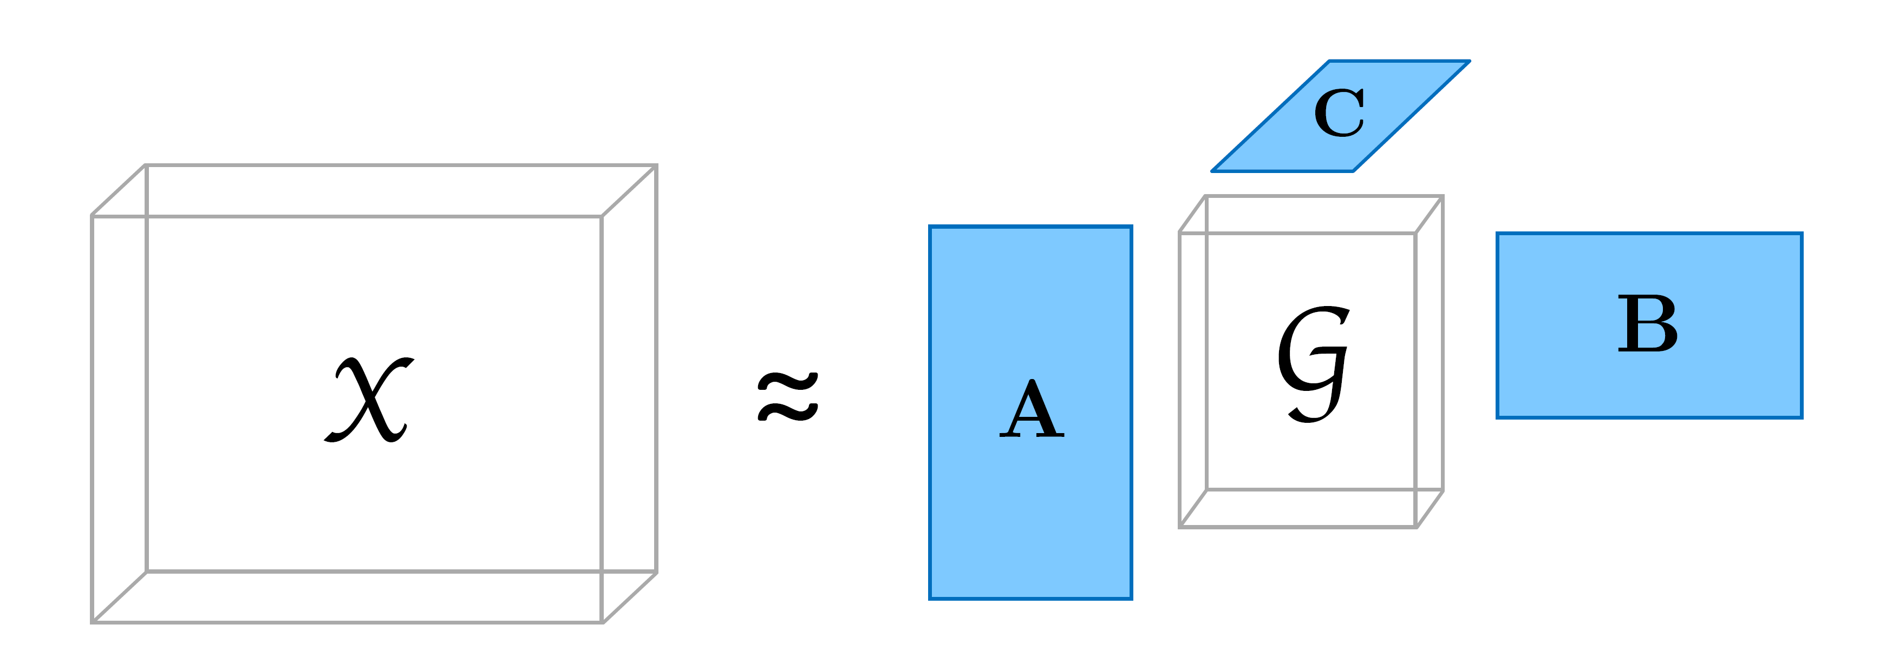

Tensor Decompositions
Singular value decomposition: $M_{ij}=A_{ip}{ B}_{jq}{ S}_{pq}$
Tucker decomposition: $T_{ijk…}=A_{ip}{ B}_{jq}{ C}_{kr} . . . { S}_{pqr…}$
Factor
matrices
Data tensor
S
T
Core
tensor
Notes:
SVD decomposes a matrix into a product of two orthogonal ones and a diagonal matrix. The diagonal elements are the singular values.
The SVD can be viewed as a generalization of the eigendecomposition to rectangular matrices.
Can we generalize this to tensors? Yes. There’s more than one way, but the most interesting one for us is the Tucker decomposition.
We can view the Tucker decomposition as embedding a tensor in the same way that we embed a vector by multiplying it by a matrix.
In the Tucker decomposition each mode of the tensor is multiplied by a matrix: all column vectors by A, row vectors by B, and tube vectors by C.
The core tensor is a more compact representation of the data tensor.

Slide 15
First Key Idea
Q: What is the relation between tensors and relations?
A: A relation is a compact representation of a sparse Boolean tensor
Alice
Bob
Chris
Dan
Alice
0 | 1 | 0 | 0
0 | 0 | 1 | 1
0 | 0 | 0 | 0
0 | 0 | 0 | 0
Alice | Bob
Bob | Chris
Bob | Dan
Bob
Chris
Dan
Notes:
The objects in the relation are the indices in the tensor.

Slide 16

Second Key Idea
Q: What is the relation between rules and einsums?
A: Rules are einsums over Boolean tensors, with a step function as the nonlinearity
Aunt(x,z) :- Sister(x,y), Parent(y,z)
Prolog
$$A_{xz}=H(S_{xy}{ P}_{yz})$$
Einsum
Aunt[x,z] = step(Sister[x,y] Parent[y,z])
Tensor Logic
Notes:
This is a remarkable fact that no one seems to have noticed before.

Slide 17
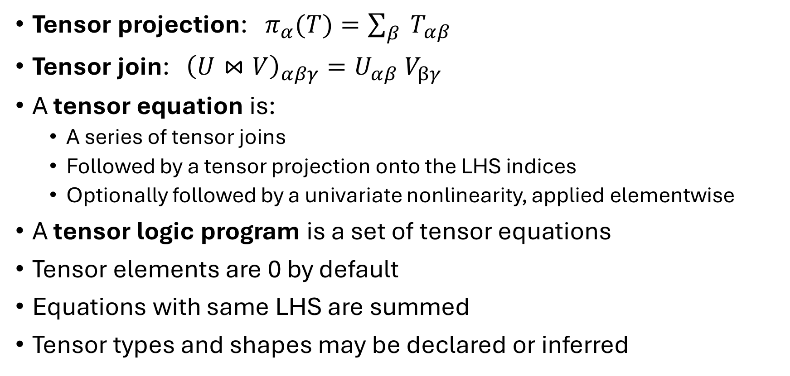
Tensor Logic
Tensor projection: $π_{α}(T)=\sum_{β}{ T_{αβ}}$
Tensor join: ${\left(U⋈V\right)}_{αβγ}={U_{αβ} V}_{βγ}$
A tensor equation is:
A series of tensor joins
Followed by a tensor projection onto the LHS indices
Optionally followed by a univariate nonlinearity, applied elementwise
A tensor logic program is a set of tensor equations
Tensor elements are 0 by default
Equations with same LHS are summed
Tensor types and shapes may be declared or inferred
Tensor₀ = f(Tensor₁ … Tensor_{n})
Notes:
So here’s the definition of tensor logic in one slide.
We define two new operations on tensors: tensor projection and tensor join.
Alpha, beta and gamma are sets of indices, interspersed in any order.
The projection of a tensor onto a subset of its indices alpha is the sum for each value of alpha of all the elements with that value.
So you can project a vector onto a scalar by summing all its elements, a matrix onto a column vector by summing each row into an element of the vector, a cubic tensor onto any one of its faces and then that face onto one of its edges and then onto a corner, etc.
If the tensors are Boolean and the projection is followed by a step function, it reduces to database projection.
The join of two tensors on a common subset of indices beta has one element for each pair of elements with the same value of beta, and the element is their product.
If beta is empty tensor join reduces to tensor product. If beta is all the indices it reduces to elementwise product.
If the tensors are Boolean it reduces to database join.
So tensor join and projection do all the operations needed for both neural networks and symbolic AI.
Rules and einsums are both tensor joins followed by projection. The only difference is in the type of the tensor (Boolean vs. real).
There are no keywords in tensor logic. Everything is done with tensor equations.

Slide 18
Syntactic Sugar
Multiple terms in one equation: Y = step(W[i] X[i] + C)
Index functions: X[i,t+1] = W[i,j] X[j,t]
Normalization: Y[i] = softmax(X[i])
Other tensor functions: Y[k] = concat(X[i,j])
Alternate aggregations: +=, max=, avg=
Procedural attachment
Prolog syntax
Etc.
Notes:
Exercise to the reader: how to implement each of these in core tensor logic.

Slide 19
Neural Networks in Tensor Logic
Perceptron (complete program):
Y = step(W[i] X[i])
W = [0.2, 1.9, -0.7, 3]
X = [0, 1, 1, 0] (or: X(1), X(2))
Y?
Multilayer perceptron:
X[i,j] = sig(W[i,j,k] X[i-1,k])
Recurrent neural network:
X[i,t+1] = sig(W[i,j] X[j,t] + V[i,j] U[j,t])

Slide 20
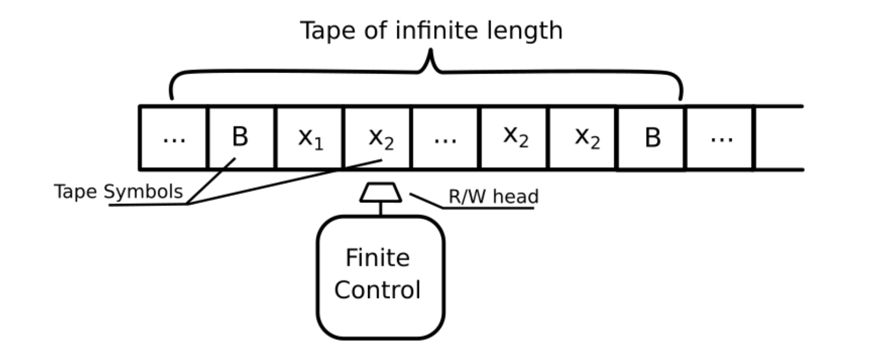
Tensor Logic Is Turing-Complete
RNNs are Turing-complete (Siegelmann & Sontag, 1995)
RNNs can be implemented in tensor logic
Therefore tensor logic is Turing-complete
But Datalog is not
Kolmogorov-Arnold representation theorem: Every multivariate function is a sum of univariate ones
Prolog puts functions inside predicates, tensor logic puts them outside

Slide 21
Inference
Forward chaining (cf. Datalog, Rete):
Treat program as linear code
At each step compute tensor elements whose inputs are available
Repeat until no new elements can be computed
Backward chaining (cf. Prolog):
Treat each tensor equation as a function
Query is top-level call
Recurse until query is answered
Best choice depends on application

Slide 22
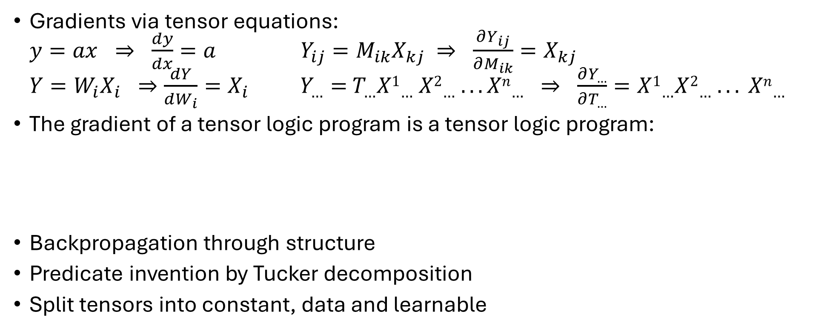
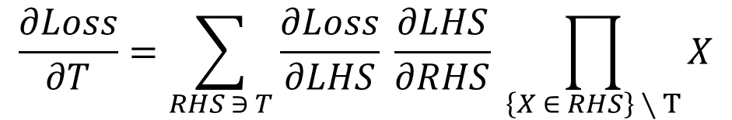
Learning
Gradients via tensor equations: $y=ax ⇒ \frac{dy}{dx}=a$ $Y_{ij}=M_{ik}X_{kj} ⇒ \frac{∂Y_{ij}}{∂M_{ik}}=X_{kj}$ $Y=W_{i}X_{i} ⇒\frac{dY}{dW_{i}}=X_{i}$ $Y_{…}={ T_{…}X1}_{…}{ X2}_{…} . . . {{Xn}_{…} ⇒ \frac{∂Y_{…}}{∂T_{…}}=X1_{…}X2_{…} . . . Xn}_{…}$
The gradient of a tensor logic program is a tensor logic program:
Backpropagation through structure
Predicate invention by Tucker decomposition
Split tensors into constant, data and learnable
$$\frac{∂Loss}{∂T}=\sum_{RHS ∋ T}{\frac{∂Loss}{∂LHS} \frac{∂LHS}{∂RHS} \prod_{\left\{X ∈ RHS\right\} ∖ T}{X}}$$
Notes:
Gradient = One rule per rule and tensor in its RHS

Slide 23
Convnets in Tensor Logic
Convolutional layer:
Features[x,y] = relu(Filter[dx,dy,ch] Image[x+dx,y+dy,ch])
Sum-pooling layer:
Pooled[x/S,y/S] = Features[x,y]

Slide 24
Graph Neural Networks in Tensor Logic
Graph: Neig(Alice,Bob), Neig(Bob,Chris), etc.
Initialization: Emb[n,0,d] = X[n,d] (node, layer, dimension)
MLP: Z[n,l,d’] = relu(W_{P}[l,d’,d] Emb[n,l,d]) , etc.
Aggregation: Agg[n,l,d] = Neig(n,n’) Z[n’,l,d’]
Update: Emb[n,l+1,d] = relu(W_{Agg} Agg[n,l,d] + W_{Self} Z[n,l,d])
Node classification: Y[n] = sig(W_{Out}[d] Emb[n,L,d])
Edge prediction: Y[n,n’] = sig(Emb[n,L,d] Emb[n’,L,d])
Graph classification: Y = sig(W_{Out}[d] Emb[n,L,d])
Notes:
Not shown: Post-aggregation MLP in each layer.

Slide 25
Attention in Tensor Logic
Query[p,d_{k}] = W_{Q}[d_{k},d] X[p,d]
Key[p,d_{k}] = W_{K}[d_{k},d] X[p,d]
Val[p,d_{v}] = W_{V}[d_{v},d] X[p,d]
Comp[p,p’.] = softmax(Query[p,d_{k}] Key[p’,d_{k}] / sqrt(D_{k}))
Attn[p,d_{v}] = Comp[p,p’] Val[p’,d_{v}]

Slide 26
Transformers in Tensor Logic
Input: X(p,t)
Embedding: XE[p,d] = X(p,t) Emb[t,d]
Positional encoding:
PE[p,d] = Even(d) sin(p / (L^(d/D_{e}))) + Odd(d) cos(p / (L^((d-1)/D_{e})))
Residual stream: Stream[0,p,d] = XE[p,d] + PE[p,d]
Attention:
Query[b,h,p,d_{k}] = W_{Q}[b,h,d_{k},d] Stream[b,p,d], etc.
Comp[b,h,p,p’.] = softmax(Query[b,h,p,d_{k}] Key[b,h,p’,d_{k}] / sqrt(D_{k}))
Attn[b,h,p,d_{v}] = Comp[b,h,p,p’] Val[b,h,p’,d_{v}]
Merge and layer norm:
Merge[b,p,d_{m}] = concat(Attn[b,h,p,d_{v}])
Stream[b,p,d.] = norm(W_{S}[b,d,d_{m}] Merge[b,p,d_{m}] + Stream[b,p,d])
MLP: MLP[b,p,d’] = relu(W_{P}[b,p,d’,d] Stream[b,p,d]), etc.
Output: Y[p,t.] = softmax(W_{O}[t,d] Stream[B,p,d])

Slide 27
Symbolic AI in Tensor Logic
Just write it in Prolog.

Slide 28
Embedded Databases
Embedding objects: Emb[obj,dim]
Embedding relations: EmbRel[i,j] = Rel(x,y) Emb[i,x] Emb[j,y]
This is a Tucker decomposition of the relation
EmbRel is the core tensor of Rel
Can be constructed in O(#tuples) time
Relation symbols can also be embedded
Reified database: DB(r,x,y)
Embedded database:
EmbDB[h,i,j] = DB(r,x,y) Emb[h,r] Emb[i,x] Emb[j,y]

Slide 29
Embedded Knowledge Bases and Reasoning
To embed a rule, replace antecedents & consequent by their embeddings:
EmbCons[…] = EmbAnt₁[…] EmbAnt₂[…] ... EmbAnt_{n}[…]
All reasoning can be done in embedding space:
Embed query and evidence
Reason with embedded rules
Extract answer
Works because einsum factors are commutative and associative:
(Rel(x,y) Emb[i,x] Emb[j,y]) Emb[i,x’] Emb[j,y’] ≈ Rel(x’,y’), etc.
Combines symbolic and analogical reasoning Embeddings are random unit vectors
Similarity of two objects = Dot product of their embeddings
Transparent and reliable
Notes:
With softmax as the nonlinearity in tensor equations, temperature = 0 means pure deduction (cf. RAG) and higher temperature means farther analogies.

Slide 30
Kernel Machines in Tensor Logic
Kernel machine: Y[Q] = f(A[i] Y[i] K[Q,i] + B)
Polynomial kernel: K[i,i’] = (X[i,j] X[i’,j])^n
Gaussian kernel: K[i,i’] = exp(-(X[i,j] - X[i’,j])^2 / Var)
Structured prediction: Y[Q,n]

Slide 31
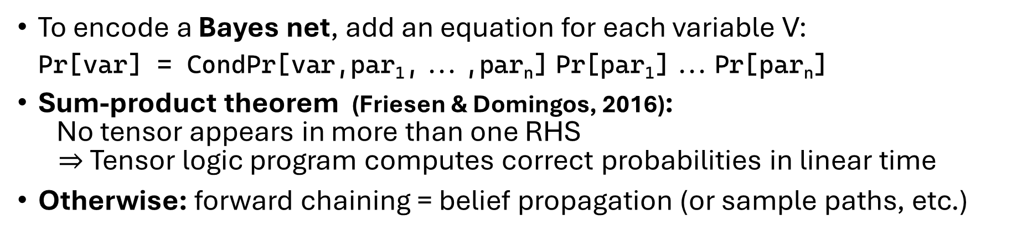
Graphical Models in Tensor Logic
Graphical Models | Tensor Logic
Potential | Tensor
Marginalization | Projection
Pointwise product | Join
Join tree | Tree-like program
Pr(Query | Evidence) | Prog(Q,E) / Prog(E)
To encode a Bayes net, add an equation for each variable V: Pr[var] = CondPr[var,par₁,...,par_{n}] Pr[par₁]...Pr[par_{n}]
Sum-product theorem (Friesen & Domingos, 2016): No tensor appears in more than one RHS $⇒$ Tensor logic program computes correct probabilities in linear time
Otherwise: forward chaining = belief propagation (or sample paths, etc.)
Notes:
To compute Z, add Z = LHS of root tensor to the program and query it.
Slight abuse of notation: should have a different tensor for each variable.
Exercise to the reader: encode a Bayes net in a single rule. That’s what you’d do to encode MRFs, etc.

Slide 32
Beyond AI
Science: tensor logic minimizes distance from equations to code
Scientific computing is tensor operations wrapped in logic
To make the logic learnable, use tensor logic
To make anything learnable, write it in tensor logic

Slide 33
Scaling Up
Option 1: Separation of concerns
Dense subtensors: GPUs
Sparse subtensors: database query engines, etc.
Option 2: All on GPUs via Tucker decomposition
Exponential efficiency gains
Bounded error probability
Dovetails with embedding and learning

Slide 34
Driving Adoption
AI is no longer a niche → Ride the wave
Backward compatibility with Python
Cure the big pains (e.g., hallucinations)
Killer apps (e.g., reasoning models, code, math)
IDEs for coding, data wrangling, modeling, evaluation, etc.
Open source community
Vendor competition
Education

Slide 35
Next Steps
CUDA implementation
Applications
Libraries
Extensions
New research directions

Slide 36

Summary
One language for all of AI
Tensor logic program = Set of tensor equations
Tensor equation = Numeric Datalog rule = Einsum
Reasoning and learning out of the box
Transparent and reliable
Don’t leave home without it
tensor-logic.org

