Slide 1
Mastering the Game of Go with
Deep Neural Networks and Tree Search
Alphgo 论文解读
Huang, Yibin(黄昳彬)

Slide 2
Table of Content（目录）
Search tree 搜索树模型
Monte Carlo Tree Search 蒙特卡洛树搜索
Supervised Learning of Policy Networks 有监督学习的策略网络
Reinforcement Learning of Policy Networks 强化学习的策略网络
Reinforcement Learning of Value Networks 强化学习的值网络
Monte Carlo Tree Search of AlphaGo
蒙特卡洛搜索树结合策略网络和值网络

Slide 3
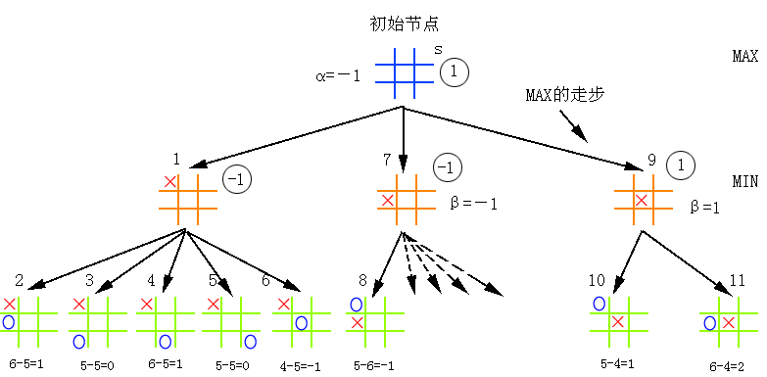
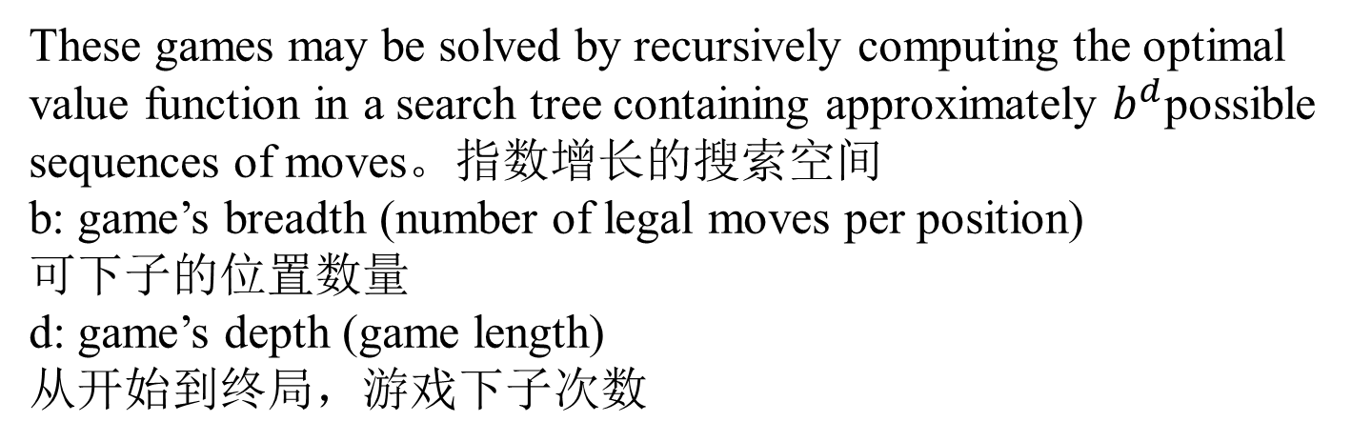
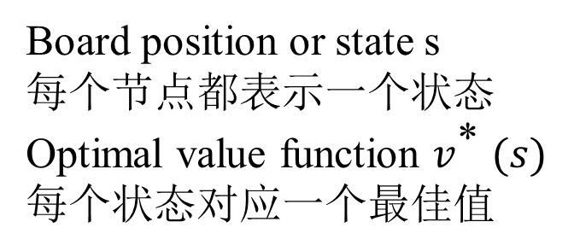
General board game model: search tree
Board position or state s
每个节点都表示一个状态
Optimal value function $v^{\text{*} }(s)$
每个状态对应一个最佳值
These games may be solved by recursively computing the optimal value function in a search tree containing approximately $b^{d}$possible sequences of moves。指数增长的搜索空间
b: game’s breadth (number of legal moves per position)
可下子的位置数量
d: game’s depth (game length)
从开始到终局，游戏下子次数

Slide 4
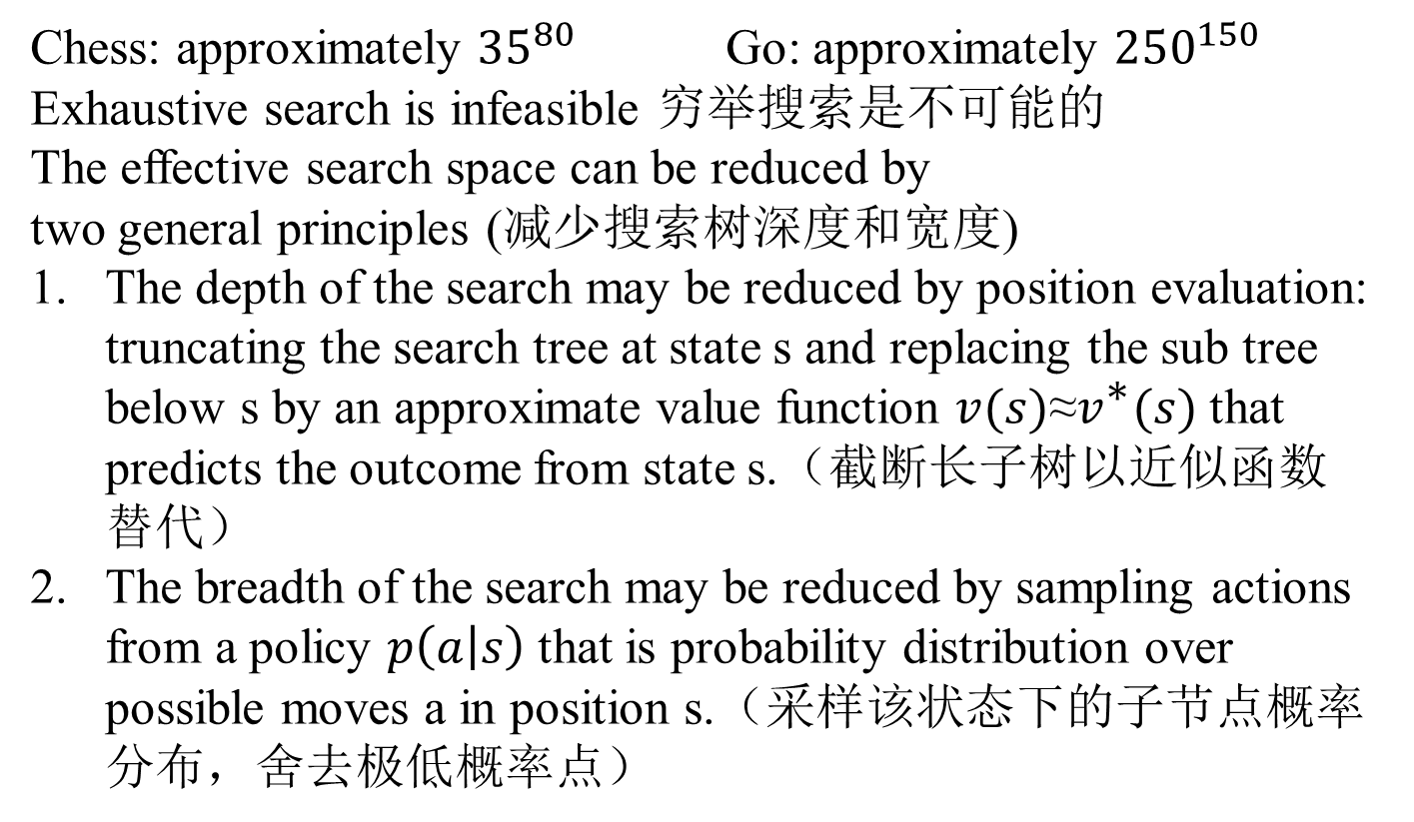
Difficulties
Chess: approximately ${35}^{80}$ Go: approximately ${250}^{150}$
Exhaustive search is infeasible 穷举搜索是不可能的
The effective search space can be reduced by
two general principles (减少搜索树深度和宽度)
The depth of the search may be reduced by position evaluation: truncating the search tree at state s and replacing the sub tree below s by an approximate value function $v(s)\text{≈}v^{\text{∗}}(s)$that predicts the outcome from state s.（截断长子树以近似函数替代）
The breadth of the search may be reduced by sampling actions from a policy $p\left(a | s\right)$ that is probability distribution over possible moves a in position s.（采样该状态下的子节点概率分布，舍去极低概率点）

Slide 5
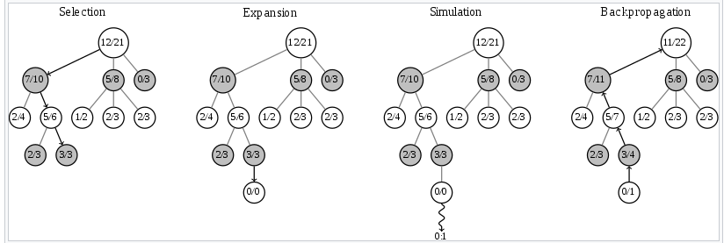
Monte Carlo Tree Search
The focus of Monte Carlo tree search is on the analysis of the most promising moves, expanding the search tree based on random sampling of the search space.
着重于最有前途的步伐分析，通过搜索空间的随机取样来扩张搜索树

Slide 6
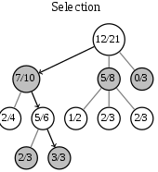

Selection of MCTS
Selection: start from root R and select successive child nodes down to a leaf node L.
由根节点R开始，不断选择子节点直到叶节点
The main difficulty in selecting child nodes is maintaining some balance between the exploitation of deep variants after moves with high average win rate and the exploration of moves with few simulations.
选择子节点需平衡两个因素：
已知高收益率节点的渴望//////未知位置模拟探索的鼓励
UCT(Upper Confidence Bound 1 applied to trees)

Slide 7
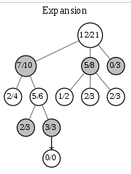
Expansion of MCTS
Expansion: unless L ends the game with a win/loss for either player, either create one or more child nodes or choose from them node C.
如果L节点未终止，则创建一个或多个子节点C

Slide 8
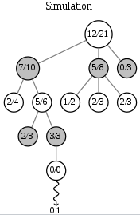
Simulation of MCTS
play a random playout from node C.
从节点C开始，模拟这个游戏直到有输有赢

Slide 9
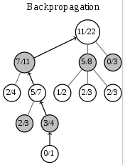
Backpropagation of MCTS
use the result of the playout to update information in the nodes on the path from C to R.
通过游戏的结果，更新从C到根节点的信息

Slide 10
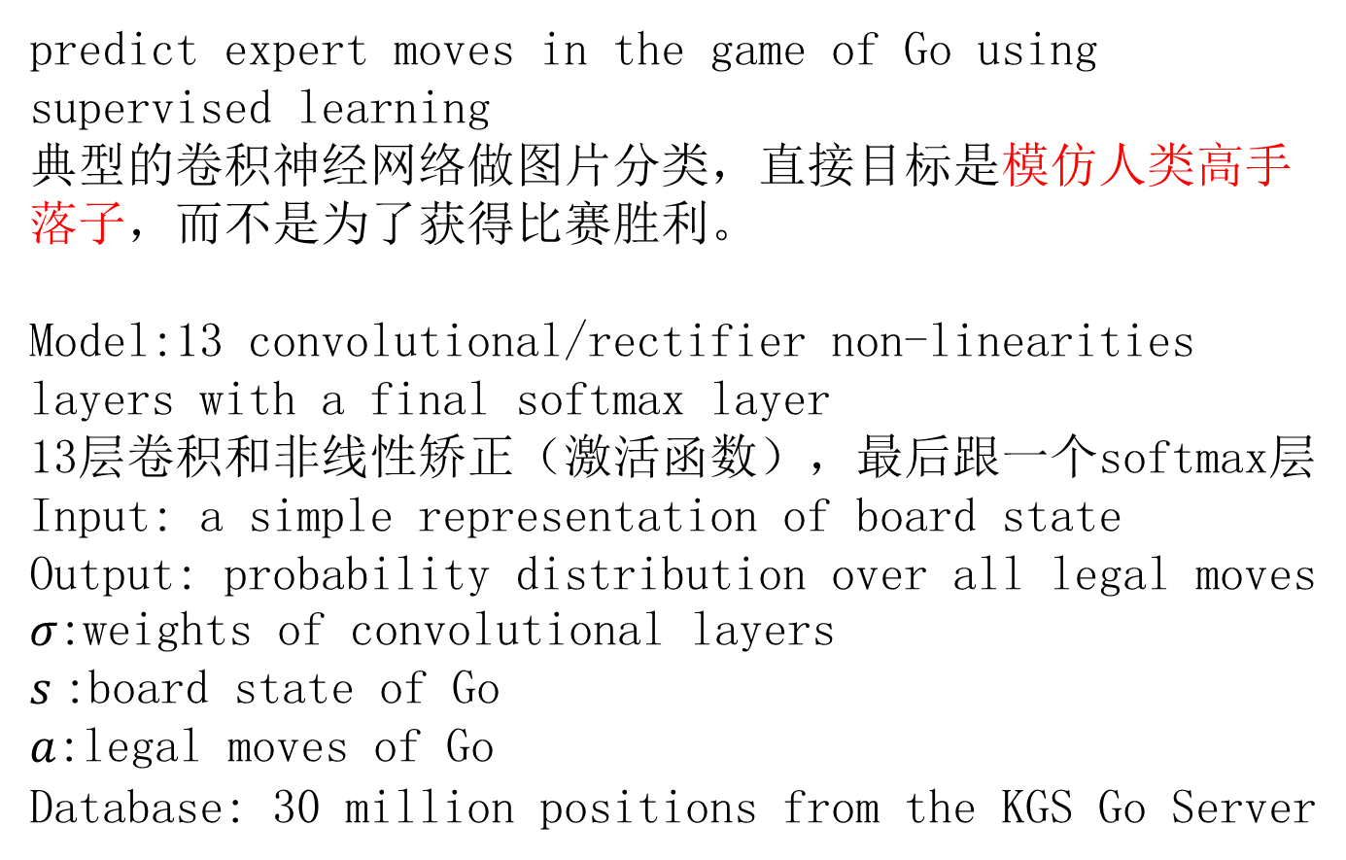
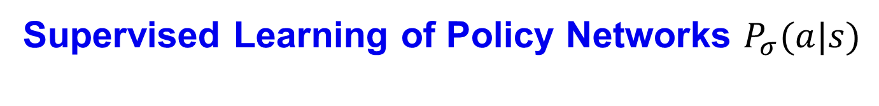
Supervised Learning of Policy Networks $P_{σ}(a|s)$
predict expert moves in the game of Go using supervised learning
典型的卷积神经网络做图片分类，直接目标是模仿人类高手落子，而不是为了获得比赛胜利。
Model:13 convolutional/rectifier non-linearities layers with a final softmax layer
13层卷积和非线性矫正（激活函数），最后跟一个softmax层
Input: a simple representation of board state
Output: probability distribution over all legal moves
$σ$:weights of convolutional layers
$s$:board state of Go
$a$:legal moves of Go
Database: 30 million positions from the KGS Go Server

Slide 11
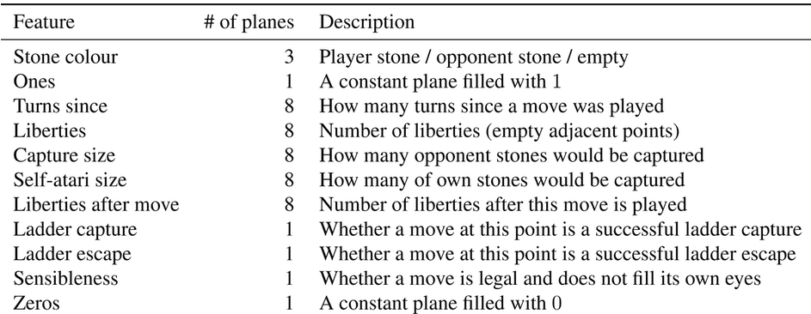
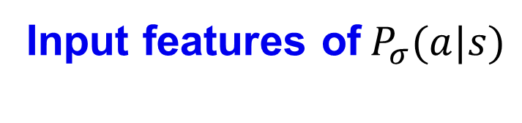
Input features of${ P}_{σ}(a|s)$
总共有48通道的19*19的二值图像
涉及一些围棋术语，未深究
有全0图像，有全1图像，还有很多组8个重复的图像（？？？）

Slide 12
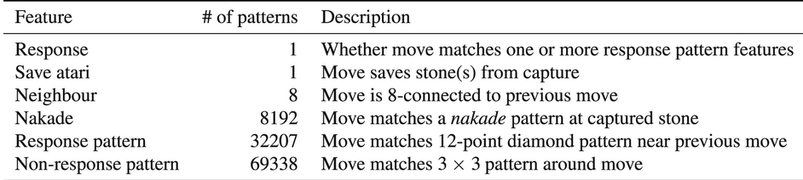
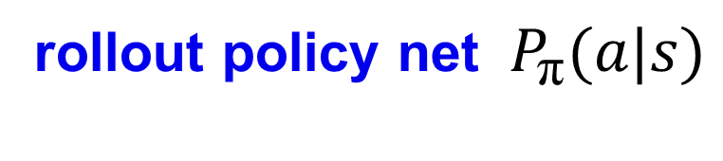
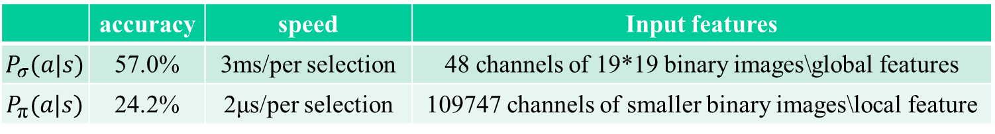
rollout policy net ${ P}_{\text{π}}(a|s)$
A faster but less accurate rollout policy to predict expert moves in the game of Go using supervised learning
同样的目标，但是更快更不准确的卷积神经网络
using a linear softmax of small pattern features with weights π
 | accuracy | speed | Input features
$${ P}_{σ}(a|s)$$ | 57.0% | 3ms/per selection | 48 channels of 19*19 binary images\global features
$${ P}_{\text{π}}(a|s)$$ | 24.2% | 2μs/per selection | 109747 channels of smaller binary images\local feature

Slide 13
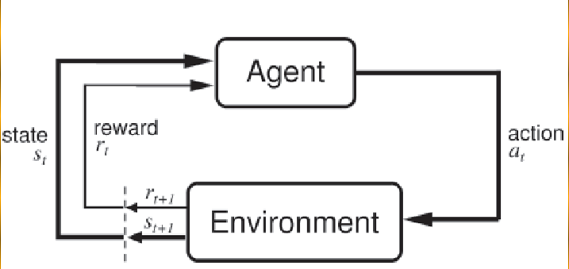
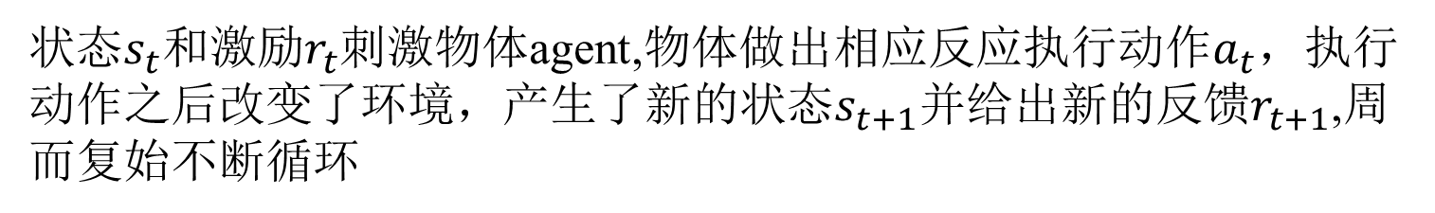
Reinforcement Learning of Policy Networks
状态$s_{t}$和激励$r_{t}$刺激物体agent,物体做出相应反应执行动作$a_{t}$，执行动作之后改变了环境，产生了新的状态$s_{t+1}$并给出新的反馈$r_{t+1}$,周而复始不断循环

Slide 14
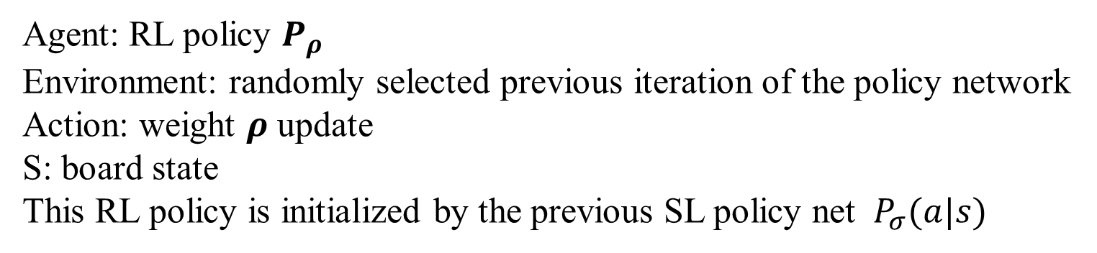
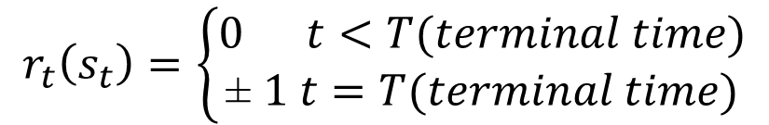
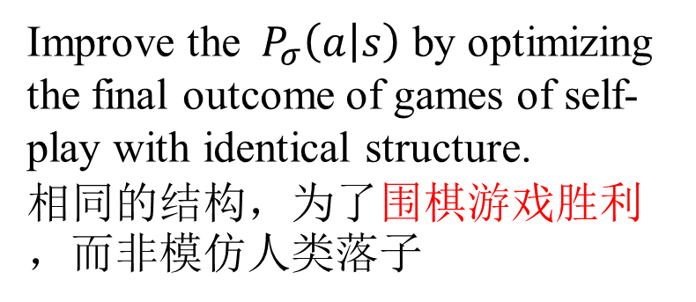
Reinforcement Learning of Policy Networks $P_{ρ}$
Improve the ${ P}_{σ}\left(a | s\right)$ by optimizing the final outcome of games of self-play with identical structure.
相同的结构，为了围棋游戏胜利，而非模仿人类落子
$$r_{t}\left(s_{t}\right)=\left\{\begin{aligned}0 t<T(terminal time) \\ \text{± }1 t=T(terminal time)\end{aligned}\right.$$
Agent: RL policy $P_{ρ}$
Environment: randomly selected previous iteration of the policy network
Action: weight $ρ$ update
S: board state
This RL policy is initialized by the previous SL policy net ${ P}_{σ}(a|s)$

Slide 15
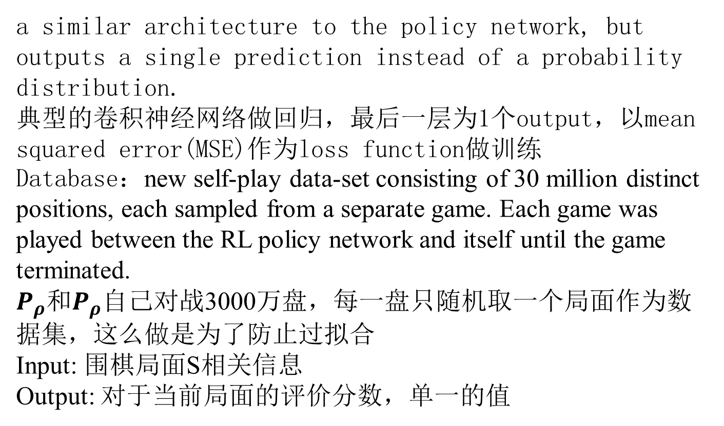
Reinforcement Learning of Value Networks $v_{θ} (s)$
a similar architecture to the policy network, but
outputs a single prediction instead of a probability distribution.
典型的卷积神经网络做回归，最后一层为1个output，以mean squared error(MSE)作为loss function做训练
Database：new self-play data-set consisting of 30 million distinct positions, each sampled from a separate game. Each game was played between the RL policy network and itself until the game terminated.
$P_{ρ}$和$P_{ρ}$自己对战3000万盘，每一盘只随机取一个局面作为数据集，这么做是为了防止过拟合
Input: 围棋局面S相关信息
Output: 对于当前局面的评价分数，单一的值

Slide 16
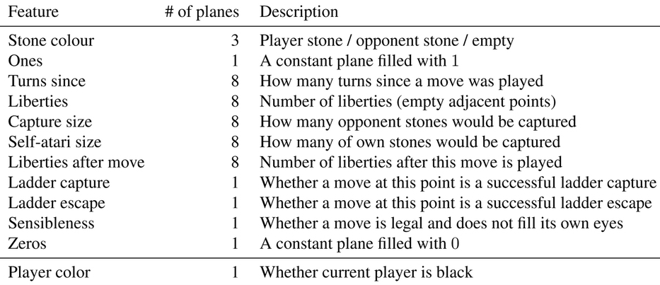
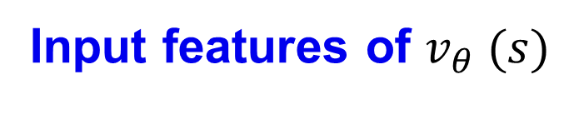
Input features of $v_{θ} (s)$
特征与之前差不多相同，多了是否是黑子的特征
因为同一个局面，对于不同方有不同的获胜概率

Slide 17
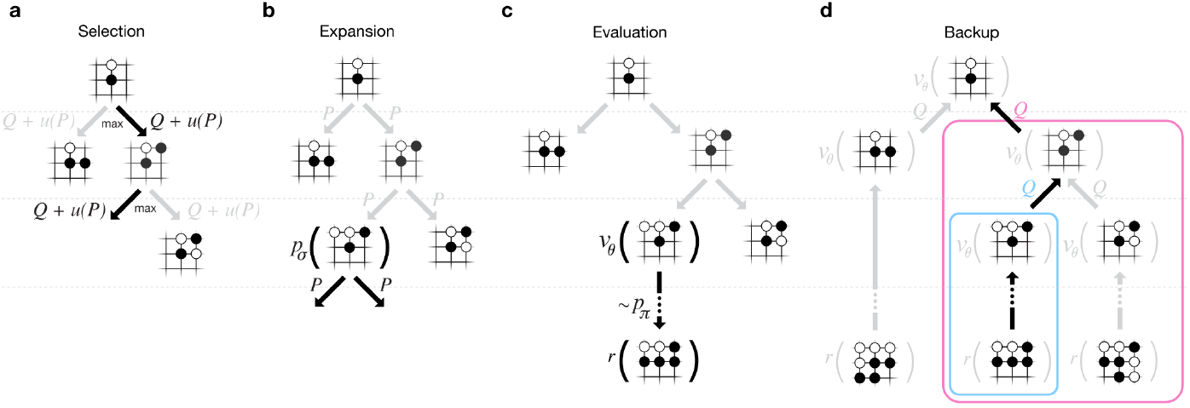
Searching with Policy and Value Networks
AlphaGo combines the policy and value networks in an MCTS algorithm that selects actions by lookahead search.
AlphaGo将策略网络和值网络结合进MCTS算法，通过超前搜索下围棋。

Slide 18
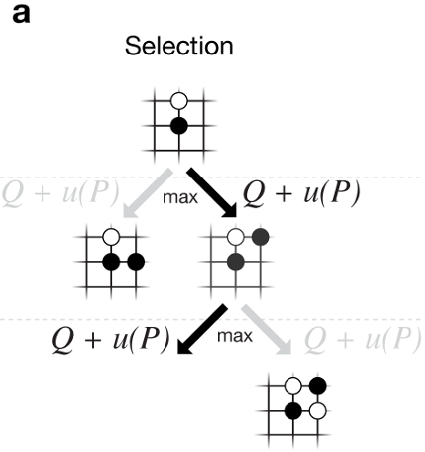

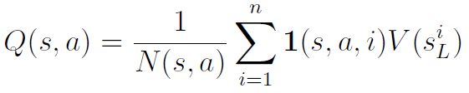
Selection of MCTS in AlphaGo
Each simulation traverses the tree by selecting
the edge with maximum action-value Q, plus a bonus u(P) that depends on a stored prior probability
P for that edge.
每次由Q + u(P)最大值来选择
子节点

Slide 19
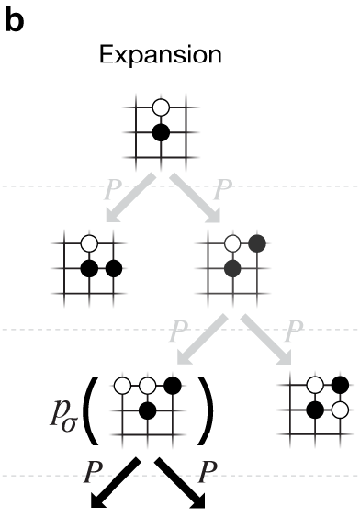
Expansion of MCTS in AlphaGo
The leaf node may be expanded; the new node is processed once by the policy network p and the output probabilities are stored as prior probabilities P for each action.
如果该叶节点没有终止，则需要扩张，通过策略网络找到概率最大的下棋点做扩张。概率最大点的概率要保存。

Slide 20
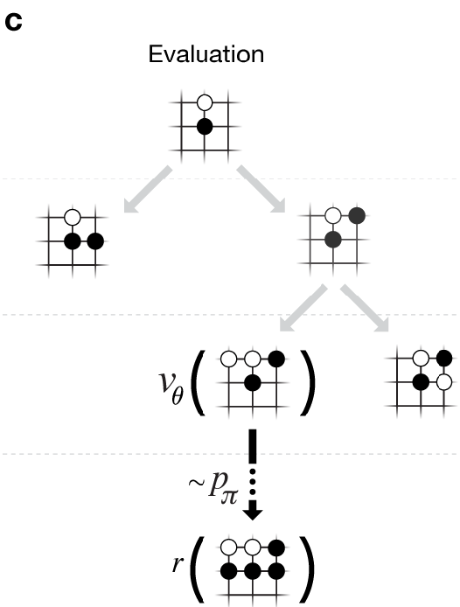
Evaluation of MCTS in AlphaGo
At the end of a simulation, the leaf node is evaluated in two ways:
using the value network v;
and by running a rollout to the end of the game with the fast rollout policy p, then computing the winner with function r.
两种方式评估这个叶节点
强化学习的值网络
通过快速策略网络模拟胜负计算反馈函数

Slide 21
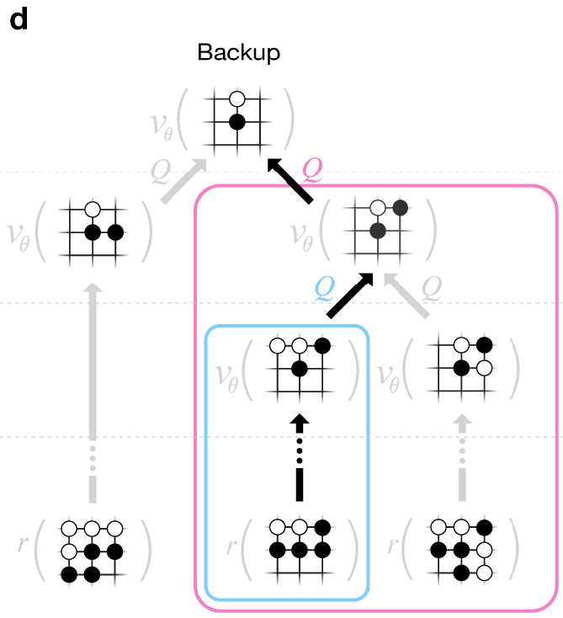
Backup of MCTS in AlphGo
Action-values Q are updated to track the mean value of all evaluations
r() and v() in the subtree below that action
更新权值Q

Slide 22
Parameters of Hardware and Software
 | AlphaGo | Distributed AlphaGo
CPU | 48 | 1202
GPU | 8 | 176
# of search threads | 40 | 40

