Slide 1
Machine Learning 3
Huang, Yibin(黄昳彬)

Slide 2
Table of Content（目录）
Boosting----Adaboost(core module of V-J face detection)
SVM(support vector machine)
支持向量机

Slide 3
Boosting
Boosting is a machine learning ensemble meta-algorithm for primarily reducing bias, and also variance in supervised learning, and a family of machine learning algorithms which convert weak learners to strong ones.
Boosting是一种合并 元算法的机器学习
一系列算法的总称：将多个弱学习算法转化为强学习算法
weak learner: consistently beat random guessing

Slide 4
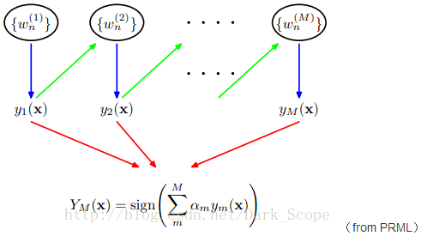
AdaBoosting: Adaptive Boosting
AdaBoost is adaptive in the sense that subsequent weak learners are tweaked in favor of those instances misclassified by previous classifiers.
AdaBoost能够自适应
初始阶段弱分类器的错误实例，能被后来的分类器专注解决

Slide 5
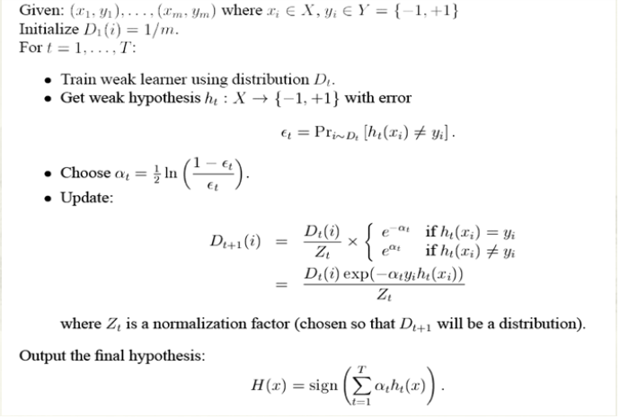
Procedure
样本权值
弱学习器误差
弱学习器权值
后来的弱分类器更专注于前者错误分类的数据

Slide 6
Advantage and disadvantage
Disadvantage：训练时间长
（每一次迭代弱分类器，都需要更新所有权值，与训练样本
数量，弱分类器数量……相关）
Advantage：预测时间短
（n * O（weak learner））
典型应用：V-J人脸检测架构

Slide 7
SVM：support vector machine
In machine learning, support vector machines (SVMs, also support vector networks) are supervised learning models with associated learning algorithms that analyze data used for classification and regression analysis.
有监督学习用于分类和回归

Slide 8
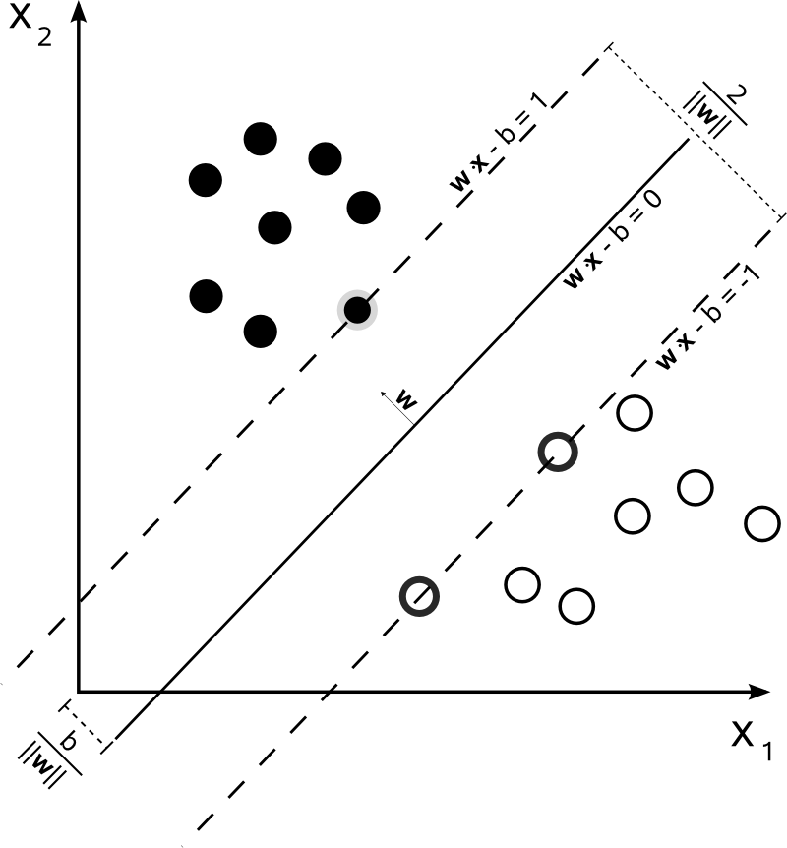
Linear SVM
margin
maximum-margin hyperplane
margin
support vectors: Data samples on the margin

Slide 9

Hard-margin
maximize the distance between the planes

Slide 10
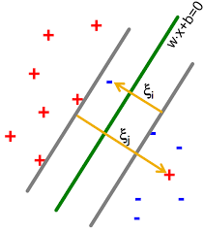

Soft-margin

Slide 11
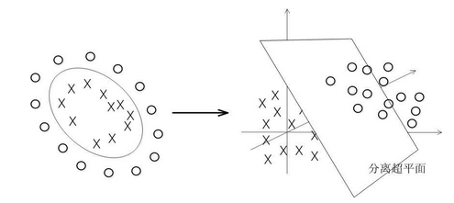
Nonlinear SVM： kernel trick
将数据映射到高维平面，然后再分割

Slide 12

Multi-classifier in SVM
n分类的SVM在libsvm的实现
1 vs n-1做二分类
最后会得到n-1个超平面

Slide 13
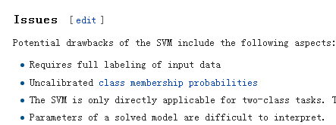
Issue
所有输入的数据要标记
对于数据没有输出置信度
经典SVM只提供二分类
很难去解释模型的参数

