Slide 1

Introduction to Machine Learning via
《Machine Learning in Action》
通过书本《机器学习实战》
来简单介绍机器学习
Presenter: Xu, Tao(徐韬) Huang, Yibin(黄昳彬)

Slide 2
Table of Content（目录）
Brief introduction to Machine Learning
（机器学习的概要介绍）
Feature preprocess (Dimension reduction)
（特征的预处理，主要为降维）
Regression
（回归）
Classification and cluster
（分类和聚类）

Slide 3
Definitions of Machine Learning
gives computers the ability to learn without being explicitly programmed
Phil Simon (March 18, 2013). Too Big to Ignore: The Business Case for Big Data. Wiley. p. 89. ISBN 978-1-118-63817-0.
在没有精确编程的情况下给予电脑学习的能力
algorithms that can learn from and make predictions on data
Ron Kohavi; Foster Provost (1998). "Glossary of terms". Machine Learning. 30: 271–274.
学习数据和预测数据的算法
ability to acquire their own knowledge, by extracting patters from raw data
Ian Goodfellow, Yoshua Bengio, and Aaron Courville (2016). Deep Learning. MIT Press.
通过原始数据来提取模式特征，获取他们自己的知识

Slide 4
Structure of Machine Learning
Feature preprocess(dimension reduction)
PCA(13) SVD(14)
Linear regression(8)
Logistic regression(5)
Decision Tree CART(9)
Regression
回归
Supervised learning
监督学习
K-NN(2)
Naïve Bayes(4)
SVM(6)
AdaBoost(7)
Decision Tree ID3(3)
Classification
分类
Machine Learning
Unsupervised learning: cluster
无监督学习：聚类
K-means(10)
Apriori(11)
FP-growth(12)
Platform: MapReduce(15)

Slide 5
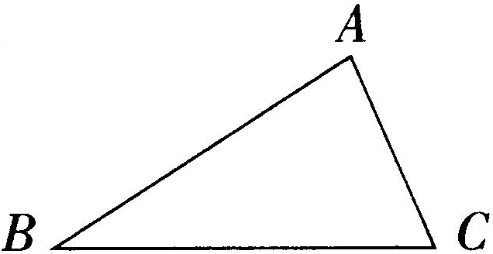
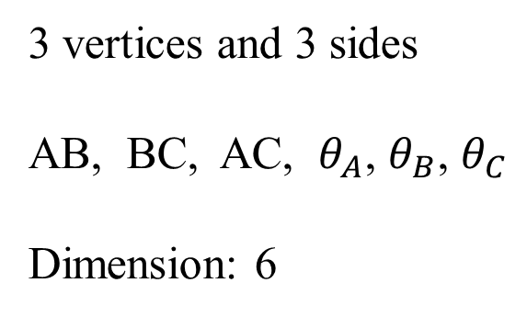
How to describe a triangle?
3 vertices and 3 sides
AB, BC, AC, $θ_{A}$, $θ_{B}$, $θ_{C}$
Dimension: 6

Slide 6
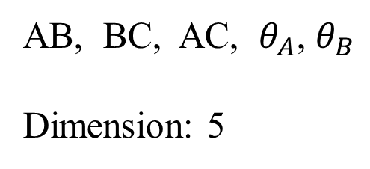
Sum of angles of a triangle
180° in a Euclidean space
AB, BC, AC, $θ_{A}$, $θ_{B}$
Dimension: 5

Slide 7
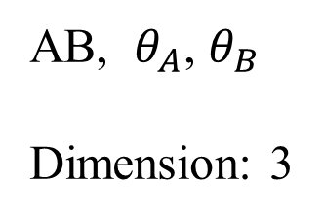
Congruence of triangles(全等三角形)
ASA (Angle-Side-Angle): If two pairs of angles of two triangles are equal in measurement, and the included sides are equal in length, then the triangles are congruent.
AB, $θ_{A}$, $θ_{B}$
Dimension: 3

Slide 8
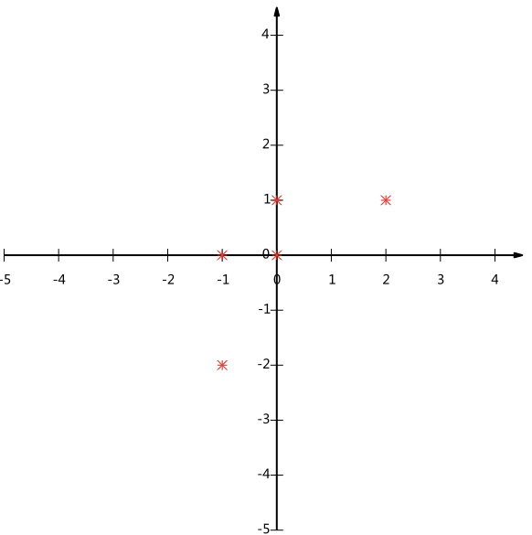
Another example in three-dimension space
A(1, 2, 3)
B(123,34, 3)
C(12,43, 3)
.
.
.
.
.
.
.
Z(x, y, 3)
All in plane z = 3
???????

Slide 9
Dimension Reduction（降维）
$x_{1}$, $x_{2}$, $x_{3}$, $x_{4}$, $x_{5}$, $x_{6}$, $x_{7}$, $x_{8}$, $x_{9}$, $x_{10}$, $x_{11}$……….... $x_{n−2}$, $x_{n−1}$, $x_{n}$
m<n
$y_{1}$, $y_{2}$, $y_{3}$, $y_{4}$, $y_{5}$, $y_{6}$, $y_{7}$, ……….... $y_{m−2}$, $y_{m−1}$, $y_{m}$
Reserve information as much as possible

Slide 10
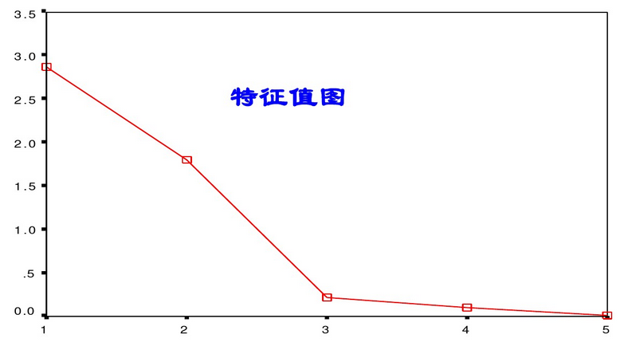
Principal component analysis(PCA)
Principal component analysis (PCA) is a statistical procedure that uses an orthogonal transformation to convert a set of observations of possibly correlated variables into a set of values of linearly uncorrelated variables called principal components.
主成分分析是一种统计过程，利用正交变换，将一组可能相关的变量观测值转化为线性不相关的变量值（主成分）
协方差矩阵 → 特征值和特征向量

Slide 11
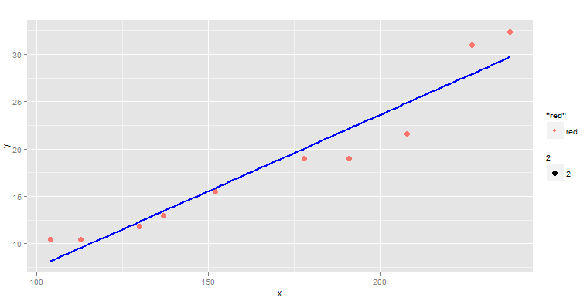
Regression analysis（回归分析）
In statistical modeling, regression analysis is a statistical process for estimating the relationships among variables.
在统计模型中，回归分析是一个估计变量间关系的统计过程。
least square method
最小二乘法拟合直线

Slide 12
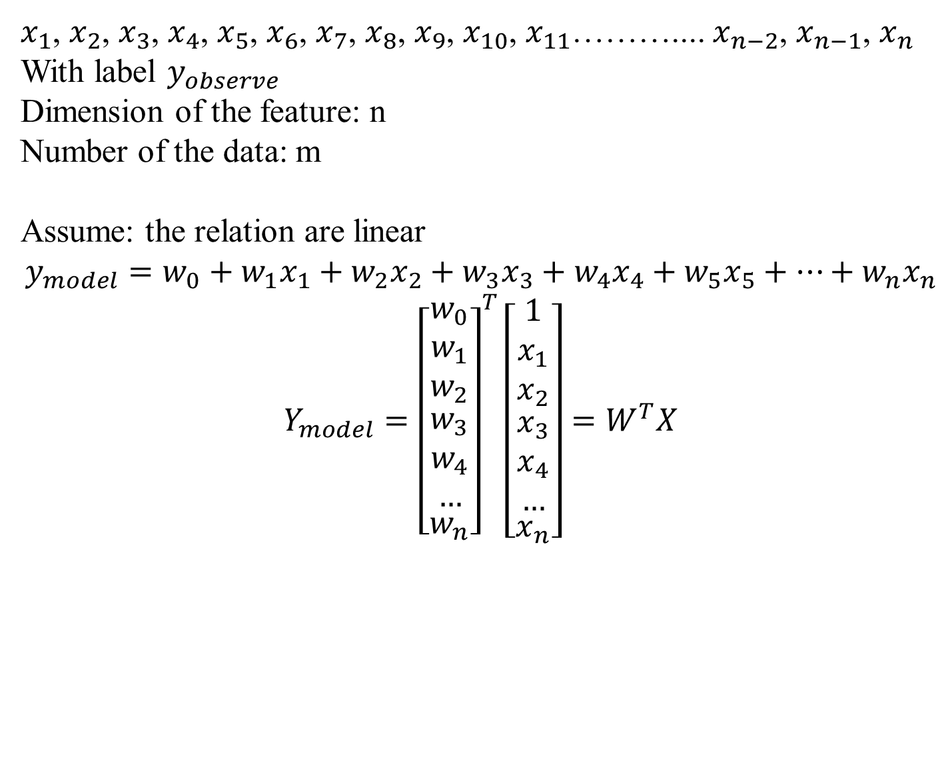
Linear Regression
$x_{1}$, $x_{2}$, $x_{3}$, $x_{4}$, $x_{5}$, $x_{6}$, $x_{7}$, $x_{8}$, $x_{9}$, $x_{10}$, $x_{11}$……….... $x_{n−2}$, $x_{n−1}$, $x_{n}$
With label $y_{observe}$
Dimension of the feature: n
Number of the data: m
Assume: the relation are linear
$$y_{model}=w_{0}+w_{1}x_{1}+w_{2}x_{2}+w_{3}x_{3}+w_{4}x_{4}+w_{5}x_{5}+…+w_{n}x_{n}$$
$$Y_{model}={\left[\begin{matrix}\begin{matrix}w_{0} \\ w_{1} \\ w_{2}\end{matrix} \\ \begin{matrix}w_{3} \\ w_{4} \\ …\end{matrix} \\ w_{n}\end{matrix}\right]}^{T}\left[\begin{matrix}\begin{matrix}1 \\ x_{1} \\ x_{2}\end{matrix} \\ \begin{matrix}x_{3} \\ x_{4} \\ …\end{matrix} \\ x_{n}\end{matrix}\right]=W^{T}X$$

Slide 13
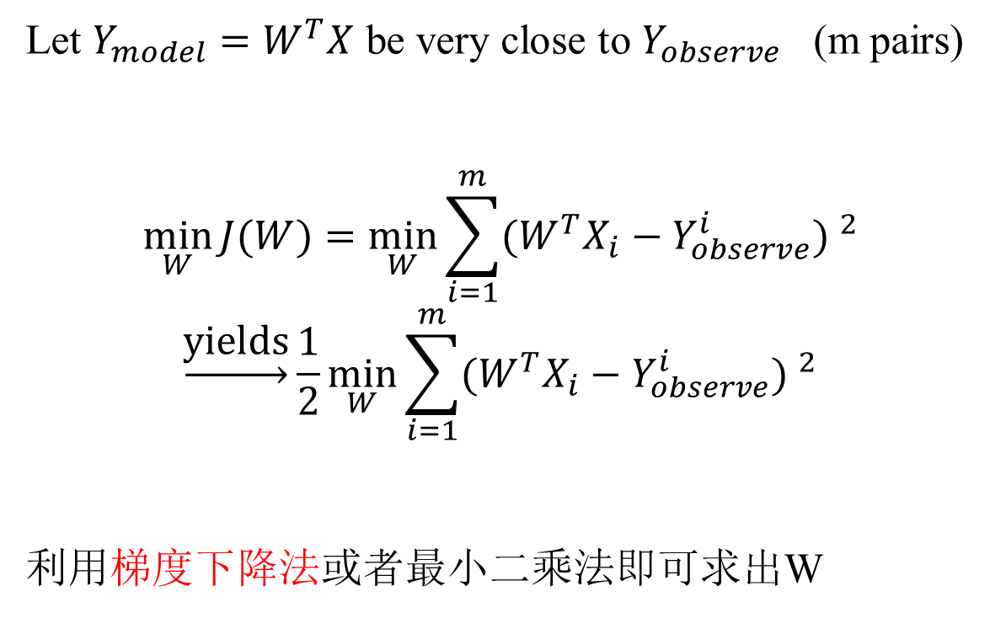
Cost function
Let $Y_{model}=W^{T}X$ be very close to $Y_{observe}$ (m pairs)
$$\min_{W}{J(W)}=\min_{W}{\sum_{i=1}^{m}{{(W^{T}X_{i}−Y_{observe}^{i}) }^{2}}}$$
$$\underset{→}{\text{yields}}\frac{1}{2}\min_{W}{\sum_{i=1}^{m}{{(W^{T}X_{i}−Y_{observe}^{i}) }^{2}}}$$
利用梯度下降法或者最小二乘法即可求出W

