Slide 1

Google Protocol Buffers
Presenter Huang, Yibin(黄昳彬)

Slide 2
Table of Content（目录）
Brief introduction of Artificial Neural Network
（高中知识介绍最简易神经网络）
Neural Redis source analysis
（Neural模块源码分析）
Neural API
（Neural模块接口介绍）
Supplementary Ⅰ: AVX
（AVX指令加速介绍）

Slide 3
Protocol Buffers
Protocol buffers are a language-neutral, platform-neutral extensible mechanism for serializing structured data – think XML, but smaller, faster and simpler.
跨语言跨平台的可扩展机制。
针对序列化的结构数据。
比XML更小更快更简单
用途包括且不限于：通信协议、数据存储
语言：Java, Python, C++, Go, JavaNano, Ruby, C#
平台：

Slide 4
How to work?
Define protocol buffer message types in .proto file
Protocol buffer compiler generate data access classes by the .proto file
Use the protocol buffer interface to access the data
1.定义自己.proto文件来组织数据结构
2.利用protocol buffer程序去编译.proto文件得到一些文件
3.这些文件可以直接用于编程

Slide 5
Neurotransmission（神经传递）
// Specifies the shape (dimensions) of a Blob.
message BlobShape {
repeated int64 dim = 1 [packed = true];
}
message BlobProto {
optional BlobShape shape = 7;
repeated float data = 5 [packed = true];
repeated float diff = 6 [packed = true];
repeated double double_data = 8 [packed = true];
repeated double double_diff = 9 [packed = true];
// 4D dimensions -- deprecated. Use "shape" instead.
optional int32 num = 1 [default = 0];
optional int32 channels = 2 [default = 0];
optional int32 height = 3 [default = 0];
optional int32 width = 4 [default = 0];
}

Slide 6
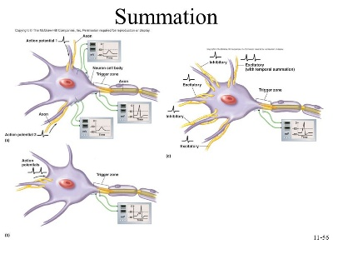
Summation（总和）
Each neuron connects with numerous other neurons, receiving numerous impulses from them. Summation is the adding together of these impulses at the axon hillock.
每个神经元都与其他神经元连接，并接受许多电子脉冲。Summation操作就是将这些电子脉冲在轴丘加起来。
Neurons can only excite or inhibit other neurons (or bias the excitability of each other through modulatory transmitters).
神经元只能刺激或抑制其他神经元。（或者通过信号调节器来调节刺激强度）
(Neurotransmission Wikipedia)

Slide 7
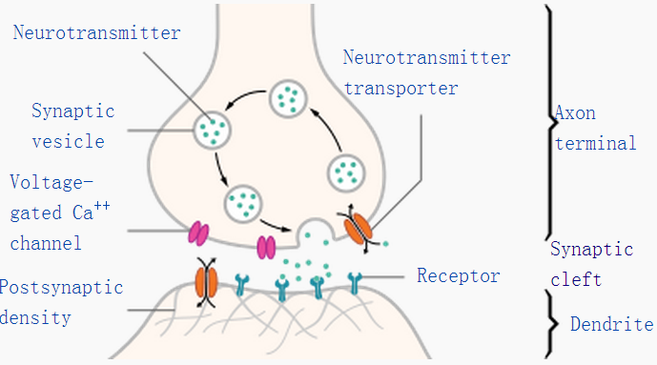
Chemical synapse：biological junctions
When a neurotransmitter is released at a synapse, it reaches its highest concentration inside the narrow space of the synaptic cleft, but some of it is certain to diffuse away before being reabsorbed or broken down. If it diffuses away, it has the potential to activate receptors that are located either at other synapses or on the membrane away from any synapse. (Chemical synapse Wikipedia )
当神经传递素在突触释放，它会在突触间隙的狭窄空间达到最大浓度。有一些在再吸附和破损前就弥散开了，如果它弥散开了，它就有可能激活受体（受体既可以在其他突触，也可以在远离突触的膜上）

Slide 8
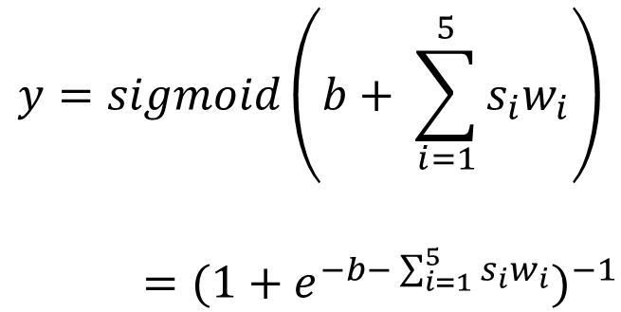
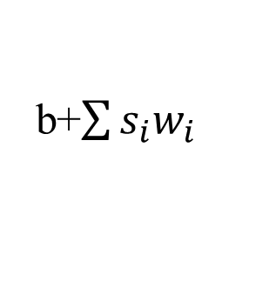
Neuron in ANN（人工网络神经元）
在生物神经元summation，bias，activation的启发下
的人工神经网络神经元
summation
bias
activation
$$y=sigmoid\left(b+ \sum_{i=1}^{5}{s_{i}w_{i}}\right)$$
$={(1+e^{−b− \sum_{i=1}^{5}{s_{i}w_{i}}})}^{−1}$
s1
w1
s2
w2
w3
b+$\sum{{s_{i}w}_{i}}$
sigmoid
s3
s4
w4
w5
s5

Slide 9

























ANN structure
$$i_{1}$$
$$w_{1}$$
$$w_{5}$$
$${net}_{h1}$$
$${out}_{h1}$$
$${net}_{o1}$$
$${out}_{o1}$$
$${out}_{o1}$$
$$w_{2}$$
$$w_{6}$$
$${target}_{o1}$$
$$w_{3}$$
$$w_{7}$$
$${target}_{o2}$$
$$i_{2}$$
$${net}_{h2}$$
$${out}_{h2}$$
$${net}_{o2}$$
$${out}_{o2}$$
$${out}_{o2}$$
$$w_{4}$$
$$w_{8}$$
input layer
hidden layer
output layer
$$b_{1}$$
$$b_{2}$$
$${net}_{h1}=w_{1}i_{1}+w_{2}i_{2}+b_{1}$$
$${out}_{h1}=sigmoid\left({net}_{h1}\right)={(1+e^{{−net}_{h1}})}^{−1}$$
$${net}_{o1}=w_{5}{out}_{h1}+w_{6}{out}_{h2}+b_{2}$$
$${out}_{o1}=sigmoid\left({net}_{o1}\right)={(1+e^{{−net}_{o1}})}^{−1}$$

Slide 10
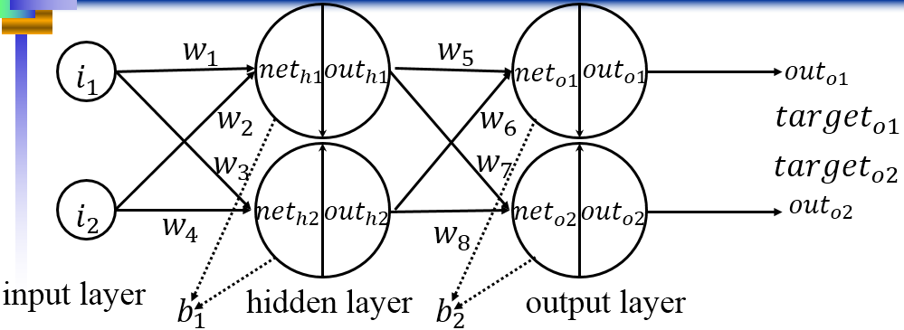
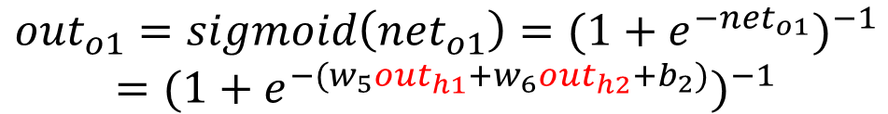
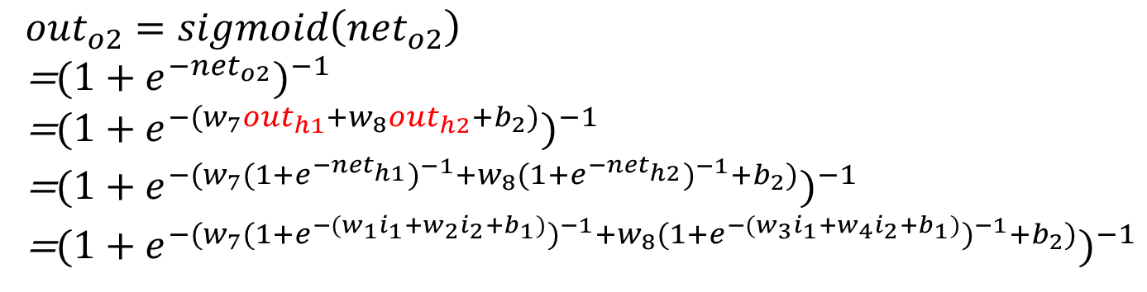
Forward pass
$${out}_{o2}=sigmoid\left({net}_{o2}\right)$$
=${(1+e^{{−net}_{o2}})}^{−1}$
=${(1+e^{−(w_{7}{out}_{h1}+w_{8}{out}_{h2}+b_{2})})}^{−1}$
=${(1+e^{−(w_{7}{(1+e^{{−net}_{h1}})}^{−1}+w_{8}{(1+e^{{−net}_{h2}})}^{−1}+b_{2})})}^{−1}$
=${(1+e^{−(w_{7}{(1+e^{−{(w}_{1}i_{1}+w_{2}i_{2}+b_{1})})}^{−1}+w_{8}{(1+e^{−{(w}_{3}i_{1}+w_{4}i_{2}+b_{1})})}^{−1}+b_{2})})}^{−1}$
$${out}_{o1}=sigmoid\left({net}_{o1}\right)={(1+e^{{−net}_{o1}})}^{−1}$$
$$={(1+e^{−(w_{5}{out}_{h1}+w_{6}{out}_{h2}+b_{2})})}^{−1}$$

Slide 11
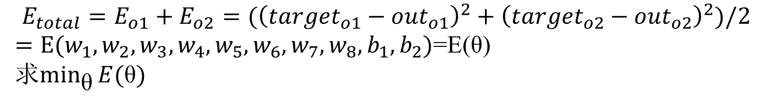
Gradient decent
Assume total error
is square error
$$E_{total}=E_{o1}+E_{o2}=({\left({target}_{o1}−{out}_{o1}\right)}^{2}+{\left({target}_{o2}−{out}_{o2}\right)}^{2})/2$$
$=E(w_{1},w_{2},w_{3},w_{4},w_{5},w_{6},w_{7},w_{8},b_{1},b_{2})$=E(θ)
求$\min_{\text{θ}}{E(\text{θ})}$
Gradient descent is a first-order iterative optimization algorithm. To find a local minimum of a function using gradient descent, one takes steps proportional to the negative of the gradient (or of the approximate gradient) of the function at the current point. (gradient decent Wikipedia )
梯度下降法是一阶迭代法优化算法。沿着方程该点的逆梯度方向步进，能够找到该方程在该点附近的局部最小值。

Slide 12
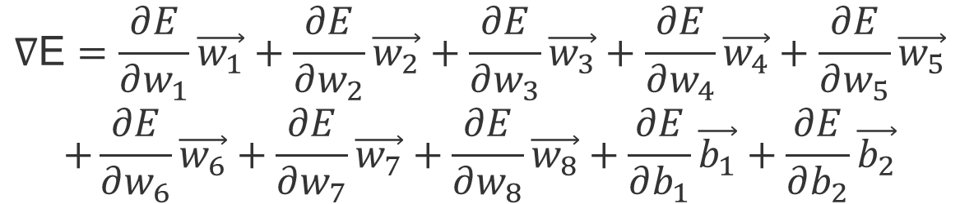
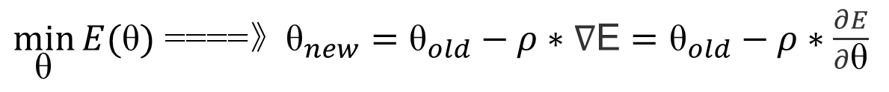
Gradient
In mathematics, the gradient is a generalization of the usual concept of derivative to functions of several variables.
在数学里，梯度是一个泛化的概念，是拥有一些变量的函数的导数。(gradient Wikipedia )
The gradient points in the direction of the greatest rate of increase of the function.
梯度指明了函数增长最快的方向。
$$\text{∇}\text{E}=\frac{∂E}{∂w_{1}}\vec{w_{1}}+\frac{∂E}{∂w_{2}}\vec{w_{2}}+\frac{∂E}{∂w_{3}}\vec{w_{3}}+\frac{∂E}{∂w_{4}}\vec{w_{4}}+\frac{∂E}{∂w_{5}}\vec{w_{5}}$$
$$+\frac{∂E}{∂w_{6}}\vec{w_{6}}+\frac{∂E}{∂w_{7}}\vec{w_{7}}+\frac{∂E}{∂w_{8}}\vec{w_{8}}+\frac{∂E}{∂b_{1}}\vec{b_{1}}+\frac{∂E}{∂b_{2}}\vec{b_{2}}$$
$\min_{\text{θ}}{E(\text{θ})}$ ====》${\text{θ}}_{new}={\text{θ}}_{old}−ρ∗\text{∇}\text{E}={\text{θ}}_{old}−ρ∗\frac{∂E}{∂\text{θ}}$

Slide 13
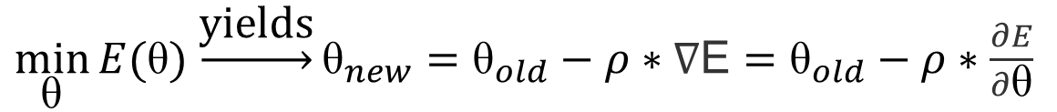
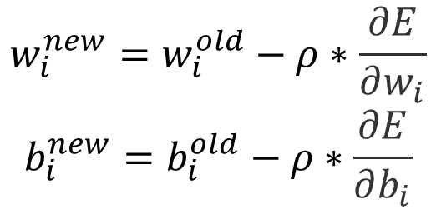
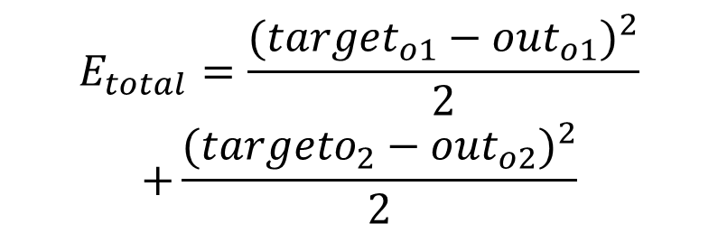
Gradient decent
$\min_{\text{θ}}{E(\text{θ})}$ $\underset{→}{\text{yields}}{\text{θ}}_{new}={\text{θ}}_{old}−ρ∗\text{∇}\text{E}={\text{θ}}_{old}−ρ∗\frac{∂E}{∂\text{θ}}$
$$w_{i}^{new}=w_{i}^{old}−ρ∗\frac{∂E}{∂w_{i}}$$
$$b_{i}^{new}=b_{i}^{old}−ρ∗\frac{∂E}{∂b_{i}}$$
$$E_{total}=\frac{{({target}_{o1}−{out}_{o1})}^{2}}{2}$$
$$+\frac{{({targeto}_{2}−{out}_{o2})}^{2}}{2}$$

Slide 14
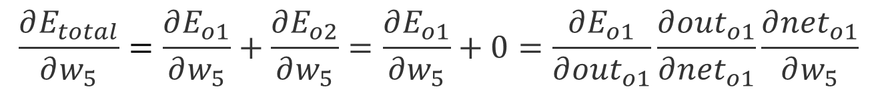
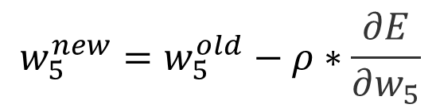
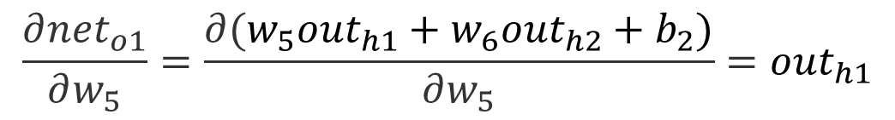
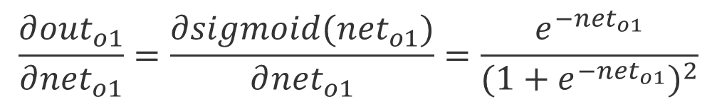
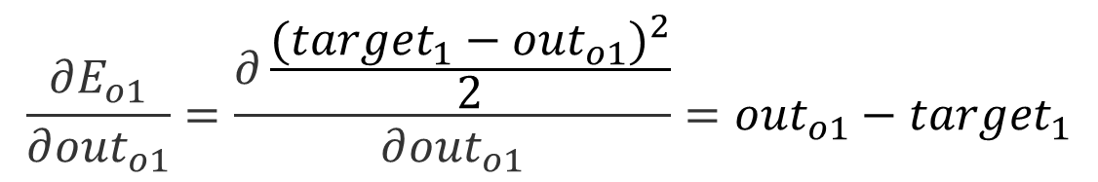
Back propagation
$$w_{5}^{new}=w_{5}^{old}−ρ∗\frac{∂E}{∂w_{5}}$$
$$\frac{∂E_{total}}{∂w_{5}}=\frac{∂E_{o1}}{∂w_{5}}+\frac{∂E_{o2}}{∂w_{5}}=\frac{∂E_{o1}}{∂w_{5}}+0=\frac{∂E_{o1}}{∂{out}_{o1}}\frac{∂{out}_{o1}}{∂{net}_{o1}}\frac{∂{net}_{o1}}{∂w_{5}}$$
$$\frac{∂E_{o1}}{∂{out}_{o1}}=\frac{∂\frac{{({target}_{1}−{out}_{o1})}^{2}}{2}}{∂{out}_{o1}}={out}_{o1}−{target}_{1}$$
$$\frac{∂{out}_{o1}}{∂{net}_{o1}}=\frac{∂sigmoid({net}_{o1})}{∂{net}_{o1}}=\frac{e^{−{net}_{o1}}}{{(1+e^{−{net}_{o1}})}^{2}}$$
$$\frac{∂{net}_{o1}}{∂w_{5}}=\frac{∂(w_{5}{out}_{h1}+w_{6}{out}_{h2}+b_{2})}{∂w_{5}}={out}_{h1}$$

Slide 15
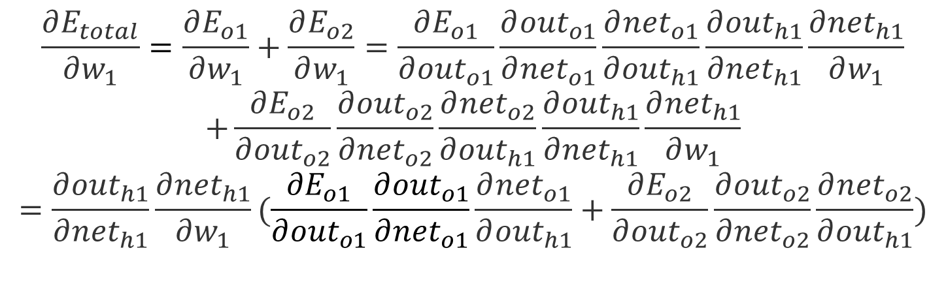
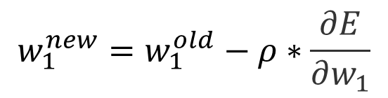
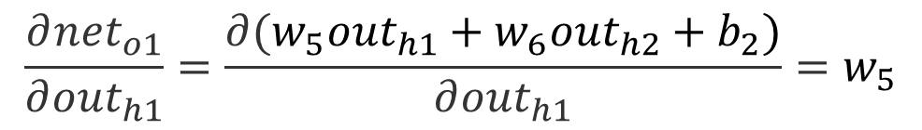
Back propagation
$$w_{1}^{new}=w_{1}^{old}−ρ∗\frac{∂E}{∂w_{1}}$$
$$\frac{∂E_{total}}{∂w_{1}}=\frac{∂E_{o1}}{∂w_{1}}+\frac{∂E_{o2}}{∂w_{1}}=\frac{∂E_{o1}}{∂{out}_{o1}}\frac{∂{out}_{o1}}{∂{net}_{o1}}\frac{∂{net}_{o1}}{∂{out}_{h1}}\frac{∂{out}_{h1}}{∂{net}_{h1}}\frac{∂{net}_{h1}}{∂w_{1}}$$
$$+\frac{∂E_{o2}}{∂{out}_{o2}}\frac{∂{out}_{o2}}{∂{net}_{o2}}\frac{∂{net}_{o2}}{∂{out}_{h1}}\frac{∂{out}_{h1}}{∂{net}_{h1}}\frac{∂{net}_{h1}}{∂w_{1}}$$
$$=\frac{∂{out}_{h1}}{∂{net}_{h1}}\frac{∂{net}_{h1}}{∂w_{1}}(\frac{∂E_{o1}}{∂{out}_{o1}}\frac{∂{out}_{o1}}{∂{net}_{o1}}\frac{∂{net}_{o1}}{∂{out}_{h1}}+\frac{∂E_{o2}}{∂{out}_{o2}}\frac{∂{out}_{o2}}{∂{net}_{o2}}\frac{∂{net}_{o2}}{∂{out}_{h1}})$$
$$\frac{∂{net}_{o1}}{∂{out}_{h1}}=\frac{∂(w_{5}{out}_{h1}+w_{6}{out}_{h2}+b_{2})}{∂{out}_{h1}}=w_{5}$$

Slide 16
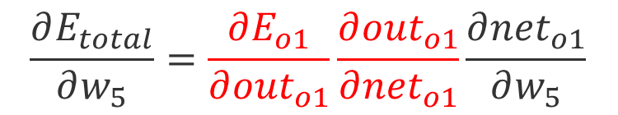
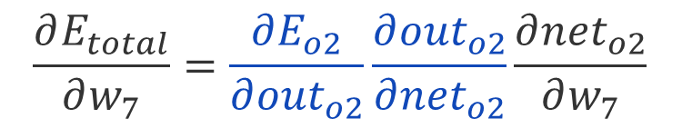
Back propagation
$$\frac{∂E_{total}}{∂w_{5}}=\frac{∂E_{o1}}{∂{out}_{o1}}\frac{∂{out}_{o1}}{∂{net}_{o1}}\frac{∂{net}_{o1}}{∂w_{5}}$$
$$\frac{∂E_{total}}{∂w_{1}}=\frac{∂{out}_{h1}}{∂{net}_{h1}}\frac{∂{net}_{h1}}{∂w_{1}}(\frac{∂E_{o1}}{∂{out}_{o1}}\frac{∂{out}_{o1}}{∂{net}_{o1}}\frac{∂{net}_{o1}}{∂{out}_{h1}}+\frac{∂E_{o2}}{∂{out}_{o2}}\frac{∂{out}_{o2}}{∂{net}_{o2}}\frac{∂{net}_{o2}}{∂{out}_{h1}})$$
$$\frac{∂E_{total}}{∂w_{7}}=\frac{∂E_{o2}}{∂{out}_{o2}}\frac{∂{out}_{o2}}{∂{net}_{o2}}\frac{∂{net}_{o2}}{∂w_{7}}$$

Slide 17
Neural Redis(源码分析)
Neural Redis is a Redis loadable module that implements feed
forward neural networks as a native data type for Redis.
Neural Redis是一个Redis数据库的可加载模块，
实现了将前馈神经网络作为数据库原生数据类型的功能。
The project goal is to provide Redis users with
an extremely simple to use machine learning experience.
这个项目是为了提供Redis数据库使用者，
一个极其简单易用的机器学习接口

Slide 18
Layer struct
struct AnnLayer {
int units;
float *output;/* output[i], output of i-th unit */
float *error;/* error[i], output error of i-th unit*/
float *weight;/* weight[(i*units)+j] */
/* weight between unit i-th and next j-th */
float *gradient;/* gradient[(i*units)+j] gradient */
float *sgradient;/* gradient for the full training set */
/* only used for RPROP */
float *pgradient;/* pastgradient[(i*units)+j] t-1 gradient */
/* (t-1 sgradient for resilient BP) */
float *delta;/* delta[(i*units)+j] cumulative update */
/* (per-weight delta for RPROP) */
};

Slide 19
Ann net struct
struct Ann {
int flags;
int layers;
float rprop_nminus;
float rprop_nplus;
float rprop_maxupdate;
float rprop_minupdate;
float learn_rate; /* Used for GD training. */
struct AnnLayer *layer;
};

Slide 20
Data interface
/* Raw interface to data structures */
#define OUTPUT(net,l,i) (net)->layer[l].output[i]
#define ERROR(net,l,i) (net)->layer[l].error[i]
#define WEIGHT(net,l,i,j) (net)->layer[l].weight[((j)*(net)->layer[l].units)+(i)]
#define GRADIENT(net,l,i,j) (net)->layer[l].gradient[((j)*(net)->layer[l].units)+(i)]
#define SGRADIENT(net,l,i,j) (net)->layer[l].sgradient[((j)*(net)->layer[l].units)+(i)]
#define PGRADIENT(net,l,i,j) (net)->layer[l].pgradient[((j)*(net)->layer[l].units)+(i)]
#define DELTA(net,l,i,j) (net)->layer[l].delta[((j)*(net)->layer[l].units)+(i)]
#define LAYERS(net) (net)->layers
#define UNITS(net,l) (net)->layer[l].units
#define WEIGHTS(net,l) (UNITS(net,l)*UNITS(net,l-1))
#define OUTPUT_NODE(net,i) OUTPUT(net,0,i)
#define INPUT_NODE(net,i) OUTPUT(net,((net)->layers)-1,i)
#define OUTPUT_UNITS(net) UNITS(net,0)
#define INPUT_UNITS(net) (UNITS(net,((net)->layers)-1)-1)
#define RPROP_NMINUS(net) (net)->rprop_nminus
#define RPROP_NPLUS(net) (net)->rprop_nplus
#define RPROP_MAXUPDATE(net) (net)->rprop_maxupdate
#define RPROP_MINUPDATE(net) (net)->rprop_minupdate
#define LEARN_RATE(net) (net)->learn_rate

Slide 21
Brief process
AnnCreateNet
Iteration:
AnnSimulateError
AnnSetDeltas
AnnCalculateGradients
AnnUpdateDeltasGD
AnnAdjustWeights

Slide 22
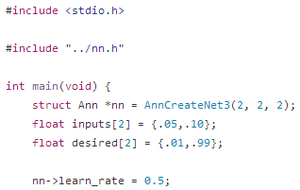
Create the net
AnnCreateNet3
AnnCreateNet
AnnAlloc AnnInitLayer AnnSetRandomWeights AnnSetDeltas
malloc net
malloc layer
check memory
set default net parameters
AnnResetLayer
(layer set null)
malloc layer parameters
check memory
Initialize all the layer parameter as 0 except bias as 1
Set random weights in the range from
-0.05 to +0.05
Set the delta values of the net to a given value
AnnLayer->weight
AnnLayer->delta
Double assignment

Slide 23
AnnCreateNet3
AnnCreateNet2\AnnCreateNet3\AnnCreateNet4
0 hidden layer \1 hidden layer \2 hidden layer
/* Create a 3-layer input/hidden/output net */
struct Ann *AnnCreateNet3(int iunits, int hunits, int ounits) {
int units[3];
units[0] = ounits;
units[1] = hunits;
units[2] = iunits;
return AnnCreateNet(3, units);
}

Slide 24
AnnCreateNet
/* Create a N-layer input/hidden/output net.
* The units array should specify the number of
* units in every layer from the output to the input layer. */
struct Ann *AnnCreateNet(int layers, int *units) {
struct Ann *net;
int i;
if ((net = AnnAlloc(layers)) == NULL) return NULL;
for (i = 0; i < layers; i++) {
if (AnnInitLayer(net, i, units[i], i > 0)) {
AnnFree(net);
return NULL;
}
}
AnnSetRandomWeights(net);
AnnSetDeltas(net, RPROP_INITIAL_DELTA);
LEARN_RATE(net) = DEFAULT_LEARN_RATE;
return net;
}

Slide 25
AnnAlloc AnnInitLayer AnnSetRandomWeights AnnSetDeltas
struct Ann *AnnAlloc(int layers) {
struct Ann *net;
int i;
/* Alloc the net structure */
if ((net = malloc(sizeof(*net))) == NULL)
return NULL;
/* Alloc layers */
if ((net->layer = malloc(sizeof(struct AnnLayer)*layers)) == NULL) {
free(net);
return NULL;
}
net->layers = layers;
net->flags = 0;
net->rprop_nminus = DEFAULT_RPROP_NMINUS;
net->rprop_nplus = DEFAULT_RPROP_NPLUS;
net->rprop_maxupdate = DEFAULT_RPROP_MAXUPDATE;
net->rprop_minupdate = DEFAULT_RPROP_MINUPDATE;
/* Init layers */
for (i = 0; i < layers; i++)
AnnResetLayer(&net->layer[i]);
return net;
}
malloc net
malloc layer
check memory
set default net parameters
AnnResetLayer
(layer set null)

Slide 26
AnnResetLayer
/* Reset layer data to zero-units */
void AnnResetLayer(struct AnnLayer *layer) {
layer->units = 0;
layer->output = NULL;
layer->error = NULL;
layer->weight = NULL;
layer->gradient = NULL;
layer->pgradient = NULL;
layer->delta = NULL;
layer->sgradient = NULL;
}
AnnResetLayer
(layer set null)
Not malloc yet

Slide 27
AnnAlloc AnnInitLayer AnnSetRandomWeights AnnSetDeltas
/* Init a layer of the net with the specified number of units.
* Return non-zero on out of memory. */
int AnnInitLayer(struct Ann *net, int i, int units, int bias) {
if (bias) units++; /* Take count of the bias unit */
net->layer[i].output = malloc(sizeof(float)*units);
net->layer[i].error = malloc(sizeof(float)*units);
if (i) { /* not for output layer */
net->layer[i].weight = malloc(sizeof(float)*units*net->layer[i-1].units);
net->layer[i].gradient = malloc(sizeof(float)*units*net->layer[i-1].units);
net->layer[i].pgradient = malloc(sizeof(float)*units*net->layer[i-1].units);
net->layer[i].delta = malloc(sizeof(float)*units*net->layer[i-1].units);
net->layer[i].sgradient = malloc(sizeof(float)*units*net->layer[i-1].units);
}
net->layer[i].units = units;
/* Check for out of memory conditions */
if (net->layer[i].output == NULL || net->layer[i].error == NULL || (i && net->layer[i].weight == NULL) ||(i && net->layer[i].gradient == NULL) || (i && net->layer[i].pgradient == NULL) || (i && net->layer[i].sgradient == NULL) || (i && net->layer[i].delta == NULL))
{
AnnFreeLayer(&net->layer[i]);
AnnResetLayer(&net->layer[i]);
return 1;
}
/* Set all the values to zero */
memset(net->layer[i].output, 0, sizeof(float)*units);
memset(net->layer[i].error, 0, sizeof(float)*units);
if (i) {
memset(net->layer[i].weight, 0, sizeof(float)*units*net->layer[i-1].units);
memset(net->layer[i].gradient, 0, sizeof(float)*units*net->layer[i-1].units);
memset(net->layer[i].pgradient, 0, sizeof(float)*units*net->layer[i-1].units);
memset(net->layer[i].delta, 0, sizeof(float)*units*net->layer[i-1].units);
memset(net->layer[i].sgradient, 0, sizeof(float)*units*net->layer[i-1].units);
}
/* Set the bias unit output to 1 */
if (bias) net->layer[i].output[units-1] = 1;
return 0;
}
malloc layer parameters
check memory
Initialize all the layer parameter as 0 except bias as 1

Slide 28
AnnAlloc AnnInitLayer AnnSetRandomWeights AnnSetDeltas
Why 3 index??
Which layer? Let’s say 2nd
Which unit of the 2nd layer?? Let’s say 1st unit
Which unit of the next layer weight linking??
Let’s say 3rd unit of the next layer.
Thus, 3 index are index of layer,
index of unit in this layer and
index of unit in next layer
两点确定一条直线，
这条直线在某个layer
/* Set random weights in the range -0.05,+0.05 */
void AnnSetRandomWeights(struct Ann *net) {
int i, j, k;
for (i = 1; i < LAYERS(net); i++) {
for (k = 0; k < UNITS(net, i-1); k++) {
for (j = 0; j < UNITS(net, i); j++) {
WEIGHT(net,i,j,k) = -0.05+.1*(rand()/(RAND_MAX+1.0));
}
}
}
}

Slide 29
AnnAlloc AnnInitLayer AnnSetRandomWeights AnnSetDeltas
Double assignment for weight and delta
void AnnSetDeltas(struct Ann *net, float val) {
int j, layers = LAYERS(net);
for (j = 1; j < layers; j++) {
int units = UNITS(net, j);
int weights = units * UNITS(net,j-1);
int i;
for (i = 0; i < weights; i++) net->layer[j].delta[i] = val;
}
}

Slide 30
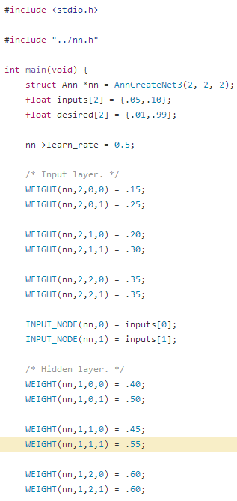
set parameters
#define WEIGHT(net,l,i,j)
(net)->layer[l].weight[((j)*(net)->layer[l].units)+(i)]
#define INPUT_NODE(net,i)
OUTPUT(net,((net)->layers)-1,i)
#define OUTPUT(net,l,i)
(net)->layer[l].output[i]

Slide 31
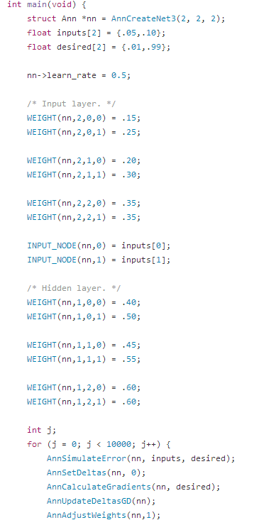
AnnSimulateError
AnnSimulateError
AnnSetInput AnnSimulate AnnGlobalError
Forward pass
Root Mean Square (RMS) error

Slide 32
AnnSimulateError
/* Simulate the net, and return the global error */
float AnnSimulateError(struct Ann *net, float *input, float *desired) {
AnnSetInput(net, input);
AnnSimulate(net);
return AnnGlobalError(net, desired);
}
Double input assignment in nn-test-1.c

Slide 33
AnnSetInput AnnSimulate AnnGlobalError
/* Set the network input */
void AnnSetInput(struct Ann *net, float *input)
{
int i, inputs = INPUT_UNITS(net);
for (i = 0; i < inputs; i++) INPUT_NODE(net,i) = input[i];
}
/* Calcuate the global error of the net. This is just the
* Root Mean Square (RMS) error, which is half the sum of the squared
* errors. */
float AnnGlobalError(struct Ann *net, float *desired) {
float e, t;
int i, outputs = OUTPUT_UNITS(net);
e = 0;
for (i = 0; i < outputs; i++) {
t = desired[i] - OUTPUT_NODE(net,i);
e += t*t; /* No need for fabs(t), t*t will always be positive. */
}
return .5*e;
}

Slide 34
AnnSetInput AnnSimulate AnnGlobalError
Find the position of weight
void AnnSimulate(struct Ann *net) {
int i, j, k;
for (i = net->layers-1; i > 0; i--) {
int nextunits = net->layer[i-1].units;
int units = net->layer[i].units;
if (i > 1) nextunits--; /* dont output on bias units */
for (j = 0; j < nextunits; j++) {
float A = 0; /* Activation final value. */
float *w = net->layer[i].weight + j*units;
float *o = net->layer[i].output;
k = 0;
for (; k < units; k++) {
float W = *w++;
float O = *o++;
A += W*O;
}
OUTPUT(net, i-1, j) = sigmoid(A);
}
}
}
Activation:
return (float)1/(1+exp(-x));

Slide 35
AnnSetDeltas
Deltas have been set in AnnCreateNet by
global definition RPROP_INITIAL_DELTA
In iteration, delta set to 0.

Slide 36
AnnCalculateGradients
AnnCalculateOutputError
Iteration for each weight
calculate the gradients

Slide 37
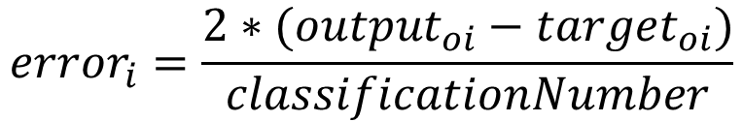
AnnCalculateOutputError
$${error}_{i}=\frac{2∗({output}_{oi}−{target}_{oi})}{classificationNumber}$$
/* Compute the error vector y-t in the output unit. This error depends
* on the loss function we use. */
void AnnCalculateOutputError(struct Ann *net, float *desired) {
int units = OUTPUT_UNITS(net);
float factor = (float)2/units;
for (int j = 0; j < units; j++) {
net->layer[0].error[j] =
factor * (net->layer[0].output[j] - desired[j]);
}
}

Slide 38
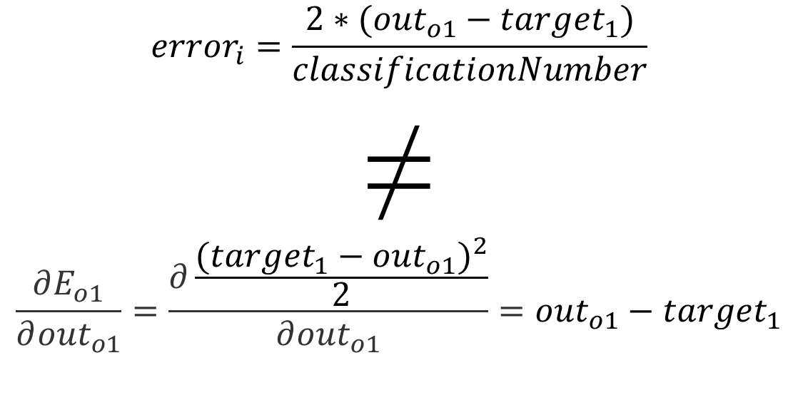
AnnCalculateOutputError Problem
$${error}_{i}=\frac{2∗({out}_{o1}−{target}_{1})}{classificationNumber}$$
≠
$$\frac{∂E_{o1}}{∂{out}_{o1}}=\frac{∂\frac{{({target}_{1}−{out}_{o1})}^{2}}{2}}{∂{out}_{o1}}={out}_{o1}−{target}_{1}$$

Slide 39
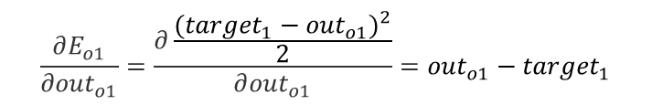
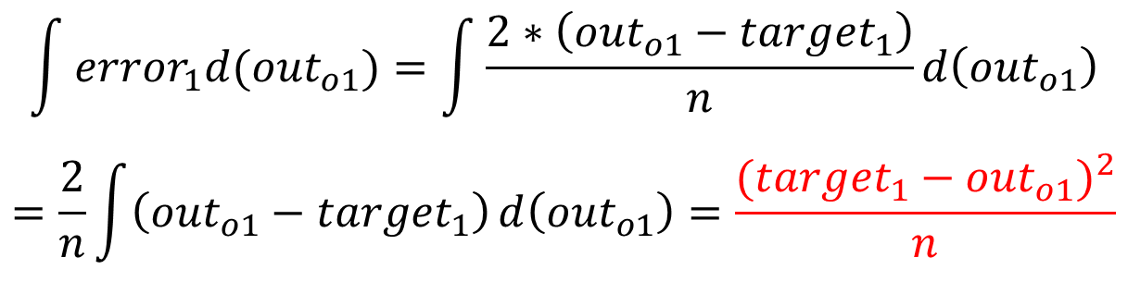
Problem continue..
$$\frac{∂E_{o1}}{∂{out}_{o1}}=\frac{∂\frac{{({target}_{1}−{out}_{o1})}^{2}}{2}}{∂{out}_{o1}}={out}_{o1}−{target}_{1}$$
Let n = classification number
$$\int{{error}_{1}d({out}_{o1})=\int{\frac{2∗\left({out}_{o1}−{target}_{1}\right)}{n}d\left({out}_{o1}\right)}}$$
$$=\frac{2}{n}\int{\left({out}_{o1}−{target}_{1}\right)}d\left({out}_{o1}\right)=\frac{{({target}_{1}−{out}_{o1})}^{2}}{n}$$
Real loss function

Slide 40

AnnCalculateGradients
void AnnCalculateGradients(struct Ann *net, float *desired) {
int j, layers = LAYERS(net)-1;
/* Populate the error vector net->layer[0]->error according to the loss function. */
AnnCalculateOutputError(net,desired);
/* Back-propagate the error and compute the gradient for every weight in the net. */
for (j = 0; j < layers; j++) {
struct AnnLayer *layer = &net->layer[j], AnnLayer *prev_layer = &net->layer[j+1];
int i, units = layer->units, prevunits = prev_layer->units;
/* Skip bias units, they have no connections with the previous layers. */
if (j > 1) units--;
/* Reset the next layer errors array */
for (i = 0; i < prevunits; i++) prev_layer->error[i] = 0;
/* For every node in this layer ... */
for (i = 0; i < units; i++) {
float error_signal, ei, oi, derivative;
int k;
/* Compute gradient. */
ei = layer->error[i];
oi = layer->output[i];
/* Common derivatives:sigmoid: oi*(1-oi)
derivative = oi*(1-oi);
error_signal = ei*derivative;
/* For every weight between this node and the previous layer's nodes: */
float *g = prev_layer->gradient + i*prevunits;
float *w = prev_layer->weight + i*prevunits;
float *o = prev_layer->output;
float *e = prev_layer->error;
/* 1. Calculate the gradient */
for (k = 0; k < prevunits; k++) *g++ = error_signal*(*o++);
/* 2. And back-propagate the error to the previous layer */
for (k = 0; k < prevunits; k++) {
*e += error_signal * (*w);
e++;
w++;
}
}
}
}
$$\frac{∂E_{total}}{∂w_{5}}=\frac{∂E_{o1}}{∂{out}_{o1}}\frac{∂{out}_{o1}}{∂{net}_{o1}}\frac{∂{net}_{o1}}{∂w_{5}}$$
$$\frac{∂E_{total}}{∂w_{1}}=\frac{∂{out}_{h1}}{∂{net}_{h1}}\frac{∂{net}_{h1}}{∂w_{1}}(\frac{∂E_{o1}}{∂{out}_{o1}}\frac{∂{out}_{o1}}{∂{net}_{o1}}\frac{∂{net}_{o1}}{∂{out}_{h1}}+\frac{∂E_{o2}}{∂{out}_{o2}}\frac{∂{out}_{o2}}{∂{net}_{o2}}\frac{∂{net}_{o2}}{∂{out}_{h1}})$$

Slide 41
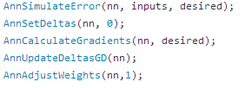

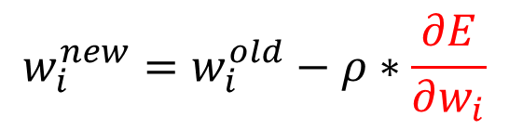
AnnUpdateDeltasGD
$$w_{i}^{new}=w_{i}^{old}−ρ∗\frac{∂E}{∂w_{i}}$$
Why summation?$\underset{→}{\text{yields}}$Batch VS Stochastic
/* Update the deltas using the gradient descend algorithm.
* Gradients should be already computed with AnnCalculateGraidents(). */
void AnnUpdateDeltasGD(struct Ann *net) {
int j, i, layers = LAYERS(net);
for (j = 1; j < layers; j++) {
int units = UNITS(net, j);
int weights = units * UNITS(net,j-1);
for (i = 0; i < weights; i++)
net->layer[j].delta[i] += net->layer[j].gradient[i];
}
}

Slide 42
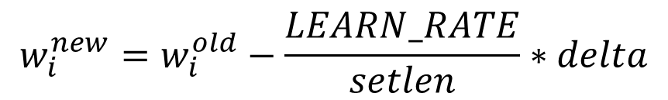
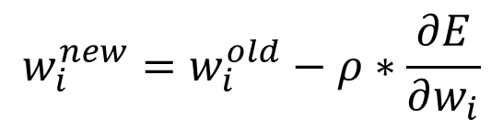
AnnAdjustWeights
$$w_{i}^{new}=w_{i}^{old}−ρ∗\frac{∂E}{∂w_{i}}$$
$$w_{i}^{new}=w_{i}^{old}−\frac{LEARN_RATE}{setlen}∗delta$$
/* Adjust net weights using the (already) calculated deltas. */
void AnnAdjustWeights(struct Ann *net, int setlen) {
int j, i, layers = LAYERS(net);
for (j = 1; j < layers; j++) {
int units = UNITS(net, j);
int weights = units * UNITS(net,j-1);
for (i = 0; i < weights; i++) {
net->layer[j].weight[i] -= LEARN_RATE(net)/setlen*net->layer[j].delta[i];
}
}
}

Slide 43
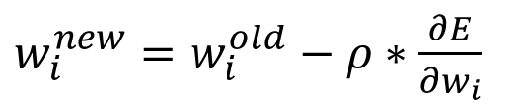
Batch gradient decent VS Stochastic gradient decent
$w_{i}^{new}=w_{i}^{old}−ρ∗\frac{∂E}{∂w_{i}}$
representativeness??
How to find the most exact gradient?
Pass all the training data to update gradients in one iteration.
Batch gradient decent
How to train the model fast?
Pass one training example to update gradients in one iteration.
Stochastic gradient decent
compromise: 1%-5% of the training data to update gradients in
one iteration.

Slide 44
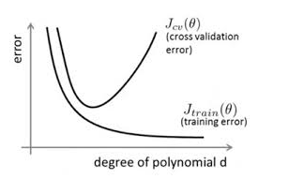
Termination of ANN
1. Early stopping before over fitting
2. Max epochs/iterations
3. Min loss

Slide 45
Neural Redis API(接口介绍)
Load the extension
NR.CREATE (REGRESSOR/CLASSIFIER)
NR.OBSERVE
……..
……..
……..
NR.OBSERVE
NR.TRAIN net AUTOSTOP
NR.RUN net XX, XX

Slide 46
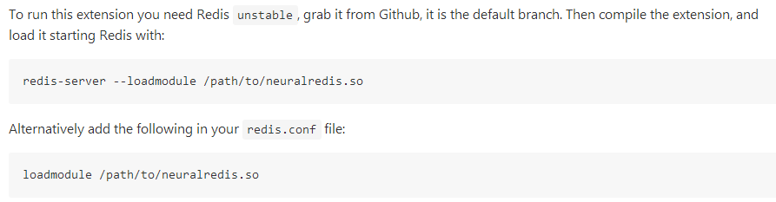
Loading the extension

Slide 47
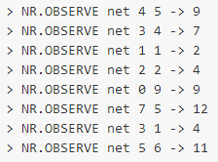


Train and test

Slide 48
AVX instructions
Advanced Vector Extensions (AVX) are extensions to the x86 instruction set architecture for microprocessors from Intel and AMD .(AVX Wikipedia )
高级矢量扩展指令集是X86指令架构处理器的扩充。这些处理器来自Intel和AMD。
AVX uses sixteen YMM registers. Each YMM register contains:
eight 32-bit single-precision floating point numbers or
four 64-bit double-precision floating point numbers.
AVX有16个YMM寄存器，每一个可以保存8个32位单精度浮点数，或者4个64位双精度浮点数
一个指令周期可以对多组对象同时进行操作

Slide 49
__m256 _mm256_mul_ps (__m256 a, __m256 b)
Load data into register
#ifdef USE_AVX
int psteps = units/8;
for (int x = 0; x < psteps; x++) {
__m256 weights = _mm256_loadu_ps(w);
__m256 outputs = _mm256_loadu_ps(o);
__m256 prod = _mm256_mul_ps(weights,outputs);
A += avx_horizontal_sum(prod);
w += 8;
o += 8;
}
k += 8*psteps;
#endif
Multiply packed single-precision (32-bit) floating-point elements

Slide 50
avx_horizontal_sum
/* Simulate the net one time. */
#ifdef USE_AVX
/* Provided to stack overflow by user Marat Dukhan. */
float avx_horizontal_sum(__m256 x) {
// hiQuad = ( x7, x6, x5, x4 )
const __m128 hiQuad = _mm256_extractf128_ps(x, 1);
// loQuad = ( x3, x2, x1, x0 )
const __m128 loQuad = _mm256_castps256_ps128(x);
// sumQuad = ( x3 + x7, x2 + x6, x1 + x5, x0 + x4 )
const __m128 sumQuad = _mm_add_ps(loQuad, hiQuad);
// loDual = ( -, -, x1 + x5, x0 + x4 )
const __m128 loDual = sumQuad;
// hiDual = ( -, -, x3 + x7, x2 + x6 )
const __m128 hiDual = _mm_movehl_ps(sumQuad, sumQuad);
// sumDual = ( -, -, x1 + x3 + x5 + x7, x0 + x2 + x4 + x6 )
const __m128 sumDual = _mm_add_ps(loDual, hiDual);
// lo = ( -, -, -, x0 + x2 + x4 + x6 )
const __m128 lo = sumDual;
// hi = ( -, -, -, x1 + x3 + x5 + x7 )
const __m128 hi = _mm_shuffle_ps(sumDual, sumDual, 0x1);
// sum = ( -, -, -, x0 + x1 + x2 + x3 + x4 + x5 + x6 + x7 )
const __m128 sum = _mm_add_ss(lo, hi);
return _mm_cvtss_f32(sum);
}
#endif
sumQuad x3+x7 x2+x6 x1+x5 x0+x4
loDual x3+x7 x2+x6 x1+x5 x0+x4
hiDual x3+x7 x2+x6 x3+x7 x2+x6
sumDual x3+x7+x3+x7 x2+x6+x2+x6
x1+x5+x3+x7 x0+x2+x4+x6
lo x3+x7+x3+x7 x2+x6+x2+x6
x1+x5+x3+x7 x0+x2+x4+x6
hi x0+x2+x4+x6 x0+x2+x4+x6
x0+x2+x4+x6 x1+x5+x3+x7
float _mm_cvtss_f32 (__m128 a)
Copy the lower single-precision (32-bit) floating-point element of a to dst.
0001

Slide 51
Thank you!

