Slide 1


Kino
Kinetic Android
Media Player
Or Avrahamy & Opher Vishnia

Slide 2
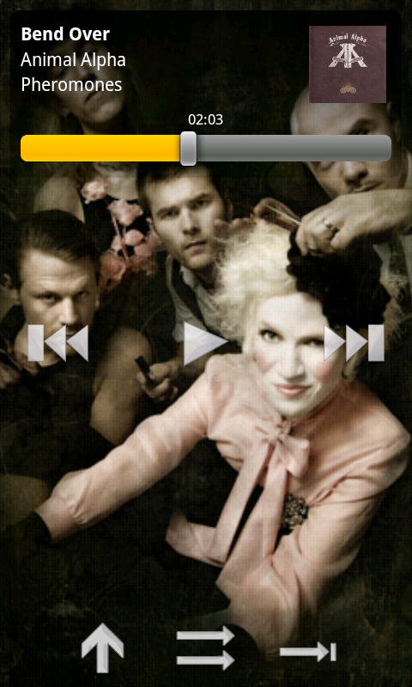
Demo

Slide 3
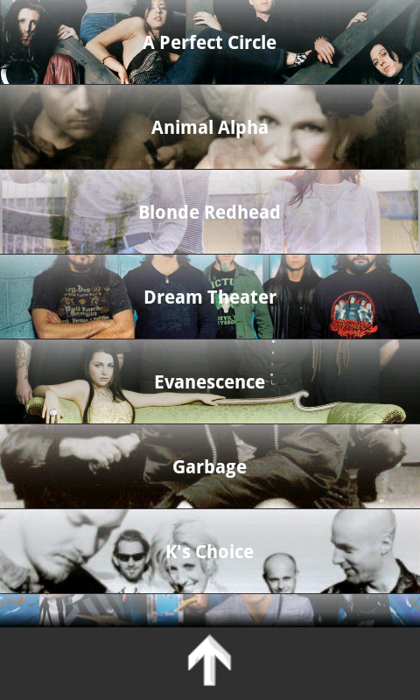
Motivation
Lack of tactile buttons in Touch Screen devices
Most media players are cumbersome and unworthy

Slide 4
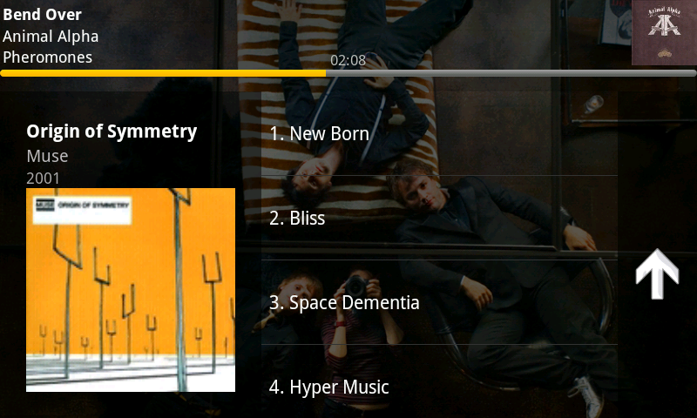
The Solution: Kino
The entire device is a button
Gestures replace “touch buttons”
An intuitive and good-looking Android media player

Slide 5
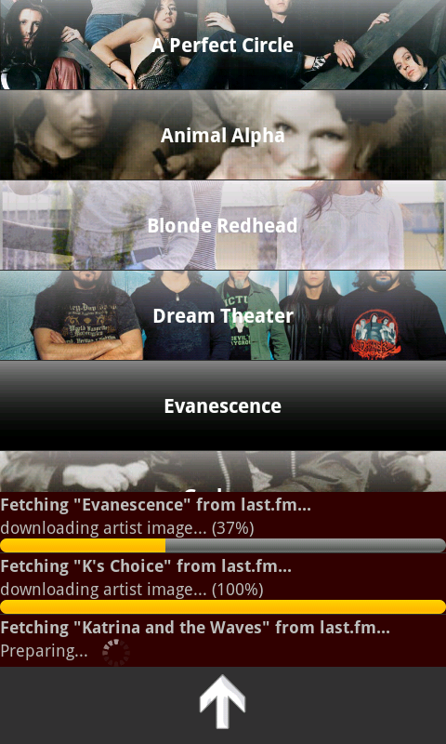
Cool Features
Double tap as an input method
Flick songs (Next/Previous)
Automagically fetched Artist and Album art

Slide 6
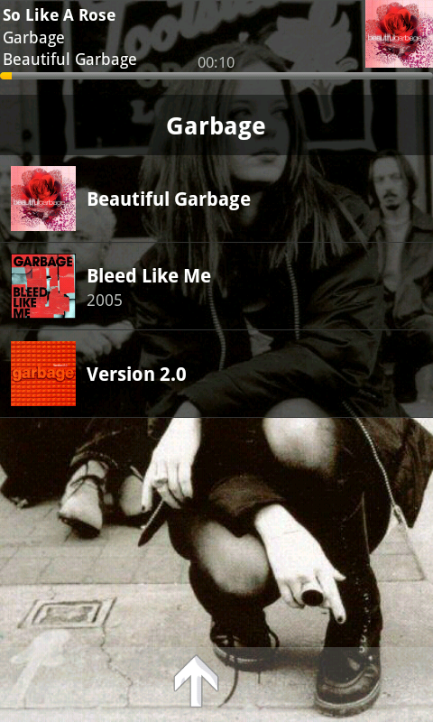
Technical Details
Considering usability issues
Identifying double tap using sound (accelerometers failed)
Downloading art from last.fm

Slide 7
Questions?

Slide 8
Thank You

