Slide 1

THE UNIVERSITY OF ZAMBIA
SCHOOL OF NATURAL AND APPLIED SCIENCES
DEPARTMENT OF COMPUTING AND INFORMATICS
VERISCREEN: A WEB-BASED SYSTEM FOR ACADEMIC DOCUMENT VERIFICATION AND HELSB LOAN SCREENING
SAMUEL CHIBINJI MWANZA: 2021465934
NOSIKU MUKUKA: 2022030346
Supervisor: Mrs. Monde Monica Kalumbilo Kabemba
Date: 23rd October 2026

Slide 2

Table of contents
01
02
04
03
Introduction
Literature overview
1.1 Problem Statement
1.2 Project Aim
1.3 Objectives
1.4 Scope of Project
Delivered system
1.1 Software systems/ Prototypes
1.2 Document generation engine
1.3 Documentation
1.4 Demonstration materials
1.5 Research contributions
Proposed Methodology
1.1 Development Approach
1.2 System Architecture
1.3 Complete workflow description
1.4 Data collection
1.5 Tools and Technologies
1.6 Ethical and legal considerations
05
Project Timeline
06
Risk Analysis
08
References

Slide 3

Introduction
01
Project Background and Description
The current difficulty
Students still depend on a visit for a stamped document
A screenshot is easy to alter and hard to check
A loan status such as Approved does not explain the record
Distance from campus makes collection slow
The university record and the loan office are separate
There is no shared sentence the student and the officer both see
What VeriScreen does
Student portal for verified academic documents
PDFs sealed with a QR code and an issued time
Phone page that says whether the document was issued
HELSB tracker from Submitted to Disbursement
Plain-language screening sentence
Same stage on the student dashboard and the officer portal

Slide 4



Problem Statement
Challenge 2: Loan Application verification
Challenge 1: Document Accessibility
A document has to be collected in person
Queues and repeat visits take study time
Each new copy needs another stamp
Distance learners are the most affected
There is no self-service verified copy
The record is digital, but the proof is still paper
Students re-download and re-upload the same files
Checking a file by hand delays a loan decision
A copied PDF can be changed before it is sent
Officers repeat work the university record already holds
Students cannot see why a decision was reached
THE CORE PROBLEM
No shared channel lets a student issue a checkable document and lets HELSB explain the decision from that record.

Slide 5
Aim
To build VeriScreen so a student can obtain a verified academic document, a phone can check its QR code, and a HELSB officer can move the loan application while both sides see the same screening sentence.

Slide 6
Objectives
1. Separate the student API and the HELSB API, with each side writing only to its own database.
2. Give the student a portal to sign in, read the record, and download a verified PDF.
3. Let the student share the application with HELSB, and let an officer advance it one stage at a time.
4. Seal each PDF with a QR code and the time it was issued, and open a clear verified or not-verified page.
5. At screening, write one plain-language sentence and show it to both the officer and the student.

Slide 7
Scope of project
In Scope
Out of Scope
A prototype web application for students and a HELSB screening portal.
PDFs for fees, results, confirmation, and the examination slip, each with a QR code.
Phone verification page, including the issued time.
Tracker from Submitted through Disbursement.
Screening sentences, a phone-width layout, and an Expo client.
Seeded students and officers, with JWT sessions and hashed passwords.
A live Banner or production HELSB connection.
A live payment gateway or real disbursement.
Biometric identity checks.
SMS notifications.

Slide 8
02
Literature Overview

Slide 9
Literature Overview
Concept | Reference | What the system does
Document verification | ISO/IEC 18004 (QR) | Each PDF carries a QR code and the time it was issued.
Session security | RFC 7519 (JWT) | Student and officer sessions use separate tokens.
Service boundary | Fielding (2000) | The browser talks to an API. The two APIs do not share tables.
Student consent | HELSB loan workflow | The student shares the application. Screening then reads that student's record.
VeriScreen issues the document, checks the QR code, and explains the HELSB decision in one sentence the student can match to the stored record.

Slide 10
03
Proposed Methodology

Slide 11
Development Approach
Built in short increments and kept only what could be shown
Samuel Chibinji Mwanza and Nosiku Mukuka
Student sign-in, records, PDFs, then the officer tracker
Screening sentence added when the tracker reached screening
Checked against four seeded students whose balances are known
Final report and this presentation, 23rd October 2026

Slide 12
System Architecture
Two portals, two APIs, two databases.
  Student portal on port 5173 calls the student API on port 8081.
  HELSB portal on port 5174 calls the officer API on port 8083.
  veriscreen_db holds the academic record. helsb_db holds the officer applications.
The officer API asks the student API for the screening sentence, then both sides store that text.

Slide 13
Workflow Description
1. Student access
Sign in with a computer number
Dashboard, documents, records, and results
Preview or download the PDF
The QR code opens the verification page
2. Share with HELSB
The student submits the application
Seeded applications already exist for the demonstration
The officer does not read the student tables directly
Universities, then schools, then applications
One button moves the pipeline one stage
Samuel is HELSB-2026-000001
The student sees the same stage
3. Officer portal
4. Payment stage
Payment is a tracker step
No live card payment
The officer records the step
The student dashboard moves with it

Slide 14
Workflow Description
5. Screening
Checks, in order: fees, registration, examinations, results
  Samuel: Not eligible: outstanding fee balance of K500.00
  Nosiku: Approved: good academic standing, fees cleared, registration confirmed.
  A Not eligible result stops the pipeline
6. Contract
Reached only when the sentence does not start with Not eligible
The contract text comes from the stored application
It is not a signed legal agreement
7. Disbursement
The last tracker stage
No money is sent
The student dashboard shows the same stage

Slide 15
Data Collection
Source
  A simulated university record loaded into MySQL
  Not a live university extract
Held for four students
  Fees, registration, examinations, grades, and applications
Samuel's latest balance is K500.00. Nosiku's fees are cleared.

Slide 16
Tools and Technologies
Student and officer portals
React, TypeScript, and Vite
APIs
Node.js and Express
Documents and sessions
PDFKit, QR codes, JWT, and bcrypt
Databases
MySQL locally: veriscreen_db and helsb_db
PostgreSQL only when a hosted URL is set

Slide 17
Ethical and legal considerations
Zambian Data Protection Act: the seed is demonstration data
The student shares the application; it is not pushed silently
Passwords are hashed. Student and officer tokens differ.
No live student, no biometric data, and no real money
The verification page names the student and document type, not the grades
Controls in the build
Separate databases for the student and the officer
Shared internal key on the screening call
Sign-out asks for confirmation
Development passwords are not for a public site

Slide 18
04
Delivered system

Slide 19
What was built
Student portal: sign-in, dashboard, documents, records, results, Help, and Settings with dark mode.
Student API: profile, fees, results, PDF download, verification page, and the screening sentence.
Record: four seeded students in veriscreen_db, including a K500.00 balance and a cleared-fee case.
HELSB portal: universities, schools, applications, and the six-step tracker.
Phone-width layout of both portals, plus an Expo client on the same student API.

Slide 20
Document Generation Engine
Fee statement, results, confirmation of registration, and examination slip. Samuel shows 14,000.00 billed, 13,500.00 paid, and 500.00 outstanding. Results include the name, computer number, and gender. The QR code carries the issued time.

Slide 21
Documentation
Final report: docs/VeriScreen-Final-Year-Report.pdf, submitted 23rd October 2026.
The report includes the architecture, the screening rules, and screenshots of both portals.
This presentation follows the same system: student portal, officer portal, QR check, and screening sentence.

Slide 22
Demonstration Materials
Student: 2021465934, Samuel Chibinji Mwanza. Password password123.
Also Nosiku Mukuka 2022030346, Grace Banda 2020123456, and Peter Zulu 2019876543.
Officer: mwaka.chanda@helsb.zm. Sites: localhost:5173 and localhost:5174.

Slide 23
Research Contributions
A working student portal and a separate HELSB officer portal.
A screening sentence tied to the fee, registration, examination, and result rows.
Samuel and Nosiku share the delivered system. A percentage split is left for the supervisor.

Slide 24
05
Project Timeline

Slide 25
Project Timeline
Phase | Outcome
Proposal and design | Completed
Student API and MySQL record | Completed
Student web portal | Completed
PDF documents and QR codes | Completed
Phone verification page | Completed
HELSB officer portal | Completed
Six-step tracker | Completed
Screening sentences | Completed
Phone-width layout and Expo client | Completed
Final report | 23rd October 2026
Presentation | 23rd October 2026

Slide 26
06
Risk Analysis

Slide 27
Risks
Technical Risks
Project and Personal Risks
The two databases can diverge if the internal call fails
Development passwords must not be used in public
PDF layout had to match the reference forms without copying private details
The tracker and the sentence had to stay in step
Report, slides, and demonstration were due together
Data and External Risks
Usability Risks
The record is simulated, so it is not a live university extract
A phone must be on the same network to open a local QR address
A narrow screen must still show the tracker and the menu

Slide 28
Risks
What we did
Kept the scope to documents, verification, the tracker, and the sentence.
Hashed passwords, separate tokens, and an internal key on the screening call.
The work is in one Git repository.
The student menu collapses on a phone, and both portals were checked at phone width.
Seeded four known cases, including K500.00 outstanding and a cleared-fee approval.
The QR page was opened from the address printed for the phone.

Slide 29
07
References

Slide 30
References
[1] Higher Education Loans and Scholarships Board. helsb.gov.zm.
[2] ISO/IEC 18004. QR Code bar code symbology specification.
[3] RFC 7519. JSON Web Token (JWT).
[4] Fielding, R. T. (2000). Architectural Styles and the Design of Network-based Software Architectures.
[5] MySQL 8.0 Reference Manual.
[6] React documentation, react.dev. Express documentation, expressjs.com.
[7] OWASP Authentication Cheat Sheet.
[8] Government of the Republic of Zambia. Data Protection Act, 2021.

Slide 31
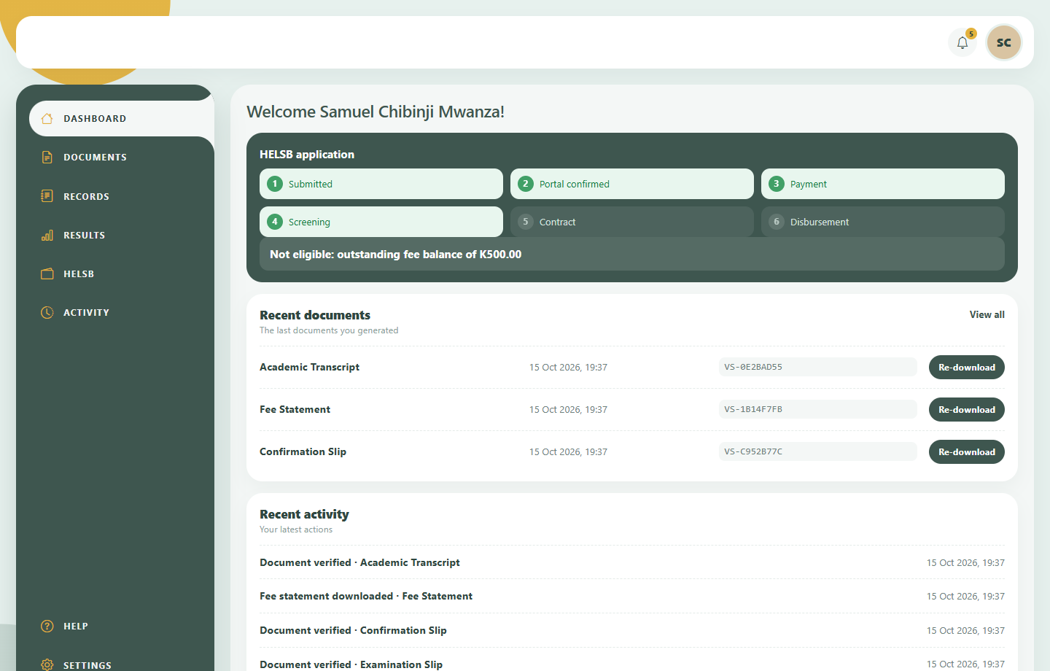
Student portal

Slide 32
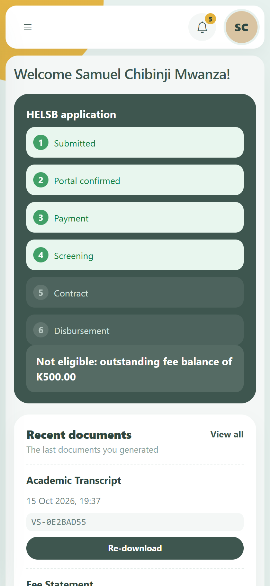
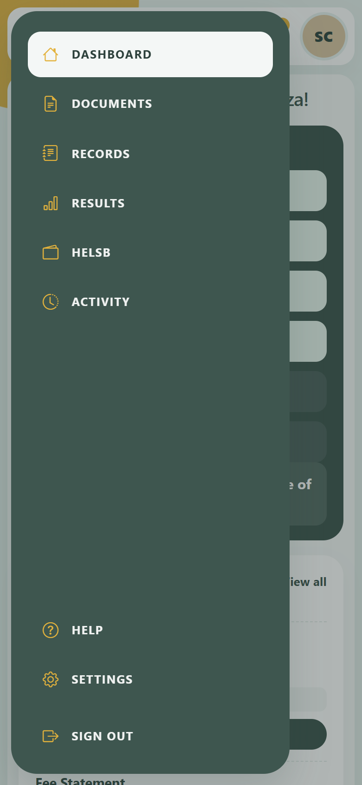
Student portal on a phone

Slide 33
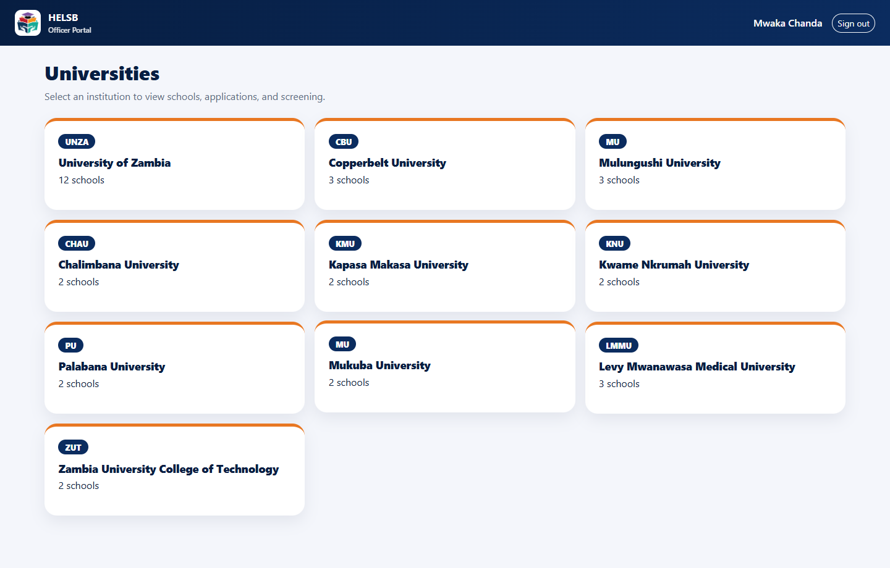
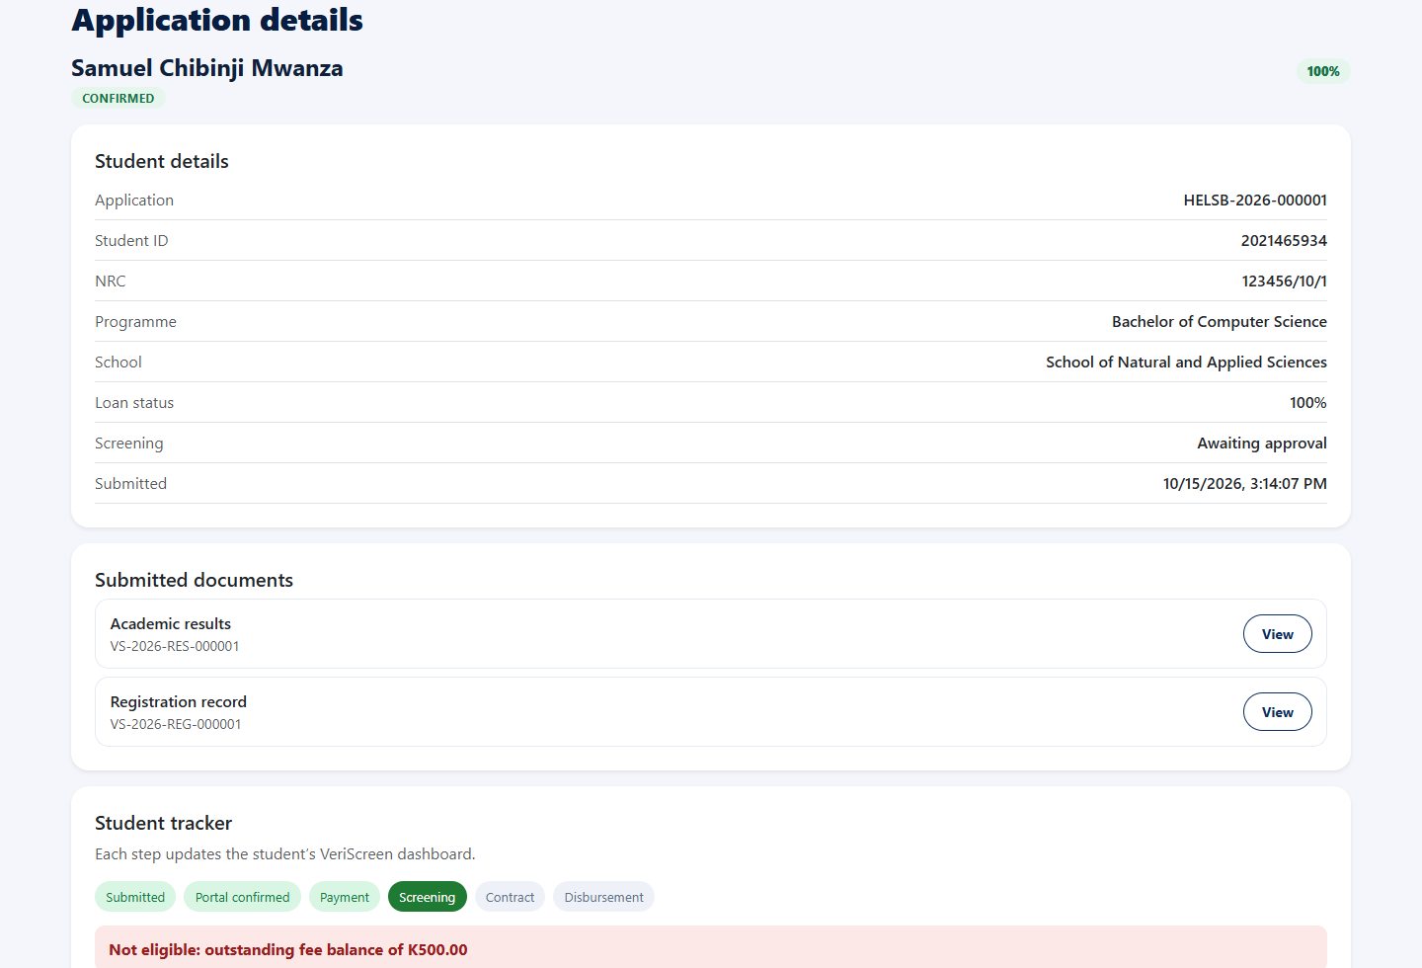
HELSB officer portal

Slide 34

Thank you for your Attention
Q & A
NOSIKU MUKUKA: 2022030346
SAMUEL CHIBINJI MWANZA: 2021465934

