Slide 1
GATHERLOOP
Static Site Deployment
Choosing an architecture on purpose, then proving it under real conditions
Ezuka Chibueze | Reg. No.: CLC/2026/TC-7/0110
Cloud & DevOps Bootcamp • Capstone Personal Project • Group 3

Slide 2
What we'll cover
01
The Scenario
GatherLoop's traffic pattern and operational constraints
02
The Design Decision
Blob hosting vs. a VM — compared honestly, then chosen
03
The Live System
Provisioning, deployment, and the CI/CD pipeline in action
04
The Incident
A real failure, diagnosed and fixed — and what it taught us
02

Slide 3




The Scenario
GatherLoop — a single-page site for a ticketed conference launch
Spiky traffic
No ops budget
Auto-deploy wanted
A skeptical founder
Near-zero for weeks, then a huge spike the morning tickets go on sale
No in-house staff available to operate or babysit a server
Content updates should go live automatically on every GitHub push
Believes “a real server” means more control — needs convincing
03

Slide 4


Two valid architectures.
Only one fits GatherLoop's actual situation.
Option A
Option B
Blob Static Website Hosting
Linux VM + Nginx
Upload files to cloud storage; Azure serves them directly. No server to run, patch, or restart.
Rent a full computer, install a web server, and operate it yourself — patches, config, uptime.
The brief's own test: don't default to what you know — compare against the client's real constraints first.
04

Slide 5
The honest comparison
Filled in for both options — the comparison is the graded part, not just the answer
Criterion | Blob Hosting | VM + Nginx
Handles the spike? | Yes — spread across Azure's infra | Only if pre-sized for peak
Maintenance burden? | Basically none | Continuous — patch, configure, watch
Cost (idle vs. spike)? | Cheap idle, small rise on spike | Fixed 24/7, whether busy or not
Breaks first under load? | Realistically nothing here | The VM's CPU / connections
Decision: Azure Blob Static Website Hosting — it solves the spike and the zero-ops constraint at once.
05

Slide 6

How it actually works
Push to GitHub → pipeline authenticates → Azure serves the update
Developer
GitHub Actions
Azure Blob $web
Visitor
Pushes to site/ on main
Authenticates via scoped service principal
Content synced via az storage blob upload-batch
Served instantly over HTTPS
Security note: the service principal is scoped to only the gatherloop-rg resource group, not the whole Azure subscription — limiting blast radius if credentials were ever compromised.
06

Slide 7
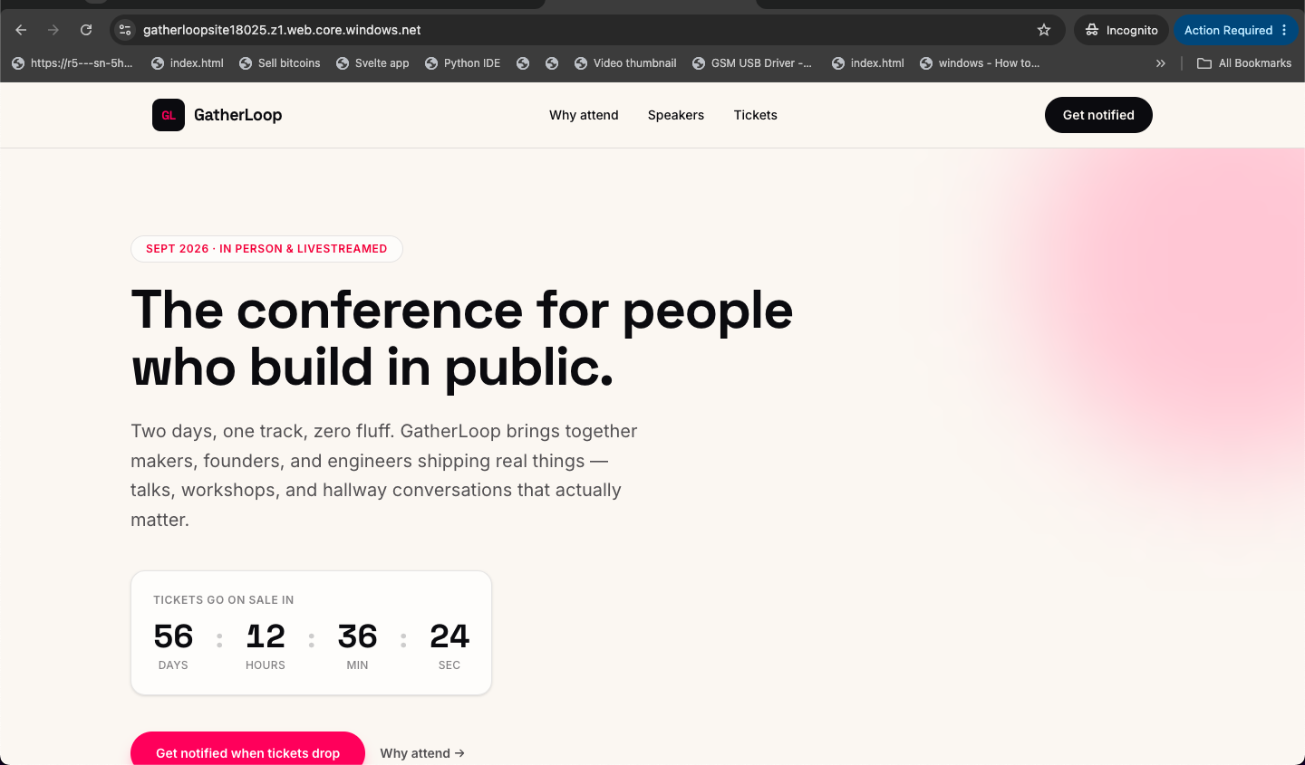
The live result
Served directly from Azure Blob storage — no server running underneath
gatherloopsite18025.z1.web.core.windows.net
07

Slide 8



A real incident
Not staged — this happened during routine credential rotation
Symptom
Investigation
Root Cause
Fix
Deploy failed — Azure login step errored on missing credential keys
Compared expected JSON keys vs. what the rotation command returned
Two Azure CLI commands return incompatible JSON key names
Remapped keys correctly, updated the secret, re-ran — passed
Design reflection: the secrets plan documented where a credential lives, but not how to rotate it safely. Now fixed by documenting the exact JSON shape alongside the rotation steps.
08

Slide 9
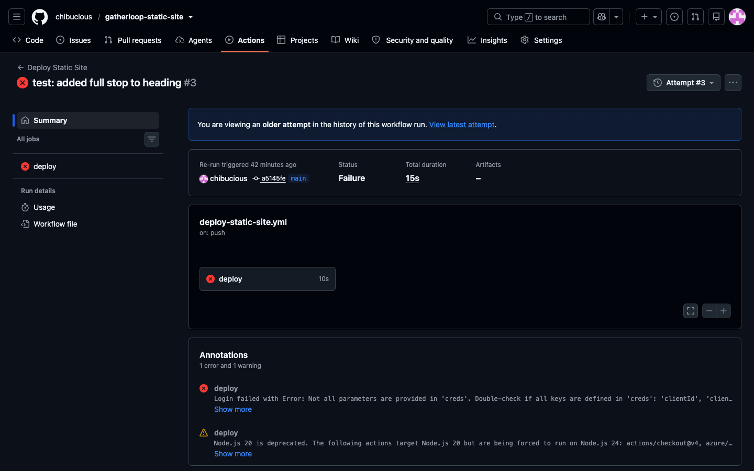
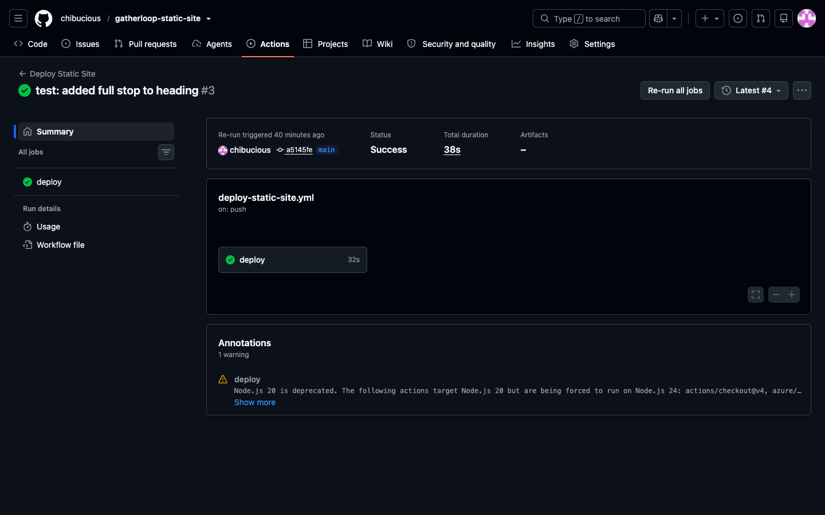
Before / After
The same pipeline, failing, then fixed and passing
✕ FAILING RUN
✓ FIXED & PASSING
09

Slide 10
Everything delivered
Site code — Tailwind CSS v4 landing page
CLI provisioning script (no manual Portal clicks)
GitHub Actions CI/CD — tested end-to-end, survived a real incident
Phase 0 design worksheet — two-architecture comparison
Full incident report — symptom through design reflection
Documented Report + this presentation
10

Slide 11
Designed on purpose.
Not a system that happened to work — one that was chosen, built, and proven under a real failure.
GitHub: github.com/chibucious/gatherloop-static-site
Live site: gatherloopsite18025.z1.web.core.windows.net
Thank you.

