Slide 1
Read Me (Delete this slide.) (1 of 2)
Presenting
The purpose of the alpha presentation is to demonstrate the alpha version of your software in order to convince everyone that your team will be successful—that is, that your team has your project completely scoped, the specifications complete, and all risks mitigated so that you are to the point where you will be capable of implementing your project, full-featured, and delivering it to your client on time.
The time limit for your presentation is 15 minutes, which will be strictly enforced. Practice your presentation to ensure that you will finish within the allotted time.
Plan on spending most of your presentation time demonstrating your software. A suggested approach is as follows.
Very Brief Review of Project Overview
Very Brief Review of System Architecture
Software Demonstration (Skipping Some or All of the Screen Shot Slides)
Brief Summary of What’s left to do?
Your software demonstration should
be rehearsed,
flow, and
demonstrate the main features of your software, possibly demonstrating some use cases.
All team members are required to dress business casual on the day of your presentation.
Content
Do not include any company confidential information in your presentation since all presentations will be posted on the web site.
Submit your presentation to your client for approval at least two working days in advance.
Throughout the PowerPoint template, replace placeholders <…> with the appropriate information.
Screen Shots
Include actual screen shots (i.e., not mockups), replacing <Title of Screen Shot> with an appropriate title.
You may duplicate the Screen Shot template slide as needed.
The screen shots are intended for posting on the web rather than for being used during your presentation so you may include as many screen shots as you like in this slide deck but skip many of them during your presentation by making them hidden slides.

Slide 2
Read Me (Delete this slide.) (2 of 2)
Required Template
Do not edit the Slide Masters.
Edit the slide center footer (Insert > Header & Footer), changing <Team Name> in the footer to your team name.
Edit the Handout Master (6 Slides Per Page) as follows.
In the left header, change <Team Name> to your team name.
In the right footer, change <Project Title> to your project title.
Do not change the organization of slides.
Submission
Although the presentations are scheduled over the course of four meetings, all teams must be prepared to present on the first day scheduled, Monday, February 20, 2012.
The order of the presentations will be posted on our All-Hands Meetings page in the afternoon or evening of the day before the first day scheduled for presentations.
Email your presentation to Dr. D. by midnight, Sunday, February 19, 2012.
For subject, use “Team <Team Name>: Alpha Presentation” as in “Team Boeing: Alpha Presentation”.
Attach the PowerPoint source file named “team-<team-name>-alpha-presentation.ppt” as in “team-urban-science-alpha-presentation.ppt”.

Slide 3
Alpha Presentation Infographic Generator
Team Urban Science
Peter Chen
Lok Cheung
Kevin Shreve
Louis Bodnar
Department of Computer Science and Engineering
Michigan State University
Spring 2012

Slide 4
Project Overview
Web App With Infographics
Display Information On Vehicle Sales, Service And Lead Management
Convey Information To OEM’s
Building Custom Library To Generate Elements Of The Infographic

Slide 5
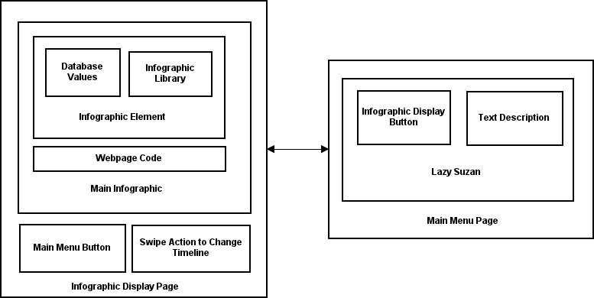
System Architecture

Slide 6
<Title of Screen Shot>

Slide 7
<Title of Screen Shot>

Slide 8
<Title of Screen Shot>

Slide 9
What’s left to do?
Swipe Gestures To Change Months
Lead Management Infographic
Service Infographic
Make Sure Data Is Fresh
Click To Bring Up Description Of Element
Main Menu Link On Infographic Display Page

