Slide 1
Beta Presentation Infographics Generator
Team Urban Science
Peter Chen
Lok Cheung
Louis Bodnar
Kevin Shreve
Department of Computer Science and Engineering
Michigan State University
Spring 2012

Slide 2
Project Overview
Web App With Infographics
Display Information On Vehicle Sales, Service And Lead Management
Convey Information To OEM’s
Building Custom Library To Generate Elements Of The Infographic

Slide 3
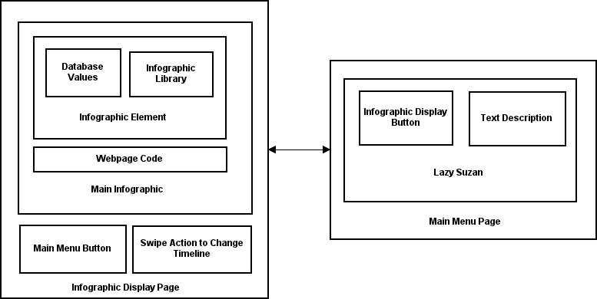
System Architecture

Slide 4
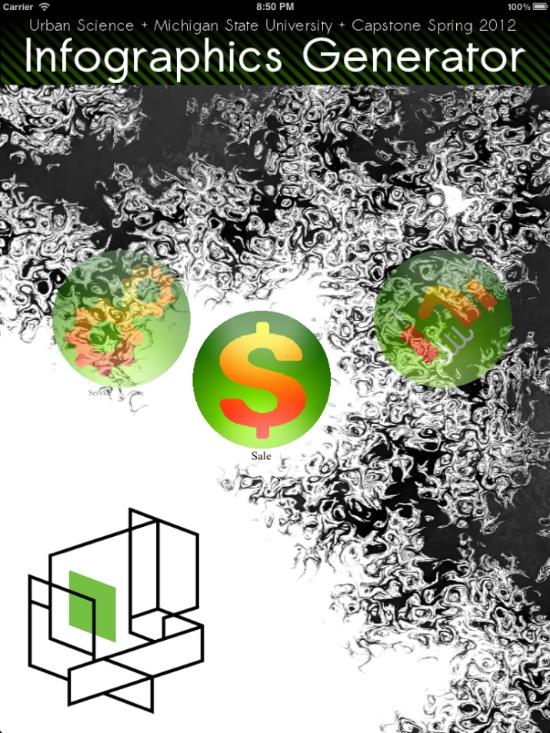
Home Page (Portrait)

Slide 5
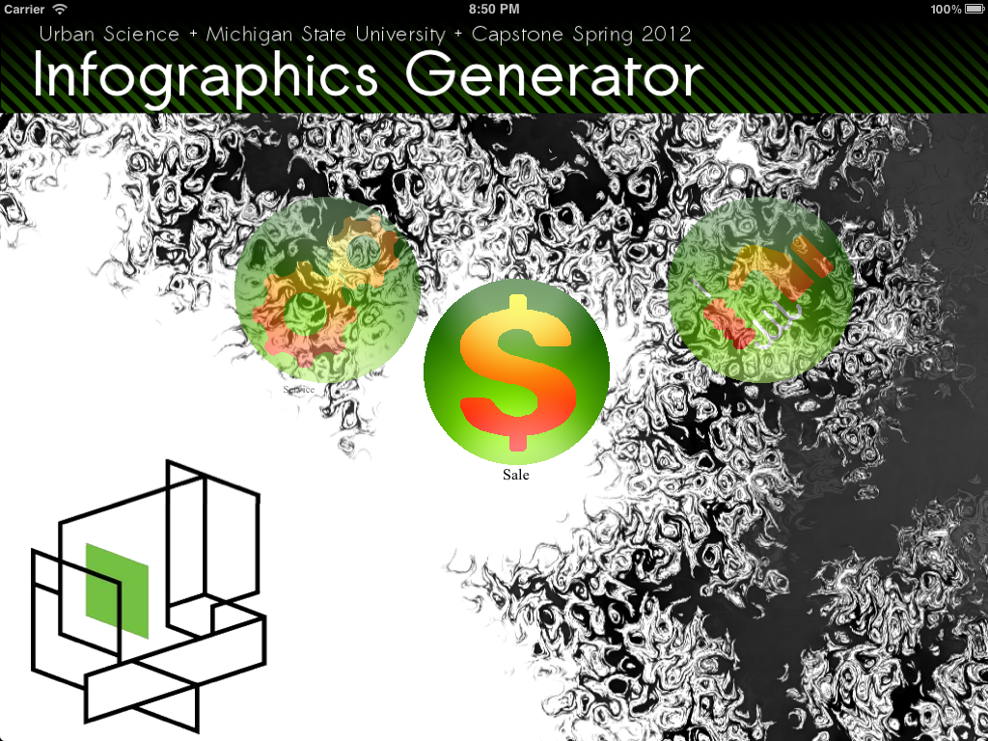
Home Page (Landscape)

Slide 6
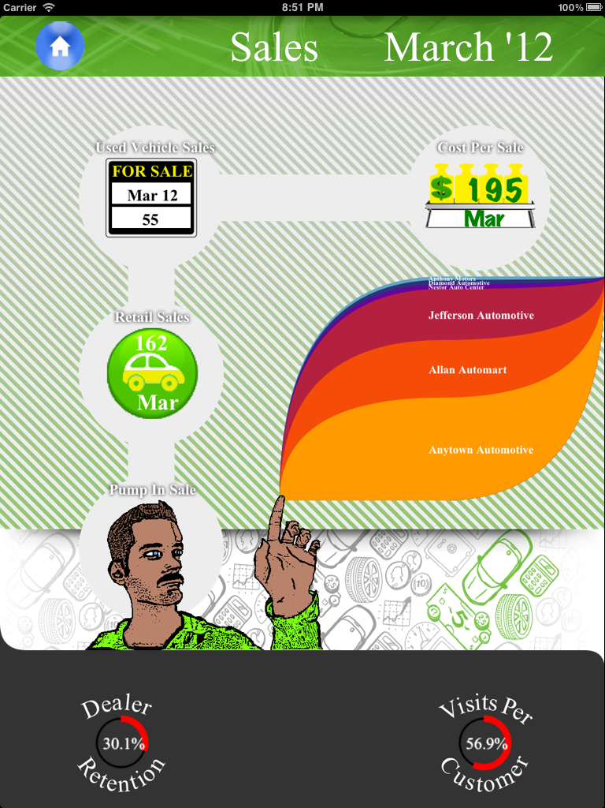
Sales Infographic

Slide 7
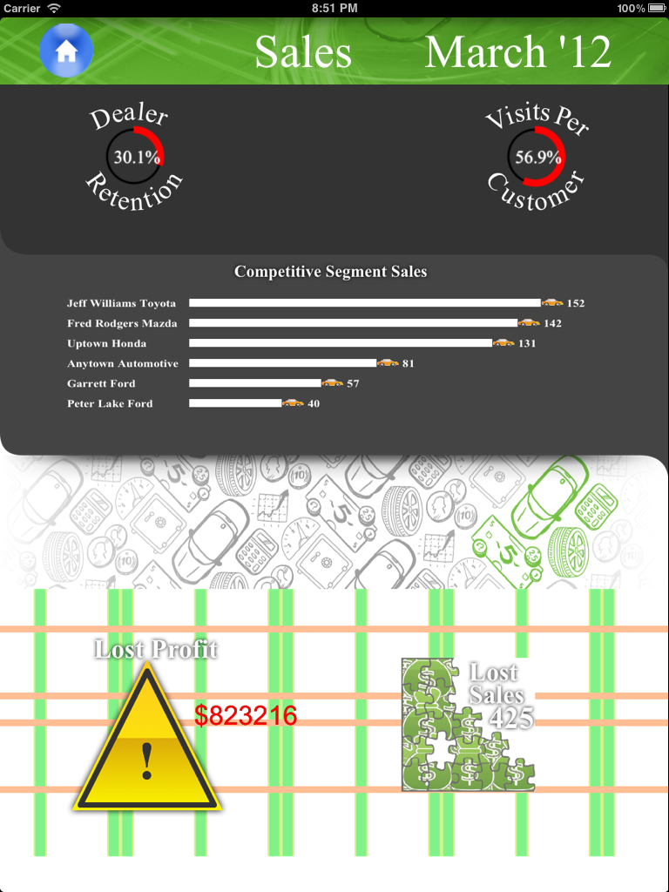
Sales Infographic cont.

Slide 8
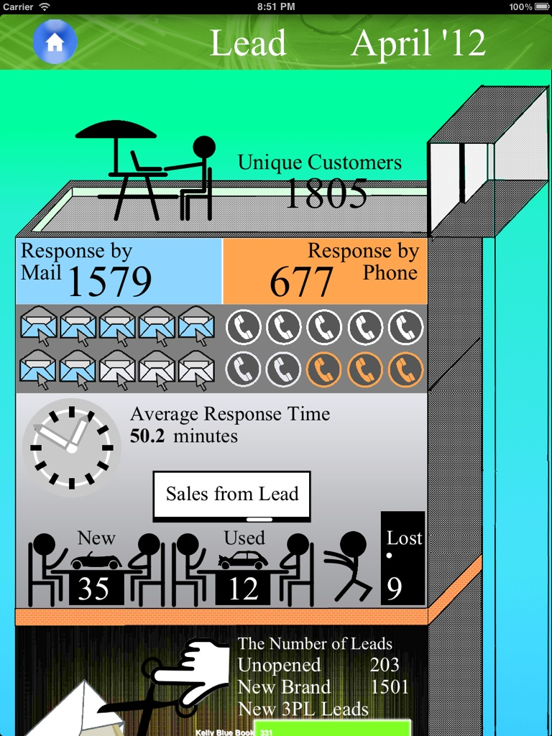
Lead Infographic

Slide 9
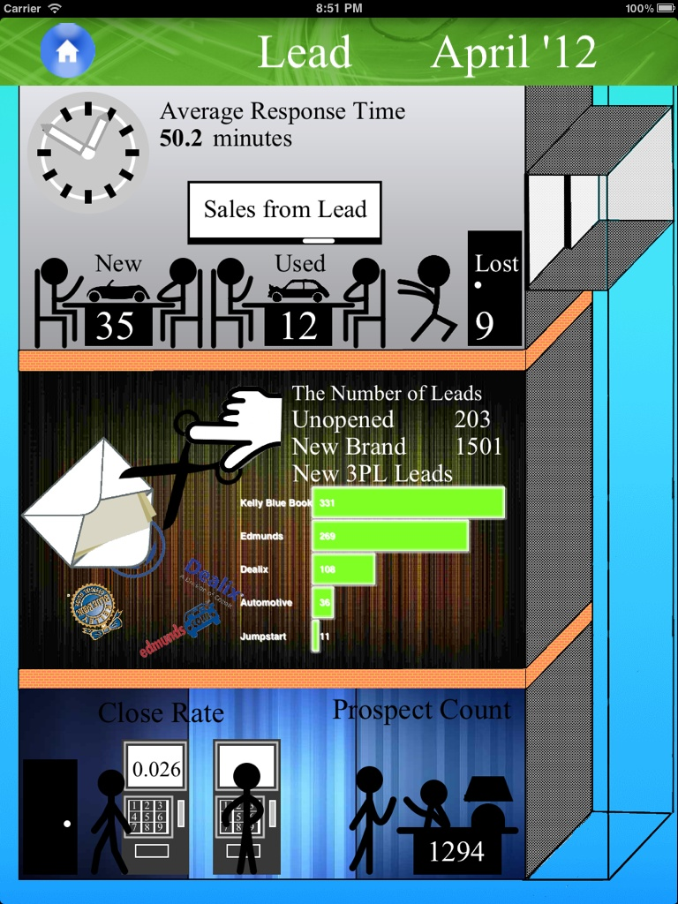
Lead Infographic cont.

Slide 10
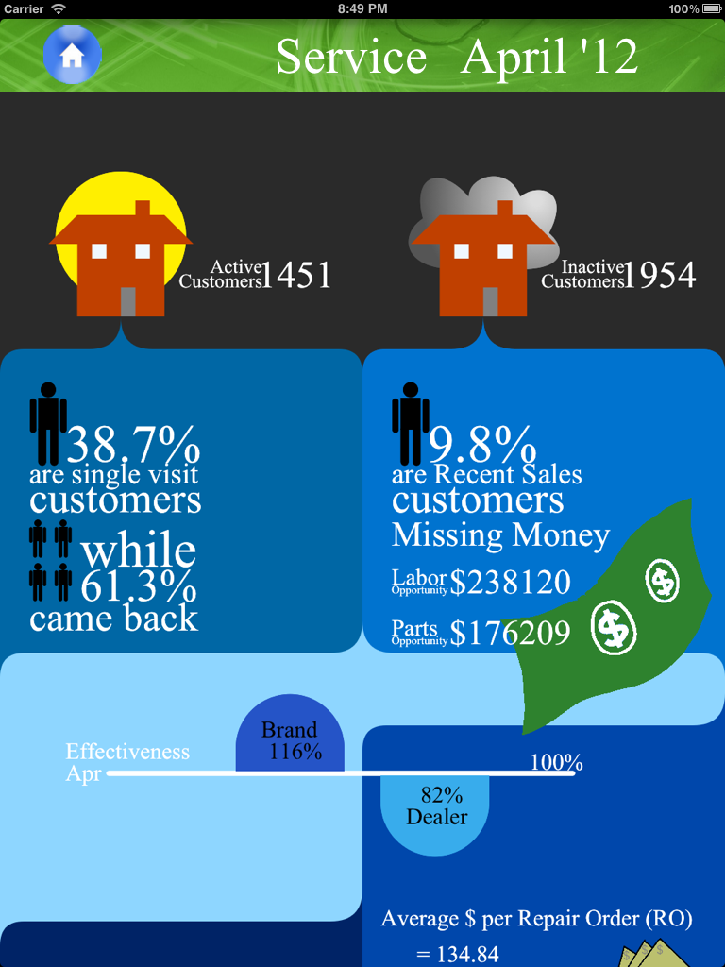
Service Infographic

Slide 11
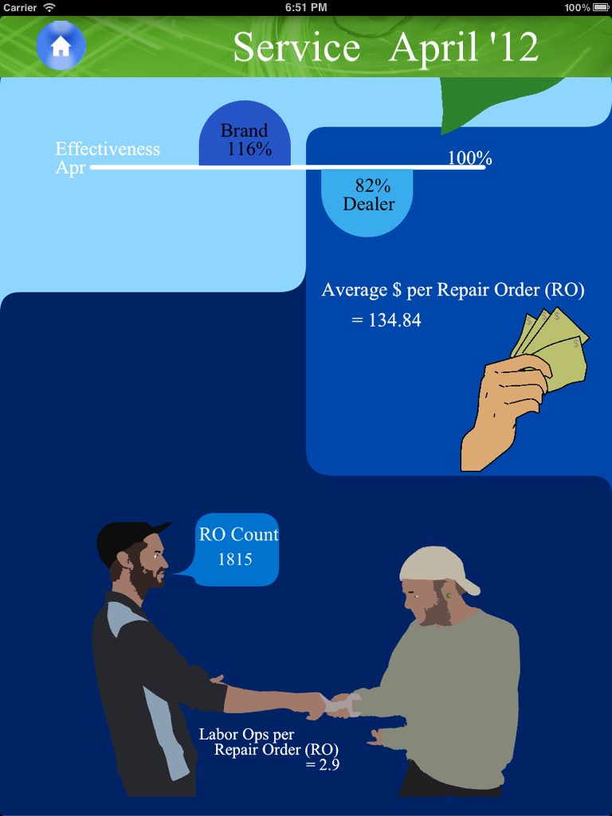
Service Infographic cont.

Slide 12
What’s left to do?
Project Video
Project Plan Document
Documentation Of Code
Mysterious Javascript Bugs
Popup Close Causes Swipe Gesture
Lead Infographic Orientation Issue

