Slide 1
Read Me (Delete this slide.) (1 of 2)
Presenting
The purpose of the beta presentation is to demonstrate that the software portion of the project is complete. While the system may not be totally bug free, the software is expected to be feature complete.
The time limit for your presentation is 15 minutes, which will be strictly enforced. Practice your presentation to ensure that you will finish within the allotted time.
Plan on spending most of your presentation time demonstrating your software. A suggested approach is as follows.
Very Brief Review of Project Overview
Very Brief Review of System Architecture
Software Demonstration (Skipping All of the Screen Shot Slides)
Brief Summary of What’s left to do?
Your software demonstration should
demonstrate that your system is feature complete,
demonstrate the main features of your software, possibly demonstrating some use cases,
be rehearsed, and
flow.
All team members are required to dress business casual on the day of your presentation.
Content
Do not include any company confidential information in your presentation since all presentations will be posted on the web site.
Submit your presentation to your client for approval at least two working days in advance.
Throughout the PowerPoint template, replace placeholders <…> with the appropriate information.
Screen Shots
The screen shots are intended for viewing by your client on the web so include as many screen shots as necessary (but at least three) to demonstrate the features of your completed software system.
You may duplicate the Screen Shot template slide as needed, replacing <Title of Screen Shot> with an appropriate title.

Slide 2
Read Me (Delete this slide.) (2 of 2)
Required Template
Do not edit the Slide Masters.
Edit the slide center footer (Insert > Header & Footer), changing <Company Name> in the footer to your company name.
Edit the Handout Master (6 Slides Per Page) as follows.
In the left header, change <Company Name> to your company name.
In the right footer, change <Project Title> to your project title.
Do not change the organization of slides.
Submission
Although the presentations are scheduled over the course of four meetings, all teams must be prepared to present on the first day scheduled, Monday, November 7.
The order of the presentations will be posted on our All-Hands Meetings page in the evening of the day before the first day scheduled for presentations.
Email your presentation to Dr. D. by midnight, Sunday, April 1.
For subject, use “Team <Company Name>: Beta Presentation” as in “Team Boeing: Beta Presentation”.
Attach the PowerPoint source file named “team-<company-name>-beta-presentation.ppt” as in “team-urban-science-beta-presentation.ppt”.

Slide 3
Beta Presentation Infographics Generator
Team Urban Science
Peter Chen
Lok Cheung
Louis Bodnar
Kevin Shreve
Department of Computer Science and Engineering
Michigan State University
Spring 2012

Slide 4
Project Overview
Web App With Infographics
Display Information On Vehicle Sales, Service And Lead Management
Convey Information To OEM’s
Building Custom Library To Generate Elements Of The Infographic

Slide 5
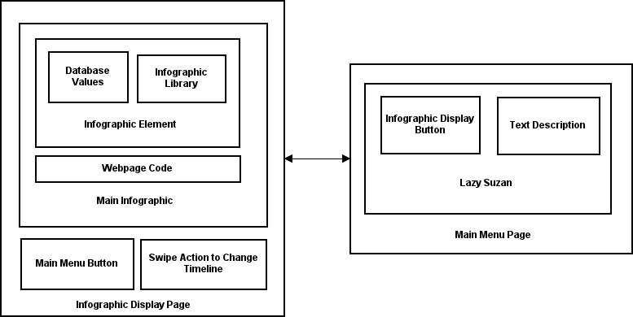
System Architecture

Slide 6
Home Page

Slide 7
Sales Infographic

Slide 8
Lead Infographic

Slide 9
Service Infographic

Slide 10
What’s left to do?
Bug Fix everything
Mysterious Javascript bugs
Documentation of code
Project Video
Project Plan Document
Popup close causes Swipe Gesture
Lead infographic orientation issue

