Slide 1
Alpha Presentation Infographic Generator
Team Urban Science
Peter Chen
Lok Cheung
Kevin Shreve
Louis Bodnar
Department of Computer Science and Engineering
Michigan State University
Spring 2012

Slide 2
Project Overview
Web App With Infographics
Display Information On Vehicle Sales, Service And Lead Management
Convey Information To OEM’s
Building Custom Library To Generate Elements Of The Infographic

Slide 3
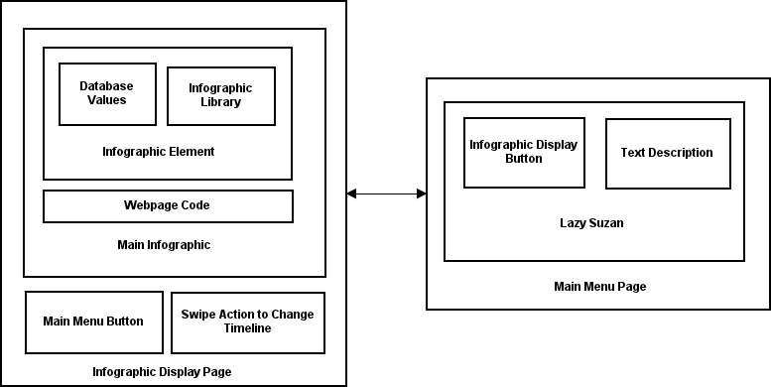
System Architecture

Slide 4
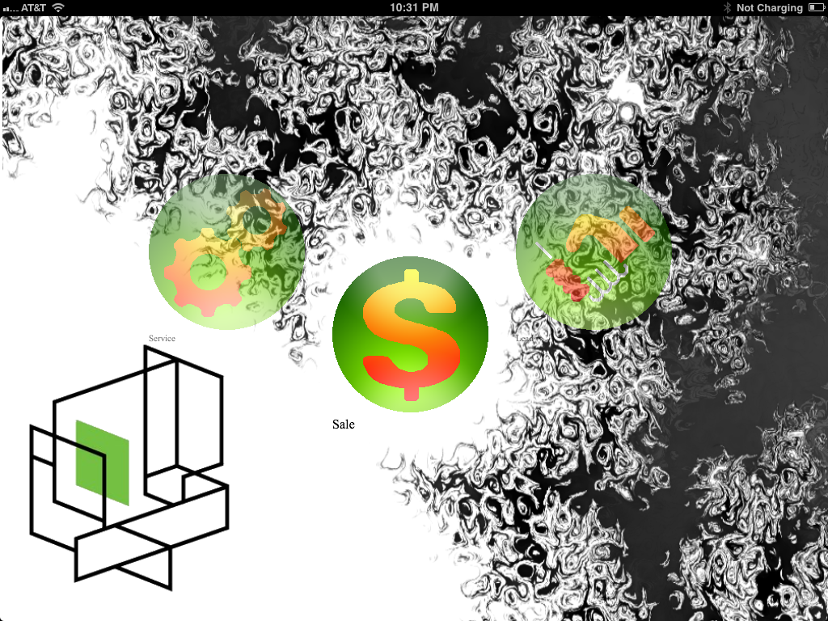
Main Menu (Landscape)

Slide 5
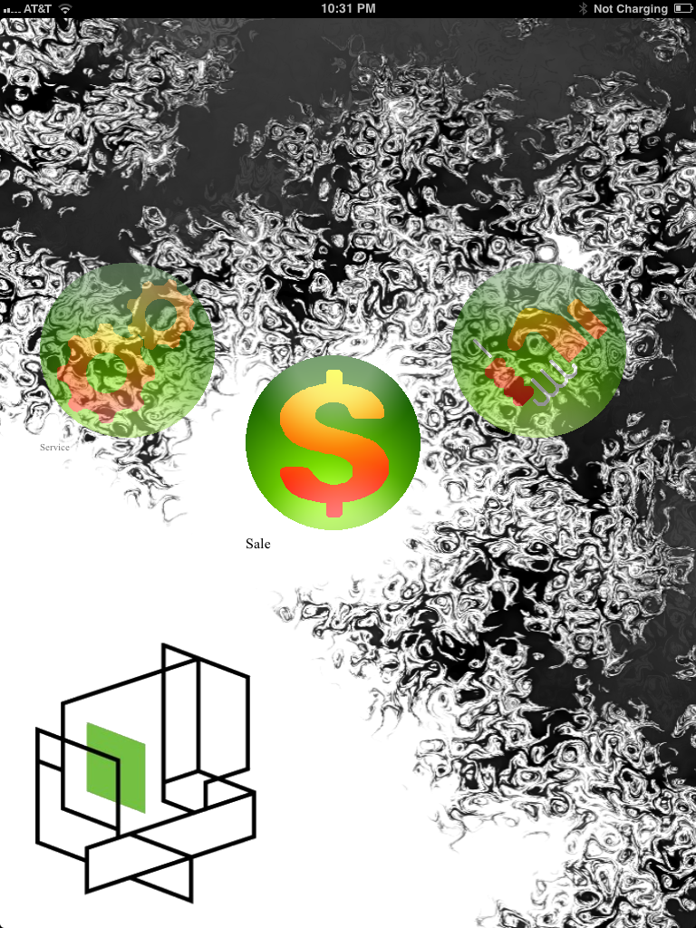
Main Menu (Portrait)

Slide 6
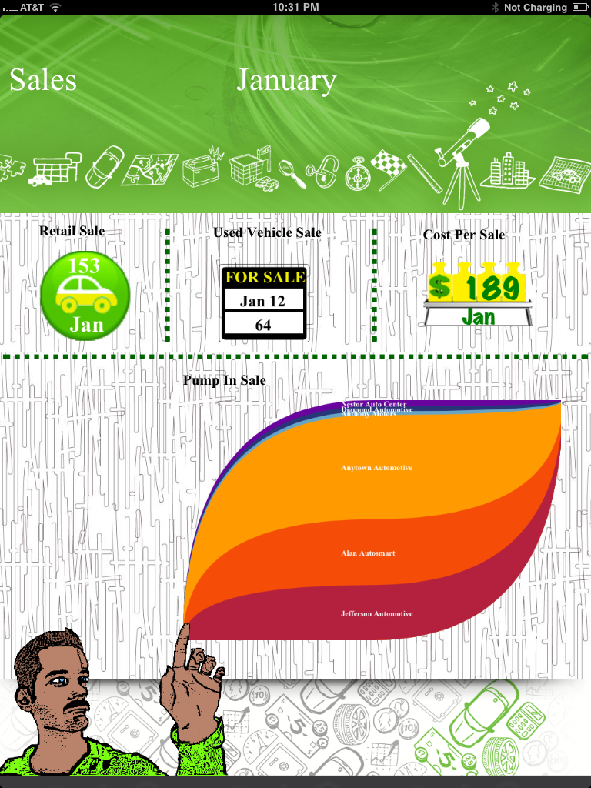
Sales Infographic

Slide 7
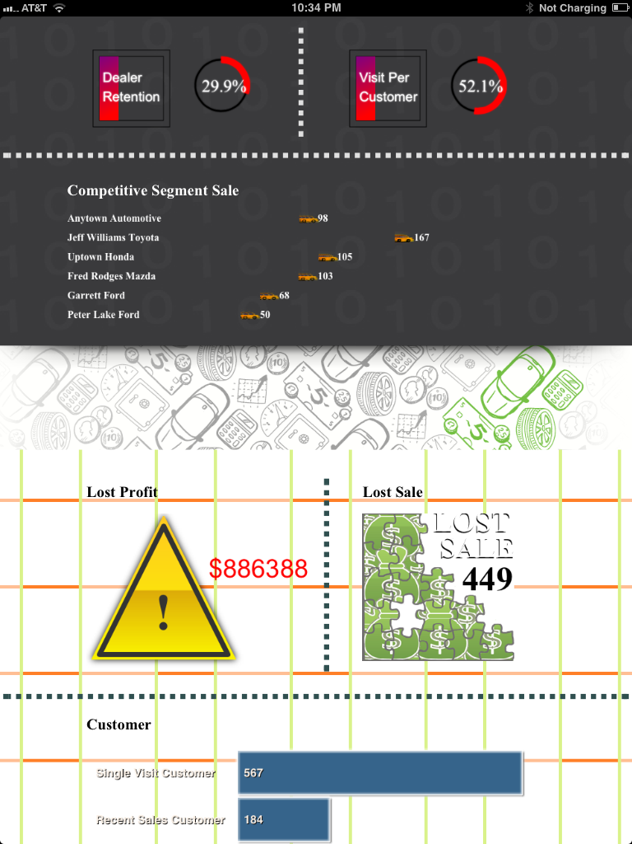
Sales Infographic

Slide 8
What’s left to do?
Swipe Gestures To Change Months
Lead Management Infographic
Service Infographic
Make Sure Data Is Fresh
Click To Bring Up Description Of Element
Main Menu Link On Infographic Display Page

