Slide 1
Project Plan Infographic Generator
Team Urban Science
Peter Chen
Louis Bodnar
Lok Cheung
Kevin Shreve
Department of Computer Science and Engineering
Michigan State University
Spring 2012

Slide 2
Project Overview
Standalone web app to display infographics
Display information on vehicle sales, service and lead management
Convey information to OEM’s
Building custom library to generate elements of the infographic

Slide 3
Functional Specifications
Spreadsheet data
Creative presentation with animations
Intuitive display of relevant data
Easy navigation through main categories

Slide 4
Design Specifications
Lazy Susan style menu
Native app feel with touch gestures
Each infographic displays monthly data
An Infographic contains many infographic elements

Slide 5
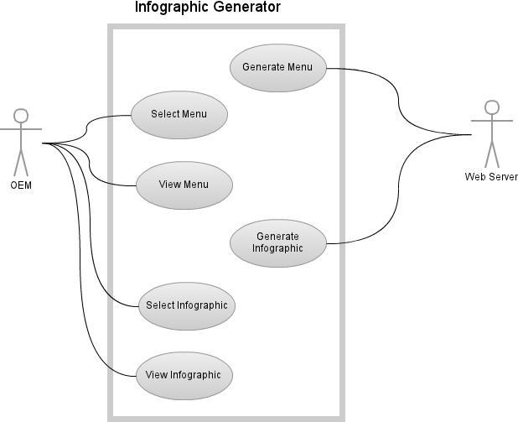
Use Case Diagram

Slide 6

Screen Mockup: Lazy Susan Menu

Slide 7
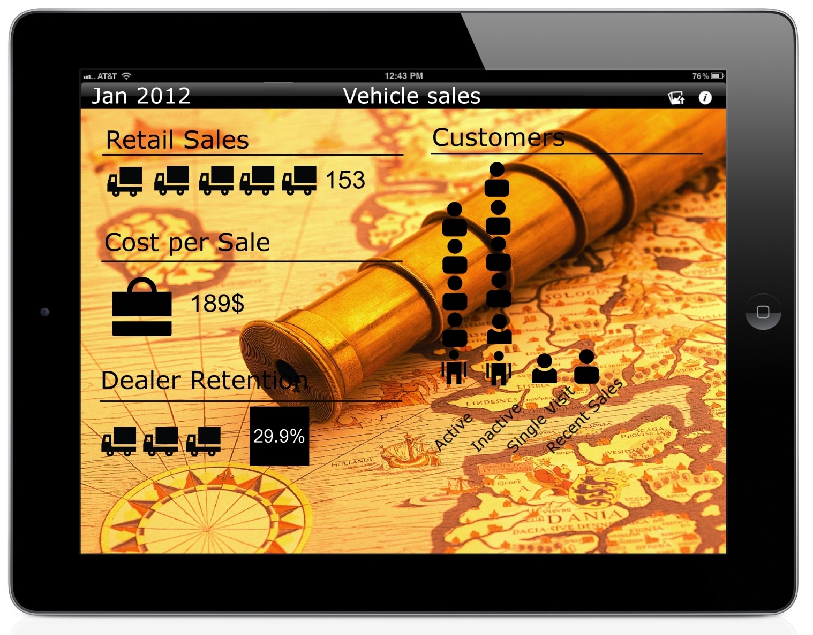
Screen Mockup: Infographic Screen

Slide 8
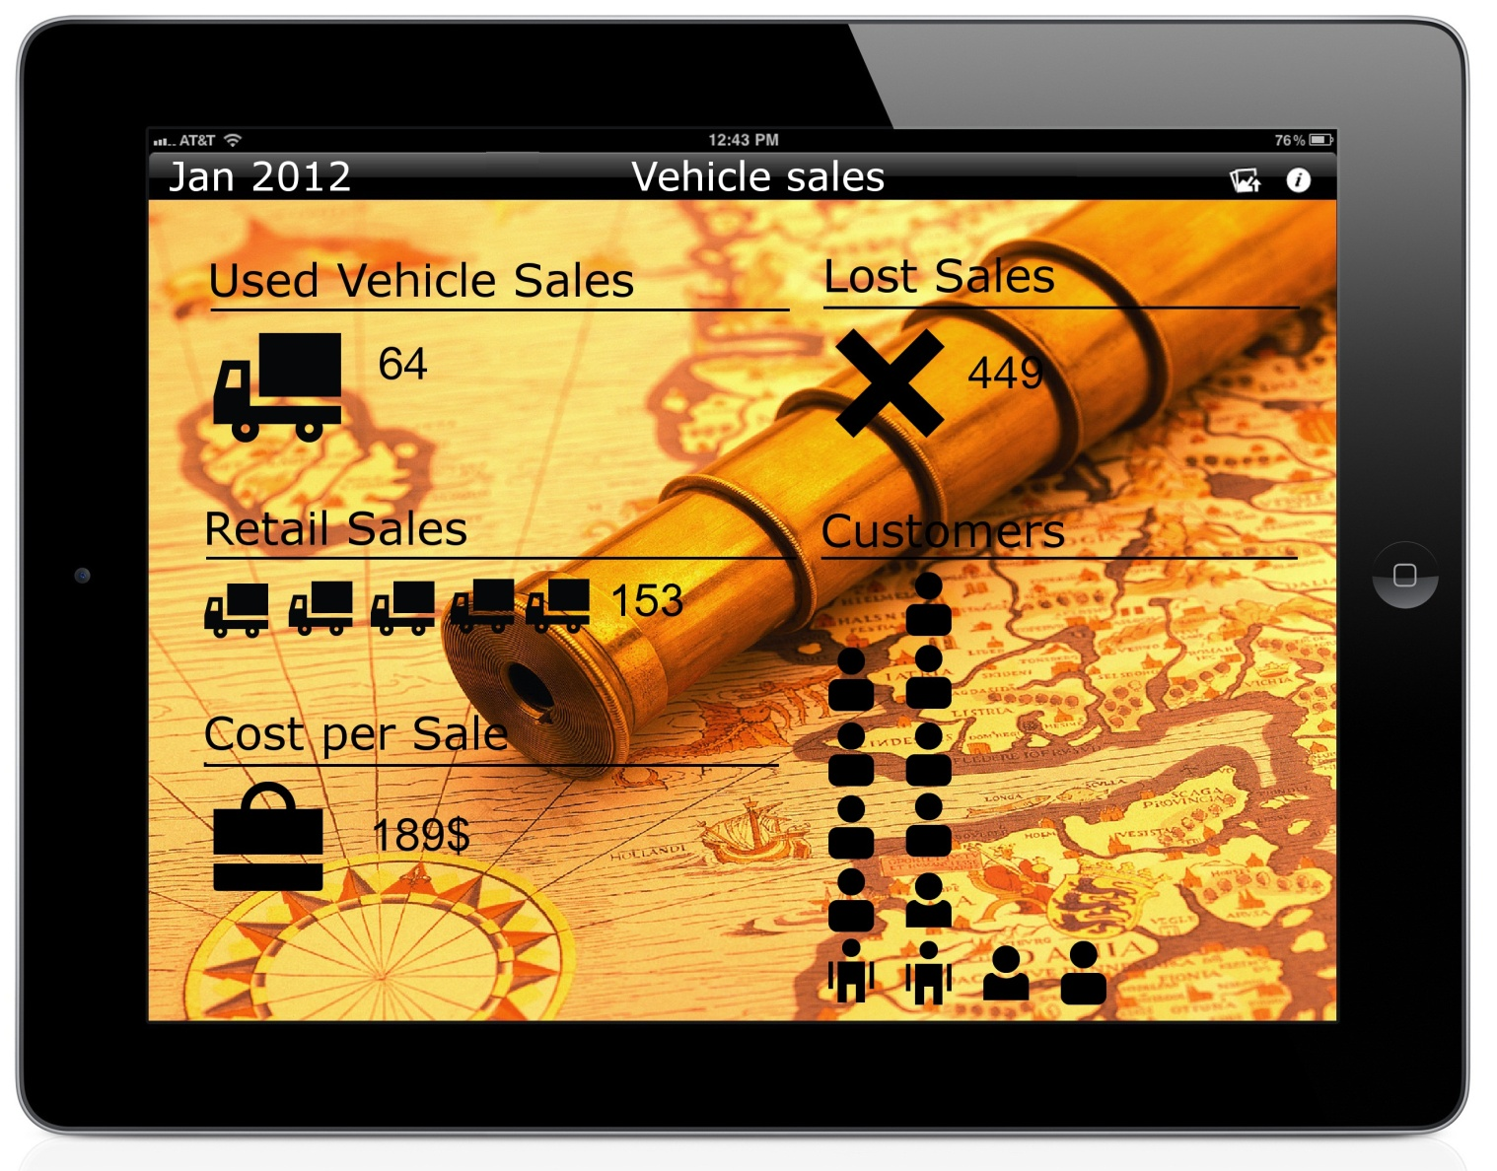
Screen Mockup: Infographic Screen

Slide 9
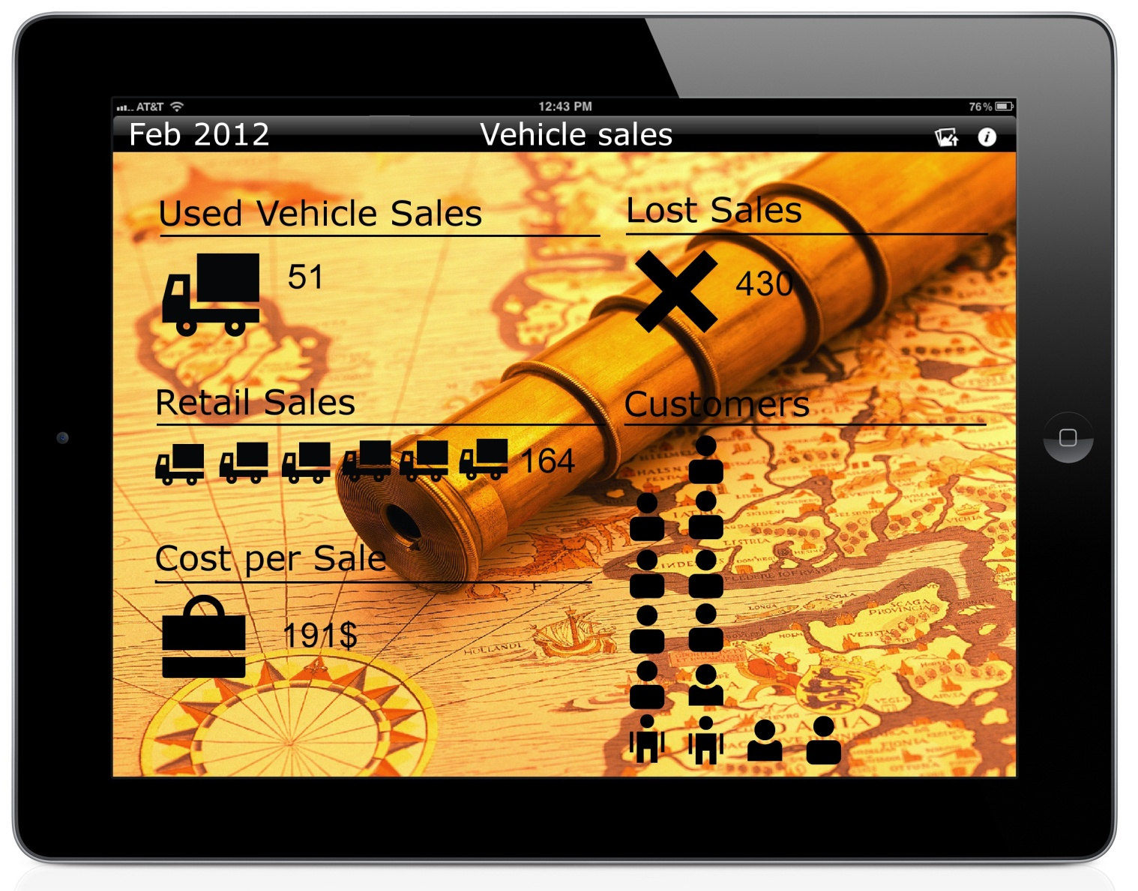
Screen Mockup: Infographic Screen

Slide 10
Technical Specifications
Infographic will be based on Key Performance Indicator (KPI) data from SQL database
Pass database information to infographic via XML file
Each infographic written in HTML5 and JavaScript
Supported on iPad via Safari

Slide 11
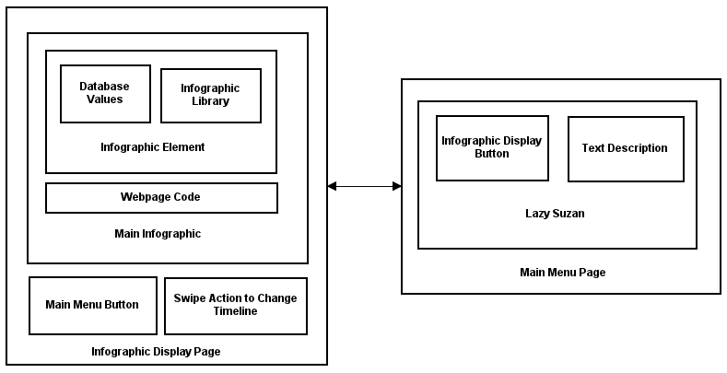
System Architecture

Slide 12
System Components
Hardware Platforms
iPad
Personal Computer
Web Server - IIS7
Software Platforms / Technologies
JavaScript and HTML5
ASP.Net
SQL database

Slide 13
Testing
Safari for iPad Browser Compatibility
User experience
Web-app performance
Orientation display

Slide 14
Risks
Languages
Ambiguous Requirements
Scheduling
Artistic Ability

