Slide 1
Project Plan Infographic Generator
Team Urban Science
Peter Chen
Louis Bodnar
Lok Cheung
Kevin Shreve
Department of Computer Science and Engineering
Michigan State University
Spring 2012

Slide 2
Project Overview
Standalone web app to display infographics
Display information on vehicle sales, service and lead management
Convey information to OEM’s
Building custom library to generate elements of the infographic

Slide 3
Functional Specifications
Intuitive display of relevant data
Easy navigation through main categories
Creative presentation with animations
Accessible via Safari on iPad

Slide 4
Design Specifications
Lazy Susan style menu
Native app feel with touch gestures
Display monthly data

Slide 5
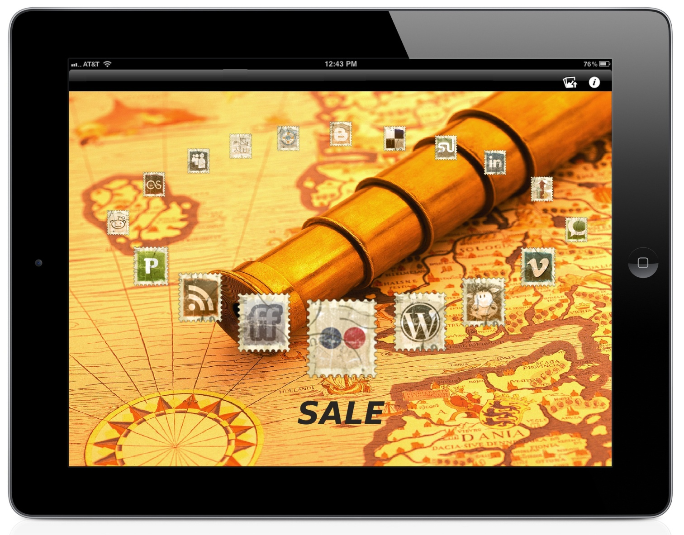
Screen Mockup: Lazy Susan Menu

Slide 6
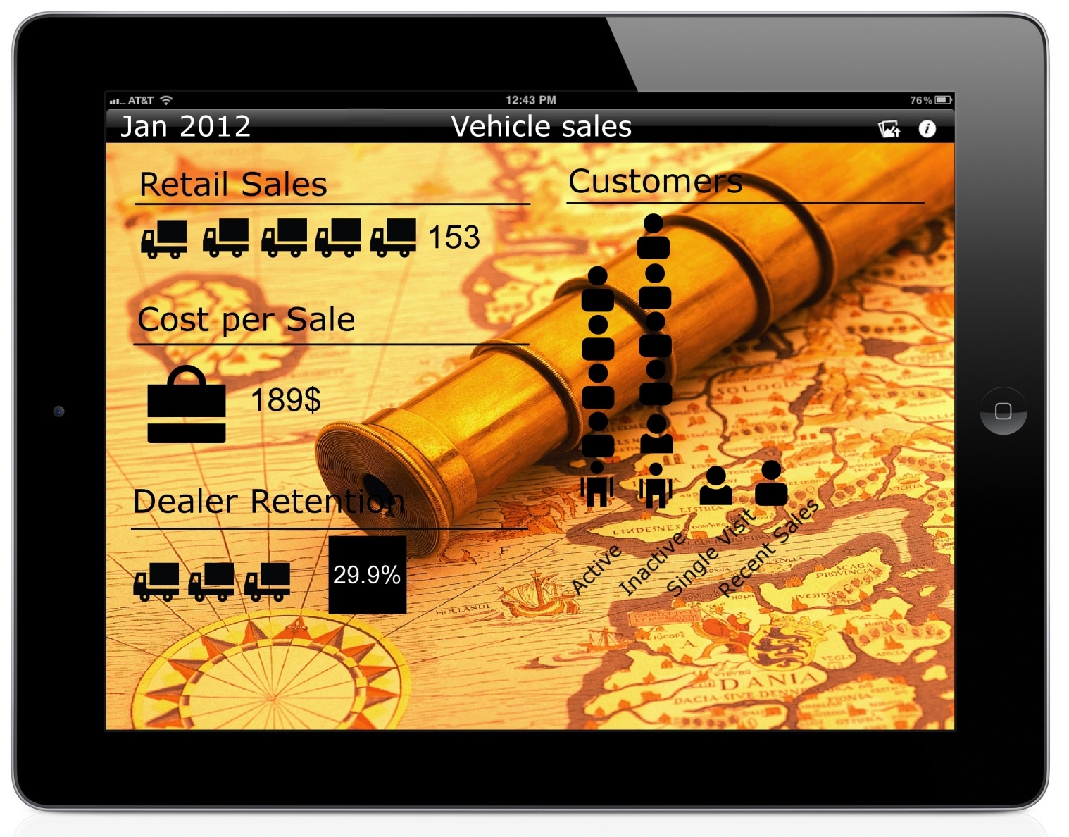
Screen Mockup: Infographic Screen

Slide 7
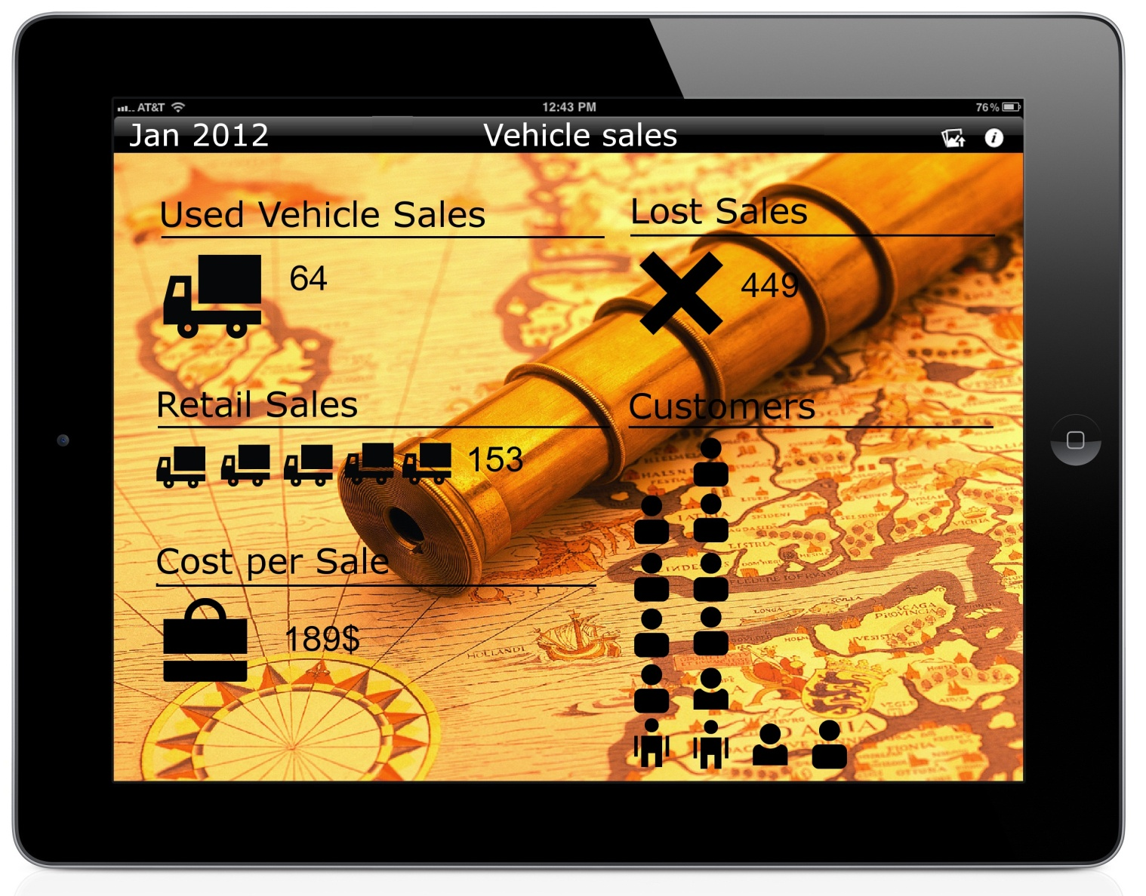
Screen Mockup: Infographic Screen

Slide 8
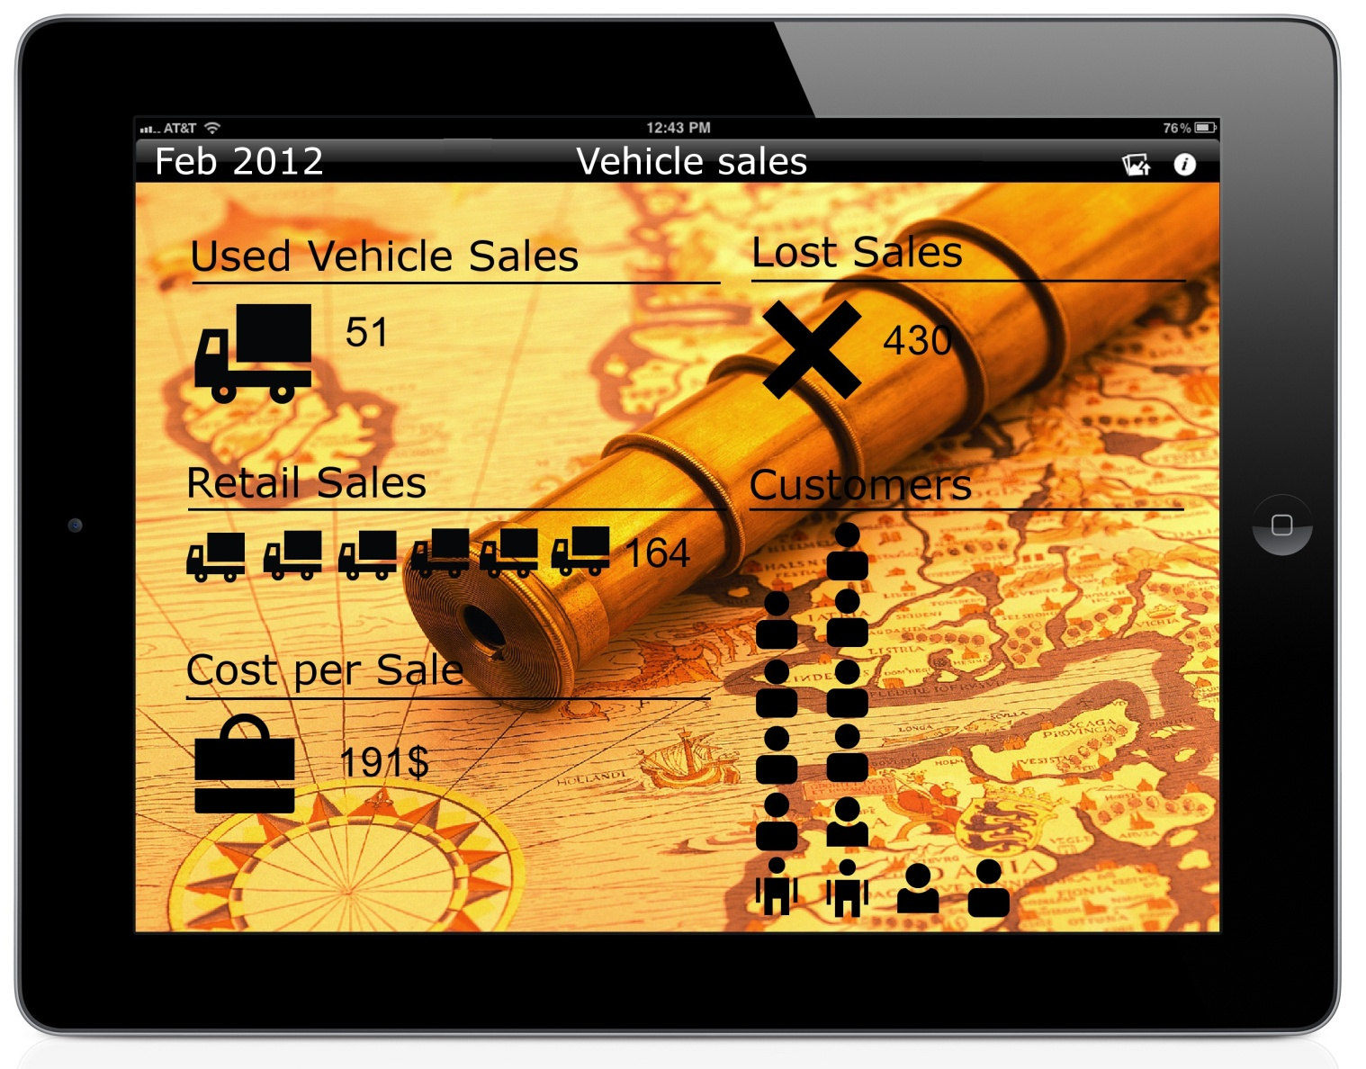
Screen Mockup: Infographic Screen

Slide 9
Technical Specifications
Infographic will be based on Key Performance Indicator (KPI) data from SQL database
Each infographic written in HTML5 and JavaScript
Supported on iPad via Safari
Pass database information to infographic via XML file

Slide 10
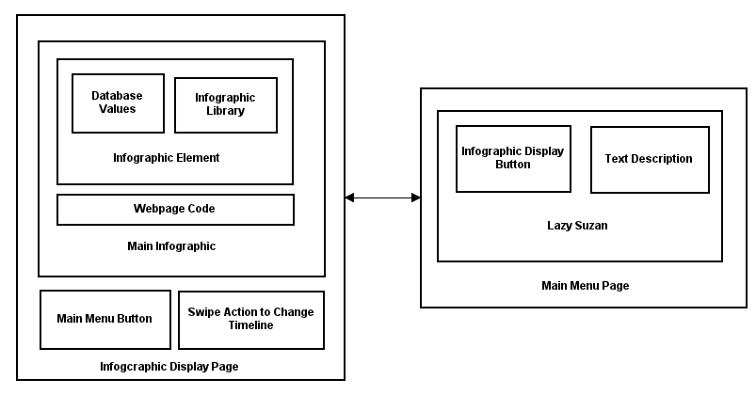
System Architecture

Slide 11
System Components
Hardware Platforms
iPad
Personal Computer
Web Server
Software Platforms / Technologies
JavaScript and HTML5
ASP.net
SQL database

Slide 12
Testing
Safari for iPad Browser Compatibility
User experience
Web-app performance
Orientation display

Slide 13
Risks
Languages
Ambiguous Requirements
Scheduling
Artistic Ability

