Slide 1

Datastores and Data assets in Azure ML

Slide 2
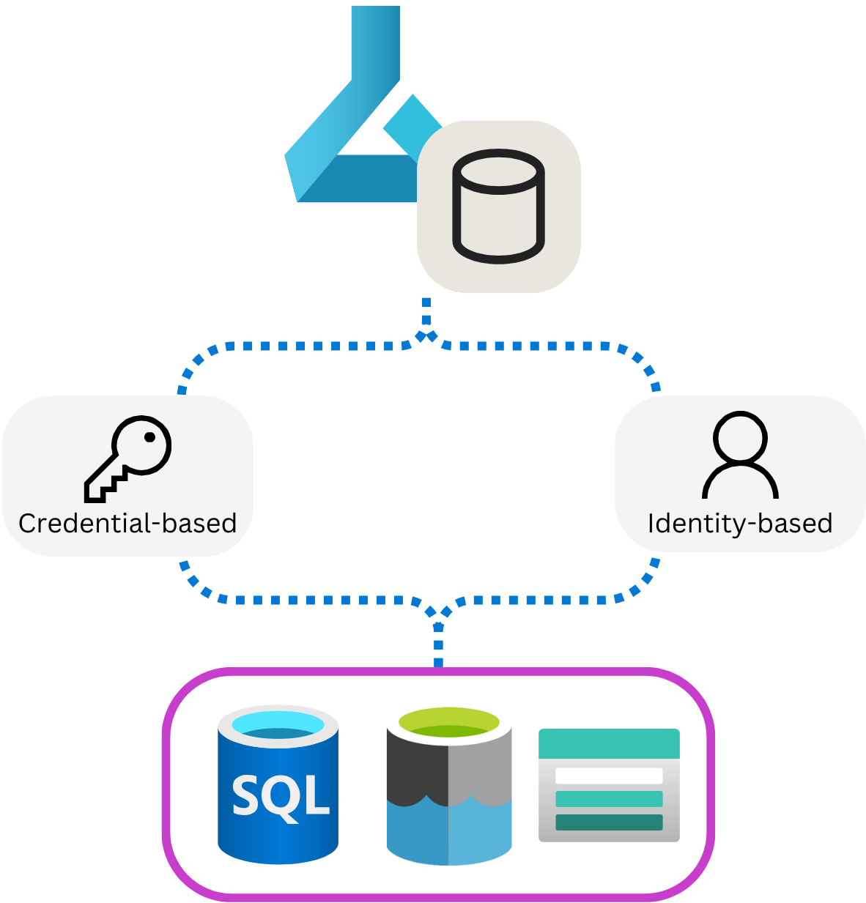
What is a Datastore?
They encapsulate the information needed to connect to data sources and securely store this connection information so that you don’t have to code it in your scripts.
The benefits of using datastores are:
1) Provides easy-to-use URIs to your data storage.
2) Facilitates data discovery within Azure Machine Learning.
3) Securely stores connection information, without exposing secrets and keys to data scientists.
Azure Machine Learning supports the creation of datastores for multiple kinds of Azure data source, including:
Azure Blob Storage
Azure File Share
Azure Data Lake (Gen 2)

Slide 3
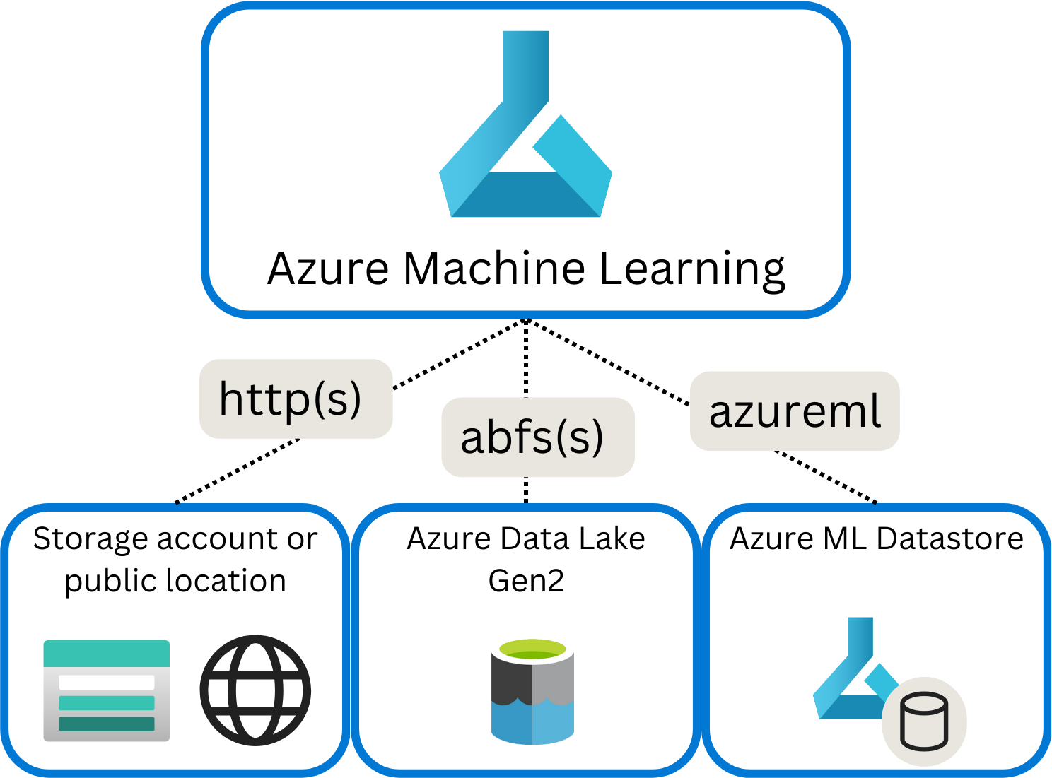
Understand URIs
Wherever you store your data, you want to access the data when training machine learning models. To find and access data in Azure Machine Learning, you can use Uniform Resource Identifiers (URIs).
http(s): Use for data stores publicly or privately in an Azure Blob Storage or publicly available http(s) location.
abfs(s): Use for data stores in an Azure Data Lake Storage Gen 2.
azureml: Use for data stored in a datastore.

Slide 4
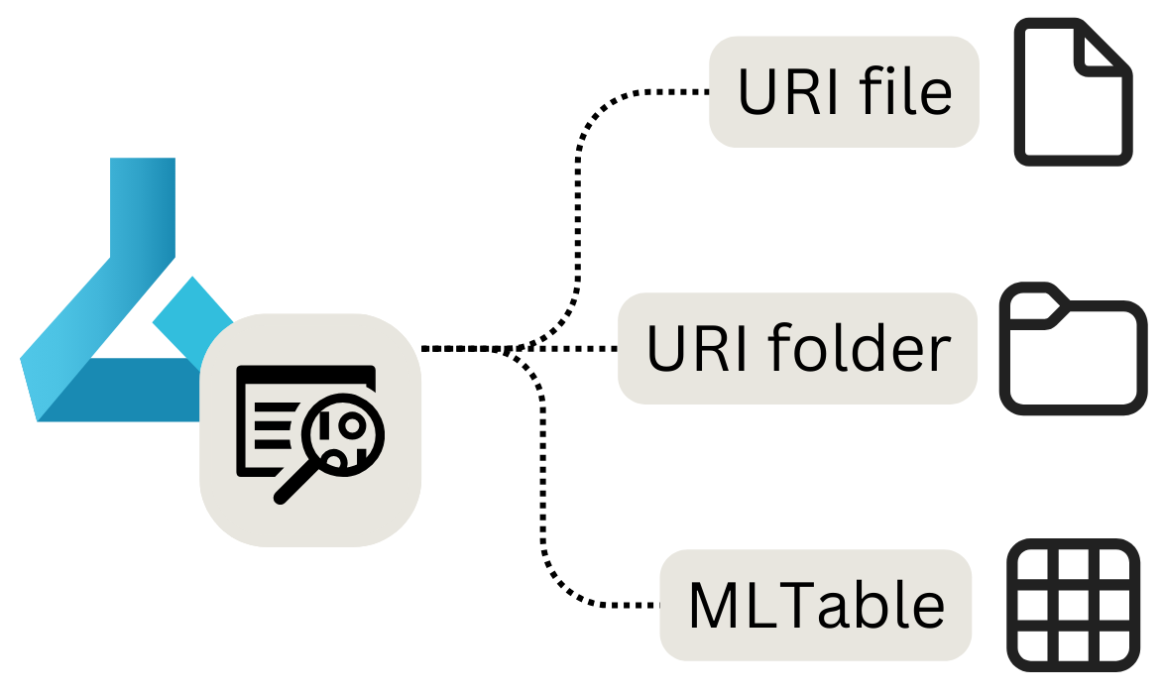
What is a Data Asset?
What is a Data Asset in Azure ML?
A Data Asset is a versioned reference to data used in machine learning workflows.
It enables consistent access to datasets across experiments, training jobs, and pipelines.
Instead of directly referencing storage paths, ML workflows reference registered data assets.
Types of Data Assets
URI File – References a single file in storage.
URI Folder – References a directory of files (for example images or documents).
MLTable – Structured dataset with schema and metadata, optimized for ML workloads.
Enables versioning, lineage tracking, and reusable data references across Azure ML workflows.

Slide 5
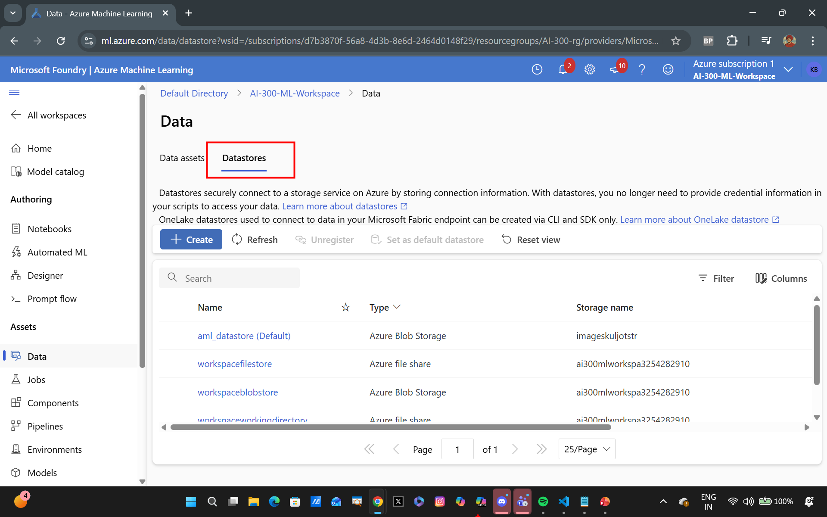

Slide 6
