Slide 1
Module 2: Overview
Applications of ML in Security
ML for Cybersecurity
Fall 2020

Slide 2
Adversaries
Ethics
Attacker’s goals
Attacker’s capabilities
Robustness of model/feature
Privacy
Fairness
Transparency
Modules 2 – 4
Module 4
Module 2
Module 1
Identify Goals & Collect Data
Data Representation
Modeling
Deployment
Pinpoint needs
Data acquisition
Data labeling
Data exploration
Data cleaning
Missing data
Feature selection
Consider fairness
Efficiency
Accuracy
Interpretability
Adversarial resistance
Performance
Evasion and attacks
Model drift
Impact on stakeholders
Module 3

Slide 3
Where Are We?
Module 1: “Statistical Modeling”
Module 2: “Data Collection/ Representation”
Foundations of ML and Data Science for Cybersecurity
Data-Driven Network and
Computer Security
Module 3: “Attacks and Defenses”
Module 4: “Deployment”
Machine Learning in the Presence of Adversaries in Security Applications
Ethics, Fairness, Responsibility,
and Transparency in
Data-Driven Cybersecurity
Notes:
A module focused on machine learning fundamentals, with applications to security. Introduction to the data science pipeline, and teach fundamental building blocks, from data ingestion and feature engineering to machine learning model selection.
Modeling; Representation; Environment; Constraints (?)

Slide 4
Goals for TODAY

Slide 5
Today’s Outline
Talk about how machine learning is used in networks
Review computer networking background
Breakout sessions
Linear regression: Exploring relationships in traffic (packets, bytes)
Logistic regression: Simple binary classification
Today’s working examples are simple, meant to illustrate

Slide 6
CONCEPT RECAP

Slide 7
Many Cybersecurity Problems Involve Large-Scale Predictive Analytics
Rare events
Time-series analysis
Analysis of heterogenous data
Analysis of communication graphs
Need to analyze data in real time
Need to detect outliers

Slide 8
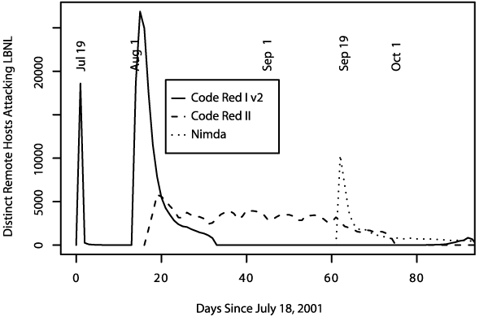
Overview (Module 2.1)
The Internet’s architecture makes it vulnerable to attacks
Common attacks: Worms, botnets, spam, malware, phishing

Slide 9
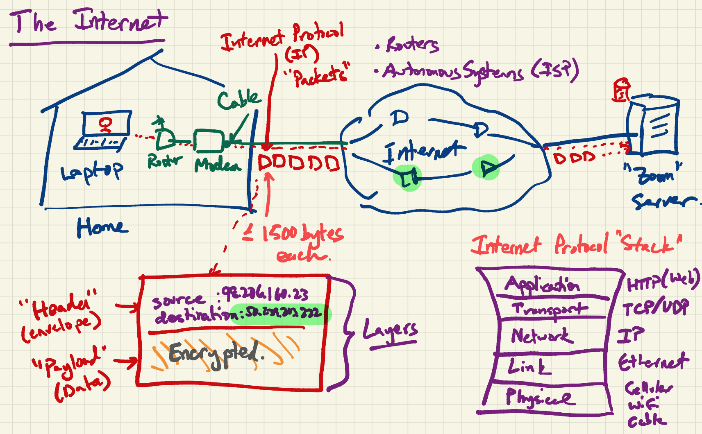
Internet 101 (Module 2.1)

Slide 10
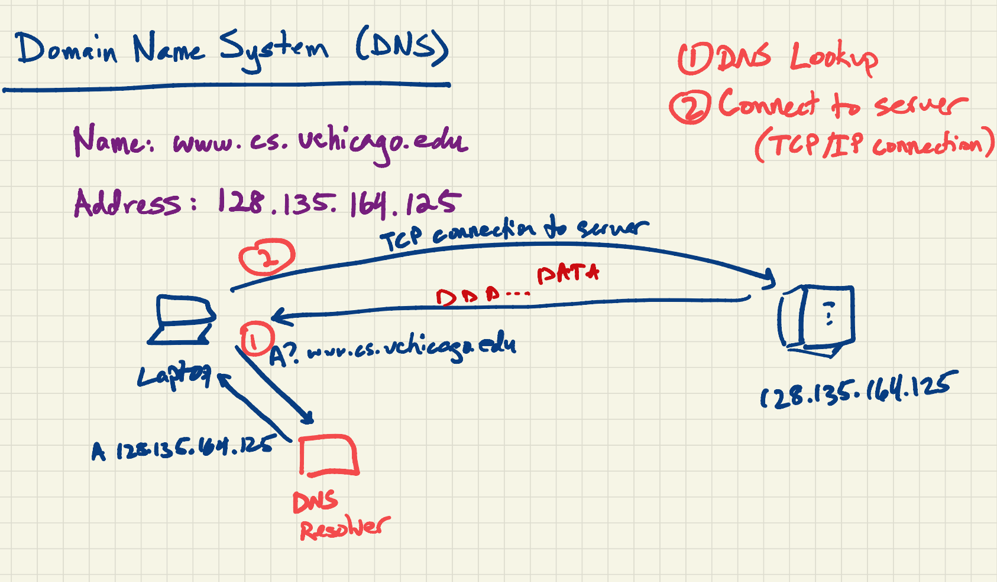
DNS (Module 2.1)

Slide 11
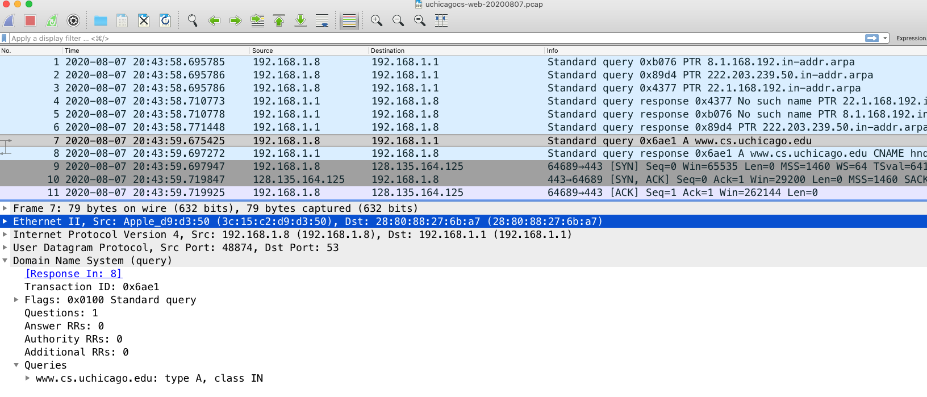
From Wireshark to Python (Modules 2.1–2.2)
Packet capture (pcap) is a common method/format for capturing network traffic
Can load traffic into Pandas for subsequent analysis

Slide 12
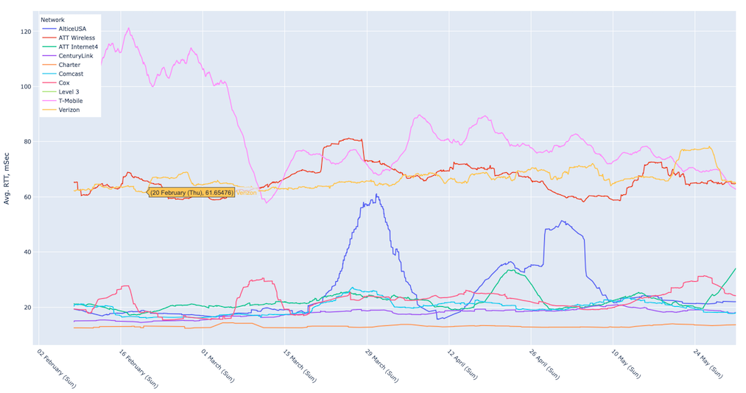
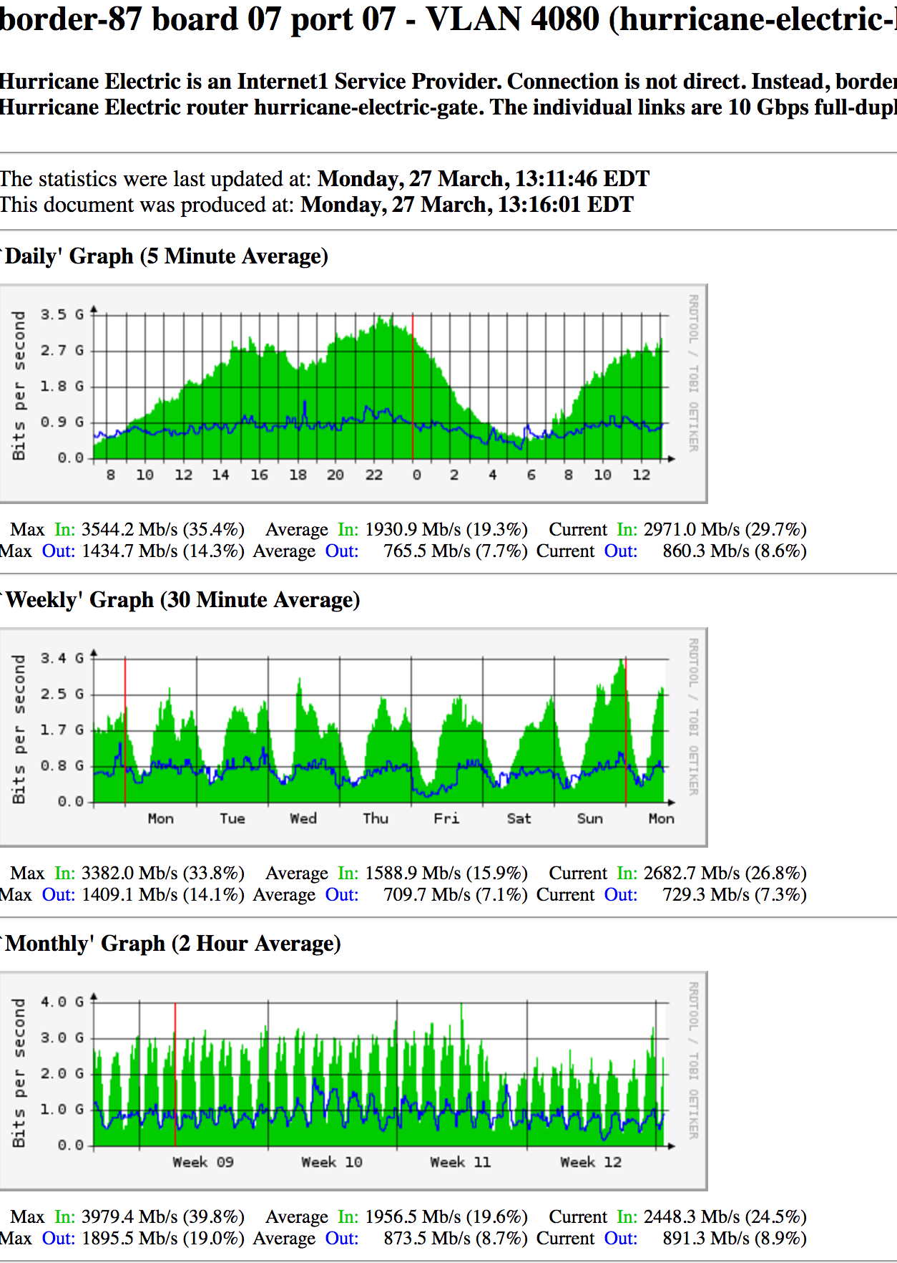
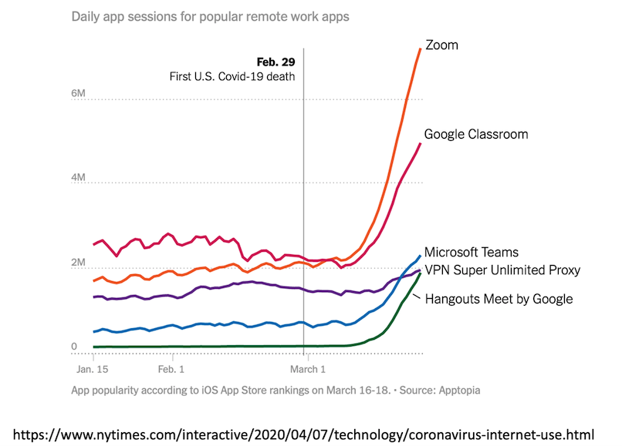
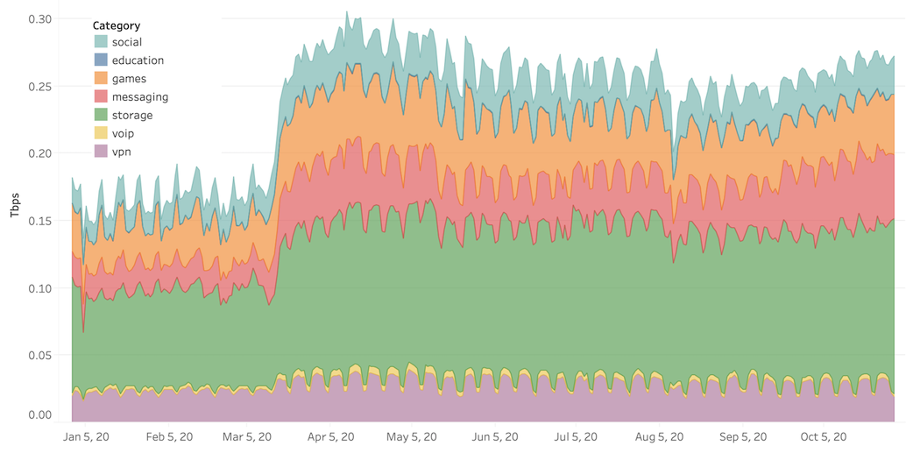

Slide 13




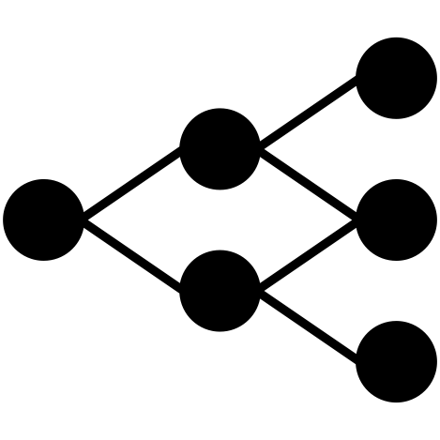
Traffic Analysis (Module 2.3)
Labels
Representation
Compression
(Optional)
Input
(Packets)
Packet
Transformation
Data
Representation
Model
Training
Output
(Trained Model)
Each step has an associated cost.
Goals:
Explore general capabilities, capturing the limits of what is possible in traffic analysis
Consider cost-accuracy tradeoffs
Notes:
Our pipeline works, but what if we want to make the representation even smaller?
Faster training
Faster transformation

Slide 14
Feature Representation (Module 2.3)
”Raw” network traffic
High volume
Models may learn the wrong things
Aggregated flows
May obscure important features (e.g., timing)
Summary statistics
Sensitive to parameter tuning
Time bins and other parameters may affect model accuracy

Slide 15
Supervised Learning (Module 2.5)
Predicting flows from packets (linear regression)
Predicting requests/responses based on size (logistic regression)
Spam filtering (Naïve Bayes)

Slide 16
Unsupervised Learning (Module 2.5)
Many reasons to use unsupervised learning
Visualization
Dimensionality reduction
Anomaly detection
Commonly used in networking for anomaly detection

Slide 17
Activity 1: Measurement

Slide 18
Main Room Discussion – Group Report
Task 1.1: Take a packet capture on your own network using Wireshark
What interesting things can you see in the traffic?
Can you think of any privacy risks associated with capture?
Task 1.2: Analyze your packet capture in Pandas using the linear regression notebook as a guide
What are some basic statistics of the trace?
How many packets?
How many IP addresses?
What else can you learn?
Task 1.3: Think of a linear regression task you might be able to run on this data
What properties in the trace might you want to predict where you could use a linear regression model?
How many linear relationships in network traffic can you think of?
Task 1.4 (coding, optional): Apply linear regression to the traffic you captured
Take the idea you devised in Task 1.3 and perform a linear regression

Slide 19
Activity 2: Classification

Slide 20
Main Room Discussion – Group Report
Task 1.1: Analysis
What types of network analysis tasks could be appropriate for linear regression?
Task 1.2: Security
What kinds of network security tasks with network traffic could be amenable to logistic regression?
Task 1.3: Trace exploration
Explore (or load) a dataset from the CICIDS network traffic repository that involves a security problem
Task 1.4 (coding, optional):
Run a classification task using one of the datasets from CICIDS

