Slide 1
Module 1:
ML in Python
A simple ML pipeline in Jupyter Lab
ML for Cybersecurity
November 10, 2020

Slide 2
Hardware and Software Preparation
You will need a laptop to get the most of the session, with Python (3.7 or higher) installed, along with numpy, scipy, sklearn, and pytorch.
You also need to have the jupyter notebook installed

Slide 3
Installation instructions
For new Python users, install the Anaconda distribution
conda install jupyterlab

Slide 4
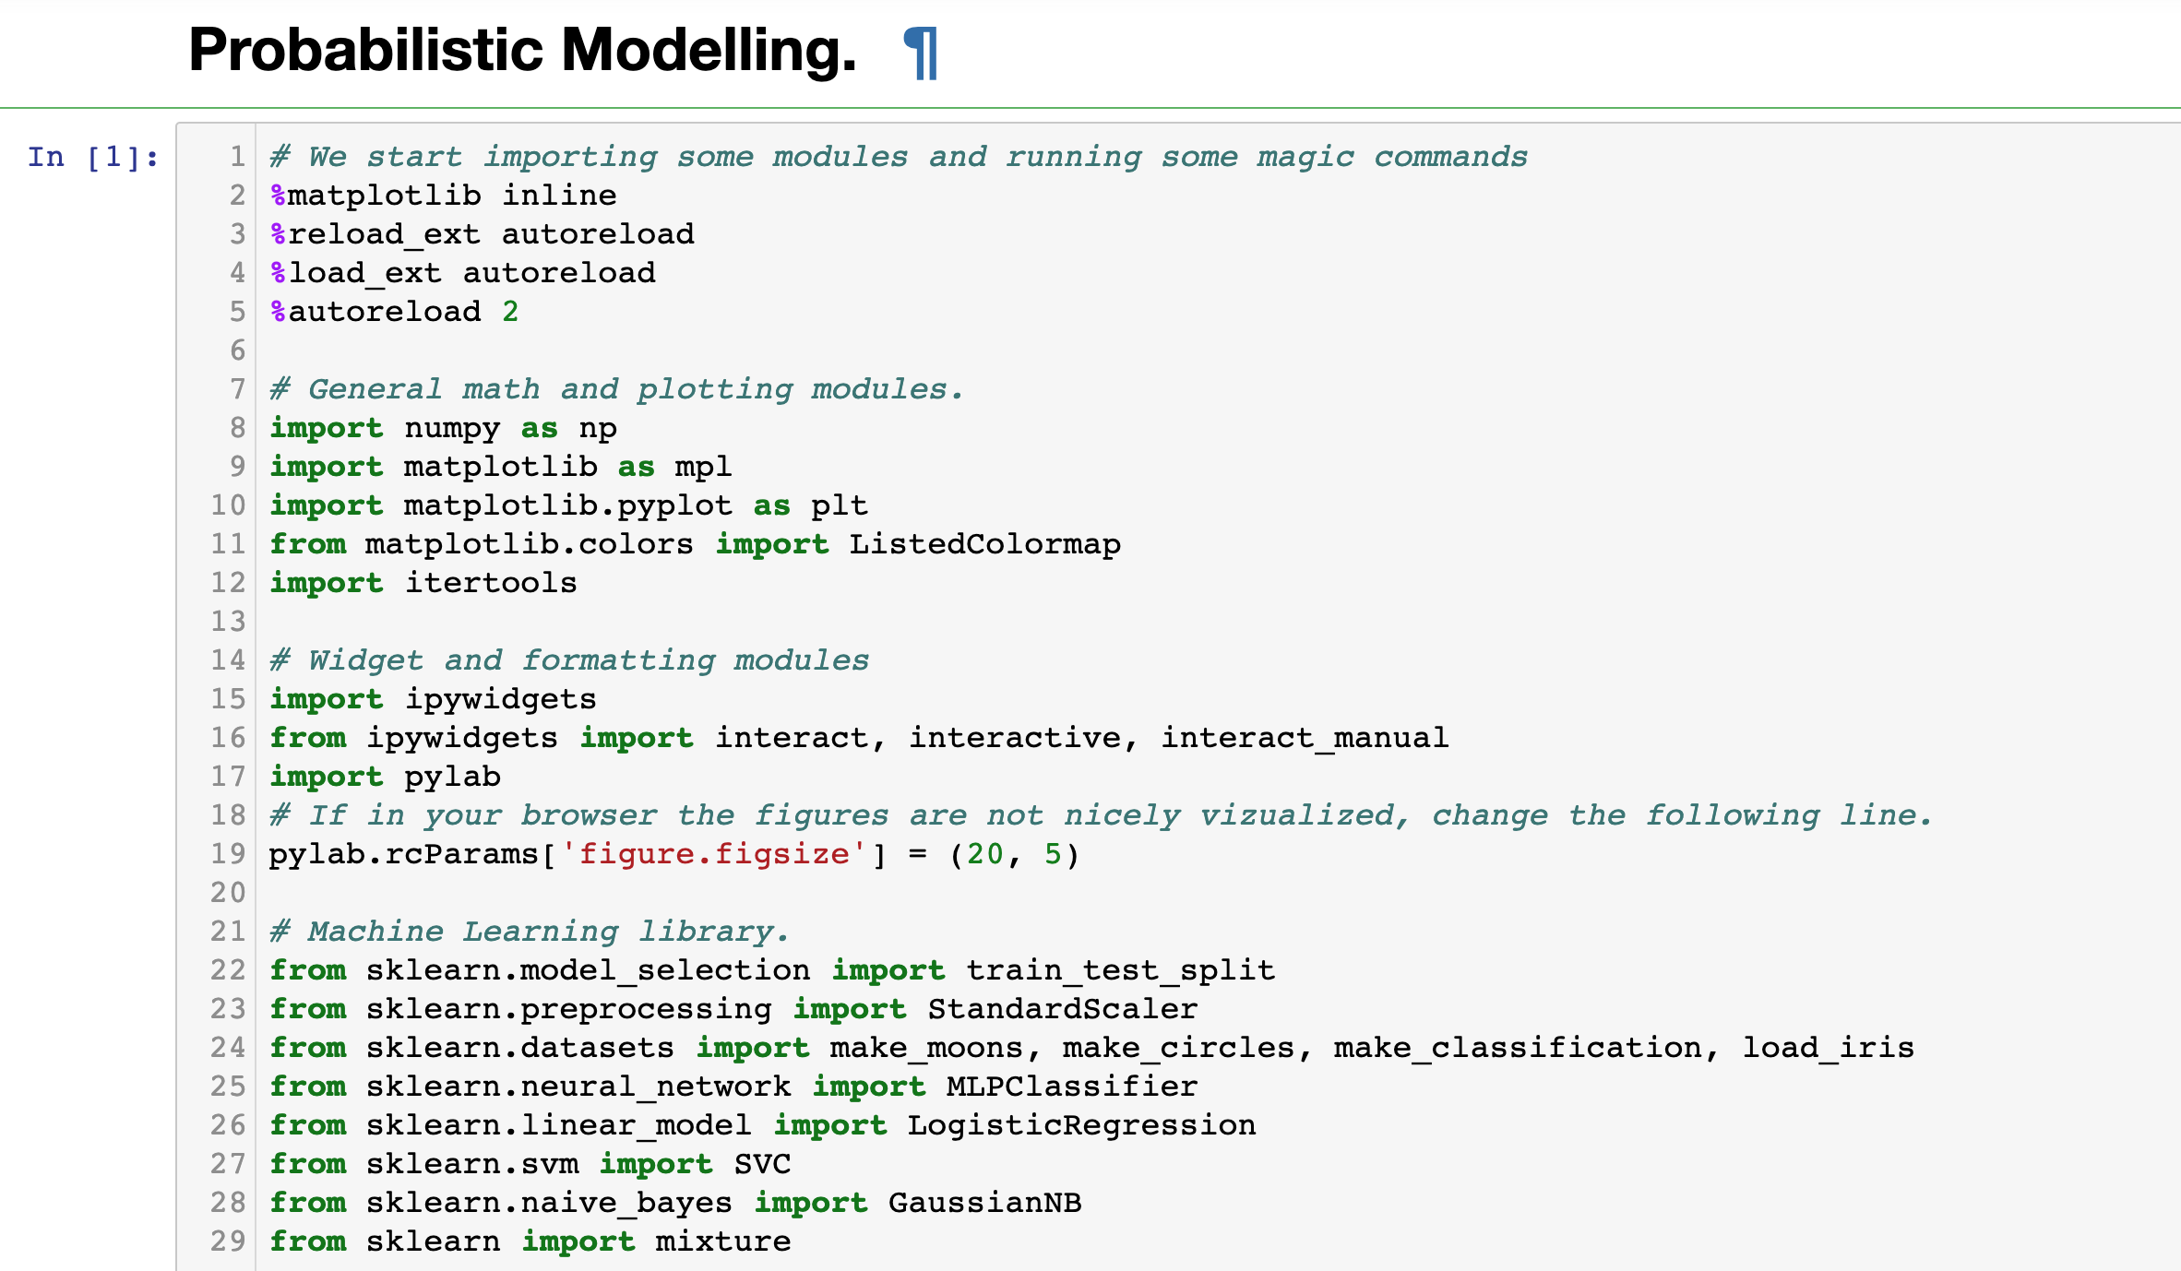
Demo of a Simple ML Pipeline

