Slide 1
Module 2: Measurement
Measuring and Analyzing Network Traffic
ML for Cybersecurity
Fall 2020

Slide 2
Learning Objective

Slide 3
Learning Objectives
Learn about how network traffic is measured.
Learn about how to represent network traffic for input to machine learning models.
Loading network traffic into software libraries.

Slide 4
Measurement and DATA Collection

Slide 5
“You Can’t Improve What You Don’t Measure.”

Slide 6
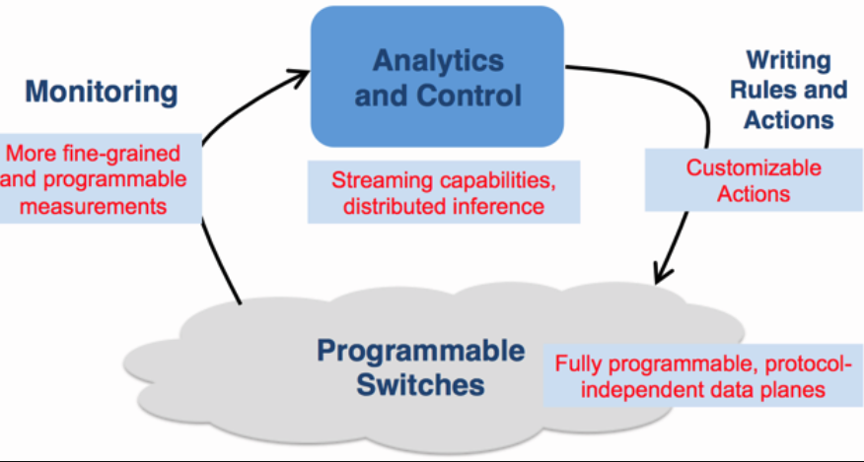

Slide 7
The Role of Measurement in Operations
Performance and Reliability
Generate reports for customers and internal groups
Diagnose performance and reliability problems
Tune the configuration of the network to the traffic
Plan outlay of new equipment (routers, proxies, links)
Security
Detect and mitigate attacks
Determine source of attacks

Slide 8
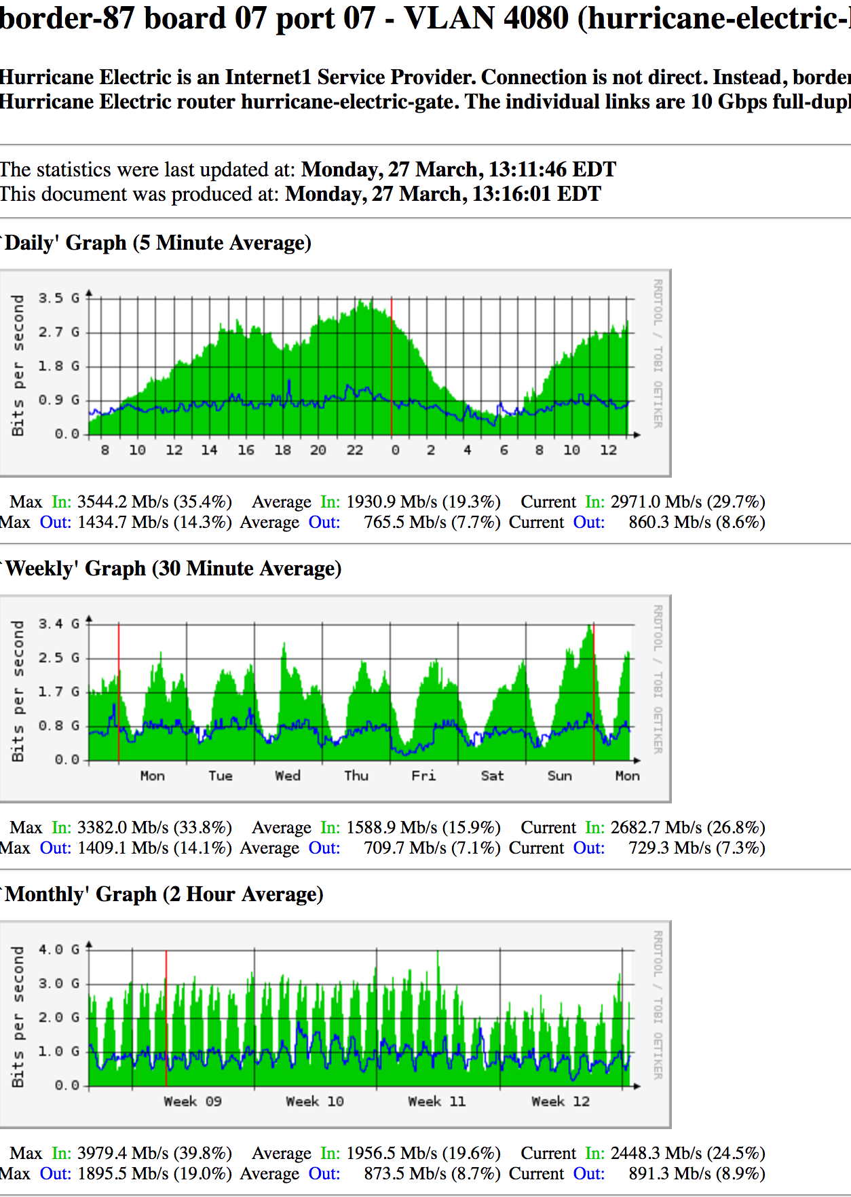

Slide 9
Types of Measurements
Active
Passive
traceroute
ping
UDP probes
TCP probes
Application-level probes
Web downloads
DNS queries
Packet traces
Complete
Headers only
Specific protocols
Flow records
Specific data
Syslogs …
HTTP server traces
DHCP logs
Wireless association logs
DNSBL lookups
…
Routing data
BGP updates / tables, ISIS, etc.

Slide 10
Ways to Collect Data
Aspects of Data Collection
Precision: At what granularity are measurements taken?
Accuracy: Does the data capture phenomenon of interest?
Context: How was the data collected?
Tools
Active
Ping, traceroute, etc.
Accuracy pitfall example: traceroute
Passive
Packet captures (e.g., tcpdump, DAG)
Flow records (e.g., netflow)
Routing data (e.g., BGP, IS-IS, etc.)

Slide 11
Strategies for Sound Internet Measurement
Cross validation
consistency checks
multiple “overlapping” measurements
database is a useful tool for cross-checking
Other considerations
Anonymization and privacy
Maintaining longitudinal data

Slide 12
Two Main Approaches
Packet-level Monitoring
Keep packet-level statistics
Examine (and potentially, log) variety of packet-level statistics. Essentially, anything in the packet.
Timing
Flow-level Monitoring
Monitor packet-by-packet (though sometimes sampled)
Keep aggregate statistics on a flow

Slide 13
Traffic Flow Statistics
Flow monitoring (e.g., Cisco Netflow)
Statistics about groups of related packets (e.g., same IP/TCP headers and close in time)
Recording header information, counts, and time
More detail than SNMP, less overhead than packet capture
Typically implemented directly on line card

Slide 14
What is a flow?
Source IP address
Destination IP address
Source port
Destination port
Layer 3 protocol type
TOS byte (DSCP)
Input logical interface (ifIndex)

Slide 15
IPFIX (Cisco Netflow, Sflow, etc.)
Basic output: “Flow record”
Newer versions have:
More flexible record format
Much easier to add new flow record types
Core Network
Approximately 1500 bytes
20-50 flow records
Sent more frequently if traffic increases
Collector (PC)
Collection and Aggregation

Slide 16
What is in a Flow Record?
Basic information about the flow…
Source and Destination, IP address and port
Packet and byte counts
Start and end times
ToS, TCP flags
…plus, information related to routing
Next-hop IP address
Source and destination AS
Source and destination prefix

Slide 17
Aggregating Packets into Flows
flow 1
flow 2
flow 3
flow 4
Criteria 1: Set of packets that “belong together”
Source/destination IP addresses and port numbers
Same protocol, ToS bits, …
Same input/output interfaces at a router (if known)
Criteria 2: Packets that are “close” together in time
Maximum inter-packet spacing (e.g., 15 sec, 30 sec)
Example: flows 2 and 4 are different flows due to time

Slide 18
Netflow Processing
Create and update flows in NetFlow Cache
Inactive timer expired (15 sec is default)
Active timer expired (30 min (1800 sec) is default)
NetFlow cache is full (oldest flows are expired)
RST or FIN TCP Flag
Expiration
Aggregation?
No
Yes
e.g. Protocol-Port Aggregation Scheme becomes
Export Version
Non-Aggregated Flows – export Version 5 or 9
Aggregated Flows – export Version 8 or 9
Transport Protocol
Export
Packet
Header
Payload
(flows)

Slide 19
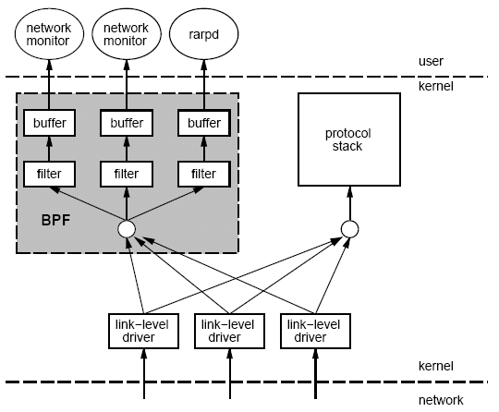
Packet Capture: tcpdump/bpf
Put interface in promiscuous mode
Use bpf to extract packets of interest
Accuracy Issues
Packets may be dropped by filter
Failure of tcpdump to keep up with filter
Failure of filter to keep up with dump speeds
Question: How to recover lost information from packet drops?

Slide 20
Demonstration

Slide 21
