Slide 1
Module 2: Overview
Applications of ML in Security
ML for Cybersecurity
Fall 2020

Slide 2
When Data Science Meets Cybersecurity
Module 2
Module 1
Data Collection
Data Representation
Modeling
Deployment
Missing data
Acquisition cost
…
Interpretability; Fairness;
Anonymization
Efficiency; Accuracy; Interpretability; Adversarial resistance;
…
Ethics, Fairness, Responsibility,
and Transparency
Module 3
Module 4
Notes:
A module focused on machine learning fundamentals, with applications to security. Introduction to the data science pipeline, and teach fundamental building blocks, from data ingestion and feature engineering to machine learning model selection.
Modeling; Representation; Environment; Constraints (?)

Slide 3
Where Are We?
Module 1: “Statistical Modeling”
Module 2: “Data Collection/ Representation”
Foundations of ML and Data Science for Cybersecurity
Data-Driven Network and
Computer Security
Module 3: “Attacks and Defenses”
Module 4: “Deployment”
Machine Learning in the Presence of Adversaries in Security Applications
Ethics, Fairness, Responsibility,
and Transparency in
Data-Driven Cybersecurity
Notes:
A module focused on machine learning fundamentals, with applications to security. Introduction to the data science pipeline, and teach fundamental building blocks, from data ingestion and feature engineering to machine learning model selection.
Modeling; Representation; Environment; Constraints (?)

Slide 4
Module Overview

Slide 5
Many Cybersecurity Problems Involve Large-Scale Predictive Analytics
Rare events
Time-series analysis
Analysis of heterogenous data
Analysis of communication graphs
Need to analyze data in real time
Need to detect outliers

Slide 6
Application-Layer DoS
Conventional attacks: Volumetric
Send high volumes of traffic towards victim
Modern attacks: Application-layer, low-volume
Exploit network traffic that can consume an aysmmetric amount of resources
SSL handshakes, DNS traffic (“amplification attacks”), Database operations
Challenge: Simply counting traffic volumes will not suffice.

Slide 7
Automation
Goal: Automated rule provisioning, automation, optimization
Machine Learning Capabilities
Clustering techniques can identify common idioms
Traffic analysis can help identify “dead code”
Time-dependent dataset analysis can predict which ACLs are needed, and when
Future: Coupling with software-defined networks for “closed loop” automation

Slide 8
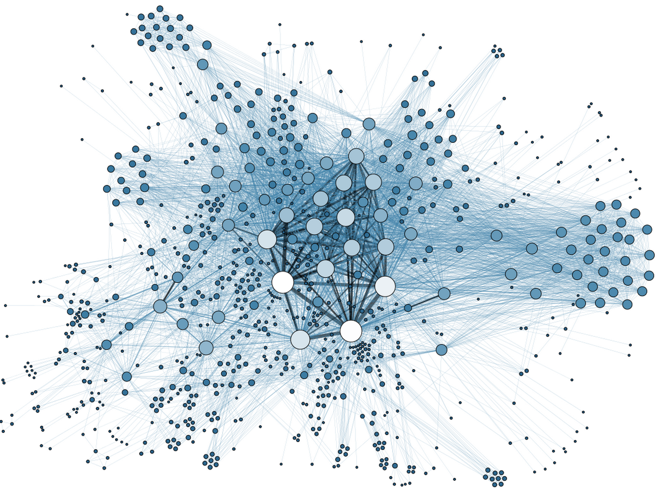
Anomaly Detection
Problem
Determine when an employee is a “flight risk” or otherwise a risk for leaking data
Insight: Sometimes flight risk is preceded by changes in communication patterns
Goal: Use data about communication patterns to detect probability of flight risk
Increase defenses (e.g., firewalling) if exfiltration could be predicted

Slide 9
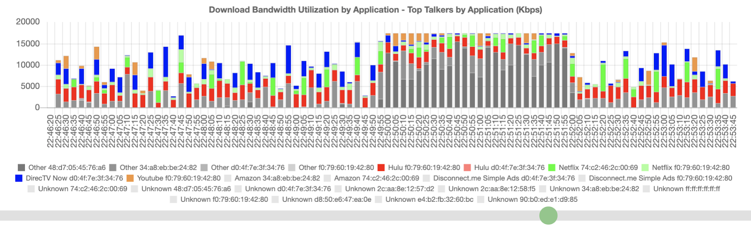
Other Applications: Performance Anomalies
Congested network
“Slowness and buffering and long time to load”
“Slow performance, video was choppy”

Slide 10
Learning Objective

Slide 11
Learning Objectives
Describe the basic architecture of the Internet and the mechanics of networked communications
Acquire and represent data for modeling and analysis
Implement simple supervised machine-learning models for cybersecurity applications
Analyze network traffic using unsupervised learning techniques, such as PCA and clustering

