Slide 1
Module 2: Networking Background
Internet and Networked Communications 101
ML for Cybersecurity
Fall 2020

Slide 2
Learning Objective

Slide 3
Learning Objectives
Networking 101
Data from networks (packets)
Domain name system (DNS)

Slide 4
Networking 101

Slide 5
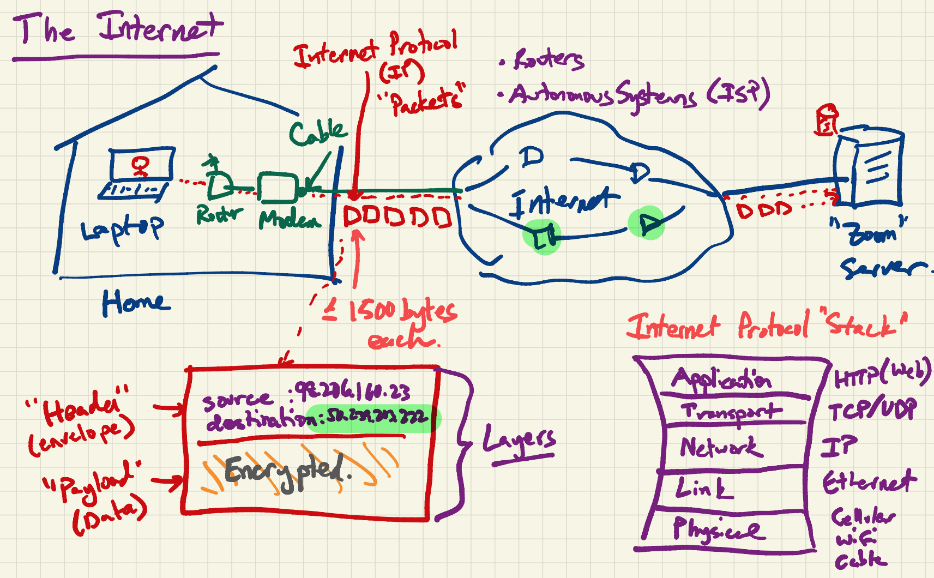

Slide 6
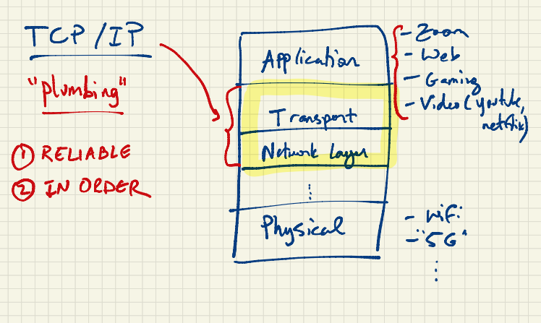

Slide 7
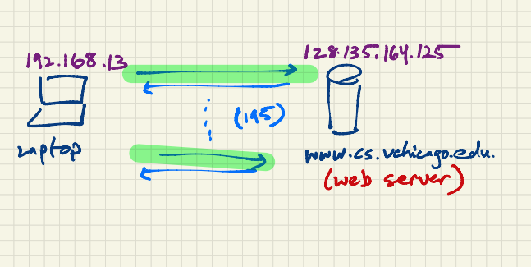

Slide 8
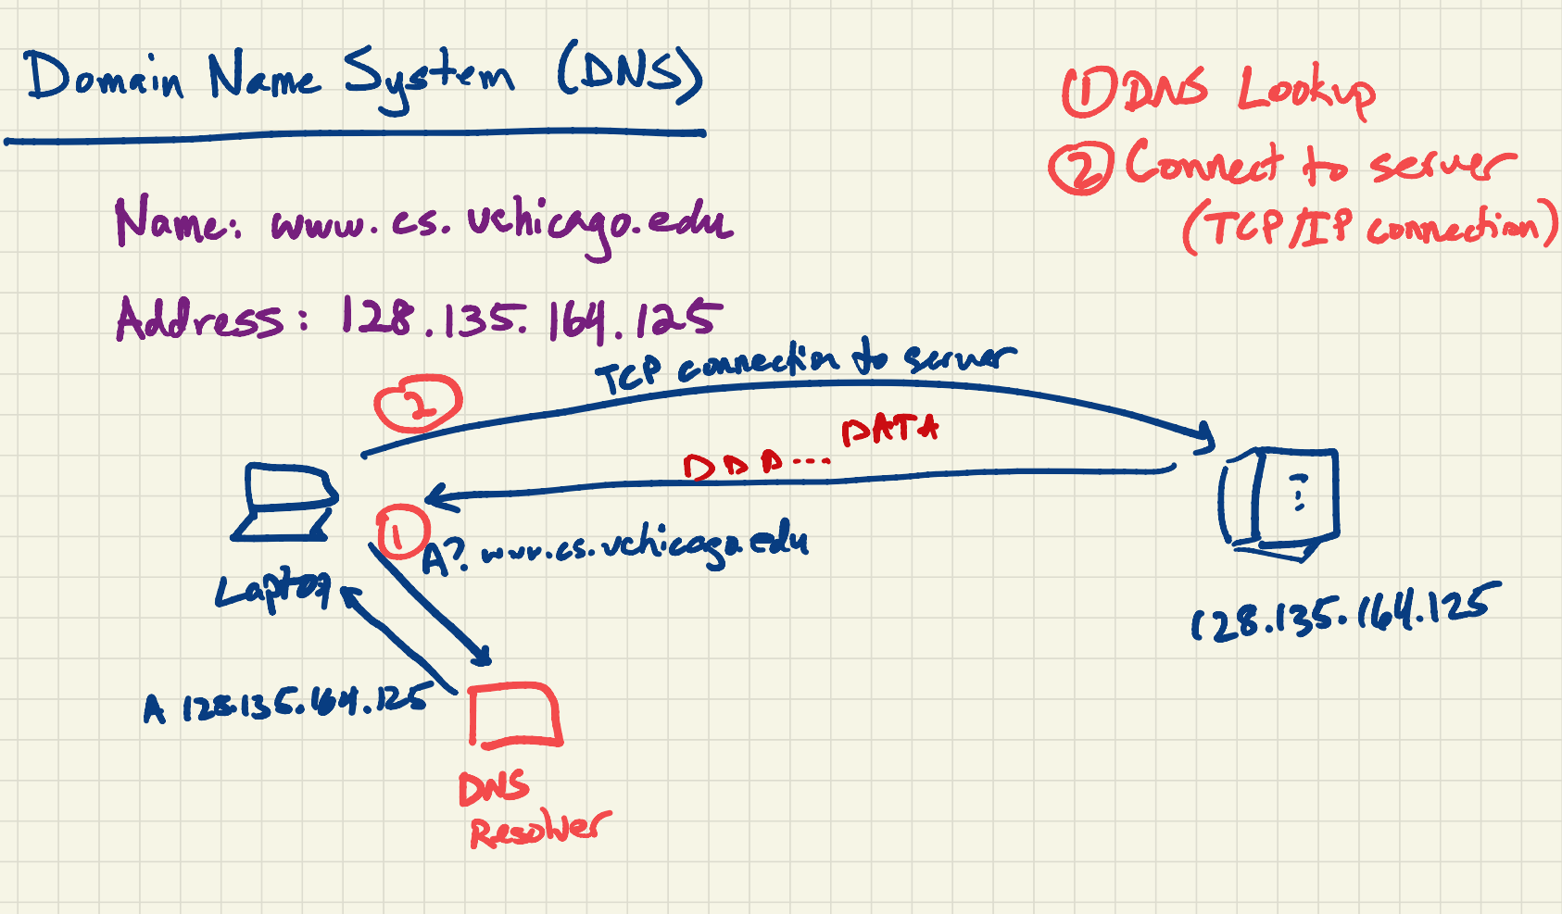

Slide 9
Demonstration: Network Traffic

Slide 10
Concepts from Network Traffic
The basic unit of network traffic is a “packet”.
Each packet has various metadata associated with it:
Addresses (Internet Protocol, Hardware)
Sizes
Times
Most traffic is increasingly encrypted but machine learning often uses this information for everything from identification to anomaly detection.

Slide 11
