Slide 1
Module 2: Measurement
Measuring and Analyzing Network Traffic
ML for Cybersecurity
Fall 2020

Slide 2
Learning Objective

Slide 3
Learning Objectives
Describe different considerations and approaches to measuring Internet traffic in a sound way
Collect network traffic using a variety of industry-standard tools and packages
Represent the network data that has been collected in ways that can be inputted into machine learning models.
Load the data into software libraries for analysis and modeling.

Slide 4
Measurement and DATA Collection

Slide 5
“You Can’t Improve What You Don’t Measure.”

Slide 6
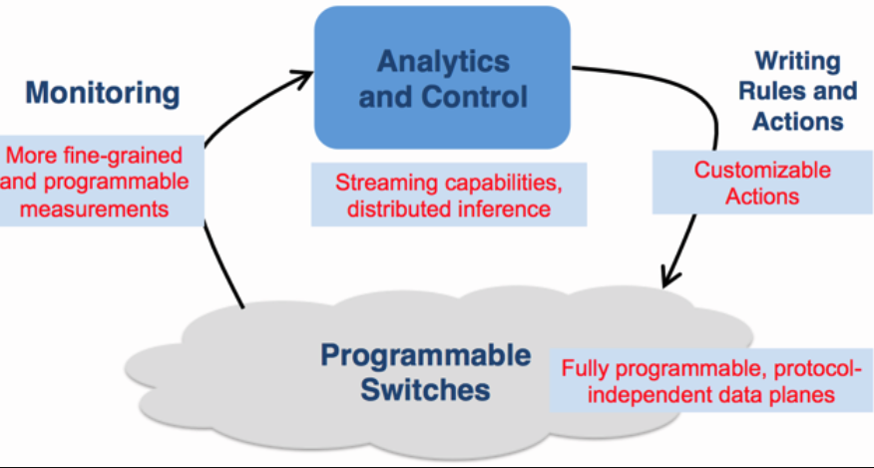

Slide 7
What Data Can Tell Us About Networks
Security (This Course)
Detect and mitigate attacks
Determine source of attacks
Identify unusual behavior
Identify devices
Performance and Reliability
Diagnose performance and reliability problems
Plan provisioning, detect customer problems, …

Slide 8
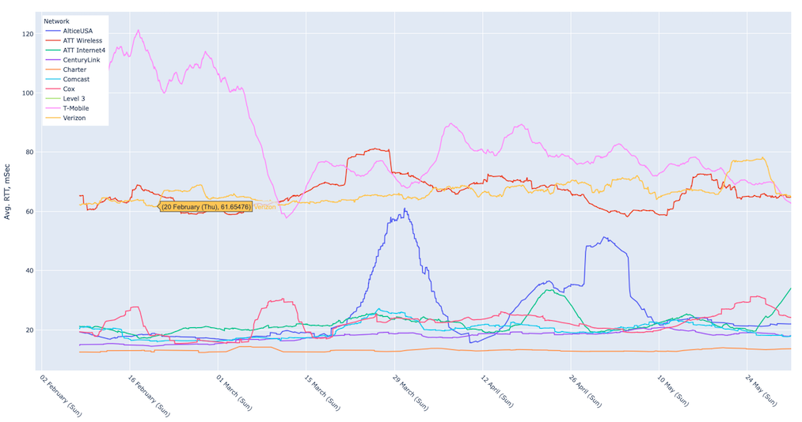
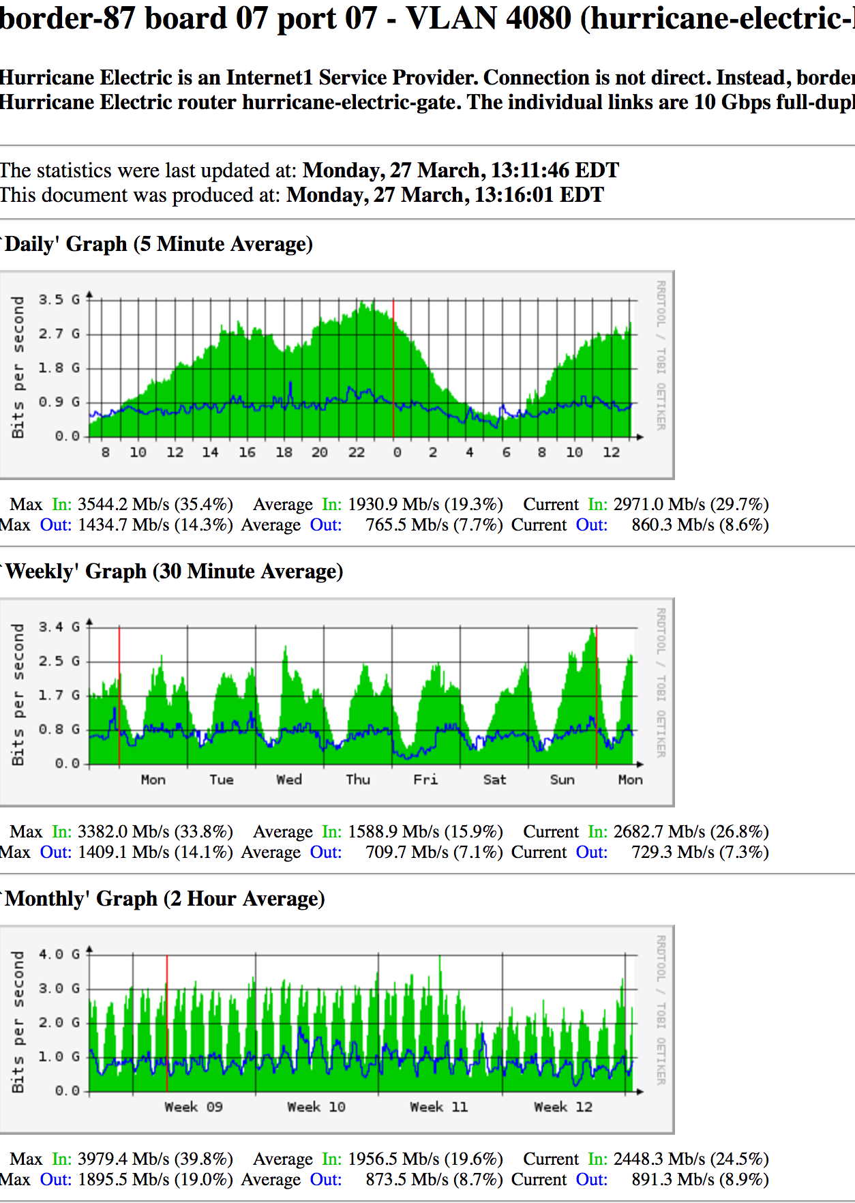
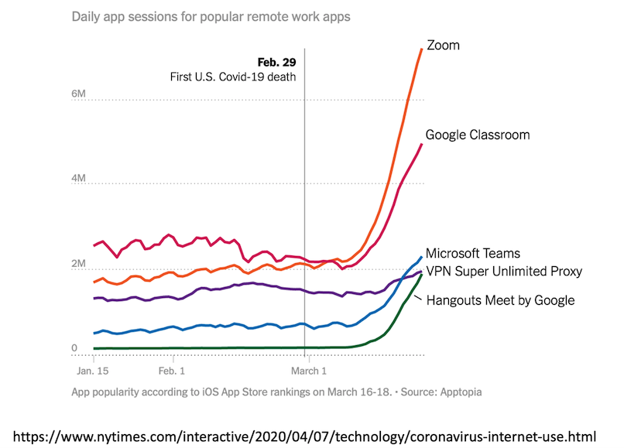
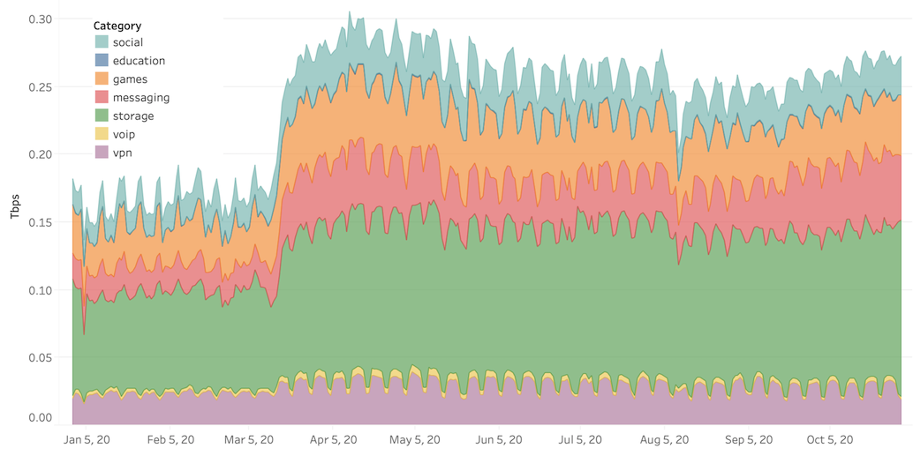

Slide 9
Types of Network Measurements (with demonstration)
Passive
Active
Packet traces
Complete
Headers only
Specific protocols
Flow records
Specific data
Syslogs …
HTTP server traces
DHCP logs
Wireless association logs
DNSBL lookups
…
Routing data
BGP updates / tables, ISIS, etc.
traceroute
ping
UDP “probes”
TCP probes
Application-level probes
Web downloads
DNS queries

Slide 10
Before Machine Learning: Data Quality!
Cross-validation
consistency checks
Multiple independent measurements of the same phenomenon
Database queries can be a useful tool
Other considerations
Anonymization and privacy
Maintaining longitudinal data

Slide 11
Measuring Network Traffic: Two Main Approaches
Packet-level Monitoring
Keep packet-level statistics
Examine (and potentially, log) variety of packet-level statistics. Essentially, anything in the packet.
Timing
Flow-level Monitoring
Monitor packet-by-packet (though sometimes sampled)
Keep aggregate statistics on a flow

Slide 12
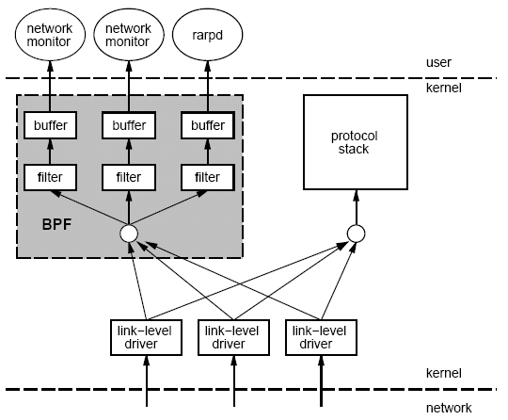
Packet Capture: tcpdump/bpf
Put interface in promiscuous mode
Use bpf to extract packets of interest
Accuracy Issues
Packets may be dropped by filter
Failure of tcpdump to keep up with filter
Failure of filter to keep up with dump speeds
Question: How to recover lost information from packet drops?

Slide 13
Traffic Flow Statistics
Flow monitoring (e.g., Cisco Netflow)
Statistics about groups of related packets (e.g., same IP/TCP headers and close in time)
Recording header information, counts, and time
More detail than SNMP, less overhead than packet capture
Typically implemented directly on line card

Slide 14
What is a Flow?
Source IP address
Destination IP address
Source port
Destination port
Layer 3 protocol type
TOS byte (DSCP)
Input logical interface (ifIndex)

Slide 15
IPFIX (Cisco Netflow, Sflow, etc.)
Basic output: “Flow record”
Newer versions have:
More flexible record format
Much easier to add new flow record types
Core Network
Approximately 1500 bytes
20-50 flow records
Sent more frequently if traffic increases
Collector (PC)
Collection and Aggregation

Slide 16
What is in a Flow Record?
Basic information about the flow…
Source and Destination, IP address and port
Packet and byte counts
Start and end times
ToS, TCP flags
…plus, information related to routing
Next-hop IP address
Source and destination AS
Source and destination prefix

Slide 17
Aggregating Packets into Flows
flow 1
flow 2
flow 3
flow 4
Criteria 1: Set of packets that “belong together”
Source/destination IP addresses and port numbers
Same protocol, ToS bits, …
Same input/output interfaces at a router (if known)
Criteria 2: Packets that are “close” together in time
Maximum inter-packet spacing (e.g., 15 sec, 30 sec)
Example: flows 2 and 4 are different flows due to time

Slide 18
Demonstration: Packet Capture in Python

Slide 19
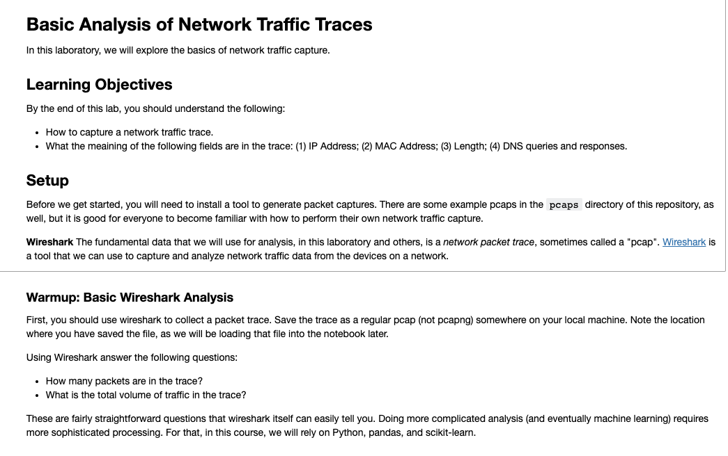

Slide 20
Start: Example Basic Analysis Questions
How many devices are on the network?
What are the most common destinations?
How much traffic is each of the devices sending?
In total?
To each destination?

Slide 21
