Slide 1
Module 2: Networking Background
Internet and Networked Communications 101
ML for Cybersecurity
Fall 2020

Slide 2
Learning Objective

Slide 3
Learning Objectives
Describe the basic infrastructure and architecture of the Internet
Explain how packets are routed through networks to communicate information
Explain the role of domain name servers in routing traffic to IP addresses

Slide 4
CyberSecurity and ML: A BRIEF History

Slide 5

Morris Worm
Nov 2, 1988 – First major worm
∼10% of Internet-connected machines affected
Robert Tappan Morris
Cornell student
Son of computer security expert
Motivated by curiosity
First CFAA prosecution
Now part of YCombinator
Notes:
The first worm was written by someone with no malicious intent, just for curiosity and fun. Things are very different today
Great writeup here
http://www.washingtonpost.com/blogs/the-switch/wp/2013/11/01/how-a-grad-student-trying-to-build-the-first-botnet-brought-the-internet-to-its-knees/
(Accidentally said in class that he was in college, actually grad school)

Slide 6
Morris Internet Worm
What it did
Determine where it could spread
Spread its infection
Remain undiscovered and undiscoverable
Effect
Resource exhaustion – repeated infection due to a programming bug
Servers are disconnected from the Internet by sys admin to stop infection

Slide 7
Morris Internet Worm
How it worked
Where to spread
Exploit security flaws
Guess password (encrypted passwd file readable)
fingerd: buffer overflow
sendmail: trapdoor (accepts shell commands)
Spread
Bootstrap loader to target machine, then fetch rest of code (password authenticated)
Remain undiscoverable
Load code in memory, encrypt, remove file
Periodically changed name and process ID

Slide 8
Morris Worm Redux
1988: No malicious payload, but bogged down infected machines by uncontrolled spawning
Infected 10% of all Internet hosts at the time
Multiple propagation vectors
Remote execution using rsh and cracked passwords
Tried to crack passwords using small dictionary and publicly readable password file; targeted hosts from /etc/hosts.equiv
Buffer overflow in fingerd on VAX
Standard stack smashing exploit
DEBUG command in Sendmail
In early Sendmail versions, possible to execute a command on a remote machine by sending an SMTP (mail transfer) message

Slide 9
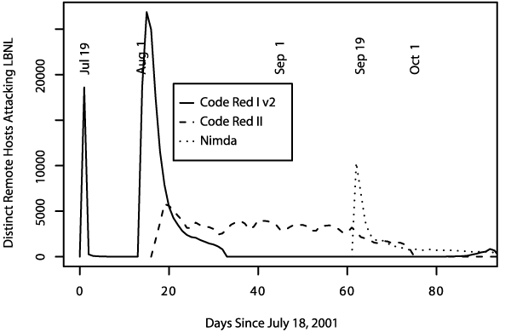
Summer of 2001
Three major worm
outbreaks

Slide 10
Example Worm: Code Red
Initial version: July 13, 2001
Exploited known ISAPI vulnerability in Microsoft IIS Web servers
1st through 20th of each month: spread 20th through end of each month: attack
Payload: Web site defacement
Scanning: Random IP addresses
Bug: failure to seed random number generator

Slide 11
Code Red I
July 13, 2001: First worm of the modern era
Exploited buffer overflow in Microsoft’s Internet Information Server (IIS)
1st through 20th of each month: spread
Find new targets by random scan of IP address space
Spawn 99 threads to generate addresses and look for IIS
Creator forgot to seed the random number generator, and every copy scanned the same set of addresses ☺
21st through the end of each month: attack
Deface websites with “HELLO! Welcome to http://www.worm.com! Hacked by Chinese!”

Slide 12
Code Red: Revisions
Released July 19, 2001
Payload: flooding attack on www.whitehouse.gov
Attack was mounted at the IP address of the Web site
Bug: died after 20th of each month
Random number generator for IP scanning fixed

Slide 13
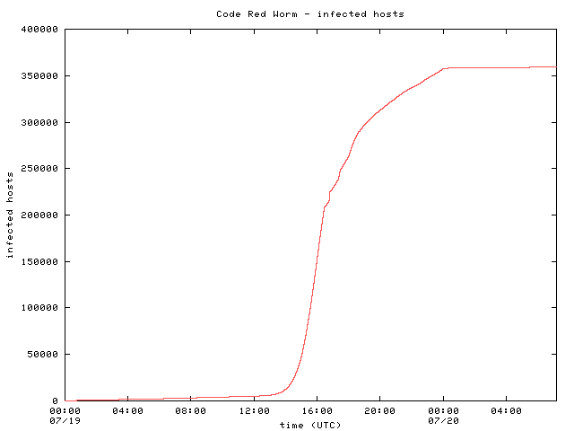
Code Red: Host Infection Rate
Exponential infection rate

Slide 14
Networking 101

Slide 15
Internet: Where Cybersecurity Attacks Happen
…
Often these attacks are detected with ML …
Give history of cybersecurity (Morris worm, 1989)
First DDoS Attacks (Ebay, Yahoo, etc. c. 2001?)
Shortly thereafter: Statistical anomaly detection (SHT, PCA)
First Step: Getting the data to train models, etc.
Notes:
Explain why people need to know what follows…

Slide 16
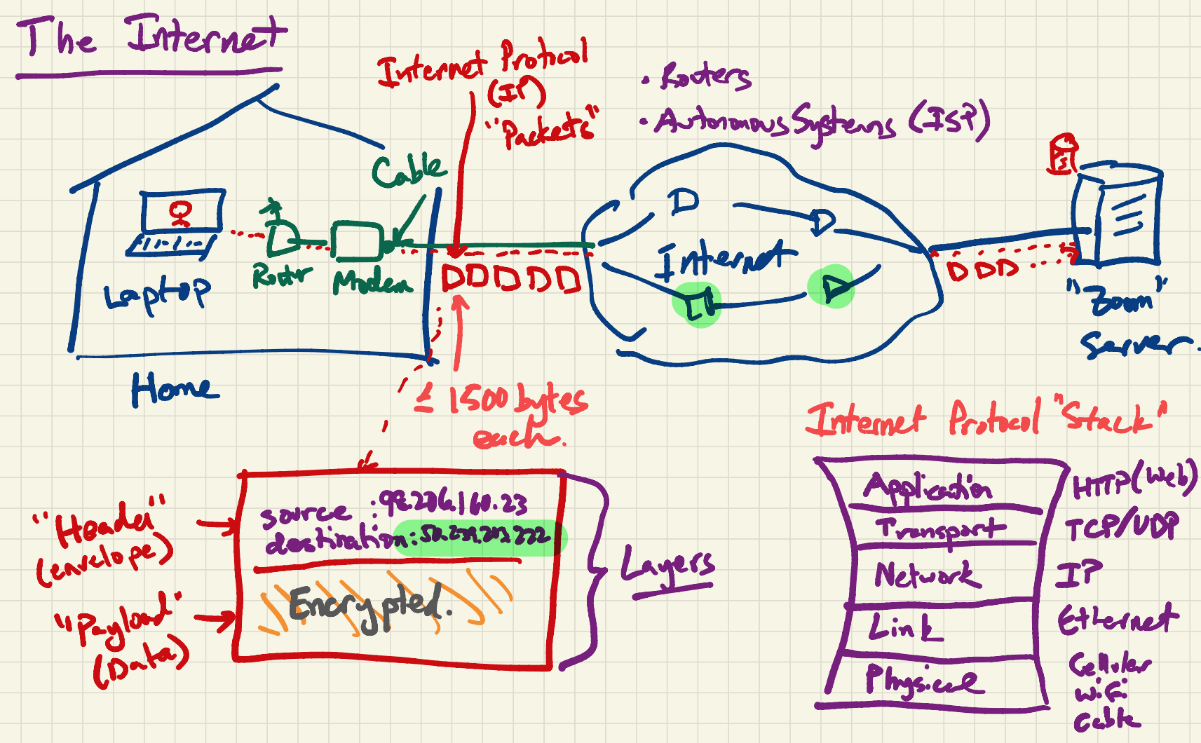

Slide 17
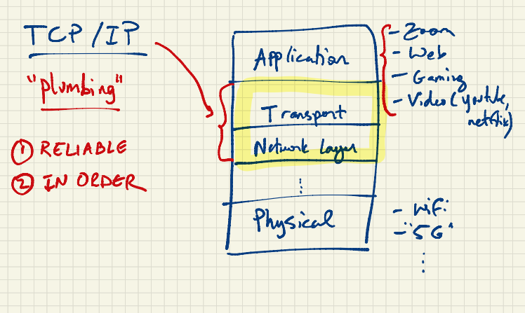

Slide 18
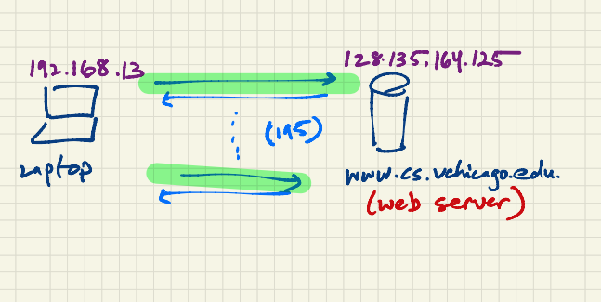

Slide 19
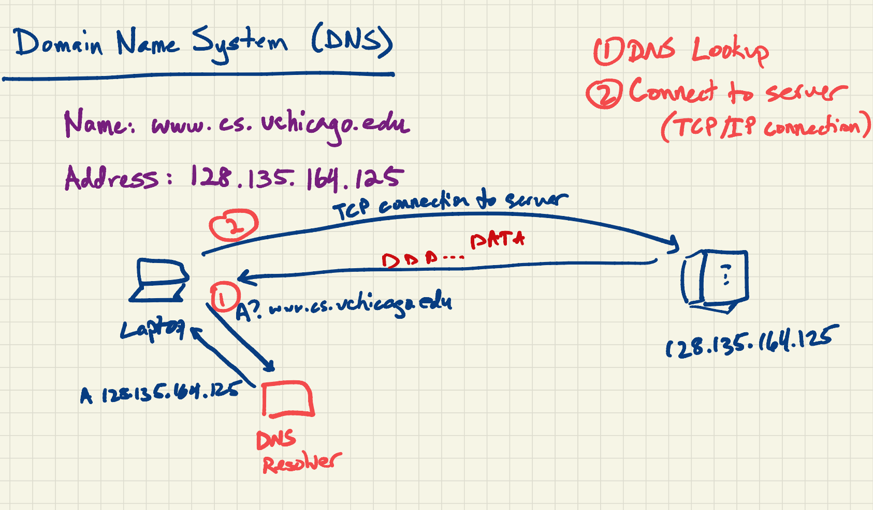

Slide 20
Demonstration: Network Traffic

Slide 21
Concepts from Network Traffic
The basic unit of network traffic is a “packet”.
Each packet has various metadata associated with it:
Addresses (Internet Protocol, Hardware)
Sizes
Times
Most traffic is increasingly encrypted but machine learning often uses this information for everything from identification to anomaly detection.

Slide 22
