Slide 1
Module 3: Security
Overview
ML for Cybersecurity
Fall 2020

Slide 2
Learning Objective

Slide 3
Learning Objectives
Learn about different types of network attacks
Discover simple examples showing how machine learning can be applied to cyberattack detection
Learn about the different approaches to detection, supervised and unsupervised learning

Slide 4
SPAM and MESSAGE ABUSE

Slide 5
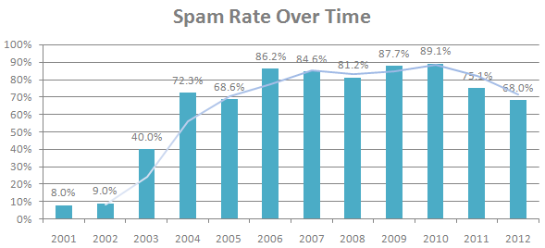
Spam: A Persistent Security Threat
70-90% of all email traffic is spam
(Sources: Symantec 2010, MAAWG 2011, Symantec 2013)

Slide 6

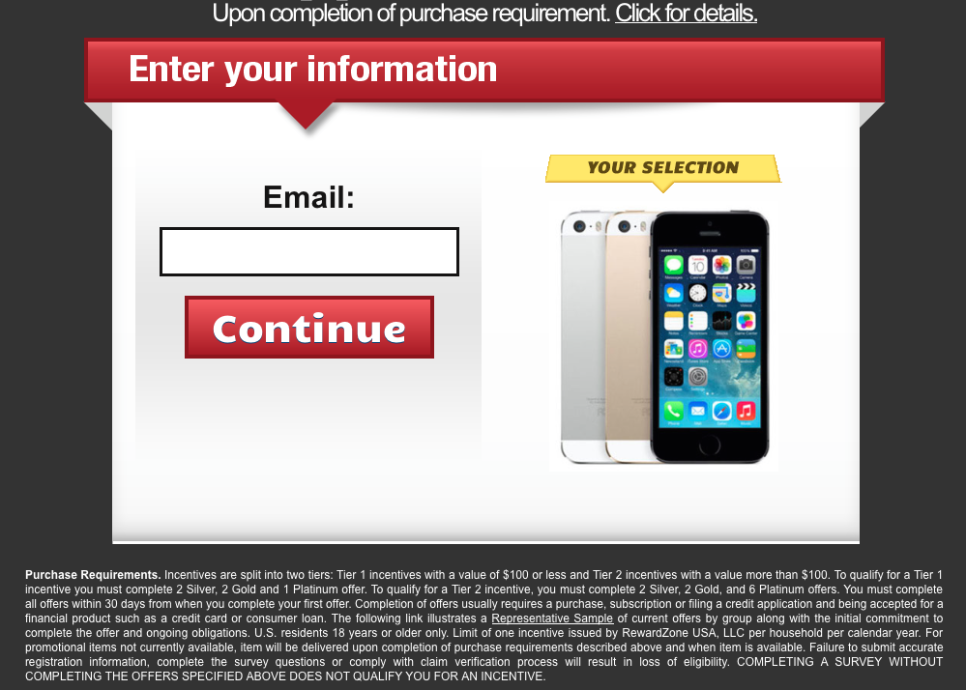
Negative Impact of Spam
Sale of illicit merchandises
e.g., pharmaceuticals, replica luxury goods
Social cost
e.g., wasted time of users
$1 spammers’ revenue
≈ $100 cost to society *
Carrier of other attacks
e.g., phishing, spyware, trojans
Illegal online pharmacy
*Rao et al. The Economics of Spam.
Journal of Economic Perspectives, Volume 26, Number 3, 2012
Fake website with bogus survey

Slide 7
NaÏVE BAYES DEtection

Slide 8
Simple Example: Naïve Bayes
Intuition: Words in spam emails differ from those in legitimate email.
Can use prior probabilities of seeing a word, given spam or ham, to compute posteriors of spam or ham.
Common early-stage spam filter (e.g., SpamAssassin)

Slide 9
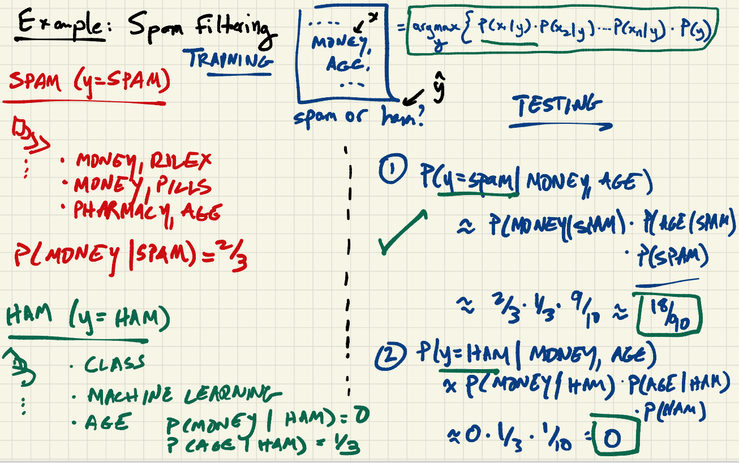

Slide 10
DEMONSTRATION: SPAM Detection

Slide 11
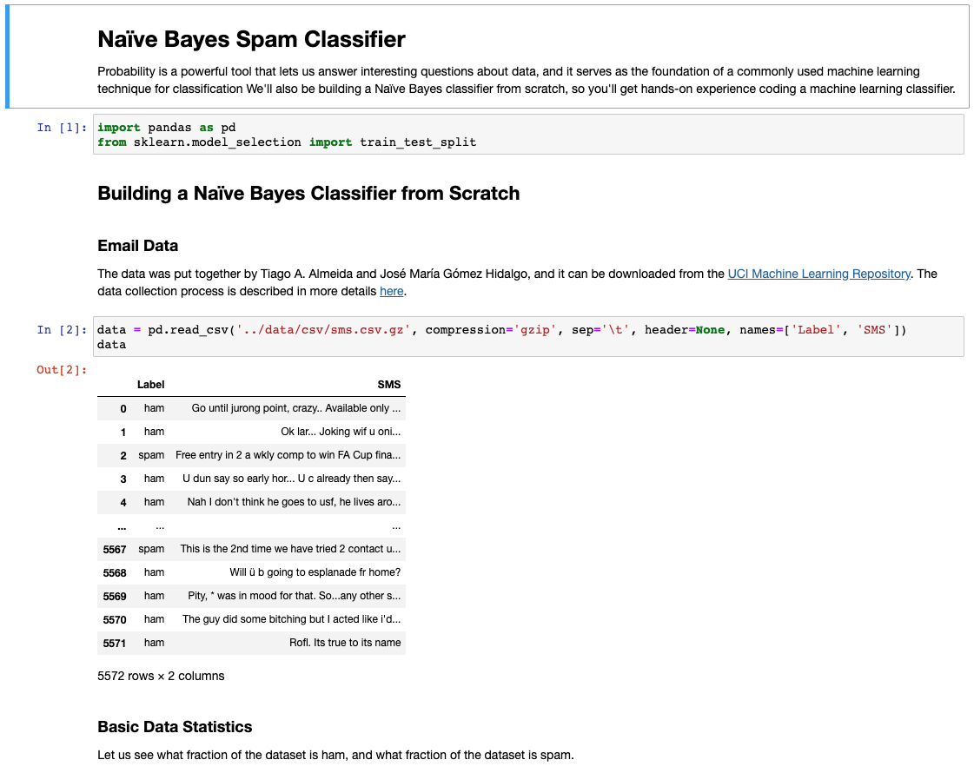

Slide 12
Problems with Content-Based Approach
Relatively easy for attackers to evade
Challenging for designers of spam filters to update models when attackers change behavior
Insight: Use supervised learning based on network-level features to distinguish spam vs. legitimate mail. (Module 3.2)

Slide 13
Module Outline

Slide 14
Rest of Module
3.1: Intrusion Detection Systems (Zeek, Snort, …)
3.2: Supervised Learning Detection
3.3: Attack Detection with Deep Learning
3.4: Anomaly Detection with Unsupervised Learning
3.5: Evasion

