Slide 1
Machine Learning for Cybersecurity
University of Chicago
Fall 2020

Slide 2

Who Am I?
Neubauer Professor Nick Feamster
Network Performance and Security
Data-Driven Approach
Measurement, Inference, Telemetry
Applications of Machine Learning
Performance analysis and prediction
Automated provisioning and troubleshooting
Anomaly detection
Intrusion detection

Slide 3
Many Cybersecurity Problems Involve Large-Scale Predictive Analytics
Rare events
Time-series analysis
Analysis of heterogenous data
Analysis of communication graphs
Need to analyze data in real time
Need to detect outliers

Slide 4
Application-Layer DoS
Conventional attacks: Volumetric
Send high volumes of traffic towards victim
Modern attacks: Application-layer, low-volume
Exploit network traffic that can consume an aysmmetric amount of resources
SSL handshakes, DNS traffic (“amplification attacks”), Database operations
Challenge: Simply counting traffic volumes will not suffice.

Slide 5
Automation
Goal: Automated rule provisioning, automation, optimization
Machine Learning Capabilities
Clustering techniques can identify common idioms
Traffic analysis can help identify “dead code”
Time-dependent dataset analysis can predict which ACLs are needed, and when
Future: Coupling with software-defined networks for “closed loop” automation

Slide 6
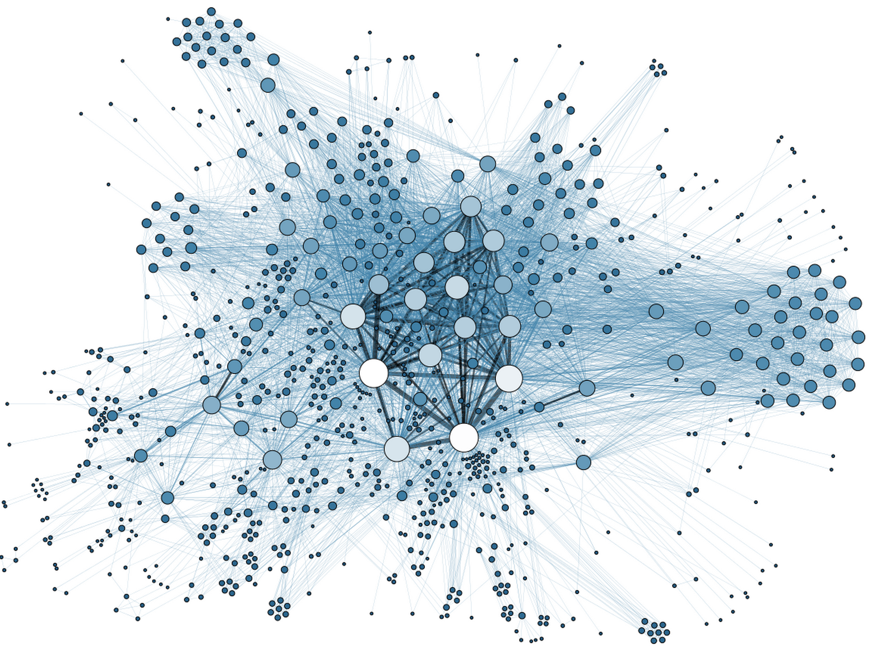
Anomaly Detection
Problem
Determine when an employee is a “flight risk” or otherwise a risk for leaking data
Insight: Sometimes flight risk is preceded by changes in communication patterns
Goal: Use data about communication patterns to detect probability of flight risk
Increase defenses (e.g., firewalling) if exfiltration could be predicted

Slide 7
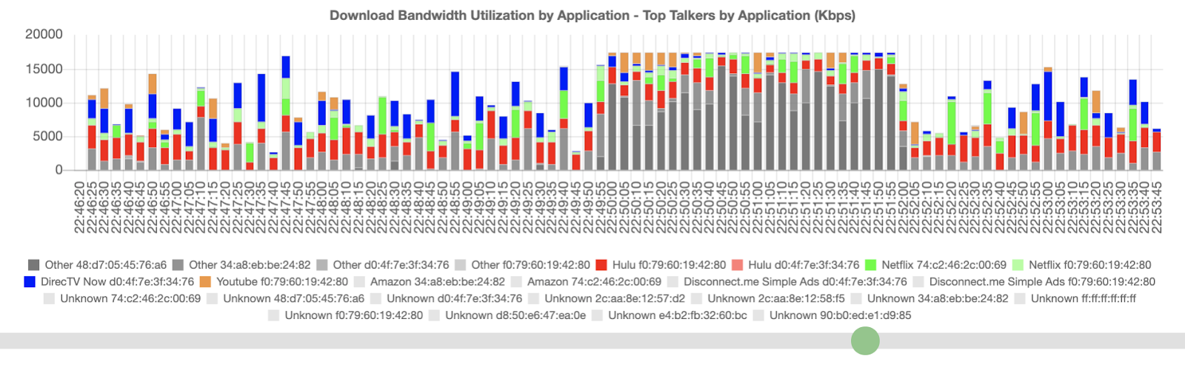
Performance Anomalies
Congested network
“Slowness and buffering and long time to load”
“Slow performance, video was choppy”

Slide 8
Learning Objectives
Internet basics
Data acquisition
Application of (simple) models
More complex applications

