Slide 1
Module 1.5:
ML in Python
Python Env for Machine Learning
ML for Cybersecurity
Notes:
Matt/Laura:
The plan is still to set up a JupyterHub instance for learners so that they can do these labs in the cloud without installing anything locally—but you might want to mention the pros and cons of working in the cloud vs installing Python locally, or why they might want to do the latter even if the former is an option.

Slide 2
Hardware and Software Preparation
You will need a laptop to get the most of the session, with Python (3.7 or higher) installed, along with numpy, scipy, sklearn, and pytorch.
You also need to have the jupyter notebook or jupyterlab installed

Slide 3
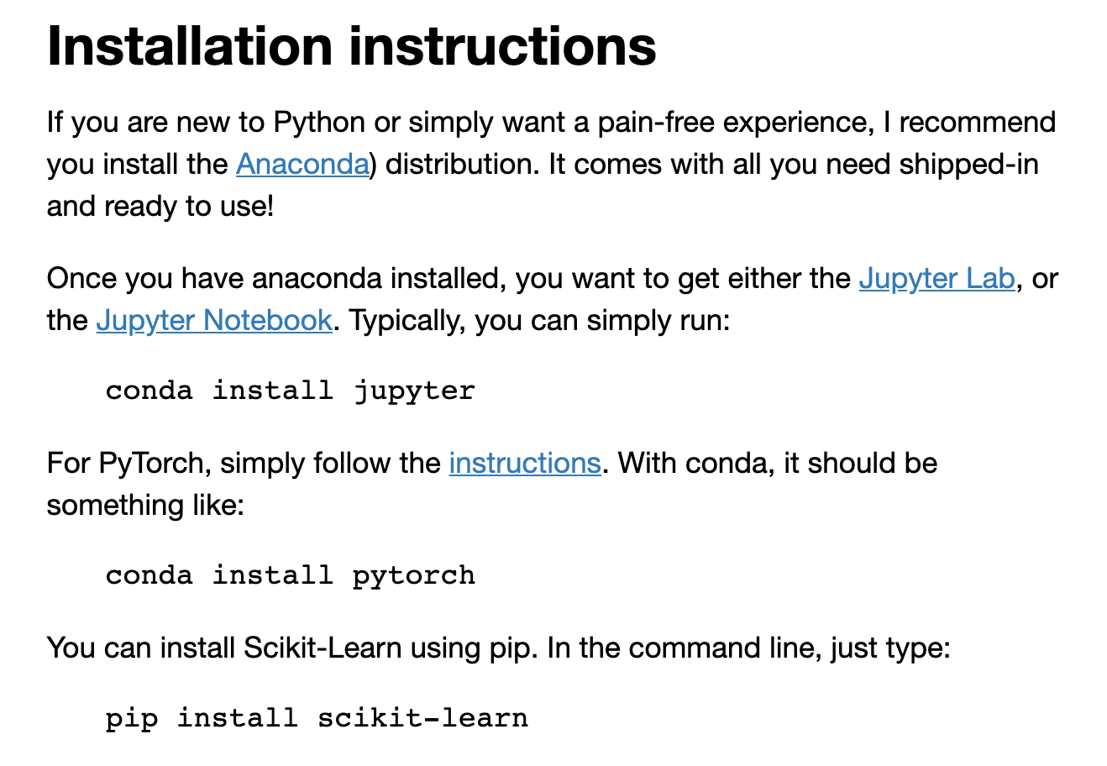

Slide 4
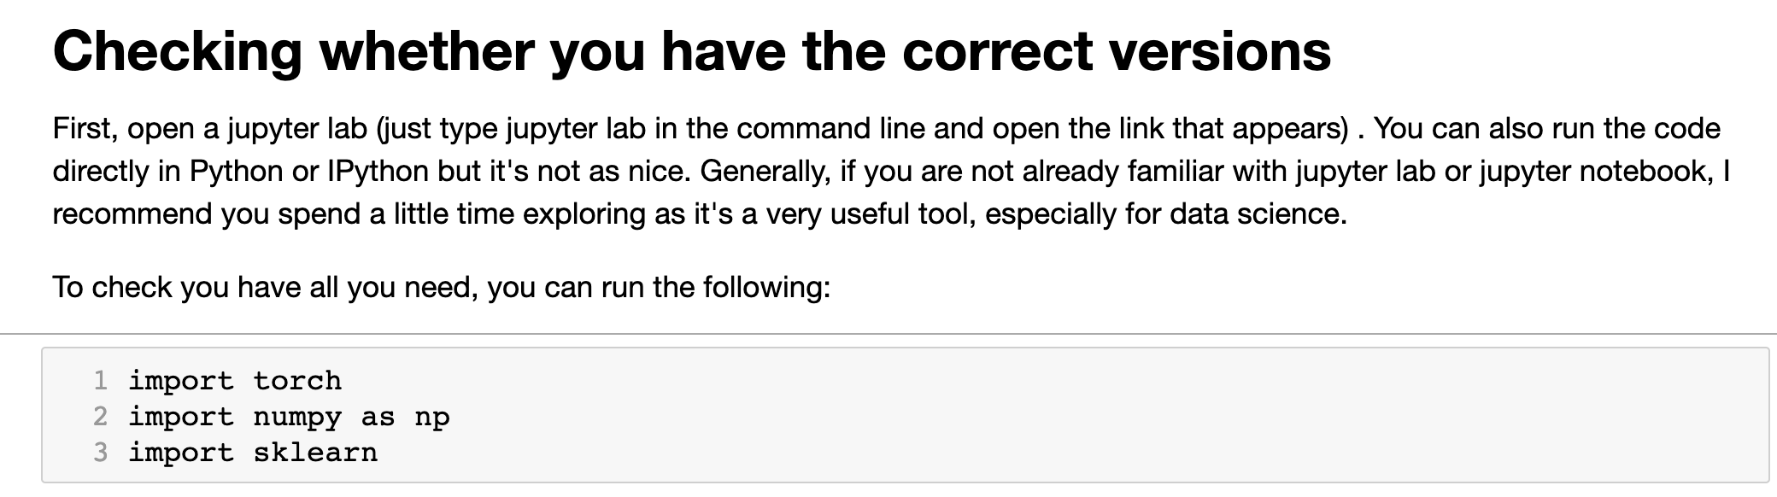

Slide 5
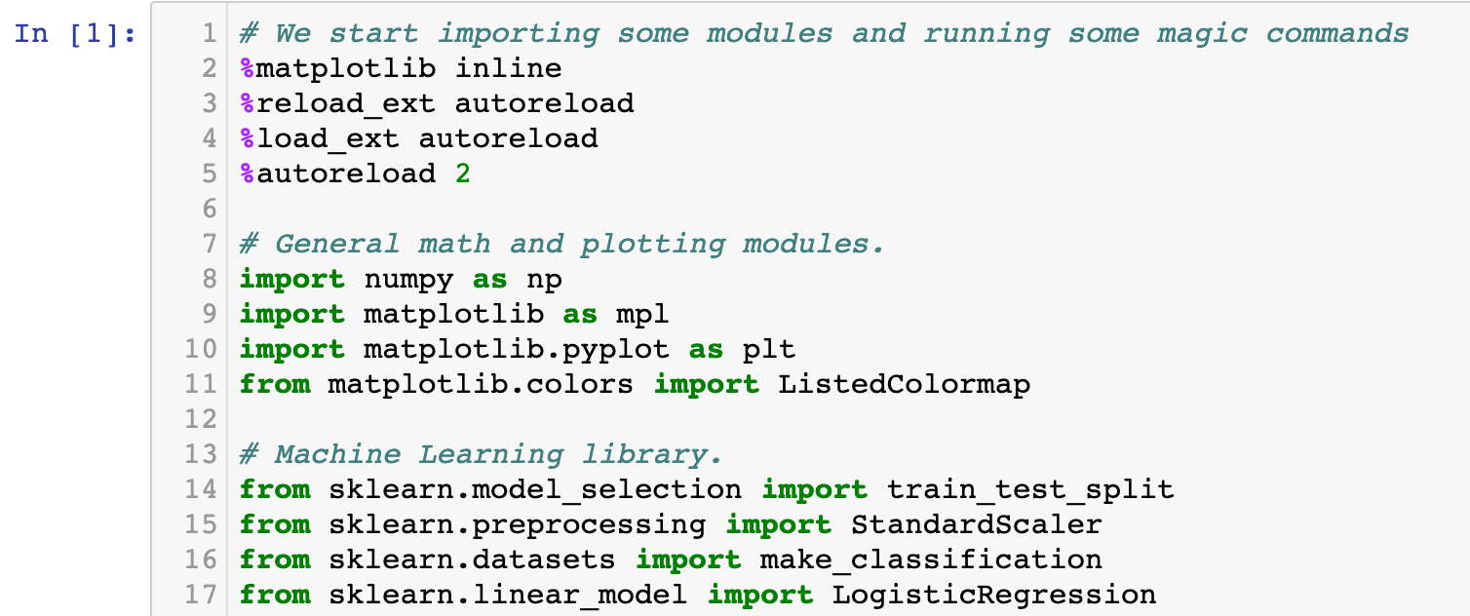
Demo of a Simple ML Pipeline: Load Libraries

Slide 6
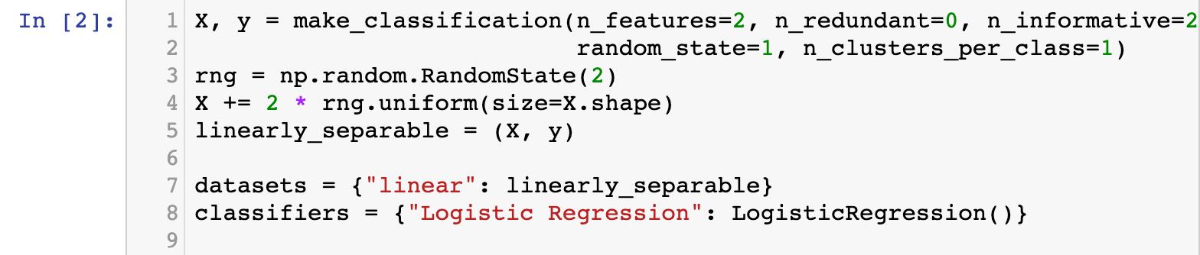
Demo of a Simple ML Pipeline: Loading Data

Slide 7
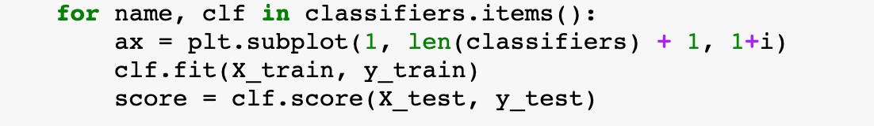
Demo of a Simple ML Pipeline: Try it out!

