Slide 1
Module 3: Security
Overview
ML for Cybersecurity
Fall 2020

Slide 2
Where Are We?
Module 1: “Statistical Modeling”
Module 2: “Data Collection/ Representation”
Foundations of ML and Data Science for Cybersecurity
Data-Driven Network and
Computer Security
Module 3: “Attacks and Defenses”
Module 4: “Deployment”
Machine Learning in the Presence of Adversaries in Security Applications
Ethics, Fairness, Responsibility,
and Transparency in
Data-Driven Cybersecurity
Notes:
A module focused on machine learning fundamentals, with applications to security. Introduction to the data science pipeline, and teach fundamental building blocks, from data ingestion and feature engineering to machine learning model selection.
Modeling; Representation; Environment; Constraints (?)

Slide 3
Learning Objective

Slide 4
Learning Objectives
Learn about different types of network attacks
Discover simple examples showing how machine learning can be applied to cyberattack detection
Learn about the different approaches to detection, supervised and unsupervised learning

Slide 5
SPAM and MESSAGE ABUSE

Slide 6
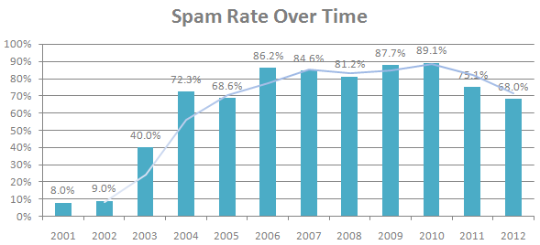
Spam: A Persistent Security Threat
70-90% of all email traffic is spam
(Sources: Symantec 2010, MAAWG 2011, Symantec 2013)

Slide 7

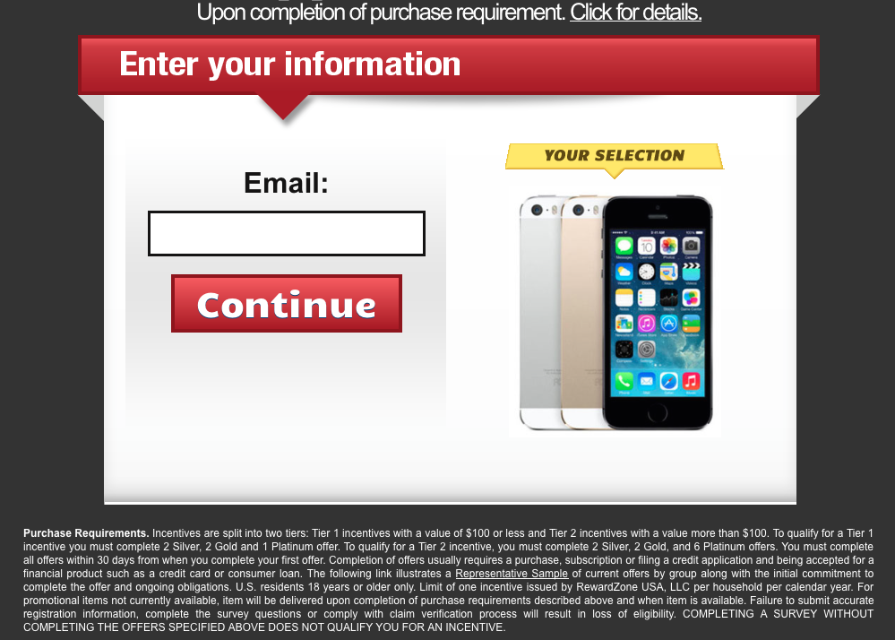
Negative Impact of Spam
Sale of illicit merchandises
e.g., pharmaceuticals, replica luxury goods
Social cost
e.g., wasted time of users
$1 spammers’ revenue
≈ $100 cost to society *
Carrier of other attacks
e.g., phishing, spyware, trojans
Illegal online pharmacy
*Rao et al. The Economics of Spam.
Journal of Economic Perspectives, Volume 26, Number 3, 2012
Fake website with bogus survey

Slide 8
NaÏVE BAYES DEtection

Slide 9
Simple Example: Naïve Bayes
Intuition: Words in spam emails differ from those in legitimate email.
Can use prior probabilities of seeing a word, given spam or ham, to compute posteriors of spam or ham.
Common early-stage spam filter (e.g., SpamAssassin)

Slide 10
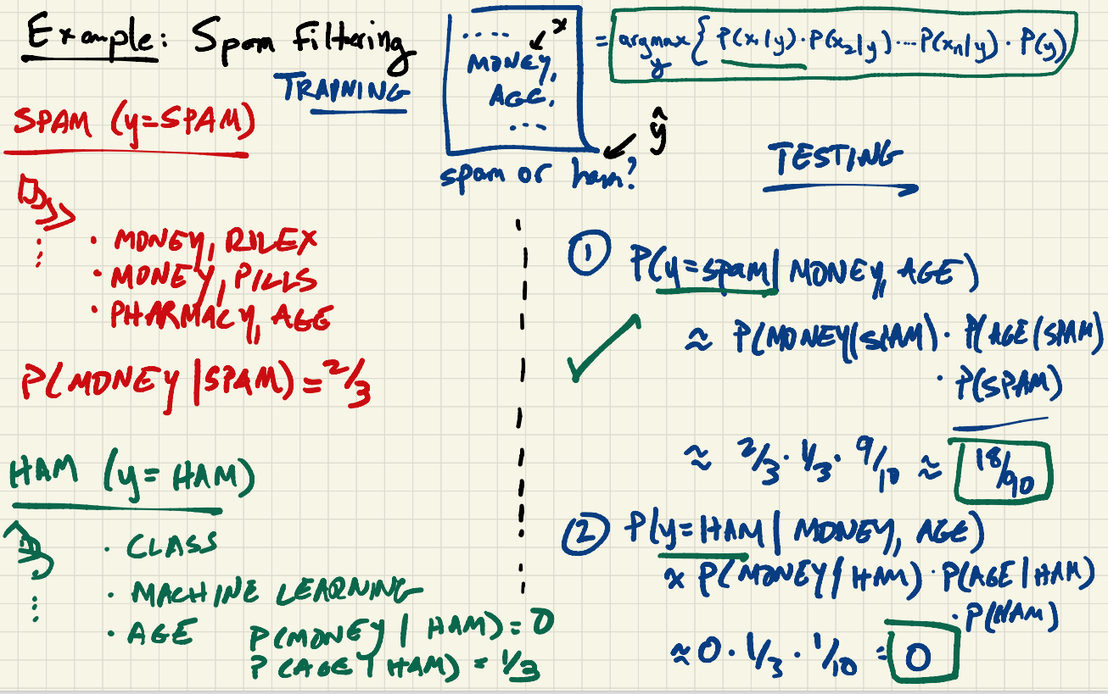

Slide 11
DEMONSTRATION: SPAM Detection

Slide 12
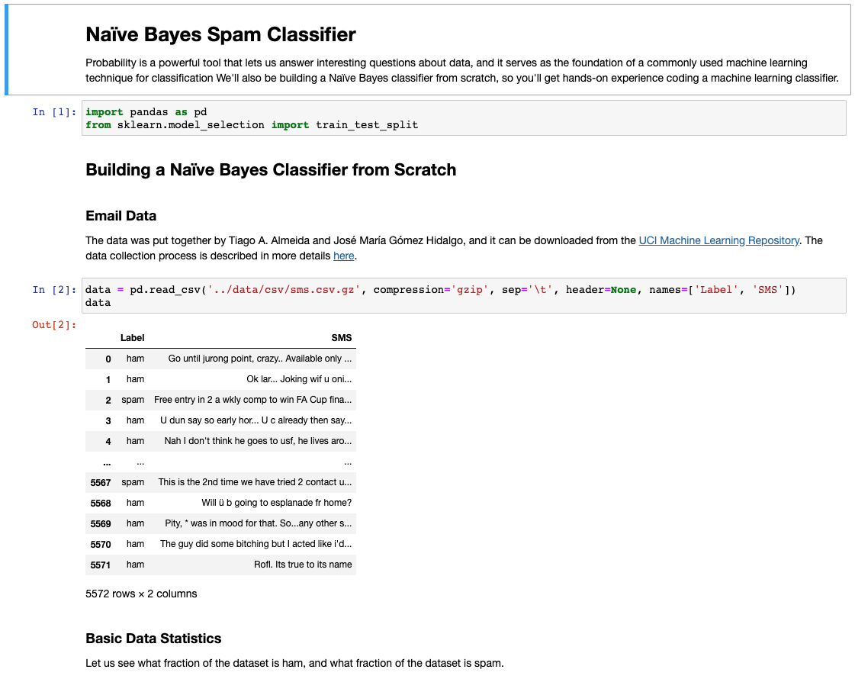

Slide 13
Problems with Content-Based Approach
Relatively easy for attackers to evade
Challenging for designers of spam filters to update models when attackers change behavior
Insight: Use supervised learning based on network-level features to distinguish spam vs. legitimate mail. (Module 3.2)

Slide 14
Module Outline

Slide 15
Rest of Module
3.1: Intrusion Detection Systems (Zeek, Snort, …)
3.2: Supervised Learning Detection
3.3: Attack Detection with Deep Learning
3.4: Anomaly Detection with Unsupervised Learning
3.5: Evasion

