Slide 1
Module 3: Security
Evasion and Adversarial ML
ML for Cybersecurity
Fall 2020

Slide 2
Learning Objective

Slide 3
Learning Objectives
Understand the security mindset when thinking about attack models
Learn about how cybersecurity models have been evaded in the past
Learn about attacks on modern ML systems, and defenses against those attacks

Slide 4
Security Mindset

Slide 5
“Know your enemy.”
Motives?
Capabilities?
Degrees of access?

Slide 6
The Security Mindset
Thinking like an attacker
Understand techniques for circumventing security.
Look for ways security can break, not reasons why it won’t.
Thinking like a defender
Know what you’re defending, and against whom.
Weigh benefits vs. costs: No system is ever completely secure.
“Rational paranoia!”

Slide 7
High-Level Approaches
Attacks
Defenses

Slide 8
Why Study Attacks?
Identify vulnerabilities so they can be fixed.
Create incentives for vendors to be careful.
Learn about new classes of threats.
Determine what we need to defend against.
Help designers build stronger systems.
Help users more accurately evaluate risk.

Slide 9
Thinking as a Defender
Security policy
What are we trying to protect?
What properties are we trying to enforce?
Threat model
Who are the attackers? Capabilities? Motivations?
What kind of attack are we trying to prevent?
Risk assessment
What are the weaknesses of the system?
What will successful attacks cost us?
How likely?
Countermeasures
Costs vs. benefits?
Technical vs. nontechnical?
Challenge is to think rationally and rigorously about risk. Rational paranoia.

Slide 10
Evasion in Cybersecurity

Slide 11

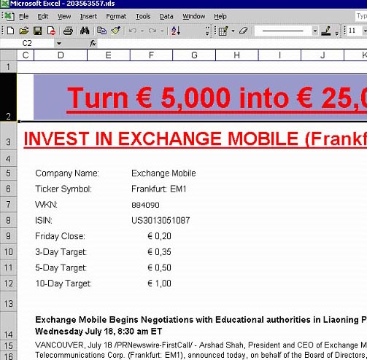

Evasion of Spam Filters
PDFs
Excel sheets
Images
...even mp3s!

