Slide 1
Finite Element Method
for readers of all backgrounds
G. R. Liu and S. S. Quek
CHAPTER 9:
FEM FOR 3D SOLIDS

Slide 2
CONTENTS
INTRODUCTION
TETRAHEDRON ELEMENT
  Shape functions
  Strain matrix
  Element matrices
HEXAHEDRON ELEMENT
  Shape functions
  Strain matrix
  Element matrices
  Using tetrahedrons to form hexahedrons
HIGHER ORDER ELEMENTS
ELEMENTS WITH CURVED SURFACES

Slide 3
INTRODUCTION
For 3D solids, all the field variables are dependent of x, y and z coordinates – most general element.
The element is often known as a 3D solid element or simply a solid element.
A 3D solid element can have a tetrahedron and hexahedron shape with flat or curved surfaces.
At any node there are three components in the x, y and z directions for the displacement as well as forces.

Slide 4
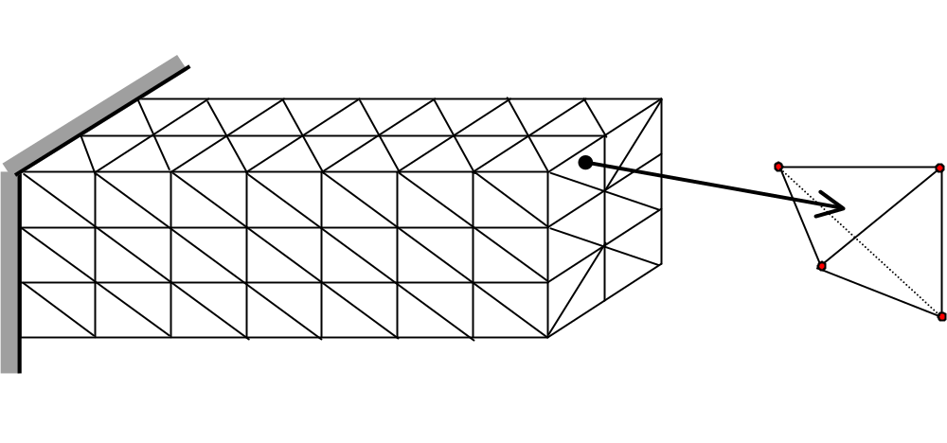
TETRAHEDRON ELEMENT
3D solid meshed with tetrahedron elements

Slide 5
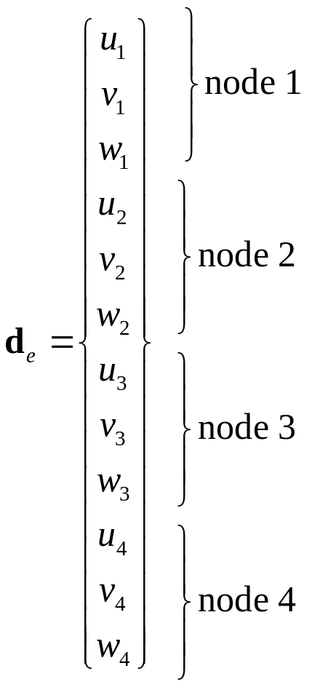
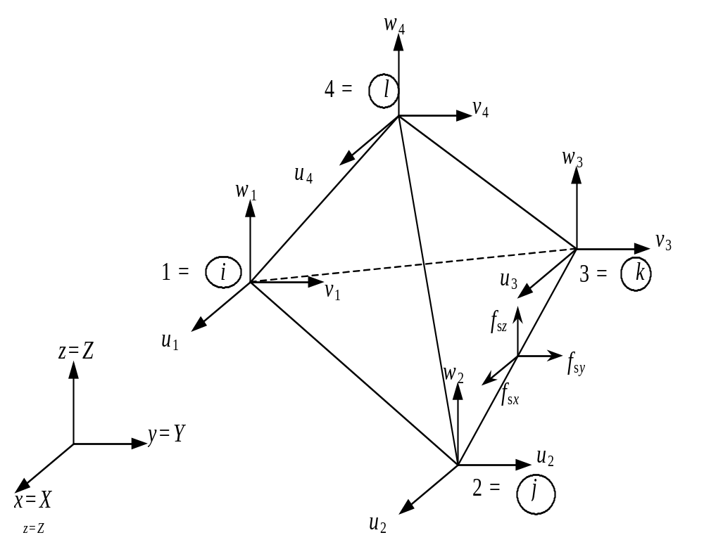
TETRAHEDRON ELEMENT
Consider a four node tetrahedron element

Slide 6
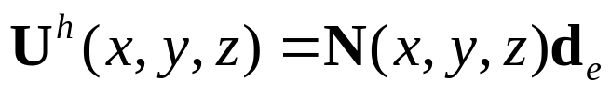
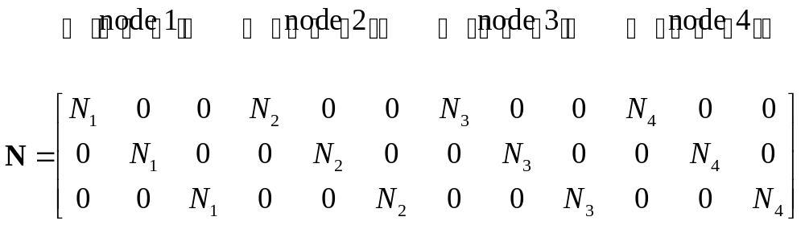
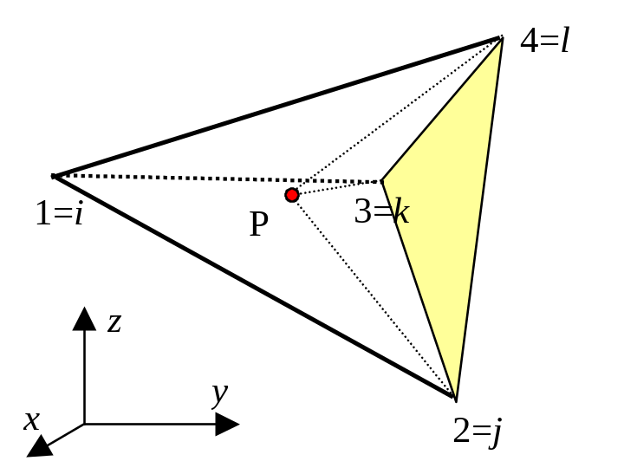
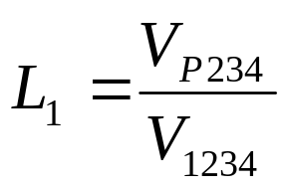
Shape functions
where
Use volume coordinates (Recall Area coordinates for 2D triangular element)

Slide 7
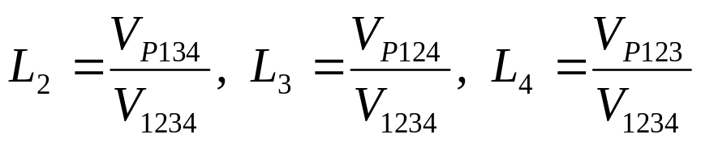
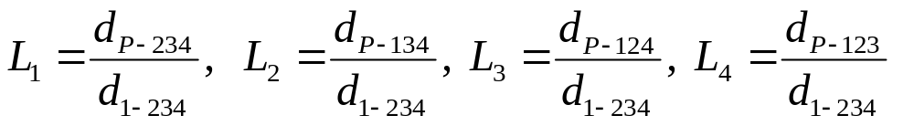


Shape functions
Similarly,
Can also be viewed as ratio of distances
(Partition of unity)
since

Slide 8
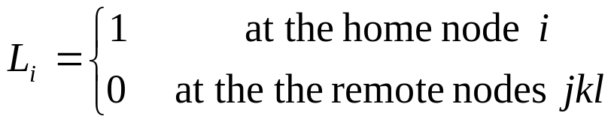
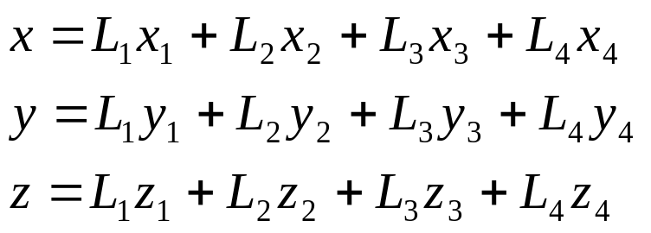
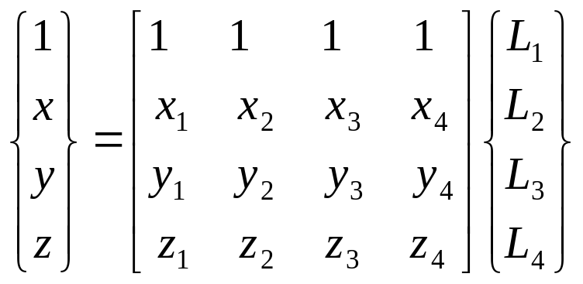
Shape functions
(Delta function property)

Slide 9
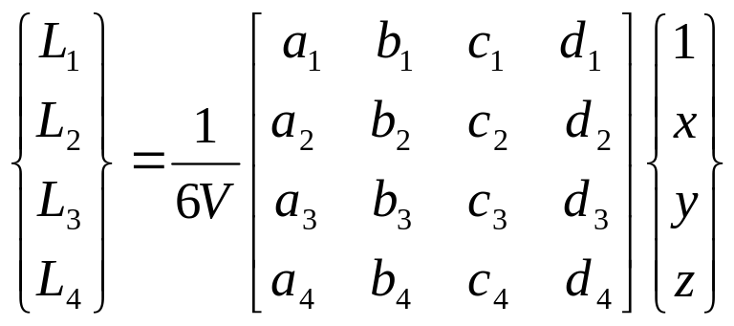
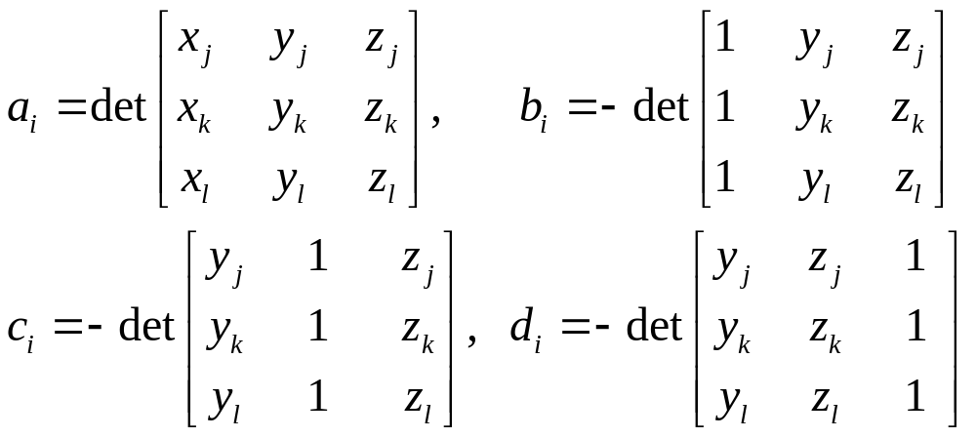
Shape functions
(Adjoint matrix)
i= 1,2
Therefore,
i
l = 4,1
l
j
j = 2,3
k
(Cofactors)
k = 3,4
where

Slide 10
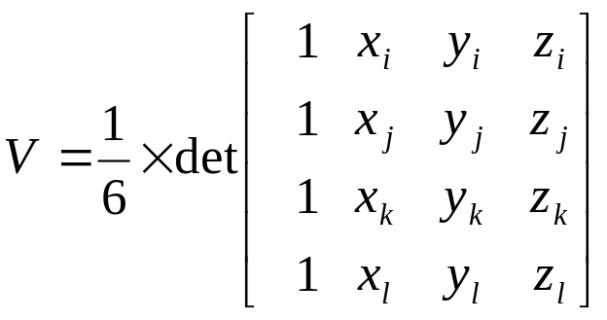
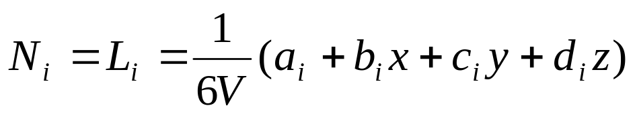
Shape functions
(Volume of tetrahedron)
Therefore,

Slide 11
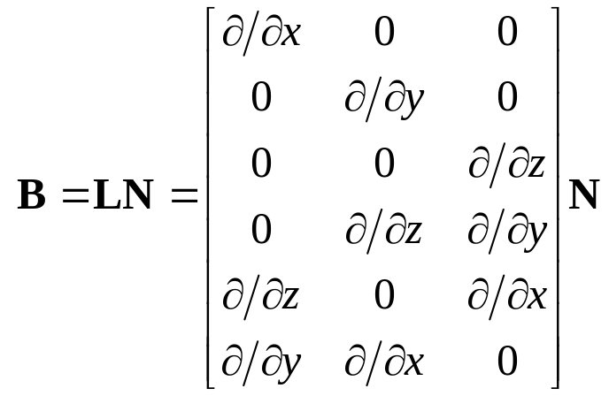
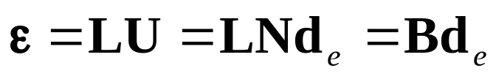
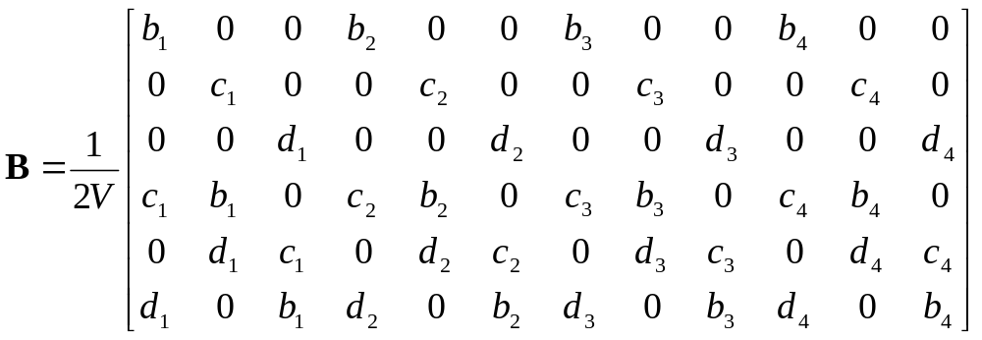
Strain matrix
Since,
Therefore,
where
(Constant strain element)

Slide 12
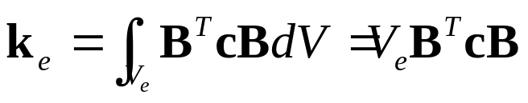
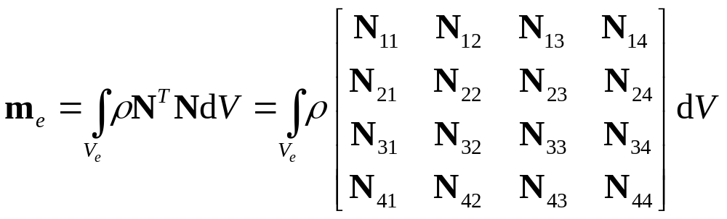
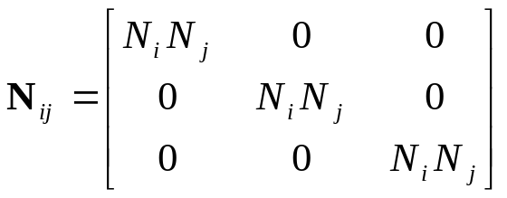
Element matrices
where

Slide 13
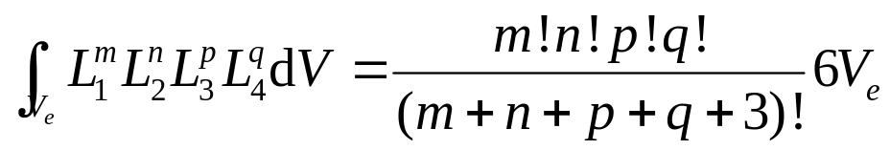
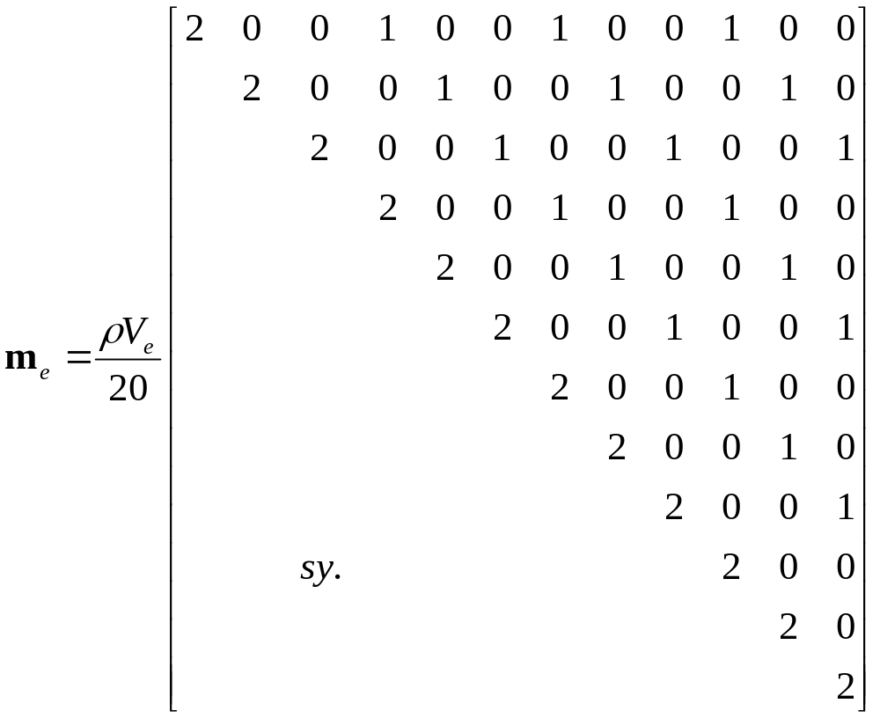
Element matrices
Eisenberg and Malvern [1973] :

Slide 14
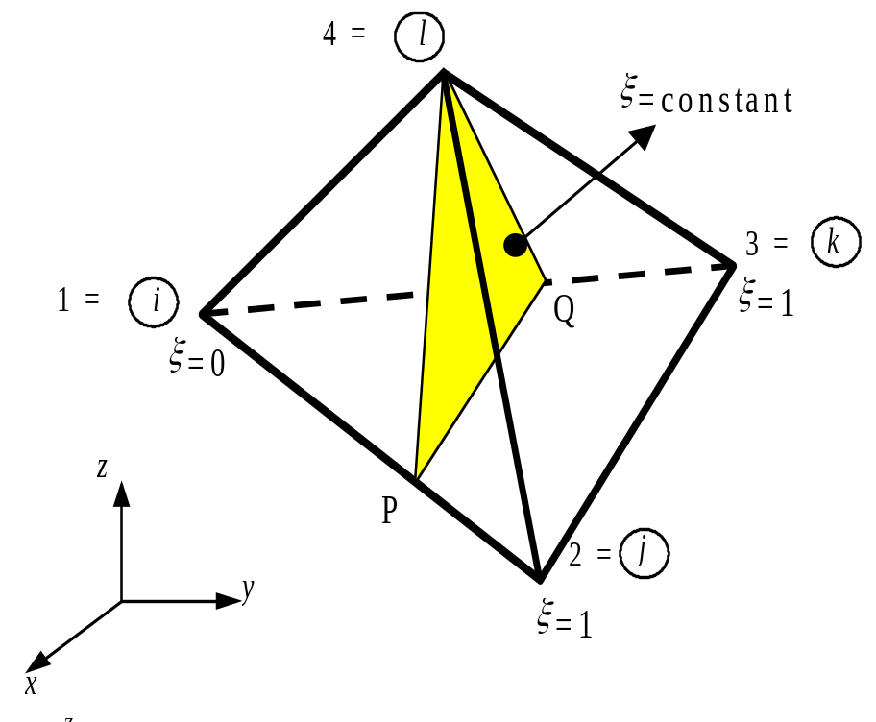
Element matrices
Alternative method for evaluating m_{e}: special natural coordinate system

Slide 15
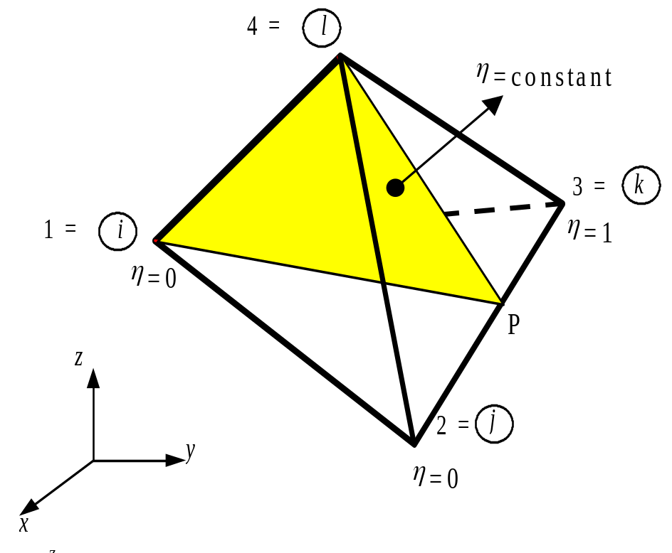
Element matrices

Slide 16
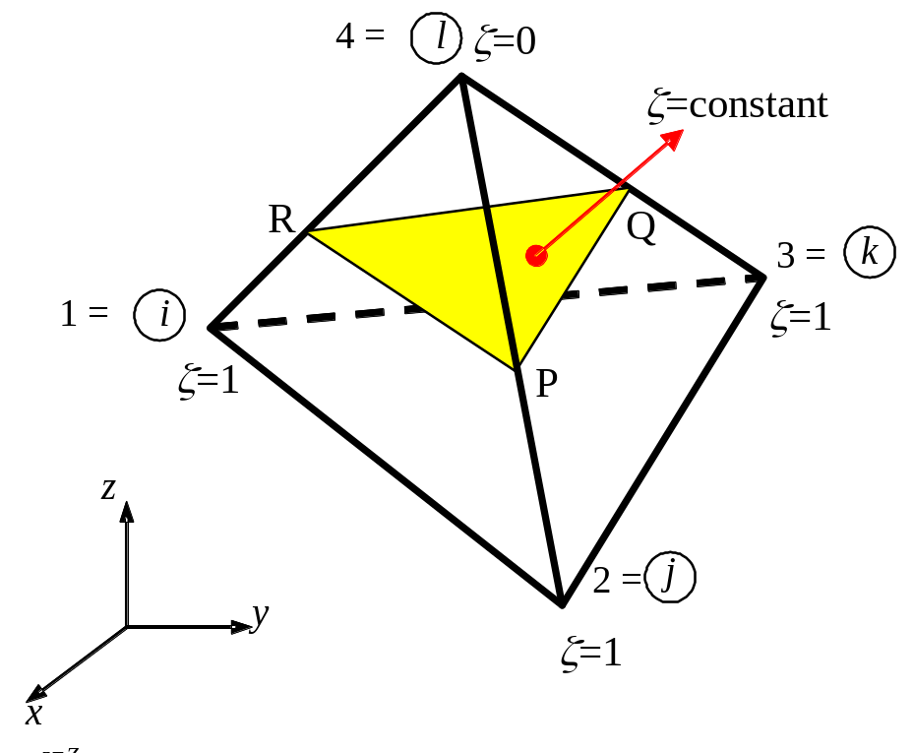
Element matrices

Slide 17
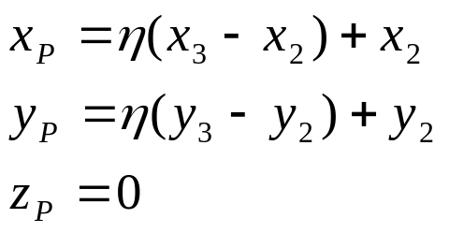
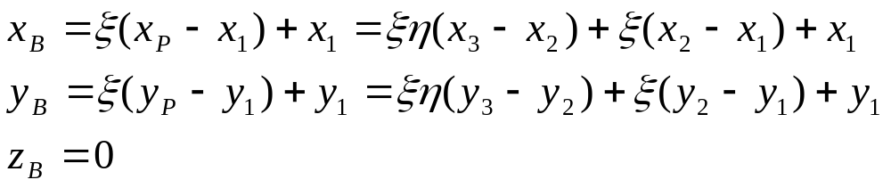
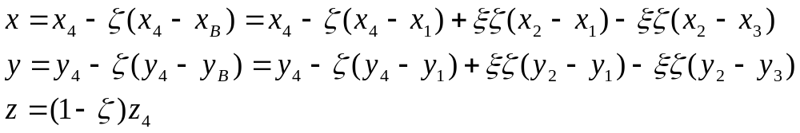
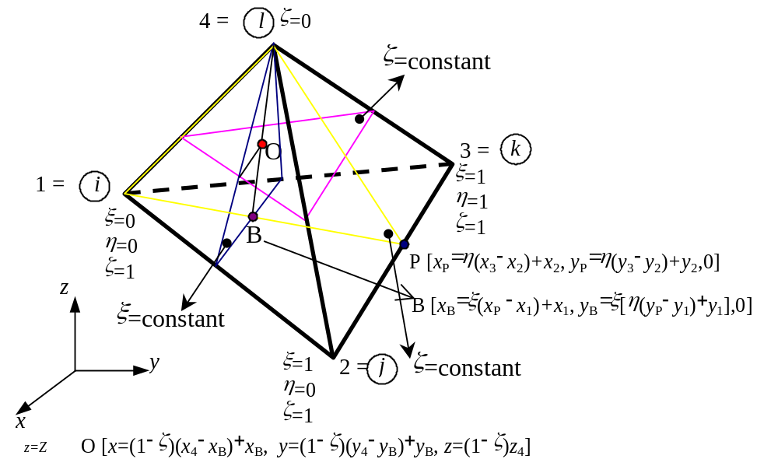
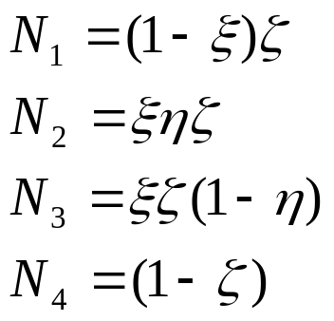
Element matrices

Slide 18
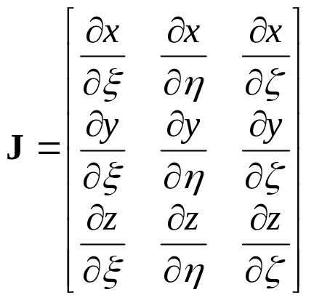
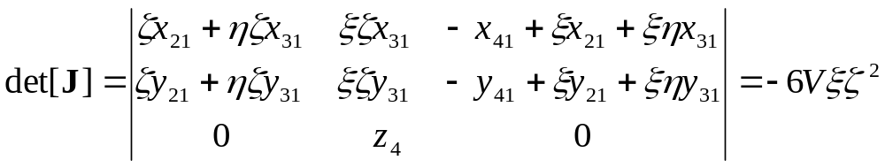
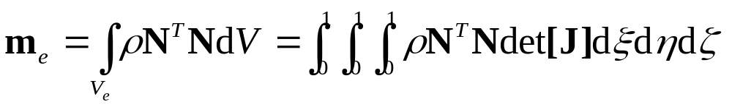
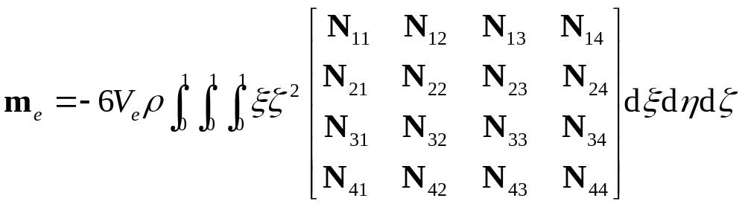
Element matrices
Jacobian:

Slide 19
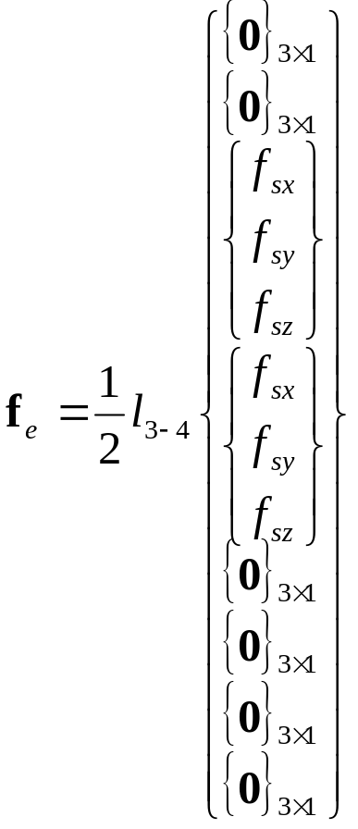
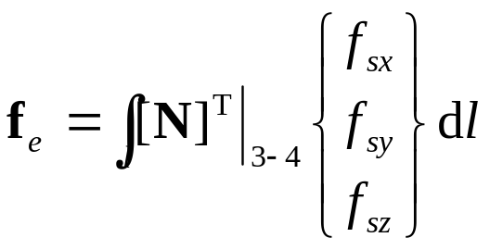
Element matrices
For uniformly distributed load:

Slide 20
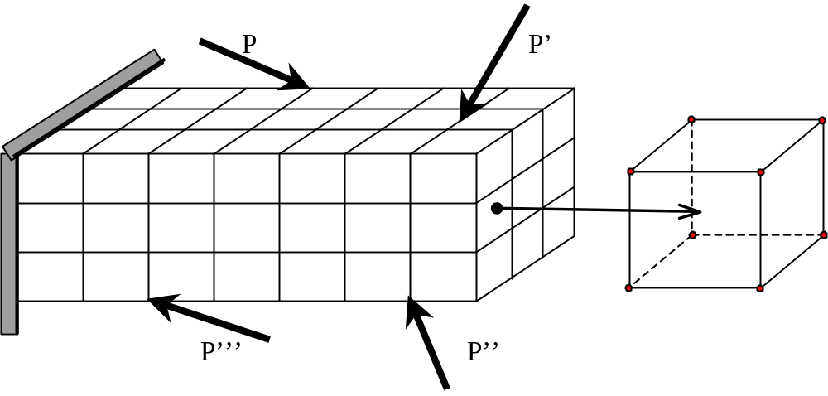
HEXAHEDRON ELEMENT
3D solid meshed with hexahedron elements

Slide 21

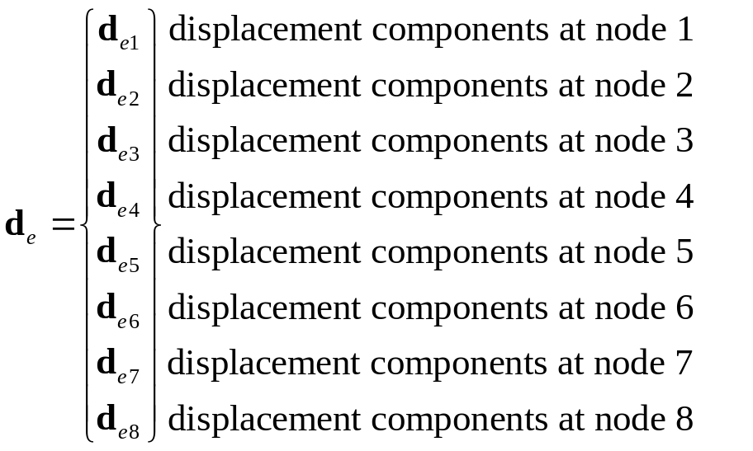
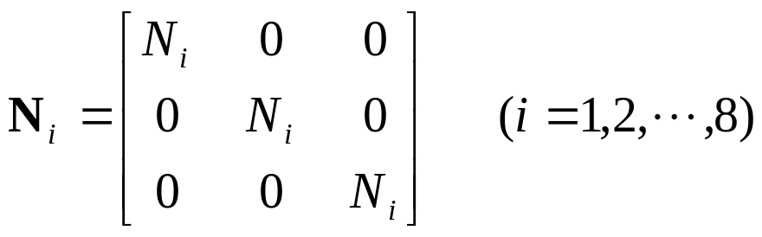
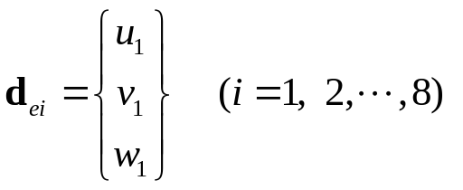
Shape functions
5
8
6
f_{sz}
4
7
1
0
z
f_{sx}
f_{sy}
2
0
y
3
x

Slide 22
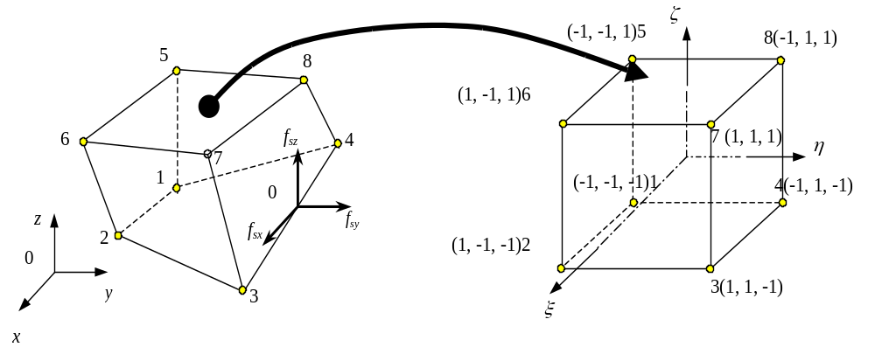
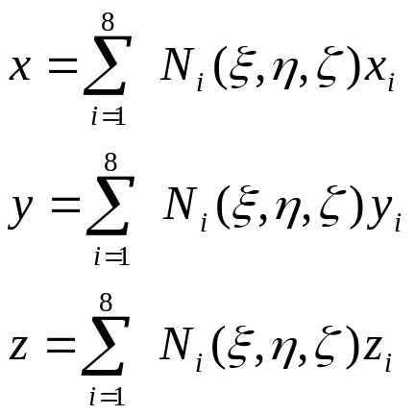
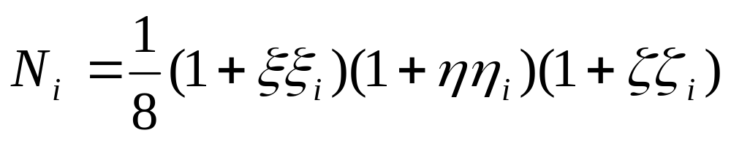
Shape functions
(Tri-linear functions)

Slide 23

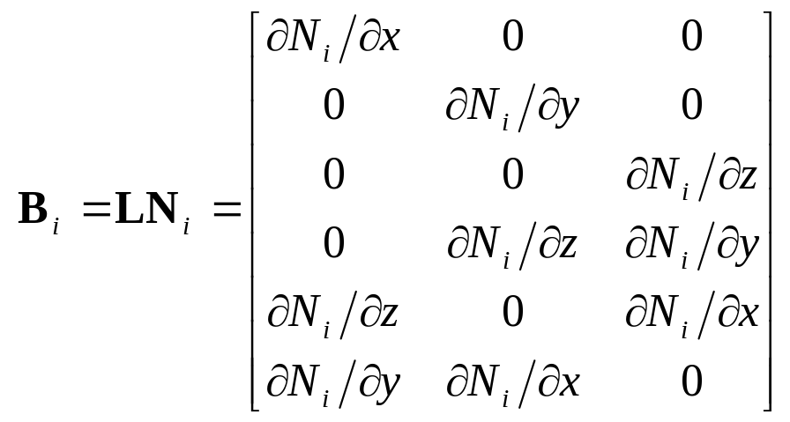
Strain matrix
whereby
Note: Shape functions are expressed in natural coordinates – chain rule of differentiation

Slide 24
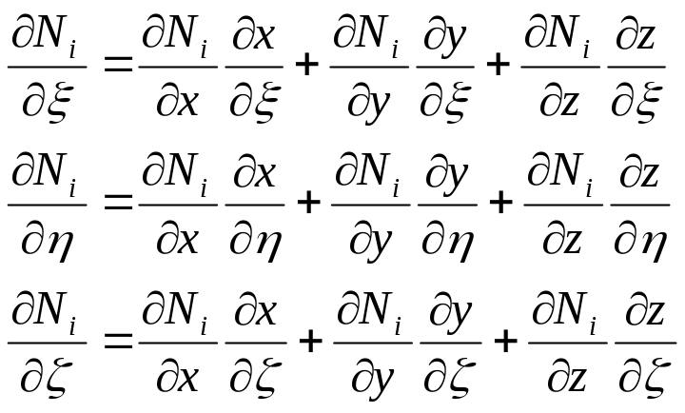
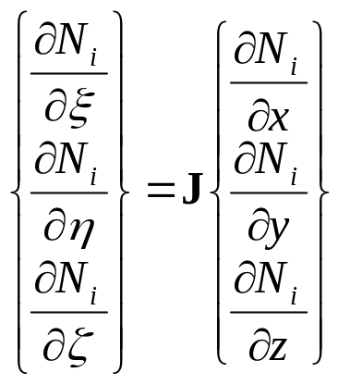
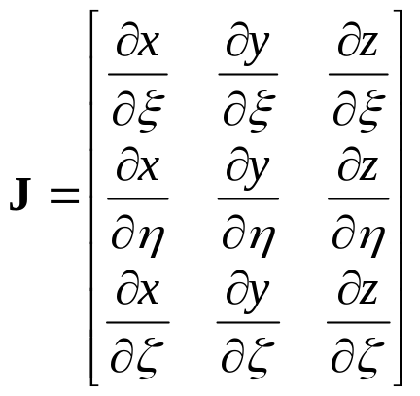
Strain matrix
Chain rule of differentiation
⇒
where

Slide 25
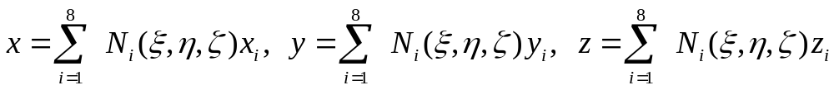


Strain matrix
Since,
or

Slide 26

Strain matrix
Used to replace derivatives w.r.t. x, y, z with derivatives w.r.t. ξ, η, ζ

Slide 27



Element matrices
Gauss integration:

Slide 28


Element matrices
For rectangular hexahedron:

Slide 29

Element matrices
(Cont’d)
where

Slide 30


Element matrices
(Cont’d)
or
where

Slide 31


Element matrices
(Cont’d)
E.g.

Slide 32

Element matrices
(Cont’d)
Note: For x direction only
(Rectangular hexahedron)

Slide 33
Element matrices
5
8
6
f_{sz}
4
For uniformly distributed load:
7
1
0
z
f_{sx}
f_{sy}
2
0
y
3
x

Slide 34

Using tetrahedrons to form hexahedrons
Hexahedrons can be made up of several tetrahedrons
Hexahedron made up of 5 tetrahedrons:

Slide 35

Using tetrahedrons to form hexahedrons
Element matrices can be obtained by assembly of tetrahedron elements
Hexahedron made up of six tetrahedrons:

Slide 36


HIGHER ORDER ELEMENTS
Tetrahedron elements
10 nodes, quadratic:

Slide 37


HIGHER ORDER ELEMENTS
Tetrahedron elements (Cont’d)
20 nodes, cubic:

Slide 38



HIGHER ORDER ELEMENTS
Brick elements
(n_{d}=(n+1)(m+1)(p+1) nodes)
Lagrange type:
where

Slide 39


HIGHER ORDER ELEMENTS
Brick elements (Cont’d)
Serendipity type elements:
20 nodes, tri-quadratic:

Slide 40


HIGHER ORDER ELEMENTS
Brick elements (Cont’d)
32 nodes, tri-cubic:

Slide 41

ELEMENTS WITH CURVED SURFACES

Slide 42

CASE STUDY
Stress and strain analysis of a quantum dot heterostructure
Material
E (Gpa)
υ
GaAs cap layer
GaAs
86.96
0.31
InAs
51.42
0.35
InAs wetting layer
InAs quantum dot
GaAs substrate

Slide 43


CASE STUDY

Slide 44

CASE STUDY
30 nm
30 nm

Slide 45

CASE STUDY

Slide 46

CASE STUDY

