Slide 1
GEARBOx Output Discussion
Dulin Wang

Slide 2
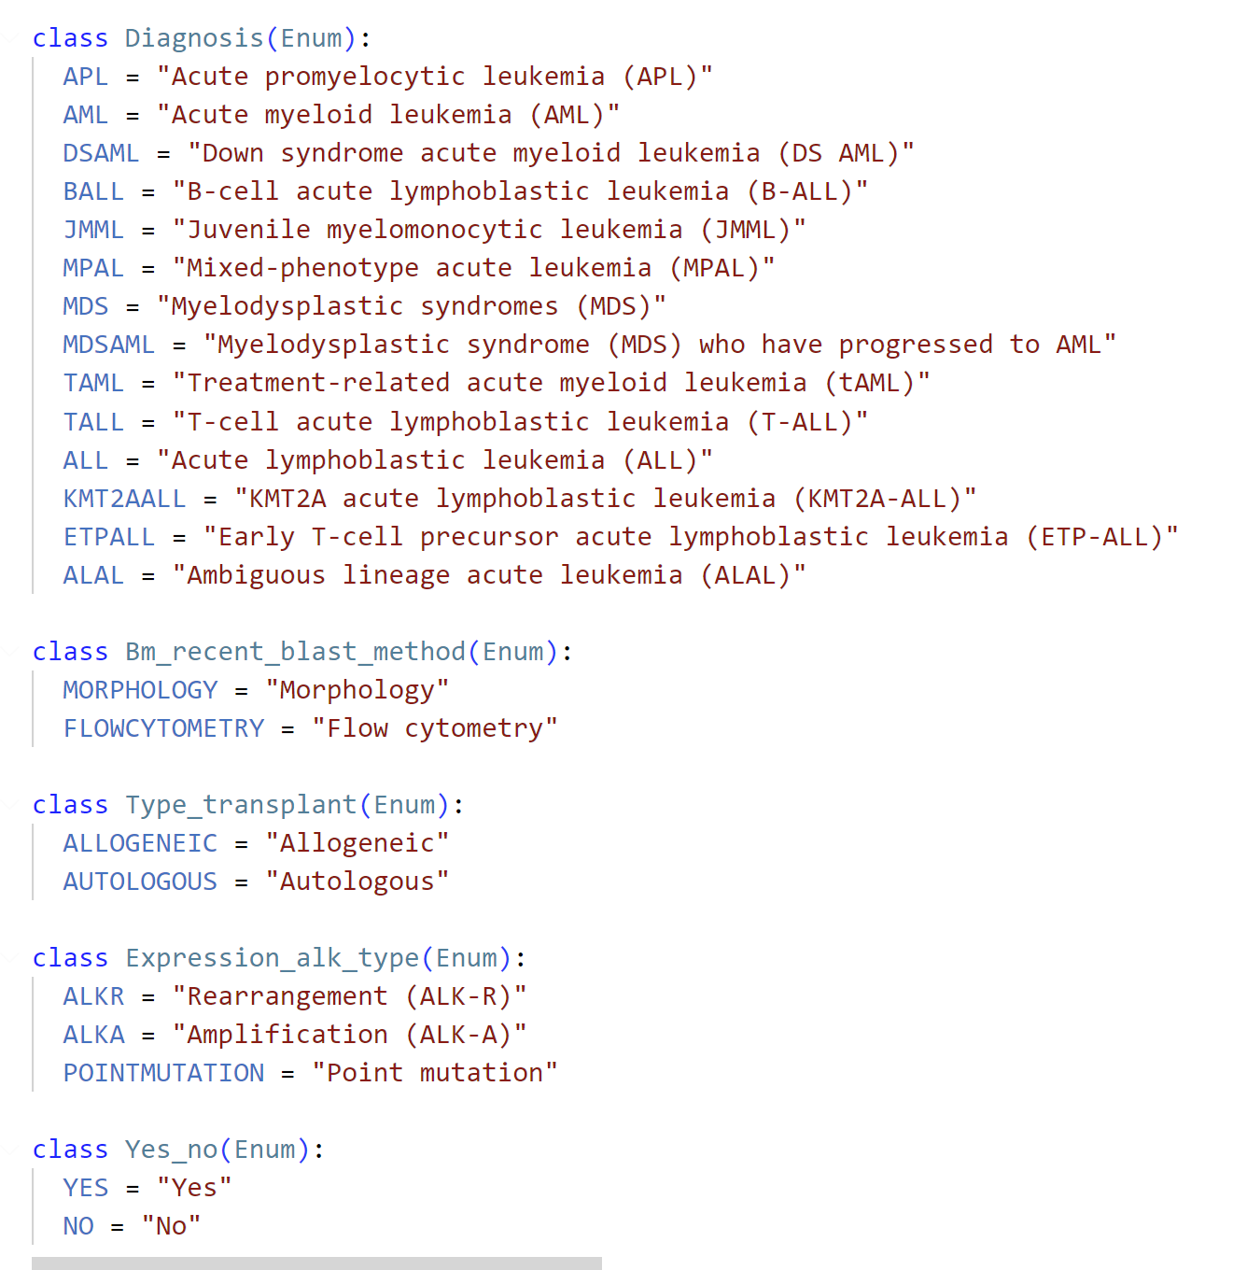
Current NER pipeline
Instructor framework
Convert enumerations to Enum class
Force the GPT output items in the class only

Slide 3
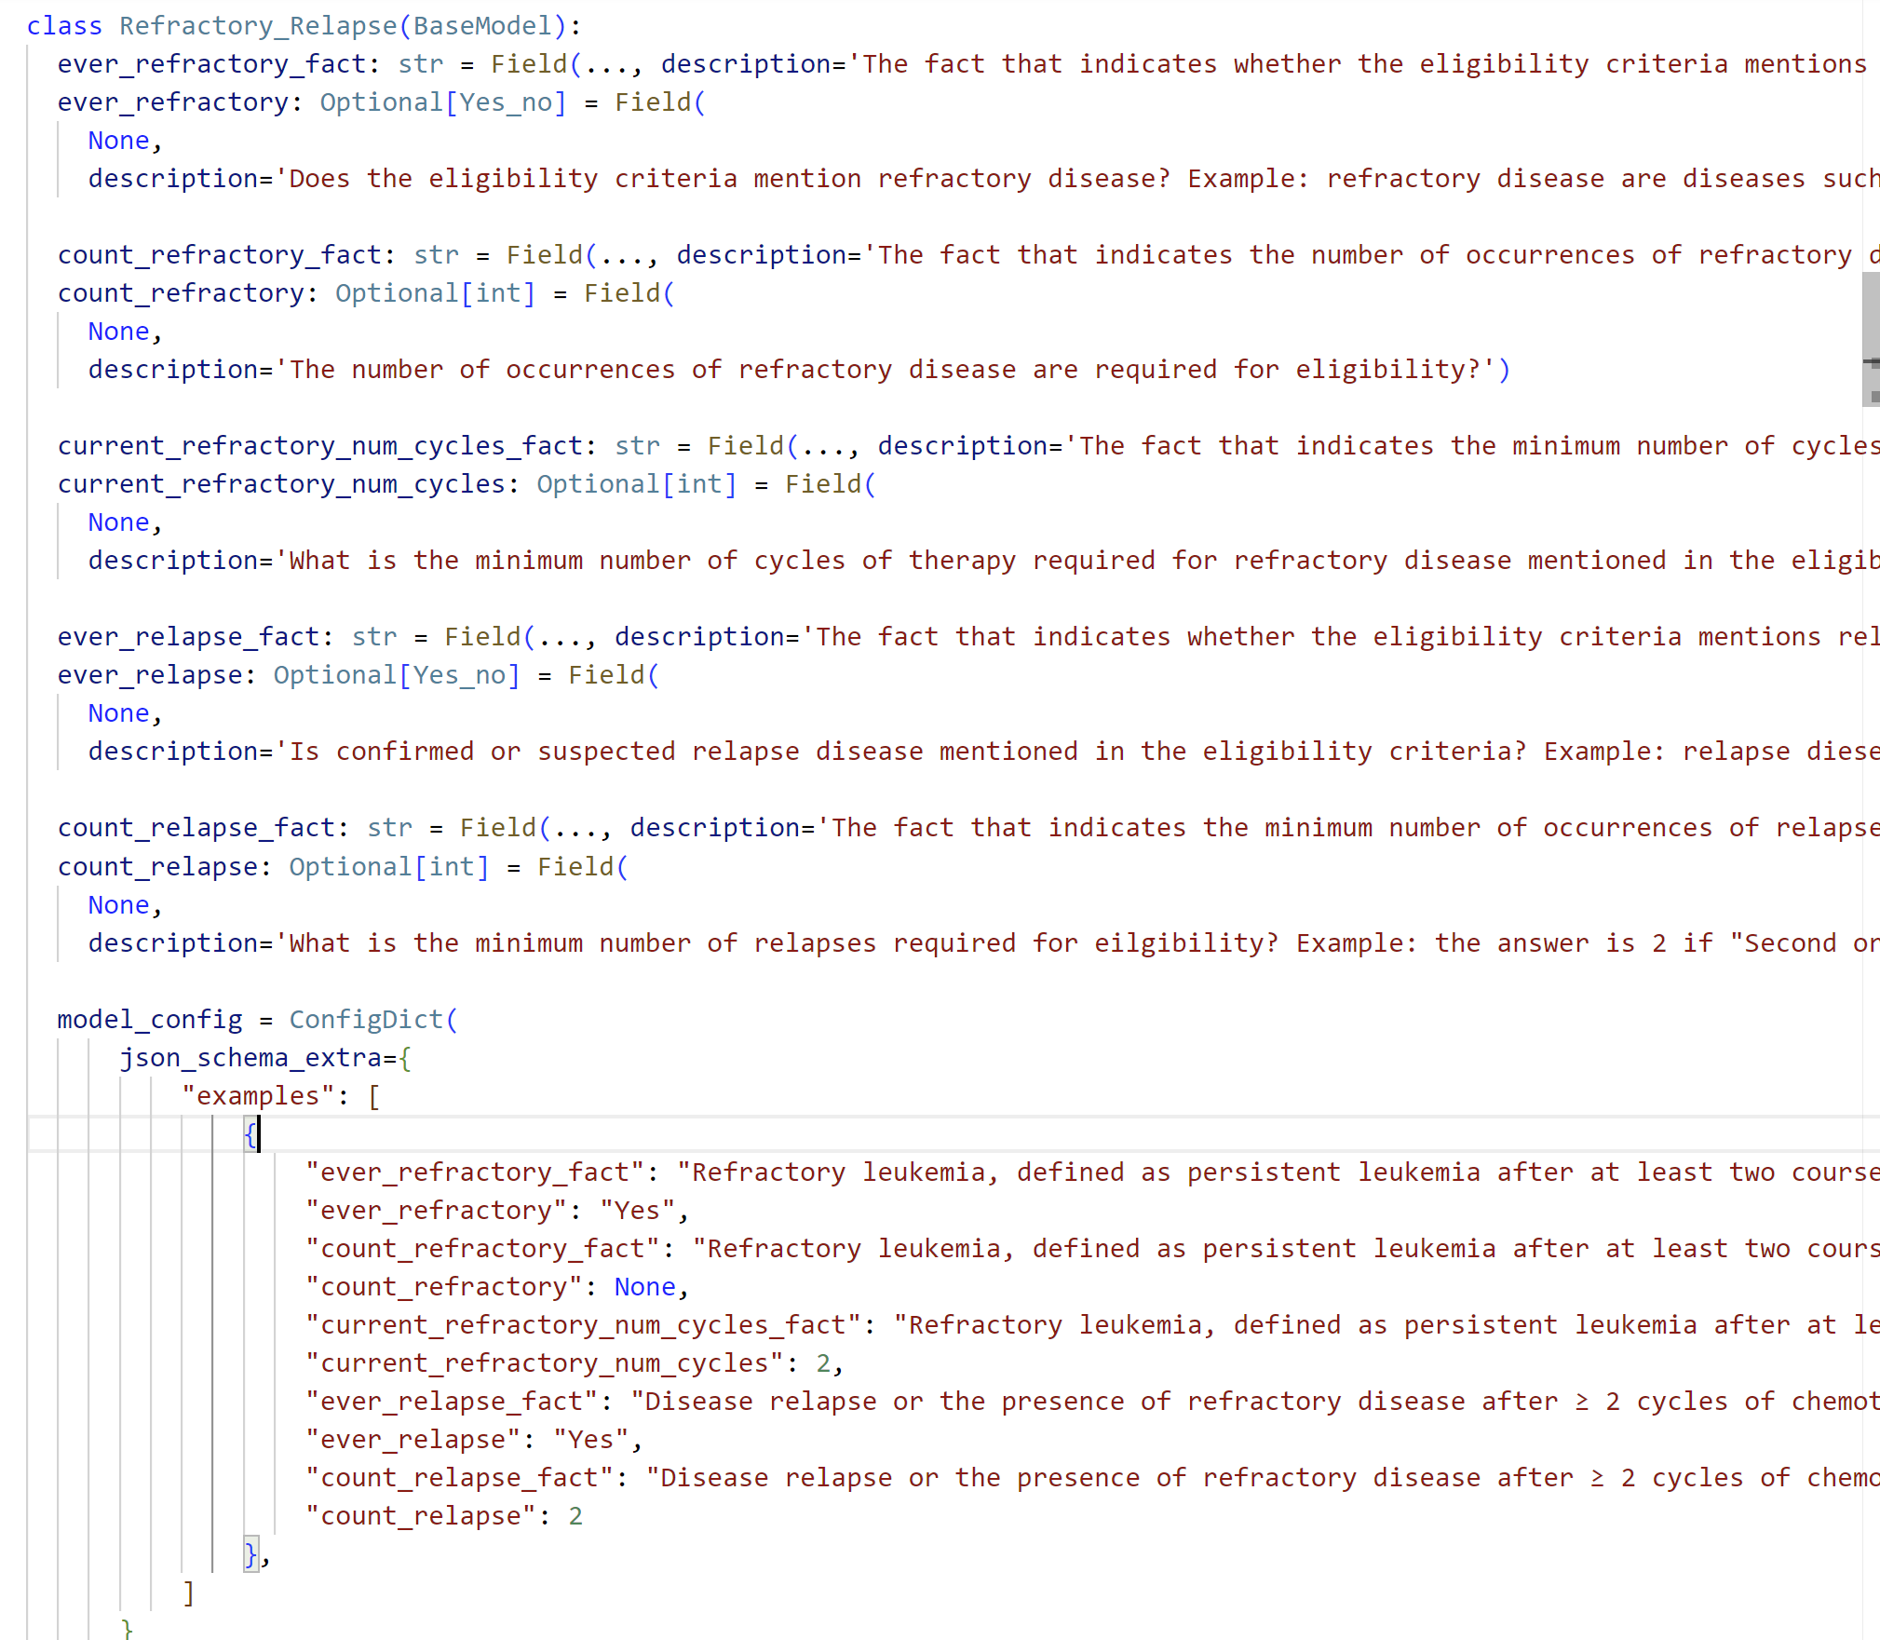
Current NER pipeline
Instructor framework
Convert query to two parts:
  Fact
  Answer
Incorporate examples with correct answer for complex sentences

Slide 4
Consistency in Ontology File
“None” and “Not applicable” should be simplified to “None”, which means can’t find related information from context.

Slide 5
Unclear Issues in Ontology File
The meaning of “No” and “None” is unclear.
  Does the eligibility criteria mention a diagnosis of isolated extramedullary disease (i.e. the absence of bone marrow involvement)?
    If a “diagnosis of isolated extramedullary disease” is mentioned, we expected output of “Yes”,
    If a “diagnosis of isolated extramedullary disease” isn’t mentioned, what is the expected output from model?
    The answer of “No” is reasonable since the context don’t mention it. However, the answer of “None” is also reasonable since we can’t find related information from the context.

Slide 6
Solutions?- #Example1
Goal: avoid mixture output of No and None; handle wash-out variables
Does the eligibility criteria mention a diagnosis of isolated extramedullary disease (i.e. the absence of bone marrow involvement)?
  Pipeline development:
  1. Extract the medical terms - Keyword search
  2. If exist, extract context info - Semantic Search
  Ontology file refining – Need Jooho’s help
  4. Provide medical terms: isolated extramedullary disease, bone marrow involvement
  3. Design query based on GEARBOx application: Does the criteria allows a diagnosis of isolated extramedullary disease (i.e. the absence of bone marrow involvement)?

Slide 7
Solutions?- #Example 2
Does the eligibility criteria mention any prior exposure to myelosuppressive anti-cancer agents?
  1. Extract the medical terms - Keyword search
  2. If exist, extract context info - Semantic Search
  4. Provide medical terms: myelosuppressive anti-cancer agents
  3. Design query based on GEARBOx application: What situations or conditions allow prior exposure to myelosuppressive anti-cancer agents for inclusion in the eligibility criteria?

