Slide 1
Clinical Trial NER
UTHealth X UChicago

Slide 2
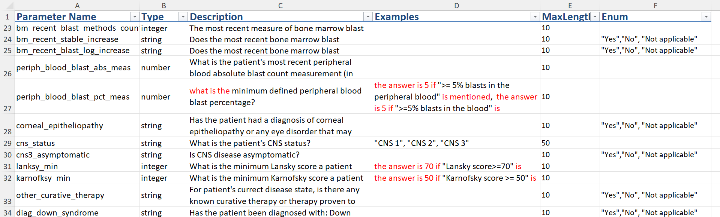
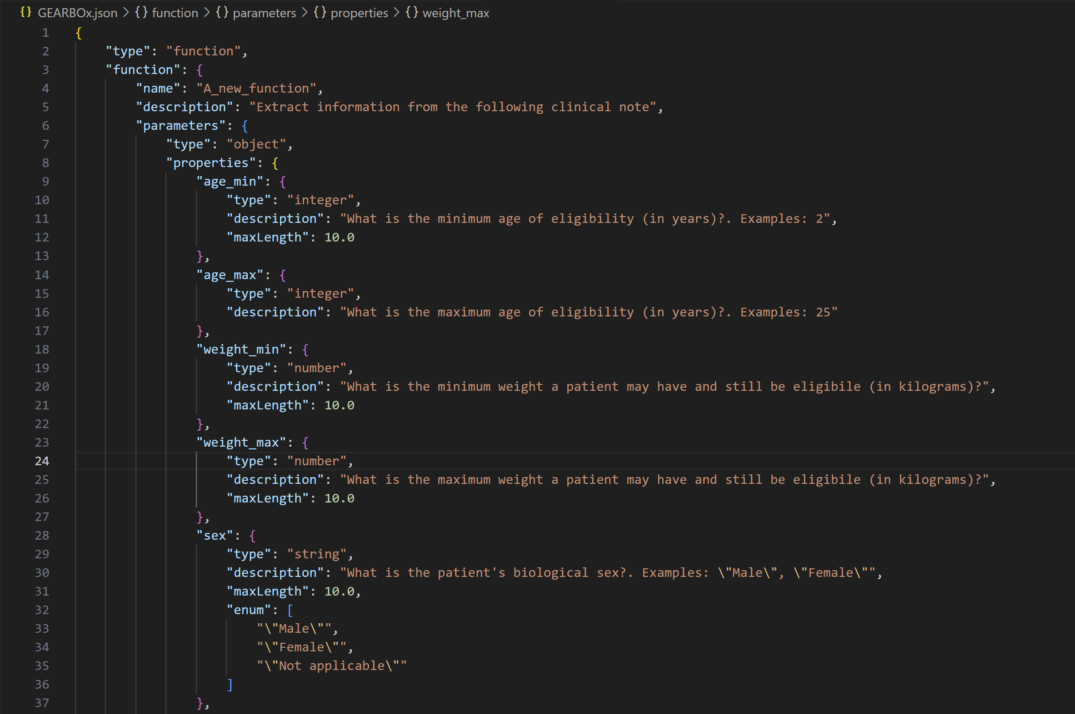
Pipeline
Ontology File
Step1: Excel File to JSON
Tool File: An information extraction function used with API

Slide 3
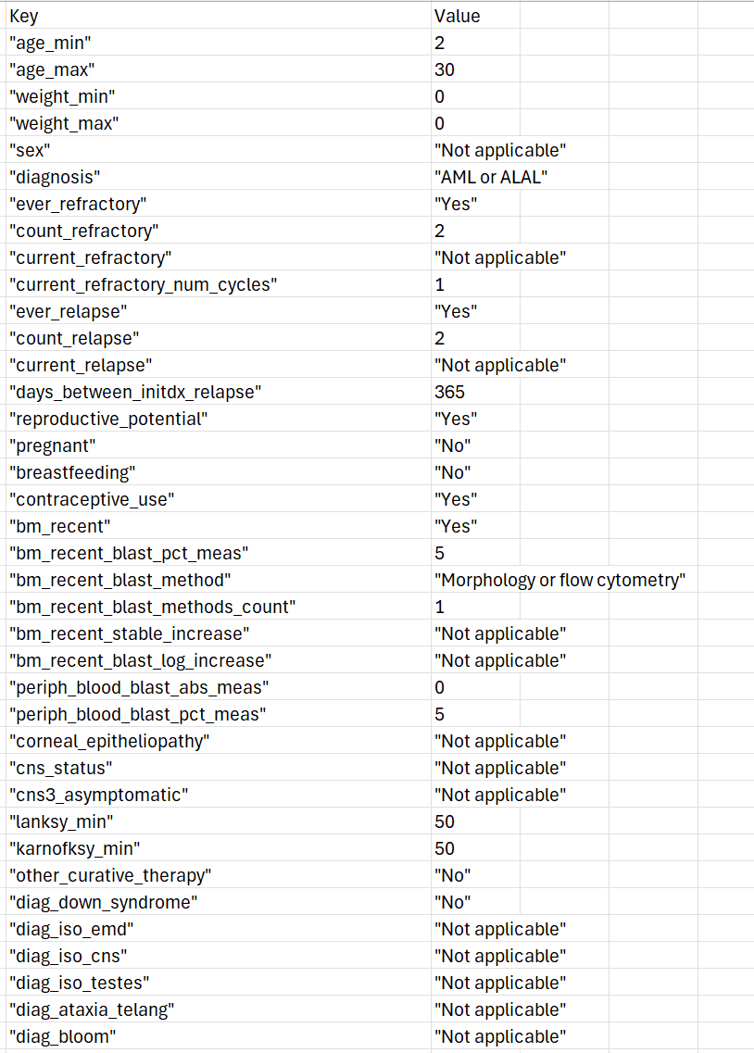
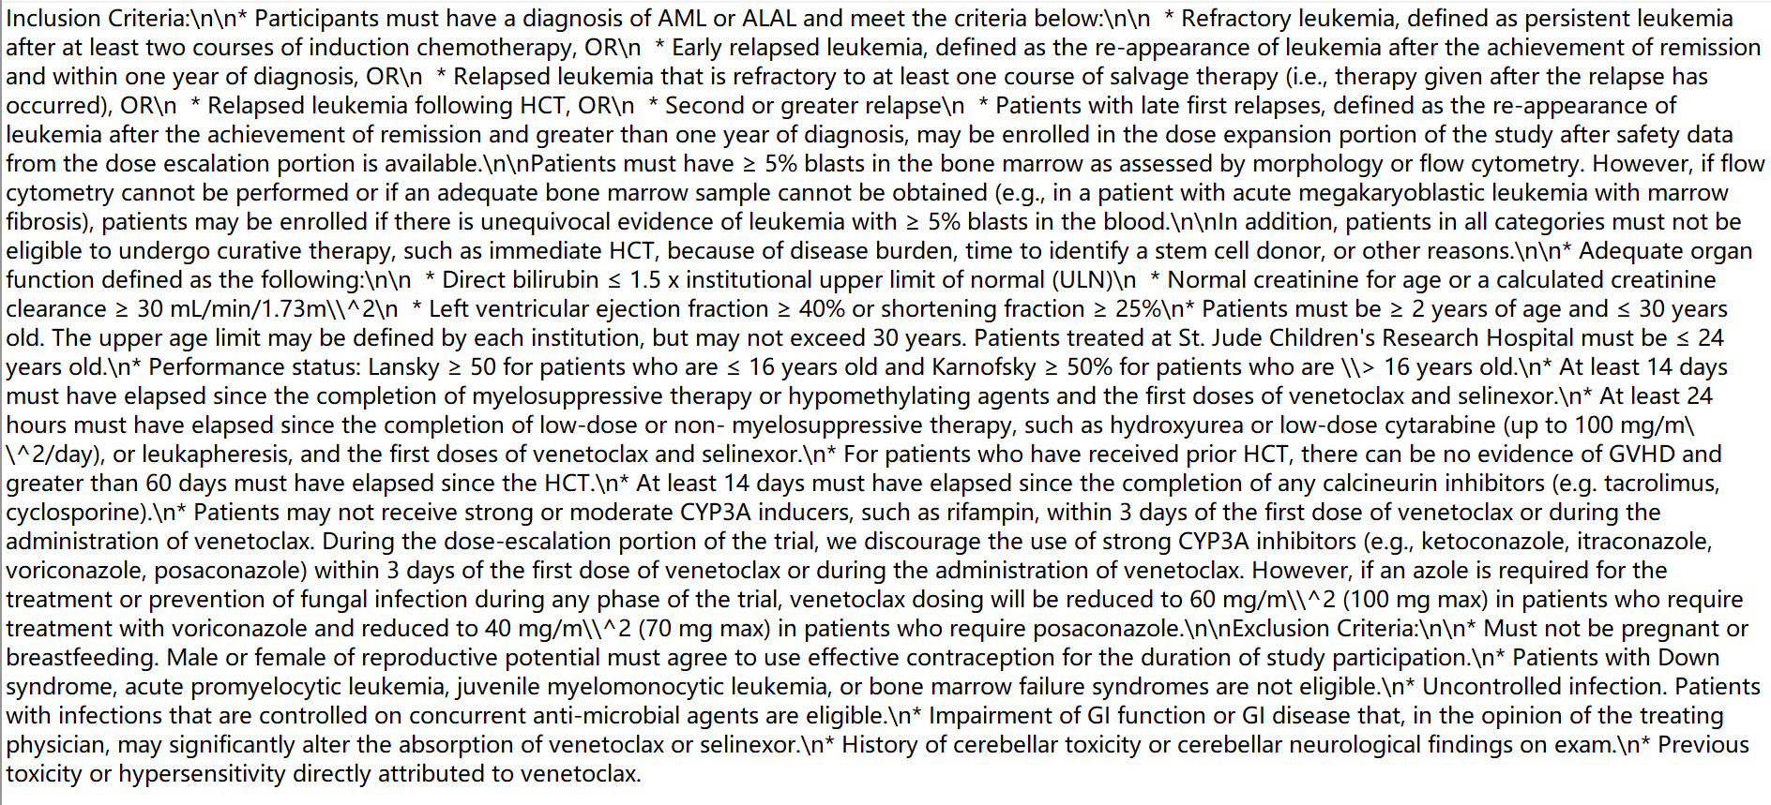

Pipeline
Clinical Trial Note
Step2: Feed clinical notes to LLM and generate output
Get a chat completion
Prompt: Extract information from the following clinical note: <clinical notes>
Call tool

Slide 4
Evaluation
Manually examine the 198 outputs on NCT04898894:
  Misunderstand: 1 case
  Hallucination:
    Make up information: 3 cases
  Minor: model outputs the non-existent number to 0
Misunderstand: ‘History of cerebellar toxicity or cerebellar neurological findings on exam.’ is in exclusion criteria.

Slide 5
Evaluation
Manually examine the 198 outputs on NCT04898894:
  Misunderstand: 1 case
  Hallucination:
    Make up information: 3 cases
  Minor: model outputs the non-existent number to 0
Hallucination: the note dose not mention Fanconi
Hallucination: the note dose not mention days to allogeneic transplant
Hallucination: the note dose not mention CYP3A4

Slide 6
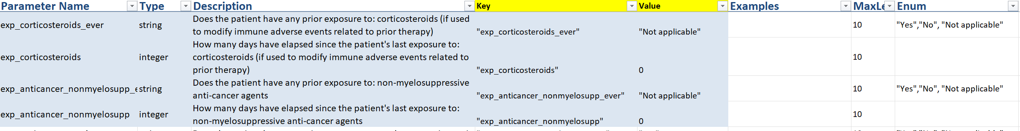
Evaluation
Manually examine the 198 outputs on NCT04898894:
  Misunderstand: 1 case
  Hallucination:
    Make up information: 3 cases
  Minor: model outputs the non-existent number to 0
Two examples here

Slide 7
Next step
How to detect hallucination?
  Use the hallucination evaluation model (e.g., HHEM developed by Vectara)
How to improve the ability to recognize concepts?
  Add fact-checking step
  Improve the description
    E.g., standardize all questions to include patients

