Slide 1
Clinical Trial NER
Output Version 3

Slide 2
Progress
Total of 3 runs of each of the three documents
  Run 1: detailed input description (clinical trial eligibility documents) + hierarchical approach (separate inclusion and exclusion criteria)
  Run 2 and 3: added chain-of-thought prompting
prompt_template = """Extract information from the clinical trial eligibility documents.
Let's think about it step-by-step:
1. Identify sections:
Start by locating the sections within each document which includes sections marked as "inclusion criteria: <inclusion>" and "exclusion criteria: <exclusion>."
2. Understand the questions:
Refer to the GEARBOx.json file to understand the specific questions associated with each parameter. These questions are found in the "description" field.
3. Analyze the text:
For each parameter in the GEARBOx.json file, analyze the content in the identified sections of the clinical notes to find relevant information that logically answers the specific questions from the "description" field.
4. Be consistent:
Ensure that the responses align with the expected format in the examples and enumeration in the GEARBOx.json file when provided."""

Slide 3
Evaluation – First Run
Manually examined the 112 outputs for the three input text files:
  Missing answers for multiple answers
  Hallucination
  Minor:
    Random/wrong answers
Answers with “or”: model only caught first answer, did not catch answers after “or”.

Slide 4
Evaluation – First Run
Manually examined the 112 outputs for the three input text files:
  Missing answers on multiple
  Hallucination
  Minor:
    Random/wrong answers
Hallucination: the note does not mention cyp3a4 but does mention cyp3a
Hallucination: the note does not mention CD123 but mentions CD33

Slide 5
Evaluation – First Run
Manually examined the 112 outputs for the three input text files:
  Missing answers on multiple answers
  Hallucination:
  Minor:
    Random/wrong answers

Slide 6
Evaluation – Second and Third Runs
Problems:
  Hallucination:
    Correct answer in first run but fabricated answers in subsequent runs
  Missing answers not solved
NCT04898894: No mention of ages in exclusion criteria
NCT05188170: No mention of ages in exclusion criteria
Notes:
Logically, if not inclusion criteria, then exclusion criteria, not in both

Slide 7
Evaluation – Second and Third Runs
Problems:
  Hallucination:
    Correct answer in first run but fabricated answers in subsequent runs
  Missing answers not solved
Notes:
Logically, if not inclusion criteria, then exclusion criteria, not in both

Slide 8
Evaluation – Second and Third Runs
Improvements:
  Corrected wrong answers from first run
  Corrected itself
NCT04915612: No mention of CD123 in inclusion criteria
NCT04915612: Other severe, uncontrolled acute or chronic medical or psychiatric condition
NCT05188170: no mention of any bone marrow failure syndrome
Notes:
Logically, if not inclusion criteria, then exclusion criteria, not in both

Slide 9
Evaluation – Second and Third Runs
Improvements:
  Corrected wrong answers from first run
  Corrected itself
Notes:
Logically, if not inclusion criteria, then exclusion criteria, not in both

Slide 10
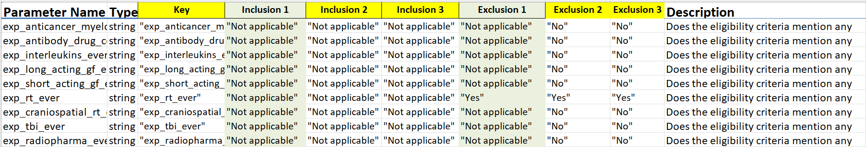
Evaluation – Second and Third Runs
Descriptions starting with: “Does the eligibility criteria mention any prior exposure to …”
  Run 1: “Not applicable”
  Run 2 and 3: “No” for exclusion criteria
  Consistent across three inputs
Notes:
Logically, if not inclusion criteria, then exclusion criteria, not in both

Slide 11
Next Steps
Need to pick up multiple answers
Continue with or without the chain-of-thought prompting?
  With: improve prompt, need multiple runs (not cost efficient)
  Without: improve with function calling
  → When description begins with “Does the eligibility criteria mention ”, set the enumeration to only “yes” and “no”
Notes:
Logically, if not inclusion criteria, then exclusion criteria, not in both

Slide 12
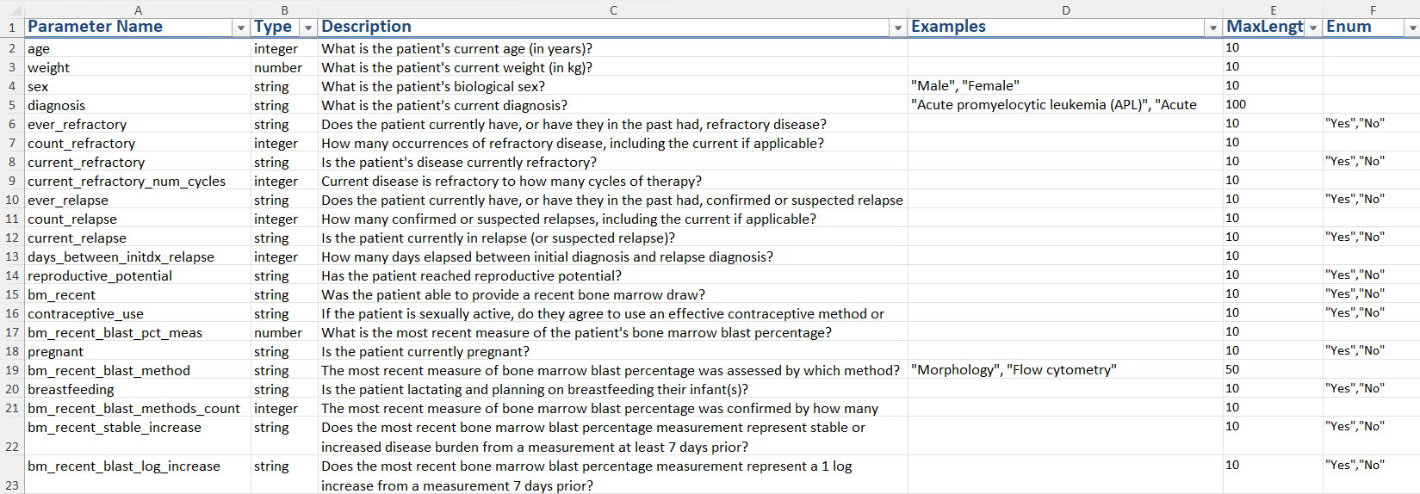
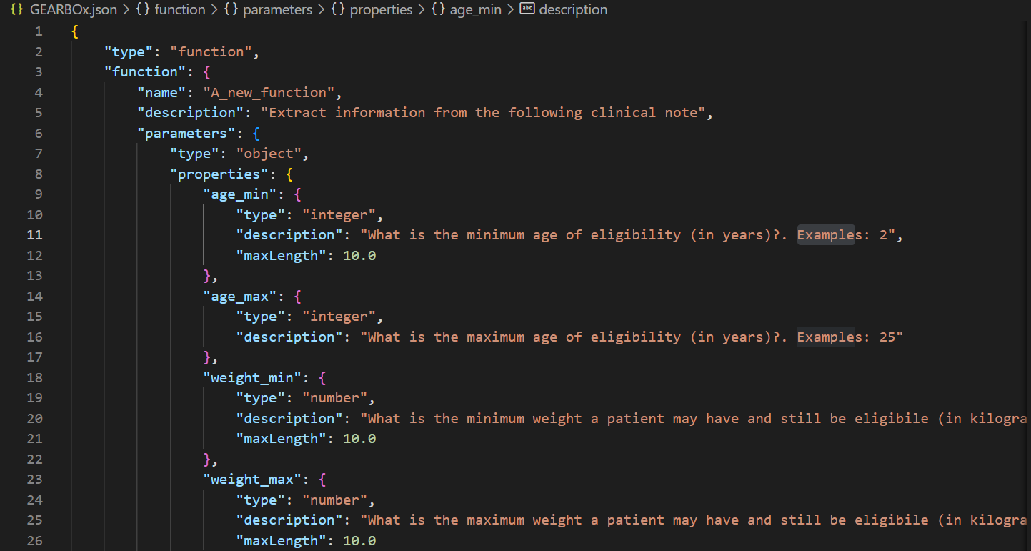
Next Steps
Ontology File
Excel File to JSON
Tool File: An information extraction function used with API

Slide 13
Next Steps
How to combine the inclusion and exclusion criteria?
  To consider: inclusion “not applicable” and exclusion “yes”
  Inclusion “yes” and exclusion “not applicable”
Notes:
Logically, if not inclusion criteria, then exclusion criteria, not in both

