Slide 1
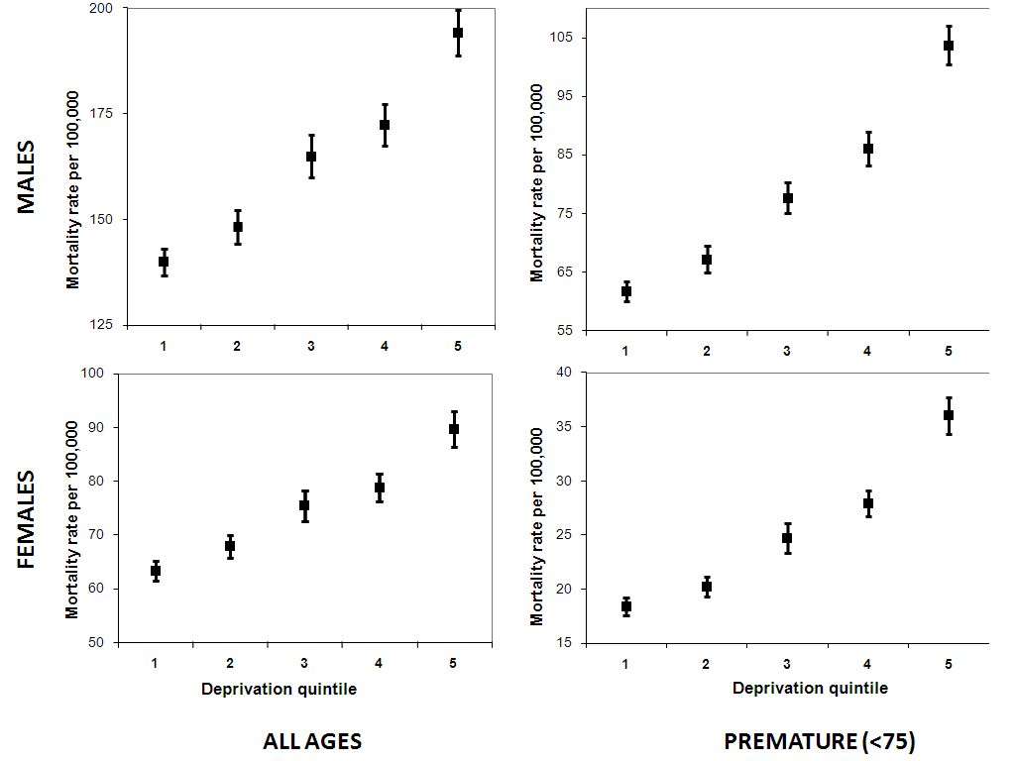



Relative deprivation between neighbouring wards is predictive of coronary heart disease mortality after adjustment for absolute deprivation of wards
Thomas Keegan², Steven Allender^{1,3}, Peter Scarborough¹, Mike Rayner¹
¹ Division of Public Health and Primary Health Care, University of Oxford, Oxford, United Kingdom OX3 7LF
² Lancaster University, Lancaster LA1 4YD ³ WHO Collaborating Centre for Obesity Prevention, Deakin University, Australia
Table 1 Descriptive statistics for CHD mortality and deprivation for English local authority areas 2001-2006 (local authorities (LAs) n = 354, wards n = 7,927)
Introduction To assess whether deprivation inequality at small area level in England is associated with coronary heart disease (CHD) mortality rates, and assess whether this provides evidence of an association between area-level and individual-level risk.
Table 2 Regression models for CHD mortality rate and absolute deprivation, and CHD mortality rate and relative deprivation (measured as difference between deprivation and mean deprivation of neighbouring wards), and of both combined (wards, n = 7,927)
Methods Mortality rates for all wards in England were calculated using all CHD deaths 2001 - 2006. Ward-level deprivation was measured using the Carstairs index. Deprivation inequality within local authorities was measured by the interquartile range of deprivation for wards within the local authority. Relative deprivation for wards was measured as the modulus of the difference between deprivation for the ward and average deprivation for all neighbouring wards.
‘Absolute deprivation’ refers to ward-level deprivation; ‘Relative deprivation inequality’ refers to modulus of the difference between deprivation in the ward and the average deprivation in all neighbouring wards; MODEL A and MODEL B are univariate models, MODEL C is a multivariate model.
Figure 1 CHD mortality rate (95% CIs) for men and women by LA deprivation quartile – England 2001-2006 (NB Scales differ between charts within this figure)
Results
Deprivation inequality within local authorities was positively associated with CHD mortality rates after adjustment for absolute deprivation (p < 0.001 for all models).
Relative deprivation for wards was positively associated with CHD mortality rates after adjustment for absolute deprivation (p < 0.001 for all models).
Sub-group analyses showed that relative deprivation was independently associated with CHD mortality rates in both affluent and deprived wards.
Conclusions
Rich wards surrounded by poor areas have higher CHD mortality rates than rich wards surrounded by rich areas.
Poor wards surrounded by rich areas have worse CHD mortality rates than poor wards surrounded by poor areas.
Local deprivation inequality has a similar adverse impact on both rich and poor areas, supporting the hypothesis that income inequality of an area has an impact on individual-level health outcomes
Contact t.keegan@lancs.ac.uk 01524 59534
Acknowledgments: Peter Scarborough, Steven Allender, Mike Rayner, Department of Public Health, University of Oxford OX3 7LF

