Slide 1
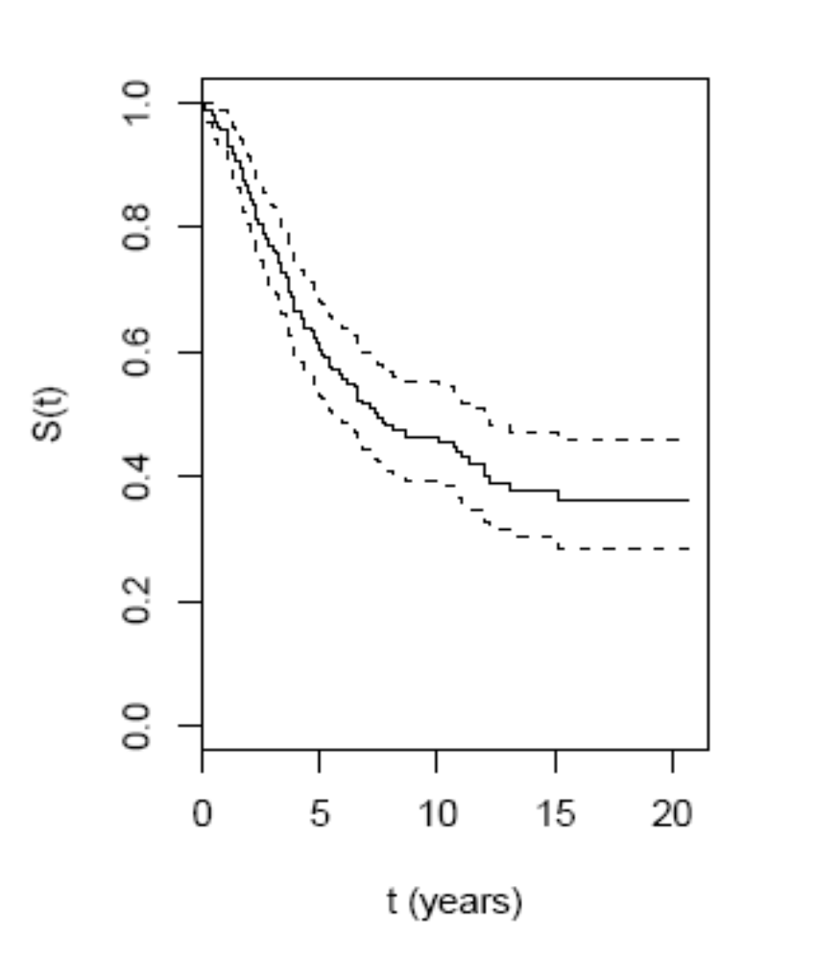
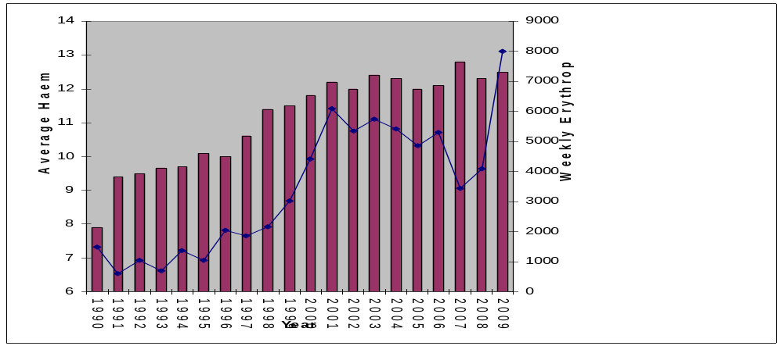
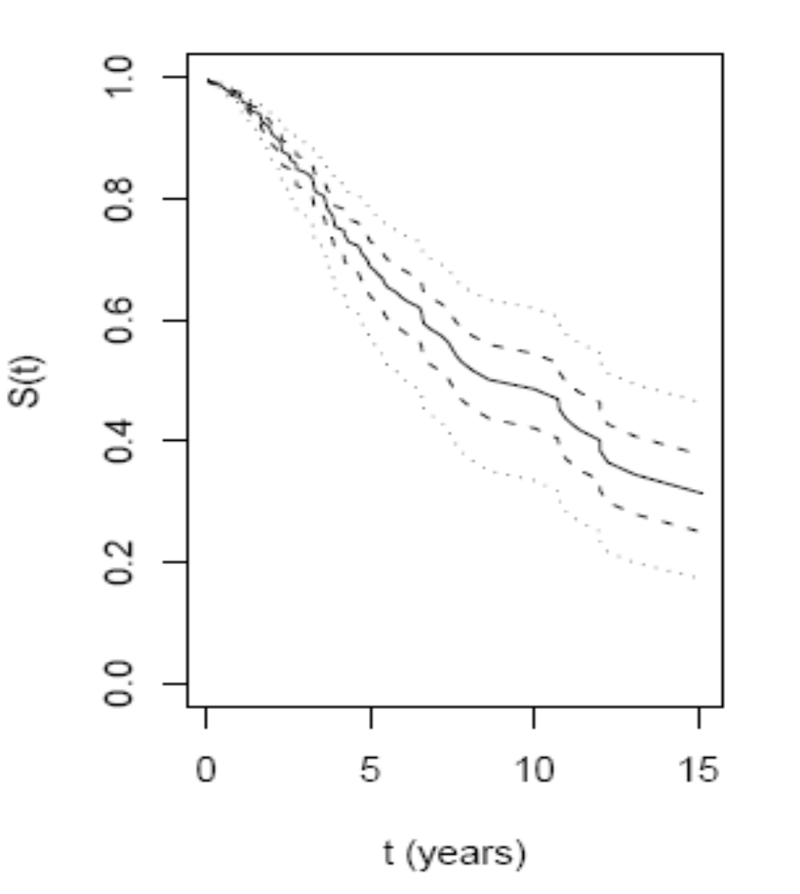
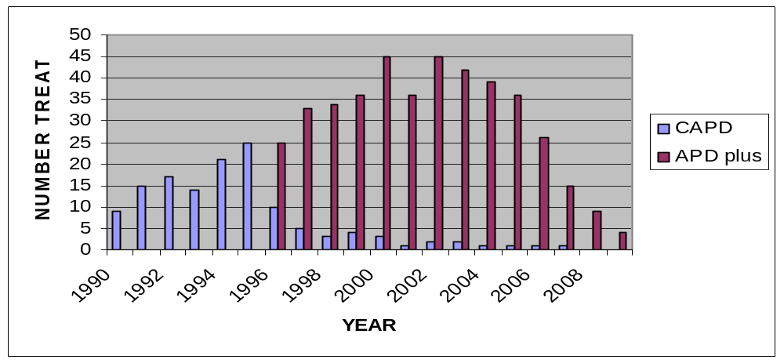
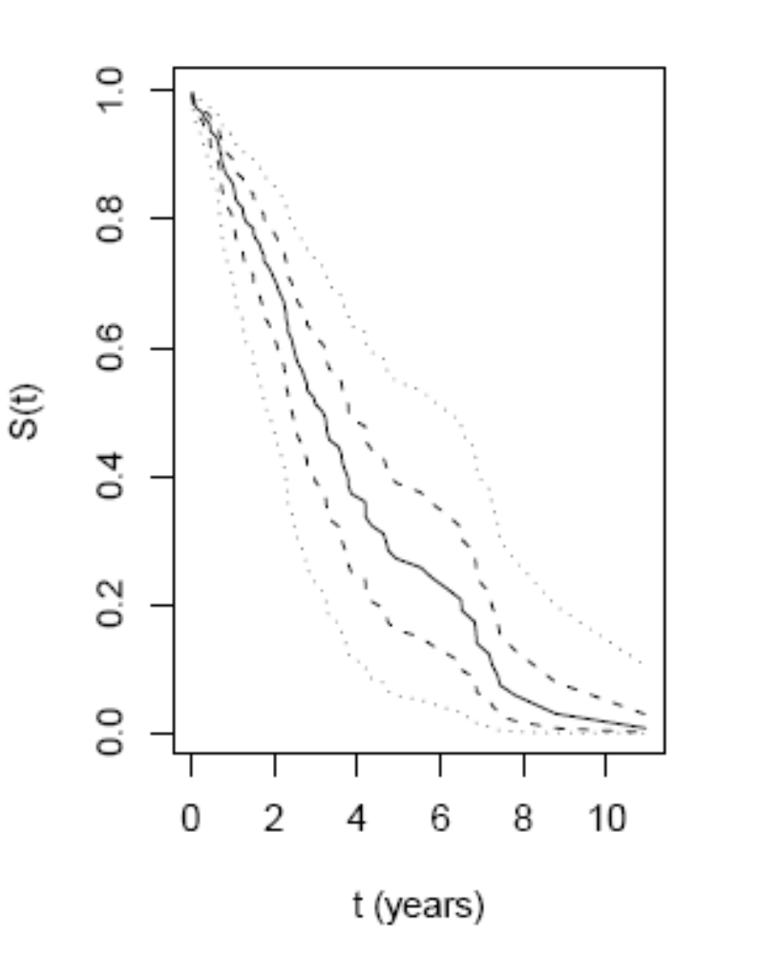
SURVIVAL AND SERIOUS LONG TERM PERITONEAL COMPLICATIONS IN PERITONEAL DIALYSIS PATIENTS
A TWENTY YEAR FOLLOW UP STUDY
Peter John Drew¹, Gemma Matthewman¹ and Peter Diggle²
Renal Unit, Maelor Hospital, Wrexham, UK¹ and Department of Medicine, University of Lancaster, UK²
Introduction
The Wrexham Renal Unit was established in 1987 and serves a population of about 300,000. A new haemodialysis facility was opened in 1989 which had sufficient capacity to allow new patients with end-stage renal failure (ESRF) a choice between unit haemodialysis (HD) and peritoneal dialysis (PD). From 1989 until December 1995, those patients who chose PD were treated with continuous ambulatory peritoneal dialysis (CAPD), but after January 1996 there was unrestricted access to automated peritoneal dialysis (APD), with use of icodextrin for the long day time dwells (APD plus). These service conditions were probably unique within the UK National Health Service at the time.
Following the intoduction of APD plus, nearly all new PD patients chose that option in preference to CAPD, and some already established on CAPD requested a transfer to the new treatment system. Our clinical impression over the next few years was that patient and technique survival improved with the introduction of APD. However, more detailed analysis, presented at the WCN in 2005, showed that there were confounding changes in practice patterns during this period, with greater use of erythropoietin (EPO), and maintenance of higher levels of haemoglobin on treatment which could have contributed to the improved technique survival. These changes in practice pattern are summarised in Figures 1and 2.
Statistical Methods
Two time-to-event outcomes have been defined: time to death and time to technique failure, defined as conversion to haemodialysis or death on treatment. Both time-to-event outcomes were right-censored at date of transplantation (59 patients), date of recovery of independent renal function (4 patients), or on 2nd August 2010 (the fifth anniversary of the day when the last patient was enrolled) for the one patient still on initial PD treatment.
Time-to-event outcomes have been summarised graphically with Kaplan-Meier estimates of the survival curves.
Formal inference concerning potential risk factors for each of the time-to-event outcomes has been conducted by fitting a Cox proportional hazards model, including terms for: weight; age; gender; pre-dialysis eGFR, albumin and haemoglobin; use of statin drugs; history of immunosuppressive treatment, acute presentation (within 1 month of needing dialysis), smoking history (within one year of dialysis); presence of diabetes; history of hypertension and ischaemic heart disease, and date of starting treatment. The analyses were then refined using a reduced model focussing on those factors that achieved significance, or near significance, at the 5% level.
The proportion of time spent in hospital whilst on treatment was analysed using a quasi-Poisson log-linear model.
Significance of individual terms in each fitted model was assessed by calculating p-values based on standard normal scores, with the convention that a p-value less than 0.05 is statistically significant.
Results of the Survival Analysis
Patient Survival
On 2/08/2010, 67 patients were still alive. Fifty five had a renal transplant, one was on the original APD treatment, two had returned to APD after several years with a transplant, and 9 were on unit HD, five after transplant failure. The unadjusted estimated patient survival was 65% at 5 years, 45% at 10 years and 35% at 20 years.
Proportional hazards analysis identified the age at start of treatment (p<0.00001), presence of diabetic nephropathy (p=0.00436), history of smoking (p=0.00390 and earlier year of start (p=0.03946) as being significant associations.
The refined analysis using the reduced model and only these four factors gave the following results: Age at start (p<0.00001), Diabetes ((p<0.00036), Smoking (p<).00212) but year of start (centred on its central value) (p<0.0514).
Figure 3 (above): Kaplan-Meier estimate of survival function for time-to-death. Dashed lines indicate 95% confidence intervals.
Encapsulating peritoneal Sclerosis
Thirteen patients in this cohort have developed clinical symptoms suggesting EPS, with the diagnosis confirmed by surgery in 7 cases and post mortem in one case, and strongly supported by CT findings in another three cases. Two other cases were strongly suspected on clinical grounds but either declined surgery or were unfit for intervention; both received terminal care. Details are summarised below.
1. Male. Started CAPD in 1993, aged 57. Diabetic Nephropathy. Failed after 9 months through loss of ultrafiltration. Never had peritonitis. Spent 11 months on haemodialysis with recurrent drainage of exudative ascites and progressive malnutrition. Post mortem showed EPS.
2. Male. Started CAPD in 1993, aged 57. Membranous nephropathy. Stopped PD after 33 months when umbilical hernia repaired. Never had peritonitis. Preferred HD but after 14 months developed exudative ascites, which required frequent drainage until 2001, when problem eased spontaneously. CT scan highly suggestive of EPS but cardiac condition and co-morbidity argued against aggressive approach. Remains well on HD in 2011!
3. Female. Started APD in 1996, aged 45. Polycystic disease. Six episodes of peritonitis in 89 months of treatment which was stopped because of ultrafiltration failure. Developed severe intra-abdominal sepsis two months after stopping PD. Major surgery one month later showed extensive cocooning of bowel. Ended up with Hartmann’s procedure and 7 days in ITU. Alive on HD.
4.Female. Started APD in 1996, aged 36. Rheumatoid with severe disability and AA Amyloid. Three episodes of peritonitis in 78 months before converted to HD because of under-nutrition. After PD stopped , developed pseudo-obstruction and mass in abdomen. Strong suspicion of EPS but in the end treatment withdrawn with no confirmed diagnosis. No PM.
5. Female. Started APD in 1997, aged 32. Chronic GN. Six episodes of peritonitis in 131 months of treatment, the last of which was unremitting and led to catheter removal. Post-op failed to settle and two laparotomies showed extensive EPS with calcification and tethered mesentery. Inoperable high perforation after first surgery. Terminal care.
6. Male. Started APD in 1998, aged 40. Late presentation with advanced renal failure, small kidneys and modest proteinuria. No peritonitis before PD stopped after 32 months because of under-dialysis. Two months later, presented with intestinal obstruction. Laparotomy showed EPS with bowel obstructed in cocoon. Alive with transplant.
7. Male. Started APD in 1998, aged 54. Diabetic Nephropathy. Three episodes of peritonitis before PD abandoned because of undernutrition after 25 months treatment. Seven months of intermittent subacute intestinal obstruction culminating in laparotomy and diagnosis of EPS. Operation successful and seemed to be recovering well when he had a cardiac arrest on day 3.
8. Male. Started APD in 1998, aged 54. Diabetic Nephropathy. Five episodes of peritonitis in the next 80 months before PD stopped because of underdialysis. Over the next 3 years, troubled by recurrent exudative ascites and poor appetite, culminating in laparotomy and major surgery for EPS in 2010. Alive on HD.
9. Female. Started APD in 1999, aged 58. Analgesic nephropathy. PD abandoned after 30 months when first peritonitis failed to settle. Persistent GI symptoms, loss of appetite and malnutrition. CT scan suggestive of EPS. Peritoneum grossly thickened, with loculated fluid, when attempt made to replace Tenckhoff catheter. Awaiting laparoscopy when died of ruptured aortic aneurysm. No PM.
10. Female. Started APD in 1999, aged 62. AL Amyloid. Five episodes of peritonitis, the last of which was unremitting and led to removal of the catheter after 83 months treatment. Transplant in 2007 and soon after developed recurrent exudative ascites and loss of appetite. Laparoscopy in April 2008 confirmed EPS. Started Tamoxifen, and immune suppression changed to Rapamycin. Slowly settled. Alive with transplant.
11. Female. Started APD in 2000,aged 57. Polycystic Disease. Four episodes of peritonitis in next 87 months, the last of which was fungal and led to tube removal. Recurrent exudative ascites on HD. CT scan suggested EPS. Cerebrovascular disease led to death before surgery.
12. Male. Started APD in 2000, aged 76. Stone disease. Four episodes of peritonitis in the next 82 months, the last of which failed to settle. Required laparotomy which showed diagnosis of EPS. Initial ITU care and then treatment withdrawal after myocardial infarction. Aged 83 years.
13. Male. Started APD in 2002, aged 55 . Diabetic Nephropathy. First peritonitis led to catheter removal after 45 months of treatment. Then developed intermittent obstruction and ascites over a six week period in hospital. High clinical suspicion of EPS and listed twice for laparotomy, but declined. Major co-morbidities led to a request for terminal care. No PM.
Figure 4 (right ): fitted survival curves at mean (solid line), upper and lower quartiles (dashed lines), and oldest (top) and earliest (bottom) and latest start dates (dotted lines).
Figure 1:Average haemoglobins of patients in this study, by year, with average doses of erythropoietin in use for each year. There was a marked increase in EPO use and average haemoglobin in the mid 1990s..
Treatment Survival
Ninety seven patients failed on treatment, with 31 dying whilst still receiving PD and a further 16 dying within one month of stopping. Sepsis related to peritonitis was a major contributing factor in 12 deaths. Time spent on the initial PD treatment at home ranged from just 2 days to nearly 11 years.
Proportional hazards analysis showed that only the date of starting treatment had a significant association with technique failure (earlier=worse, p=0.0354). However, serum albumin at the start of treatment (p=0.0569), a history of cigarette smoking (p=0.0549) and a history of ischaemic heart disease (p= 0.0922) were almost significant.
The refined analysis, using the reduced model and just these 4 factors found all except smoking significant , so a final model with just the three significant factors was used and gave the following results: date of start (p<0.0006); pre-dialysis serum albumin (p<0.02) and history of ischaemic heart disease (p<0.03)
Figure 2: The numbers of patients in this study treated with CAPD and APD plus, by year. There was a dramatic decrease in CAPD treatment after APD was introduced in 1996
With an established data base, we have maintained 100% follow up of those patients who chose to start chronic treatment for ESRF with PD, and have made observations about factors affecting technique and patient survival over a 20-year period. We have established the cause of death where this has occurred, in all cases, and identified a number of deaths related to peritonitis, as well as a high incidence of encapsulating peritoneal sclerosis (EPS), often diagnosed sometime after the patient has left the PD programme. This has been a prominent cause of major morbidity as well as mortality.
Figure 4: Kaplan-Meier estimates of the survival function for time to failure. The solid line is the mean, the dashed lines the earliest (bottom) and latest quartiles, and dotted lines the earliest (bottom) and latest starts.
Patients and Clinical Methods
We have looked at technique and patient survival in 161 consecutive new ESRF patients (aged 17-85 yrs.) who have chosen PD as their preferred first chronic treatment option. All were established on PD within 90 days of their very first dialysis which may have been emergency haemodialysis, and started treatment between 29/12/1989 and 2/08/2005.
PD catheters were inserted by a mini-laparotomy technique, under general anaesthesia, by one of two operators, and always had a downward draining exit site. Intra-peritoneal vancomycin was given at the time of insertion. CAPD patients used either Baxter “Solo” or Fresenius “Andy” systems and most commonly made 4 two litre exchanges per day. APD patients used Baxter “Home Choice” systems and Baxter fluids, instilling an average of 10.7 ± 1.7 litres of fluid overnight and 1.3 ± 0.7 litres Icodextrin by day.
For the purposes of this study we have divided the patients into quartiles, based on date of starting treatment: Q1: (29/12/1989-9/06/1994); Q2: (16/06/1994-21/07/1997); Q3: (4/08/1997-29/01/2001) and Q4: (16/04/2001-2/08/2005). Comparative details of the four groups are given in the Table below.
Twenty two patients survived on the initial PD treatment (one with CAPD) for more than five years, but had a high incidence of EPS (see table below)
Group | 5-year survivors | EPS (confirmed) | Catastrophic Peritonitis (with EPS)
Q1 (n = 40) | 1 | 2 (1 confirmed) | 0
Q2 (n = 40) | 7 | 3 (2 confirmed) | 6 (1 with EPS)
Q3 (n = 40) | 7 | 7 (5 confirmed) | 4 (1 with EPS)
Q4 (n = 41) | 7 | 1 (0 confirmed) | 2 (0 with EPS)
5-year survivors | 22 | 7(5 confirmed) | 4 (2 with EPS)
Time on treatment spent in hospital
Thirty eight patients spent no days in hospital whilst they were receiving PD treatment. At the other extreme, one patient spent 206 days in hospital during a career on PD of just over six and a half years. On average, patients spent about 7 days per year in hospital.
Variable | Q 1 | Q 2 | Q 3 | Q 4
Number of patients | 40 | 40 | 40 | 41
Average age (years) (with range) | 47.7 (18-80) | 53.2 (25-85) | 53.1 (23-79) | 56.2 (20-77)
Males | 24 | 20 | 25 | 29
Mean Start haemoglobin (g/dl) | 9.0 | 9.6 | 10.6 | 11.5
Mean start serum albumin (g/l) | 37.8 | 37.6 | 36.9 | 35.5
Mean start eGFR, (ml/min, Cockcroft &Gault) | 5.5 | 6.6 | 7.7 | 7.5
Acute presentation | 8 | 4 | 6 | 3
Statin treatment at start of PD | 0 | 2 | 11 | 18
Smoker (within 1 year of start) | 15 | 10 | 17 | 13
Diabetic nephropathy | 7 | 13 | 12 | 16
Hypertension (>140/90 at start or on treatment) | 28 | 24 | 29 | 39
Ischaemic heart disease (Previous MI or angiogram evidence ) | 9 | 6 | 11 | 7
Immune suppressed at start | 6 | 3 | 2 | 3
A logistic regression model identified the following factors had a significant association with the proportion of treatment time spent in hospital: Pre-dialysis haemoglobin (p=0.00647); History of hypertension (p=0.00803); history of ischaemic heart disease (p=0.02566) and age at start of treatment (p=0.02473)
Conclusions
In our institution, PD technique and overall patient survival, both adjusted for pre-existing risk factors, have improved over the period 1990-2010 but long term success has come with the increased risk of death related to peritonitis and morbidity associated with Encapsulating peritoneal Sclerosis, which affected nearly one third of those who spent more than five years on PD treatment.
Catastrophic Peritonitis
Sixty seven patients completed treatment without ever getting peritonitis. However, three patients presented in extremis with peritonitis (2 x pseudomonas and one Staph. Aureus) and either had cardiac arrest in the emergency department or died in intensive care on the day of admission. One patient perforated a sigmoid diverticulum and died of septic shock two days after discontinunig PD with only 2 days spent at home and 19 days on PD. Another 8 patients had peritonitis that did not respond to antibiotics and required catheter removal but died during the same admission and within one month of developing the peritonitis.
World Congress of Nephrology, Vancouver, April 2011

