Slide 1

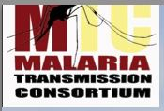


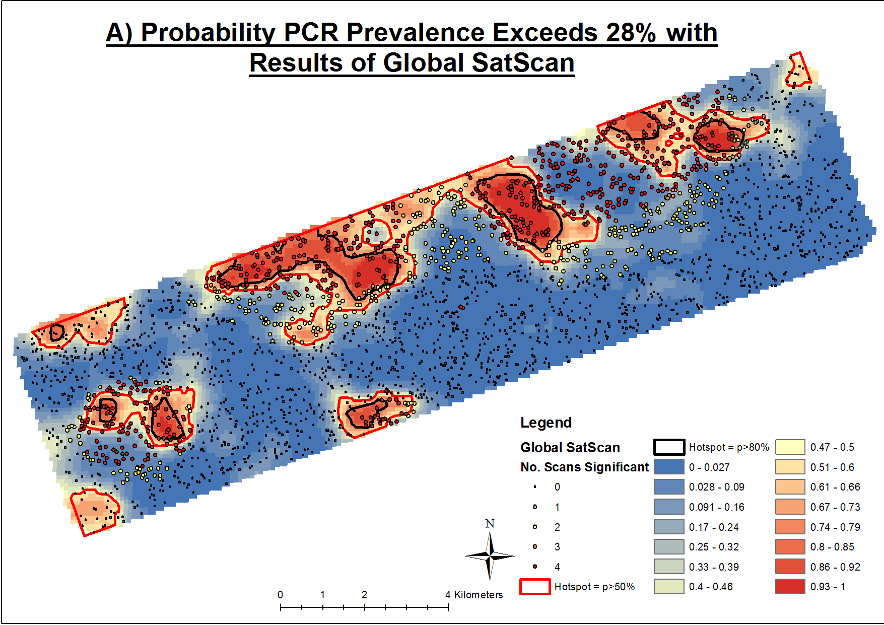
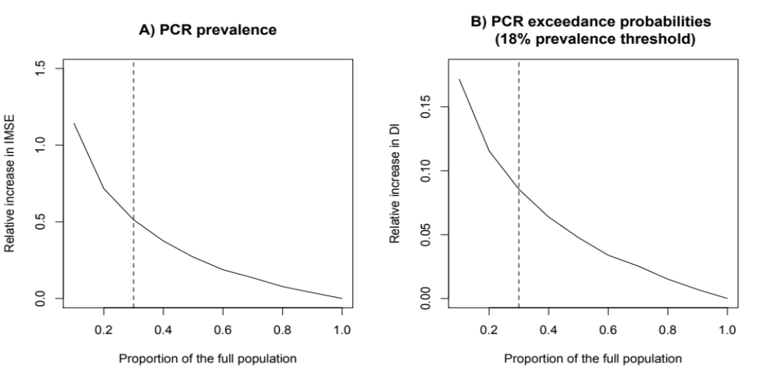
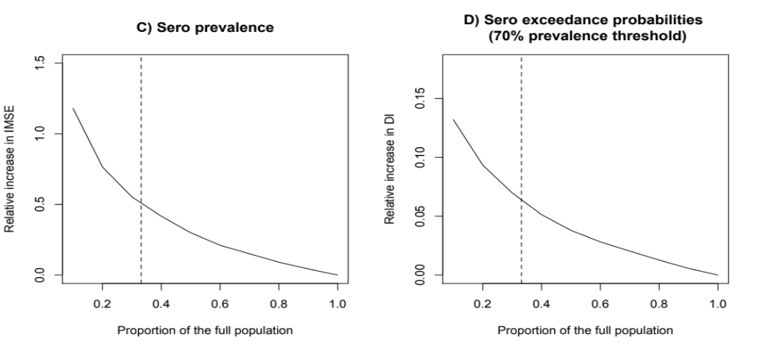
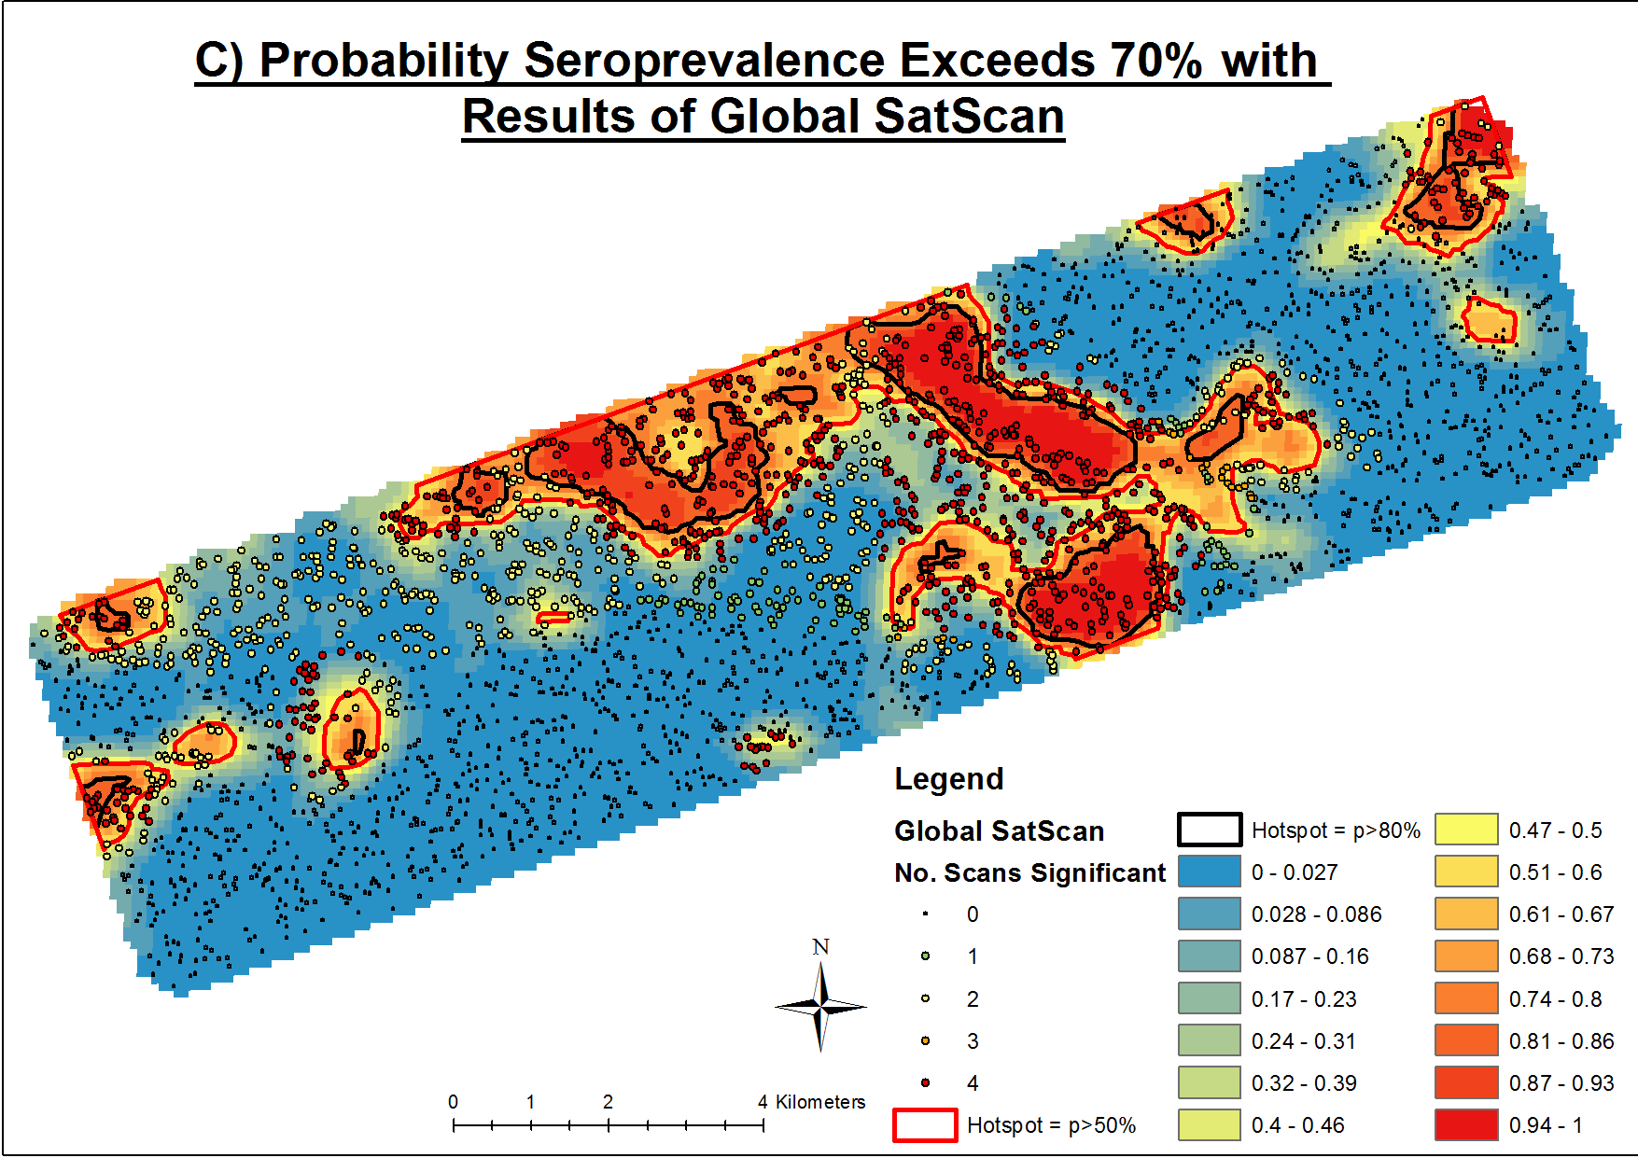
Impact of Geostatistical Methods on Determining Boundaries of Hotspots of Malaria (#1521)
Stresman GH^{1*} Giorgi E^{2*} Baidjoe A³ Knight P⁴ Odongo W⁵ Owaga C⁵ Shagari S⁵ Makori E⁵ Stevenson J^{1,5,6} Drakeley C¹ Cox J¹ Diggle PJ^{2,7} Bousema T^{1,3}
* Authors Contributed Equally
¹ London School of Hygiene and Tropical Medicine, London UK, ² Lancaster University, Lancaster UK, ³ Radboud University Nijmegen Medical Centre, Nijmegen the Netherlands, ⁴ University of Bath, Bath UK, ⁵ Kenya Medical Research Institute, Kisumu Kenya, ⁶ Johns Hopkins Bloomberg School of Public Health, Baltimore USA, ⁷ University of Liverpool, Liverpool UK
Title Verdana
Bold 72pt
Introduction
Results
In low endemic settings, targeting malaria interventions to hotspots of transmission can offer an attractive approach for malaria control and elimination programs.¹ Several studies have been conducted that have identified ‘hotspots’ of malaria at various spatial scales. However, methodologically, there has been little consistency as studies have used a range of different malaria metrics, cluster detection methods, or assumptions within the same method.^{2, 3} Here we assess the impact of different malaria metrics (parasitological and serological), sample size, and hotspot detection technique (model-based geostatistics [MBG] and spatial scan statistics) on the delineation of hotspot boundaries in an area of low and heterogeneous transmission in the western Kenyan Highlands.
Boundaries based on current malaria infection (Figure 1A) and exposure (Figure 1B) with MBG showed reasonable overlap: houses identified as being within a hotspot showed a 92.3% agreement although some hotspots were missed
Poor to moderate correlation of houses identified as part of hotspots defined using the two methods tested (table 1)
Sample size had an impact on MBG model efficiency; hotspot boundaries for both current infection (figure 2A) and exposure (figure 2B) were impacted when the sampled population was 20.9% of the total population with a second step in impact observed at 9.2% of the total population.
Methods
Table 1: Comparison of hotspots identified and correlation (r) of houses identified by different SatScan assumptions and MBG (gold standard).
All buildings were mapped using satellite data providing a complete sampling frame for the population.
17503 individuals in 3213 randomly selected compounds in the 100 km² study area were assayed for current infection by PCR and for exposure to AMA1 and/or MSP1₁₉ by ELISA.
Environmental data were obtained from the ASTER elevation model and Quickbird satellite imagery.
A MBG approach was validated: spatial variation in predicted prevalence and exceedance surfaces for both outcome measures was modelled.
The impact of sample size was determined by imputing a complete dataset assuming all compounds had been sampled and re-running the model on randomly selected subsets of the data.
Hotspots and houses in hotspots consistently detected by MBG and SatScan were determined
  SatScan assumptions: 1) a global and locally weighted sampling frame, 2) circular and elliptical shaped scanning windows and, 3) different scanning window sizes.
 | PCR Prevalence |  |  | Seroprevalence
SatScan | # Overlap | # Missed | r | # Overlap | # Missed | r
GLOBAL SCAN
Circular 50% | 5 | 3 | 0.300 | 11 | 1 | 0.333
Circular 25% | 7 | 1 | 0.297 | 11 | 1 | 0.339
Ellipse 1K | 7 | 1 | 0.301 | 8 | 4 | 0.267
Ellipse 250 | 7 | 1 | 0.325 | 8 | 3 | 0.295
Combined | 7 | 1 | 0.263 | 11 | 1 | 0.248
LOCAL SCAN
Circular 50% | 6 | 2 | 0.284 | 10 | 2 | 0.273
Circular 25% | 6 | 2 | 0.258 | 9 | 2 | 0.276
Ellipse 1K | 7 | 1 | 0.288 | 8 | 3 | 0.303
Ellipse 250 | 6 | 1 | 0.287 | 8 | 3 | 0.303
Combined | 7 | 1 | 0.289 | 9 | 3 | 0.314
Figure 1 – Probability contour map showing the probability That malaria infection exceeds the defined prevalence threshold with Satscan results showing the households that were located within a hotspot for PCR (A) and seroprevalence (B).
Figure 2: The impact of reduced sample size on model efficiency for the predicted surfaces for PCR (A) and seroprevalence (B). The dashed vertical line represents the sample size achieved during the community survey.
B)
B)
Conclusions
We show that, in this setting, the choice of malaria metric, sample size, and statistical method have a significant impact of the size and location of hotspots.
Defining a hotspot is an operational decision with uncertainty present ideally being accounted for with the methods used, and that converting this decision to one of a test of significance is hiding, rather than solving the problem of exactly how you define it.
Our results provide the first comprehensive assessment of the challenges associated with applying hotspot theory to practice at the local level.
Improving health worldwide www.lshtm.ac.uk

