Slide 1
PREDICTIVE SERVICE ISSUE RESOLUTION
Resolving the card issue before
the customer asks
A long-term-memory agent that reads behaviour, predicts the card problem, and offers the fix in-session — replace, activate, dispute or unlock.
Proof of concept · FastAPI + Google ADK 2.0 + Redis · four interchangeable long-term-memory architectures

Slide 2
THE PROBLEM
Today the bank waits to be asked
Intent is visible, and ignored
The customer does the routing
Every visit starts from zero
The customer searches “debit card blocked”, then opens Card management three times in five minutes. Every one of those signals is already in the bank's clickstream — and nothing acts on it.
They have to find the right page, guess whether this is a block, a dispute or a dead card, and often give up and call — the most expensive channel the bank runs.
The chatbot has no idea this same card was blocked last month or that the customer always chooses “unlock”. No memory means no learning and no personalisation.
What predictive resolution changes
Behaviour is the signal, memory is the context, and resolution is one click inside the page the customer is already on:
Search + repeat visits + declines → friction score with an explainable reason for every point
Long-term memory → the issue this customer keeps hitting and the fix they accepted last time
Agent tools → replace / activate / dispute / unlock executed in-session, then written back to memory

Slide 3
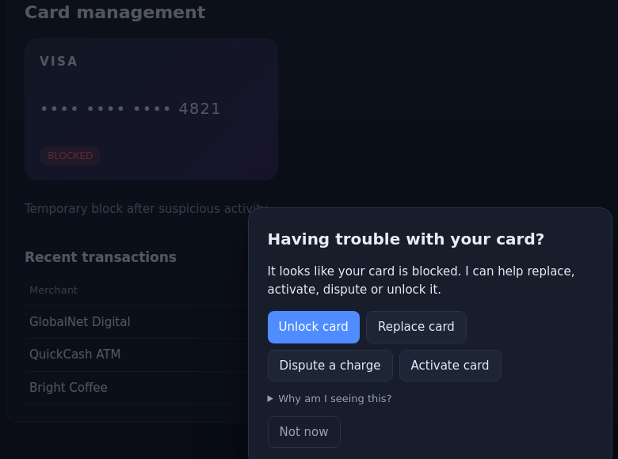
WHAT YOU WILL SEE
The intervention, in the demo
Proactive, not reactive
“Having trouble with your card? I can help replace, activate, dispute or unlock it.” The predicted issue is blocked, so Unlock card is ranked first — the other three stay one click away.
Explainable by construction
The agent brain panel shows every contribution: card-issue search +0.30, two card-page visits +0.35, memory of a past blocked issue +0.15. No black-box score, so risk and compliance can audit each prompt.
Search “debit card blocked” → open Card management twice → the offer fires at 0.65

Slide 4
ARCHITECTURE
How it works
Observe
Predict
Intervene
Resolve
Remember
Search, page views, declines and IVR calls land in a rolling Redis window.
Weighted, explainable friction score; issue taxonomy; ranked actions; cooldowns.
Proactive offer inside the page, best action first, with a “why” disclosure.
ADK agent tools hit the card system of record: replace, activate, dispute, unlock.
Outcome, preference and feedback persist to long-term memory for the next visit.
Agent runtime
Two memories, two jobs
Google ADK 2.0 LlmAgent (Gemini) with four card tools plus preload_memory / load_memory. A deterministic rule engine backs the same contract, so the demo runs with no API key and gives identical, repeatable results on stage.
Short-term: the conversation itself, as an ADK session in Redis.
Long-term: durable facts, resolutions, feedback and a structured customer profile — pluggable across four architectures and fed straight back into the predictor as features.

Slide 5
THE POC's CORE
Four memory architectures, one interface
Redis always holds behavioural signals, card state and sessions. The long-term version is selected with CARE_MEMORY_BACKEND — one architecture at a time, never a hybrid.
Version | Selector | Store | Retrieval | Why it matters
Document | mongo | memories + profiles collections | lexical IDF + recency | Durable, queryable, familiar operationally
Vector | chroma | ChromaDB, all-MiniLM-L6-v2 (no API key) | cosine nearest neighbour | Recalls paraphrases the customer actually types
Graph | graph | Neo4j Customer / Memory / Issue / Action / Card | text match + shared-entity traversal | Answers relationship questions, not just similarity
Redis | redis | sorted set + profile hash | lexical IDF + recency | Zero extra infrastructure for a laptop demo
Swappable because the service contract is fixed
Every version implements the same CareMemoryService (remember / search_records / search_memory / get_profile / update_profile / increment_profile_counter) on five storage primitives, so the predictor, the agent and the UI never change when the architecture does. Switching the whole memory tier in the demo is one environment variable and a restart.

Slide 6
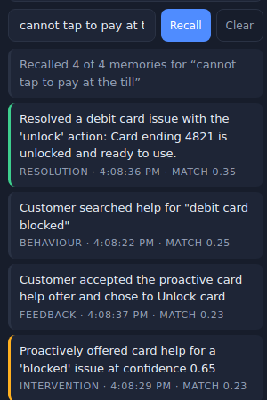
SIDE BY SIDE
Why vector and graph earn their place
Vector — semantic recall
Query “cannot tap to pay at the till” shares no word with “card blocked”, yet ChromaDB returns the blocked-card resolution at match 0.35 and drops everything below the 0.2 floor. The lexical versions return nothing for the same query.
Graph — structural recall
Neo4j promotes metadata to entities: (:Memory)-[:ABOUT_ISSUE]->(:Issue), -[:RESOLVED_WITH]->(:Action), -[:ON_CARD]->(:Card). Query “accepted offer” reaches the resolution memory through the shared Action(unlock) node, and the UI shows how many entity links got it there — the basis for “this issue recurred 3× on the same card after a reissue”.
Recall box: a query sharing no words with the memories still returns them

Slide 7
VALUE
Benefits
Deflects the expensive channel
Cuts time-to-resolution to one click
The fix is offered at the moment of friction, inside the page — before the call, the chat queue or the branch visit. Every accepted offer is a contained contact, and the demo records acceptance so deflection is measurable per intervention.
No navigation, no triage, no repeating the story. The predicted issue picks the action, and the agent executes it against the card system of record in-session.
Gets better with every visit
Explainable and controllable
Resolutions, preferences and dismissals persist, so the next prompt leads with what worked last time and the friction score already knows this is a recurring problem — personalisation without asking the customer anything.
Every point of the score has a stated reason, interventions are suppressed off-context, after a dismissal and inside a cooldown — the guardrails a bank needs before it is allowed to speak first.
Reusable beyond cards
Signals, taxonomy and tools are configuration. The same loop covers payments, mortgage applications, onboarding drop-off and claims — one predictive-care platform, many journeys.

Slide 8
FROM POC TO PRODUCTION
How this gets productionised
Real signals instead of demo events
Real systems of record
Memory as a governed data product
cards.py becomes an adapter over the card-management, fraud and disputes APIs. Actions run through the bank's orchestration with idempotency keys, step-up authentication for replace/unlock, and a dispute case created in the servicing platform rather than mocked.
Replace the /api/events calls with the existing clickstream and core feeds: web/app analytics, auth events, declined-authorisation stream, IVR and card-status changes, published to Kafka. The predictor consumes a feature view (Flink or a feature store) instead of a Redis window.
Pick one architecture per need — documents for profiles, managed vector search for episodic recall, a graph for relationship questions — behind the same CareMemoryService. Add tenant isolation, encryption, PII minimisation, retention/erasure jobs for GDPR, and consent flags checked before any memory is written or used.
Model, prompt and safety controls
Platform and operations
Prove the lift, then scale
Containers on Kubernetes behind the existing gateway, managed Redis and database services, OpenTelemetry traces plus latency/error SLOs, intervention-rate and acceptance dashboards, and kill switches per journey. CI runs the current test suite plus contract tests per memory backend.
Start shadow-mode (score, do not prompt) to calibrate thresholds, then a 1–5% holdout A/B on containment, time-to-resolution, call volume and CSAT. Promote per-journey once the lift clears the guardrails, and let the accepted/dismissed feedback already captured retrain the ranking.
Gemini via Vertex AI with private networking, prompt/response logging, tool allow-lists, output validation and a hard rule that money-moving actions need explicit confirmation. Score weights move out of code into a versioned config so risk owns them, with champion/challenger evaluation.

Slide 9
APPENDIX
Running the demo
Start the stack
Golden path (90 seconds)
docker compose -f predictive_care/docker-compose.yml up -d
redis:6379 · mongo:27017 · chroma:8000 · neo4j:7687
pip install -e ".[vector,graph]"
CARE_MEMORY_BACKEND=chroma predictive-care --port 8100
swap chroma for graph, mongo or redis to change the architecture
CARE_FORCE_RULES=true keeps it deterministic without a Gemini key
1. Search “debit card blocked”.
2. Open Card management, go back, open it again.
3. The offer fires at 0.65 with Unlock card first — accept it.
4. Recall “cannot tap to pay at the till” to show semantic memory.
5. New visit → the score starts at 0.85 and leads with unlock.
What is proven, and what is still mocked
Proven end-to-end on real Docker services: prediction, proactive offer, the four resolution actions, memory write-back, personalisation, and semantic and graph recall — all four memory versions pass the same browser journey.
Mocked on purpose: the bank of record (accounts, card, transactions), the clickstream (UI-generated events) and authentication. Those are the first three integrations on the production path.

