Slide 1
Transition to Linux/.NET/Azure SQL Stack from LAMP Stack
Adopting .NET Core allows the use of modern language features of C#, such as strong typing and asynchronous programming.
It is known for its high performance, often surpassing traditional PHP applications in benchmarks.
The application requirements can be fully fulfilled with .NET Core and can be hosted on Azure App Service.
This transition aims to leverage the robust and scalable technologies offered by Microsoft Azure.

Slide 2
Use of Azure Blueprints to Ensure Compliance from Day One
Azure Blueprints will be used to define a repeatable set of Azure resources that adhere to certain requirements and standards, leading to a more secure, compliant, and manageable cloud environment, and version control.

Slide 3
Multi-tier Architecture Design
Web Tier
Data Tier
Caching Layer
Security Measures
Backup and Monitoring
Private network connectivity
Private endpoints
Environment Separation
Azure Traffic Manager

Slide 4
Web Tier
The web tier uses Azure App Service (Linux) and CDN in conjunction with Azure Blob Storage
Azure App Service handles business logic and restful API calls, while CDN and Azure Blob Storage serve static web artifacts
Azure Active Directory (Azure AD) is used for user authentication and authorization
The adoption of .NET Core allows the use of modern language features of C#, such as strong typing and asynchronous programming
Azure App Service deployment slots feature is used to achieve minimum deployment downtime by leveraging hot swap.

Slide 5
Data Tier
The data tier uses Azure SQL Database with Geo-Redundancy and Transparent Data Encryption (TDE) enabled.
This provides protection against regional outages and ensures encryption at rest.
Azure SQL Database allows the use of advanced features like automatic tuning, threat detection, and Azure Active Directory integration.
Azure AD authentication is set up to allow only authorized users to access the databases.

Slide 6
Caching Layer:
Azure Redis Cache is integrated to enhance the performance of the application by caching frequently accessed data, reducing the load on the Azure SQL Database and improving response times.
It can also be used for session state caching if the application has a lot of user sessions.

Slide 7
Security:
Azure Security Center is used for unified security management and advanced threat protection.
Azure Storage Service Encryption are used for safeguarding data at rest.
Azure Application Gateway serves as a web application firewall against common web-based threats.
Azure Key Vault is used to store database and other confidential credentials.

Slide 8
Backup and Monitoring:
Azure Backup is used to back up the Azure SQL Databases, and Azure Monitor is used to enhance the availability and performance of the applications.
Azure Monitor offers a comprehensive solution to collect, analyze, and act on telemetry data from Azure and on-premises environments. Azure AD is used to control access to monitoring data.

Slide 9
Private Network Connectivity
Azure Private Link is used to establish secure and private connectivity between the application in Azure and on-premises backend systems.
This ensures that the data is transferred over a private network, enhancing security.

Slide 10
Private Endpoints:
Azure Private Endpoints are used to securely access Azure services over a private IP address in the Virtual Network. This ensures that the data does not traverse over the public internet, enhancing security.

Slide 11
Environment Separation:
Each environment (DEV, UAT, PROD) is separated using different Azure Resource Groups and Virtual Networks. This ensures isolation and prevents accidental changes or deletions in different environments.

Slide 12
Leveraging Azure Traffic Manager for Increased Robustness
Azure Traffic Manager is used to distribute traffic optimally to services across global Azure regions, while providing high availability and responsiveness.

Slide 13
Leveraging Azure Traffic Manager (Priority Routing)
Configuration:
Create Azure SQL Databases in different regions: Make the database in HK as the primary database and the database in Singapore as a secondary (read replica).
Create the Traffic Manager profiles: This profile will control the distribution of user traffic for service endpoints in different datacenters.
Add endpoints to the Traffic Manager profile: In this case, The Traffic Manager profile will point to the App Gateway instance in HK with priority 100 and to the App Gateway instance in SG with priority 200.
Set up health checks endpoints in the Traffic Manager.
To perform a failover in Azure SQL Database, you can use the Active Geo-Replication feature. Here are the steps:
Promote the database in SG and the primary one

Slide 14
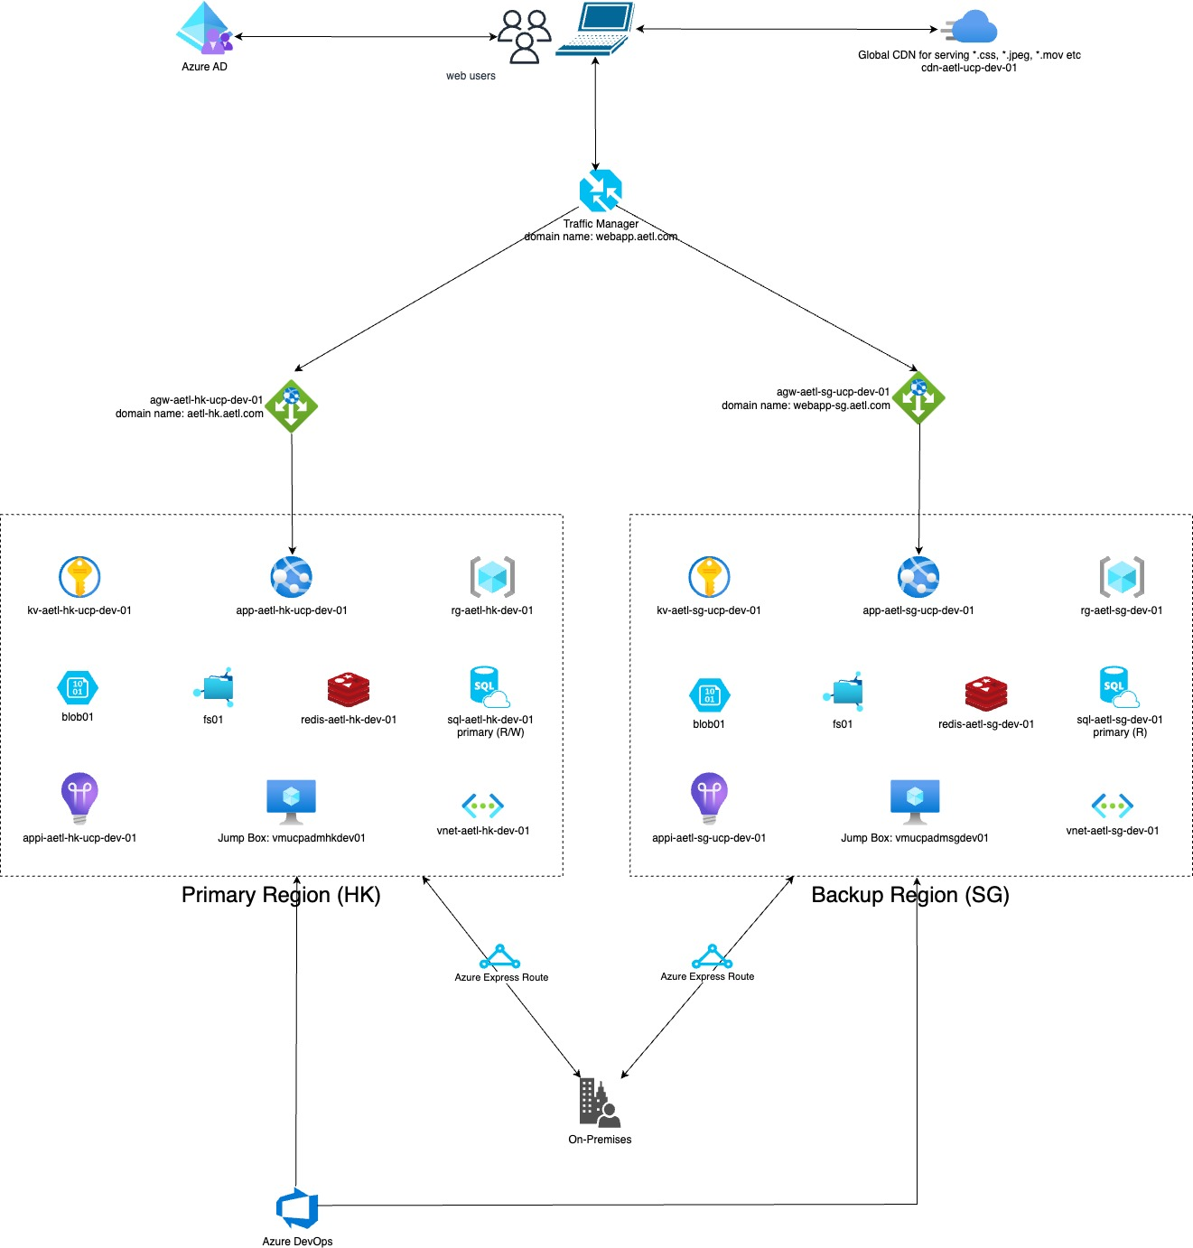

Slide 15
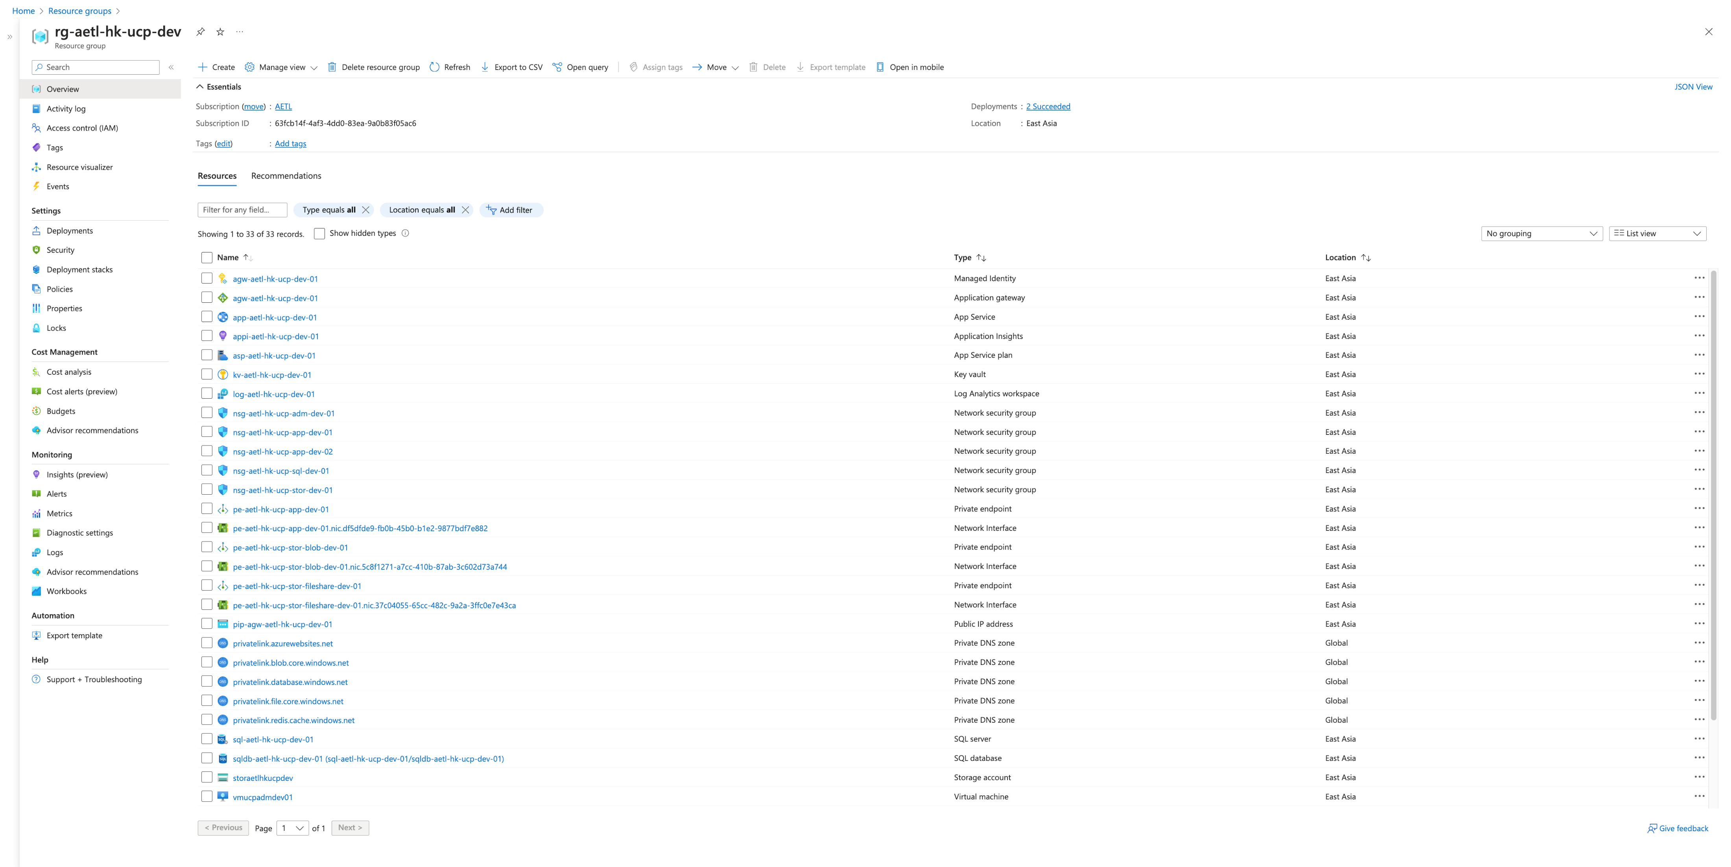

Slide 16
