Slide 1

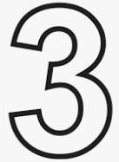
Homework 2
Implement a JavaScript program that reads 8 integers from the keyboard and print them on the webpage by using images of the digits
Show all the numbers by images,
The range of the numbers is 1~999
You need to handle the issue if the input integer is out of range
Without the code, 20 points will be deducted
Parse these 8 integers to find and print
Maximum
Minimum
Median
Prime numbers
Armstrong numbers, if you copy the code from Wiki, 50 points will be deducted https://en.wikipedia.org/wiki/Narcissistic_number

Slide 2
Homework 2
If the integers belong to the integers of the Fibonacci sequence, you need to print them out.
Fibonacci sequence https://en.wikipedia.org/wiki/Fibonacci_number
Use CSS and HTML to present your output results
At least two tables are necessary
Without the table, 20 points will be deducted
All results need to be rendered by images of the digits
Source code comments are welcome
As I have mentioned in class, no array is allowable
If you use array, the grade will be 0 point
Each array will be deducted 20 points
The content and layout will affect your grade
Delay = Copy = 0
We will use Microsoft Edge to check your homework
Name it index.html, we will access the website from here
You can create multiple html files (name other files as you want)

Slide 3
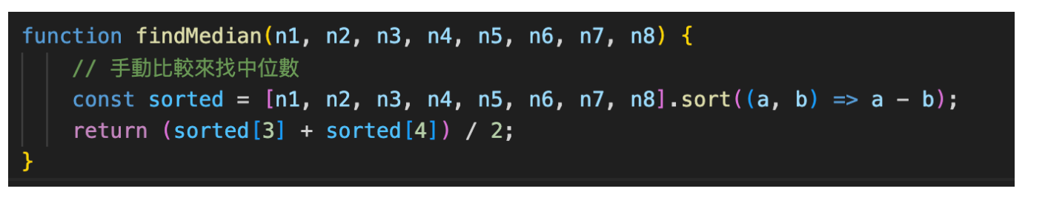
Homework 2
You can store your answers to string
Then using [] to get character for rendering images
No [] can be used in remaining codes
No iterable object in remaining codes
The following code is not allowable
No querySelectorAll()

Slide 4
Homework 2
Deadline: 10/13 23:30
Upload to E3
Zip the whole web site!
Otherwise your grade will be deducted by 20
Title of the index.html file (<title>) & file name
HW2_學號_學生名
HW2_學號_學生名.zip
Otherwise your grade will be deducted by 30
In all the source code files, you need to add the identifications on the top of your files
Otherwise your grade will be deducted by 20
<!--4001234567 王小明 第II次作業10/11
4001234567 Ming Wang The Second Homework 10/11-->

