Slide 1
Homework 3
Based on your HW1, you need to add some new functions
Do not use any library or related website tools
HW3 will be viewed under Google Chrome
Delay = Copy = 0
In all the source code files, you need to add the identifications on the top of the files
Otherwise your grade will be deducted by 20
<!-- 4001234567 王小明 第三次作業 11/1
4001234567 Ming Wang The Third Homework 11/1 -->
Compress all your files into HW3_學號_學生名.zip
Otherwise your grade will be deducted by 20
If you have any questions, please contact all the three TAs through E3 mail system
Deadline: 11/1 23:30

Slide 2
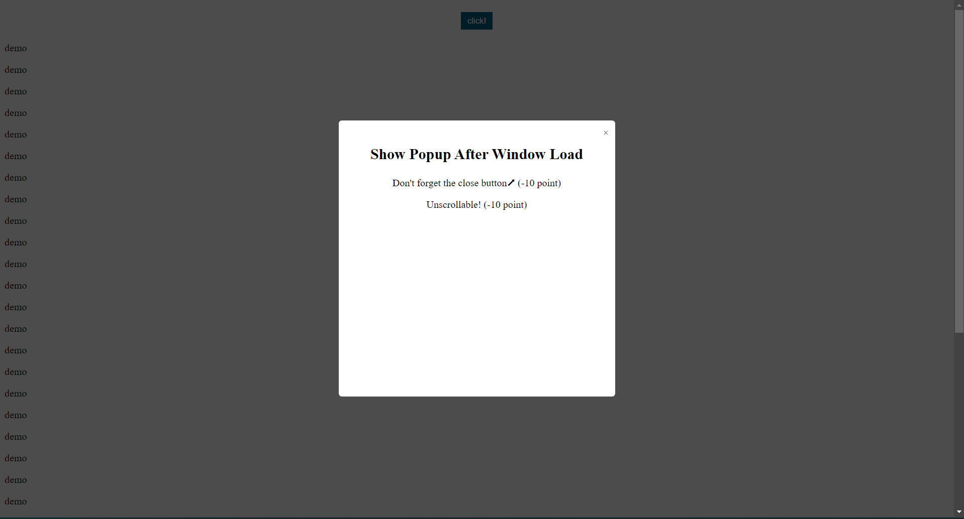
Homework 3
Create a “HW3_學號_學生名.pdf” in HW3_學號_學生名.zip
Show the screenshots of all the required functions
Write down the locations (.html) of the functions
Example:
Show the popup automatically after page load
Location: b.html

Slide 3
Homework 3
Use window.open() to add the following functions
Click the button to open a link in new tab (in current window) (-10 points)
Click the button to open a link in new window (-10 points)

Slide 4
Homework 3
*Design the content of the pop-ups by yourself.
Show the pop-up automatically after page load
Make it unscrollable (-5 points)
Add the close button in the popup (-10 points)
Darken the background behind the popup (-5 points)
Show the pop-up when the user clicks the button
Make it scrollable (-5 points)
Add the close button in the popup (-10 points)
Darken the background behind the popup (-5 points)

Slide 5
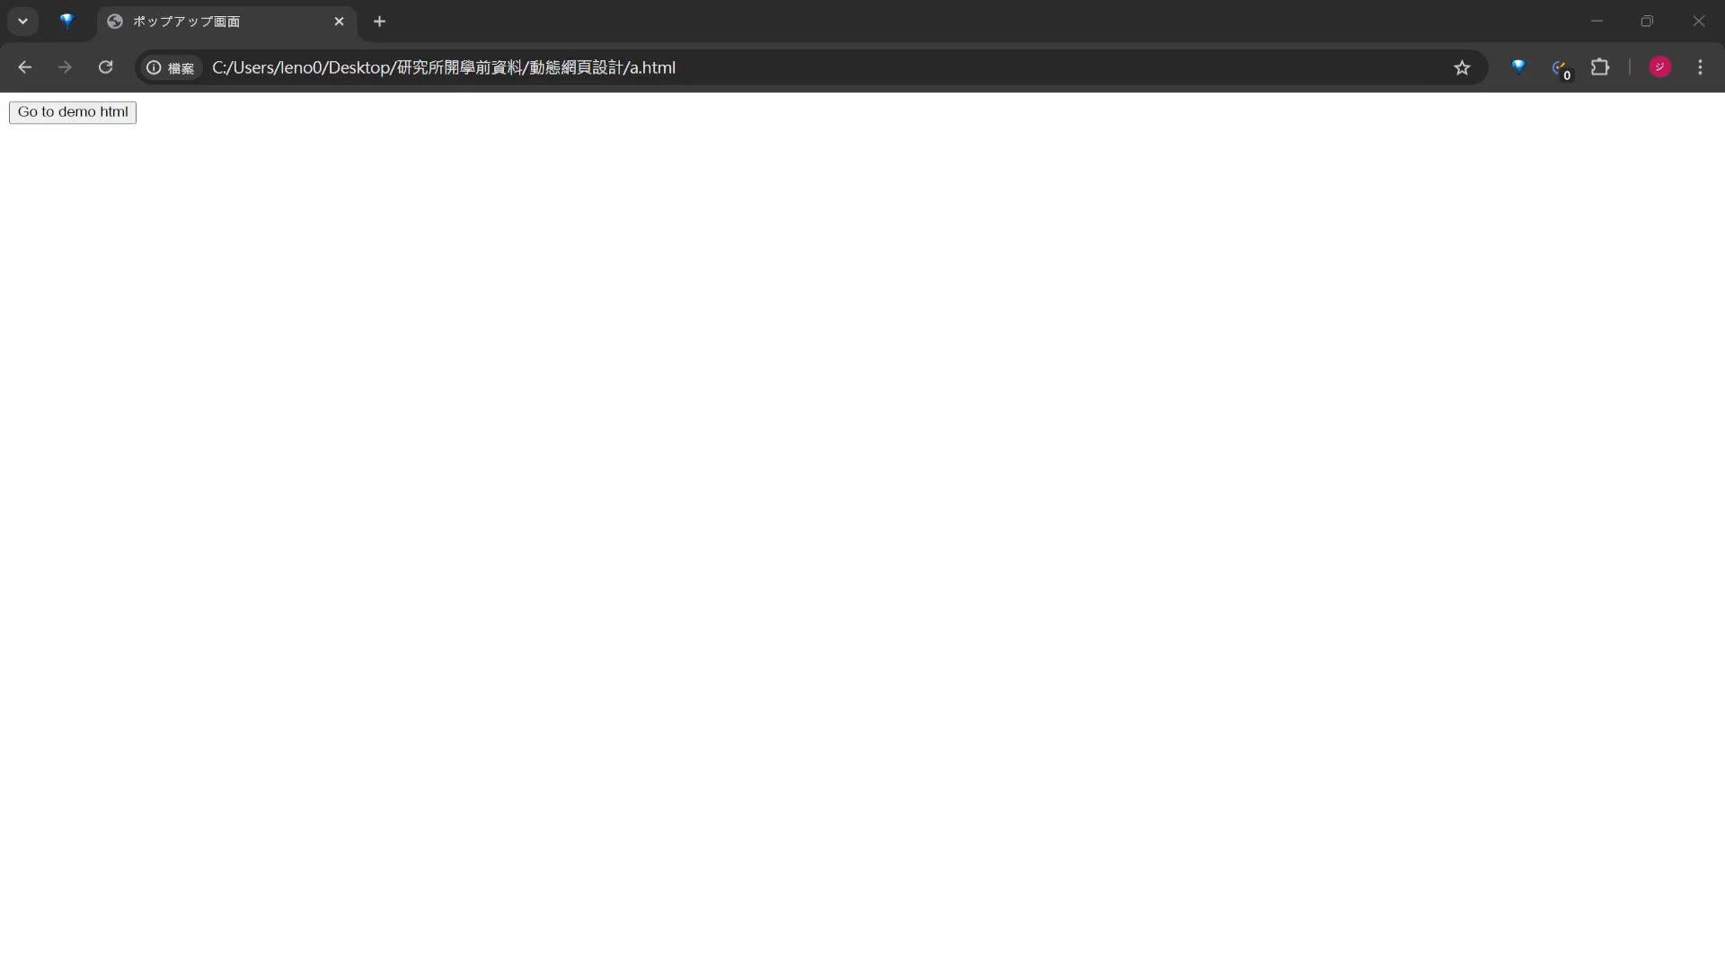
Demo Video

Slide 6
Homework 3
*Design the content of the pop-ups by yourself.
Show the pop-up advertisement
Show the advertisement at bottom right corner of the screen (-5 points)
Show the advertisement 3 seconds after page load (-5 points)
Add the close button in the popup (-10 points)
Make it noticeable but smaller than ⅓ of whole page (-5 points)
Show the browsed time after page load
Show it at the same page that shows the advertisement (-5 points)
Display in the format “xxxx.ds”, where xxxx is the zero-padded integer part of the passed seconds and d is the decimal part (-5 points)
ex: 0013.4s for 13.4 passed seconds after page load
Update every 0.1 second (-5 points)
Time display is tolerable with the error less than 0.5 second (-5 points)

Slide 7
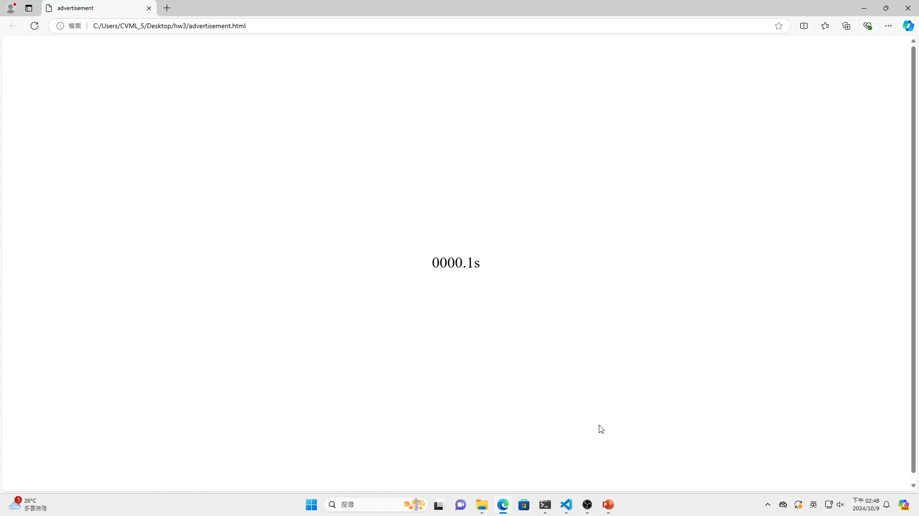
Demo Video

Slide 8
Homework 3
You need to implement scroll detection with javascript on one of the page (-10 points)
Trigger some animations, events or images when browsing

Slide 9
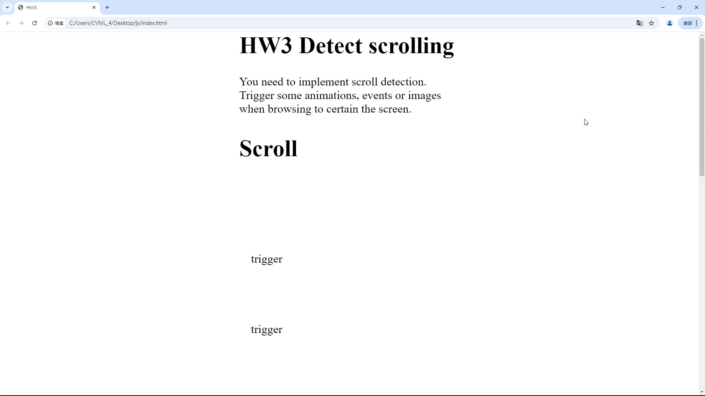
Demo Video

Slide 10
Homework 3
Design 5 different functions with JavaScript by yourself (each -10 points)

