Slide 1


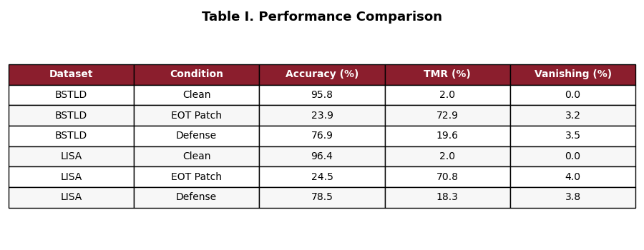
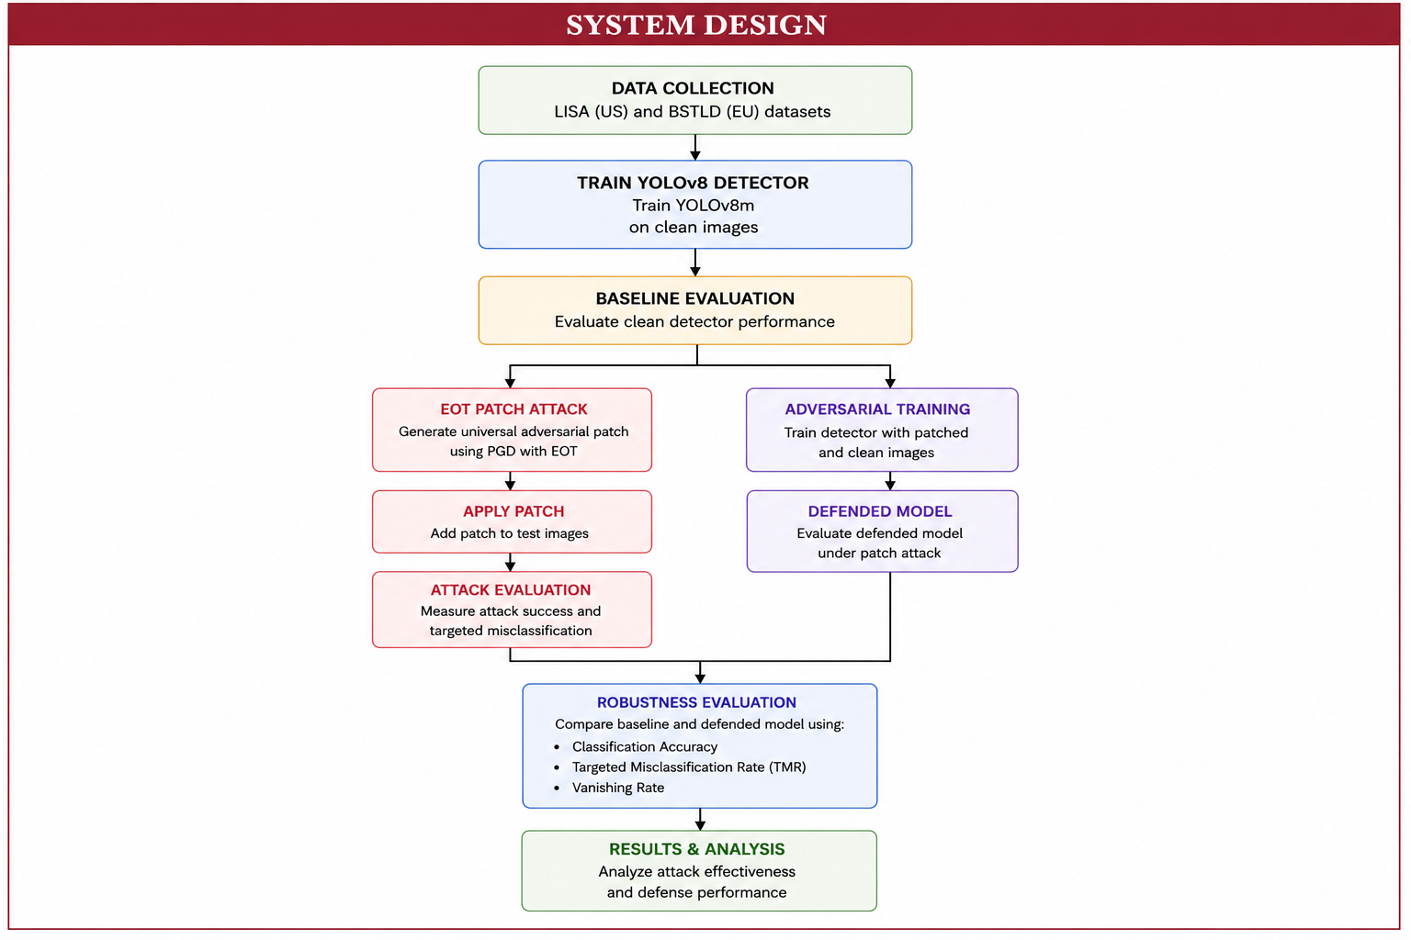
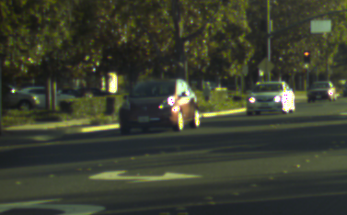
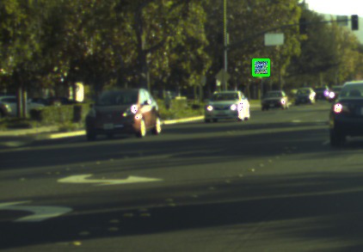
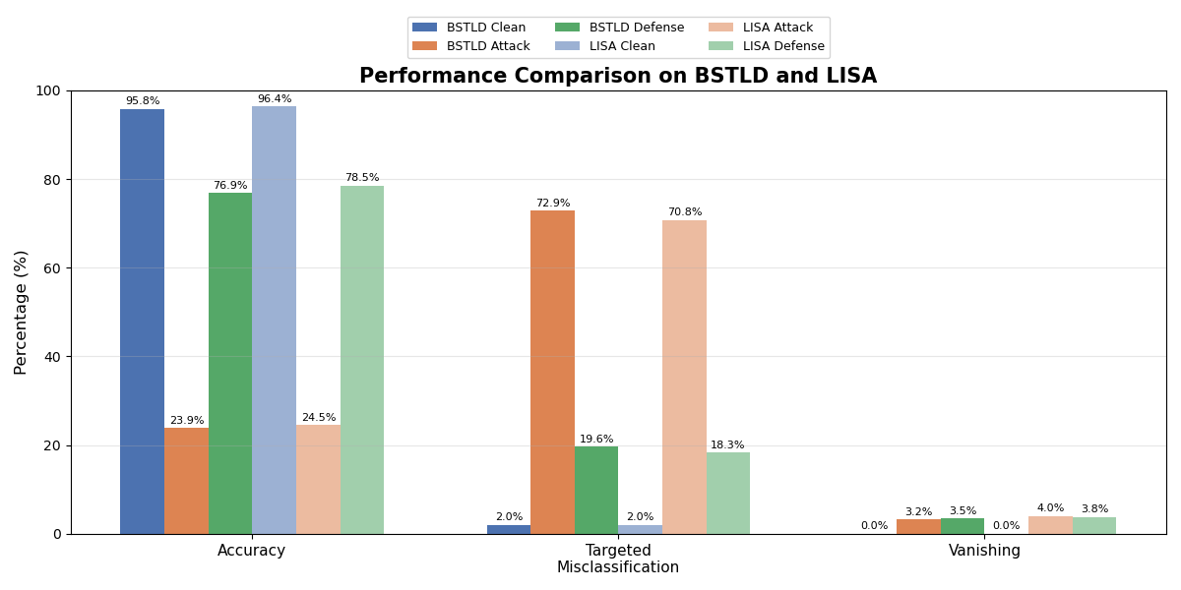


Adversarial Patch Attacks and Defenses for Traffic-Light Classification
Chinualumogu Nwosu
Mentors: Sumaiya Tasneem, Dr. Ahmad Alsharif
INTRODUCTION
SYSTEM DESIGN
RESULTS
Motivation: Misreading a red light as green can send a vehicle through an intersection. Detection is relatively stable, but the classifier that reads the light's state is vulnerable to physically realizable adversarial patches. Most adversarial research targets traffic signs or general object detection. Traffic-light recognition has received comparatively little attention.
Research Questions:
Can adversarial patches fool YOLO traffic-light classifiers?
Can adversarial training improve robustness?
Figure 4. Performance metrics for BSTLD and LISA under clean, EOT patch attack, and adversarial defense conditions.
Figure 1. Clean BSTLD traffic-light image.
Figure 2. BSTLD image with EOT adversarial patch.
EXPERIMENTAL SETUP
Datasets | LISA (US) and BSTLD (EU): dashcam images with annotated traffic-light states
Model | YOLOv8m, COCO-pretrained, trained separately on each dataset
Threat Model | White-box (gradient access); patch is a printable sticker on the light
Adversarial Attack | Universal patch, targeted red → green. 125 × 125 px, scaled to the detected light. PGD (20 steps) under Expectation over Transformation (EOT): sampled over random rotation, brightness, translation, and scale so it survives real viewing conditions.
Defense | Adversarial training: frozen patch re-applied to training images with labels unchanged, so the patch must not alter the predicted state
Evaluation Metrics | Classification Accuracy: Correct light state, given the light was detected Targeted Misclassification Rate (TMR): red lights flipped to green by the attack Vanishing Rate: Lights not detected at all under attack
Figure 5. Performance under clean, EOT patch attack, and defense conditions.
EOT patch reduced classification accuracy from 95.8% to 23.9% (BSTLD) and 96.4% to 24.5% (LISA).
Adversarial training reduced TMR from 72.9% to 19.6% (BSTLD) and from 70.8% to 18.3% (LISA).
CONCLUSIONS
EOT adversarial patches consistently induced targeted red-to-green traffic-light misclassification.
Adversarial training improved robustness while preserving clean accuracy.
Consistent trends across BSTLD and LISA indicate the approach generalizes across datasets.
Future work includes adaptive attacks and real-world validation.
Figure 3. Adversarial attack, defense, and evaluation pipeline.
ACKNOWLEDGMENTS
This material is based on a study supported by the National Science Foundation under Grant No. 2244371. Any opinions, findings, and conclusions or recommendations expressed in this material are those of the author(s) and do not necessarily reflect the views of the National Science Foundation, and the U.S. Government assumes no liability for the contents or use thereof.

