Slide 1
Reactive Programming with RXJS

Slide 2
About
Reactive programming is programming with concurrent data streams.
https://www.sitepoint.com/functional-reactive-programming-rxjs/
https://www.sitepoint.com/parallel-javascript-with-paralleljs/
http://reactivex.io/rxjs/manual/overview.html
http://reactivex.io/rxjs/class/es6/Observable.js~Observable.html#static-method-combineLatest

Slide 3
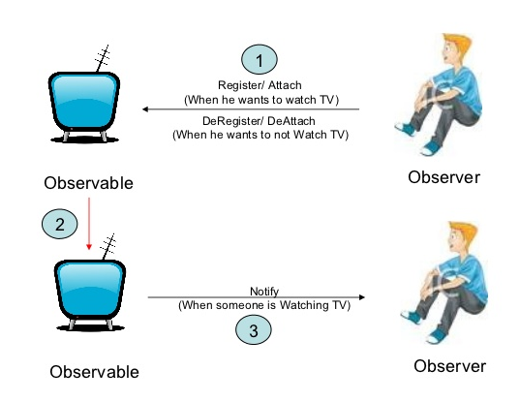
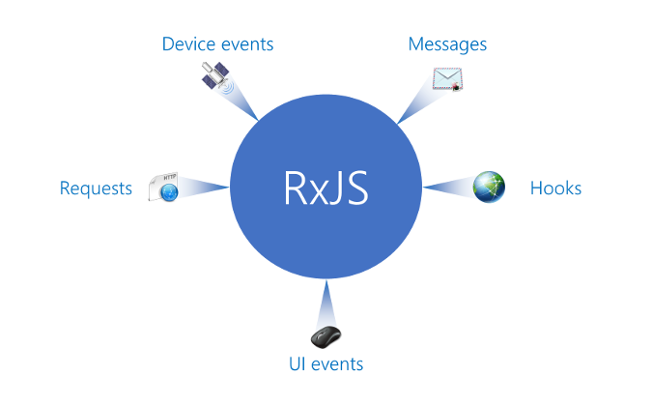
RXJS Basics
RXJS Basics
Observable – produce events
Observer – consume events
Example 1
Example 2
Example 3
Example 4

Slide 4
Main entities
RXJS Basics
Observable: represents the idea of an invokable collection of future values or events.
Observer: is a collection of callbacks that knows how to listen to values delivered by the Observable.
Subscription: represents the execution of an Observable, is primarily useful for cancelling the execution.
Operators: are pure functions that enable a functional programming style of dealing with collections with operations like map, filter, concat, flatMap, etc.
Subject: is the equivalent to an EventEmitter, and the only way of multicasting a value or event to multiple Observers.
Schedulers: are centralized dispatchers to control concurrency, allowing us to coordinate when computation happens on e.g. setTimeout or requestAnimationFrame or others.
Example 1
Example 2
Example 3
Example 4

Slide 5
Main entities
RXJS Basics
Hot observables are pushing even when we are not subscribed to them (e.g., UI events).
Cold observables start pushing only when we subscribe. They start over if we subscribe again.
------------------------------------------------------
First-order Observable emits simple things: objects, numbers, strings etc.
Higher-order Observable emits higher-order data like Promises or other Observables
Example 1
Example 2
Example 3
Example 4

Slide 6
Observable
RXJS Basics
Think of RxJS as Lodash for events.
Observables can be created with create, but usually we use the so-called creation operators, like of, from, interval, etc.
Each Observable must define how to dispose resources of that execution when we create the Observable using create(). You can do that by returning a custom unsubscribe function from within function subscribe()
In order to subscribe for observable call subscribe function on the observable object and pass three functions (next, error, complete)
When you subscribe, you get back a Subscription, which represents the ongoing execution. Just call unsubscribe() to cancel the execution.
Example 1
Example 2
Example 3
Example 4

Slide 7
Observer and hot execution
RXJS Basics
Cold observable can be easily converted to Hot observable with .publish() function;
What is an Observer? An Observer is a consumer of values delivered by an Observable. Observers are simply a set of callbacks, one for each type of notification delivered by the Observable: next, error, and complete. The following is an example of a typical Observer object:
Example 1
Example 2
Example 3
Example 4

Slide 8
Subject
RXJS Basics
An RxJS Subject is a special type of Observable that allows values to be multicasted to many Observers. While plain Observables are unicast (each subscribed Observer owns an independent execution of the Observable), Subjects are multicast.
A Subject is like an Observable, but can multicast to many Observers. Subjects are like EventEmitters: they maintain a registry of many listeners.
Internally to the Subject, subscribe does not invoke a new execution that delivers values. It simply registers the given Observer in a list of Observers, similarly to how addListener usually works in other libraries and languages.
Example 1
Example 2
Example 3
Example 4

Slide 9
Multicasted Observables
RXJS Basics
A "Multicasted Observable" passes notifications through a Subject which may have many subscribers, whereas a plain "unicast Observable" only sends notifications to a single Observer.
A multicasted Observable uses a Subject under the hood to make multiple Observers see the same Observable execution.
Example 1
Example 2
Example 3
Example 4

Slide 10
Methods
RXJS Basics
All methods in RXJS use ‘methods chaining’ technique
Basic time windows methods:
Buffer
Throttle
Debounce
Example 1
Example 2
Example 3
Example 4

Slide 11
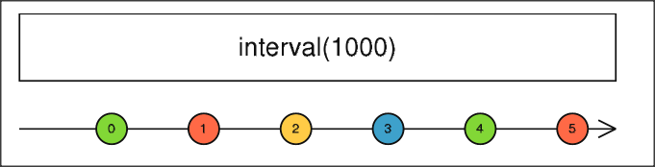
Interval
RXJS Basics
Creates an Observable that emits sequential numbers every specified interval of time, on a specified Ischeduler.
Emits incremental numbers periodically in time.
Example 1
Example 2
Example 3
Example 4

Slide 12
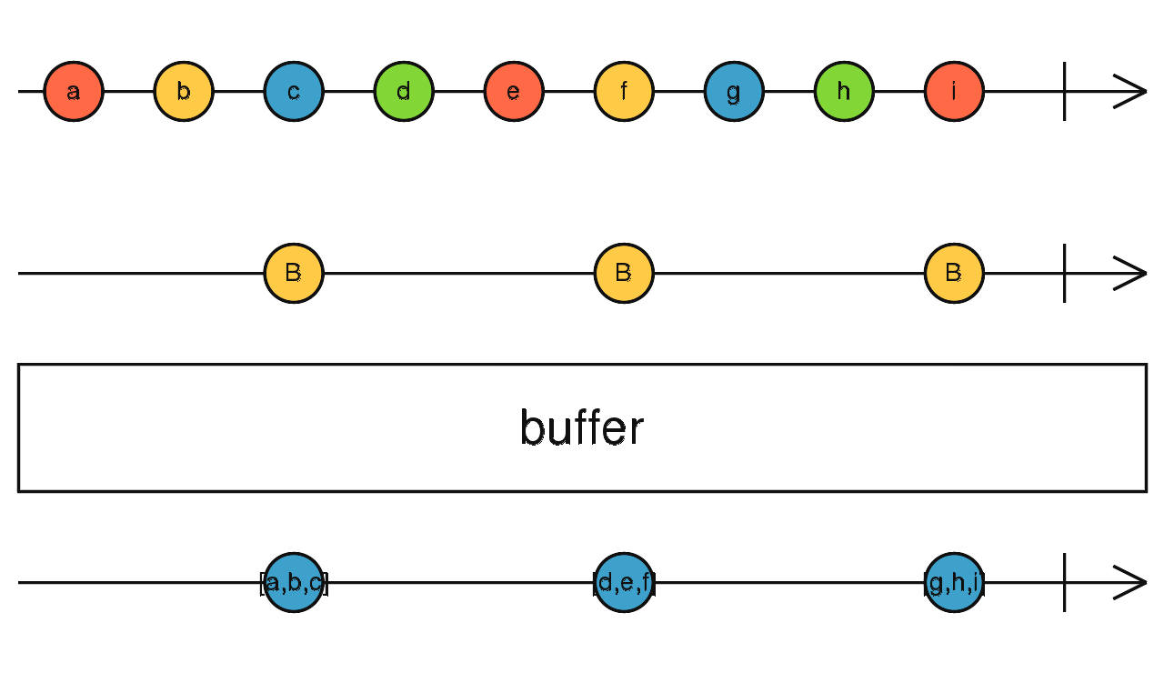
Buffer
RXJS Basics
public buffer(closingNotifier: Observable<any>): Observable<T[]>
Buffers the source Observable values until closingNotifier emits.
Example 1
Example 2
Example 3
Example 4
Collects values from the past as an array, and emits that array only when another Observable emits.

Slide 13
Buffer
RXJS Basics
public buffer(closingNotifier: Observable<any>): Observable<T[]>
Buffers the source Observable values until closingNotifier emits.
Example 1
Example 2
Example 3
Example 4
Collects values from the past as an array, and emits that array only when another Observable emits.

Slide 14
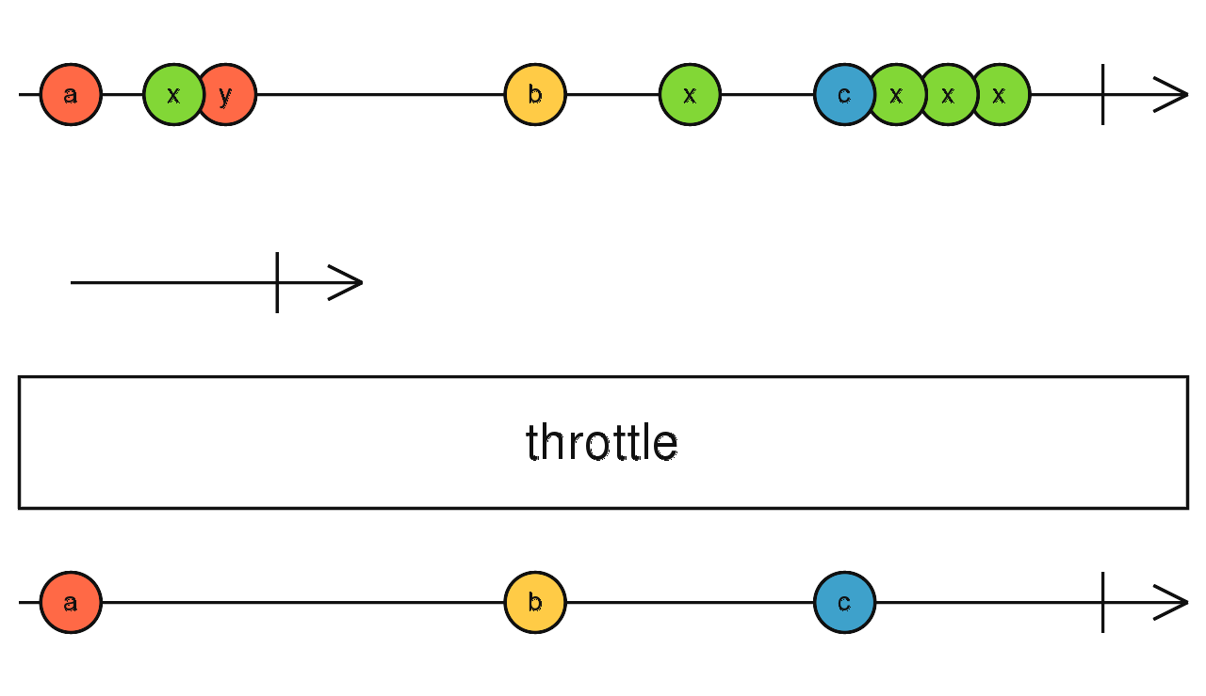
Throttle
RXJS Basics
public throttle(durationSelector: function(value: T): Observable | Promise): Observable<T>
Example 1
Emits a value from the source Observable, then ignores subsequent source values for a duration determined by another Observable, then repeats this process.
Example 2
Example 3
Example 4
It's like throttleTime, but the silencing duration is determined by a second Observable.

Slide 15
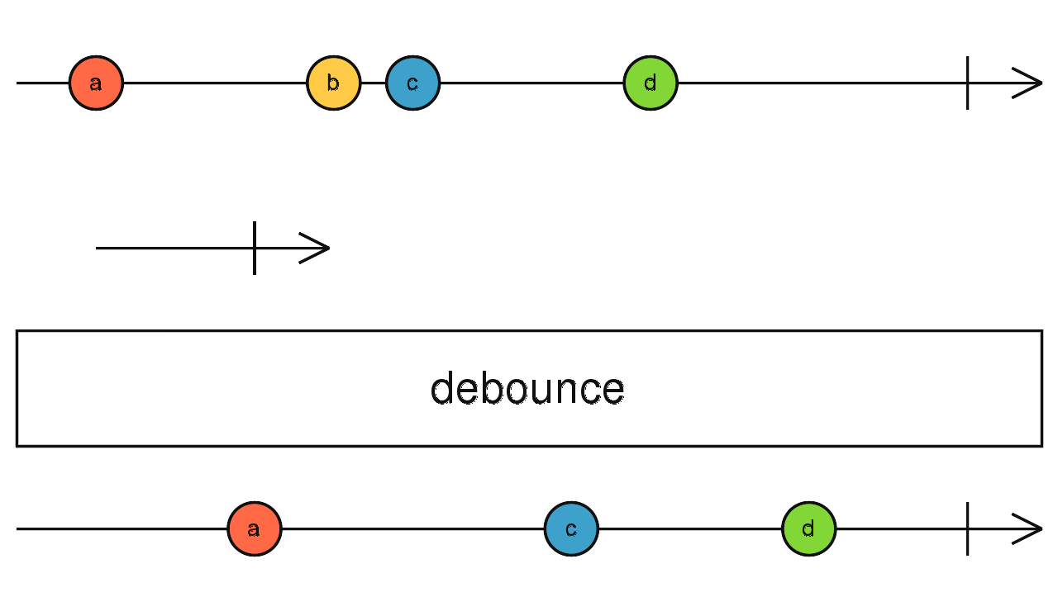
Debounce
RXJS Basics
public debounce(durationSelector: function(value: T): Observable | Promise): Observable
Example 1
Emits a value from the source Observable only after a particular time span determined by another Observable has passed without another source emission.
Example 2
Example 3
Example 4
Example 5
It's like debounceTime, but the time span of emission silence
is determined by a second Observable.

Slide 16
Debounce
RXJS Basics
public debounce(durationSelector: function(value: T): Observable | Promise): Observable
Example 1
Emits a value from the source Observable only after a particular time span determined by another Observable has passed without another source emission.
Example 2
Example 3
Example 4
Example 5
It's like debounceTime, but the time span of emission silence
is determined by a second Observable.

Slide 17
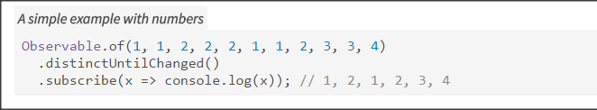
distinctUntilChanged
RXJS Basics
Example 1
Example 2
Example 3
Returns an Observable that emits all items emitted by the source Observable that are distinct by comparison from the previous item.
Example 4
Example 5

